Slide 1

WAARNG G5 and
18 U.S.C. § 871
SecArmy LDS Exercise

Slide 2
PBR as RPG
Built a program that conducted a Monte Carlo simulation of the problem
  “…use randomness to solve problems that might be deterministic in principle”
  Used for very complicated problems (cf. complicated vs. complex)
Exposes probabilistic trends by throwing lots (112M) of dice
https://github.com/stephen-riley/lds-project-sim
Notes:
RPG == Role Playing Game
Quote from Wikipedia
Program threw 112,500,000 dice

Slide 3
Assumptions and constraints
Assigned 0-10 scale for military experience
Adjusted all other stats to 0-10 range
Adjusted round weights (eg. +3 for military experience) to percentage multipliers
  +3 becomes 130%
  -4 becomes 60%
Only used stats that had round weights
(More on Character later)

Slide 4
Simulation structure
do 250 times:
do round=1..4:
apply round weights to stats
n = number of presidents to eliminate based on round #
do 10,000 times:
while < n presidents have died:
pick 2 remaining presidents
the 2 presidents "fight"
"kill" the one that lost most often
the president who won does NOT get returned to the pool
record win/loss records

Slide 5
How they “fight”
Calculate score for each president, S₁ and S₂
  Σ stat × weight
Pick a random number between 0 and (S₁ + S₂)
If number is < S1, president 1 wins
Gives underdogs a chance
  …but as # of attempts approaches infinity, that chance disappears

Slide 6
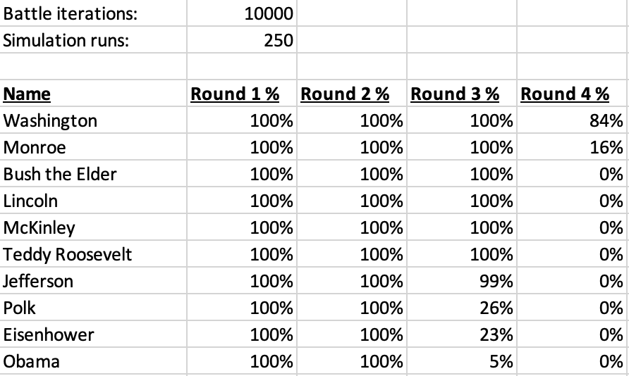
Results

Slide 7
Character counts
The pure simulation model does not account for character as it relates to coalition building.
To answer this concern, an alignment chart was created to identify advantages/disadvantages based on the contender’s assessed character.
Note: Round 1 and 2 rely more on building coalitions, and Round 3 and 4 rely more on self-preservation. Weighting remained equal, but assessed score was changed based on this (see next slide)

Slide 8
Round 1 + 2
 | Authoritarian | Neutral | Libertarian
Individualist | 1 | 2 | 3
Neutral | 4 | 5 | 6
Collectivist | 7 | 8 | 9
Character refers to the contender’s intent- high EQ doesn’t always mean collectivist. For round 1 and 2, character is scored as above. Alliances are considered essential to survival in round 1 and 2.

Slide 9
Round 3 + 4
 | Authoritarian | Neutral | Libertarian
Individualist | 9 | 8 | 7
Neutral | 6 | 5 | 4
Collectivist | 3 | 2 | 1
Character refers to the contender’s intent. In Round 3, betrayal and self-preservation become key tools for survival. Overall weighting for character decreases, but assessed scores flip as above.

Slide 10
Presidential Grouping
 | Authoritarian | Neutral | Libertarian
Individualist | Monroe Tyler Johnson, A McKinley Wilson Ford Reagan Trump | Taft Pierce | Madison Buchanan Cleveland Harding Coolidge
Neutral | Adams (Younger) Teddy Roosevelt Nixon Bush (Younger) Adams (Elder) Harrison (Elder) Polk Filmore | Hoover Arthur Bush (Elder) Taylor | Washington Jefferson Grant Hayes Clinton
Collectivist | Jackson Van Buren Lincoln Garfield FDR Truman Kennedy LBJ Obama Biden | Harrison (younger) Eisenhower | Carter

Slide 11
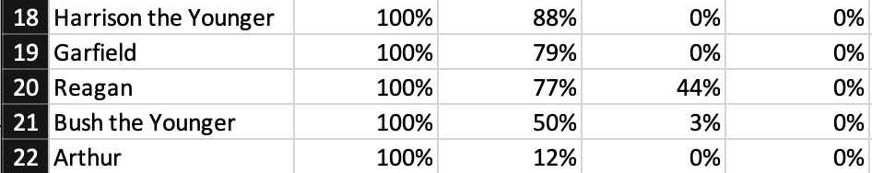
Of note…
When Reagan did survive the second round, he was much more successful in Round 3 than his immediate peers
Demonstrates the importance of the by-round weights

