Slide 1

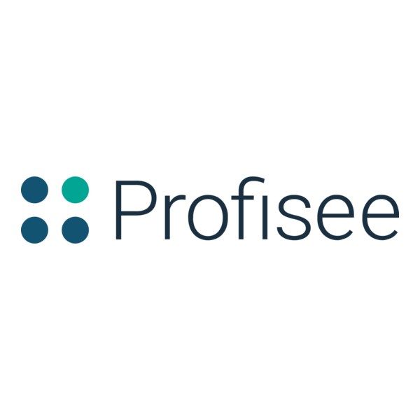

Emergency Meeting
Gamifying Data Stewardship (Hackathon 2026 Demo)
Team: Stephen Vick + Darias Brown
x
Notes:
0:00–0:30 (Stephen)
- “We built a browser-based Among Us-style Skeld and embedded a real stewardship interaction as a game task.”
- “This is a concept demo: a friendly, lightweight way to make stewardship more approachable while producing measurable quality signals.”
- “Quick baton pass: Darias will demo the Fix Wires task (2 minutes), then I’ll come back to explain the model and metrics.”

Slide 2
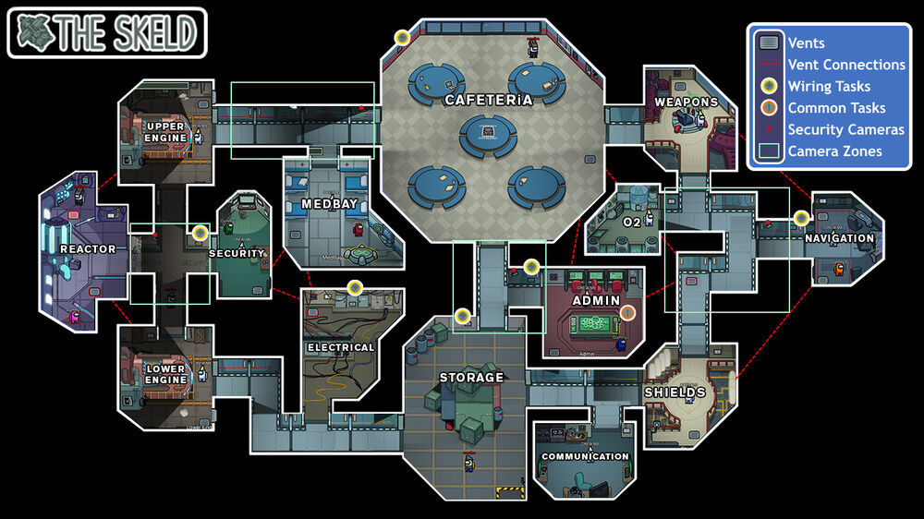
What we’re demonstrating
A playful UI wrapper around real stewardship work
A navigable Skeld-style map (WASD + collisions + room HUD)
Rooms represent domains (Electrical = patient matching today)
Tasks are deliberate interactions—not one-click approvals
Immediate feedback creates learning + auditability signals
10-minute scope: 1 world + 1 task + 1 metrics model
Notes:
0:30–1:20 (Stephen)
- “We kept scope to what’s demoable in 10 minutes: one world, one task, and the metrics model.”
- “The key idea is organizationally friendly: keep the underlying governance the same, but improve the experience so stewards are more likely to engage carefully.”
- “Now Darias will show the task itself.”

Slide 3
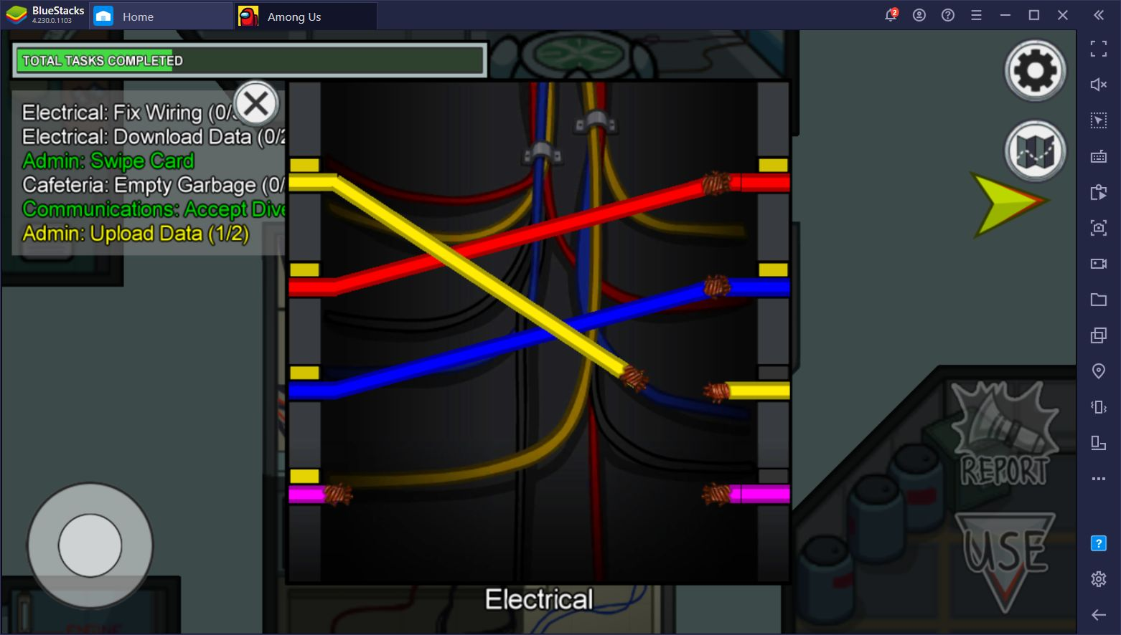
Live demo (2 minutes): Fix Wires = Field-to-Value Matching
What to watch for
Deliberate mapping: each field must be matched to the right value
Wrong match → immediate feedback → retry (captures learning signal)
Correct completion → “Task Complete” + time-to-complete metric
Everything is attributable to the steward identity (player)
Baton: Darias drives now → Stephen resumes after completion
Notes:
1:20–3:20 (Darias drives; Stephen silent)
- Darias runs the mini-game end-to-end.
- Suggested beats (keep tight):
1) Walk to Electrical
2) Open the panel
3) Make one intentional mistake to show feedback
4) Fix it, complete task
- Hand back: “That’s the task—Stephen will explain why this matters and how we measure it.”

Slide 4
Why this matters: game mechanics produce quality signals
Per-steward (player) signals
First-attempt accuracy (right vs wrong)
Retry count (learning signal)
Time-to-complete (velocity / friction)
Streaks / consistency over sessions
Domain breakdown by room (patient / customer / product)
Operationally friendly outcomes
More observable decision-making (less “rubber stamping”)
Risk-based review: focus oversight where confidence is low
Training feedback loop: retries decline as proficiency increases
Recognition: spotlight strong stewards with trust scores
Integration-ready: tasks can call the same MDM rules/APIs
Notes:
3:20–6:30 (Stephen)
- “The point isn’t that games replace governance—it’s that games can wrap governance with deliberate interaction + measurement.”
- “We’re not claiming every org has an engagement crisis; we’re showing a method that can *increase engagement and improve quality* in a low-friction, org-friendly way.”
- “The win is measurement: accuracy, retries, and time-to-complete become signals for coaching and review prioritization.”

Slide 5
Next steps (post-hackathon) + close
Where this goes next
More rooms → more stewardship tasks (merge/split, golden record, address standardization)
Leaderboards + team challenges (opt-in, department-friendly)
Adaptive difficulty (harder cases for high-confidence stewards)
Reviewer dashboard powered by trust + exceptions
Direct integration: Profisee matching/survivorship APIs behind tasks
Thank you — Q&A
Notes:
6:30–10:00 (Stephen)
- “In ten minutes we showed: a world, a task, and a measurement model.”
- “We believe this can make stewardship more approachable and can improve decision quality by making each action deliberate and measurable.”
- “Happy to talk through integration options and which stewardship tasks map best to which mini-games.”

