Slide 1
JackBlack
By: Stephen Tsai

Slide 2
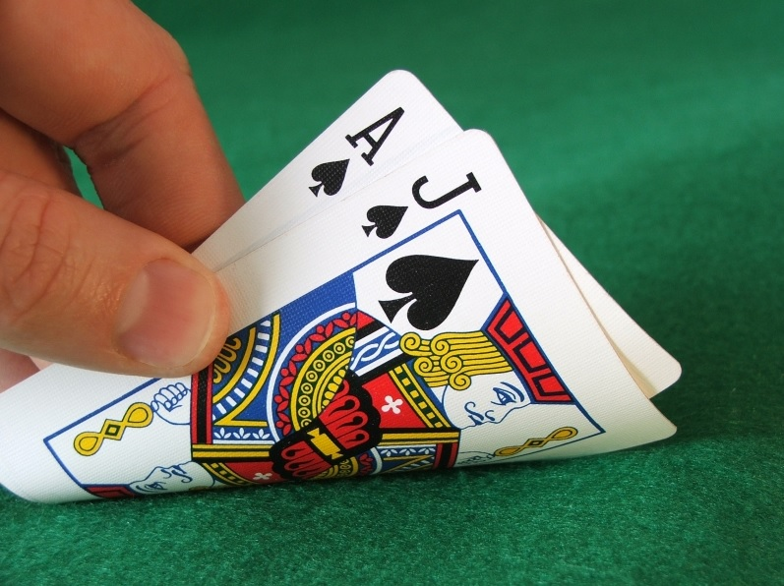
What is JackBlack?
JackBlack is a variation of the popular casino game Blackjack
In Blackjack, you have a 4.8% chance of being dealt a winning hand
The odds of winning are a little harsh…
But in JackBlack, you have a 43.8% of being dealt a winning hand!

Slide 3
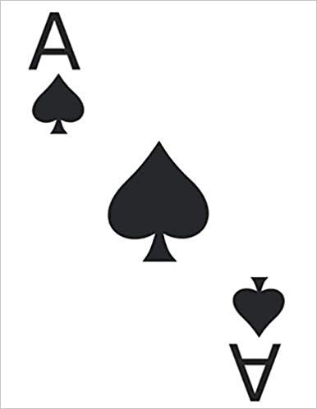
How do I play?
In JackBlack you want to find the difference of the cards to try to get closest to 0.
If the value of your hand become negative, you lose.
You can ask to hit another card if you are not satisfied with your first hand
Only the top card of the dealer's hand would be shown
So the optimal hand you want is a pair of the same cards.
In JackBlack, aces will only count as 1

Slide 4
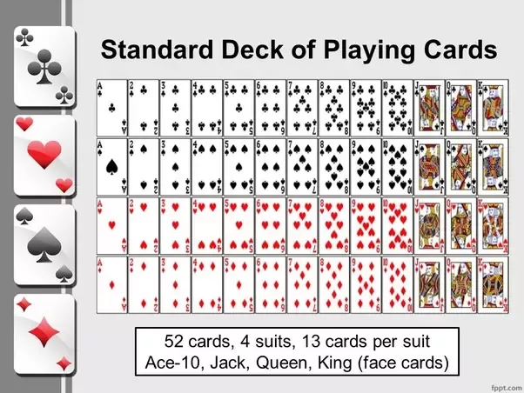
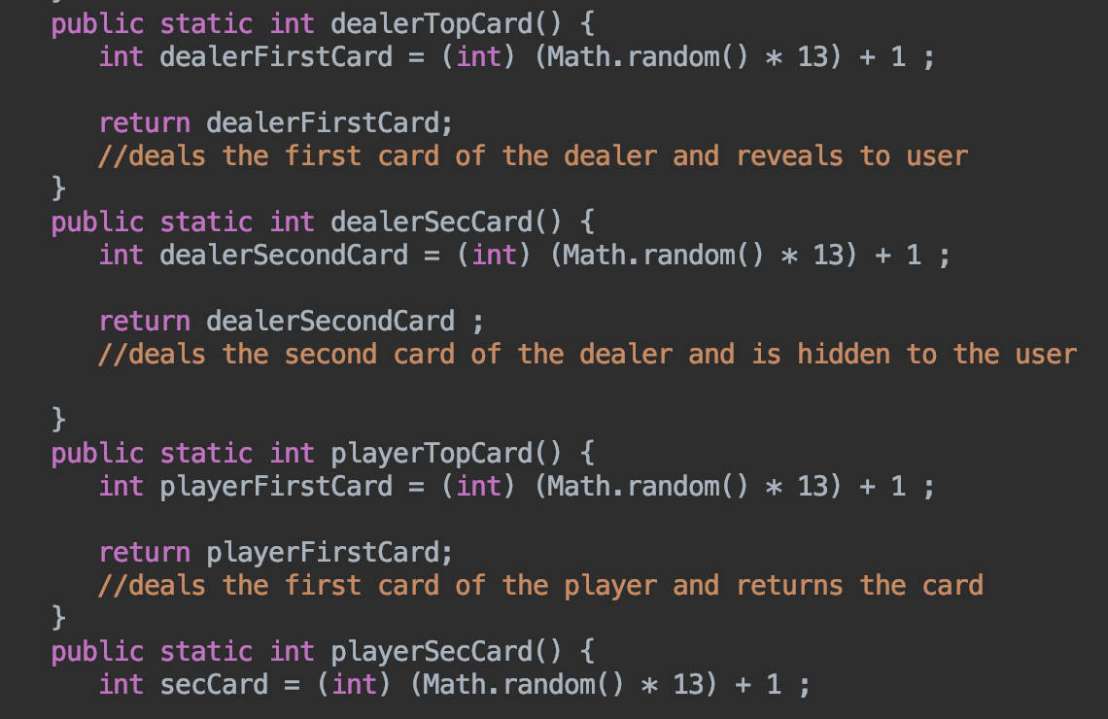
Here I used math.random to simulate the user being dealt cards in a casino. I used math.random to get a random number from 1-13 to imitate cards in a deck. (ace - king)

Slide 5
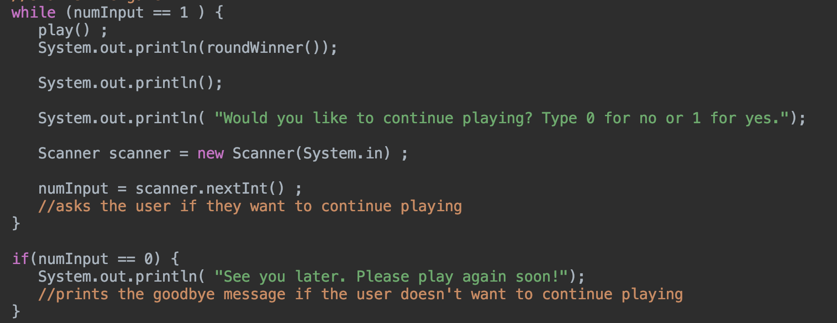
Here I have a while loop and a scanner to determine if the user wants to continue to play after every hand.
If the user types 1, the game continues but if the user types 0, the game ends.

Slide 6
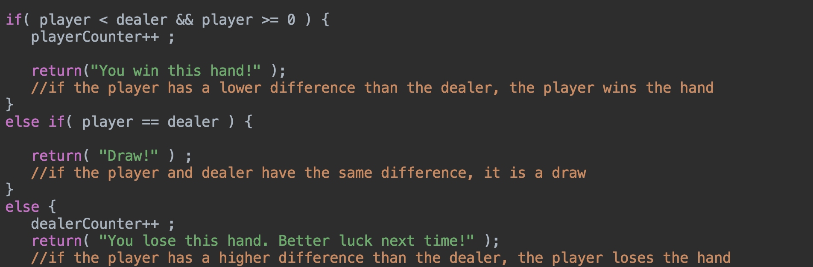
Here I used and if, else if, and else statement to compare the users hand and the dealer's hand to see who won the hand.

Slide 7

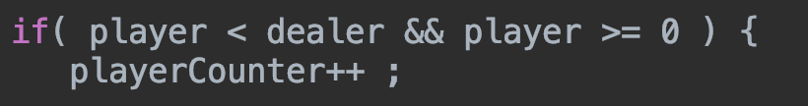

Here I have a live counter of the player/dealer wins. After every hand, the user can see their wins versus the dealers wins.

Slide 8
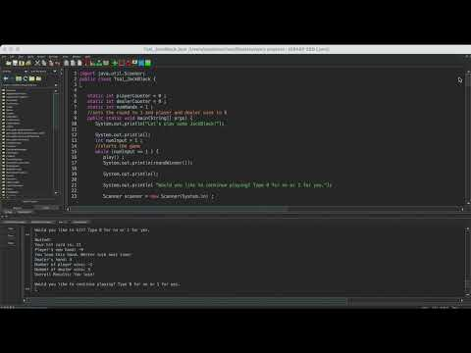
Video Demonstration

