Slide 1
Insight into HDB public housing trends
Dataset source:
https://data.gov.sg/dataset/resale-flat-prices

Slide 2
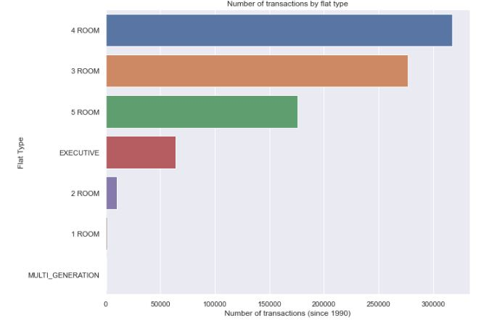
Number of transaction by flat type
The most number of transactions are the 4 room, follow by the 3 room.
We can infer that 4 room is the highest in demand given the sweet spot of low price and availability of 3 bedrooms.
5 room type comes 3rd in place due to the higher price factor.

Slide 3
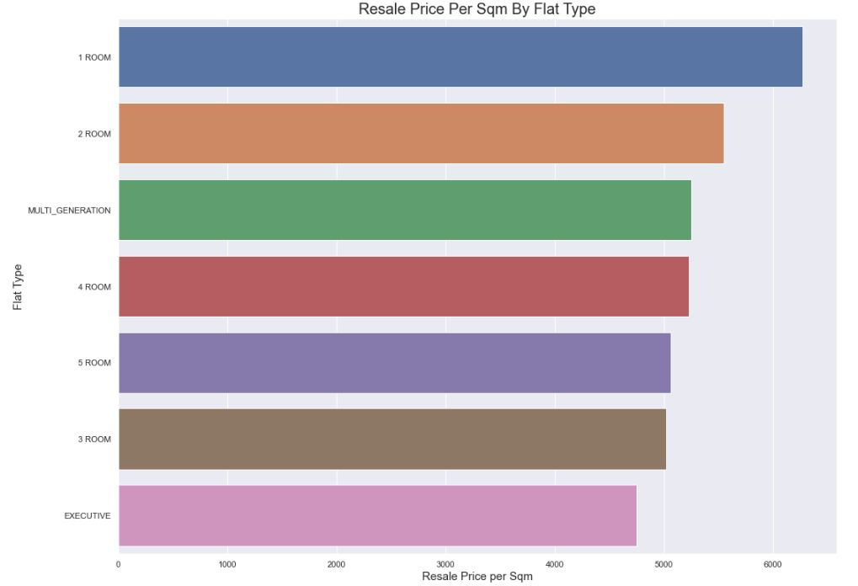
Price per square meter by flat type
Price is the highest for 1 room type, follow by 2 room, both due to it’s small size.
Price for multi-generation maintains at the 3rd due to the low supply and it’s niche.
Price for 4 room is still higher than 5 room due to the demand being higher.
Price for 3 rooms remains low even though the demand is high (being 2nd to 4 room), perhaps due to ageing.
Price for executive is the lowest due to the low demand.

Slide 4
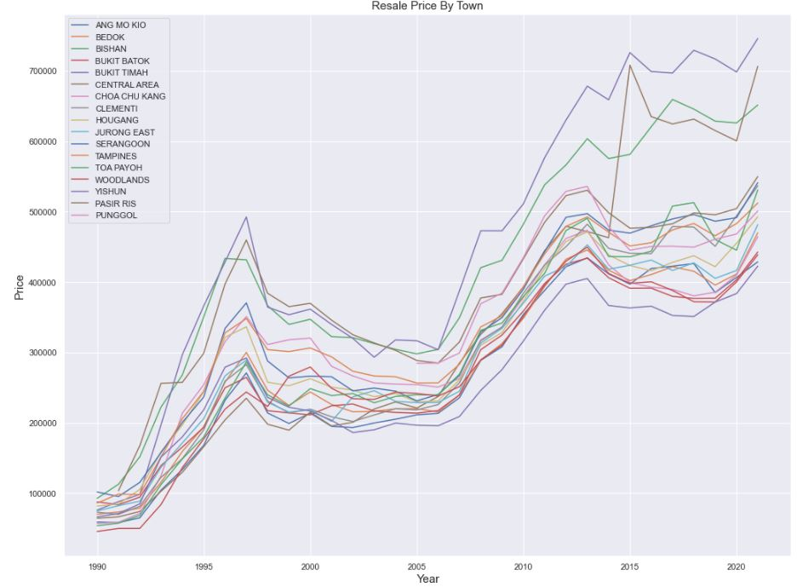
Resale Price Trend By Town
The price fluctuates the most for the top tier towns such as Bukit Timah, Central Area and Bishan due to speculations.
The highest fluctuations come from flats in the Central Area; as in 2013 it was clearly undervalued due to cooling measures imposed by the government.
The rest does not fluctuates as much.
The least fluctuations are in Yishun, Woodlands, Jurong East, Ang Mo Kio etc.

Slide 5
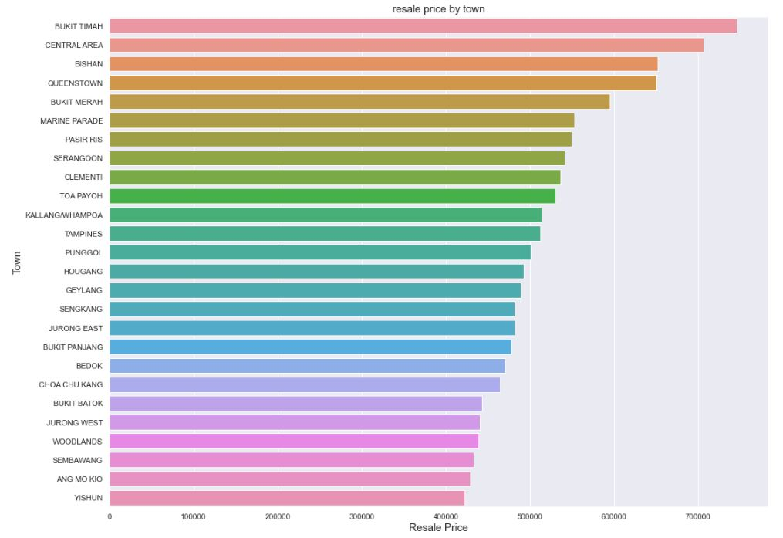
Price Ranking By Town (Yr 2020 -2021)
Price is the highest at south and central areas (Bukit Timah, Central Area, Bishan, Queenstown and Bukit Merah).
Then follow by east (Marine Parade and Pasir Ris)
The middle tier consist of mature estates which are not too far from the central areas (Serangoon, Toa Payoh, Kallang, Hougang etc.
In the west side, Clementi is in most demand given it’s proximity to popular educational facilities.
Ang Mo Kio is the 2nd lowest due to ageing.

Slide 6
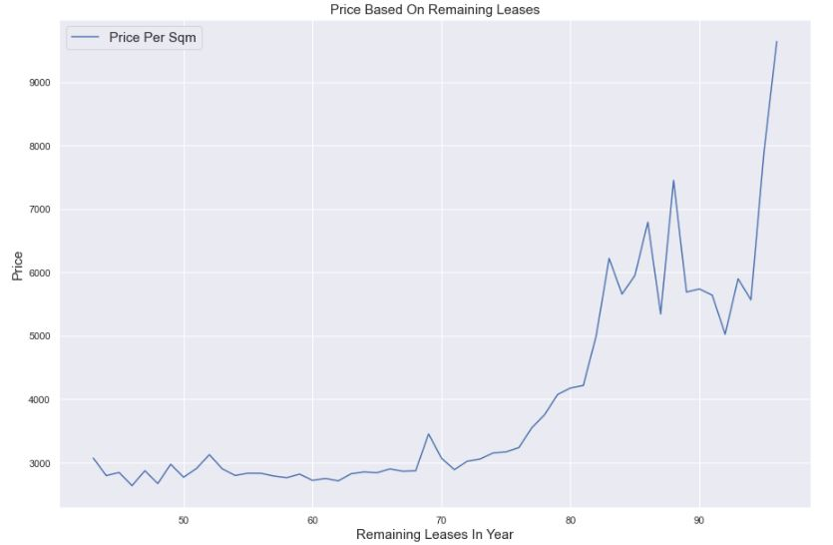
Price By Remaining Leases (years)
Price higher when flat is young (ie relatively long remaining leases)
However fluctuations are due to supply and demand conditions. When a glut is driven by a group of sellers in the same vicinity (as it reaches the 5 year minimum occupancy period), price dips. And when supply is low, the price goes up again.
However there is positive trend between remaining leases and price.

Slide 7
What Are The Top 3 Drivers Of Price?
Floor Area
62%
Remaining Leases
50%
Town
5%
DRIVERS OF PRICE | SCORE
FLOOR AREA | 62
REMAINING LEASES | 50
TOWN | 5

Slide 8
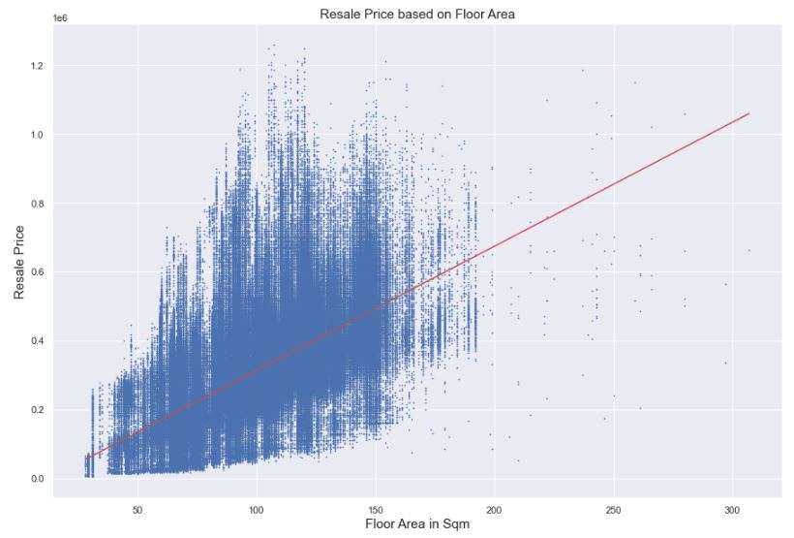
What Are The Top 3 Drivers Of Price? Floor Area
FLOOR AREA
Visualize that as floor area increases, resale price increases as well, as indicated by the red line.
The correlation score is 62%.
This means 62% of the prices can be explained by the size of the floor area.

Slide 9
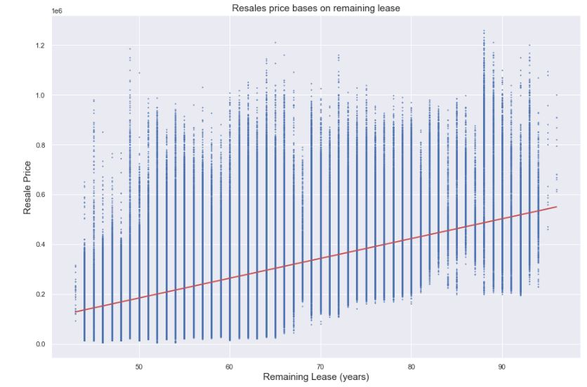
What Are The Top 3 Drivers Of Price? Remaining Leases
REMAINING LEASES
Visualize that as remaining leases are high, resale price are high as well, as indicated by the red line.
The correlation score is 50%.
This means 50% of the prices can be explained by the size of the floor area.

Slide 10
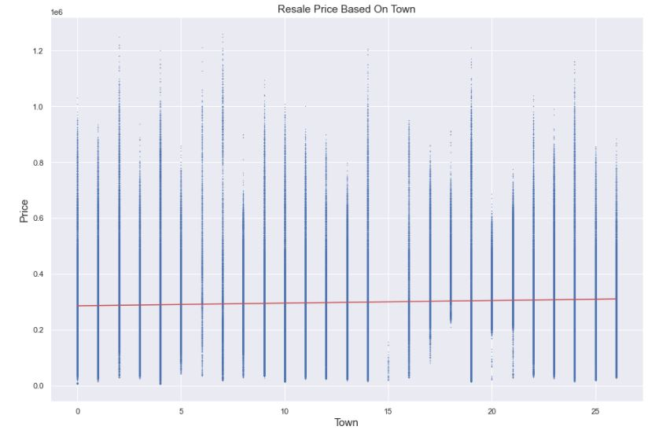
What Are The Top 3 Drivers Of Price? Town
TOWN
The relationship between price and location (ie. Town) is weak (5) because a buyer decides on a certain location based on other factors and not on price.
Nevertheless, popular location does drives up the price.

Slide 11
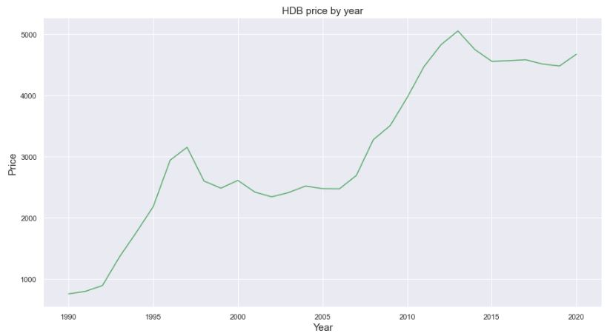
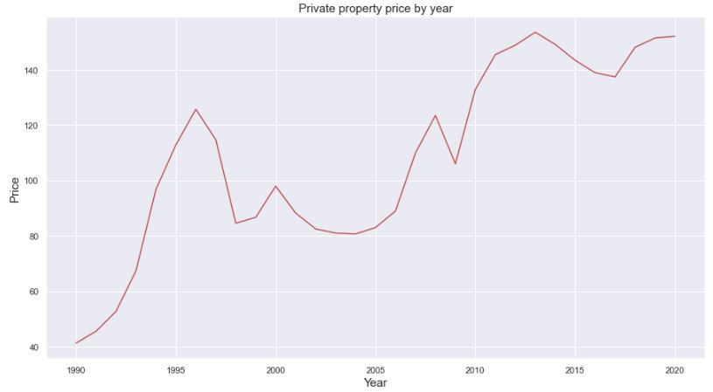
PRICE STABILITY OF HDB VS PRIVATE PROPERTIES
The red dotted line represents the 2007-2008 financial crisis which caused private property prices to drop by at least 25%.
Whereas during the same period, HDB prices were not affected.
The blue dotted line represents the 2013 (12 Jan) cooling measure by the government. Both sees a dip in prices as transaction volume slows.
The black dotted line represents the 2018 cooling measures aimed at discouraging speculators from buying properties for investment purposes. However private property prices still increased.
Whereas HDB remains stable.

Slide 12
Conclusions
The top 3 drivers of HDB flats are floor size, remaining leases and town location.
However popular location does not directly drive up the prices because buyer decides on location based on other factors and not on investment purposes.
HDB prices are relatively more stable than private property prices.
4 room flat types remain to be the most popular among all others.
Prices in mature estates will remain low due to age of flat as it approaches end of lease. Eg Ang Mo Kio

