Slide 1
Stephen Scott COMPENG 4TN4 Instructor: Seyed Mehdi Ayyoubzadeh
Star Tracker without a Star Database
2022

Slide 2
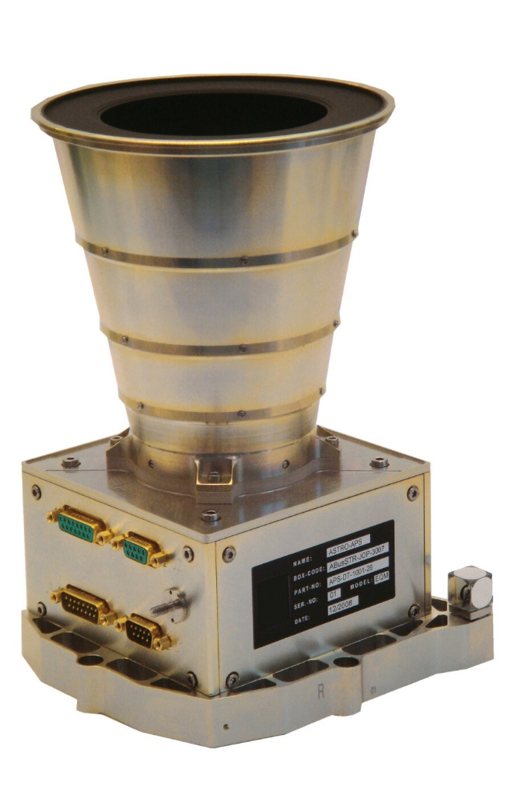
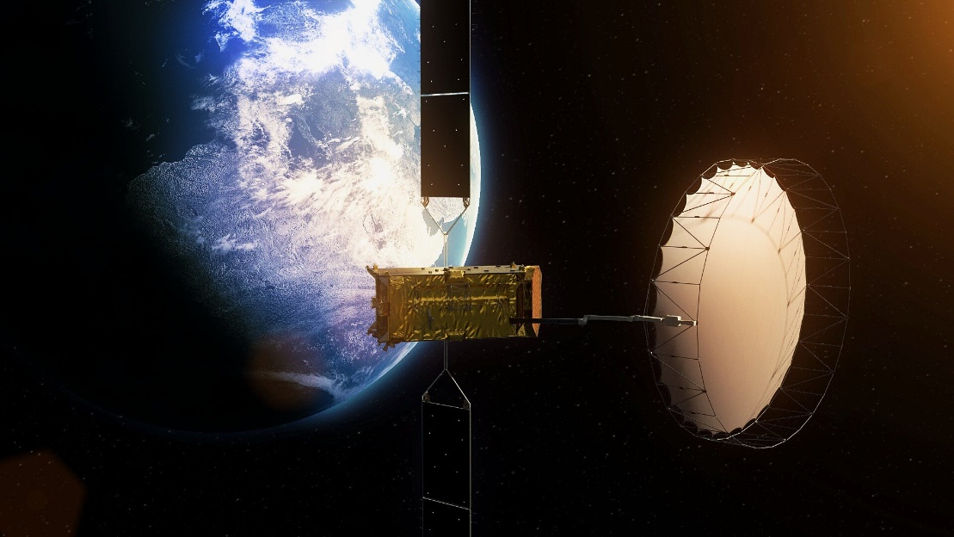
What is a star tracker?
European Space Agency. Alphasat. 2013
Camera system often found on satellites
Expensive to implement effectively, not often used on low-budget nanosatellites

Slide 3
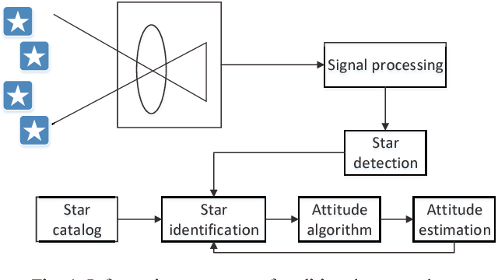
Why do satellite’s need a star tracker?
Jianan, Y. et al. “Pico-satellite attitude determination using a star tracker with compressive sensing”. 2015
Helps to stabilize the satellite (reduce pointing error)
Used in trajectory control system

Slide 4
The issue with star trackers
Jianan, Y. et al. “Pico-satellite attitude determination using a star tracker with compressive sensing”. 2015
Star lookup is computationally expensive
Expertise in subject is needed to implement effectively (not helpful to small missions like university CubeSats)

Slide 5
Related work
H. Yoon, Y. Lim, and H. Bang. New star-pattern identification
using a correlation approach for spacecraft attitude determination.
Journal of Spacecraft and Rockets, 48(1), 2011.
T. Delabie, J.D. Schutter, and B. Vandenbussche. Highly
efficient attitude-estimation algorithm for star trackers using
optimal image matching. Journal of Guidance, Control, and
Dynamics, 36(6), 2013.
K.T. Kim and H. Bang. Reliable star pattern identification
technique by using neural networks. The Journal of the Astronautical
Sciences, 52:239–249, 2004.
Correlation algorithm
Optimal image matching
Neural Network
Compare image to on-board database and maximize cost function
Stars as Gaussian distributions
Correlate images in image space using heat map
Match pairs of images optimally on top of each other
Eliminates complex coordinate conversions
Uses Euclidean squared distance
Use neural network to maximize star lookup efficiency
Group neighbouring stars together in database

Slide 6
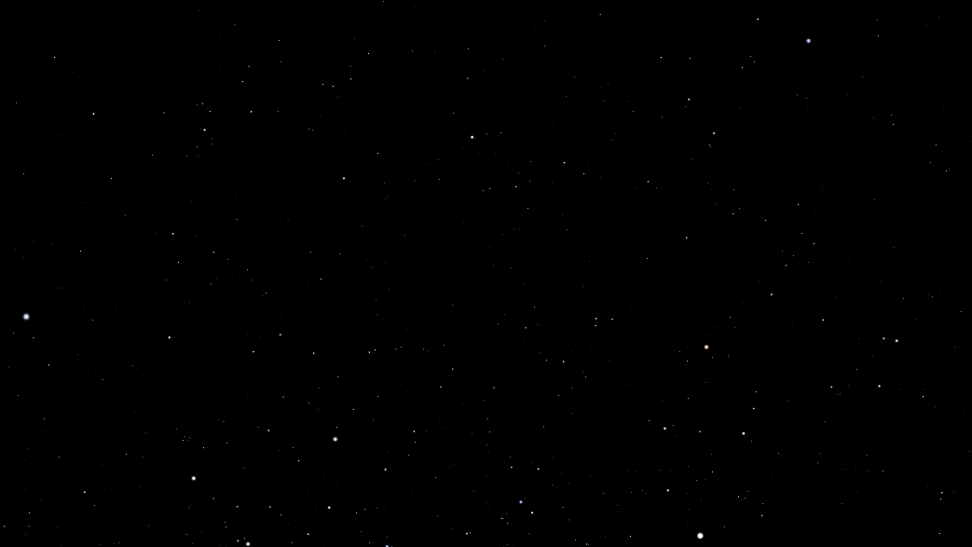
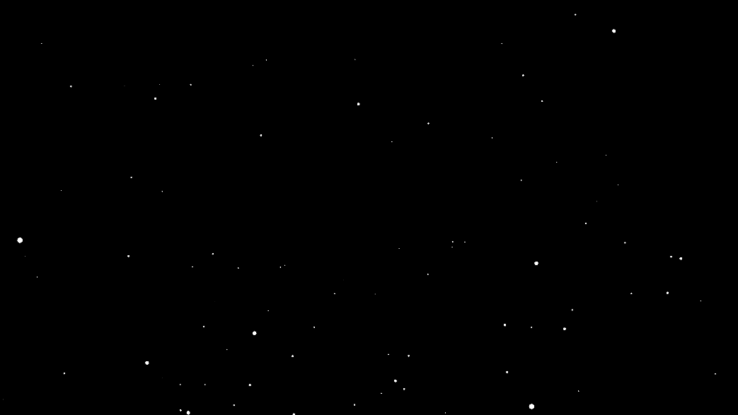
The proposed method
Generate simulated star image dataset using open-source planetarium (Stellarium)
Original Image
Preprocessed Image
Stellarium 0.22.0. https://stellarium.org. 2022
2,592 images by incrementing right ascension/declination angles by 5 degrees
Deep space objects, milky way, and other elements disabled in Stellarium
Gaussian blurred with sigma = 2, binarized using Otsu optimal threshold

Slide 7
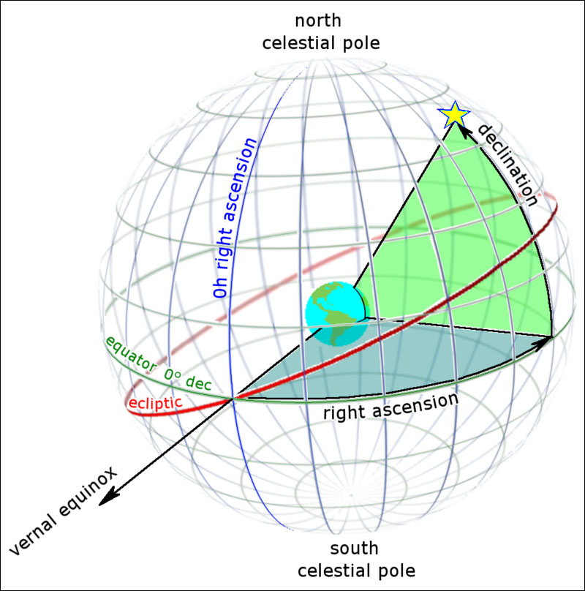
The proposed method
Generate simulated star image dataset using open-source planetarium (Stellarium)
King, B. Right Ascension & Declination: Celestial Coordinates for Beginners. 2019
Images were further classified into 4 regions based on RA and DEC
North-East, North-West, South-East, and South-West

Slide 8
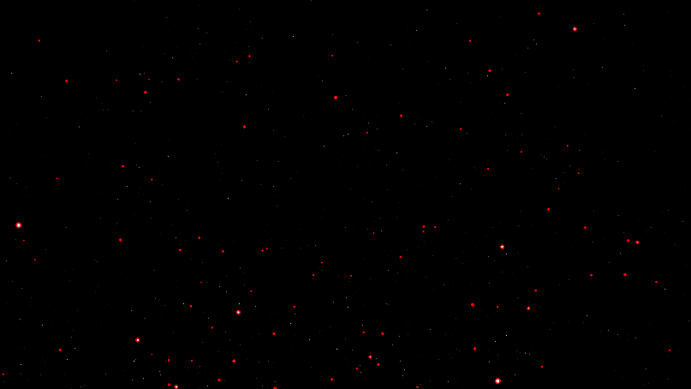

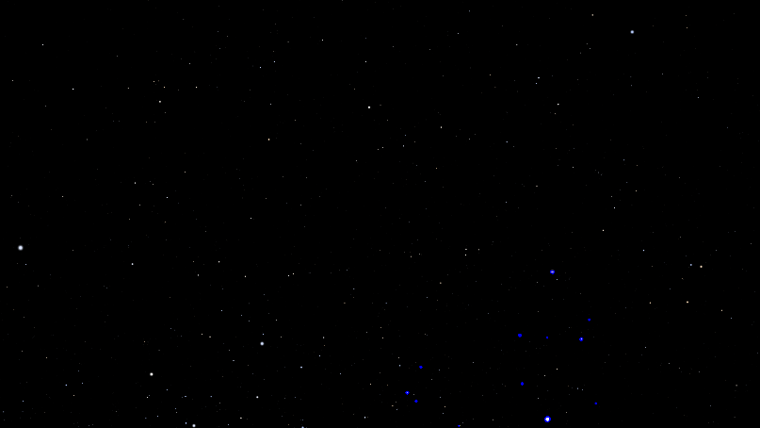
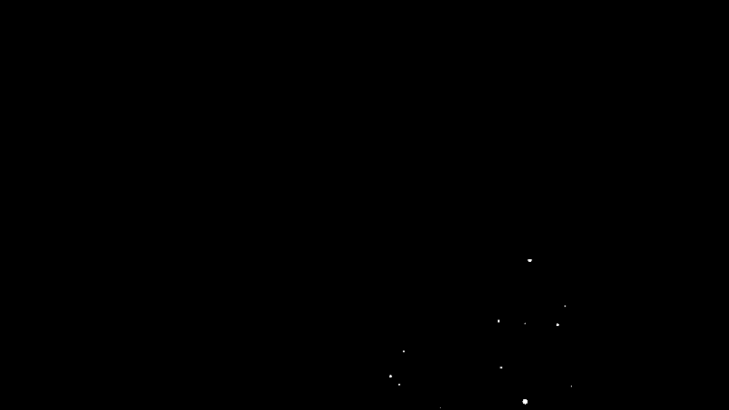
The proposed method
Find largest contour, get 4 brightest stars in region around largest contour
Stellarium 0.22.0. https://stellarium.org. 2022

Slide 9
The proposed method
Train Support Vector Machine (SVM) using feature vector
Feature No. | Feature Description
1 | Radius of brightest star (star 1)
2 | # non-zero pixels around brightest star
3 | Radius biggest star in local region (star 2)
4 | Radius 2nd biggest star in local region (star 3)
5 | Radius 3rd biggest star in local region (star 4)
6 | Radius 4th biggest star in local region (star 5)
7 | Euclidean distance stars 1:2
8 | Euclidean distance stars 1:3
9 | Euclidean distance stars 1:4
10 | Euclidean distance stars 1:5
11 | Euclidean distance stars 2:3
12 | Euclidean distance stars 2:4
13 | Euclidean distance stars 2:5
14 | Euclidean distance stars 3:4
15 | Euclidean distance stars 3:5
16 | Euclidean distance stars 4:5
Matrix norm computed

Slide 10
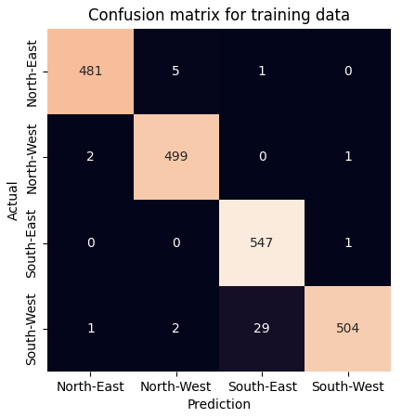
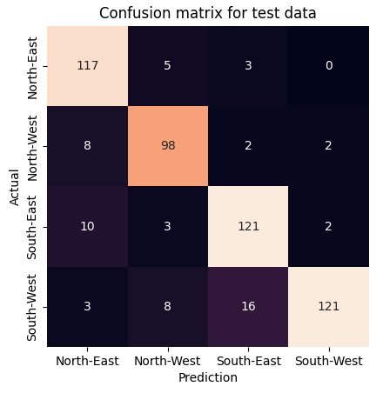
The proposed method: Results
Struggles with distinguishing between South-East/West skies
88.1% accuracy on the test set

Slide 11




The alternate method
Downscale images to 96x96
Blur images with Gaussian blur (sigma = 40) to reduce sparsity
Augment the dataset with rotated images
0 degrees
90 degrees
180 degrees
270 degrees
Augmented dataset has 10,368 images

Slide 12
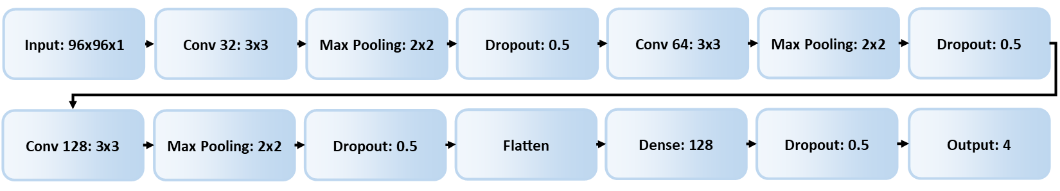
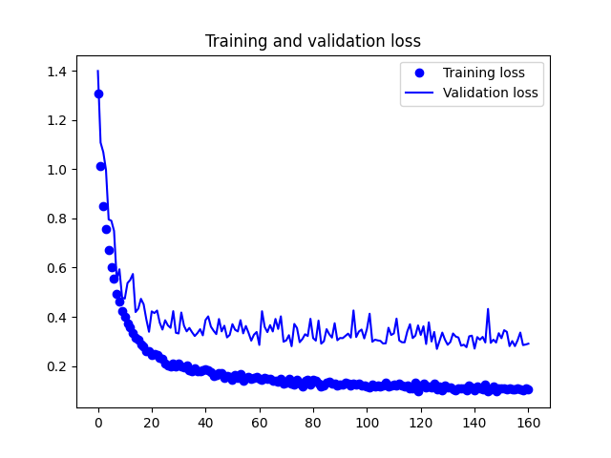
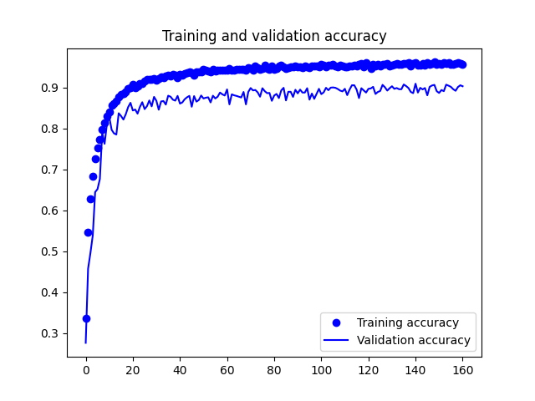
The alternate method
Train a Convolutional Neural Network on the augmented dataset
Adam optimizer used with learning rate = 0.001
Batch size = 32

Slide 13

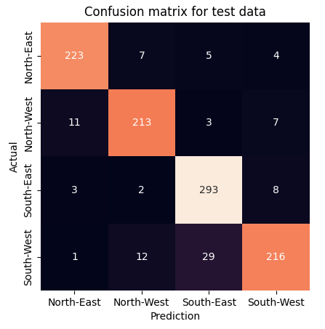
The alternate method: Results
Also struggles with distinguishing between South-East/West skies
91.1% accuracy on the test set

