Slide 1
Stephen Scott COMPENG 4TN4 Instructor: Seyed Mehdi Ayyoubzadeh
Star Tracker without a Star Database
2022

Slide 2
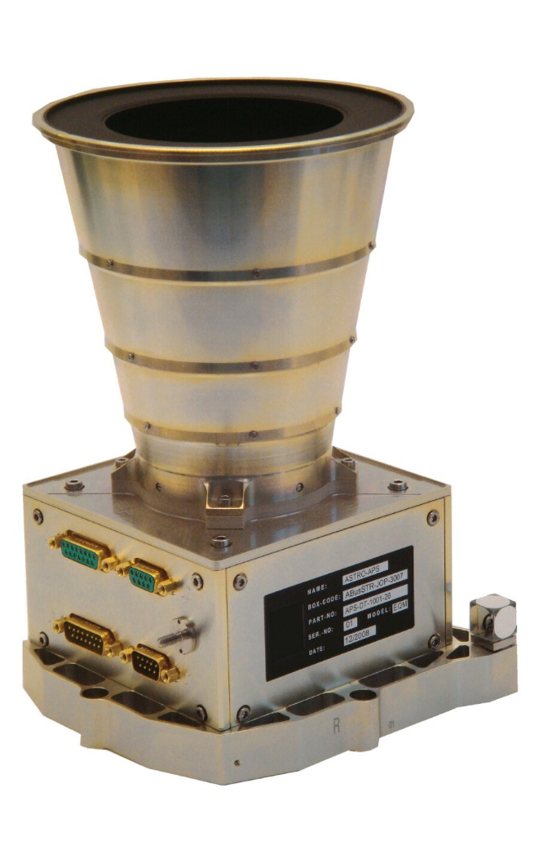
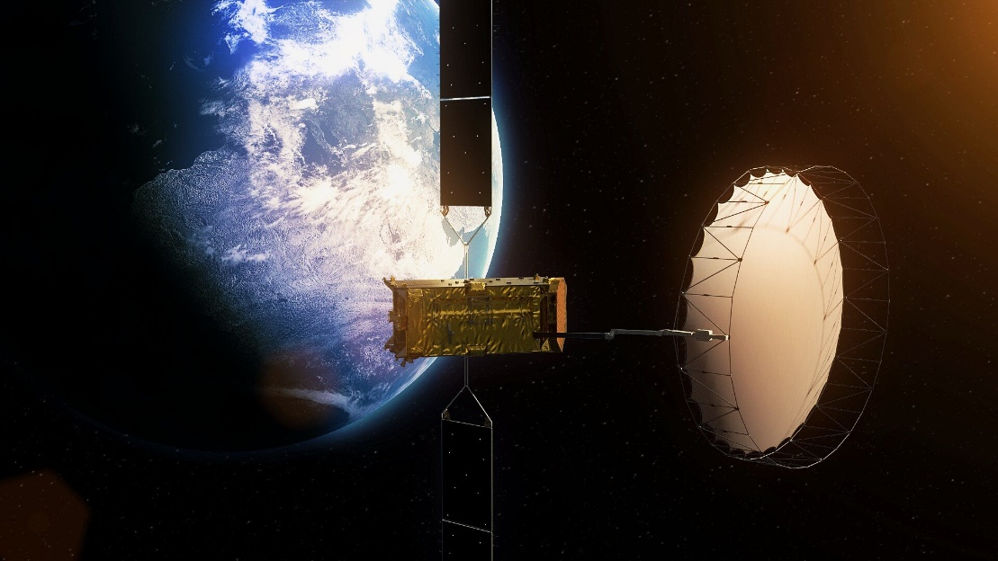
What is a star tracker?
European Space Agency. Alphasat. 2013
Camera system often found on satellites
Expensive to implement effectively, not often used on low-budget nanosatellites

Slide 3
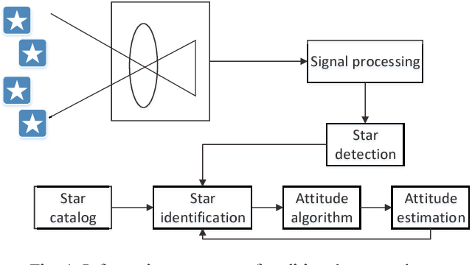
Why do satellite’s need a star tracker?
Jianan, Y. et al. “Pico-satellite attitude determination using a star tracker with compressive sensing”. 2015
Helps to stabilize the satellite (reduce pointing error)
Used in trajectory control system

Slide 4
The issue with star trackers
Jianan, Y. et al. “Pico-satellite attitude determination using a star tracker with compressive sensing”. 2015
Star lookup is computationally expensive
Expertise in subject is needed to implement effectively (not helpful to small missions like university CubeSats)

Slide 5
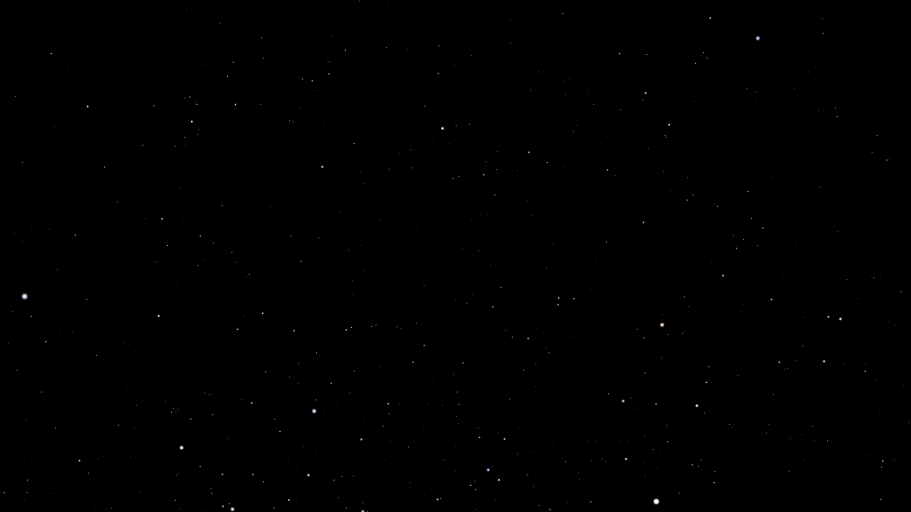

The proposed method
Generate simulated star image dataset using open-source planetarium (Stellarium)
Original Image
Preprocessed Image
Stellarium 0.22.0. https://stellarium.org. 2022
2,592 images by incrementing right ascension/declination angles by 5 degrees
Deep space objects, milky way, and other elements disabled in Stellarium
Gaussian blurred with sigma = 2, binarized using Otsu optimal threshold

Slide 6
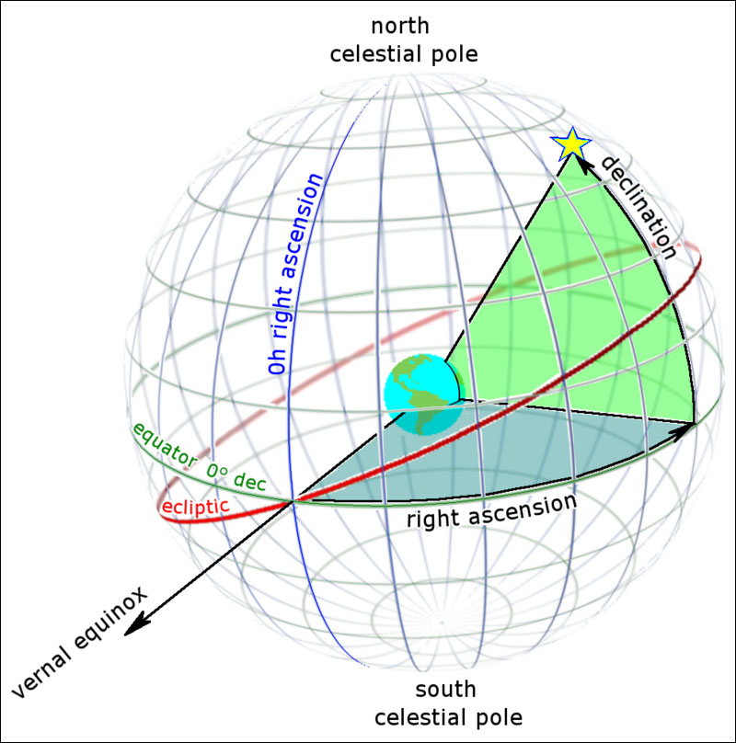
The proposed method
Generate simulated star image dataset using open-source planetarium (Stellarium)
King, B. Right Ascension & Declination: Celestial Coordinates for Beginners. 2019
Images were further classified into 4 regions based on RA and DEC
North-East, North-West, South-East, and South-West

Slide 7
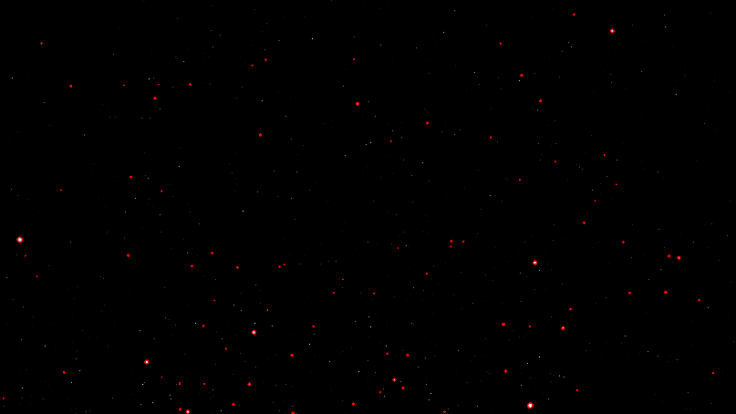

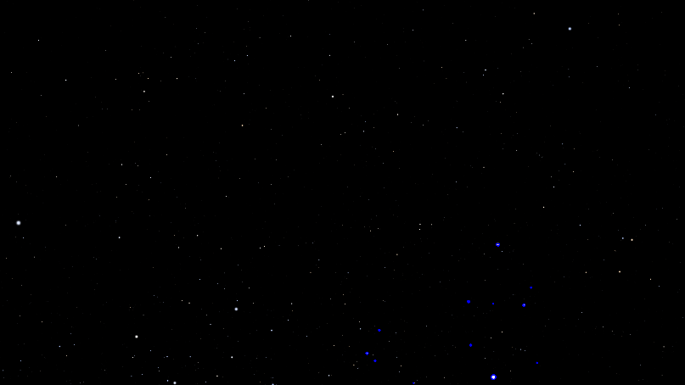

The proposed method
Find largest contour, get 4 brightest stars in region around largest contour
Stellarium 0.22.0. https://stellarium.org. 2022

Slide 8
The proposed method
Train Support Vector Machine (SVM) using feature vector
Feature No. | Feature Description
1 | Radius of brightest star (star 1)
2 | # non-zero pixels around brightest star
3 | Radius biggest star in local region (star 2)
4 | Radius 2nd biggest star in local region (star 3)
5 | Radius 3rd biggest star in local region (star 4)
6 | Radius 4th biggest star in local region (star 5)
7 | Euclidean distance stars 1:2
8 | Euclidean distance stars 1:3
9 | Euclidean distance stars 1:4
10 | Euclidean distance stars 1:5
11 | Euclidean distance stars 2:3
12 | Euclidean distance stars 2:4
13 | Euclidean distance stars 2:5
14 | Euclidean distance stars 3:4
15 | Euclidean distance stars 3:5
16 | Euclidean distance stars 4:5
Matrix norm computed

Slide 9
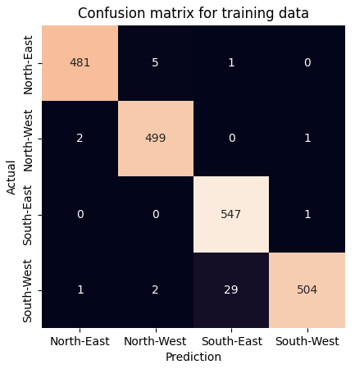
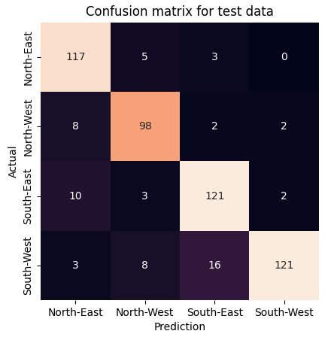
The proposed method: Results
Struggles with distinguishing between South-East/West skies
88.1% accuracy on the test set

Slide 10




The alternate method
Downscale images to 96x96
Blur images with Gaussian blur (sigma = 40) to reduce sparsity
Augment the dataset with rotated images
0 degrees
90 degrees
180 degrees
270 degrees
Augmented dataset has 10,368 images

Slide 11
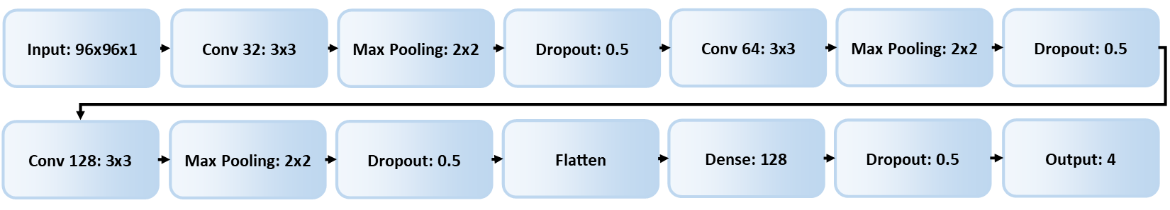
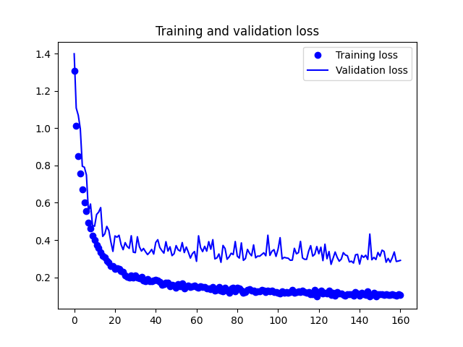
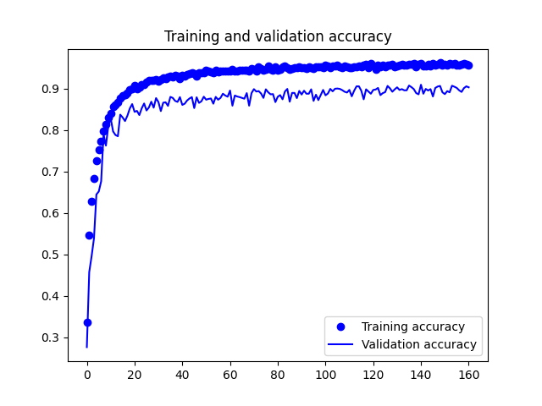
The alternate method
Train a Convolutional Neural Network on the augmented dataset
Adam optimizer used with learning rate = 0.001
Batch size = 32

Slide 12

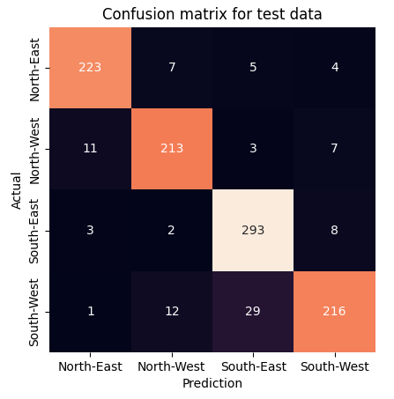
The alternate method: Results
Also struggles with distinguishing between South-East/West skies
91.1% accuracy on the test set

