Slide 1
TECHNICAL PROPOSAL
DisbursePro
Enterprise Disbursement Platform
Control, visibility, and orchestration
for enterprise money movement
Qsoftwares Ltd | Digital Financial Solutions | April 2026

Slide 2
The Problem
!
Manual Processes
Petty cash, informal transfers, physical handoffs to field workers
$
No Accountability
Missing receipts, untracked expenses, no audit trail
?
Zero Visibility
Finance teams cannot track how company funds are being used
X
High Risk
Cash theft, fraud, disputes with no evidence trail
A field worker needs fuel money. The company has no structured way to get it to them.

Slide 3
Our Solution
DisbursePro
A structured platform where companies load funds, set disbursement rules
and approval workflows, and disburse to employees through mobile money.
Approval Workflows
Full Audit Trails
Initiator submits, Approver reviews
Every action timestamped and tracked
Real-time Reporting
Mobile Money
Spend by purpose, employee, period
Airtel, MTN MoMo, Zamtel Kwacha

Slide 4
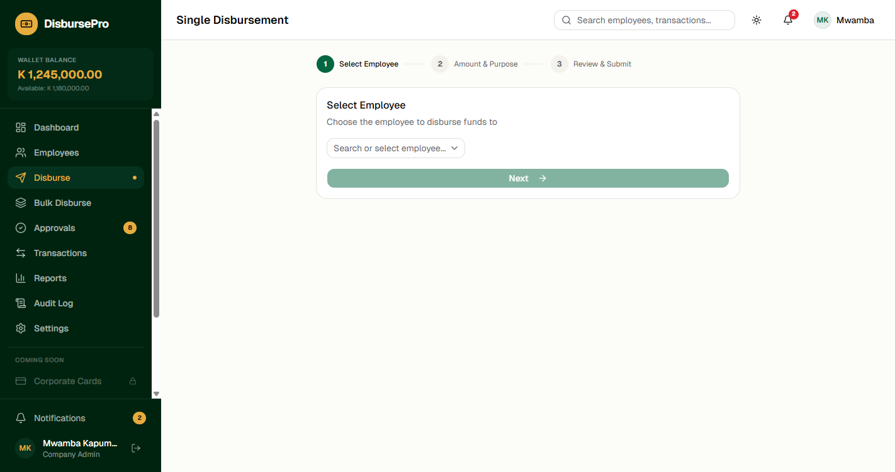
How It Works
1
2
3
Load Wallet
Initiate & Approve
Disburse
Company funds credited
by Operations
Finance submits,
Approver reviews fees
Employee receives via
mobile money instantly

Slide 5
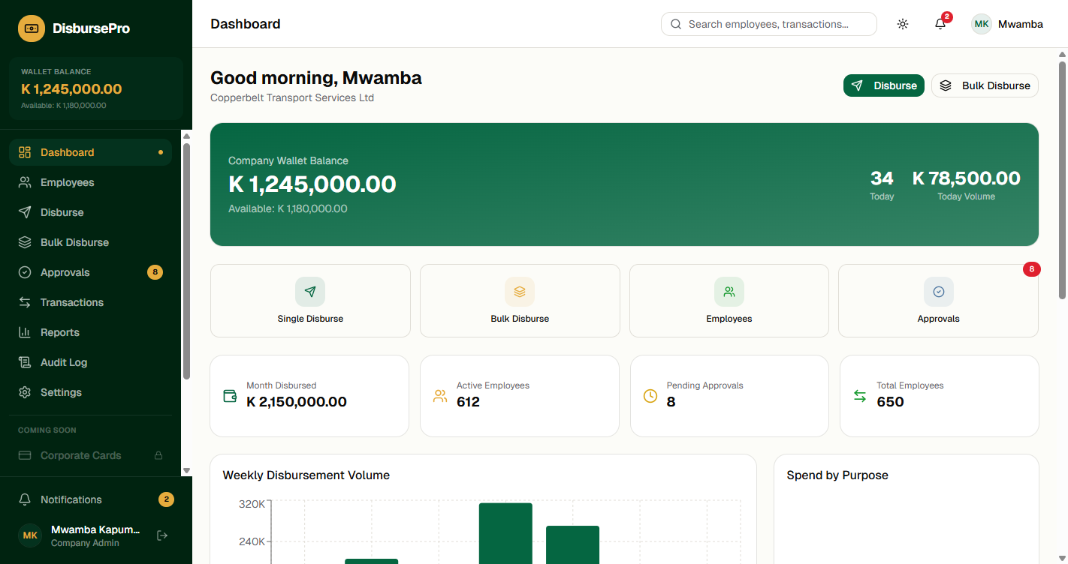
Company Dashboard
Wallet balance, quick actions, spend analytics, and recent disbursements at a glance

Slide 6
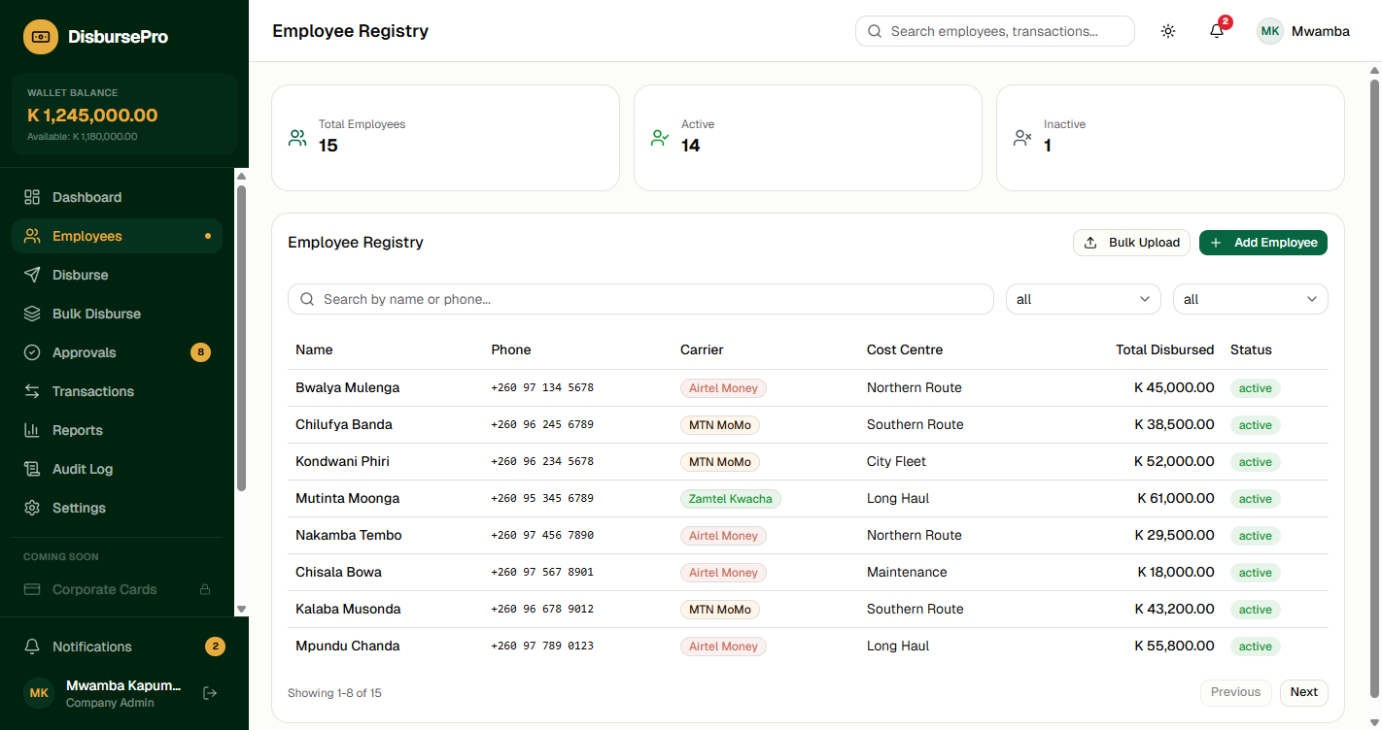
Employee Registry
Manage 650+ employees with bulk CSV upload, carrier linking, and cost centre assignment

Slide 7
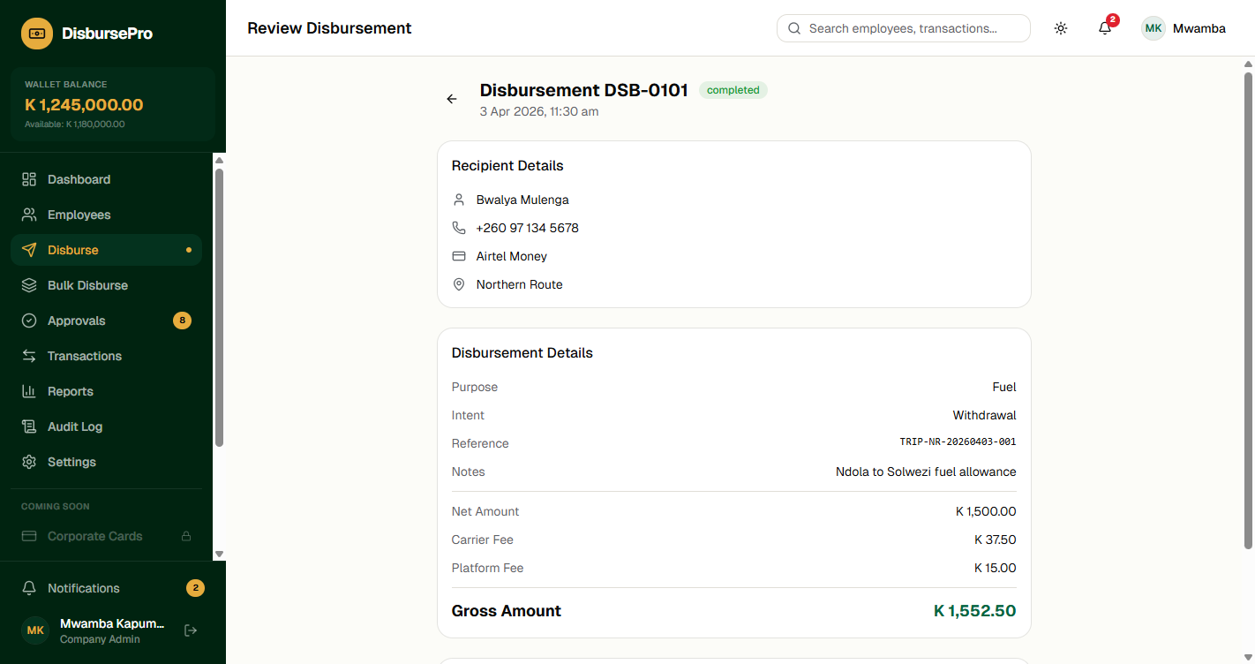
Disbursement with Fee Calculation
Real-time fee breakdown: Net Amount + Carrier Fee + Platform Fee = Gross Amount

Slide 8
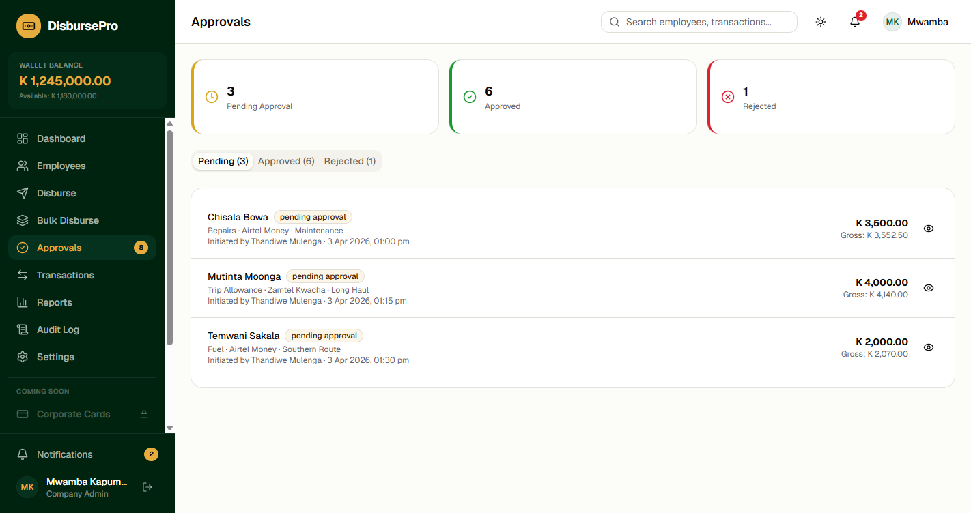
Approval Workflows
Initiator submits for review. Approver sees full fee transparency before approving or rejecting.

Slide 9
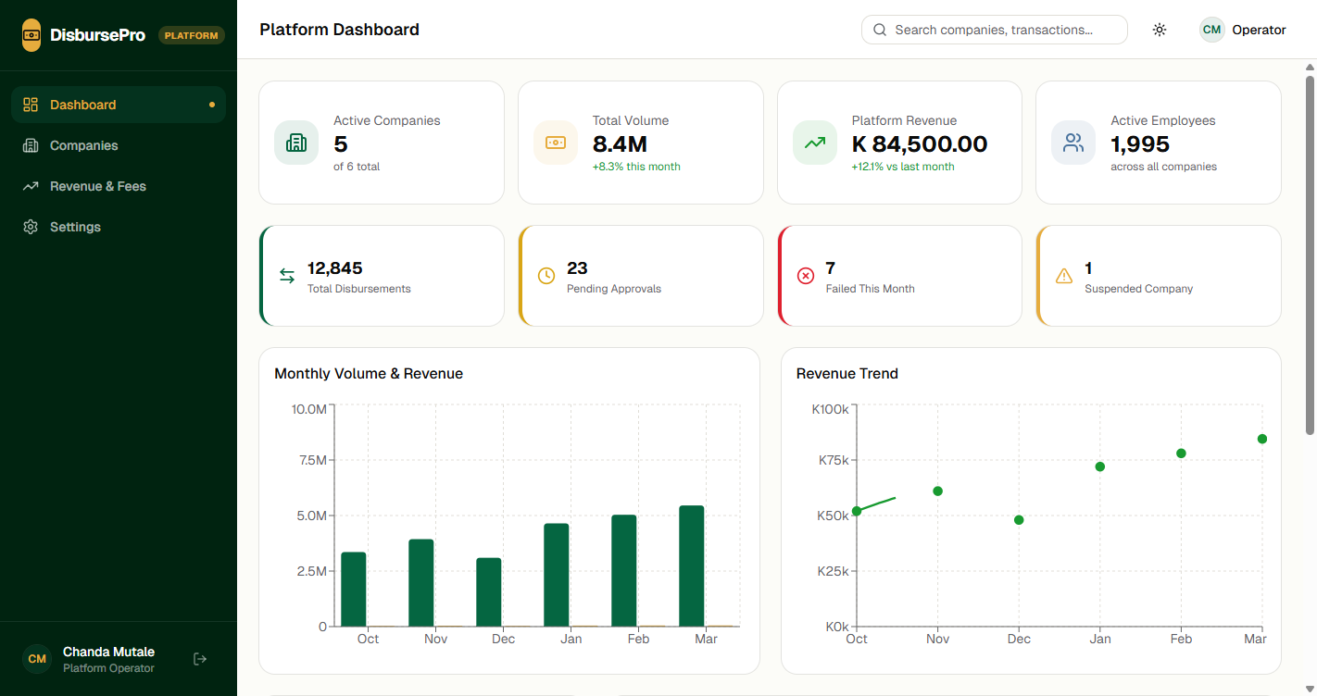
Platform Operator Dashboard
System-wide visibility across all companies: KPIs, volume, revenue, carrier distribution

Slide 10
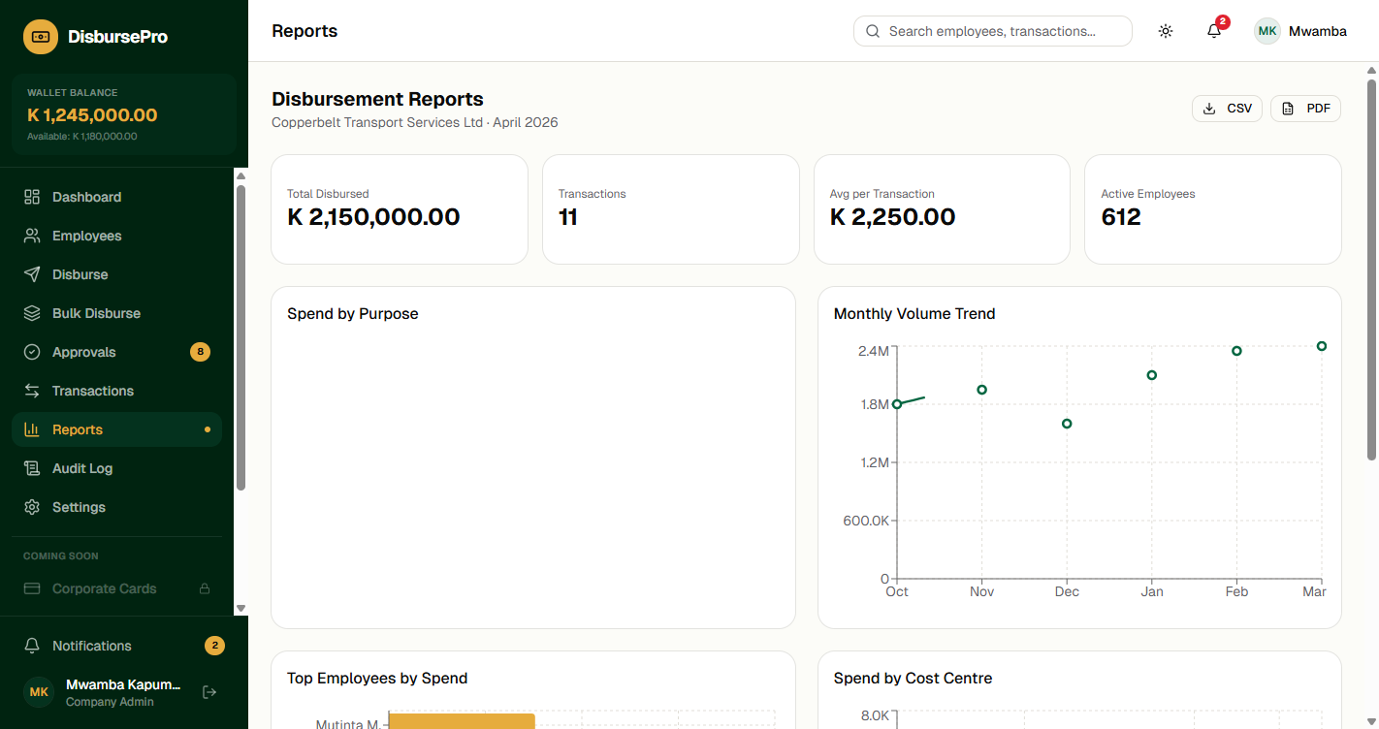
Reports & Analytics
Spend by purpose, employee, period, and cost centre with CSV/PDF export

Slide 11
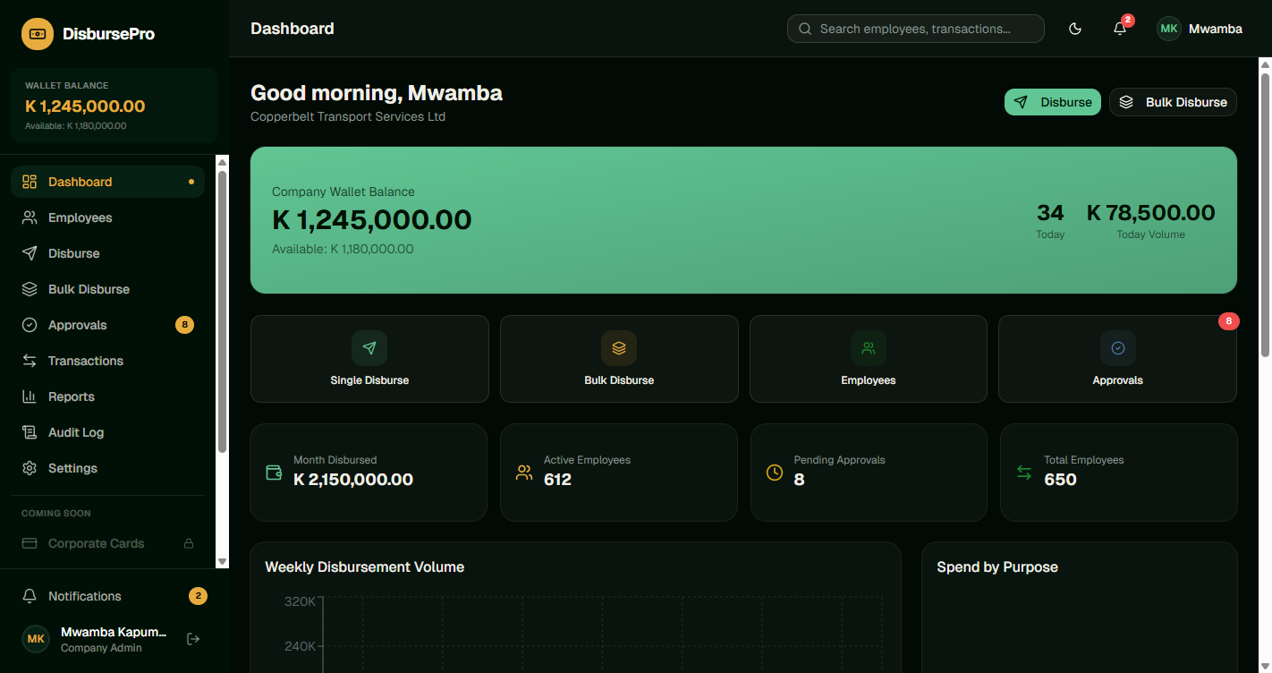
Full Dark Mode Support
Complete dark theme for reduced eye strain and professional appearance

Slide 12
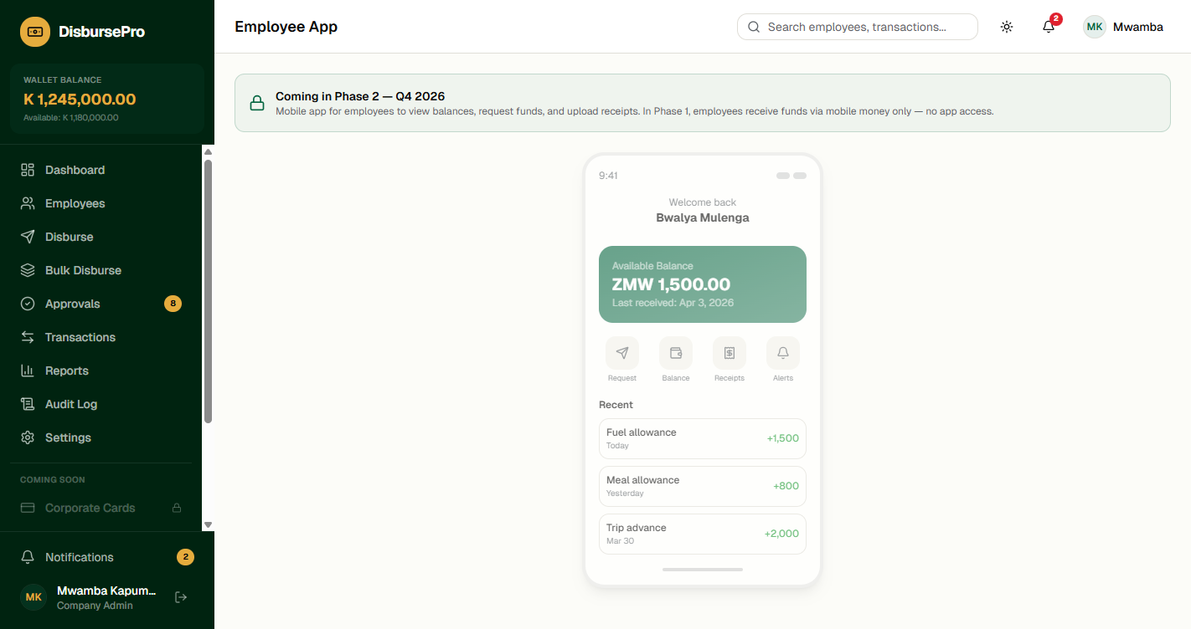
Phase 2 Vision
Features visible in the MVP interface, activated in the full build
Corporate Cards
Prepaid cards with merchant tracking
Self-service Deposits
Mobile money & card top-up
Employee App
Balance view, fund requests, receipts
Multi-currency
USD/ZMW forex with caps
ERP Integrations
Sage, QuickBooks, Xero, Pastel
Phase 2 features are visible but inactive in the MVP — users see the full product vision from day one.

Slide 13
Technical Architecture
React 19 + TypeScript
API-First Design
Modern, type-safe frontend with Tailwind CSS
RESTful APIs with OpenAPI docs + Webhooks
Multi-Tenant SaaS
PostgreSQL Ledger
Tenant isolation, scalable to 1,000+ clients
Double-entry style wallet management
Cloud Hosted
Event-Driven Audit
AWS or Azure with Docker/Kubernetes
Immutable audit logging for compliance
License-free. No vendor lock-in. Full IP transfer. Your team operates independently.

Slide 14
Timeline & Pricing
PHASE 1 — MVP
FULL BUILD
$15,000
$95,000
8 Weeks
12–14 Weeks Post-MVP
Working prototype already built
Mobile money payout integration
Full approval workflows & audit
2–20 enterprise pilot clients
Cards, deposits, employee app
Multi-currency forex
ERP integrations
3-month post-deploy support
Full IP transfer | License-free | No vendor lock-in | Enterprise documentation
Pricing within your stated ranges: MVP $10K–$20K | Full Build $80K–$150K

Slide 15
Why Qsoftwares Ltd
Working Prototype
28 pages already built and functional. We demonstrate, not just promise.
Proven Fintech Experience
NeoBank (30 pages), 9 payment integrations, Apache Fineract experience.
Zambian Market Knowledge
Airtel Money, MTN MoMo, Zamtel Kwacha. Bank of Zambia regulations.
Clean Handover
Full IP transfer. License-free. Enterprise docs. No vendor lock-in.

Slide 16
Thank You
Ready to demonstrate the prototype.
Qsoftwares Ltd Digital Financial Solutions qsoftwares.com

