Slide 1


My pooja paath
application
Prepared by
Mega Infomatix Software Solutions
C-Ground Floor, Sana Palace-2, Opp. Sahara Ganj,
Hazratganj, Lucknow-226001
Contact Information
Office Number: 0522-4070607
Contact No.: +91-9807 562620,
SkypeID: mohammad.shiblee

Slide 2

Get Started

Slide 3
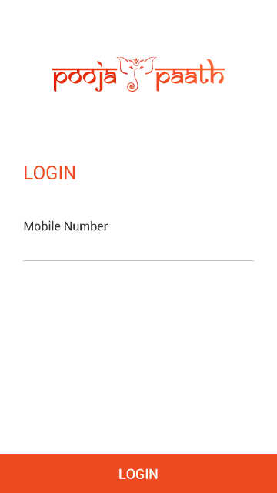
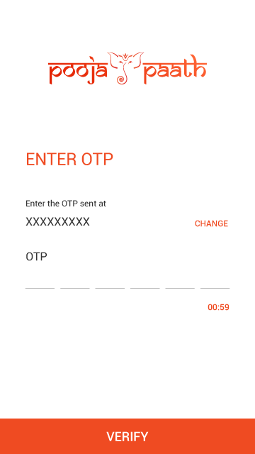
Login and OTP Verification

Slide 4
Customer Dashboard

Slide 5

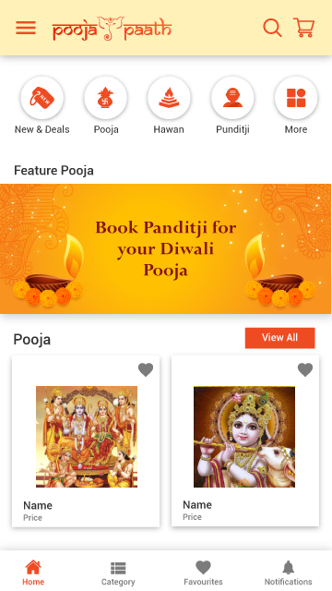
Dashboard

Slide 6
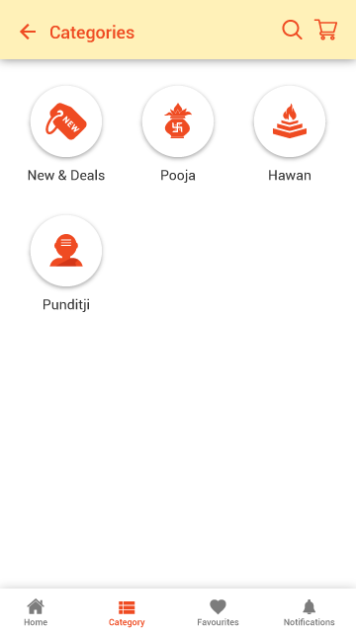
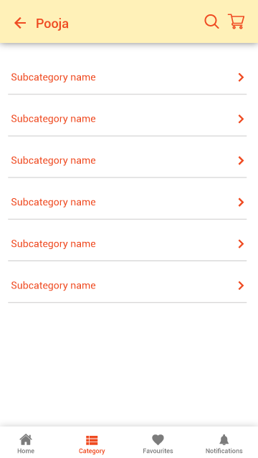
Category and Subcategory

Slide 7
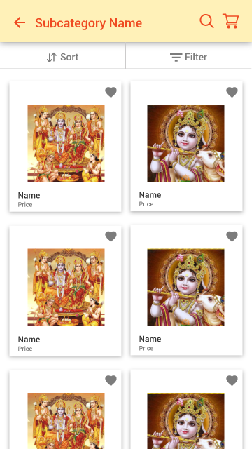
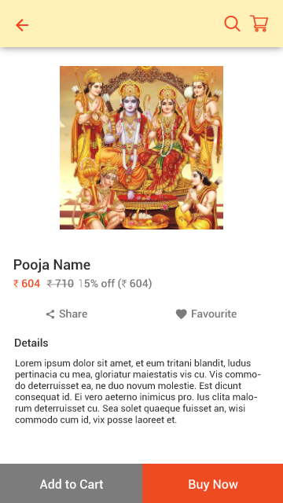
Product List and Product Detail

Slide 8
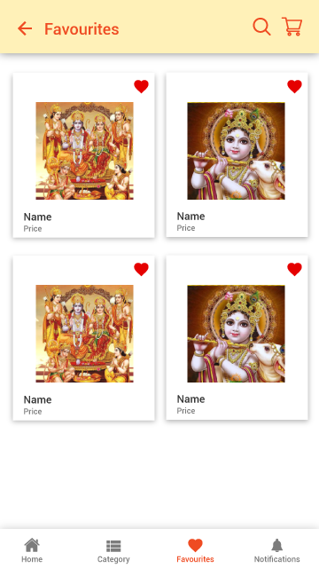
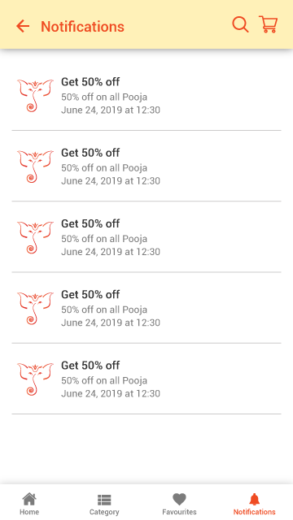
Favourites and Notifications

Slide 9
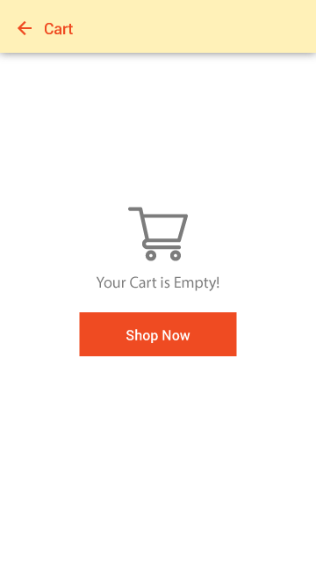
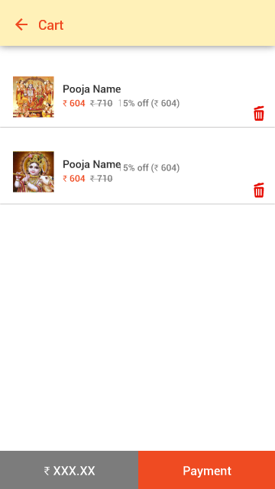
Cart

Slide 10
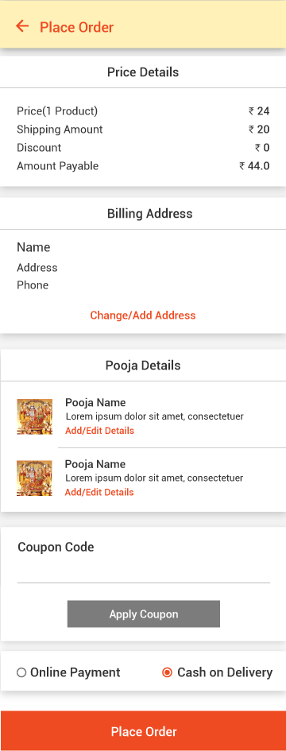
Place Order

Slide 11
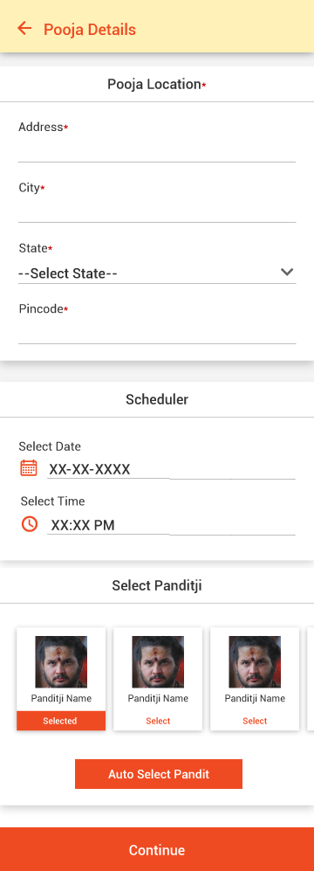
Add/Edit Pooja Details

Slide 12
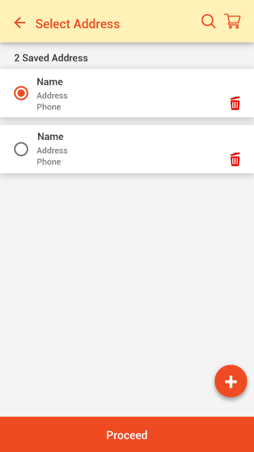
Select Address

Slide 13
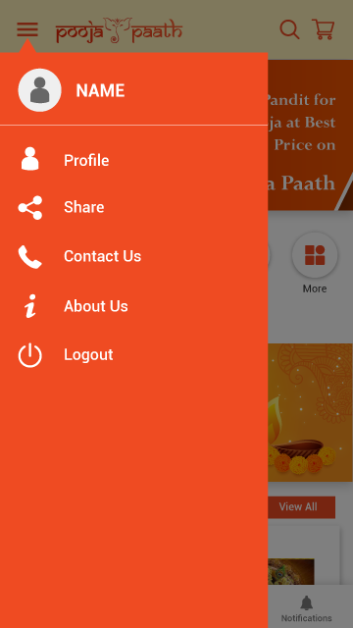
Left Menu

Slide 14
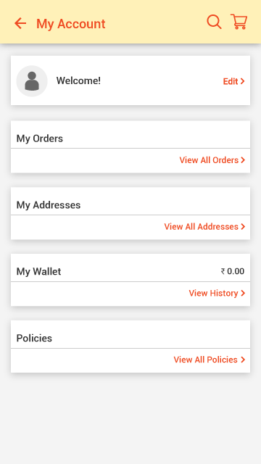
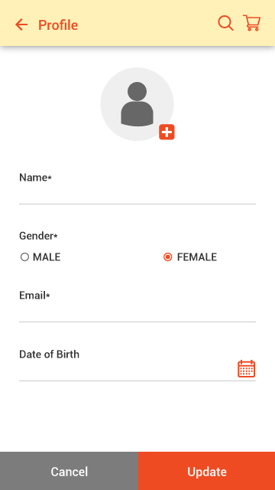
My Account and Profile

Slide 15
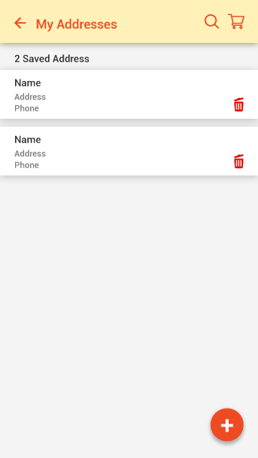
My Addresses

Slide 16
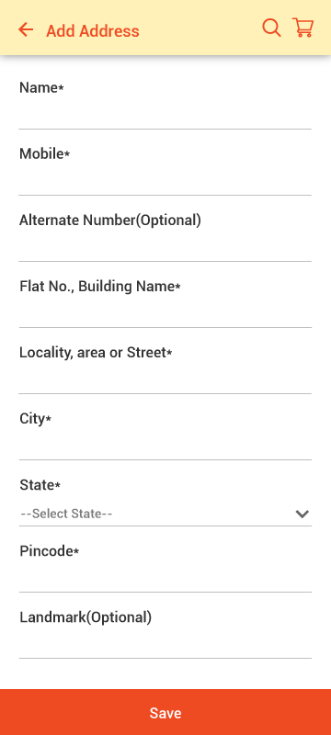
Add new address

Slide 17
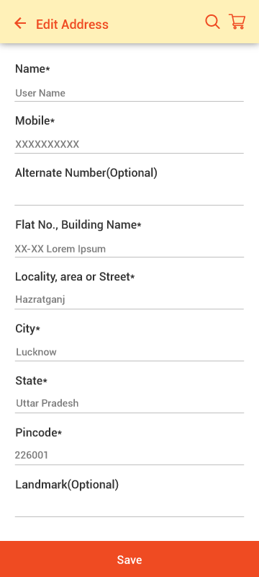
Edit Address

Slide 18

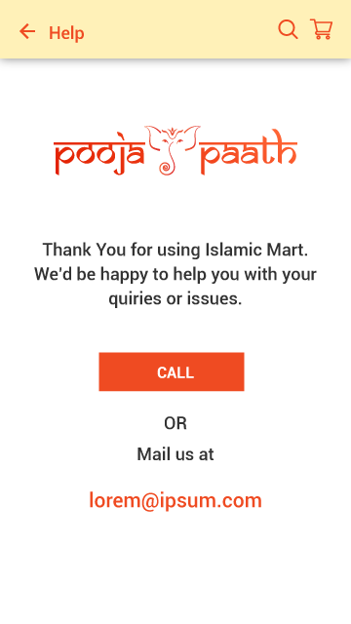
About us and Help

Slide 19
Pandit Dashboard

Slide 20
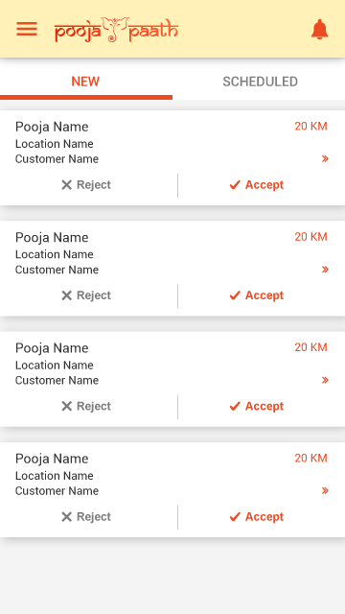
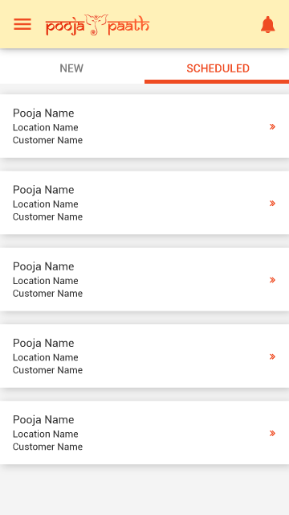
Dashboard

Slide 21
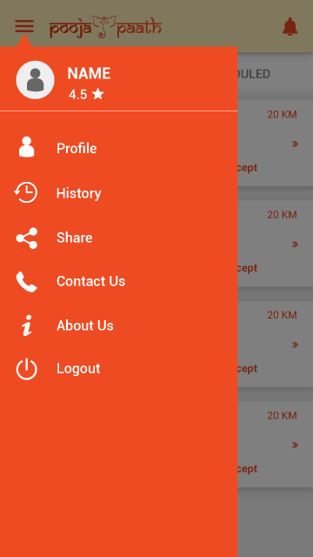
Left Menu

Slide 22
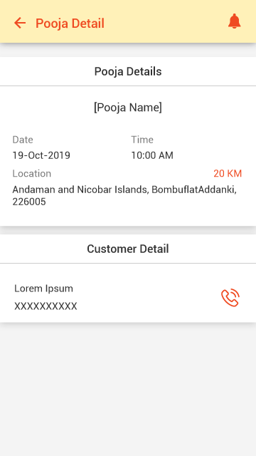
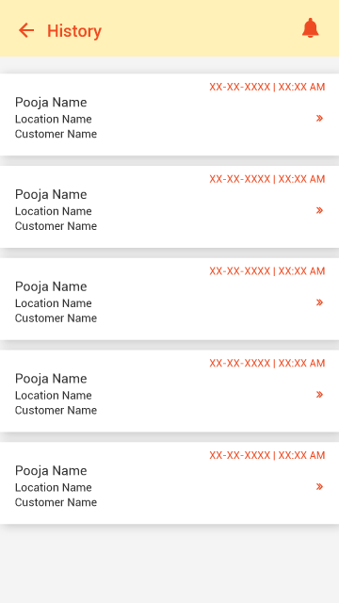
Pooja Detail and History

Slide 23
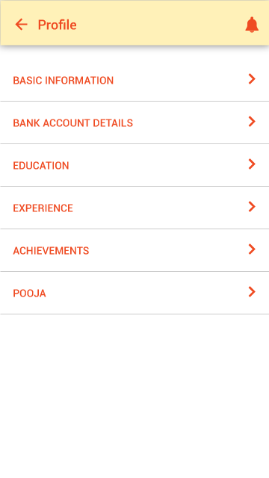

Profile and Basic Information

Slide 24
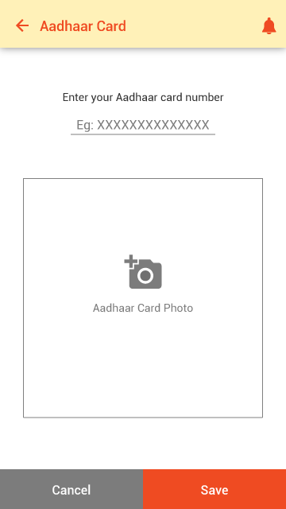
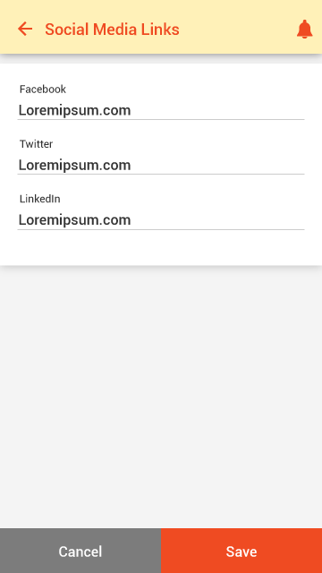
Upload Aadhaar and Social Media Links

Slide 25
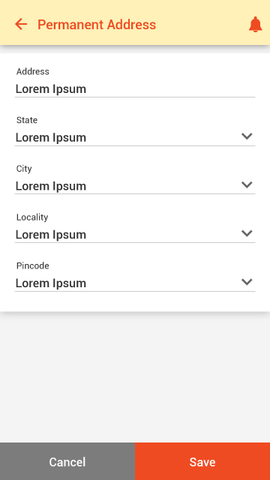
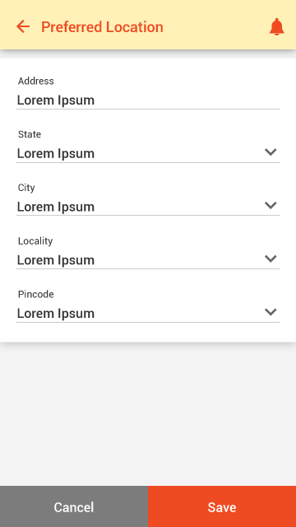
Permanent Address and Preferred Location

Slide 26
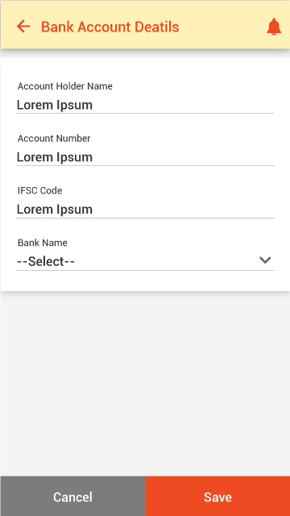
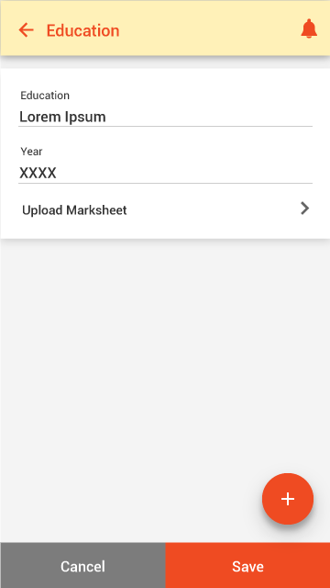
Bank Details and Education

Slide 27
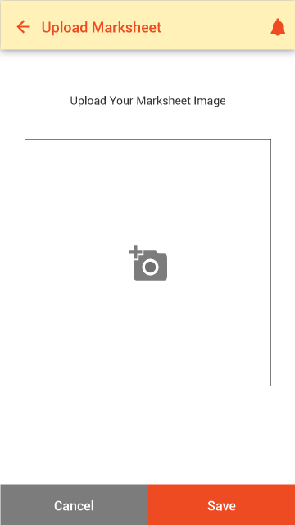
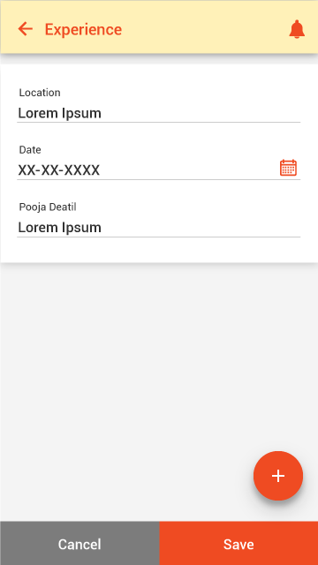
Upload Marksheet and Experience

Slide 28
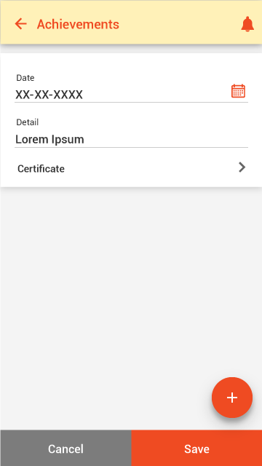
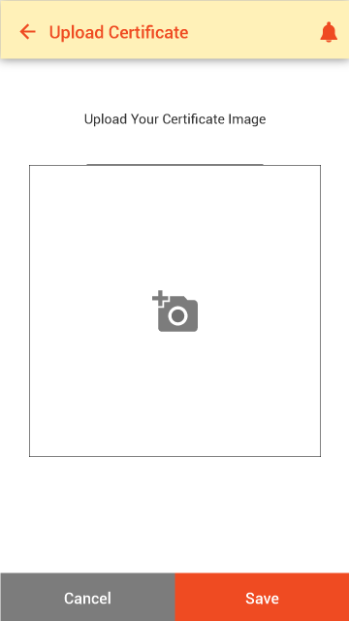

Achievements, Upload Certificate and Pooja

Slide 29
THANK YOU
PREPARED BY
Mega Infomatix Software Solutions

