Slide 1
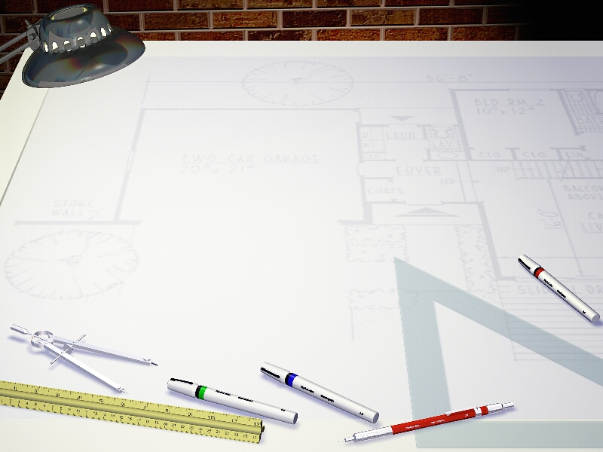
Java Programming 1
Lecture 2
Introduction to Java
Java Mechanics and the JDK
Introducing OOPS

Slide 2
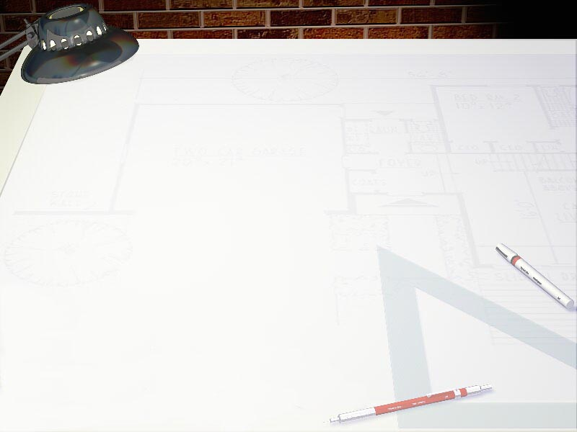
Installing the Java JDK
If you want to work at home, you'll need the Java Standard Edition, Java Development Kit (J2SE JDK)
Complete video walkthroughs on my web site:
  http://csjava.occ.cccd.edu/~gilberts/JDK6-install/
  http://csjava.occ.cccd.edu/~gilberts/java6JDK/
  http://csjava.occ.cccd.edu/~gilberts/JDK6/
Visit http://java.sun.com - click on J2SE link
Set the PATH environmental variable to include JDK bin folder where you installed the JDK

Slide 3
Step 0 – Your Installation
Open OpenOffice Writer and create a new document
Save the file as LastnameFirstname_ic02
  Replace LastnameFirstname with your actual name
Put your name and today's date at the top of the sheet
Title it "CS 170 In-class Exercise 2"
Exercise 1: Open a command shell
  Describe what you did to open it
  Paste a picture of the shell window below description
Exercise 2: Type javac –version
  Describe the first line of output

Slide 4
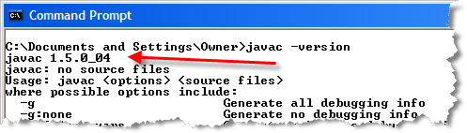
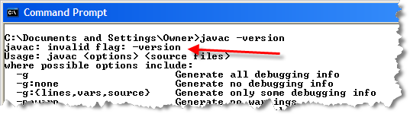
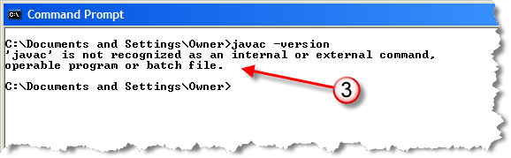
Trouble-shooting
Outcome 1: All OK
Outcome 2: Earlier JDK – need at least version 1.5
Outcome 3: No JDK or bad path

Slide 5
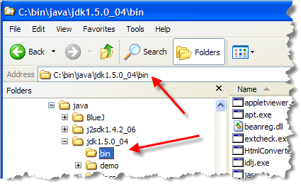
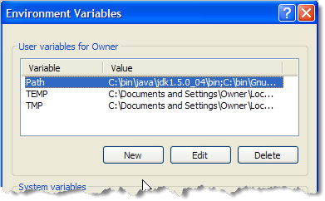
Fixing the Path
Step 1: Locate the JDK bin
folder in Windows Explorer
Step 2: Open the Advanced
Tab in My Computer, click
Environmental Variables
Step 3: find Path in User
Variables, add JDK path
  Not found: New to create
  Edit to add to existing
Vista: in User Accounts

Slide 6
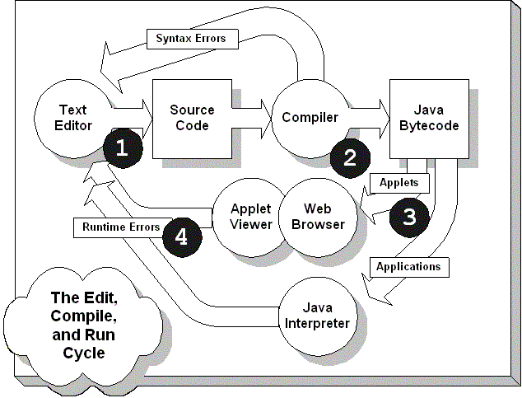
Step 1: Writing the Code
Use a text editor to write your programming instructions in the Java language
  Notepad, SciTE,
  vi, TextWrangler
This is source code
Save in a file with
the extension .java

Slide 7
Step 2: Compiling
Use a Java compiler to translate your source code into executable machine code
  javac, jikes,
  Eclipse
This is bytecode
Produces a file with
the extension .class
If syntax errors occur,
return to text editor

Slide 8
Step 3: Run your Program
Use a Java interpreter or JIT compiler to translate the bytecode into native machine code
Applications: java, javaw
Applets: HTML
  Web browser,
  appletviewer
If runtime errors occur,
return to text editor

Slide 9
Your First Java Program
We'll first write an application using the J2SE JDK
The basic tools you'll need are:
  A text editor to write your source code (we'll use SciTE)
  The javac compiler and java interpreter from the JDK
Using the command line
  Create a cs170home folder in your U:\ drive
  Create a unit01 folder inside of cs170home
  Start the SciTE editor (Sc1.exe) from the command line
Exercise 3: describe steps you followed to do the above

Slide 10
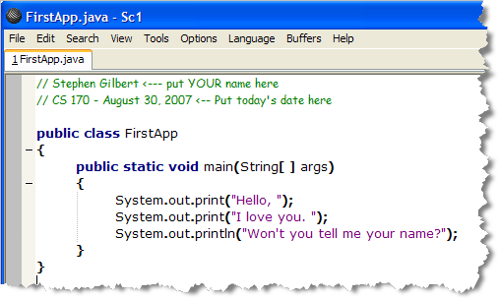
Enter Java Source
Save empty file inside unit01 as : FirstApp.java
Type and save (again) the following Java program
  Note that "println" is short for "print line"; "el-en" not "1-en"

Slide 11
Compile your code
Exercise 4: in the command window change to the directory containing your source code and list the files
  What commands did you use?
  Take a picture of listing and paste it under the answer
Use the javac command to compile your code
  U:\cs170home\unit01\> javac FirstApp.java

Slide 12
When Bad Things Happen
Compiler Errors
  Capitalization: (System not system, String not string)
  Spelling the name of your source file incorrectly
  Forgetting or mismatching the number of braces
  Mistaking parentheses for braces
  Misspelling the name of a variable
Edit and then recompile until there are no errors
Exercise 5: Display a list of files in your folder
  What files does the folder contain after compiling?
  Take a picture of listing and paste it under the answer

Slide 13
Run the program
Run the program with this command:
  U:\cs170home\unit01\> java FirstApp
  Note that you don’t use the .class extension
  Use the java interpreter, not the javac compiler
Exercise 6: Show me the output of your program
  Snap a screenshot or copy and paste the text
What can go wrong at this point? 2 things:
  Can't run without compile: dir to check the class file
  The CLASSPATH environmental variable may be set

Slide 14
Messing with CLASSPATH
Tells the Java interpreter where to look for classes
Some programs (Kodak, QuickTime) set it incorrectly
Three possible remedies:
  1. Type set classpath= every time you open a shell
  2. Use java –cp .; ClassName to run your files
  3. Add .; to the classpath environmental variable

Slide 15
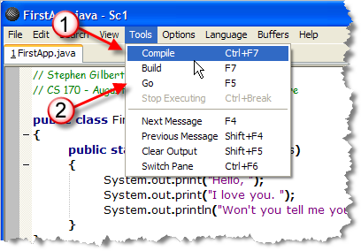
Compiling From SciTE
You can compile and run Java programs from SciTE
To compile:
  Tools->Compile
  from menu, or
  press Ctrl+F7
To run:
  Choose Tools->Go
  from the menu, or
  press F5
Exercise 7: Compile and run, then take a screenshot

Slide 16
Correcting Errors in SciTE
SciTE will point out your syntax errors
  Mistakes in program's "grammar" (missing semicolon)
  Won't point out all errors though (logic and runtime)
Exercise 8a-e: Make these changes to your program and compile. If the program compiles, then run it. Explain what happens each time. If necessary, show me a screenshot.
  Change main to Main. Compiles? Runs?
  Change args to Args.
  Change String to string.
  Change public to Public.
  Change the first { to (

Slide 17

The BlueJ IDE
A free Integrated Development Environment (IDE)
  Written in Java, so it works on the Mac, Windows, Unix
    Small download (about 3MB)
    Must have SDK already installed
  Integrates and editor, compiler and debugger
  Adds a “code pad” where you can test Java snippets
Object-focused as well as program focused
  Interactively create and manipulate objects
OCC version customized: just copy C:\apps\bluej

Slide 18
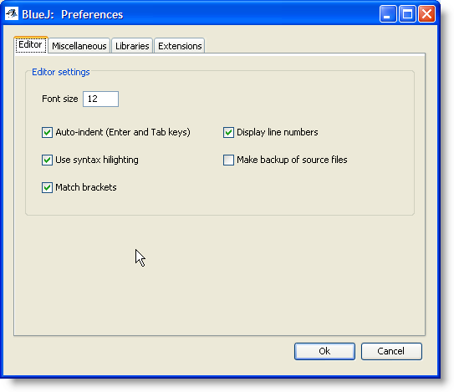
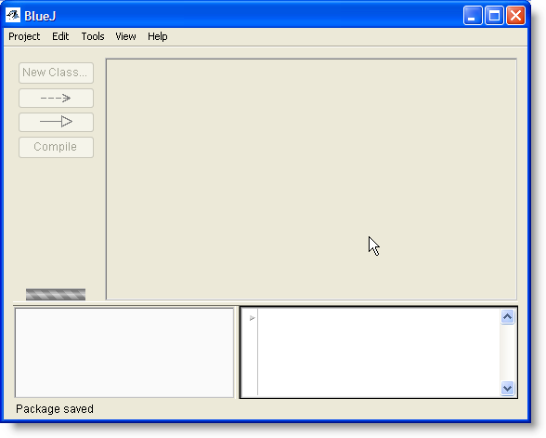
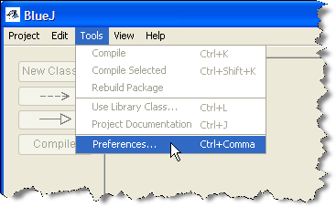
Configure
Start from Programming folder on the desktop
Configure using
Preferences on
the Tools menu
Editor options
  Line numbers
  Font size
  Backups
Exercise 9:
Snap a screenshot

Slide 19
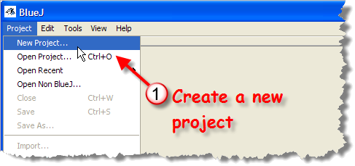
BlueJ Projects
Put your programs into projects in BlueJ
  Folders with source code and compiler information
  Usually create one project for each program
  Put projects in your cs170home folder
Create a project named ic02a inside unit01 folder
Exercise 10:
shoot a
screenshot

Slide 20
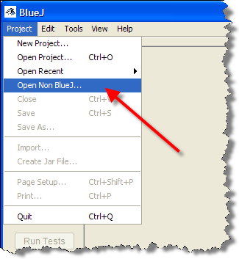
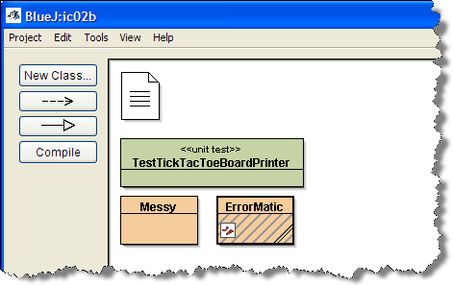
Importing Projects
I'll supply starter code for many of your assignments and exercises. You must import to work with them
Copy ic02b-Starter.zip from Q: to U:\cs170home
To import an existing project,
Choose Open Non-BlueJ…
from Project menu
Exercise 11:
Locate the file
ic02b-Starter.zip
and open it.

Slide 21
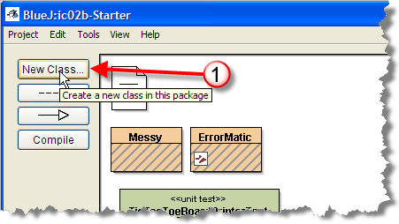
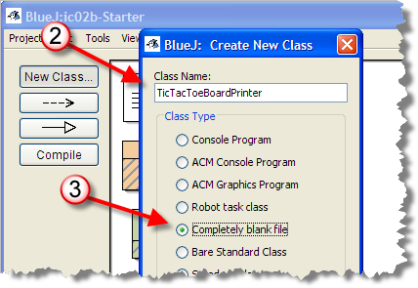
BlueJ Templates
BlueJ uses templates
to get you started
  To learn Java syntax,
  start with a blank file
Exercise 12: Create a new
class using the Completely
Blank File template named
TicTacToeBoardPrinter

Slide 22
Program Organization
Every Java program is a class definition
  Class definition is a blueprint to construct objects
  The basic class structure looks like this:
  … some stuff
  public class SomeClassName
  {
  … some more stuff
  }
  Must be stored in SomeClassName.java
  Only one public class per file

Slide 23

The Class Heading
Class definitions have two parts: heading & body
  Heading for
  classes looks
  like this:
Starts with a declaration: public class
  Announces to the compiler what is to follow
Both of these are keywords or reserved words.
  “Built-in” vocabulary (50 words, page 1121-23 (App F)
  Always in lowercase
  Can’t be used for variables or methods
Exercise 13: identify each of the keywords in FirstApp

Slide 24
The Name of the Class
The name of the class is: FirstApp
  This is an identifier, not a keyword
  An identifier is a name that you make up
    You'll create names for classes, methods, fields, etc.
Java language syntax rules for identifiers
  Case sensitive
  Contains letters, digits, $, and underscore
    Avoid using the $, Java uses it internally
  Cannot start with a digit
  Cannot use a reserved or keyword as an identifier
Exercise 14: list all of the identifiers used in FirstApp

Slide 25
Express Yourself
Exercise 15: As we look at different syntax issues we'll complete the TicTacToeBoardPrinter program on page 30 in your book (Exercise P1.3)
  Double-click TicTacToeBoardPrinter to open it
  Add the necessary code to create the class
  Compile it using the Compile button in the editor
  Click the Run Tests button
  Shoot a screenshot with the first test running correctly.

Slide 26
Method Basics
Class body is delimited by braces { } (begin...end)
Inside the class body, you'll define two things:
  Attributes -- the data fields used to store object state
  Methods -- where the actions take place in an object
Methods are used in two places in your programs
  When you define or specify instructions to perform
  When you use, invoke or call a method

Slide 27
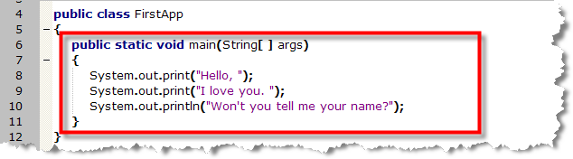
Defining a Method
An object’s methods are where actions occur
  The main() method is the application “starting point”
Methods are defined inside your class
  Consist of a heading and body, just like a class

Slide 28
The Method Heading
This method heading contains these five pieces
  public : access specifier determines who can invoke it.
  If public, anyone, if private, only other methods in class.
  static : modifier. Method is associated with the class.
  Most methods will not use this modifier, but main() must
  void : method return type. For procedures, put void here.
  main : the name of the method, used to invoke it. Java looks for this name when it runs your program
  (String[] args) : the parameter list, consisting of a set of parentheses and information used to customize its behavior.

Slide 29
The Method Body
Delimited by braces { } (begin...end) like a class
Inside the body you'll put Java statements
  Think of a sentence in a natural language
  Every statement ends with a semicolon ;
The FirstApp main() method has three statements:
  Prints a phrase on the console window when run

Slide 30
Express Yourself
Exercise 16: Add an empty main() method to your TicTacToeBoardPrinter program. (You won't have any statements inside your method, but you need to provide the correct heading and the braces for the method body.)
Compile and then run the test program again. Keep correcting your program and re-running the tests until you've defined the main() method correctly, except for the program output. (The very last test).
  Shoot a screen-shot showing the tests passing

Slide 31
Calling a Method
A method is some code that performs an action
  You "tell" the object to perform the action like this:
  System.out.print(“Hello, I love you.”);
This is often called "sending a message" to the object
  The message is print()
  Message is sent to a PrintStream object named out
    This object “lives” inside the System class
  The String “Hello, I love you.” is a parameter
Also called invoking or calling a method

Slide 32
Displaying Output
The System.out object is known as the console or standard output object.
  The single parameter (or argument) you supply is displayed in a text-based window
  The parameter can be text (inside quotes) or a number
  System.out.print("Hello, ");
  System.out.println("I love you.");
The print() method leaves the cursor on the same line, while println() moves it to the next line

Slide 33
Express Yourself
Exercise 17: Use the console output object and its print() and/or println() methods to cause TicTacToeBoardPrinter to display a Tic Tac Toe board. Compile and then run the test program again. Keep correcting your program and re-running the tests until all the tests work correctly.
  Shoot a screen-shot showing the tests passing

Slide 34
Style & Punctuation
Style and Punctuation Issues
  Java is freeform language; relies on punctuation, not position of characters on the line
  Up to you to use space to add readability
    Try to group related statements into "paragraphs"
    Span lines if statement is large
    Don't normally put multiple statements on one line
    Indent statements inside class and method bodies
  See bad example on page 17
See the CS 170 Programming Style Guide

Slide 35
Express Yourself
Exercise 18: Use the console output object and its print() and/or println() methods to cause TicTacToeBoardPrinter to display a Tic Tac Toe board. Compile and then run the test program again. Keep correcting your program and re-running the tests until all the tests work correctly.
  Shoot a screen-shot showing the tests passing
Exercise 19: You've learned enough syntax to fix the ErrorMatic program. Get it to compile and run. Shoot me a screen-shot of the output.

Slide 36
Comments
Comments help human readers understand your code
  Comments are ignored by the compiler
Java has three kinds of comments
  Single line: start with //, end at the end of a line
  Multi-line comments, delimited by /* and */
  JavaDoc comments, start with /**, end with */
    Use special tags like @author and @version
    See the style guide for more info on required tags

Slide 37
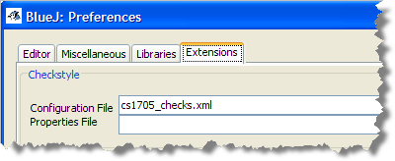
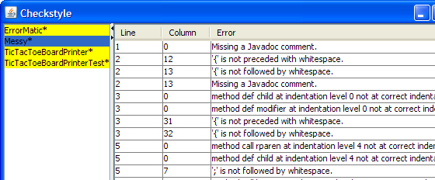
Checking Your Style
BlueJ has a "plugin" that will check your style
  Based on rules very similar to our style guide
Exercise 20: Open Messy.java in the editor
  Configure using
  cs1705_checks.xml
  Choose Tools
  Checkstyle
  Select Messy
  and correct

Slide 38
What is Web-Cat?
An online homework submission and testing tool
  Developed by Stephen Edwards at VT
  Awards for helping students learn
  Password sent to your OCC email
Submit your assignments via the Web
  Simple programs graded on how well they meet the tests that I develop similar to the one we just ran
  Later, you'll supply your own tests

Slide 39
Simple Testing
Testing is based on :
  checking the syntax against the specification
  running your code with different inputs
  comparing your output with expected (correct) output
Most homework assignments are graded
  4.5 points given for correct output
  .5 point given for style using Checkstyle and PMD
    Comments, indenting, following style guide

Slide 40
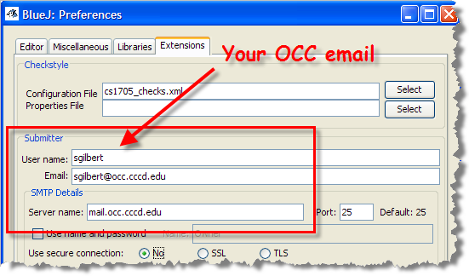
The BlueJ Submitter
BlueJ will automatically submit your homework
Step 1: Configure using your OCC email name

Slide 41
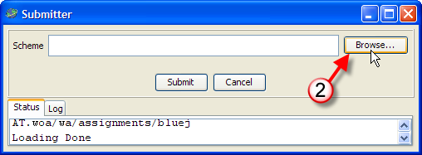
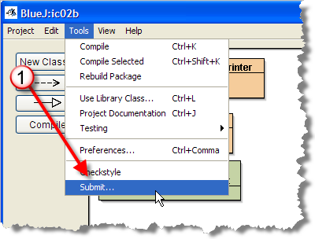
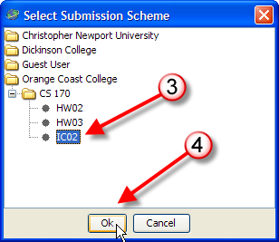
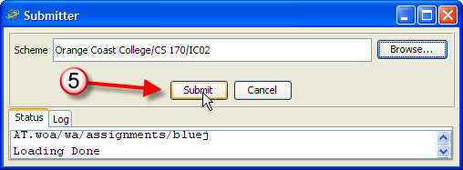
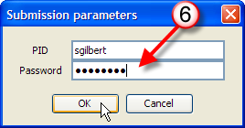
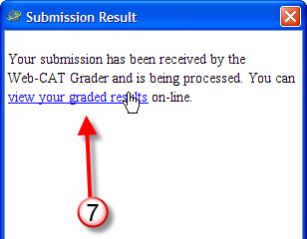
The BlueJ Submitter
Step 2: Submit the current project

Slide 42
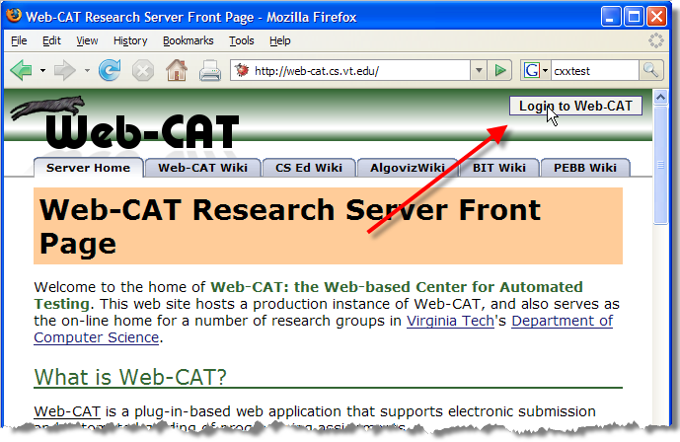
Web-Cat via the Web
Visit: http://web-cat.cs.vt.edu/

Slide 43
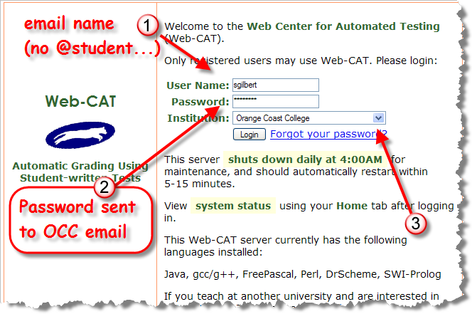
Logging In

Slide 44
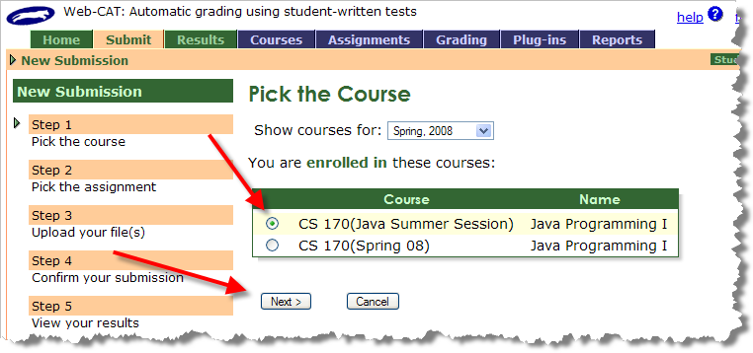
Submitting an Assignment
Web assignments must be manually zipped up

Slide 45
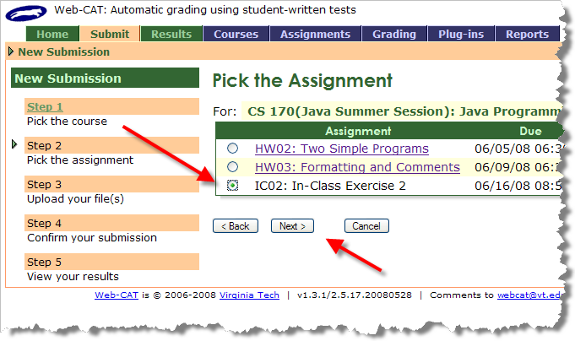
Pick the Assignment

Slide 46
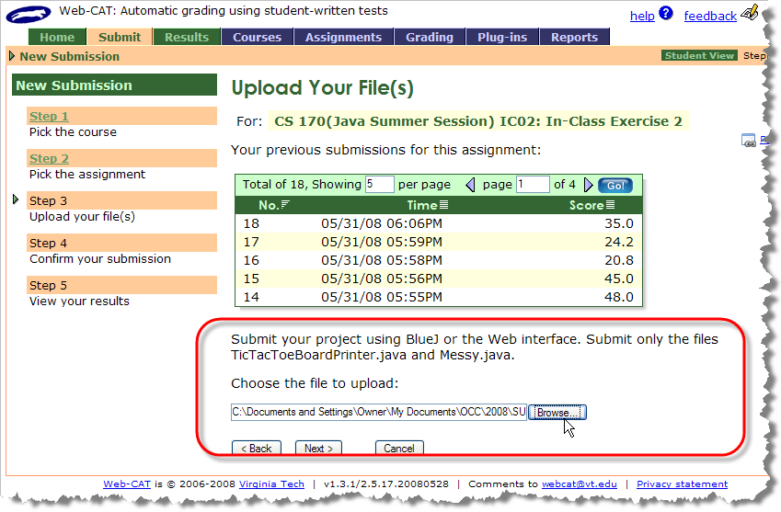
Browse for your file

Slide 47
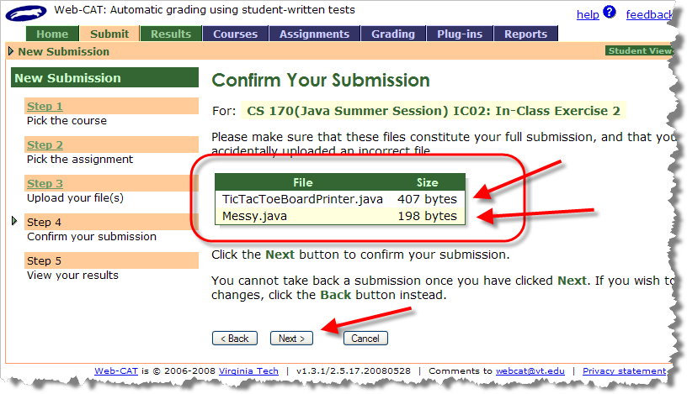
Confirm your Submission

Slide 48
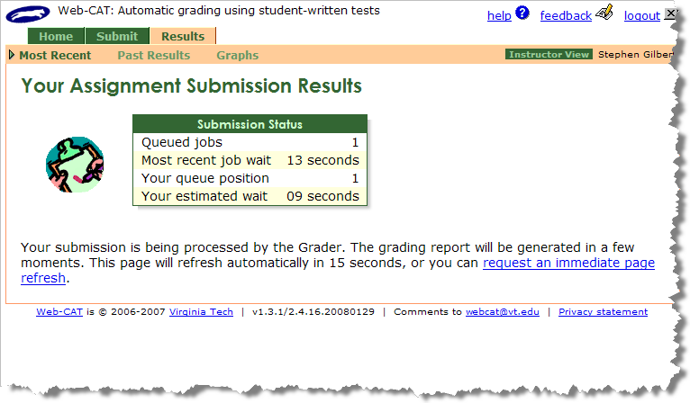
Wait for the Results

Slide 49
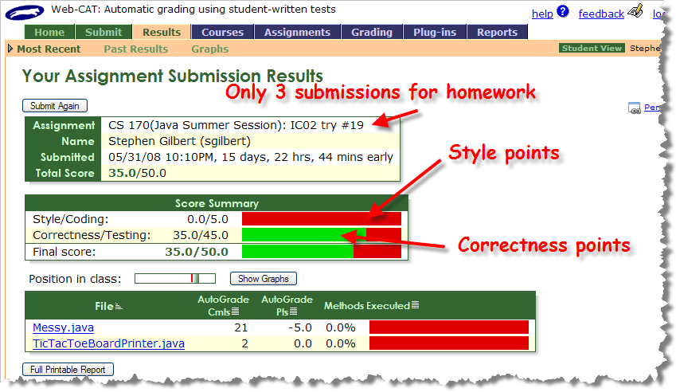
Your Results

Slide 50
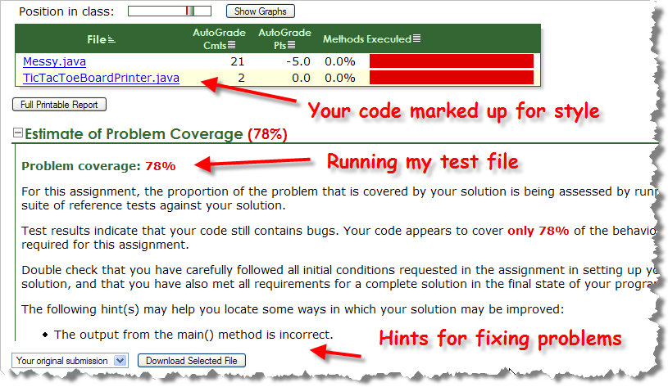
Test Results

Slide 51
Lab and Homework
In-class exercise: submit before you leave today!
  Save as a PDF file
  Drop into submissions folder on Q: drive
Read Chapter 2 for Thursday
  Chapter 1 quiz on Thursday
Complete assignments on the homework page
  Problem 2 (Thursday): similar to tonight's exercise
  Problem 3 (Monday): style only, like Messy

