Slide 1


Java Programming 1
Lecture 5
Java Applets and ACM Graphics
Java Applets
and ACM Graphics

Slide 2

Express Yourself
Use OpenOffice Writer to create a new document
Save the file as LastFirst_ic05
  Replace LastFirst with your actual name
Put your name and today's date at the top of the sheet
Title it "CS 170 In-class Exercise 5"
Exercise 1: Start BlueJ and create a new project named ic05. Create a new class named HelloApplet using the Swing Applet template. Shoot me a screen-shot. (Step-by-step pics on next slide.)

Slide 3
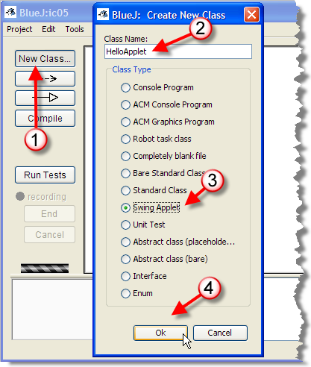

Your First Applet
Click the New Class button
Name: HelloApplet
Template: Swing Applet
OK

Slide 4
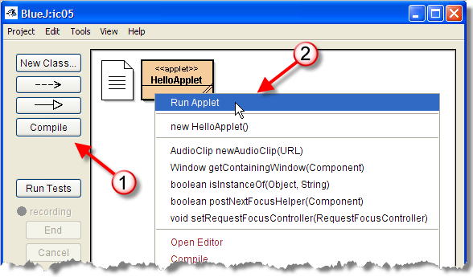
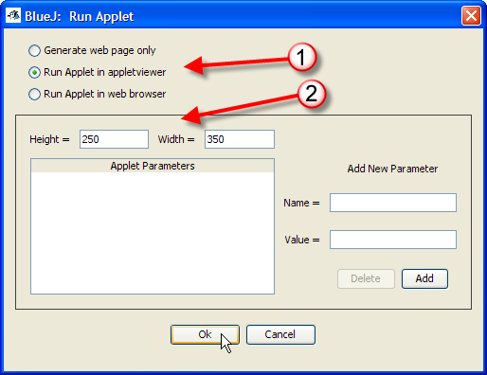
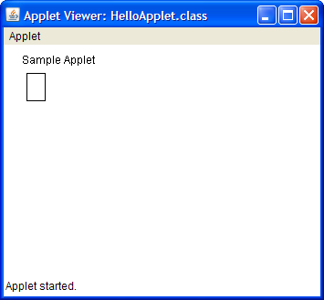
Running the Applet
Compile, right-click, Run Applet

Slide 5

Looking at an Applet
Let's see how HelloApplet is different than FirstApp
Same basic syntax and organization as FirstApp
Class definitions have two parts: heading & body
  Heading for
  HelloApplet
  looks like this:
  Starts with keywords public class
  Stored in a file named HelloApplet.java
  Body is delimited by braces
Heading has two extra words on the end

Slide 6
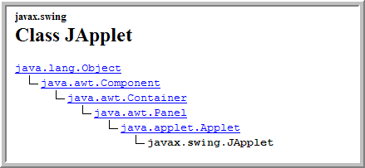
"extends JApplet"?
Says that the class HelloApplet
  Adds something to, or builds upon the JApplet class
  HelloApplet is a subclass of superclass JApplet
  FirstApp implicitly extends the Object class
Where does JApplet come from?
  Not a keyword, isn't all lowercase
  One of the supplied Java API classes
  Full name is javax.swing.JApplet

Slide 7

Class Body
Class body is delimited by braces { } (begin...end)
Inside the class body, you'll define two things:
  Attributes -- the data fields used to store object state
  Methods -- where the actions take place in an object
HelloApplet already has one sample field defined
  We won't use it for now, so just delete it.

Slide 8
Redefining Methods
An object’s methods are where actions occur
  HelloApplet is a "child" of JApplet, so it inherits several methods from its parent and grandparents
  These five methods are automatically called:
    init(), start(), stop(), destroy(), and paint()
  The inherited versions don't do anything interesting
  We can override or redefine these methods
HelloApplet overrides paint() and init() methods
  The init() method includes code for a browser bug

Slide 9
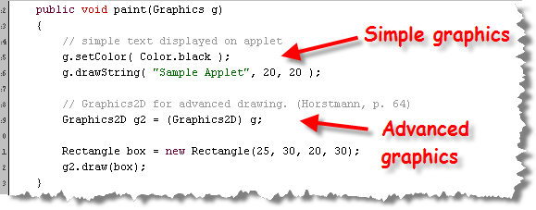
Defining a Method
Methods, remember, are defined inside your class
  Consist of a heading and body, just like a class
  Template uses both simple and advanced graphics

Slide 10
The Method Heading
The method heading contains these four pieces
  public : the access specifier determines who can invoke this method. If public, anyone can call it. If private, then it can only be called from other methods in this class.
  void : the method return type. Methods that produce no value, like paint(), put void here.
  paint : the name of the method, used to invoke it.
  (Graphics g) : the parameter list, a set of parentheses and a formal parameter used to customize the method. Each argument has a type, Graphics, and a name g.

Slide 11
The Method Body
Delimited by braces { } (begin...end) like a class
Inside the body you'll put Java statements
  Every statement ends with a semicolon ;
The paint() method contains five statements:
  The first section uses "simple" graphics
  The second uses the Java 2D API from your text
Skim the book's Graphics2D material if interested
  Won't be tested on or have Graphics2D assignments
We will learn how to use traditional Graphics class

Slide 12
Who? (The Receiver)
paint() is passed a Graphics object named g
  FirstApp used a PrintStream System.out object
  Communicate with objects by sending messages
  Let's send a message to g, asking it to print something
1. Start by saying "who" should get the message
public void paint(Graphics g)
{
g
}
This is called
the "receiver"

Slide 13
What? (The Request)
2. Next, tell the object what to do
Separate receiver and request with a "dot"
public void paint(Graphics g)
{
g.drawString
}
This is called
the "request"

Slide 14
Parameters
3. Add parentheses, and pass any parameters
What parameters?
Read the JavaDocs!
  Arguments, receiver, must match documentation
public void paint(Graphics g)
{
g.drawString("Hello, I love you!", 20, 20);
}
Add parentheses,
parameters, semicolon

Slide 15
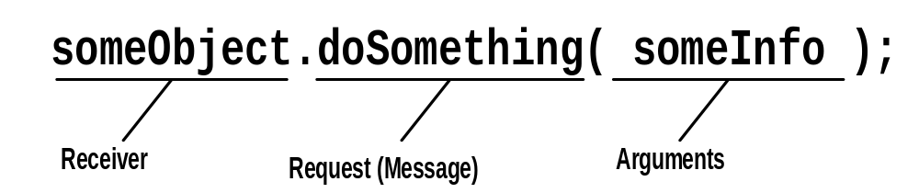
Message Recap
Receiver: who the message goes to
Request: what you want the object to do
Parameters: additional needed information
Receiver
Request (Message)
Parameters

Slide 16
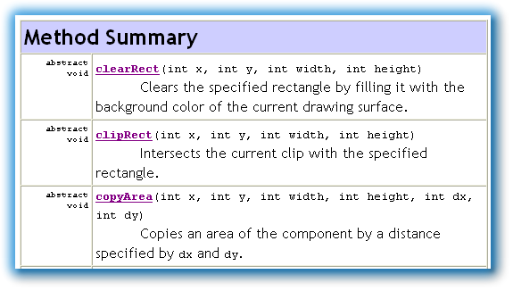
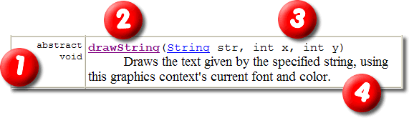
Deciphering the Docs
Read the method docs to “talk” to your objects
  Locate the method summary
  Identify the return type column, name of method
  Identify the arguments you can pass to methods
  Know how to pass int, String, double arguments

Slide 17
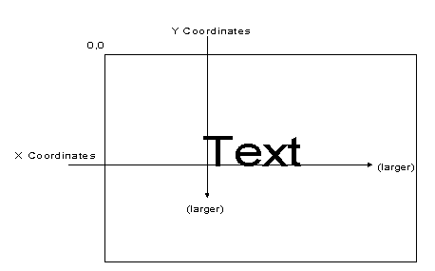
The drawString() Method
The drawString( ) method takes three arguments:
  A String containing the message to display
    A String is "text between double-quotes"
  Two int for the horizontal and vertical position
    An int is just a plain whole number
Coordinates start in upper-left
position (0,0) called origin
x increases to right
y increases down

Slide 18
Express Yourself
Exercise 2: Delete all of the code inside HelloApplet's paint() method. Then use the drawString method to display the phrase: "Hello, my name is Steve", "I think I Love You" on two lines, one above the other, centered in your applet. Replace my name with your name, of course. Show me two screenshots: one of your program running, and one of your paint() code.
  Hint: you'll need to adjust the x, y arguments using trial and error. There is no "center this line" command.

Slide 19
The Graphics Class
What is the purpose of the Graphics class?
  Provides both an environment and methods
The "default" Graphics "environment"
  1. Font, used when you call drawString()
  2. Painting color
  3. Painting mode
  4. Coordinate system
Methods include those to draw text and shapes

Slide 20
Painting Lines
The simplest of the various drawing methods is :
  void drawLine(int x1, int y1, int x2, int y2)
Method signature defines return type and arguments
  What's drawLine()'s return type ? What’s that mean?
Takes 4 int arguments representing line endpoints
  Uses 1-pixel wide pen in the default color
  Inclusive algorithm: x1,y1-x2,y2 are both drawn

Slide 21
Express Yourself
Exercise 3: Using the drawLine() method, draw a box around the phrase in the center of your applet. Show me two screenshots, one of your code and one of your applet running.
Exercise 4: Create a new applet class named Artist. Delete the code in the paint() method, the extra variable, and update the header. The program will draw a house. Snap me a screenshot of your code after making these changes.

Slide 22
Hands On: Using drawLine( )
Exercise 5
Show me your code
Snap a pic of running applet
Draw a triangle 100 pixels high, with a base of 300
Center the apex over the base
  Put the triangle 10 from the left, 10 down from the top
300 px
100 px

Slide 23
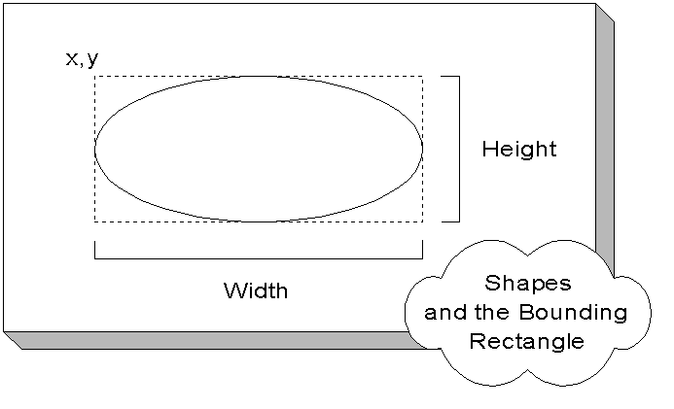
Drawing Closed Shapes
Could use same 4 args to draw rectangles or ovals
  Instead, Java’s shapes use a different "bounding box“
  Uses width and height instead of x2, y2

Slide 24


Drawn versus Filled Shapes
Coordinates used for x,y represent "points"
  Infinitely small location located between pixels
  Example: points 2,2 and 6,6
Shape-drawing methods
come in two varieties
  Those that draw an outline
    Use 1-pixel wide pen that
    hangs down/right
  Those that fill an area
Drawn shapes are 1-pixel
bigger than filled shapes

Slide 25
Plain Rectangles
Three methods:
void drawRect(int x, int y, int width, int height)
void fillRect(int x, int y, int width, int height)
void clearRect(int x, int y, int width, int height)
  First draws outline anchored at x,y in foreground color
    Will be one pixel higher and wider than requested
  Second draws solid square in foreground color
  Last works like fillRect(), using background color

Slide 26
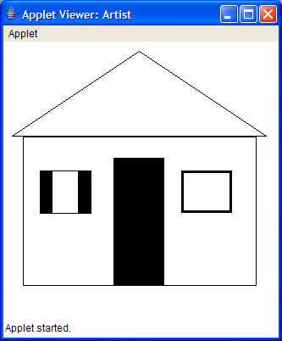
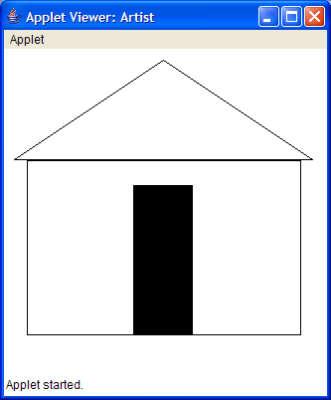
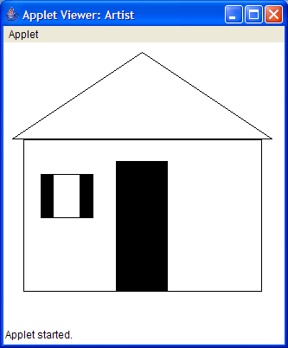
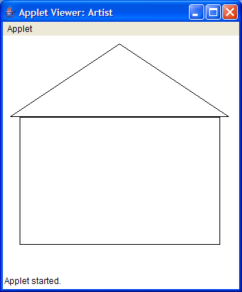
Hands On: Using Rectangles
Exercise 6
Show me your code
Snap a pic of running applet
Let’s put this to work by drawing a “house” underneath the “roof” we’ve already created
  Use drawRect() to paint a
  rectangle 275 pixels wide and
  175 pixels high under the roof
  Use fillRect() to paint a door
  in the middle of the house
  What would you use to paint
  a window, like this?
  How about this?

Slide 27
Drawing Thicker Lines
Issue a sequence of drawRect() calls
  Each time, increase x, y by 1
  Decrease width and height by 2
  g.drawRect(10, 10, 100, 100);
  g.drawRect(11, 11, 98, 98);
  g.drawRect(12, 12, 96, 96);
Use a combination of fillRect() and clearRect()
  g.fillRect(10, 10, 100, 100);
  g.clearRect(20, 20, 80, 80);

Slide 28

Express Yourself
Exercise 7: Using what you've learned about rectangles and drawing thicker lines, look up the documentation for the Graphics class and see how you'd draw some circles.
  Then, create another applet (in the same project), called Target, and draw an archery
  target like this. (Don't try to make it
  red for right now; we'll learn how to
  do that next.)
  Shoot me a screen-shot of your program running and show me your code

Slide 29
The Color Class
Simple RGB Class in the java.awt package
  Don’t confuse java.awt.color package
Internal representation is a 32-bit (RGBA) integer
  8 bits red (R), 8 bits green (G), 8 bits blue (B)
  Means we can have 256 levels of each color
  0 means “no color”, 255 means “full color”
You don’t care about the internal representation
  You’ll use the public constructors and methods
  Later, if the internal representation changes, your programs will still continue to work

Slide 30
Creating Color Objects
Look up Color class, find constructor summary
  Color(int red, int green, int blue);
  Color(float red, float, float blue);
  Pass int values between 0 (off) and 255 (on)
  Pass float values between 0F (off) and 1.0 (on)
Here are some examples:
  Color red = new Color(255, 0, 0);
  Color black = new Color(0, 0, 0);
  Color white = new Color(1.0F, 1.0F, 1.0F);
  Color lightGray = new Color(.9F, .9F, .9F);

Slide 31
The setColor() Method
setColor() changes the current painting color
Use with your Color variable like this:
  public void paint(Graphics g)
  {
  Color brush = new Color(255, 128, 128);
  g.setColor(brush);
  }
Exercise 8: Make your target red. Snap a picture.
Exercise 9: Put green windows and a red door on your artist's cottage. Snap a picture, show me your code.

Slide 32
Other Color Constructors
Modern browsers can also display transparent colors
  Color(int red, int green, int blue, int alpha);
  The alpha channel is 0 (transparent) to 255 (opaque)
You can also specify colors using a single integer
  Color(int colorValue);
  Mostly useful when working with HTML Hex colors

Slide 33
Color Class Constants
Objects and variables take up space in memory
  Color r1 = new Color(255, 0, 0);
  Color r2 = new Color(255, 0, 0);
  Takes up room for two variables and two objects
Class constants: predefined values stored in class
  Accessed using class name, rather than object name
  Color r1 = Color.red;
  Color r2 = Color.red;
  g.setColor(Color.lightGray);

Slide 34
Express Yourself
Here’s one of the Color constructors you just studied:
  Color(int red, int green, int blue);
Exercise 10: Write a statement that creates a Color variable named background. Don’t initialize it.
Exercise 11: Set the variable background to the color green, using the constructor shown here.
Exercise 12: Change background to a medium gray.
Do it both with and without using a constructor

Slide 35

The ACM Class Libraries
The ACM Java libraries were designed for students
  ACM: Association for Computing Machinery
    Computer Science Professional
    and Academic Organization
    Student membership is about $20 per year
    http://www.acm.org
Java Task Force (JTF) – Eric Roberts (Stanford) chair
  Review the Java language
  Develop a stable collection of libraries for teaching
  http://jtf.acm.org
We’ll use several classes from the library

Slide 36
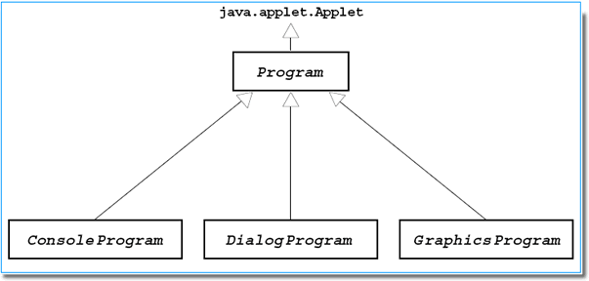
The ACM Program Classes
Problem 1: Java doesn’t have any “program” classes
  Can stick a main() method inside any (or all) classes
  Can’t access instance variables, not necessarily called
  Not very object-oriented
Problem 2: Applets are OO, but need Web browser
Solution: ACM program classes
  Simple and OO like applets
  Can be run as both applets or applications
  Change input style by changing a single line of code
  Both console-mode and graphics versions

Slide 37
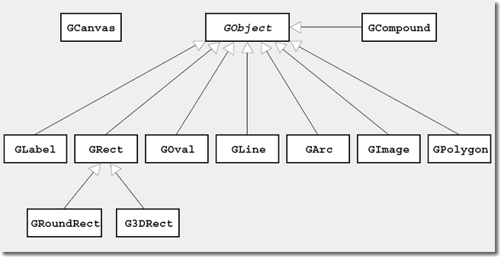
The ACM Graphics Classes
Applet graphics are not particularly object-oriented
  Used Graphics drawOval() method, not Oval object
  Precise instructions on how to draw, and in what order.
  Reliance on specific sequence, and focus on actions, is really at the heart of procedural programming
Want to start using independent graphical objects
  Easy to build in standard Java, but none built-in
  We'll start with the ACM GraphicsProgram class, and the components in the acm.graphics package

Slide 38
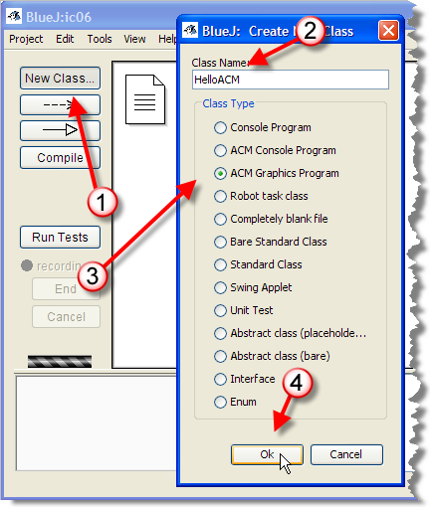
The HelloACM Program
We’ll use the GLabel class
to display “Hello, I love you!”
Step 1: Add a new class
  Name: HelloACM
  Type: ACM Graphics
Step 2: Open file

Slide 39
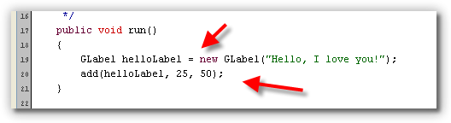
ACM Hello Changes
Notice differences from Java Applet
  Different imports: acm.program, acm.graphics
  Extends Graphics program instead of Applet
  A run() method instead of a main() method
Create a GLabel and add it to the applet at 25, 50

Slide 40
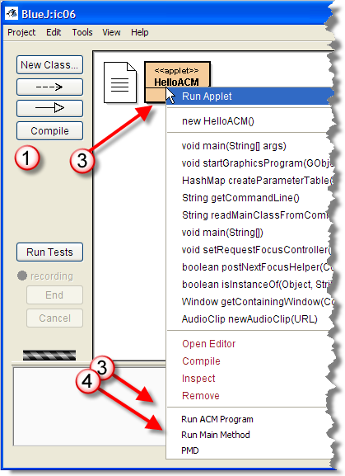
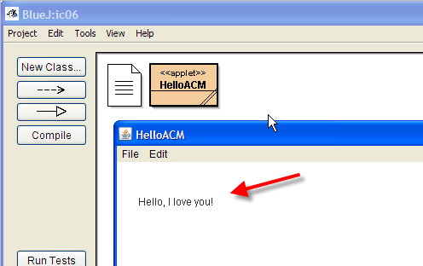
Compile and Run
Click the Compile button,
or, click Compile
in the editor
Right-click and choose
Run ACM Program,
or Run Main Method
Exercise 13:
Snap a photo
showing applet
and run()

Slide 41
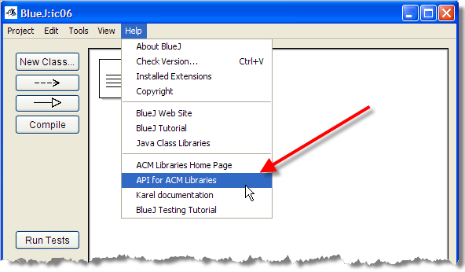
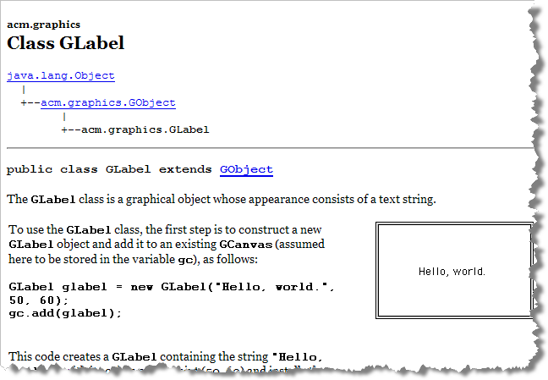
The GLabel Docs
Unlike drawString(), a GLabel object is persistent
  You can send it messages and manipulate it
ACM Docs can be found at the JTF site:
  http://jtf.acm.org/javadoc/student/index.html

Slide 42
Font, Color and Caption
Exercise 14
Use your name, choose
your font & color. Snap
Use a font descriptor: type-weight-size
  helloLabel.setFont(“Serif-bold-36”);
Change the color by using the setColor() method
  helloLabel.setColor(Color.red);
Change the caption with the setLabel() method
  helloLabel.setLabel(“Hello, my name is Steve.”);

Slide 43

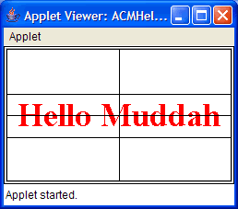
Changing Position
The GLabel origin is the baseline of the text printed
  Kind of unusual, but it’s how drawString() works
Centering text was hard with
drawString(). It's easier with
the GLabel class

Slide 44
Changing Position
Change position using setLocation()
Use getWidth() and getHeight() for size
  Can center your labels using code like this:
  double w = this.getWidth(); // or omit the word this
  double h = getHeight();
  double wLbl = helloLabel.getWidth();
  double hLbl = helloLabel.getHeight();
  helloLabel.setLocation(w/2 - wLbl/2, h/2 + hLbl/4);

Slide 45
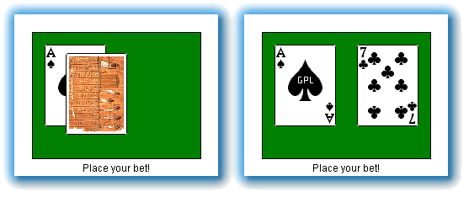
The TwoCards Applet
Let’s sample some of the other ACM graphics classes
  Create a new class called TwoCards
  Follow steps from ACMHello

Slide 46
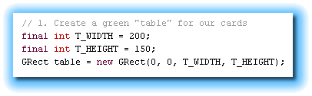
1A. Create the Table
We’ll use the GRect class for the table
  Define two constants for width and height
  Create a GRect using 0,0 and T_WIDTH and T_HEIGHT

Slide 47
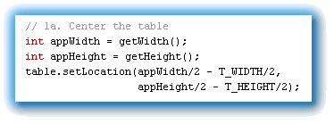
1B. Center the Table
Center the table like you centered your GLabel

Slide 48
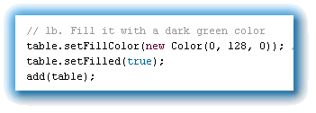
1C. Color the Table
GRect is a “fillable” class—has optional background
  Specify the color using setFillColor()
  Turn filling “on” using setFilled()
  Add the table to the surface of the app

Slide 49
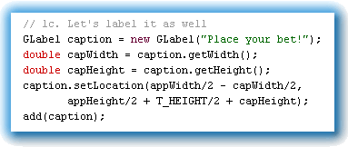
1D. Caption the Table
Position a GLabel underneath the table
  Create the label and calculate its size
  Use setLocation() to position it
  Add it to the surface of the application

Slide 50
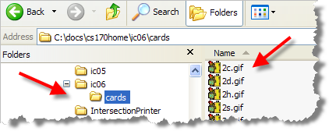
Getting the Card Images
Card images are generally copyrighted
  Can’t just scan in the cards from a pack of Bicycles
One handy source of GPL card images
  http://www.waste.org/~oxymoron/cards
  Can use without charge; replace for commercial use
Unzip images and store in folder named cards in same directory as your Java source code
  Files named 2c.gif,
  as.gif, tc.gif, etc.
  Back is b.gif

Slide 51
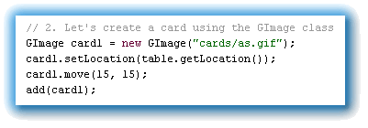
2A. Creating the First Card
We’ll use the GImage class to create our cards
  Use the “Ace of Spades” to initialize the first card
  Set its location in the corner of the table
  Move it to the right by 15 pixels
  Add it to the app

Slide 52
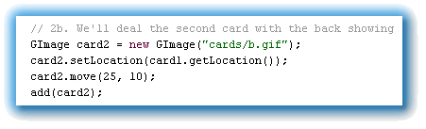
2B. Creating the Second Card
Use the card back to initialize card2
  Set the location to the corner of card1
  Move it right by 25 and down by 10
  Add it to the app

Slide 53
Express Yourself
Exercise 15: Compile and run TwoCards. Show me a screen-shot.
In-class exercise: submit before you leave today!
  Save as a PDF file
  Drop into submissions folder on Q: drive
Want to know more? ACM Class Library tutorial available from the links page.
Read Chapter 3 for Thursday
Complete problems on the homework page

