Slide 1

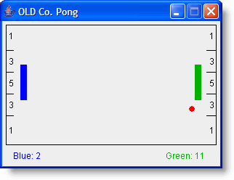
Java Programming 1
Lecture 6
Defining Classes
Creating your
Own Classes

Slide 2

Express Yourself
Use OpenOffice Writer to create a new document
Save the file as LastFirst_ic06
  Replace LastFirst with your actual name
Put your name and today's date at the top of the sheet
Title it "CS 170 In-class Exercise 6"
Exercise 1: Copy the Pong project from the Q: drive to your local folder. Start BlueJ and open your copy of the Pong project. Show me a screen shot.

Slide 3
Writing Your Own Classes
Heart of OO programming is defining classes (Ch 3)
  We’ve used primitive types and different object types
  Programs haven’t had multiple classes or methods
Skills you’ll need to define your own classes:
  Know how to define instance variables
  Know how to write constructors
  Know how to write simple methods
  Know how to pass arguments to methods
  Know how to write methods that return values

Slide 4
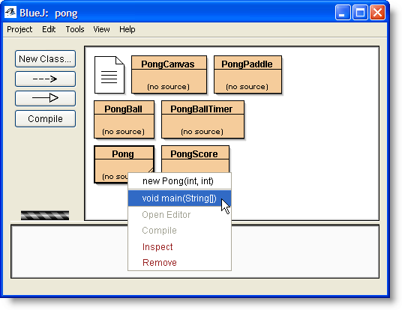
Getting Setup
Notice that Pong classes don’t have source with them
Run the Pong game by right-clicking
  Press “b” to start the ball bouncing
  What happens! Nothing works!
Exercise 2: Snap a pic.
Your job: implement the
three non-working classes
  PongScore
  PongPaddle
  PongBall

Slide 5
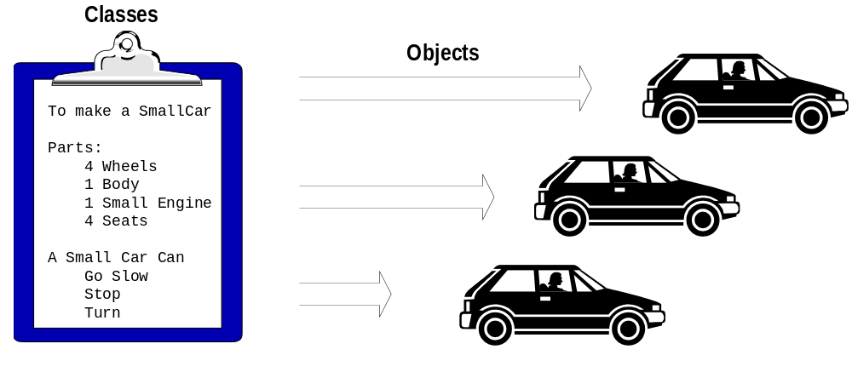
Review: What Are Classes?
A pattern or blueprint that describes the common characteristics of a category of objects

Slide 6
The Class Definition Contains…
Attributes
  Object
  Data
Methods
  Object
  Actions
Serial Number
Attributes
Color
Engine
Body
A Car Class
Start
Stop
Methods
Turn
Go forward
Go reverse

Slide 7
Class Definition
When you define a class, you specify
  The data attributes that hold its object's state
  The methods that define object behavior
Some methods modify the object
  These are called mutator methods
  setColor() and setFont() modify Graphics object
Some methods return information about an object
  These kinds of methods are called accessors
  The length of a String, parts of a Color object

Slide 8
The PongBall Class
The PongBall class represents the ball in the game
  The Pong program uses the PongBall class
The Pong game first creates a PongBall object
  It then calls the ball's move() method repeatedly
  After calling move() it calls getX() and getY() to find out where the ball is located.
  If it looks like the ball would "hit the wall", then the Pong program calls either bounceX() or bounceY() to cause the ball to rebound
These are the methods that you have to write

Slide 9
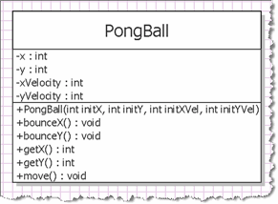
The UML Diagram
Here’s the UML class diagram for the PongBall class
  UML: Unified Modeling
  Language: Standard
  OO diagramming tool
  (like blueprints in
  construction)
  4 data attributes
  One constructor
  Two accessors
  Three mutators

Slide 10
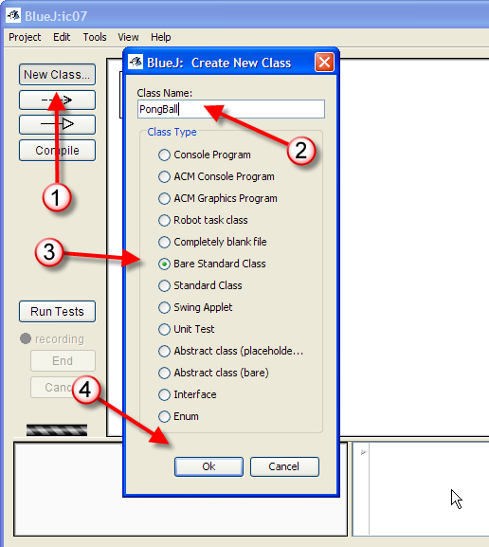
Implementation
Close the Pong project and create an ic06 project
Create a new class
  1. Click New Class
  2. Name PongBall
  Spelling important
  3. Bare Standard Class
  4. Click OK
Double-click to open
Complete heading
Exercise 3: Snap a pic.

Slide 11
PongBall Data
Four data attributes
represent ball’s state
  x and y represent
  the ball’s position
  xVelocity and
  yVelocity represent
  the velocity of the ball
  in both the x and y directions
  A negative xVelocity means ball is moving right to left

Slide 12
Defining Instance Variables
We’ll create instance variables for each attribute
Instance variables or fields
  Defined outside of any method, but inside class
  Can be used inside any method in the class
  private type name [ = initial-value ];
Modifier will normally be keyword private
  Don't want variable used outside of class

Slide 13
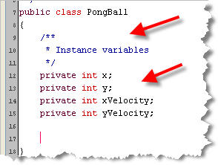
Pong Instance Variables
Add instance variables for each data attribute
  Start with a JavaDoc comment
Exercise 4
Snap a screenshot.

Slide 14
Mutator Methods
Some methods modify the object
  These are called mutator methods
How do you tell if
a method is a mutator?
In PongBall, those are:
  move(),
  bounceX(), and
  bounceY()

Slide 15
Implementing Mutators
Step 1: Write the empty methods (public interface)
  Access specifier : public for methods
  Return type : mutator methods are always void
  Names : move(), bounceX(), and bounceY()
  Arguments: none for these, but still need ()
Place braces around empty bodies
Exercise 4: Write the method skeletons for these three mutators and snap a picture

Slide 16
Commenting the Interface
What actions should we perform in our methods?
  Need to read specification supplied by the designer
  Represent the contract that your class should fulfill
  Provides information you’ll need to implement behavior
For each method, add documentation by adding special JavaDoc comments that describe:
  A single sentence that describes what it does
  What each of the parameters (if any) mean
  What values the method returns

Slide 17
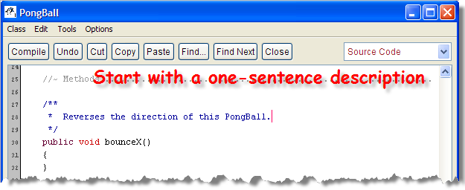
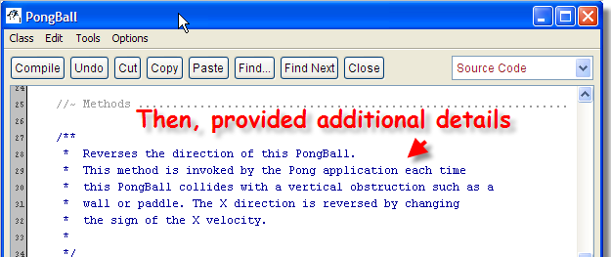
Writing JavaDoc Comments
Exercise 5
Complete docs for bounceY, move
Snap a screenshot.
Find the specification on the class links page
  Locate the PongBall bounceX() method spec
Add a JavaDoc comment to your code like this:

Slide 18
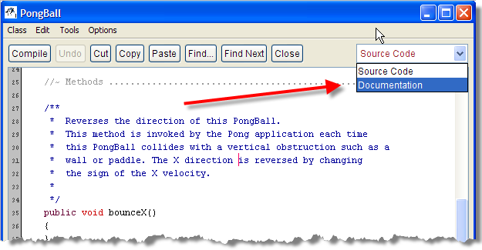
Viewing the JavaDocs
BlueJ let's you see your docs as the users will
  In the editor, change Source Code to Documentation
Exercise 6
Switch views.
Snap a screenshot.

Slide 19
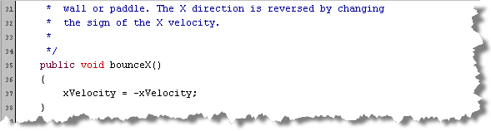
Modifying State
For bounceX() and bounceY(), change the sign of the corresponding instance variable using assignment
For move(), add the correct velocity value to the correct positioning element
Exercise 7
Complete bounceX, move.
Snap a screenshot.

Slide 20
Accessor Methods
Some methods return information about an object
  These kinds of methods are called accessors
  Accessors are value-producing methods
Value-producing methods:
  Must have a return type other than void
  Must end with a return expression (see page 97)
  public returnType methodName( parameters )
  {
  // statements
  return typeExpression;
  }

Slide 21
PongBall Accessors
PongBall has two accessor methods, getX(), getY()
Step 1: Let's write the JavaDoc comments first
  See the specification
  document for the
  info you need
  Add an @return
  tag for every
  value-producing
  method

Slide 22
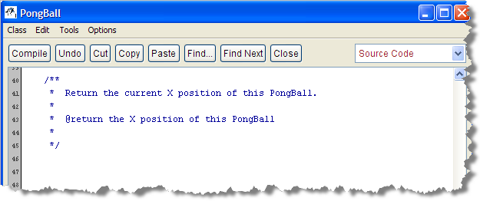
Accessor JavaDocs
Here's what the docs should look like for getX()
  Pretty simple method. Most will have more info.
Exercise 8
Add JavaDoc for getX, getY.
Snap a screenshot.

Slide 23
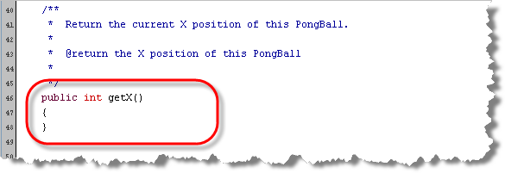
Implementing Accessors
Step 2: Write the heading
  Access specifier : make these methods public
  Return type : accessors are never void
  Names : getX() and getY()
  Arguments : none for these methods, but need ()
Exercise 9
Add heading for getX, getY.
Snap a screenshot.

Slide 24
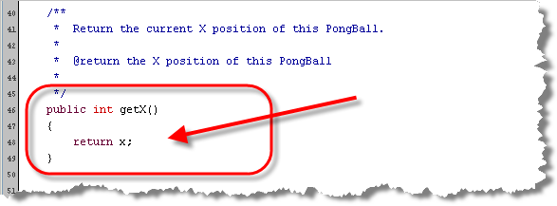
Implementing Accessors
Step 3: Write the code in the body
  Remember, every accessor must end with a return
Exercise 9
Finish getX, getY.
Snap a screenshot.

Slide 25
Initializing PongBall
Instance variables are automatically initialized
  Given values 0, false, or null depending on type
Normally want to explicitly initialize your objects
  Pong expects to place ball in center of the screen
  Note that there are no mutator methods that allow a client (the Pong class) to set the values for x and y
This is done by writing a constructor

Slide 26
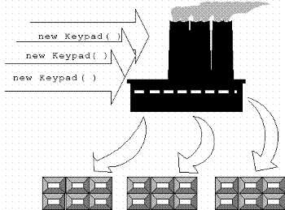
What Are Constructors?
Constructors are defined inside a class like a method
  But, they are not called directly like a method
  Instead, called when you use the new operator
  Java uses the constructor to initialize your object
A constructor is like a
factory that creates an
object. It is responsible for
initializing an object’s fields
when the object is created.

Slide 27
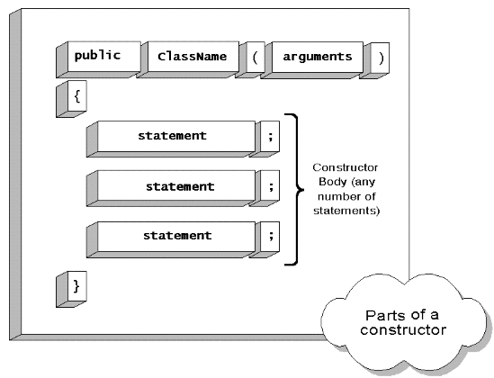
Constructor Syntax
Constructor look like methods, with two constraints:
  The name is always the same as the class
  The constructor cannot have a return type

Slide 28
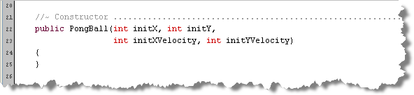
Constructor Interface
Step 1: Write the header
  Access specifier : is always public
  Return type : constructors never have a return type
  Names : the same as the class: PongBall
  Parameters: (or arguments) one for each initial value
    Supply both the type and a name for each variable
    Separate each declaration by commas

Slide 29
What are Parameters?
Most methods/constructors require extra information
  Math.sqrt() requires the number to operator on
  PongBall needs to know initial values for fields
Sent to your method via “parameters” or “arguments”
There are two kinds of parameters:
  Formal parameters are variables used in the method
    Designed specifically to for passing information
  Actual parameters or arguments are the values that are supplied when the method is called

Slide 30
Local Variables
A formal parameter is like a local variable, but designed especially to hold method-input information
Here’s how a regular local variable is defined:
  public void aMethod()
  {
  int aLocalVar = 32;
  }
  The variable aLocalVar is an "int-shaped bucket"
  holding an int value, initialized using assignment
  Has exactly same value each time method is called

Slide 31
Formal Parameters
Formal parameter is similar to a local variable, except:
  It is declared inside the argument list
  You must include a type for each argument
  It is given a value when the method is called
aMethod() with a formal parameter (or argument)
  public void aMethod(int arg)
  {
  int aLocalVar = 32;
  }

Slide 32
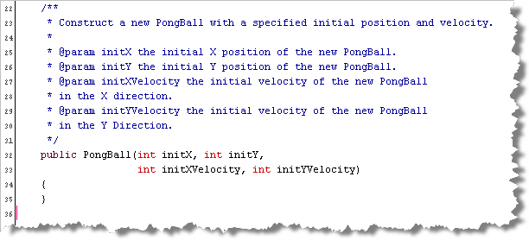
Constructor JavaDoc
Step 2: Document the constructor
  Use one @param tag for each parameter
  Separate name with space, end with a period
Exercise 10
Complete constructor JavaDoc.
Snap a screenshot of documentation view.

Slide 33
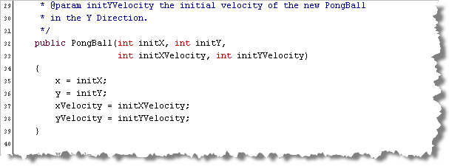
Constructor Implementation
Step 3: Initialize each of the instance variables
  Assign the actual parameters to the fields
  Check carefully; make sure not to accidentally reverse

Slide 34
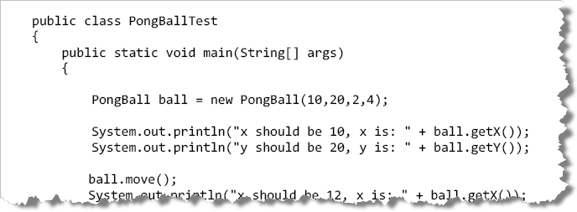
Testing the Class
Can’t just drop class into your pong directory
  Don’t really know how the Pong class uses it
  You’ll need to write independent unit tests
Add a new class named PongBallTest
  Copy starter code from specification document

Slide 35
Simple Unit Tests
Exercise 11: Run the test program and shoot a screen-shot of the output.
Notice how the test program works
  Creates a PongBall object using specific values
  Prints out the values to make sure they’re expected
  Calls mutator and prints values again
Exercise 12: Add code to test the bounceX() and bounceY() methods. Run your test program and shoot a screen-shot.

Slide 36
Integrating PongBall
To “integrate” PongBall, copy .class file into the BlueJ Pong project folder
  Open the BlueJ project and run Pong
  Press “B” key to start ball bouncing
To finish the game, we'll complete the remaining two classes. Let's start with the PongScore class.
  You'll do PongPaddle as a homework assignment
Exercise 13: Create a new file named PongScore.java, using the Completely Blank File template. Show me a screen shot.

Slide 37
Review: JavaDoc
JavaDoc comments allow you to automatically generate the documentation for your code
  Comments start with /** and end with */
File comment at the top of each file
  Sentence describing the general purpose of class.
  @author – your name
  @version – the date
Exercise 14: Add a file comment to PongScore.java
Show me a screenshot. (Examine specification on links page to see what PongScore does.)

Slide 38
Review: Class Structure
Every Java program is a class definition
  Class definition is a blueprint to construct objects
  The basic class structure looks like this:
  … some stuff
  public class SomeClassName
  {
  … some more stuff
  }
Exercise 15: add basic structure for the PongScore class and shoot a screenshot

Slide 39
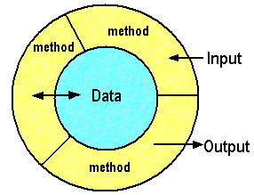
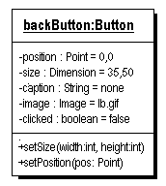
Review: State and Data
Objects store their data in instance variables
Encapsulation: objects responsible for their own data
  Only access to object state is through public methods
Instance variables or fields
  Defined outside of any method, but inside class
  Can be used inside any method in the class
  private type name [ = initial-value ];

Slide 40
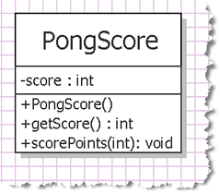
PongScore Fields
One instance variable
representing the current
score for each player
Exercise 16: add the
definition for the
PongScore instance
variable, and shoot
a screenshot.
  Add a JavaDoc comment before the variable
  explaining what it represents.

Slide 41
Review: Methods
Methods that modify an object are called mutators
Accessors return information about an object
  public void methodName( parameters )
  {
  // statements
  }
  public returnType methodName( parameters )
  {
  // statements
  return typeExpression;
  }
Mutator
Accessor

Slide 42
Review: Writing Accessors
Exercise 17: find the
accessor in the
PongScore class
and write the method
along with a JavaDoc
comment.
  Your JavaDoc comment
  should have a sentence
  explaining what the method
  does as well as use the @return tag to explain what the returned value represents.

Slide 43
Review: Parameters
Extra information passed into your method when called
  Formal parameters are variables defined in heading
  Actual parameters are the values supplied calling
Formal parameter is declared inside the method header
  You include a name and type for each argument
  public void myMethod(int par1, int par2)
  {
  }
Type
Name

Slide 44
PongScore Mutator
Pong program supplies actual parameters, you need to supply formal parameters for the PongScore mutator method.
Exercise 18: find the
mutator in the PongScore
class and write the method
along with a JavaDoc
comment using the
@param tag for each
parameter.

Slide 45
Review: Constructor
Instance variables are automatically initialized
  Given values 0, false, or null depending on type
Normally want to explicitly initialize your objects
This is done by writing a constructor
Constructor look like methods, with two constraints:
  The name is always the same as the class
  The constructor cannot have a return type
Exercise 19: write and doc PongScore constructor

Slide 46
Review: Automatic Unit Tests
Earlier in the lecture, you manually wrote unit tests
  Created a PongBall, called it's methods
  Compared expected state to actual state
BlueJ has a feature to automatically add record and run a suite of unit tests using a program called JUnit
  JUnit is standard Unit Testing tool, not just for BlueJ
  We used these to test our Karel programs
Exercise 20: once PongScore compiles, right-click and create a test class. Shoot a screen-shot

Slide 47
Creating Test Cases
Create two PongScore objects on the object bench
  Right-click test class, Object Bench to Test Fixture
Right-click test class, choose Create Test Method
  Name first method: Construction
  Check that each object has the value 0
  Stop recording and Run All Tests
Exercise 21: shoot a screen-shot showing that the JUnit tests pass. Then, open up PongScoreTest and shoot a screen-shot of the code. Note that it is similar to that you hand-wrote for PongBallTest.

Slide 48
Tests and Integration
Exercise 22: create two more tests, this time testing the scorePoints() method. Check with different values for each PongScore objects. Try to use some of the different assertions available. Once you are finished, run the tests and shoot a screen-shot of the JUnit test runner and another of your code.
Exercise 23: to integrate your new class, copy the file PongScore.class into your Pong project and open it in BlueJ. Run the project, start the ball bouncing, and shoot me a screen-shot showing the points for each side being scored.

Slide 49
Finishing Up
Before you leave today:
  Save your ic06 document as a PDF file
  Drop in Q:\faculty5\sgilbert\cs170\submissions
Reading: complete Chapter 3 (Skip section 3.9)
Homework Assignments
  The PongPaddle class
  The Employee, Student and Moth classes with associated JUnit test programs.

