Slide 1

Java Programming 1
Lecture 7
Functional Decomposition and Fundamental Types
Methods for Problem Solving,
Variables,
Input, and Numbers

Slide 2

Express Yourself
Use OpenOffice Writer to create a new document
Save the file as LastFirst_ic07
  Replace LastFirst with your actual name
Put your name and today's date at the top of the sheet
Title it "CS 170 In-class Exercise 7"
Exercise 1: copy PatrolTheCastle project from Q: and open it in BlueJ. Create an object and call task().

Slide 3
A Visit From Karel
Methods can be used for more than just setting values or returning information about an object.
  Provide a powerful way to solve a problem
  Put multiple steps into a single, simple method
  Functional decomposition or divide and conquer
Your last Karel problem was fairly long, a lot of steps
  Let's use functional decomposition to complete a more complex job, in a simpler way

Slide 4
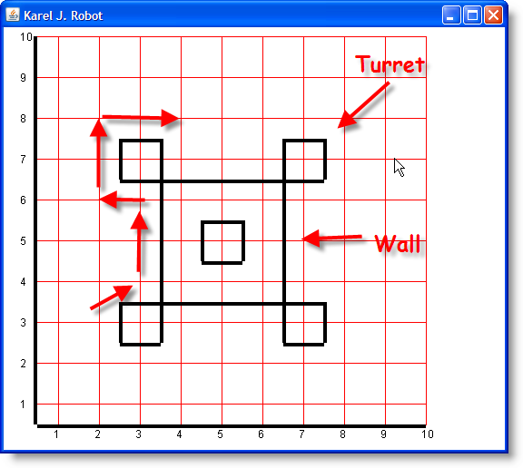
Karel Patrols the Castle
Here's the castle and the route we want Karel to follow
Think how many lines
you'd have to write to
patrol once around
  Hard to understand
  Hard to find your
  mistakes
What if we had a robot
that already knew how
to patrol a castle?

Slide 5
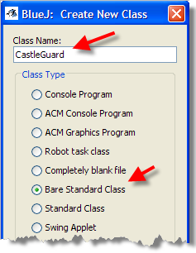
Our First CastleGuard
Inheritance allows us to create a new specialized version of our OCRobot and add new commands
Exercise 2: add a new Bare
Standard Class to your project,
and name it CastleGuard. Then,
open the file in your editor.

Slide 6
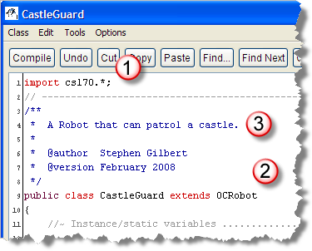
Setting Up CastleGuard
Add these changes to CastleGuard and compile:
  import cs170.*;
  on line 1
  extends OCRobot
  on the header line
  Add a comment and
  your name at the
  top of the class

Slide 7
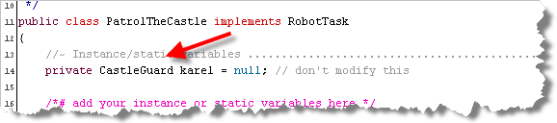
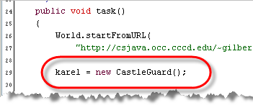
Setting Up the Task
Add these changes to PatrolTheCastle
  Change the OCRobot variable to a CastleGuard
    Ignore the "don't modify this" comment
  Initialize karel using the CastleGuard() constructor
Exercise 3: create a PatrolTheCastle, call task()

Slide 8
Adding turnRight
The OCRobot can't turnRight() so you had a bunch of turnLeft() commands in your last homework.
To add turnRight() to CastleGuard, add a method
  public void turnRight()
  {
  turnLeft();
  turnLeft();
  turnLeft();
  }

Slide 9
Moving to the Start
We can do the same thing to move Karel into the starting position, even though we'll only do it once
  public void goToWork()
  {
  move();
  move();
  move();
  turnRight();
  move();
  move();
  turnLeft();
  }

Slide 10
Patrolling the Wall
Patrolling a wall is very simple, just two moves()
Exercise 4: add the patrolWall() method to the CastleGuard robot and compile.
To use the new methods, just add this code to your PatrolTheCastle program. Then, create an instance of your program and call task()
  karel.goToWork();
  karel.patrolWall();

Slide 11
Patrolling a Turret
Patrolling a turret is a little more complex. You need to use turnLeft(), move() and turnRight() to bring karel so he's ready to patrol the next section of wall.
Exercise 5: write the patrolTurret() method and then add one line to your robot task class to call your method. Create an instance of your task class and call it's task() method to make sure Karel is lined up OK.
Exercise 6: call patrolWall() and patrolTurret() until karel has completed his rounds. Turn him off.

Slide 12
Improving the Artist
Exercise 7: Start BlueJ and create a new project named ic07. Import the file Artist.java from ic05.
  Open the Artist class and show me a screen shot.
How “easy to understand” is the code in Artist?
  Can you tell by reading that it draws a house?

Slide 13
Literals and Magic Numbers
When you call a method you pass information like this:
  g.drawRect( 0, 0, 100, 100 );
  The values 0 and 100 are called literals or constants
Problems with literals
  No meaning associated with number (magic number)
  Making changes to code can be difficult
Solution? Use named values called variables

Slide 14
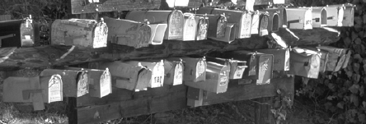
Review: What are Variables?
Programming languages store their data in variables
“Named, (usually changeable) storage area that holds a value”
Like a “mailbox” or “bucket” that holds information

Slide 15
Review: What are Values?
The data stored inside a variable is called its value
  A variable can have different values as a program runs
Different kinds of values we can put in a variable
  We can store different numbers or text in a variable
  PI = 3.14159;
  myAge = 54;
  myStreetNumber = "575“;
  PI holds a real number, myAge a whole number
  myStreetNumber contains characters
    Can't perform arithmetic on myStreetNumber
Notes:
When we store values in a variable, we can classify each value by the kind of thing that it is. For instance, we can store either text or numbers in a variable. We call this a value's type. Here are some examples:
PI = 3.14159
MyAge = 54
MyStreetNumber = "575"
Both PI and MyAge contain numbers, but they are different kinds of numbers: PI contains a real number, with a fractional part, while MyAge holds a whole number with no fractional part. In contrast, the variable named MyStreetNumber doesn't contain a number. Instead, it contains a sequence of three characters: the character "5" followed by the character "7" followed again by the character "5". In programming, we call a sequence of text characters, enclosed in double quotes, a string literal.
The major difference between the numeric variables PI and MyAge, and the string variable MyStreetNumber, is that you can't use MyStreetNumber as part of an arithmetic formula or expression. Let's take a quick look at expressions now.

Slide 16

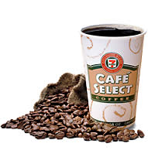
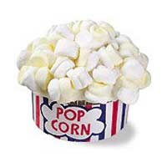
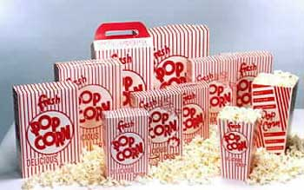
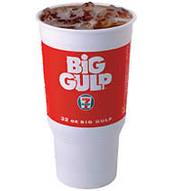

Review: What are data types?
Different kinds of variables for different kinds of data
Different sizes of containers for same kind of data

Slide 17
Review: Creating Variables
You can define (or create) variables in two places:
  Inside a method : called a local variable
  Outside a method : called a field or instance variable
You define a local variable using this syntax:
  type name = initial-value;
  Parts in gray are optional.
  The parts in red are required

Slide 18
Review: Assignment
Values are placed in variables using assignment
  int num = 23; // initializing assignment
  num = 45; // executable assignment
Value can be from input, a literal, or an expression
  num = readInt("Enter a whole number”);
  PI = 3.14159;
  area = PI * radius * radius;
Notes:
A variable is a named "chunk" of memory, but most of the time, we don't care about the chunk of memory at all—what we care about is what's inside the memory. The number stored inside a variable is called the variable's value. As your program runs, you can store different numbers inside the same piece of memory. (That's why we call it a variable, since its value can vary as the program runs.)
To put a new value in a variable, you use a VBA assignment statement like this:
Variable = Value
The assignment statement kind of looks like an equation in algebra, but it really works a little bit differently. The assignment statement copies the value on the right, and stores the copy in the named memory location on the left. The value part can come from input, like this:
Radius = InputBox("Enter the radius")
Or, it can be a literal value, like this:
PI = 3.14159
Or, it can be a numeric expression like this:
Area = PI * Radius ^ 2

Slide 19

Review: How It Works
Unlike a mailbox, a variable can hold exactly one value
  Placing a value in a variable, (assignment),
  replaces the value previously stored there
  myAge = 58;
  kathysAge = MyAge;
  kathysAge = 57;
  kathysAge contains 58, then 57
  myAge contains 58 for the length of the program
We say that assignment performs a destructive copy
Notes:
If you think of a variable as a mailbox, then assignment is like putting a letter inside the mailbox. With memory, though, each mailbox is just big enough to hold exactly one value. When you put a second value into a variable, the one that's there is replaced. (The computer science term for this is a destructive copy.) Here are some examples using two variables, MyAge and KathysAge. (Kathy is my wife.).
The statement MyAge = 54 puts a copy of the value 54 into the variable named MyAge.
The statement KathysAge = MyAge makes a copy of the value 54 that is currently stored in the variable MyAge, and then stores that copy in the variable KathysAge. There is no transfer of value; the variable MyAge still has its own copy of the number 54.
The statement KathysAge = 52, replaces the 54 that the variable previously held with the new value 52. The old value 54 is overwritten, not saved.
Notice that the variable KathysAge varies as the program runs. At one point it contains the number 54, and later in the program's execution, it contains the value 52.
Notice also that the variable MyAge contains the value 54 for the entire length of the program. Assigning MyAge to KathysAge in line 2 doesn't change MyAge at all.

Slide 20
Assignment
In Java, assignment is an operator, not statement
  The job of the assignment operator is to:
  Copy the value on its right
  into the variable on its left,
  and return the result copied
  as its value
The variable on the left is changed when this happens
  (Remember, this is a destructive copy )

Slide 21
Review: Kinds of Assignment
The assignment operator is used in two situations
1) to give an initial value to a new variable at creation
  int x = 5; // initialize i to 5
  This is a declaration, not an executable statement
  It can appear outside of any method
2) to copy a value into an existing variable
  x = 23; // copy (store) the value 23 in location x
  Executable statement; must appear inside a method

Slide 22
Review: Assignment or Equal
Assignment is not “equality” (like algebra)
  x = x + 1; // OK in Java, nonsense in algebra
Means that the operand on the left must be a variable
  13 = a + b; // OK in algebra, nonsense in Java
Java uses a different operator to test equality
  if ( a == 5 ) ... ; // Not ( a = 5 )

Slide 23
Defining Local Variables
So far, we’ve only learned about a few types
  Type int stands for whole numbers
  Type String stands for a sequence of characters
Here are some example declarations:
  int x = 10;
  int roofWidth = 300;
  int roofHeight = 100;
  int center = x + roofWidth / 2;

Slide 24
Artistic Variables
Modify Artist to use these and other variables
  Create variables to represent the position of the house
  Create variables for the width and height of the house
  Create variable for the width and height of the roof
    Can these depend on the size of the house?
  Create variables for the width and height of the door
  Create variable for height and width of each window
Is the modified program easier to understand?
Modify some of the "base" variables. What happens?
Exercise 8: Show me your code and a screen-shot of your running program.

Slide 25
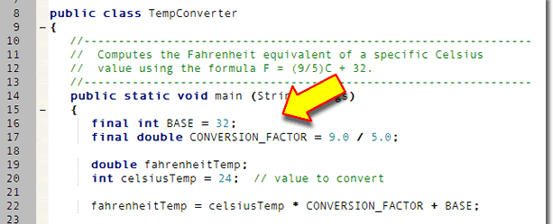
Constants
Named constants are “variables that don’t vary”
  Make code clearer by eliminating magic numbers
  Create by adding modifier final in front of declaration
  For instance variables, use public static final
  Convention is to use UPPER_CASE for names

Slide 26
Interactive Programs
So far, our programs have been static, not dynamic
  They work exactly the same each time they run
We make our programs dynamic or interactive by having them process input supplied by the user
  Input can be commands (mouse, menu or keyboard)
  Input can also be data, which we'll store in variables
The basic pattern for interactive programs:
  Create a variable to hold the user's input
  Ask the user to enter some data (called a prompt)
  Read the data, convert it, and store it in the variable

Slide 27
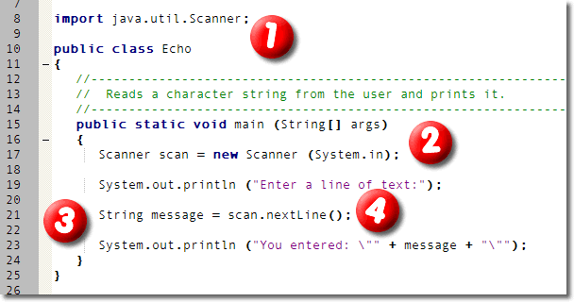
The Scanner Class
The Scanner class simplifies console input
  Import the java.util.Scanner class
  Create a Scanner variable using System.in
  Call nextLine(), and store input in a String variable

Slide 28
Express Yourself
Exercise 9: Create an interactive program that asks the user for their name, and then replies, "Hello <name>, I think I love you!". Use this pattern:
  Create a BlueJ Console program
  Make sure you import the java.util.Scanner class
  Create a Scanner variable in your program
  Create a String variable to hold the user's name
  Ask the user to enter their name
  Read the name using the Scanner object
  Print the reply, using the name entered by the user

Slide 29
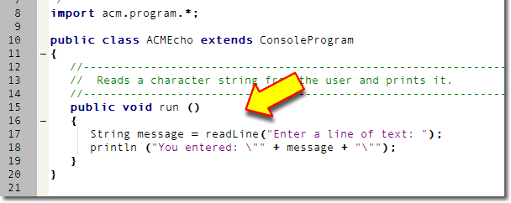
ACM Input
ACM programs have their own input methods
  Part of the ConsoleProgram class
To read a line of text from the keyboard use readLine()

Slide 30
Express Yourself
Exercise 10: Create the same program, using the ACM ConsoleProgram class. Use this pattern:
  Create a BlueJ ACM Console program
  Create a String variable to hold the user's name
  Read the user's name using the readLine() method
    Don't need a separate prompt line. Just ask the user to enter their name when calling readLine()
  Print the reply, using the name entered by the user

Slide 31
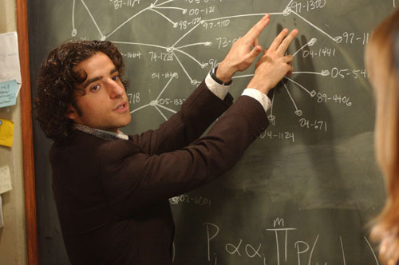
Numbers
Working with Integer
and Real Number Types

Slide 32
The Great Divide
Java programs are composed of cooperating objects
  You've used Applet, Color, and Graphics, etc.
  Peer inside, and you'll find simpler components
At the bottom - the bit : "atoms" of the computing world
One step up are primitive or fundamental types
  Similar to objects: have state and behavior
  Value types rather than reference types
  Unlike objects, can only hold a single, simple value
  Manipulated by operators rather than methods
  Behavior is built-in; it cannot be extended

Slide 33
Decimal Numbers
Internally, computers use binary to represent everything from whole numbers to real numbers to text to graphics
  A binary number uses base 2 instead of base 10
In base 10, or decimal:
  We use ten digits, the digits 0 to 9
  Each digit's value is based
  on its positional value
  4123 is 3 ones, 2 tens,
  1 hundreds and
  four thousands
4
1
2
3
Ones
Tens
Hundreds
Thousands
Notes:
How does VBA store information inside variables? Well, internally, all computers and all programs use binary numbers to represent everything. This includes text, numbers, sound, and graphics. A binary number is just like the decimal numbers you grew up with, except it uses base 2 instead of base 10.
We call our decimal number system base 10, because it uses ten digits: 0 to 9. When we combine these digits together to produce larger numbers, the digits actual value depends upon its position in the number as a whole. If the digit is in the first position, it represents the number of ones, the second position represents the number of tens, the third the number of hundreds, followed by thousands, ten-thousands, etc.
Here's an example. Consider the number 4,123. Starting in the right-hand position is the digit 3. Since it's in the right hand position, this means our number has 3 ones. The next positions is the number of tens, and the digit in this position is 2 so we add 2 * 10 or 20. The third position is the hundreds, and here we have the digit 1, so we add 1 * 100 or 100. Finally, in the fourth position, we have the number 4. Since this is the thousands position, we have 4 * 1000 or 4000. If we add all of those together—4000 + 100 + 20 + 3—we end up with our final number.

Slide 34
Binary Numbers
In the base 2 or binary number system
  We use only two digits 0 and 1
  Instead of the tens,
  hundreds, and thousands
  places, which are powers
  of ten, each place value
  is a power of two
  1101 represents 1 one,
  0 twos, 1 four and
  1 eight (or 13)
1
1
0
1
Ones
Twos
Fours
Eights
Notes:
In the base two or binary number system, there are only two digits, 0 and 1. (Of course, that's why binary is used for digital computers, because electronic components like transistors, which can be on or off, can easily represent the binary digits in a binary number.)
Because we have only two digits, the positions in the number take on a different meaning. Instead of the ones, tens, hundreds, and thousands places, we have the ones, twos, fours, eights, sixteens, and so on. Notice that each place is simply two times the place value to its right, just like in the decimal system, each place is just ten times the place value to its right.
If we look at the binary number 1101, you can see that, in decimal, it represents 1 one plus 0 twos plus 1 four plus 1 eight, or 13.
Now, the reason you need to understand this, is to understand how VBA stores different types of numbers. Let's look at that now.

Slide 35
Explain Yourself
Exercise 11: In binary, how do you represent these?
  (Assume that these are decimal numbers)
  3
  5
  10
  8
  130
  255

Slide 36
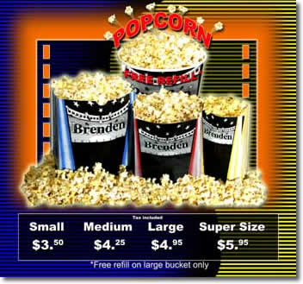
Meet the Integers
The first primitive types we'll look at are integers
Whole numbers, including zero and negative
  27 and -345 are integers, 7.25 is not an integer
Theoretically, integers are infinite
  No matter how big, there's always room for another digit
Computer-implemented integer primitives are finite
  Stored in fixed area of memory, so different “sizes”
  Represents "integer concept", limited by constraints
  Similar to the way B/W photo represents reality

Slide 37
Signed and Unsigned
Computer integers come in two varieties
  Signed integers hold both positive and negative numbers
  Unsigned integers hold only zero and the positive numbers
For any given amount of storage:
  Both types can store the same "number of numbers"
    Eight bits can store 256 numbers whether signed or unsigned
  The unsigned number represents a greater (2X) magnitude
    With 16 bits, unsigned = 0 – 65,535 (65,536 values)
    As an unsigned = -32,768 to 32,767 (65,536 values)
All Java integers are signed

Slide 38
The "Four Families" Integers
The byte uses 8 bits of storage
  Represents 256 numbers from -128 to 127
The short uses 16 bit of memory
  Represents 65,536 numbers from -32,768 to 32,767
The int (the "natural sized") uses 32 bits of memory
  Represents slightly more than 4 billion numbers
  -2,147,483,648 to 2,147,483,647
The long uses 64 bits of memory
  Represents numbers from (roughly) +/- nine quintillion

Slide 39
Defining Integer Variables
Write literal numbers (values) without commas or dots
  byte myAge = 55;
  short milesToGo = 23455;
  int populationUSA = 263456732;
  long populationWorld = 5374678328;
Literals use int storage, even if small
Literals assume number is decimal (base 10)
You can change these assumptions if you like

Slide 40
Initializing long Variables
This line, from the previous slide, doesn’t compile:
  long populationWorld = 5374678328;
  The literal 5374678328 is too big for 32 bits
To write a literal integer that uses 64 bits, add the suffix L to the end of the number, like this:
  long populationWorld = 5374678328L;
  Avoid using the lowercase “l” because it looks like a “1”

Slide 41
Number Bases
Integers are written as decimal, but stored as binary
  Sometimes, it’s easier to write using a different base
  Suppose you want an applet background to match this:
  <body style="background-color : #fffbf7;">
  HTML color is a hexadecimal or base-16 number
To write integers in another base, you add a prefix
  Literals that start with zero are octal (base 8)
  Literals starting with zero-x are hexadecimal (base 16)
  Color bgColor = new Color(0xfffbf7);

Slide 42
Express Yourself
Exercise 12: Write a declaration that defines and initializes this variable. Use smallest type possible.
  Define and initialize a variable named students that holds the number of students in the class right now.

Slide 43
Express Yourself
Exercise 13: Write a declaration that defines and initializes this variable. Use smallest type possible.
  Define and initialize a variable that holds a whole number representing the number of inches from the Clark Computing Center in Costa Mesa to the magnetic North Pole of the ex-planet Pluto. (You can guess if you don't know the exact number.) Choose your own name for the variable.

Slide 44
Express Yourself
Exercise 14: Write a declaration that defines and initializes this variable. Use smallest type possible.
  Define a variable named occStudents that holds the number of students registered at OCC (about 25,000).

Slide 45
Express Yourself
Exercise 15: Write a declaration that defines and initializes this variable. Use smallest type possible.
  A variable named voters that can hold the number of voters in the next US presidential election. (Make a reasonable guess of the number.)

Slide 46
Express Yourself
Exercise 16: Which are legal Java integer literals?
  3
  2+3
  "2+3"
  5,280
  0L
  0.333333
  0xcafebabe
  0xCafeBabel
  083

Slide 47
Express Yourself
Exercise 17: Write Java statements to:
Declare two int variables, x and y, initializing x to 10.
Assign the value 3 to the int variable y.
Update the value of x by adding 5 to it.
Create an int variable z, copy the contents of y into it.
Exchange (swap) the contents of x and y. Create another variable or two if you need them

Slide 48
Integer Wrap-around
Integer wrap-around or overflow when too big
    (400000 * 400000 / 400000) == 2715?
    2147483647 + 1 == - 2147483648?
Which integer type should you use in your programs?
  Unless you have a reason not to, use the int
  Smaller sizes won't necessarily save memory
  Calculations always use int or long

Slide 49
Integer Input
The integer value 123 in your program is stored like this:
  0000-0000 0000-0000 0000-0000 0111-1011
When user enters 123 at the keyboard, it is not a number
  Instead it is three characters '1', '2', and '3', like this:
  0000-0000 0011-0001
  0000-0000 0011-0010
  0000-0000 0011-0011
Integer input must convert from one to the other

Slide 50
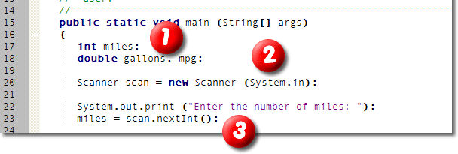
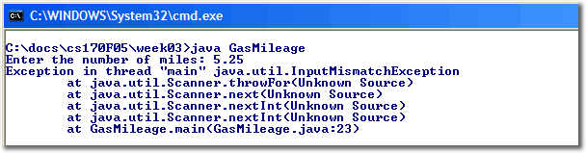
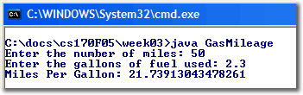
Scanner Input
You can use the Scanner class to read and convert
  Create an int variable (miles) and a Scanner object
  “Prompt” the user for the correct kind of input
  Use the Scanner’s nextInt() method to read
User must enter a whole number when program runs
  Generates a runtime error if given unexpected input
  Known as “throwing an exception”

Slide 51
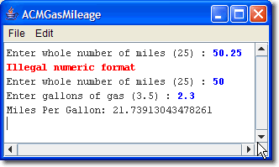
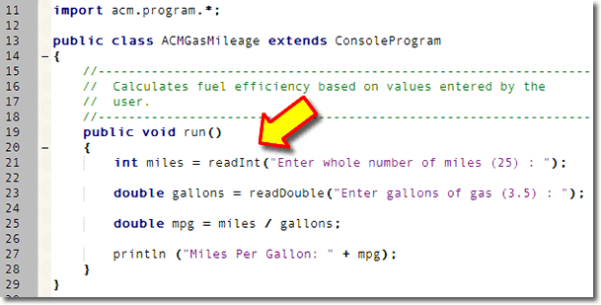
ACM Console Input
ACM programs use the method named readInt()
  Provide a prompt string when calling the method
  “Catches” runtime errors and asks the user to re-enter

Slide 52
Finish Up
In-class exercise: submit before you leave today!
  Save as a PDF file
  Drop into submissions folder on Q: drive
Finish Chapter 4 by Thursday
Complete problems on the homework page
Midterm next Monday

