Slide 1

Java Programming 1
Lecture 8
Real Numbers and Math
Real Numbers,
Arithmetic,
and Java Objects

Slide 2

Express Yourself
Use OpenOffice Writer to create a new document
Save the file LastFirst_ic08
  Replace LastFirst with your actual name
Put your name and today's date at the top of the sheet
Title it "CS 170 In-class Exercise 8"
Exercise 1: Open BlueJ and create a new project named ic08. Create a class named EX08A using the ACM Console template. Ask the user to enter two integers, read the result from the console, add them together and display the sum. Run and snap a shot.

Slide 3

Real (floating-point) Numbers
Floating-point types
  Can hold a fractional amount
Binary value is divided into three parts
  A binary fraction, called the mantissa
  A signed binary integer called the exponent
  A single bit used to represent the sign
Sign
Exponent
Mantissa [Binary Fraction]

Slide 4
A Floating Point Example
How can we convert 13.75 to a floating-point number?
  Step 1: convert the integer part to a binary number
    1101 – 1 x 8 + 1 x 4 + 1 * 1
  Step 2: convert the fractional part to a binary number
    .11 : 1 x 1/2 + 1 x 1/4
  Step 3: calculate the exponent
    Need to move the “decimal” point left by 4
    Mantissa is 110111 and exponent is 100
This is a simplified example
  Actual storage is slightly more complex

Slide 5
Explain Yourself
Exercise 2: Assume a 16-bit floating-point number
  1 sign bit
  4-bit exponent
  11-bit mantissa
1: How would you represent
  17.25
  -5.5
2: What number is this?
  1001-0110-1000-0000

Slide 6
Varieties of Real Numbers
Java has two kinds of real (floating-point) numbers
  A float uses 32-bits (or 4 bytes) of storage
  The double uses 64-bits (or 8 bytes) of memory
Floating-point types have both a range and precision
  Range is the largest and smallest number you can store
  Precision is the accuracy of the number
  Precision is measured in significant digits

Slide 7
Range and Precision
The float type can represent:
  Numbers as small as 1.4E-45
    .0000000000000000000000000000000000000000000014
  Numbers as large as 3.4E+38
    340,000,000,000,000,000,000,000,000,000,000,000,000
  The precision is about 8 digits
The double type can represent:
  Numbers as small as 4.94E-324
  Numbers as large as 1.79E+308
  The precision is about 16 digits

Slide 8


Defining Real Variables
Use double or float for type name
Floating-point literals can be written in two ways
  Decimal notation: 3.45, .7653, 2.0
  Exponential notation: 1.0E6, 2.7563e-15
  double first = .234;
  double second = 7.5432;
  double third = 1.234e-12;
  float fourth = 3.2F;
  Must use a suffix of F or f when writing a float literal
  May use a suffix of D or d when writing a double literal

Slide 9
Express Yourself
Exercise 3: Write a declaration that defines and initializes this variable. Use the smallest type possible.
  Define a variable named kids that holds the average number of children per American family. Initialize it to one and three-quarters using decimal notation:

Slide 10
Express Yourself
Exercise 4: Write a declaration that defines and initializes this variable. Use the smallest type possible.
  Define a variable named atoms representing the number of atoms in the known universe. Initialize it to a pretty big number using appropriate notation :

Slide 11
Express Yourself
Exercise 5: Write a declaration that defines and initializes this variable. Use the smallest type possible.
  An electron, moving in copper wire, travels 12 inches in a nanosecond. Define secondsPerInch that holds the time (in seconds) that it takes an electron to travel one inch. (A nanosecond is a billionth of a second.):

Slide 12
Express Yourself
Exercise 6: Which are legal Java real literals?
What's wrong with those that aren't legal?
  0.333333
  1e1
  -23.900e-0.5
  7.527-e3
  4.5f
  3D

Slide 13

Floating-point Input
Use the same "pattern" as you did for integer input
  Only the method names are different
With Scanner, use nextFloat() or nextDouble()
With ACM, use readFloat() or readDouble()

Slide 14
Express Yourself
Exercise 7: Let's modify the program we started out with (EX08A). Create a double or float variable named price. Ask the user to enter the price of a hamburger, and store the result in your variable. Now, create a second int variable called pennies. Multiply the price by 100, and store the result in pennies. Print out the number of pennies.
What happens when you compile?

Slide 15
Conversion and Assignment
Java allows you to write assignments like this:
  double a = 5;
This is called a widening conversion
  Assignment between types with no lost information
    double d = 123.45F; // OK
    float f = 123.45; // Not OK
    int x = 123;
    byte b = x; // Not OK
    long l = x; // OK

Slide 16
Casting
Sometimes you know that no data will be lost
  Or, the data loss may be acceptable
You can tell Java to “try” to store closest value
  This is called a "cast" or "type cast"
  It creates a temporary expression value
Cast syntax : (new-type) value
  int x = 123
  byte b = (byte) x; // OK
  byte b = (byte) 256; // OK???
  int n = (int) .999; // OK???

Slide 17
Express Yourself
Exercise 8: Use casting to fix the compiler error when you store the double value into pennies. Run your program and enter a value of 4.35 for the hamburger. How many pennies did you collect? Shoot me a screenshot.

Slide 18
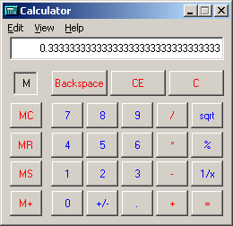
Floating Point Limitations
Floating-point numbers represent approximations
  They are especially unsuited for monetary applications
  The value .1 cannot be exactly represented in binary
Similar to the problem with
1 / 3 in decimal
If you enter this into a calculator
you see something that looks like:
Called a "representational error"
  Your book calls it a rounding error

Slide 19
What About Money?
What about money, if floating-point isn't that good?
  We can get closer, by using Math.round()
Exercise 9: Try it, re-run and shoot a pic.
Better, we could create an accurate Money class
  Use longs to represent mills accurately
Java already has a similar class called BigDecimal
  BigDecimal d = new BigDecimal("4.35");
  BigDecimal e = new BigDecimal("100");
  BigDecimal f = d.multiply(e);
  System.out.println(f);

Slide 20
Express Yourself
Exercise 10: Fix your program again, this time to use BigDecimal for your price variable. That means you'll have to read String input to construct your variable. Run and shoot me a picture of the result.

Slide 21
Guidelines: What To Use
Choosing between decimal and scientific notation
  Very large or very small numbers, use scientific
Choosing between float and double
  double is natural size for most modern hardware
  Absent a compelling reason to use float, use double
Choosing between double and int
  Using double is significantly slower and less accurate
  Use int unless you need fractions, then use double
Money: use BigDecimal or longs for mills

Slide 22

Expressions
You
do
the
Math

Slide 23
Expression Vocabulary
What is an expression?
“Any combination of
operators and operands
which, when evaluated,
yields a value”
So, what are operators and operands?

Slide 24
Operands
Operands are symbols which represent values
Here are some of the things that can act as operands
  Literals 3 + 5 [ 3 and 5 are values ]
  Variables a - 3 [ a contains a value ]
  Method call 2 * func(a) [ func() produces a value ]
  Expression (a+3) * 5 [ a + 3 results in a value ]

Slide 25
Operators
Operators are symbols that perform an operation
  Operation may be performed on one or more operands
Every operator has these three characteristics:
  Arity: number of operands required
    Unary, binary, tertiary (ternary)
  Precedence: order in which operations are performed
  Associativity: determines whether operations
  should occur left-right or right-left

Slide 26
Evaluation
Key concept: every expression produces a value
  Value may be used anywhere a literal value is used
  a = 7;
  a = 3 + 4;
Value produced may be stored, or used immediately
  int fontsize = 72 / 2; // 36 points
  f1 = new Font("Serif", Font.BOLD, fontsize);
  f2 = new Font("Serif", Font.BOLD, 72/2);

Slide 27
Numeric Operators
These are the five commonly used numeric operators
  + Addition
  - Subtraction or unary minus
  * Multiplication
  / Division (both integer and real)
  % Remainder or modulus (also works with reals)
  int a = 7, b = 12;
  int diff = b - a;
  int product = b * a;
  int quotient = b / a;
  int remainder = b % a;

Slide 28
Integer Division Operations
Integer division works like primary-school long division
  The quotient is calculated, remainder discarded
  The result, an integer, is truncated, not rounded
The remainder operator returns the “remainder” part
  12 % 7 is 5: 7 “goes into” 12 once, with 5 left over
  The sign of the result is the sign of the numerator
Exercise 11:Here are some challenge problems
  int a = 5 % 3;
  int b = 0 % 2;
  int c = 12 % 12;
  int d = 2 % 0;

Slide 29
Precedence
Precedence is a rule used to evaluate an expression
  Precedence determines "which operator goes first"
  Operators with "higher" precedence go first
    int x = 5 - 5 * 3; // -10, not 0
  Can be overridden using parentheses
    int x = (5 - 5) * 3; // 0
See complete chart in Appendix E in your book

Slide 30
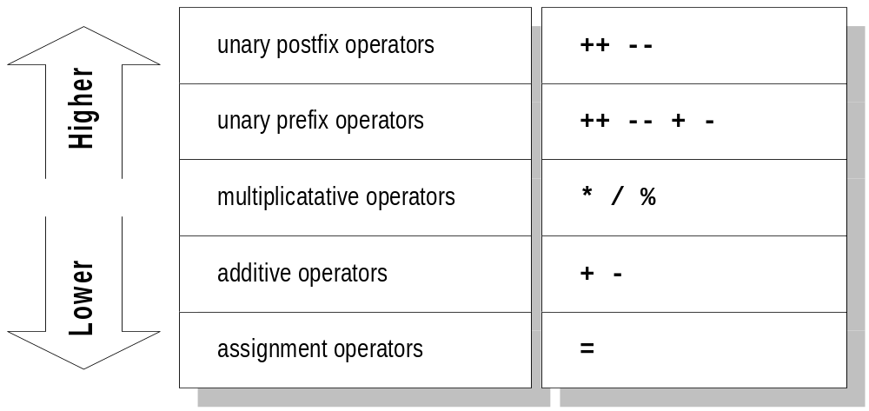
Precedence Levels

Slide 31
Associativity
Determines order of operation when operators share operands at the same level of precedence
  5 * 7 / 2; // 17
  Binary operators usually are left-associative
  Assignment and unary operators are right-associative
Precedence is the same as order of evaluation
  Java guarantees left-to-right evaluation (unlike C)
  Every operand will be evaluated before operation

Slide 32
Express Yourself
Exercise 12: What is the value of e after this runs?
  Tracing ("be" the computer) is a fundamental skill
int a = 3, b = 4, c, d, e;
c = (a % b) * 6;
d = c / b;
e = (a + b + c + d)/4;

Slide 33
Side Effects
The 5 numeric operators don't modify their operands
Consider this example:
  int sum = num1 + num2;
  num1 and num2 are unchanged after this
  The variable sum is changed
  This change is called a side effect
Java also has a few other side-effect operators
  Increment/decrement, shorthand assignment

Slide 34
Shorthand Assignment
To sum an amount in runningTotal you'd write:
  runningTotal = runningTotal + currentAmount;
  You have to write the word runningTotal twice
Java has a shorthand way to write the same thing:
  runningTotal += currentAmount;

Slide 35
More Shorthand Assignment
There are shorthand versions of all binary operators:
  a += b; // same as a = a + b;
  a -= b; // same as a = a - b;
  a /= b; // same as a = a / b;
  a *= b; // same as a = a * b;
  a %= b; // same as a = a % b;

Slide 36
Express Yourself
Exercise 13: Write equivalent "shorthand" if possible:
x = 2 * x;
x = x + y – 2;
sum = sum + num;
z = z * x + 2 * z;
y = y / (x + 5);

Slide 37
Up and Down
Increment and decrement operators
  Unary operators (++, --) that add or subtract one
  Can only be applied to a variable
  Produce both a value and a side-effect
You may use the operator before or after the variable
  Both have exactly the same side-effect on variable
  Variable is always incremented or decremented by 1
  int a = 5;
  a++; // a is now 6
  ++a; // a is now 7

Slide 38
Pre and Post
The "expression" or "returned" value is different
With pre-increment (before the variable)
  The variable is updated
  The new value is returned as the expression's value
With post-increment (after the variable)
  The original value is saved temporarily
  The variable is updated
  The original value is returned as the expression's value
  int first = 1, second = 2;
  int third = first++; // third==1, first==2
  int fourth = ++second; // fourth, second == 3

Slide 39
Express Yourself
Exercise 14: What value does each variable contain after each statement is executed? (U if not defined)
int a = 5, b = 6, c;
a = b++ + 3;
c = 2 * a + ++b;
b = 2 * ++c – a++;

Slide 40
Mixed-type Expressions
What happens when Java evaluates this expression?
  x = 5.3 * 2;
  5.3 is a double, but 2 is an int
With these expressions, Java promotes the 2
  Creates temporary value, 2.0, to use in the expression
  Called a promotion, because no data is lost
  The expression result will be a double, not an int
  Most precise type used in calculation

Slide 41
Promotion Rules
Java data is arranged in a hierarchy
Types holding more info at the top, less at bottom
Hierarchy used to determine type of promotion
  1) Expression contains byte, short or int
  2) Expression contains long
  3) Expression contains floating-point type
  4) Expression contains float and double
Promotion occurs only when encountered
  double value = 5 / 4 / 3.0

Slide 42
Express Yourself
Exercise 10: What value does each variable contain after each statement has been executed?
int a = 3, b = 5, sum;
double c = 14.1;
sum = a + b + (int) c;
c /= a;
b += (int)c – a;
a *= 2 * b + (int)c;

Slide 43

A Little More Math
Classes for calculating formulas and creating
and using Random
Numbers

Slide 44
Using the Math Class
Java's Math class is used for complex calculations
  Part of the java.lang package so you don't import it
All of the methods in the Math class are static
  You never create a Math object
Methods for basic numeric operations
  Static constants: Math.E and Math.PI
  Square root: Math.sqrt(double);
  Raising a number to a power
    Math.pow(double a, double b) (a b)

Slide 45
Express Yourself
Look up the documentation for the Math class
Exercise 11: These two variables represent the sides of a right triangle. The hypotenuse is the square root of the sum of the squares of the two sides. Create a variable hypotenuse and calculate its value:
  double sideA = 3.175, sideB = 7.952;

Slide 46
Express Yourself
Look up the documentation for the Math class
Exercise 12: The variable total may be positive or negative. Use a method or methods in the Math class to compute and print the absolute value of total.
double total = scan.nextDouble();

Slide 47
Random Numbers with Math
The Math.random() method is very easy to use
  Generates random numbers between 0.0 and 1.0
  0.0 is included and 1.0 is excluded
Normally, we want a wider range and a different type
  Use multiplication to get the "number of instances"
  Use casting to convert to the correct type
  Use addition to put the number in the range you want
    int die = (int) (Math.random() * 6) + 1;

Slide 48
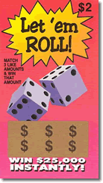
Let ‘em Roll
Imagine a lottery game where winner
must guess six numbers between
39 and 173 (inclusive)
  Here's how you'd generate the
  first number in the sequence
  int min = 39;
  int max = 173;
  int range = max - min + 1;
  int p1 = (int)
  (Math.random() * range) + min;
Exercise 13: Generate in CodePad. Screen shot.

Slide 49
Express Yourself – Wild Ovals
Step 1: Create a new applet in BlueJ called WildOvals
  Paste the starter code from the class links page
Step 2: Complete the program using Math.random()
  In paint(), draw a solid, colored oval on the screen
  Use random numbers for the oval coordinates and size
  Generate 4 ints falling inside the area of the applet
  Use the smaller of them as x and y
  Calculate a value for width and height.
Step 3: Generate a random color for the oval.
Exercise 14: Snap a picture of your applet running

Slide 50
Finish Up
In-class exercise: submit before you leave today!
  Drop into Q:\faculty5\sgilbert\cs170\submissions
Finish reading Chapter 4
  We'll cover Strings and formatting Thursday
  Chapter 4 quiz on Thursday
Midterm Exam on Monday
  Objective questions from Chapters 1-4A

