Slide 1

Java Programming 1
Lecture 9
Characters and Strings
See How Computers
Store Characters, and
Work with String Class
Methods

Slide 2

Express Yourself
Use OpenOffice Writer to create a new document
Save the file as LastFirst_ic09
  Replace LastFirst with your actual name
Put your name and today's date at the top of the sheet
Title it "CS 170 In-class Exercise 09"
Exercise 1: Open BlueJ and create a new project named ic09. Create a class named EX09A using the ACM Console template. Ask the user to enter mileage and gallons as real numbers. Read the response, calc and print miles-per-gallon. Run and snap a shot.

Slide 3
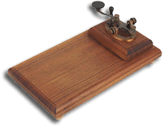
Storing Characters
Computer can't process anything but binary numbers
  Means that human-readable text must be encoded
  Everyone agree that 'A' is stored as 65 in computer
  Similar to way that Morse Code (telegraph) works
One of the first codes was EBCDIC
  IBM mainframe standard
  Extended Binary Coded Decimal Interchange Code
Considered "proprietary" by IBM; others used ASCII
  American Standard Code for Information Interchange

Slide 4
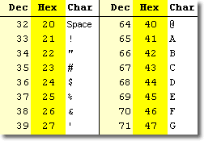
Unicode
ASCII was designed to be efficient
  Most characters stored in 7-bits
  Small size meant quick transmission
Modifying it for non-English languages was difficult
  The "extra bit" used to provide alternate characters
  "Code-pages" allowed DOS programs to switch
Better solution is to use more memory than a byte
  Several different variations
  Most of the world has standardized on Unicode
  Go visit at www.unicode.org

Slide 5
The char Data Type
The char data type is used to store single characters
  Uses two bytes of storage per character
  Each storage location is interpreted using Unicode
You create char variables just like other primitives
  char initial = <char literal>;
  char controlA = <char literal>
  char hTab = <char literal>;
  char backslash = <char literal>;
  char copyright = <char literal>;

Slide 6
Writing char Literals
How do you write a literal D? Here’s a first attempt:
  char initial = D;
  Can’t just use the character; looks like a variable
  Must use some punctuation
  Character used in Java is a single quote (')
  char initial = ' D ';
  Single/double quotes are not interchangeable

Slide 7
Other char Literals
Some characters are not "printable"
  ASCII 0-31 traditionally used to control hardware
    Thus, named "control characters"
How do you include such characters in your code?
  Generated by holding down CTRL+ Character
  Still used to "control" software
  Can write these by simply using the integer value
  char ctrlA = 1;

Slide 8
"Special" Characters
Java has a second way to enter "special" characters
  These include some control characters and punctuation
  The method is called an escape sequence
An escape sequence has two parts
  The escape character
    In Java, the escape character is the backslash (\)
    Tells the compiler "Look out - special instructions ahead!"
  Followed by a translation value

Slide 9
Predefined Escape Sequences
Here are some common escape sequences
  Predefined to make them easy to use
  \b Backspace (value 8, Ctrl+H or backspace)
  \t Tab (numeric value 9, Ctrl+I or Tab)
  \n Newline (numeric value 10, Ctrl+J)
  \r Return or Enter (numeric value 13, Ctrl+M)
  \f Form-feed character (numeric value 12)

Slide 10

Unicode Escape Sequences
Escape sequences represent any Unicode character
Start with \u or \U, then 4-digit hex Unicode value
Use escapes to create char variables or in strings
  char controlA = '\u0001';
  char tradeMark = '\u2122';
  char copyright = '\u00A9';
  String message = "\u00BC is \u00BD of \u00BD\n";
Difference between characters and glyphs

Slide 11
Escaping Punctuation
Store an apostrophe inside a char
  char apostrophe = '\'';
Store a quote inside a String
  String msg = "and then he said, \"Hello\"";
Store a backslash inside a String
  String iniFile = "C:\\Windows\\my.ini";

Slide 12
Express Yourself
Exercise 2: Find the Registered trademark symbol (not TM) in the Unicode characters on page 1059. Display a sentence in CodePad that contains the character. Shoot me a screen-shot.
Exercise 3: Us CodePad to print your name, surrounded by quotes ("Stephen Gilbert"). Shoot me a screen-shot.
Exercise 4: Use CodePad to print the String: "The tab escape sequence is \t, while the newline is \n". Print me a screen-shot.

Slide 13
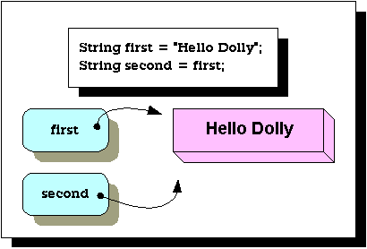
Meet the Strings
What are Strings in Java?
  Immutable sequences of 0…n characters
Strings are like primitives in several ways
  Initialize using a literal rather than using new
Strings really are
objects, though,
not primitives
  Strings are
  references
  not values

Slide 14
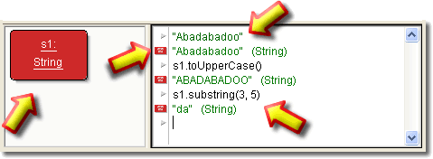
Strings and BlueJ
Code Pad makes it easy to work with String methods
  Type a String literal into Code Pad
  Drag it and drop it on the Object Bench
  Use the object to experiment with String methods

Slide 15
A Tale of Two Strings
The null String is an uninitialized String
  It's reference contains the value null
  The only thing you can do to it is initialize it
The empty String is a String of length 0
  Send messages to the empty String, but not the null
  String emptyString = '''', nullString;
  int len = emptyString.length(); // OK
  int len2 = nullString.length(); // Error

Slide 16
String Operations
Java "overloads" two operators to work with strings
Plus [ + ] concatenates or "pastes" strings together
  String s1 = "How", s2 = "now";
  String s3 = s1 + " " + s2;
You can also use +=, but only on a string variable
  s3 += " brown cow";
Exercise 5: Use CodePad to concatenate your name and the null string. Screen-shot of the result.

Slide 17

Retrieving Characters
Characters stored “contiguous” in memory
  You can access each character by its position
  Note, though, that numbering starts at 0, not 1
To retrieve a character, use charAt(int position)
  Value returned is a char, not a String

Slide 18
Using charAt()
Here are some examples that use charAt()
  1: String s1 = "Conch", s2 = "fritters", s3 = "";
  2: char firstChar = s1.charAt(0);
  3: char lastChar = s2.charAt(s2.length()-1);
  4: char whatChar = s3.charAt(0);
  5: char thatChar = "What".charAt(0);
Exercise 6: Use CodePad to try out each of these examples. Show me a screen-shot of the result.

Slide 19
Searching Methods
Return the position of a character or string
  indexOf(arg) returns position of the first occurrence
  lastIndexOf(arg) returns the position of the last
  Both return -1 if arg can’t be found in the search string
  1: String s1 = “Abadabadoo”;
  2: int p1 = s1.indexOf(“daba”);
  3: int p2 = s1.indexOf(‘o’);
  4: int p3 = s1.lastIndexOf(‘o’);
  5: int p4 = s1.indexOf(“doom”);
Exercise 7: Use CodePad to try out each of these examples. Show me a screen-shot of the result

Slide 20
Builder Methods
Strings are immutable, they can’t be changed; Builder methods create new Strings, transforming existing ones
s.toUpperCase(), s.toLowerCase()
  Returns String translated to either upper or lower case
  String upperPet = "pet".toUpperCase();
  String lowerPet = "Pet".toLowerCase();
  upperPet.toLowerCase(); // logical error?
Exercise 8: Use CodePad to try out each of these examples. Show me a screen-shot of the result. Why is the last one a logical error?

Slide 21
Replacing Characters
Replace characters using s.replace(‘a’,’b’)
  Returns String with all occurrences of a replaced by b
  String mod = "Mom".replace('m', 'd');
  String bad = "Dad".replace('D', 'B');
Java 5 and 6 replace() method which with the CharSequence interface, which includes String
Exercise 9: Use CodePad to try out each of these examples. Show me a screen-shot of the result

Slide 22
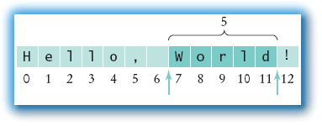
Substrings
Substring methods extract a portion of a string, given a starting index and an (optional) ending index
  s.substring(start), s.substring(start,end)
Version 2 returns substring starting (and including) position start, up to, and excluding, position end
  1: String s1 = "Hello, World!";
  2: String s2 = s1.substring(7); // World!
  3: String s3 = s1.substring(7, 12); // World

Slide 23
Express Yourself
Exercise 10: The string name contains "Last, First". You can use the String trim() method to remove extra spaces before and at the end of a string. You know that name contains a comma, but you aren't sure if there's a space after the comma or not. Using CodePad, initialize the variable name using your own name. Then, use the indexOf(), substring() and trim() functions to extract the first and last name into two new variables: first and last. Try your code both with and without extra spaces surrounding the comma. Show me a screen-shot of the result

Slide 24
Input and Output
Converting Numbers to Strings
and Strings to Numbers

Slide 25
Numbers and Strings
The integer number 123 is stored like this in memory:
  0000-0000 0000-0000 0000-0000 0111-1011
If you enter 123 at the keyboard, it is not a number
  Instead it is three characters '1', '2', and '3', like this:
  0000-0000 0011-0001
  0000-0000 0011-0010
  0000-0000 0011-0011

Slide 26
Strings to Numbers
For calculations, text must be converted to numbers
  Integer class has a parseInt() method to do that
  This is a static method, so you use the class name
This is useful when you can’t use the Scanner class
  Getting numeric input from a TextField in a GUI app
  String aStr = someTF.getText();
  int num = Integer.parseInt(aStr);

Slide 27
Other Conversions
Java has several "wrapper" classes like Integer
  Discussed briefly on page 158-59 in your textbook
For floating-point input, use the Double class
  You can use either of these ways to convert
  String dStr = dTF.getText(); // String from user
  double a = Double.parseDouble(dStr);
  double b = Double.valueOf(dStr).doubleValue();

Slide 28
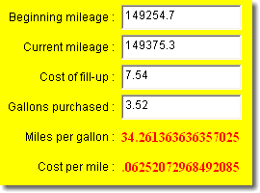
From Numbers to Strings
Once you've completed your calculations, you'll want to display them on the screen
  You cannot display "raw" binary numbers
  Instead, you have to turn the results back into a String
Concatenation automatically turns numbers to text
  double result = a / b + c; // some calculation
  String output = "result = " + result; System.out.println(output);
Problem is you don't have control over the format

Slide 29
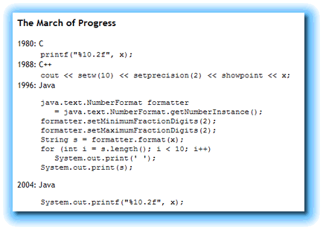
printf() and String.format()
The C standard library introduced the printf() method
  Java 5 adds printf() to the System.out object
  Very concise, but a little “unsafe”; be careful when using
System.out.printf("Result: %10.2f", var);
  First parameter is a format string which can contain:
    Normal text which will print as is (Answer is )
    Placeholders or format specifiers for each variable
  Format specifiers start with %, followed by format type
    %f for floats and double, %d for integers, %s for string

Slide 30
More on Formatting
Can include width, precision, flags with specifier
  "%5d" – integer right-aligned in a 5 character field
  "%5.2f" – real with 2 digits of precision, 5-wide
  "%-20s" – string left aligned in a field 20 wide
  "%,d" – integer with decimal separator
You must provide a variable for each specifier
  The variable must be the correct type
  Not checked by the compiler
String.format() uses the same specifiers

Slide 31
Express Yourself
Exercise 11: Create a new Console Application. Ask the user to enter their first name and desired yearly salary, separated by a space. Use the Scanner's next() method to read into two String variables. Use the conversion methods to convert the salary into a double and store it in a double variable. Use printf() to display the result like this:
Name: Steve
Desired salary: $ 1,275,315.75
Paste your code into ic09.

Slide 32
Finish Up
In-class exercise: submit before you leave today!
  Drop into Q:\faculty5\sgilbert\cs170\submissions
Midterm Exam on Monday
Chapter 4 Quiz right now

