Slide 1

Java Programming 1
Lecture 10
Simple Decisions
Midterm Exam Review
Boolean Values, Relational Operators
and the if Statement

Slide 2

Express Yourself
Use OpenOffice Writer to create a new document
Save the file as LastFirst_ic10
  Replace LastFirst with your actual name
Put your name and today's date at the top of the sheet
Title it "CS 170 In-class Exercise 10"
Exercise 1: Open BlueJ and create a new project named ic10. Copy the folder named cards from Q: and drop it in your ic12 folder. Create a class named EX10A using the ACM Graphics template. Shoot me a screen-shot.

Slide 3
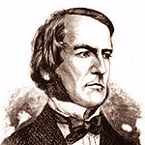
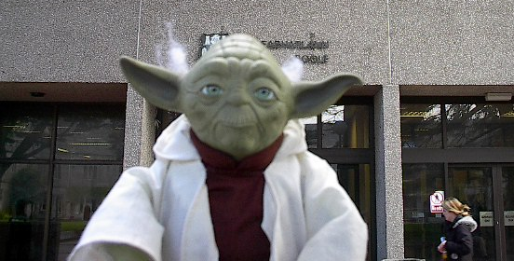
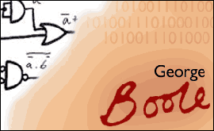
George Boole
1815-1899 : Developed the mathematical connection between Algebra and logic that underlies computing
Notes:
George Boole, one the most famous mathematicians of the 19th century.
Boole was born in 1815 to a working-class family. He was a self-taught child prodigy in both science and Latin, who couldn’t afford to attend college, yet became a professor of Mathematics (and later Dean of Science) at Queens College in Cork Ireland.
Boole’s 1854 paper, “An Investigation Into the Laws of Thought, on Which are Founded the Mathematical Theories of Logic and Probablility” detailed the relationship between algebra and logic, and and it is this study on which much of today's computer technology is based. The result is now know as Boolean logic or Boolean algebra.
Boole died on 8th December, 1864. One November day he walked to school in the pouring rain and proceeded to teach in wet clothes. As a result he contracted a chest infection which ultimately turned into pneumonia.
His condition was made worse by his wife's attempts to help him. She subscribed to the widely held view that the cure should match the cause and so while Boole took to his bed, she threw buckets of cold water over him.
Finally, here’s a rare picture of one of Boole’s most famous later disciples, on a visit to the Boole library in Cork Ireland.

Slide 4
The boolean Primitive Type
The last of the four primitive types is boolean
  (Note that there is also a Boolean wrapper class)
  The boolean type has two possible values
  boolean literals are written as true and false
    Remember, Java is case sensitive
Such literals can be used as method arguments
  card1.setVisible(false);
  myRect.setFilled(true);

Slide 5
Creating Some Cards
We can use the GImage class to represent cards
  We'll make both of these instance variables
  Use the “Ace of Spades” to initialize the first card
  Use the "Back" image for the second card
  private GImage card1 = new GImage("cards/as.gif");
  private GImage card2 = new GImage("cards/b.gif");
Exercise 2: Shoot a screen-shot of your code

Slide 6
Position and Display
In the run() method, position and display the cards
  Move card1 15 to the right and 15 down
  Set the location of card2 to the corner of card1
  Move it right by 25 and down by 10
  Add both of them to the surface of the app
  card1.move(15, 15);
  card2.setLocation(card1.getLocation());
  card2.move(25, 10);
  add(card1);
  add(card2);
Exercise 3: Compile, run
and snap a picture.

Slide 7
Responding to Mouse Events
A GraphicsProgram can "listen" for mouse events
  Then, you write a method to respond to the event
  Add these two lines to your program
  import java.awt.event.*; // at top of file
  addMouseListeners(); // at end of run()
There are several kinds of mouse events
  Clicked, Moved, Entered, Exited, Dragged, etc..

Slide 8
Express Yourself
Let's add a method to handle a mouse click
  public void mouseClicked(MouseEvent e)
  {
  }
Exercise 4: All ACM graphical objects have a setVisible(boolean) method. Passing true makes the object visible, while passing false makes it invisible. In your mouseClicked() method, make card2 invisible. Run your program, click and shoot a screen-shot.

Slide 9
boolean Variables and Methods
You create boolean variables like other variables
    boolean visible = false;
Methods can also produce boolean values
  Normally store result in a boolean variable
    visible = aLabel.isVisible();
    enabled = aButton.isEnabled();
    showing = aWindow.isShowing();

Slide 10
The boolean NOT Operator
The unary NOT symbol is the exclamation point !
  It appears in front of its boolean operand
  It produces the reverse of the expression it operates on
  boolean visible = true;
  boolean what = !visible; // false
  visible = !visible; // toggle
!
Boolean
Operand
Boolean
result

Slide 11
Express Yourself
Exercise 5: All ACM graphical objects have an isVisible() accessor method that returns true if the object is visible and false otherwise. In your mouseClicked() method, call isVisible on card2, and save the result in a boolean variable. Then use the NOT operator to pass the opposite value to card2.setVisible(). Run your program, make sure you can "toggle" the card, and shoot a screen-shot.

Slide 12
The Relational Operators
Most boolean values are produced by comparing two values using the relational operators
Six operators: <, <=, >, >=, ==, !=
  Relationship between two values? true or false
Example | Result
a < b | true if a is less than b; otherwise false
a <= b | true if a is less than or equal to b; otherwise false
a > b | true if a is greater than b; otherwise false
a >= b | true if a is greater than or equal to b; otherwise false
a == b | true if a is equal to b, otherwise false
a != b | true if a is not equal to b, otherwise false

Slide 13
Primitive Relations
You can compare most primitive numeric types, including char, but not boolean, without problem
  You don't have to worry about precision or size
<
>
Numeric
<=
Numeric
Boolean
Operand
>=
Operand
result
==
!=

Slide 14
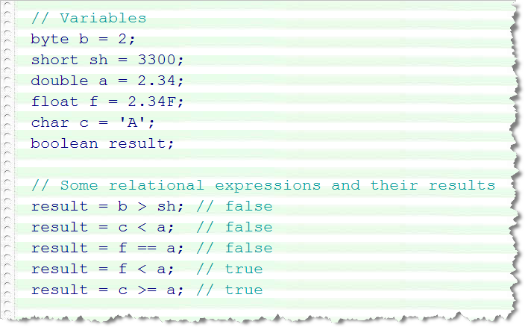
Express Yourself
Exercise 6: Here are some primitive variables along with some relational expressions. Type these variables into CodePad and then try out each of the expressions below. Shoot a screen-shot of the result
  b > sh
  c < a
  f == a
  f < a
  c > a
Variables of
several different
primitive types

Slide 15
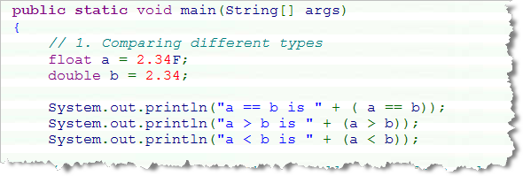
Floating-point Relations
Generally, you shouldn't use == or != with reals
Problems with mixed type comparisons
  With mixed type, 2.34 and 2.34F are NOT equal
  They have different bit patterns

Slide 16
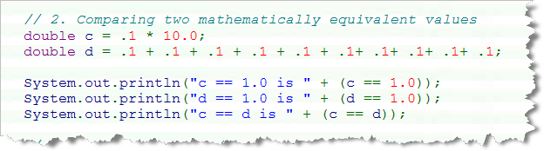
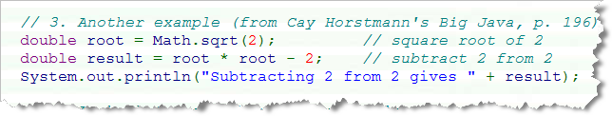
Floating Point Calculations
Even within the same type logically equivalent binary calculations may cause the results to differ
  Multiply .1 * 10.0, and then add .1 ten times
  Mathematically equivalent, but differ in Java

Slide 17
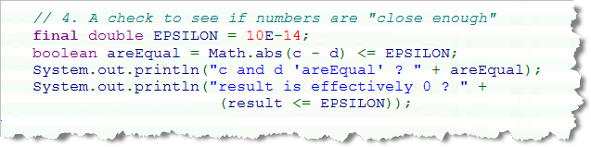
Safe Real Comparisons
There is no “one-size-fits-all” solution
  For “dollars and cents” (accurate to a penny) do this
  (int)(( a + .005) * 100) == (int)(( b + .005) * 100)
A more “general purpose” algorithm looks like this:

Slide 18
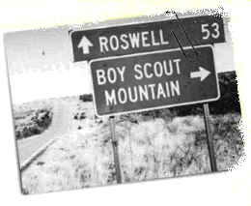
Introducing Selection
One type of Flow of Control
statement in computer programs
Selection acts as “highway divider” in your code
  Causes conditional execution of alternative code
  Also known as “branching”
  Uses boolean expressions from relational operators
  If your salary is less than $ 25,000 then
  Calculate tax based on 15% marginal rate
  otherwise
  Calculate tax based on 15% base
  and a 28% marginal rate

Slide 19
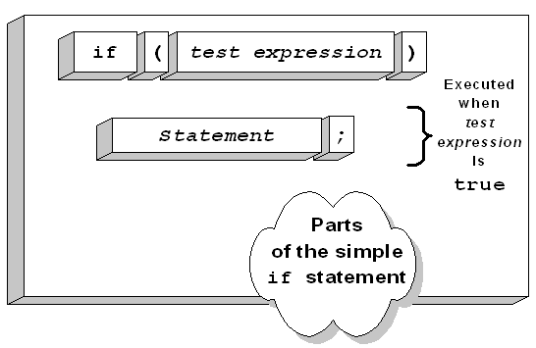
The if Statement
Like classes and methods, the if has two parts
  The header contains a boolean condition
  The body contains code to be executed
If the condition is true,
then the code in the
body is executed
If the condition is false,
the code in the body is
skipped

Slide 20
Syntax Points
The keyword if must be in lower-case
  If or IF won't work
Place a boolean expression in the parentheses
  The parentheses are required (unlike VB or Pascal)
  You can't use a numeric value like C
Don't put a semicolon after the condition
  Common error, not be caught by the compiler
  Real body always executed when this happens
The body consists of a single statement

Slide 21
A Few Fine Points About if
Many languages use the = symbol for equality
  if (x = 10) won't compile in Java
  if (ok = true) does compile, but is always incorrect
Never compare against the literals true or false
  if (ok == true) is very very poor style
Many languages use <> to mean not-equal
  if ( x <> 10 ) won't compile in Java
Use >= rather than => which doesn't compile

Slide 22
Express Yourself
Exercise 6: Let's have the card disappear only when we click on the face-down card (rather than clicking anywhere). All GObjects (like our cards) have the method contains(x, y) which returns true if the x,y coordinates are inside the object. We can get our mouse coordinates by calling the MouseEvent getX() and getY() methods. (A MouseEvent object is a parameter to mouseClicked, recall.) Modify mouseClicked so it only flips card2 when you click on the card itself. Show me your code.

Slide 23
Express Yourself
Exercise 7: Now that you know how to click on a card, let's flip it over rather than having it disappear. To do that, we'll need a boolean variable, isFaceUp. Add that as an instance variable and initialize it to false. Now, when you click on the card, check the variable, if isFaceUp is false, then use the setImage() method to using one of the card faces for card2, followed by repaint(). Be sure to set isFaceUp to true. Run and shoot a screen-shot. Show me your code.

Slide 24
Express Yourself
Exercise 8: Create a new class named Fraction. We'll use this class to look at comparing objects.
A Fraction
  has two fields, numerator and denominator
  a constructor that takes two ints
  three accessors getNumerator(), getDenominator(), and toString()

Slide 25
Object Relations
When comparing objects and Strings you can only use the == and != operators, not >, <, >=, or <=
  You should not mix different object types
  Don't compare a Button with a Label, for instance
  You can compare an Object with any object type
Object or
==
Object or
Boolean
String
!=
String
result

Slide 26
Express Yourself
Exercise 9: Here are some CodePad exercises
  Create three Fraction objects (a, b, c) : 1/2, 1/2, 1/3
  Create two Strings (s1, s2), containing "Hi Mom"
  What happens with the following comparisons:
    s1 == s2
    s1 > s2
    a == c
    a > c
    a == b
    a != s1
Shoot me a screen-shot.

Slide 27
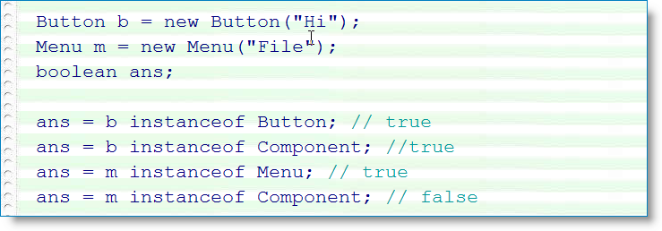
The instanceof Operator
A 7th relational operator works only with objects
  Uses keyword instanceof instead of a symbol
  true if object on left is instance of class on right
  Also if object belongs to a subclass of class on right
Exercise 10: See if s1 is an instance of Fraction, String, Object. See if a is an instance of Number, Object.

Slide 28
Simple Equality
With objects, == measures identity or simple equality
  Two variables refer to the same object or String
  Here's an example with three Fraction variables
  Fraction a = new Fraction(1, 2);
  Fraction b = new Fraction(1, 2);
  Fraction c = b;

Slide 29
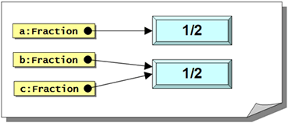
Fractions in Memory
In memory, the
Fractions and
variables look
like this
Here's what happens when we compare these:
  a == b; // false - different Fraction objects
  b == c; // true - same Fraction
  a == c; // false - different Fractions

Slide 30
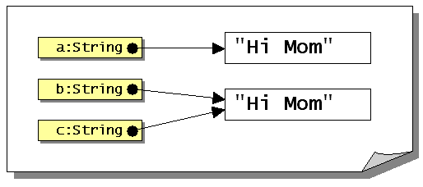
Strings Comparisons
Strings are objects; comparisons work the same way
If you look at this code:
  String a = "Hi Mom";
  String b = "Hi Mom";
  String c = b;
You'd expect to
see this in
memory:

Slide 31
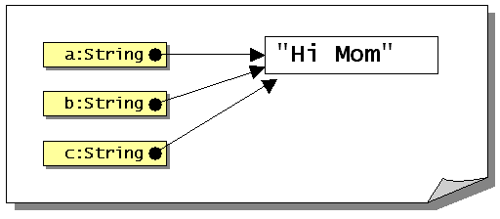
Strings in Memory
With the same boolean expressions, though:
  a == b; // true??? - Why?
  b == c; // true - same String
  a == c; // true???
The reason the Strings
are identical is because
Strings are immutable,
so memory really looks
like this:

Slide 32
Value Equality
Value equality: two objects have the same contents
  This varies on a type-by-type basis
Types that are comparable in this way will overload the Object method called equals()
Exercise 11: Try this in CodePad:
  String name = "Freddie".substring(0, 4);
  name == "Fred";
  name.equals("Fred");

Slide 33
Comparing Strings
Methods for comparing Strings
  s == s2
    Compares the addresses in the variables s and s2
    Returns true if s and s2 refer to the same string
  s.equals(s2), s.equalsIgnoreCase(s2)
    Returns true if two strings have the same contents
    Lexical, not dictionary comparison
  s.compareTo(s2)
    Compares contents of String s and the String s2.
    Returns 0 if equal, positive if s is “greater” than S2,
    negative if less

Slide 34
Express Yourself
Exercise 12: Add an equals() method to the Fraction class. This is a predicate method (that is, it will return true or false). It takes one Fraction as a parameter. It should return true if two objects have the same address, and it should also return true if two Fractions have both the same numerator and same denominator.
Exercise 13: Add a test program. Create three Fractions (1/2, 1/2, 1/3). Test your equals() method several different ways. Shoot a screen-shot.

Slide 35
What Card Was Picked?
Import file Ex10B.java from Q:, then open it.
  A GRect table with two GImage cards face down
  Want to flip over the card that was clicked
  Use getElementAt(x, y) method to get a reference to the object that was clicked.
    Save in a Object variable named picked
  int x = e.getX();
  int y = e.getY();
  Object picked = getElementAt(x, y);

Slide 36
Simple If Actions
You can compare an Object against any object type
  Compare picked to card1 using an if statement
    If true, use setImage() to "flip" the card over
  if (picked == card1)
  card1.setImage(getRandomCard());
  Repeat for the card2 variable
Exercise 14: Run and make sure you can flip each card by clicking on it. Copy and paste your code.

Slide 37
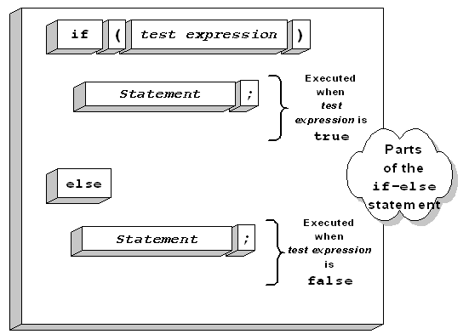
A Small Problem
Your program is misleading and not very efficient
  If you pick card1, your code still checks card2
  Not necessary because choice is mutually exclusive
Java's if has an else
portion that can be
efficiently used for
such either/or
conditions
Exercise 15: Modify to use else-if. Snap a picture of your code

Slide 38
Blocks and Indentation
Most of the time, you need to carry out several actions inside the body of an if statement, not just one
To do this, surround the body with braces (a "block")
  if ( amountSold <= 35000)
  {
  bonusPct = .035;
  bonusAmt = amountSold * bonusPct;
  }
Indent the code inside the block by one tab stop

Slide 39
Why Use Braces?
Braces are not required for a single-line if statement
Still a good idea, even when not required
  Helps avoid mistakes when modifying code
  if (amountSold <= 35000)
  bonusPct = .035;
  else
  bonusPct = .075;
  bonusAmount += amtSold * BonusPct;
  if (amountSold <= 35000)
  bonusPct = .035;
  else
  bonusPct = .075;
  bonusAmount += 100;
  bonusAmount += amtSold * BonusPct;

Slide 40
The Phantom Semicolon
Common mistake: a semicolon after the condition
  if (filesAreAllBackedUp);
  {
  formatTheHardDrive();
  }
Because of the semicolon, this fragment of code says:
  1. Check to see if files are backed up
  2. If they are, don't do anything (the null statement)
  3. Format the hard-drive regardless of the backup

Slide 41
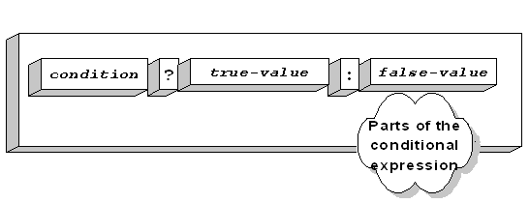
The Selection Operator
You can't use if-else in a formula
  An if is a statement, not an expression
  Means you often need an additional variable
Selection operator is like if-else as an expression
  AKA the ternary, tertiary or conditional operator
  Works similar to the =IF() function in Excel

Slide 42
Conditional Operator Syntax
The first operand must be a boolean condition
  Followed by a ?
The true and false parts are separated by a colon
  Both parts must be compatible types
  int value = (amt > 0) ? 10 : 30; // OK integers
  int value = (amt > 0) ? 10 : "Hi"; // No, different types
Can "nest", but quickly becomes unreadable

Slide 43
The Cigar Party
Log into your JavaBat account
  In the Logic problems, locate Cigar Party
Exercise 16: Spend 5 minutes using if and else to try and solve the Cigar Party problem shown here.
  When squirrels get together for a party, they like to have cigars. A squirrel party is successful when the number of cigars is between 40 and 60, inclusive. Unless it is the weekend, in which case there is no upper bound on the number of cigars. Return true if the party with the given values is successful, or false otherwise.
Snap a picture of your best run

Slide 44
Finish Up
In-class exercise: submit before you leave today!
  Drop into Q:\faculty5\sgilbert\cs170\submissions
Read Chapter 5
  Start working on homework problems
  Chapter 5 quiz next Tuesday
We'll probably start Chapter 6 on Monday.

