Slide 1

Java Programming 1
Lecture 11
More Selection
Nested If Statements
The Switch and Selection Operators
Boolean Operators and Enumerated Types

Slide 2


Logical Operators
Many times, you need to test several values at once
  Check if an input falls between 1 and 100, for instance
Java's logical operators can to combine several tests
  Logical operators work on boolean values
One unary logical operator: NOT (!)
Five binary logical operators
  Two versions of AND (&&, &)
  Two versions of OR (||, |)
  One exclusive OR (^)

Slide 3
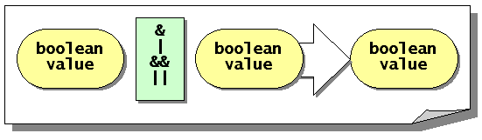
The Binary Logical Operators
Two versions of AND, two versions of OR
  Each requires two boolean operands
  Each produces a boolean result

Slide 4
The AND Operators
The symbol used by Java for AND is && or &
Corresponds to normal use of word "and"
  Both conditions must be true for a true result
  If either condition (or both) is false, result is false
  if ( units >= 123 && GPA >= 1.5)
  youGraduate();

Slide 5
The OR Operators
The symbol used by Java for inclusive OR is || or |
Corresponds to natural understanding of OR
  If any condition is true, the result is true
  Both conditions must be false for a false result
  if ( quiz > 75 || homework > 95 )
  finalGrade = 'B';
The logical exclusive OR operator (^) is rarely used
  If exactly one condition is true, the result is true

Slide 6
Express Yourself
Use OpenOffice Writer to create a new document
Save the file as LastFirst_ic11
  Replace LastFirst with your actual name
Put your name and today's date at the top of the sheet
Title it "CS 170 In-class Exercise 11"
Exercise 1: Log into Javabat and then use the logical operators to complete the Cigar Party problem and snap a picture of your best run.

Slide 7

The Impossible Condition
When no combination of operands could ever be true
  "Give a 25% discount to children who are under 13
  and to patrons who are 65 and older"
A "literal" reading results in code like this:
  if ( age < 13 && age > 65 )
  discount = .25;
  else
  discount = 0;
No possible value for age where this could be true

Slide 8
The Unavoidable Condition
When no conceivable condition could ever be false
  "If the patron's age is greater than 12 or less than 66, charge 8.75 for the ticket. Everyone else pays 5.75."
A "literal" translation results in code like this:
  if (age > 12 || age < 66)
  ticketPrice = 8.75;
  else
  ticketPrice = 5.75;
For every possible value of age, the condition is true

Slide 9
Solutions
Both conditions caused by confusing AND and OR
First example
should look like
this:
Second example
should look like
this:
if ( age < 13 || age > 65 )
discount = .25;
else
discount = 0;
if ( age > 12 && age < 66 )
ticketPrice = 8.75;
else
ticketPrice = 5.75;

Slide 10
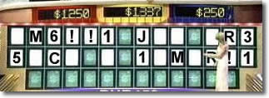
How Much to Evaluate?
Sometimes, you "know" the answer to an expression without evaluating the entire thing.
  Wheel of Fortune when the answer is obvious
  No? How about this: what is the value of 0 * x?
  You know the value is 0, whatever value x has
Expressions using logical operators are similar
  The value of 2 + 2 == 5 && a > b is false
  The values stored in a and b are irrelevant

Slide 11
Short-circuit Evaluation
When using the || and && operators, Java stops evaluating once it can determine the result
This is called short-circuit or lazy evaluation
  The expression is evaluated from left to right
  Evaluation stops when the result is assured
For && stops when a false value is encountered
For || stops when a true value is encountered
| and & evaluate both sides regardless

Slide 12
Short-circuit Examples
When should you use short-circuit and when should you use the “full-evaluation” operators?
  Most of the time, you’ll use the short-circuit operators
  Here are some examples
  if ( (a != 0) && ( b / a > 12 )) // OK
  if ( (a != 0) & ( b/a > 12)) // NOT OK
  if ( (a > 10) || (b++ > 7)) // Problem?
  if ( (a > 10) | (b++ > 7)) // OK

Slide 13
Precedence
Relational operators appear below arithmetic operators
  isTrue = a > 3 + 5; // OK, parens not required
Logical operators appear below relational operators
  isTrue = a > 3 || a < 1; // parens not required
Logical AND is higher than logical OR
  isTrue = 10 < 15 || 5 > 8 && 3 > 5;

Slide 14
Simpler Boolean Expressions
Tell me what this means:
  "It's not true that some people won't be confused by logical expressions with NOT operators applied to AND and OR expressions."
This is true: we often have a hard time deciphering AND and OR expressions, especially with NOT
  Sometimes, rearranging terms can make things clearer
Best way to write correct boolean expressions is to write simpler boolean expressions

Slide 15
Expressions Using NOT
NOT reverses the sense of any boolean expression
  Not always the clearest way to write the code
  boolean overtime = hours > 40;
  boolean straightTime = ! (hours > 40);
Most of us have to think about this to understand it:
  "If hours > 40 is true, (overtime), then NOT hours
  greater than 40 is false, so straightTime is false.
  If hours greater than 40 is false, (no overtime), then
  NOT false is true, so straightTime is true."

Slide 16
Alternatives to NOT
Most of us find this way of writing the example clearer:
  boolean straightTime = hours <= 40;
Relational operators let you avoid NOT like this
NOT Expression | Equivalent
! (a == b) | a != b
! (a > b) | a <= b
! (a < b) | a >= b
! (a <= b) | a > b
! (a >= b) | a < b

Slide 17
NOT, AND, and OR
NOT becomes even more complex when combined with the other logical operators, AND and OR
  Test for those who can legally drink but
  who don't yet qualify for Social Security
  if (age >= 21 && age < 65) ...
  Now consider its negation
  if ( ! (age >= 21 && age < 65) ) ...
  Again, most of us have to think about it

Slide 18
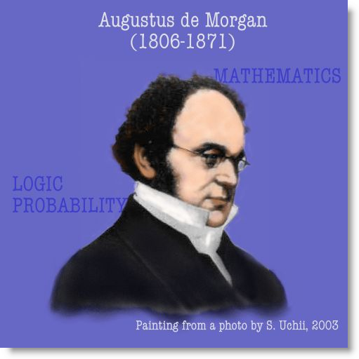
De Morgan's Law
Designed to simplify these kinds of expressions
  ! (A && B) is equivalent to !A || !B
  ! (A || B) is equivalent to !A && !B
Convert our previous example like this:
  if ( ! (age >= 21) || ! (age < 65) ) ...
  then, using alternatives to NOT, we get
  if ( age < 21 || age >= 65 ) ...

Slide 19
Express Yourself
Exercise 2: Simplify these Boolean expressions
  ! (x > 0 && y > 0)
  !(x != 0 || y != 0)
  !(country.equals("US") &&
  !state.equals("HI") &&
  !state.equals("AK"))
  !(x%4 != 0 ||
  !(x %100 == 0 &&
  x % 400 == 0))

Slide 20
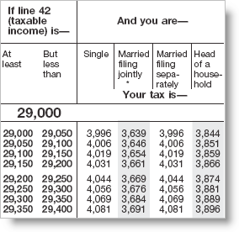
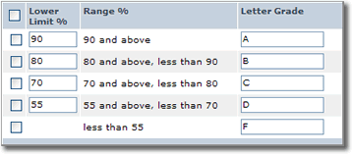

Multi-Way Branching
Many problems involve branching statements with more than just the two alternatives handled by if-else
  Calculating grades based on a numeric score
  Income taxes based on filing status and income
  Writing menu-type code based on a user selection
Three different techniques
  Sequential if statements: related comparisons
  Nested if statements: levels of decision making
  The switch statement: “numbered” branches

Slide 21
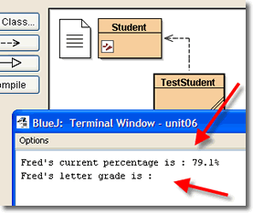
Student and TestStudent
Exercise 3: Download ic11.zip and open using Open Non-BlueJ. Compile and run TestStudent. Shoot a screen-shot. We'll explore different ways to solve.
  Assign letter grades based on numeric scores
Note Student is finished except for this part

Slide 22
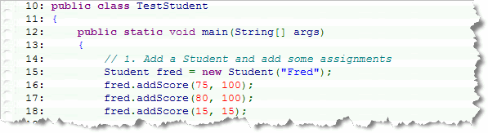
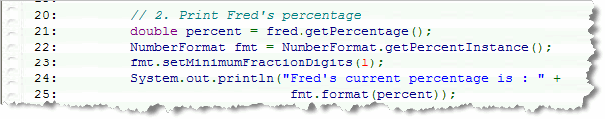
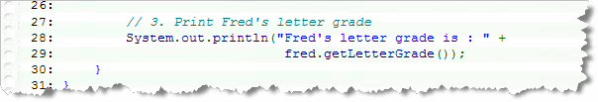
Inside TestStudent
TestStudent creates a Student and adds some tests
Then getPercentage() is used to return current score
Finally, getLetterGrade() prints letter grade

Slide 23
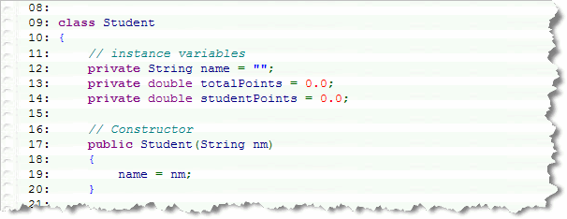
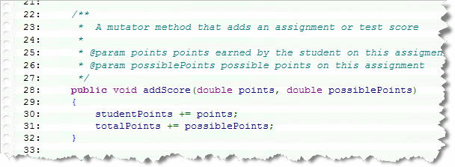
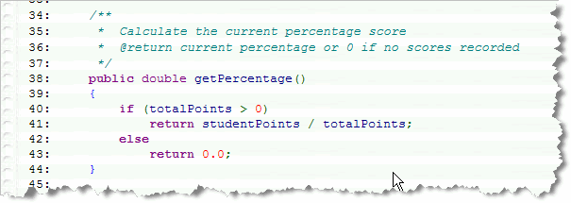
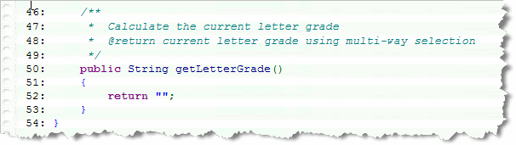
Inside Student
Fields name, totalPoints, studentPoints
Mutator addScore() modifies student and total points
Accessor getPercentage() calculates numeric grade
Accessor getLetterGrade() is incomplete

Slide 24
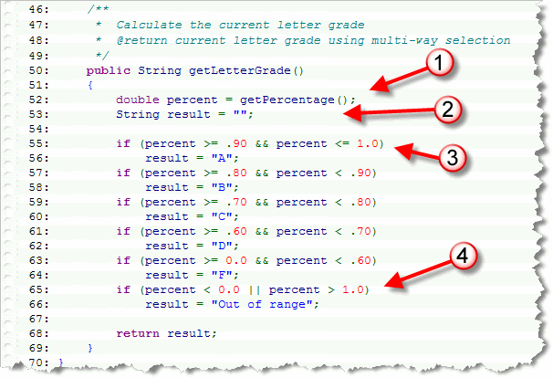
Independent if Statements

Slide 25
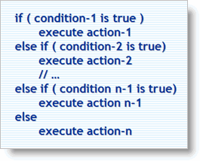
Multiple Selection
Independent ifs, but interdependent conditions
  Inefficient: all six conditions are tested each time
Better: “Multiple Selection Algorithmic Pattern”
  “Pattern” is a recipe for
  solving a particular
  category of problem
  AKA as “ladder-style”
  if-else statements
Pitfall: order is significant

Slide 26
Express Yourself
Exercise 4: Multiple-selection pattern
  Modify getLetterGrade() to use this pattern
  Shoot a screen shot of your method
Questions to ask
  What range do you start with?
  When and how do you handle "out of range" values
  like those less than 0.0 or over 100.00?

Slide 27

Nested if Statements
Can also combine Boolean expressions with nesting
  One if statement embedded inside the body of another
  if (x > 0)
  {
  if (y <= 0)
  quadrant = SIRIUS;
  else
  quadrant = OMEGA;
  }
  The nested if can appear in the
  else part as well
A nested
if statement

Slide 28
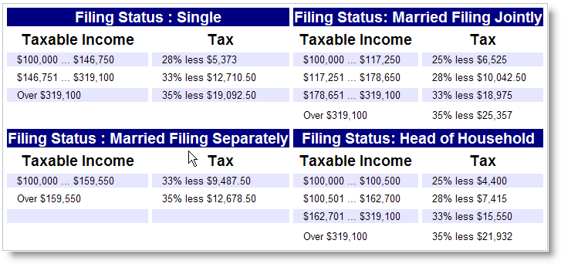
Using Nested if Statements
Use nested ifs when you have levels of decisions
  Calculating income tax, for instance
  First decide on filing status, then decide on income

Slide 29
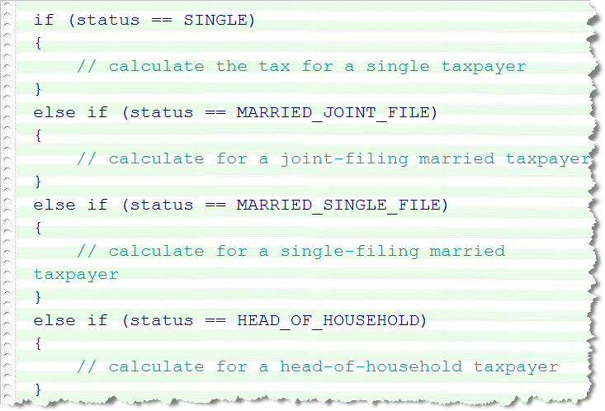
Filing Status
Use sequential ifs to determine filing status

Slide 30
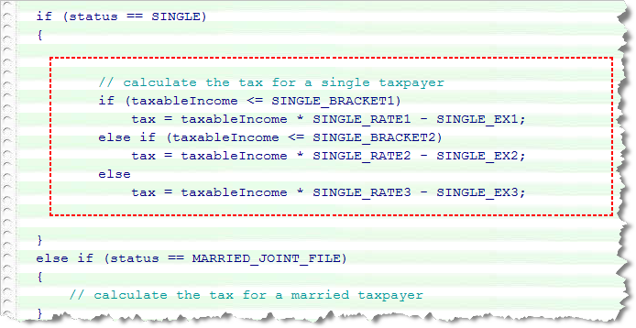
Calculating Tax
Use nested sequential ifs to calculate the tax
Exercise 5: Modify getLetterGrade() to use nested ifs. Which parts are leveled and which sequential? Shoot a picture of your code.

Slide 31
The Dangling else
Nested if-else statements cause problems if every
if statement doesn't have a corresponding else
  This is called the "dangling else" as shown here
    if ( age > 12 )
    if ( age > 64 )
    print(“You get the Senior discount.”);
    else
    print(“You get in free.”); // false
The else gets attached to the closest unmatched if
  You can use braces to fix this or add another else

Slide 32
Menu-Style Code
With ladder-style if-else-if, you might sometimes find yourself writing “menu-style” code that looks like this:
  int choice = getUserChoice();
  if ( choice == 1 ) ...
  else if (choice == 2) ...
  else if (choice == 3) ...
  else ...
  Notice that each condition is testing the same variable
  Each test is made against a literal expression
Java has a more efficient way to do this: the switch

Slide 33

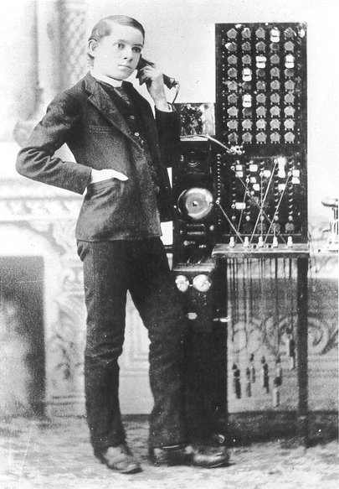
What is the switch?
A selection statement based on integer evaluation
  Named after the switches
  used by the phone company
  Dial a number and get
  connected to your party
  Think also, of a menu or
  vending machine

Slide 34
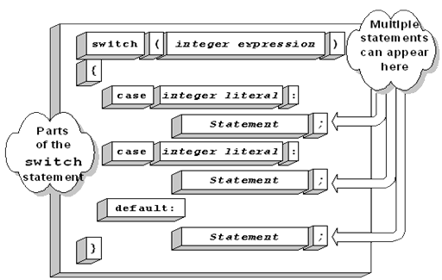
Parts of the switch
The parts of a switch statement are
  The test condition or
  switch selector
  A body surrounded
  by braces (required)
  A set of labeled code
  fragments called
  case blocks
  A "flow-of-control"
  statement called break

Slide 35
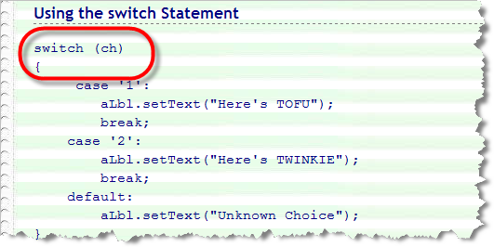
The switch Selector
The switch selector can be most integer expressions
  Includes int, short, byte, and char
  Can't use boolean, long, float, double, or String
  Placed in parentheses following keyword switch

Slide 36
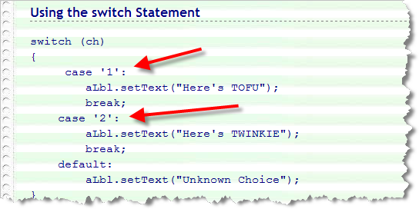
The Case Block
Each case block begins with the keyword case
  Followed by an integer constant and a colon
  Called the case label
  Literals or static final constants; no variables, ranges

Slide 37
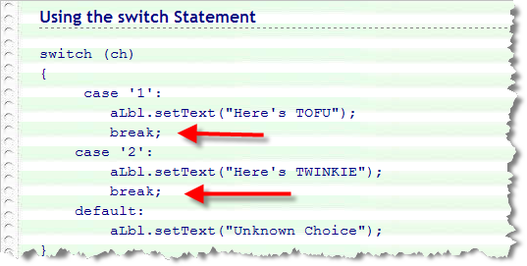
How the switch Works
When a case label matches the switch selector
  Java "jumps" to the code immediately following label
Continues executing all the remaining code
  This is called "fall through"
  Usually put a break statement at end of every case

Slide 38
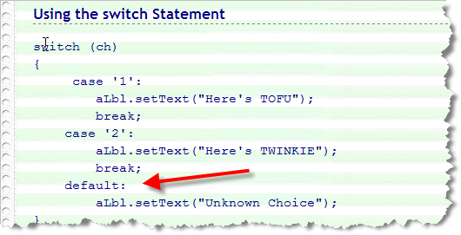
The default Case
If the switch selector doesn't match any case?
  Jump to code past switch or provide a default case
  Use keyword default followed by a colon

Slide 39
Express Yourself
Exercise 6: Using the switch. As you learned, you can only use an integer as a switch selector, not a double. However, you can use casting to turn the grade percentage into an appropriate integer which you can use as a switch selector.
  Modify getLetterGrade() to use this pattern
  Shoot a screen shot of your method

Slide 40
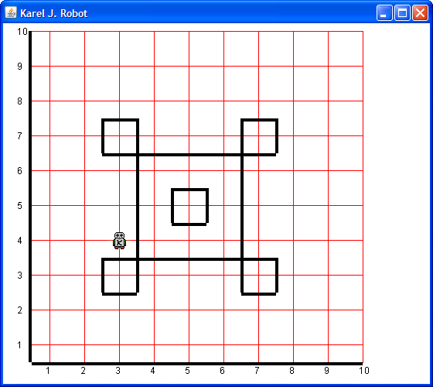
Karel Returns
When we last saw Karel, he was busy working as a security guard, patrolling the castle at Disneyland
Exercise 7: Create a PatrolTheCastle object on the workbench and call it's task
method. Snap a picture when
Karel is finished working.
So, how does Karel's boss
know that he just didn't come
to work and fall asleep?

Slide 41
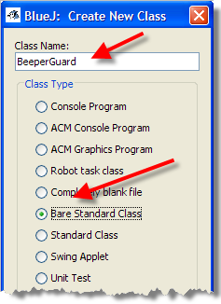
The BeeperGuard
We created a specialized version of OCRobot named CastleGuard using inheritance. Let's create a new version that drops a beeper each time it moves. That way the boss can check up on him.
Exercise 8: add a new Bare
Standard Class to your project,
and name it BeeperGuard. Then,
open the file in your editor.

Slide 42
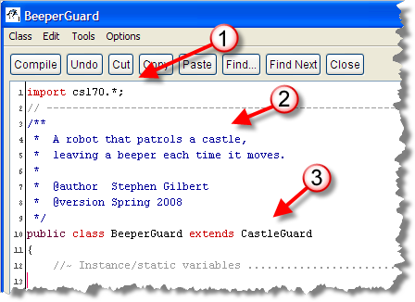
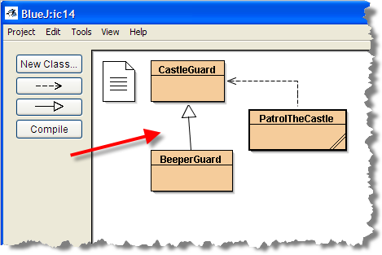
Setting Up BeeperGuard
Add these changes to BeeperGuard and compile:
  import cs170.*;
  on line 1
  extends CastleGuard
  on the header line
  Add a comment and
  your name at the
  top of the class
Note that BeeperGuard
is now a specialized kind
of a CastleGuard

Slide 43
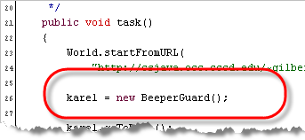
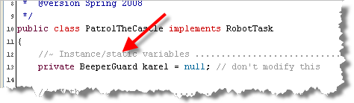
Setting Up the Task
Add these changes to PatrolTheCastle
  Change CastleGuard variable to BeeperGuard
  Initialize karel using the BeeperGuard() constructor
Exercise 9: create a PatrolTheCastle, call task()

Slide 44
Dropping Beepers
The BeeperGuard already knows how to move, but we want to extend its existing behavior. To do that, we have to override the move() method like this:
  public void move()
  {
  putBeeper();
  super.move();
  }
We call the "parent's" move() by using super
Exercise 10: Add the new move() method, create a task and patrol the castle. Shoot a screen-shot.

Slide 45
What's Wrong?
The BeeperGuard has no beepers in its bag
  Give it some beepers by adding a constructor
  public BeeperGuard(int st, int ave,
  Direction facing, int beepers )
  {
  super(st, ave, facing, beepers);
  }
Doesn't compile, since CastleGuard has no constructor either. Copy same constructor to CastleGuard (change name) and compile.

Slide 46
Starting Work
Now Karel can "teleport" to work. No need for the goToWork() method. Comment out the method from CastleGuard, comment out the method call from PatrolTheCastle, and create karel like this:
  karel = new BeeperGuard(4, 3, North, infinity);
Exercise 11: patrol the castle and shoot a picture.
What happens if Karel goes around twice?

Slide 47
Decisions and Karel
Karel comes equipped with many decision-making methods that we can use without any additional work.
boolean frontIsClear(); // alone on corner?
boolean nextToABeeper(); // with a beeper?
boolean nextToARobot(); // with a robot?
boolean facingNorth(); // or West, East, etc.
boolean anyBeepersInBeeperBag();
boolean running();

Slide 48
Cleaning Up
Let's change Karel so that he picks up a beeper if one is sitting on a corner, and drops one if it's empty:
  public void move()
  {
  if (nextToABeeper()) pickBeeper();
  else putBeeper();
  super.move();
  }
Exercise 12: change the world to castle2, patrol the castle and shoot a picture.

Slide 49
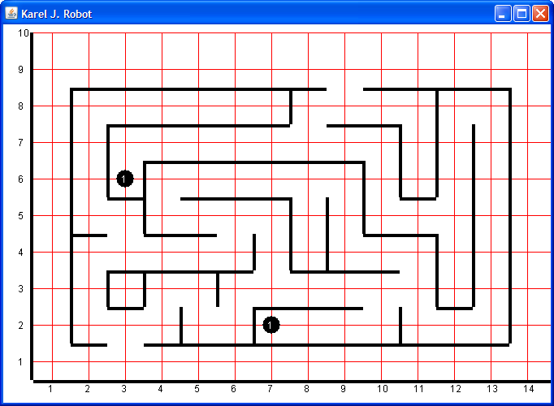
Express Yourself
Create a Robot to walk the fixed maze shown here:
  MazeWalker extends OCRobot, add any methods
  Make sure you enter at 1,3 and leave at 9,9
  Walk entire maze,
  pick up beepers
  where you
  find them
  Change URL to
  "lab02h.php" and
  run again to make
  sure you get all
  beepers.

Slide 50
Finish Up
In-class exercise: submit before you leave today!
  Drop into Q:\faculty5\sgilbert\cs170\submissions
Start reading Chapter 6
Find homework assignments on Links page

