Slide 1
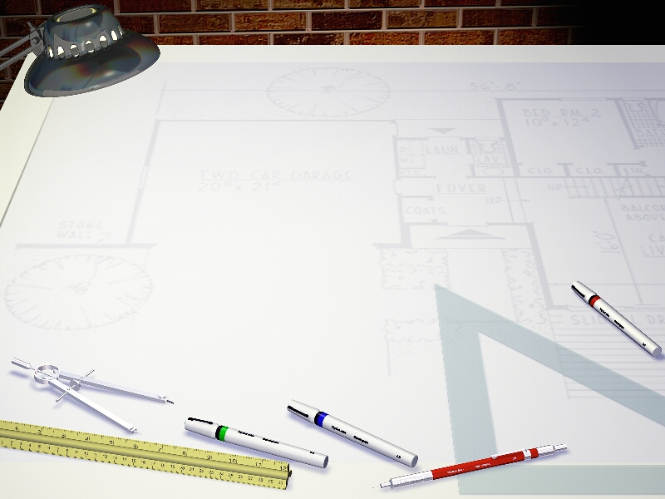
Java Programming 1
Lecture 12
Eclipse and Loops
A Professional
Integrated Development Environment
Introducing Iteration

Slide 2

Express Yourself
Use OpenOffice Writer to create a new document
Save the file as LastFirst_ic12
  Replace LastFirst with your actual name
Put your name and today's date at the top of the sheet
Title it "CS 170 In-class Exercise 12"
Exercise 1: As we start working with Eclipse, you'll learn how to create several different kinds of programs. I've bundled these into a folder (Week5) on the Q: drive. Copy this folder to your cs170 home folder. Shoot a screen-shot in Windows Explorer.

Slide 3

What is Eclipse?
A full-featured professional development environment
  Originally developed by IBM, now open-source
  Platform and framework: plug-ins for different features
  Written in Java, so it runs on Unix, Mac and the PC
  Free and open-source so you can modify it
  Editor, compiler, debugger and many different features
Exercise 2: Start Eclipse
from the Programming folder
on the desktop. Shoot a
screen-shot of the window.

Slide 4
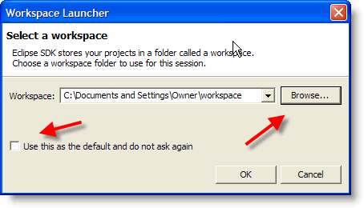
The Workspace
The Eclipse workspace contains your files, projects, IDE customizations and preferences
  Default lab workspace configuration is U:\eclipse
  At home, though, you'll see this dialog at first

Slide 5
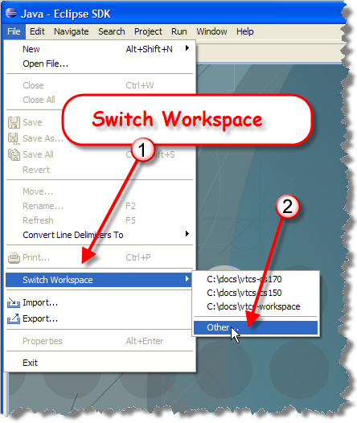
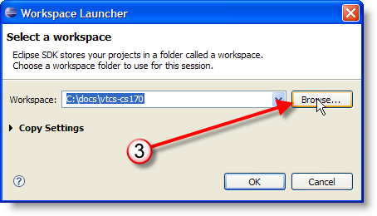
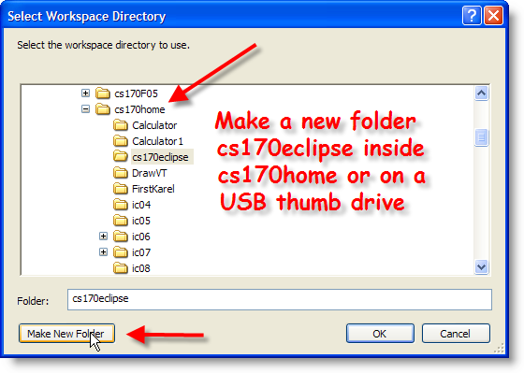
Switch Workspaces
Switch workspaces with File->Switch Workspace
  Can put on a “thumb drive” and carry around with you

Slide 6
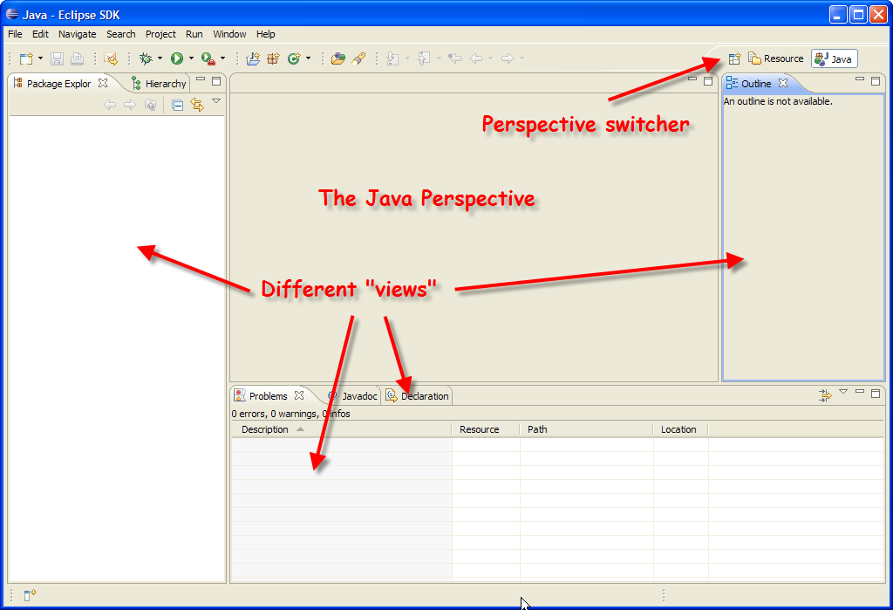
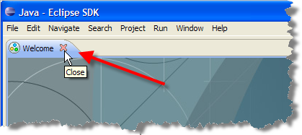
The Java Perspective
Close the Welcome screen (first item on Help menu)

Slide 7
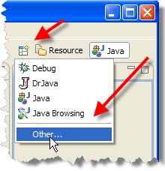
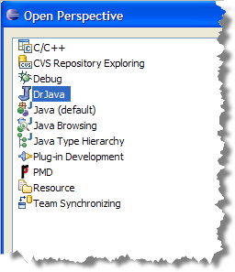
Perspectives
Combination of windows and layout devoted to a specific task is called a perspective
Exercise 3: click Open Perspective
button, choose Other from drop-down.
Choose Resource and then Dr. Java.
Shoot a screen-shot of each.
Switch back to Java perspective.

Slide 8
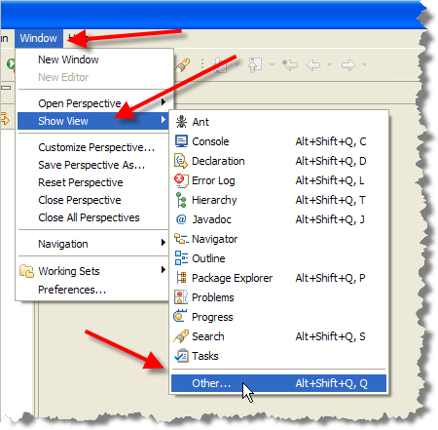
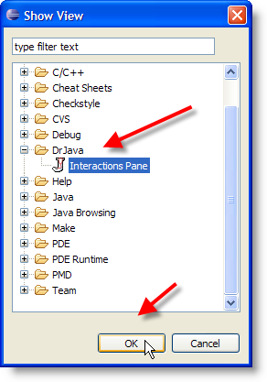
Views
Individual windows in a perspective are called views. You can add or remove a view from any perspective.

Slide 9
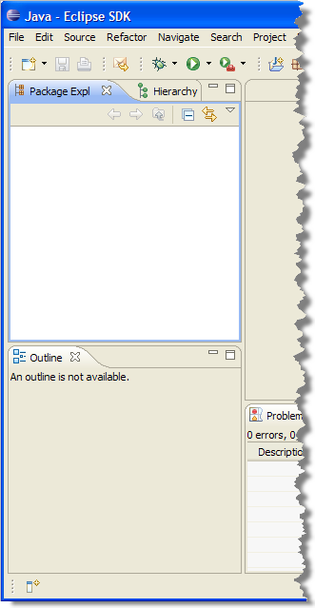
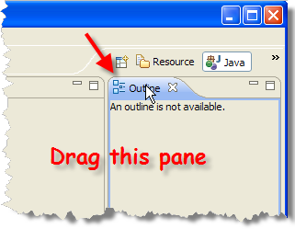
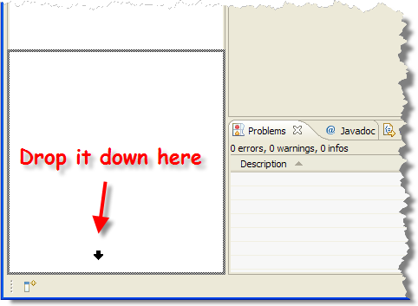
Arranging Views
You can also move, float and dock individual views

Slide 10
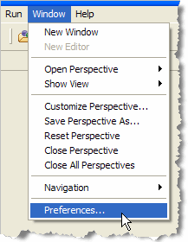
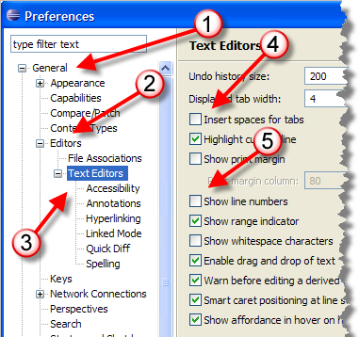
The Preferences Dialog
Most options are accessed by choosing Preferences from the Window menu. Start with General

Slide 11
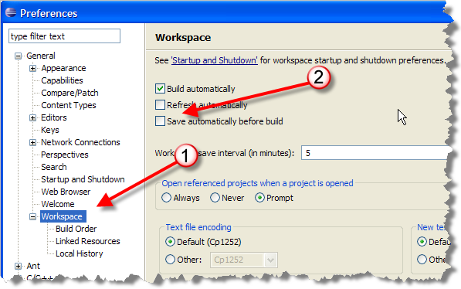
Workspace Preferences
Set workspace to Save automatically before build so you can just run your programs without saving

Slide 12
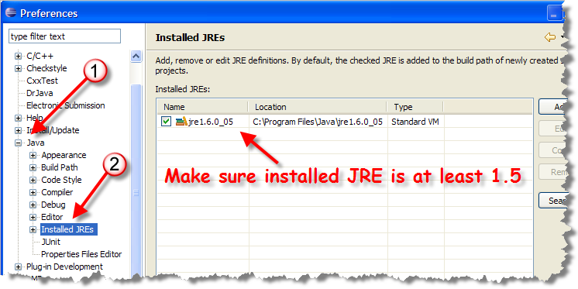
Installed JRE
Check JRE (used to run Eclipse). Need at least 1.5

Slide 13
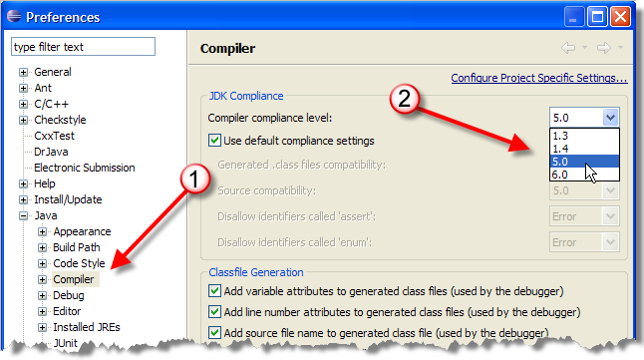
Compiler Conformance
Used for generated code. Set to 5.0 for compatibility.

Slide 14
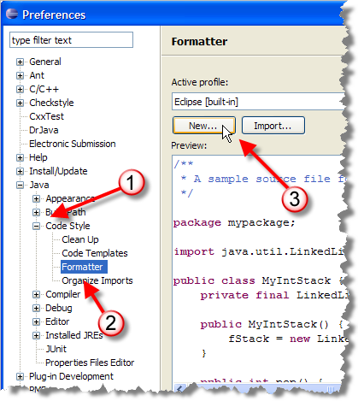
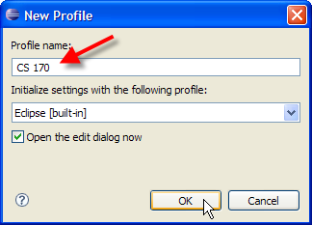
Code Formatting
Eclipse will automatically format your code for you
  Built-in styles are different than class or text
Create a formatting profile
for CS 170
  Choose Formatter
  under Code Style
  Click New
  Name the profile CS 170

Slide 15
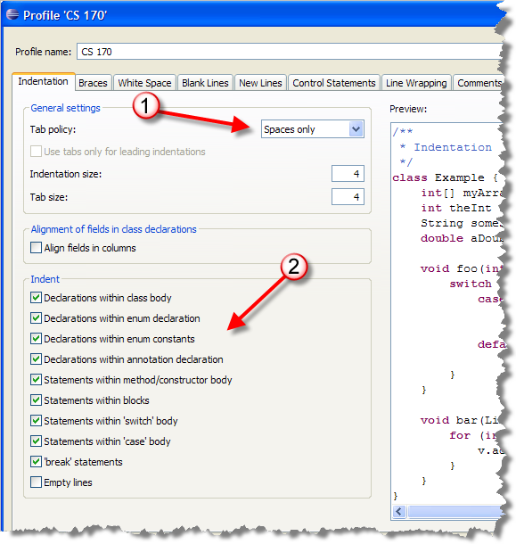
Indentation
Indentation
  Spaces only
  Select all
  checkboxes

Slide 16
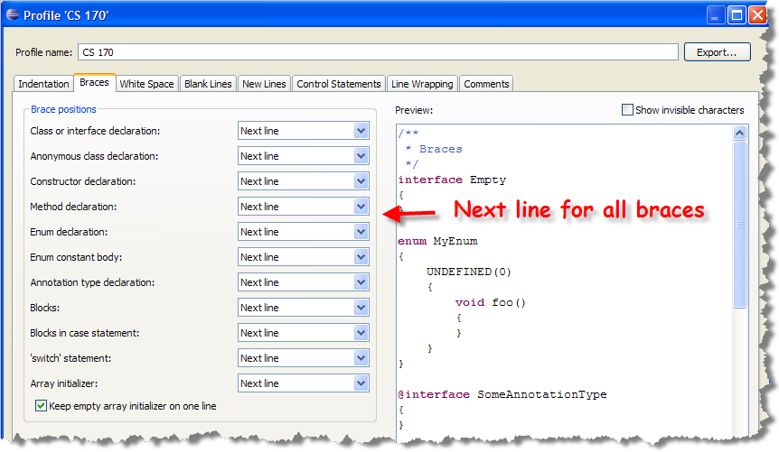
Braces
Set all braces to appear on next line like this:

Slide 17
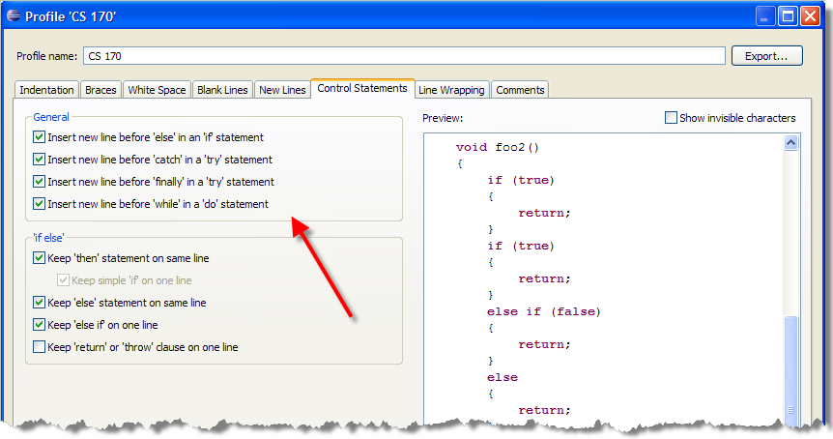
Control Statements
Configure line breaks with control statements like this:
Exercise 4: Snap pics of
of the Indentation, Braces
and Control Statements
preferences pages.

Slide 18
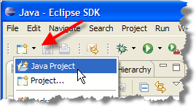
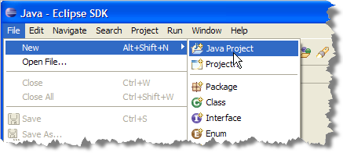
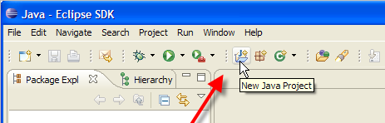
Working with Existing Code
How do you use Eclipse to work with existing code?
  We'll see by opening some code from Chapter 6
Click New Java Project icon or from File menu
  Must be in Java Perspective

Slide 19
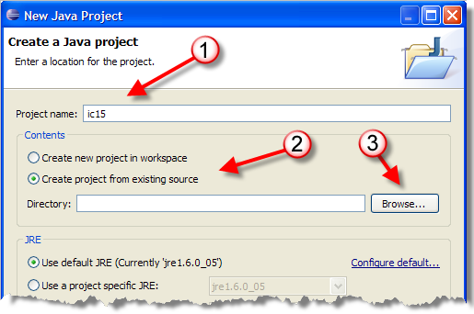
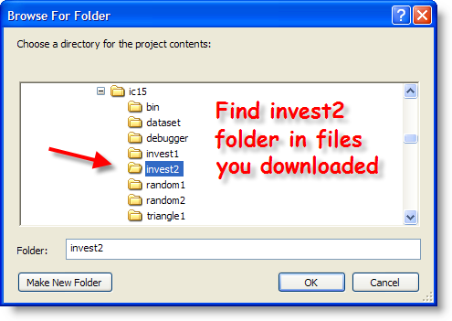
Creating a Project
Name ic12, Create from existing source, Browse
  Find invest2 folder, select and then click Finish

Slide 20
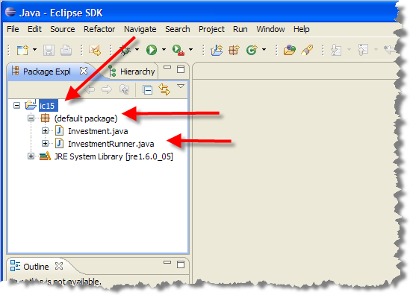
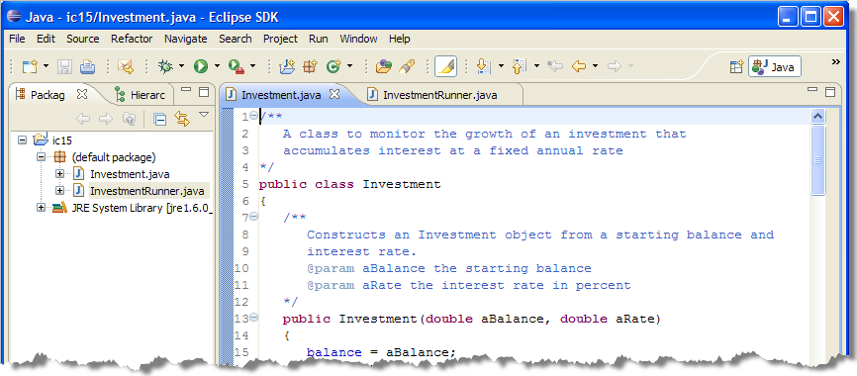
Package Explorer and Editor
Files appear in Package Explorer window
  Open default package and double-click source files

Slide 21
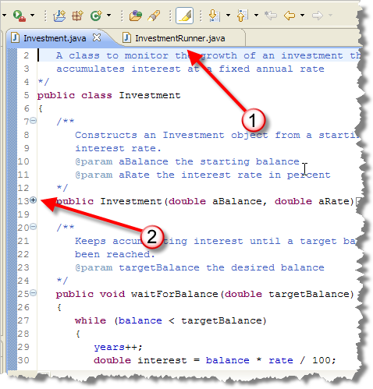
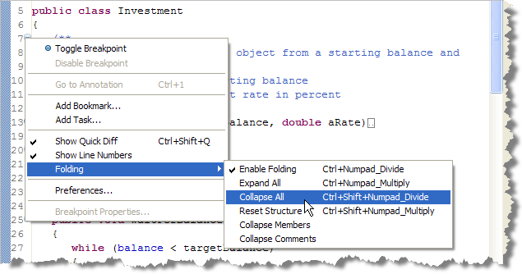
Editor Features
Tabbed windows
Code folding
Exercise 5: Collapse All
in Investment.java and
snap a pic. Then restore.

Slide 22
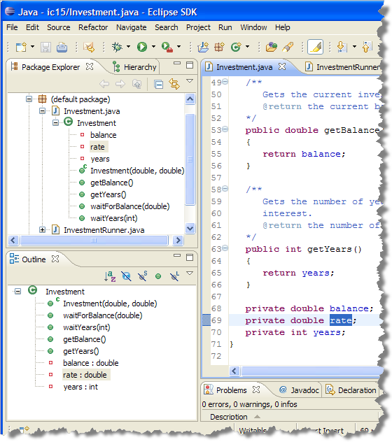
Outline Views
Format the
code in both
files using
Source menu
Two outline
views allow
you to quickly
navigate to
methods,
or fields

Slide 23
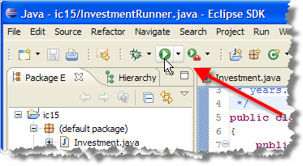
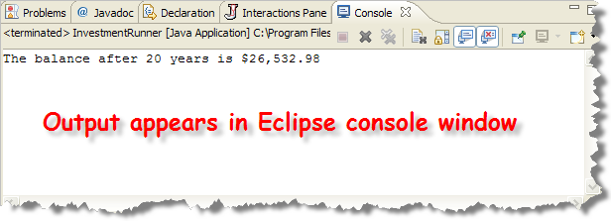
Running Your Program
Use Run button
menu on active
editing window,
or right-click file
in Project Explorer,
choose Run As…
Exercise 6: Run the program
and snap a pic. What happens
if you try to run Investment.java?
Notes:
Running Your Program
You can run your program in several different ways, as shown here:
You can run the file currently active in the editing window by dropping down the Run menu and choosing the appropriate run method. If your program is an application you'll be given the choice to run it as an application, if it is an applet, you'll be given that selection as well.
You can run any program in the Project Explorer, (not just the active program), by selecting the file, right clicking, and choosing Run As from the context menu.
Eclipse tries to "understand" your code, and will give you the options that seem "possible". In this case we're offered the option of running as a Java application (which is appropriate), and as an SWT app, which isn't. It's up to you to know how your program should be run.
What happens when you run your program depends on what kind of program it is. If its an applet, Eclipse automatically launches the Appletviewer; you don't have to create an HTML file. If it's a console-mode program, Eclipse launches its internal console application (much like SciTE) and runs your program from inside the IDE, as shown here:

Slide 24
Eclipse Features
Other features of Eclipse we'll use
  Syntax errors caught as you type
    Kind of like auto-spell-check in your word processor
  Code is automatically compiled when saved
  Don't have to remember packages to import
    The Quick-Fix feature helps you fix problems
  Content-Assistant helps you write code
  Wizards walk you through common tasks
  Code is automatically formatted
I'll introduce these as we go through the semester

Slide 25
Working at Home
You can install the version that we use in the labs
  Customized by same folks who created Web-Cat
  Windows-only, installs C++ features also
  Grab the installer from the Q: drive, downloads
Non-Windows, or latest version of Eclipse
  Download from http://www.eclipse.org
  Choose Java IDE for Java (or Eclipse classic)
  Between 80 and 150 MB
Unzip on your local machine (no install)
Create a shortcut to the executable

Slide 26

Introducing Loops

Slide 27
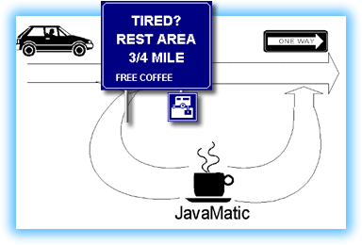
What Is Iteration?
A CS term that means repeating a set of actions
  Also called repetition or looping
  Statements used in iteration are called loops
Loops are flow-of-control statements similar to if
  Like the if statement, a
  loop evaluates a condition
  If the condition is true,
  a group of actions are
  performed
  If the condition is false,
  the actions are skipped

Slide 28
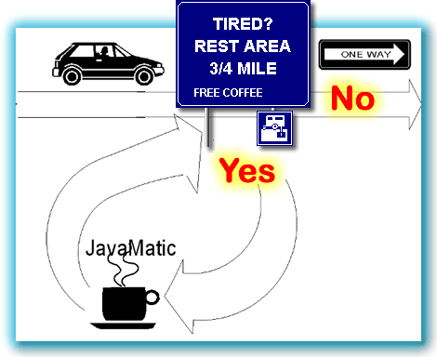
Iteration and Selection
Iteration is not the same as selection, however
A loop returns to its test
after performing its actions
If the test is still true,
then the actions are
performed again
A selection statement only
performs its actions once
You cannot replace a loop with a selection statement

Slide 29
Java and Iteration
Java has three loops: while, do-while, and for
  Each designed to work best in a particular situation
One difference is where the test is made
Test at the bottom
Test at the top
{
// Loop Body
}
{
// Loop Body
}
Loop Test
Loop Test

Slide 30
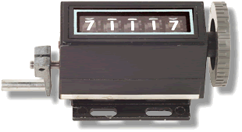

Loop Classification
Where tested is not the best method of classification
  Doesn't provide any empirical guidance
  Better to ask how each loop is controlled
Two basic methods of loop control
  Simplest method relies on a counter
    Called counting or counted loops
    "Repeat these actions 10 times"
  More complex loops test the
  occurrence of a particular event,
  or combination of events.
    These are called indefinite or
    indeterminate loops

Slide 31
Counted Loops
A counted loop is simplest kind of loop
  The loop bounds is controlled by a counter
  Use it to for "perform this action 10 times"
Java's for loop specializes in this
  for (int count = 0; count < 10; count++)
  {
  System.out.println(“count=”+count);
  }

Slide 32
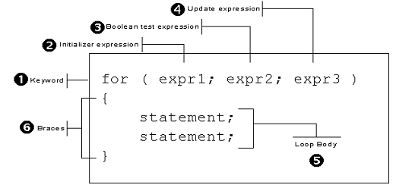
The for Loop Syntax
The for loop has both a header and body (like if)
Header has 3 expressions: initialize, test, and update

Slide 33
Initialization Expression
The initialization expression
  Executed once, before the loop is entered
  Always executed, regardless of the test
  Usually used to declare your counter variable
  for (int counter = 0; … ; … )
  {
  // Can use counter here
  }
  // Cannot use counter here

Slide 34
The Test Expression
Works just like the test in an if statement
  If true, loop body is entered. If false, it is not.
  Always evaluated at least once
  Also ends with a semicolon (like initialization)
  for (int counter = 0; counter < 10; … )
  {
  // Can use counter here
  }
  // Cannot use counter here

Slide 35
The Update Expression
Executed after the body of the loop is finished
  Always executed one fewer times than test
  Usually used to update your counter
  Not followed by a semicolon
  for (int counter = 0; counter < 10; counter++)
  {
  // Can use counter here
  }
  // Cannot use counter here

Slide 36
Investment.java
Calculates investment value over n years (or number of years to reach a particular value).
  Can't just multiply (or divide) by percentage
  Invest $ 1,000 @ 10% APR, compounded annually
  First year you earn $100 (10% of $1,000)
  Next year you earn $110 (10% of $1,100)
Investment class
  Fields: balance, rate, years
  Constructor: initializes all fields
  Accessors: getBalance() and getYears()

Slide 37
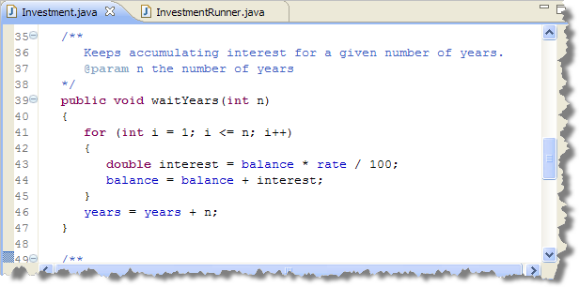
The Future Value
Using a for loop to calculate the value after n years

Slide 38
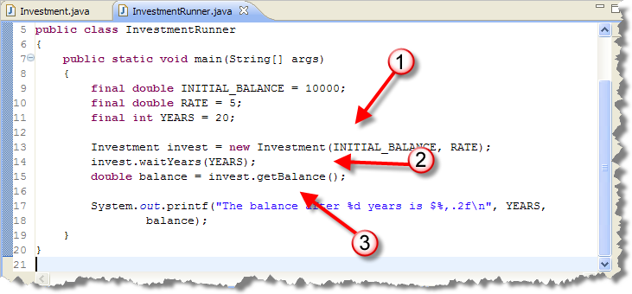
InvestmentRunner
Create an investment, wait n years, get the balance

Slide 39
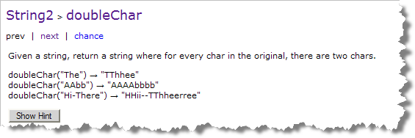
Express Yourself
Exercise 7: some loop exercises at JavaBat.com
  Select the
  doubleChar
  exercise in
  the String2
  section
Questions you should ask?
  Can we figure out how many times we need to loop?
    If so, then we can use a counter-controlled for loop
  What output is needed? What do we do inside the loop?

Slide 40
Loops and Strings
Some tips to help you process Strings with loops
  Use the length() method to visit every character
  Use the charAt() or substring() method to extract
  The indexOf() method is also useful
  int len = str.length();
  for (int i = 0; i < len; i++)
  {
  char ch = str.charAt(i);
  String strCh = str.substring(i, i+1);
  }

Slide 41
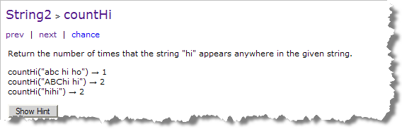
Another Exercise
Exercise 8: another loop exercises at JavaBat.com
  Select the
  countHi
  exercise in
  the String2
  section
Use substring(i, i+2) and the equals() method
Don't want to go through entire string
  Can end up looking "past end" which causes a crash
No need for special case

Slide 42
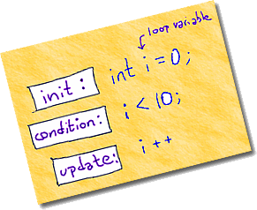
Introducing the while Loop
Counted loops with for are easy
All of the pieces are in one place
  The initializer for your counter
  The test expression
  The update expression
The simpler, general-purpose while loop can
also be used to create counted loops
  It's just not quite as convenient as for
Notes:
Counted Loops with while
The for loop makes writing counted loops very easy because it puts the pieces you need—a place to initialize your counter, a place to test your counter, and a place to update your counter—all within easy reach.
You can, however, do exactly the same thing with Java's simpler, but more general-purpose while loop; that's what your textbook does when it first explains how to use a loop on page 228. In my mind, though, using a while loop is just not quite as convenient.

Slide 43
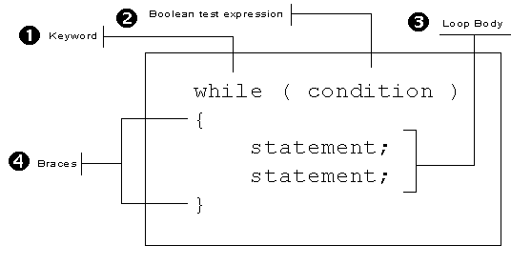
The while Loop Syntax
Parts of a while
  Keyword while, a boolean test, loop body
Notes:
The while Loop Syntax
The while loop, which you can see in the illustration below, only has three parts:
the keyword while
a boolean test
a loop body

Slide 44
Counted while Loops
To use the while statement to build a counted loop,
you must do three things:
  1. Create a counter variable, and initialize it
  before the loop is encountered.
  2. Test the counter variable inside the while
  loop's boolean condition expression
  3. Update your counter at the end of the loop
  body. This takes the place of the for loop's
  update expression.
Notes:
To use the while statement to build a counted loop, you must do three things:
Create a counter variable, and initialize it before the loop starts. This takes the place of the initialization expression in the for loop.
Test the counter variable inside the while condition.
Update your counter at the end of the loop body. This takes the place of the update expression in the for loop.

Slide 45
A Counted while Skeleton
Here is a skeleton for building counted while loops:
  int counter = 0;
  while (counter < 10)
  {
  // Loop body statements
  counter++;
  }
Notes:
Here's the basic skeleton for a counted loop, written with while:
// A Counted Loop Skeleton with while
int counter = 0;
while ( counter < 10 )
{
// Loop body statements
// Update loop counter
counter++;
}

Slide 46
Express Yourself
Exercise 9: Rewrite the following for loop into a while loop.
  int s = 0;
  for (int i = 1; i <= 10; i++)
  s = s + i;
Exercise 10: Rewrite the JavaBat countHi program using a while loop instead of a for loop.

Slide 47
Three Common Loop Errors
Several problems common to counted while loops
Problem 1 : Using an "expired" counter
  Define and initialize counter in for initializer
    Looks empty if you forget initialization
    Allows you to use the same variable name in each loop
  The while requires counter initialization before loop
    Scope of counter is "rest of program"
    Cannot create a new counter for each while loop
Must remember to initialize counter before the loop
Notes:
Caveats
There are three common errors that often occur when writing counted loops using while. By learning what they are, and then checking for each one when you write your loops, you increase your chances of writing a correct loop the first time.
Expired Counters
When using the for loop, you usually create and initialize your counter variables inside the initialization expression of the for loop. If you forget to do so, the for loop condition usually looks "empty", which acts as a reminder.
With the while loop, however, you must define and initialize your counter outside the while loop. This has several implications:
In the for loop, the scope of the counter variable is restricted to the body of the loop. That is not true for the while loop.
If you have several while loops, and each of them use the same counter variable name, then you cannot redeclare the variable for each new loop. All of your loops will use the same variable.
You must, however, remember to reinitialize the counter before each loop, even though you can't redefine it. Forgetting to do this often leads to the case of the expired counter. If a counted while loop is preceded by another, and both use the same counter variable, you may forget to reinitialize the counter for the second loop. This doesn't create a syntax error, but it does give you the wrong answer.
There are two possible solutions to the expired counter problem.
If you give all of your counters unique names, you won't run into the problem. Sometimes, however, this is hard to do. Thinking up a new name when you really want to use the common counter names like i, idx, or counter, can be difficult.
A better solution is to train yourself to always initialize your counter on the line immediately preceeding the while condition. After a bit, a missing initialization starts to look as "empty" as the missing initialization section in a for loop.

Slide 48
Common Loop Problems
Problem 2 : Endless Loops
  A loop that never reaches the bounds condition
  Not unique to while loops, but counted while loops are especially susceptible
    Counter update statement is often far removed from test
    Makes it easy to forget the update
  Solution?
    Use the for loop for counted loops
    Get the loop mechanics working before the details
Notes:
Endless Loops
The problem of endless loops is not unique to counted while loops. You can create endless loops in a variety of ways. (For instance, if you change the bounds of the exponential for loop shown at the end of the previous section to 100000 from 10000, it will become an endless loop. Can you tell why?)
Still, a counted while loop lends itself to endless loops in a way that the others don't. Because the while loop places the counter update expression at the bottom of the loop—which may be far removed from the while loop condition by the time all of the intervening statements have been added—it is easy to forget it.
With the for loop, leaving out the update expression creates an "empty" looking loop condition, but not with the while loop.
The easiest solution to this problem is to use the loop-building strategy presented in the previous lesson. If you start by first writing the "mechanics" of the loop--bounds, precondition, and update--you are less likely to get distracted by the "real" statements and forget to add the update expression at the end of the loop.

Slide 49
Common Loop Errors
Problem 3 : The phantom semicolon
  If you put a semicolon after the test condition of a while loop, its body is the null statement
  int cups = 0;
  while (cups < 10 );
  {
  // This is unreachable
  cups++;
  }
Notes:
Phantom Semicolon
This last problem is also not restricted to while loops; it affects selection statements and for loops as well.
If you put a semicolon after the condition of a while (or for) loop, the body of the loop becomes the null statement. Here's an example:
while (cups < 10);
{
// Can NEVER get here if cups is < 10
}
Because of the semicolon, you are saying:
As long as cups is less than ten, do nothing.
This creates two problems:
If cups was originally less than ten, you will have an endless loop. Because nothing in the null body changes the value of cups, it will remain at its intial value.
If cups was greater-than or equal-to ten, you will not have an endless loop, but the statements that were intended to be executed as part of the loop body will be executed exactly once.

Slide 50
Finish Up
In-class exercise: submit before you leave today!
  Drop into Q:\faculty5\sgilbert\cs170\submissions
Finish reading Chapter 6
  We'll cover more loops on Tuesday and Thursday
  We'll also cover some more Eclipse features
  Chapter 6 quiz next Monday

