Slide 1

Java Programming 1
Lecture 14
Looping, Enumerations and Random Objects
A Loop-building Strategy
Enumerated Types and
the Random class

Slide 2

Express Yourself
Use OpenOffice Writer to create a new document
Save the file as LastFirst_ic14
  Replace LastFirst with your actual name
Put your name and today's date at the top of the sheet
Title it "CS 170 In-class Exercise 14"
Exercise 1: Go to http://www.javabat.com and spend ten minutes working on the String3 gHappy problem. Shoot a screen-shot of your best run.
Exercise 2: Open Eclipse, create a new project ic14. Import LoopBuilding.java and run. Snap a picture.

Slide 3

How to Write Loops
Loops are a common source of errors in code
You must have a loop-building strategy
  Gives you some place to start
  Step-by-step approach helps avoid errors
Strategy designed by Doug Cooper
  Professor at Berkeley who wrote "Oh Pascal"
  Will help you write correct loops first time
Also see "How to Write Loops", Section 6.1

Slide 4
Identifying Bounds & Goal
Before we can write a loop, we have to be able to describe the bounds, goal and plan of the loop
The bounds are the actions that make the loop "work"
  Think of them as the "loop mechanics"
  These are the actions that start and stop the loop
  "Continue working from 8:00 to 5:00"
The goal is what we want the loop to accomplish
  These are the actions that calculate, add, or count
  "Complete each of the 1040A forms in your inbox“
The plan is the actions needed to reach the goal

Slide 5
A Simple Example
Use this problem statement as an example:
  Count the characters in a String until a period is encountered. Assume the String contains a period.
The goal? Count characters before a period
The bounds of the loop? A period was encountered
A plan to reach the goal?
  a) get a character, b) increment a counter
Can use same bounds, but have different goal

Slide 6
Express Yourself
Exercise 3: Here are some more goals: come up with a bound and a plan for each one
  a) Skip fifty input characters.
  b) Find position of letter F in input that includes an F.
  c) Divide 35 by 6 using subtraction.
  d) Count the number of F's in an input word.
  e) Print an integer in reverse.

Slide 7
The Four Sides of a Loop
Each loop has four "places" where actions occur
Precondition : actions
that occur before the loop
Bounds : the loop test
Operation : the actions
that the loop performs
Postcondition : actions
taken after the loop is
complete
// Before the loop
The Loop Bounds
{
// Inside the loop
}
// After the loop

Slide 8
Step 1: The Loop Bounds
What's the first thing you need to know when using a new appliance or software package?
How to turn it off !!!
Same thing is true for loops. Begin by asking:
“What will make this loop quit?"
  Correctly stopping your loop is the single most
  important step in writing a correct loop

Slide 9
Step 1: Pseudocode
// Before the loop
while ch is not a period
{
// Inside the loop
}
Exercise 4: Add this bounds
to charsInFirstSentence method.
Continue to add code.
// After the loop

Slide 10
Step 2: The Preconditions
Next, ask yourself
"How do I get into the loop?"
Precondition statements usually involve:
  Creating variables needed by the bounds
  Initializing them to some reasonable value
In our example we have two variables
  ch which is a char and str which is a String
Must make sure that ch holds first character in str
Notes:
Step 2: The Preconditions
Step 1, writing the bounds, makes sure that it is possible to get out of the loop. When you write this portion you'll have to make sure your boolean condition is not unavoidable or impossible, just as you did with selection statements.
Now that you've convinced yourself that it's possible to exit the loop, you have to write the statements that make it possible to enter the loop. Step 1 asks "How do I get out?", while Step 2 asks "How do I get in?"
Take a look at your bounds condition:
While current-character is not a period
and ask yourself:
what is current-character?
where did it come from?
how did it get a value that I can check?
Precondition statements usually involve creating variables and initializing them to some reasonable state. In our example, we have two variables implied by the problem statement, current-character, which is a character, and sentence, which is a string.
Before you encounter the loop bounds, you must make sure that current-character holds one of the characters in sentence, otherwise, you have no assurance that you will ever enter the loop--the value in current-character will be unknown.

Slide 11
Step 2: The Preconditions
str is a String parameter
ch is a char variable
Assign the first character from str to ch
while ch is not a period
{
// Inside the loop
}

Slide 12

Step 3: Advance the Loop
Add statements that move you closer to the bounds
Suppose we didn't add any statements to loop
  If str began with a period, the loop would not be entered and the program would perform correctly
  Otherwise, once the loop was entered, nothing would change the value of ch, so the loop would repeat over and over again
  This is called an endless loop
Solution: store next character from str in ch
Notes:
Step 3: Advance the Loop
Now that you've written the bounds and preconditions, it's time to advance the loop. Advancing the loop means that you add statements to the loop body that move you closer toward the loop bounds.
Suppose, for instance that we didn't put any statements inside the loop body used here. What would happen?
If the sentence began with a period, the loop would not be entered and the program would perform correctly.
Otherwise, when the loop body was entered, nothing in the body would change the value of current-character, so you would have no way out of the loop; it would simply repeat over and over, endlessly. Creating such endless or infinite loops is a very, very common error.
To avoid an endless or "dead" loop, you must make sure that the statements on the inside of the loop body change something that is tested in the loop bounds.
In this case, that's as simple as storing the next character in the sentence in the current-character, like this:

Slide 13
Step 3: Advance the Loop
str is a String parameter
ch is a char variable
Assign the first character from str to ch
while ch is not a period
{
Assign next character in str to ch
}

Slide 14
Loop-Building Part I Review
Step 1: Write the loop bounds
  Check for unavoidable and impossible conditions
  Do we have any necessary bounds to think about?
Step 2: Write the loop preconditions
  Add and initialize any variables used in the test
Step 3: Advance the loop
  Write statements in the loop body that move you
  toward the loop bounds
Ensure the loop works before putting it to work
Notes:
Moving Toward the Goal
At this point, the mechanical portion of your loop—the part that makes it "work", so to speak—is finished. You should be able to compile your code (once you "translated it" to a programming language, of course), and it should run correctly.
The whole purpose of a loop, however, is to get some real work done, to accomplish the goal. Up until now, we've ignored the goal portion entirely, because we want to make sure the loop works, before we put it to work.
When writing the code to carry out the goal of the loop you follow a different order than you did while working on the loop bounds. When concentrating on the loop's goal, you'll:
start int the precondition area,
move to the operations in the loop body,
and then deal with the postcondition.
You didn't have to worry about the postcondition region while programming the mechanical operation of the loop, but it is often significant when it comes to the loop's goal.
Let's look at each of these steps in a little more detail.

Slide 15
The Goal
Step 4: Start with the goal preconditions
Ask yourself:
  What information is produced?
  Usually involves creating and initializing variables
    Counters: used to count something
    Accumulators: used to add up something
  In our program we need:
    A counter to hold the number of characters
    The counter should be initialized to 0
Notes:
Step 4: The Goal Precondition
The goal of every loop (like the goal of every program) is to produce information of some sort or to carry out some useful modification of a piece of data, such as increasing the price of all of the products in your database. (I guess you could have a loop that was designed just to take up some processor time, but I won't consider those kinds of loops here).
Many common loops involve two kinds of calculations: counting things and adding up or otherwise processing different quantities. To do that, you'll often create special kinds of variables called counters and accumulators. An accumulator is just a name used for a variable that stores a sum of some sort.
In the precondition area of your loop, you'll create and initialize the variables necessary to carry out the goal of the loop. In our case, the goal is to count the characters in the first sentence, so we need a counter variable initialized to zero.
Ask yourself:
What information is produced?
Then, ask yourself what variables you'll need to store that information.

Slide 16
The Operations
Step 5: Perform necessary operations in body
Look at Step 4, and ask yourself:
  How is the data processed?
  Usually involves updating variables or making tests
  In our case, we need to update our counter each
  time we go through the loop
Notes:
Step 5: The Goal Operations
Because a loop can have many different goals, its very hard to generalize about this step. A good way to start, though, is to look at the variables you created in Step 4, and ask:
How is the data processed?
Are you calculating a sum, counting different occurrences, or transforming existing values into new values?
The statements inside the loop body will almost always update the variables created in the precondition in some way. For this example, we merely need to increment our counter every time through the loop, since each time we read a character (that isn't a period), we want to count it.

Slide 17
The Final Results
Step 6: Make postcondition tests
Ask yourself
  Has the loop reached its goal?
  Loop exits because bound is reached, not because the goal is necessarily accomplished
  In our case (counter) no test is necessary
  If averaging, for instance, would need to make sure that the loop had actually been entered
Notes:
Step 6: The Postcondition
In the postcondition, you often must check one of the bounds conditions to see how to proceed, but that's not always the case. Let me give you a short example.
Suppose you were writing a loop to calculate the average of all the positive numbers entered by the user. For your bounds condition, you had the user enter 0 or a negative number. When the loop terminates, you can't immediately calculate an average; instead, you'll have to first check to see if the user actually entered some positive numbers; if the user immediately terminated the loop by entering a negative number, attempting to calculate an average would result in a "divide by zero" error.
As I said, you don't always need to write code to deal with the postcondition; however, you still need to ask yourself this question whenever you're loop is finished:
Have I reached my goal?
In our case, we don't need to check the postcondition because, if we never enter the loop, our counter will be zero, which is the correct answer.

Slide 18
Express Yourself
Exercise 5: Here are some modifications to make to the loop in charsInFirstSentence.
  Do we have too many variables? Simplify the loop.
  Can you really assume that every sentence will end in a period? Modify the method to return -1 if there is no period in the String. (This involves a post-condition test)
  Test your loop and then paste your code and a screenshot of a run under several conditions.

Slide 19
Iterators
Objects or methods that allow you to sequentially access all of the elements in a collection, regardless of how those elements are physically stored in memory
  We’ll look at some more sophisticated iterators later
  For now, let’s look at the Scanner as an iterator
In addition to reading the keyboard, a Scanner can:
  Read and process each line of text in a text file
  Process each individual word or token in a line of text
Exercise 6: Import WordCounter.java into ic14
Notes:
Processing Data with Iterators
An iterator is an object that allows you to apply some operation to all of the members of a group of related variables, using a loop. As your textbook puts it: "iterators provide a consistent and simple mechanism for systematically processing a group of items."
Such groups of related items or variables are known as collections, and Java has several different types. We'll take a closer look at the array and ArrayList collection types in the next unit. In this unit, though, let's take a look at an iterator object you've already met: the java.util.Scanner class.
Up until now, we've used the Scanner class to read console input. The class is actually much more versatile than that, however. Using a Scanner as an iterator allows us to:
read and process each line of text in a file
process each individual word in a line of text
You already saw how to do this in the last unit, (Lesson 6E), where you used nested if statements to count the words in a TextArea. In that program, you had to carefully monitor each character to see if you were entering or leaving a word, and then act accordingly. The iterators provided by the Scanner class will do all of that for you automatically.

Slide 20
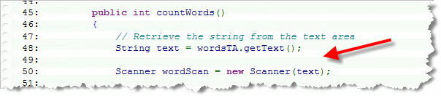
Counting Words
Locate the countWords() method, and then construct a Scanner object using the text variable
  Note that the Scanner object will “step through” the text String, just like it steps through keyboard input
  The Scanner sees both as a stream of characters
Notes:
WordCounter Revisited
To see how an iterator works, let's build a second version of the word counting program from Lesson 6E, this time, using the Scanner class to loop through the words in our TextArea and count them. We'll call this version WordCounter2.
Here are the steps to follow:
In Eclipse, (or BlueJ, if you like), create a new class called WordCounter2.
Copy the starter code from WordCounter2.java and paste it into the class you've just created. This is almost the same code we used back in Unit 6.
In the countWords() method, extract the text from your TextArea, (as you did previously), but use that text to construct a new iterator using the Scanner constructor. (Up until now, you've only passed System.in to the Scanner constructor. Passing a String means that we'll treat its text as our input source.)

Slide 21
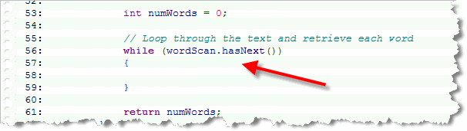
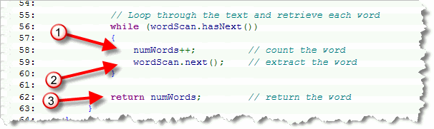
Counting Words
Step 3: All iterators have a hasNext() method
  Use that as the bounds of our loop
Step 4: Inside the loop, use the next() method to extract the item (word) that you want to process
Exercise 7: Copy text of Moby Dick, Shoot a
screenshot of code and the running program
Notes:
You'll want to continue processing the String while there are still words left to count. You can do that by calling the iterator's hasNext() method. This method will return true while there are still words left to read.
Inside the body of your loop, you can extract the next word by using the iterator's next() method. In our case, of course, we don't do anything with the word we get back; we just count it. When the method is finished, we return the word count.
Here's the finished program, WordCount2.java that you can open and examine in your browser. Click this link to run the applet, and compare the results to the original WordCount program from Lesson 6E. (Note that because WordCount2 uses the Scanner class, you'll only be able to run it on a computer that has Java 5.0 installed.

Slide 22
Iterators and Text Files
You can use a Scanner to read the lines in a text file
Exercise 8: Copy moby.txt into your ic14 project folder. Then, add a new class named LineCounter.
  Generate comments and a main() method
  Add import java.io.*; to the top of the file
  Add throws Exception to main() signature
  Construct a Scanner like this:
  Scanner reader
  = new Scanner(new File("moby.txt"));
Notes:
You can use the Scanner class to iterate over the text in a file as well as over the characters in a String or the input from the keyboard.
The program URLDissector from page 240 in your textbook shows how to open a file, using the File class constructor to create a new File object, and pass that object to the Scanner constructor: When you do this, its possible that you won't be able to open the file for some reason, triggering a runtime error. Anticipating that possibility, we add the phrase throws Exception to the main() method header. (If you fail to do this, your code won't compile. In an upcoming lesson, you'll learn how to intercept and recover from such runtime errors.)

Slide 23
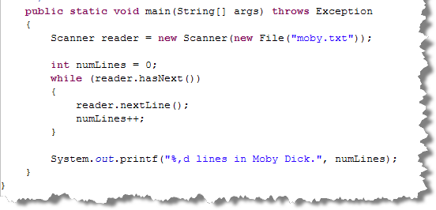
Reading Text
Use hasNext() and nextLine() to read text
  Using next() would read next word instead
Notes:
Reading Lines of Text
Once the file is open, you can loop through each line of text by testing the hasNext() function, and then calling the nextLine() method inside the loop. If we used the next() method, instead of nextLine(), the program would read the next word (like WordCounter2) from the file, rather than the next line.
Reading Tokens
Once each line has been extracted, the URLDissector program uses a second Scanner (1), this one designed to break each line into its individual parts, (called tokens). A token is just a "meaningful chunk of text". Words are tokens, as are the operators, operands, and keywords in a programming language like Java.
To define a token, you specify the characters that separate one token from another. These are called delimiters. Once you've created your Scanner object, you can let it know how to separate different tokens by way of the useDelimiter() method (2), like this: Once the program specifies the forward slash as the token delimiter, the next() method (3) no longer returns the next word, but the next portion of the line of text up-to the slash.

Slide 24
Card Demo
Last two topics left to cover in Chapter 5 and 6 are enumerated types and the Random class.
Let's return to our playing card example and create a class that represents playing cards
Exercise 9: Copy the cards folder and add it to your project. Then import the CardDemo program. Shoot a screenshot of your workspace.

Slide 25
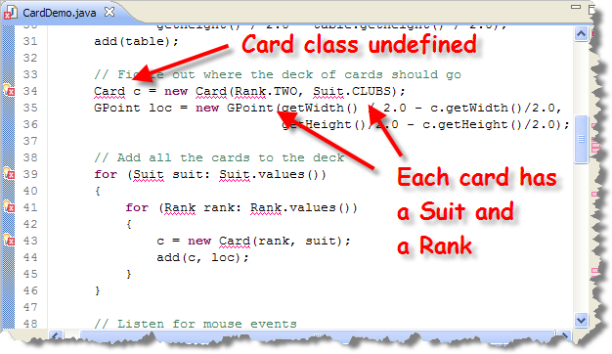
CardDemo.java
CardDemo creates a stack of Card objects on table
  Some parts are missing. Let's start with Card.

Slide 26
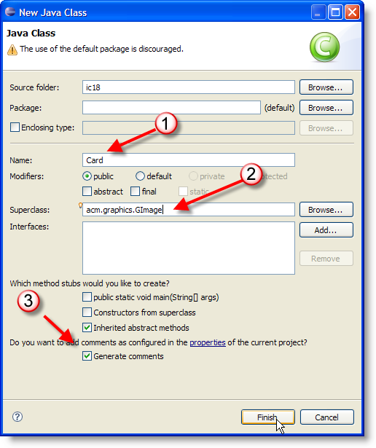
The Card Class
Create a new
class Card,
acm.graphics.GImage,
no main method,
comments

Slide 27
Modeling Playing Cards
Every playing card has two defining data elements
  Rank: 2-10, Jack, Queen, King, Ace
  Suit: Clubs, Spades, Diamonds, Hearts
We'll represent these as instance variables
  The question is, what kind of data?
  String? Assume we have a constructor like this:
    Card(String rank, String suit);
  User writes Card c = new Card("Ac", "Cubs");
Compiler can't catch this, but enumerated types can

Slide 28
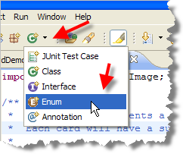
Enumerations
Enumerations are user-defined types like classes
  Each type has a restricted number of values
  Think days of the week, months, compass points, etc.
Create an enumerated type using the enum keyword
  These types are strongly type-checked
  A better way to create named constants
Exercise 10: In Eclipse, create
two new Enums, one named
Rank and one named Suit. Shoot
a screenshot of your workspace.

Slide 29
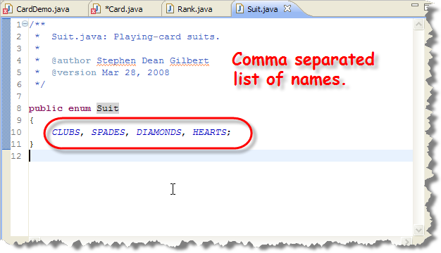
Specifying Values
Need a name for each value. Since they are constant, its convention to use upper-case for the name
Exercise 11: Add values for Rank.
Start at TWO, end with ACE.

Slide 30
Using Enumerated Types
Use them like an "integer" wrapper type
  Suit suit; // an enum variable
  suit = Suit.HEARTS; // initializing
  suit == Suit.CLUBS; // compare with != and ==
  switch(suit) { // use as a switch selector
  suit.ordinal() // position in list
  Suit.values().length // elements in enum list
  Suit.values().[n] // elements number n
  Card(Rank rank, Suit suit) // formal parameters

Slide 31
Constructing Cards
Let's add our fields and a constructor to Card
  Add a private Rank and Suit instance variable
  Create a constructor that takes a Rank and Suit
    Use super("cards/b.gif"); as the first line
    This initializes the GImage part using the card back
  Assign both parameters to the fields you defined
Everything now compiles except one missing method
  Add a private boolean field, isFaceDown
  Add a void method flip() that just toggles the field
Exercise 12: run and shoot a screen-shot.

Slide 32
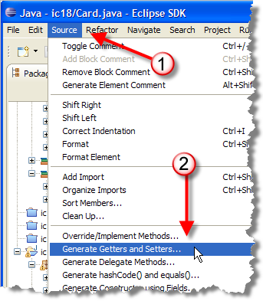
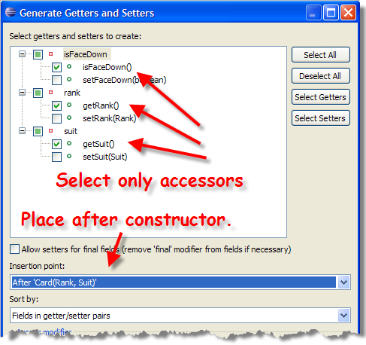
Accessors and Mutators
Eclipse will write a lot of code for you
  Let's start with accessors for the our fields

Slide 33
Flipping the Card
To display the card image when we flip it, we need to generate the correct name, then use setImage()
  Each card image is "cards/" + rank + suit + ".gif"
  Ranks go from 2-9,t,q,k,a
  Suits go c, s, d, h (the order we declared them)
We can do that several different ways
  We can use two methods, generating the rank and suit symbols, using a switch statement
  We can use ordinal() along with substring()
  We can add methods to the Rank and Suit enums

Slide 34
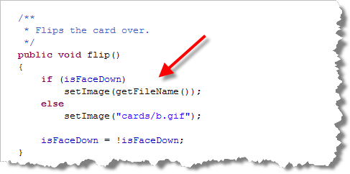
Changing flip()
Here's the change to the flip() method

Slide 35
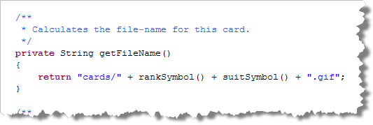
Getting the File Name
Here's the getFileName() method:

Slide 36
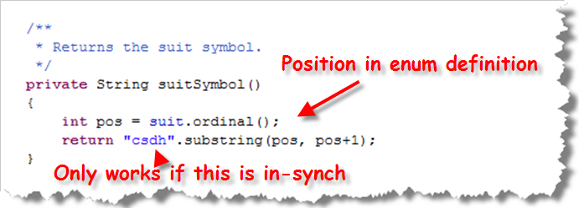
The suitSymbol() Method
Calculates the symbol based on its ordinal position
  Real drawback: breaks if you change order in enum

Slide 37
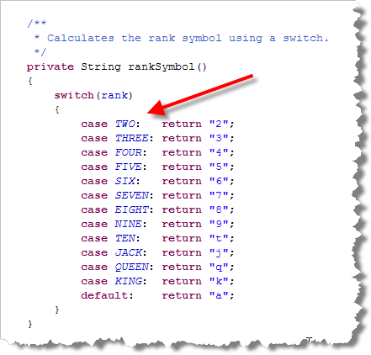
The rankSymbol() Method
Uses switch,
so still works if
values are
reordered in
enum definition
Exercise 13:
Run, make sure
you can drag and
flip the cards.
Snap a pic.

Slide 38
The Random Class
The java.util.Random class provides a more complete set of random number generating functions
  Unlike Math.random(), these are not static
  You first create a Random object like this:
  Random gen1 = new Random();
  Random gen2 = new Random(20L);
  The 20L passed to the second constructor is a seed
  Same sequence of numbers each time it is used
  Default constructor uses the system clock for the seed

Slide 39
Random Numbers
Once you have a Random object, use it like this:
  int iNum = r1.nextInt();
  float fNum = r1.nextFloat();
  double dNum = r1.nextDouble;
  double gNum = r1.nextGaussian();
  int iNum2 = r1.nextInt(5); // 0 - 4
Gaussian distribution mean at 0.0 and std dev of 1.0.
  Both positive and negative numbers
  Possible values > 1.0

Slide 40
Random Cards
Exercise 14: Complete loop by
constructing and adding Card.
Run and shoot a screen-shot.
Locate the loop in CardDemo.java
  Uses an "enhanced" for loop (Ch 8) to select all cards
  Cards are in fixed suit-rank order
For 52 cards, can generate a random suit and rank
  Random gen = new Random();
  for (int i = 0; i < 52; i++) {
  int r = gen.nextInt(13); // random rank
  int s = gen.nextInt(4); // random suit
  Suit rands = Suit.values()[s];
  Rank randr = Rank.values()[r];

Slide 41
Finish Up
In-class exercise: submit before you leave today!
  Drop into Q:\faculty5\sgilbert\cs170\submissions
Chapter 6 quiz next Monday
Read Chapter 8 (not Chapter 7)
    Lightly skim 8.1, 8.2, 8.3, 8.4. 8.5, Skip 8.9
    Study 8.6, 8.7, 8.8, 8.10
Midterm Exam 2 on Tuesday
  Will cover Chapters 5 and 6

