Slide 1

Java Programming 1
Lecture 15
Debugging
Java's Jump statements
Eclipse and the Debugger

Slide 2

Express Yourself
Use OpenOffice Writer to create a new document
Save the file as LastFirst_ic15
  Replace LastFirst with your actual name
Put your name and today's date at the top of the sheet
Title it "CS 170 In-class Exercise 15"
Exercise 1: Open Eclipse and close all open projects
  Create a new ic15 project
  Import Word.java and SyllableCounter.java from the
  Q: drive using Import from File System
  Snap a picture and paste it into your document

Slide 3
Using a Debugger
Modern IDEs (like Eclipse) contain programs called debuggers, that help you locate bugs by letting you interactively follow the execution of your programs
  You can stop and restart your program and see the contents of variables when your program is temporarily stopped
  Using a debugger is not cost free—it takes time to set up and carry out an effective debugging session
We'll follow sample debugging session on page 267

Slide 4
Three Useful Commands
Larger programs are harder to debug without using a debugger, so learn how to use one is time well spent.
Three important commands:
  Run to a particular location (called a breakpoint)
  Step to next line (step into, over)
  Inspect the contents of a variable
Exact names vary from debugger to debugger, but all support them

Slide 5
Run To a Particular Line
Program is supposed to print syllables in word
Exercise 2: Run SyllabusCounter and enter "hello yellow peach" as the input. Shoot a screen-shot.
Let's run the program line by line
  To do this, we need to set a breakpoint in the code
  When the program encounters this line it will go into suspended animation, and we can examine it
Exercise 3: Go to line 40, (header of countSyllables), and right-click to the left of the line number. Choose Toggle Breakpoint from menu. Snap a screen-shot.

Slide 6
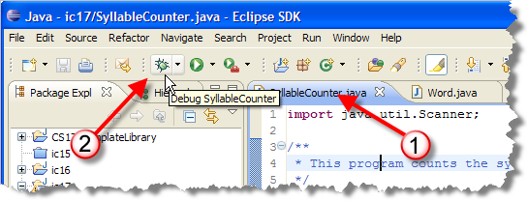
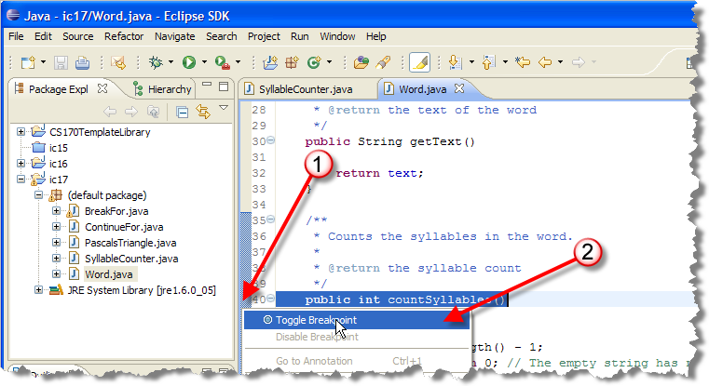
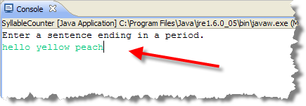
Starting the Debugger

Slide 7
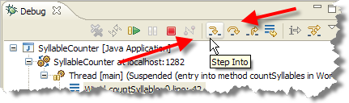
Step Over and Into
Exercise 4: Shoot a screen-shot of debug display
"Step over" and "Step into" commands advance
  The "step over" skips over function calls
  "Step into" advances into function calls
  Run to line advances to cursor position

Slide 8
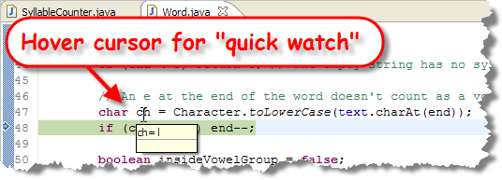
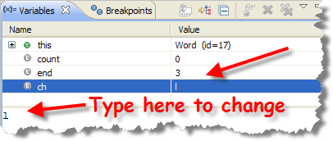
Inspecting Variables
Exercise 5: put cursor on line 48, run to line. Snap.
With program stopped, you can values of variables.
  Eclipse shows the values of all variables and allows you to change them as well.

Slide 9
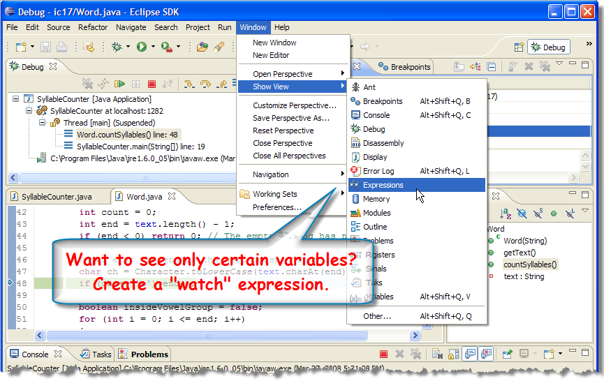
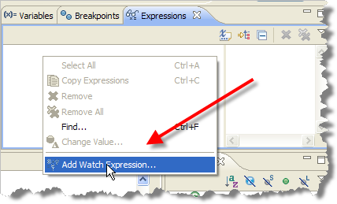
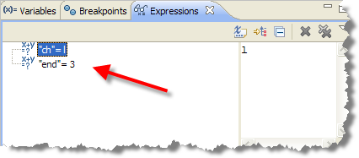
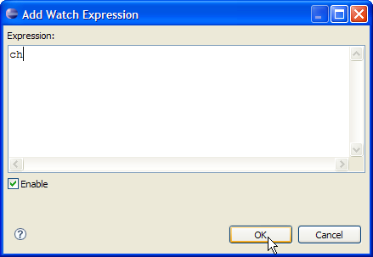
Watching Variables

Slide 10
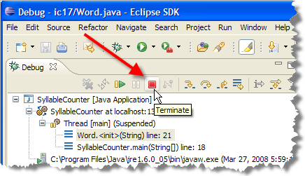
Restarting
Note that end is 3, so
we get "hell", not "hello".
Can't go back in time,
so Terminate session
like this:
Exercise 6: Put break-point on the Word constructor that creates the word passed to countSyllables
  Add watches for variables i and j
  Run to line 21, where text is set
  Single-step and shoot a screenshot of variables

Slide 11
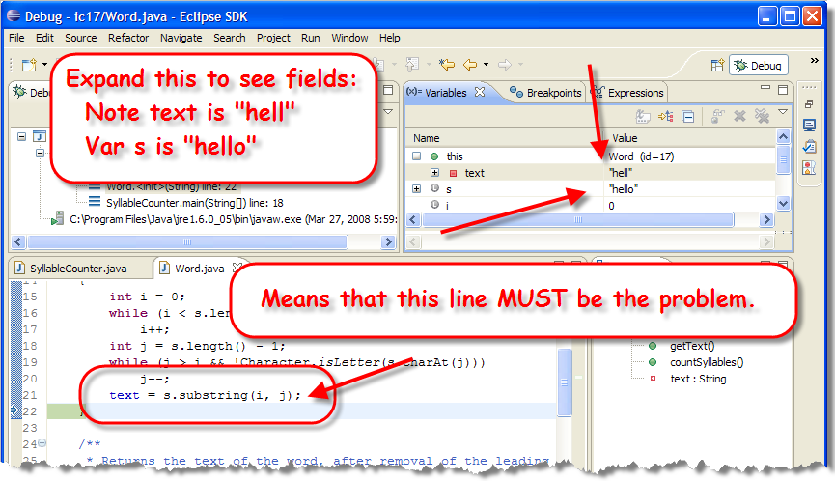
Tracking Down the Problem

Slide 12
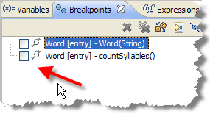
Try Again
Exercise 7: Fix the substring, turn
off the breakpoints and run the
program again. Snap a pic.
Still a problem. Let's look closer.
  Re-enable the breakpoint for countSyllables
  This time, just enter "hello"
  Single-step through countSyllables

Slide 13
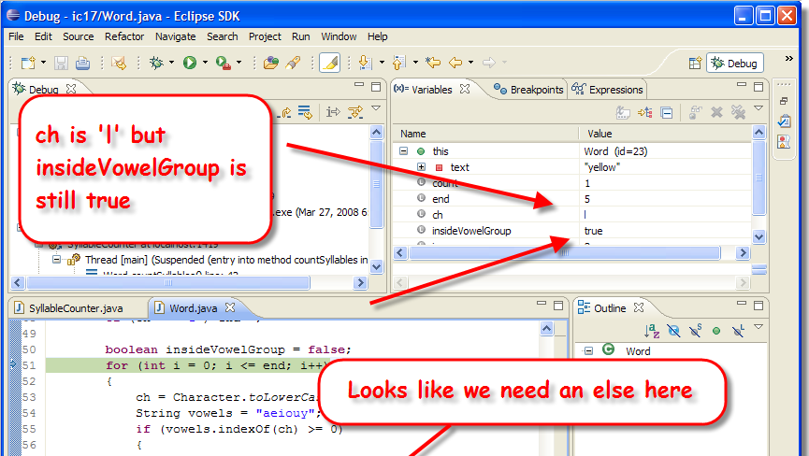
Checking Vowels
Exercise 8: Fix, run and snap a picture.

Slide 14
First, You Break It
Before you can debug your program, you must be able to reliably reproduce the error
  What numbers did you enter?
  Where did you click the mouse?
  Run the same program again
  Type in exactly the same input.
Don't try to fix it until you can break it at will

Slide 15
Next, Isolate and Understand
Use Divide and Conquer to locate and isolate
  Step over functions, don't step into them
  Locate the last procedure before failure
  Step into that procedure, and repeat
To understand the bug, you have to know what your program should do
  Before inspection, know expected values
  If value is correct, look elsewhere
  Double-check computations

Slide 16
Debugging Tips
Look for off by one errors.
Look for computation errors
  Is the formula typed in correctly?
Look at "big picture" when numbers large or complex
Avoid quick fixes - they tend to create problems elsewhere. Possibly the program logic is incorrect and the program needs to be redesigned.

Slide 17
A Little More Eclipse
Configuring the Checkstyle Plug-in
  Activating Checkstyle for your project
  Creating your own rule set
  Modifying individual rules

Slide 18
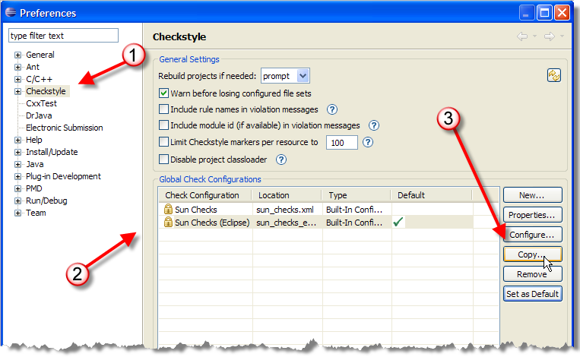
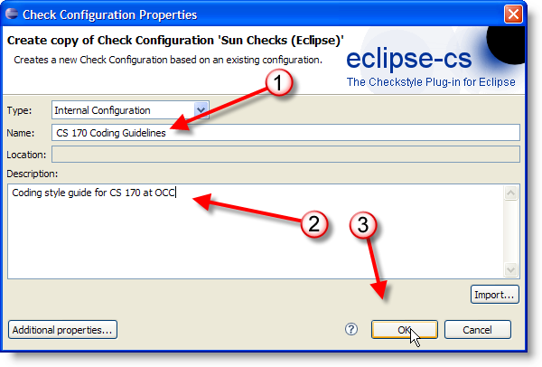
CS 170 Checkstyle
Need to add a custom configuration for CS 170

Slide 19
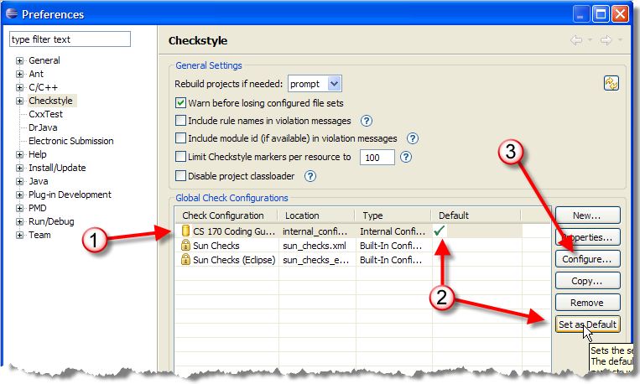
Configuring Checkstyle
Make CS 170 the default, and click Configure

Slide 20
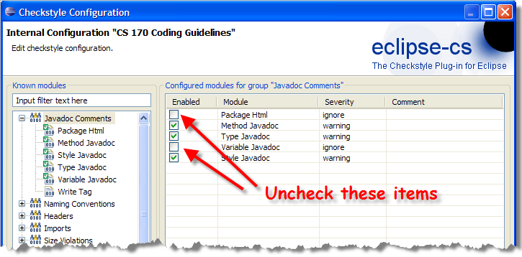
Javadoc Configuration
When you configure you can do three things
  Add or remove rule-sets using buttons at bottom
  Configure how a specific rule works using a dialog
  Enable or disable rules using checkboxes like this:

Slide 21
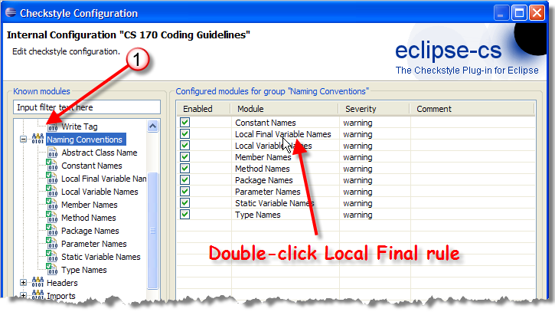
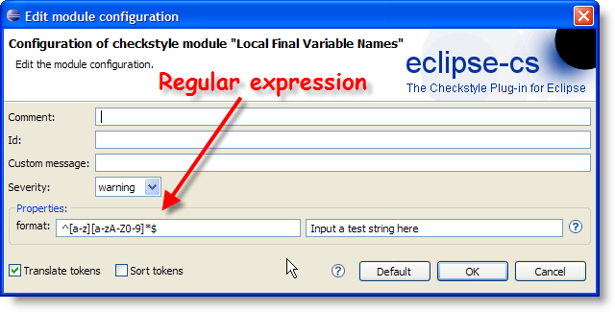
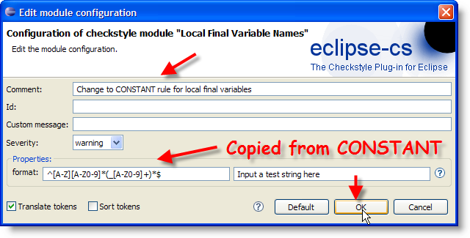
Naming Rules
Let's change the naming rules for local constants

Slide 22
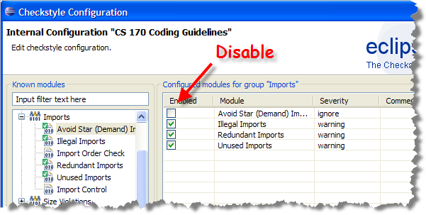
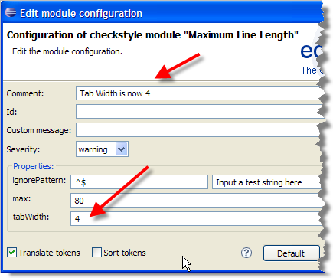
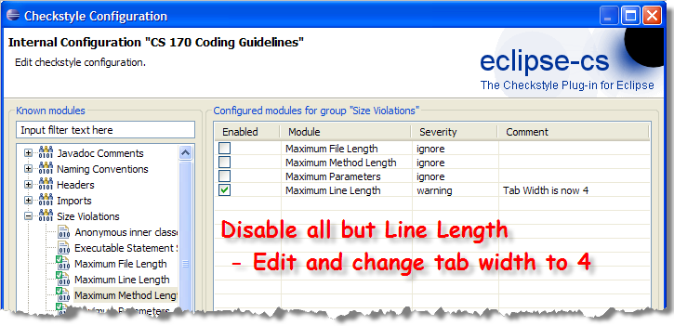
Imports and Size

Slide 23
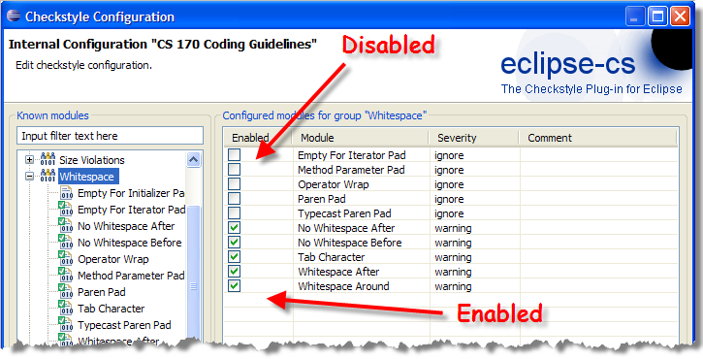
Whitespace
Enable and disable the items selected below

Slide 24
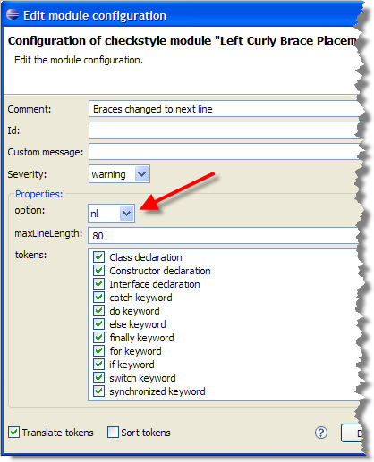
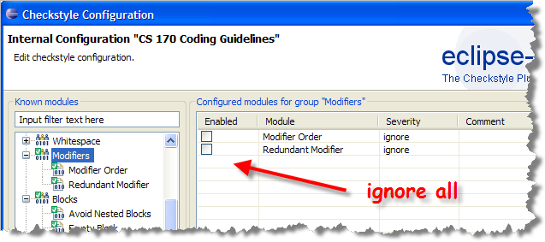
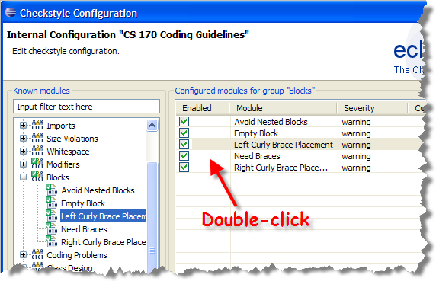
Modifiers and Blocks
Ignore all modifiers, change brace position on blocks

Slide 25
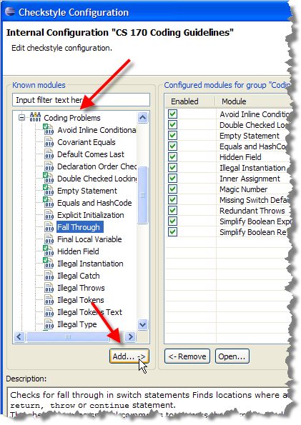
Coding Problems
Many options. Let's add a
check for switch
fall-through
  Note that this allows
  special comments
  when fall-through
  is desired
May want to de-select
the Magic Number
and a few other checks

Slide 26
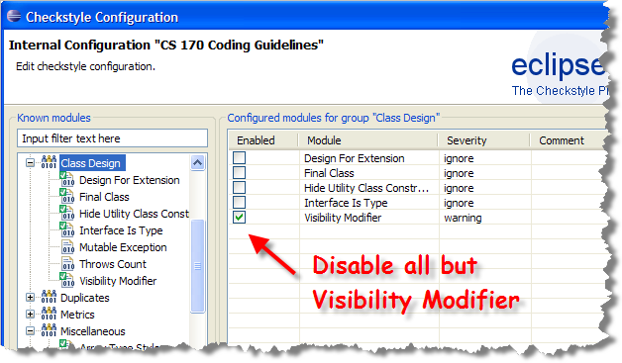
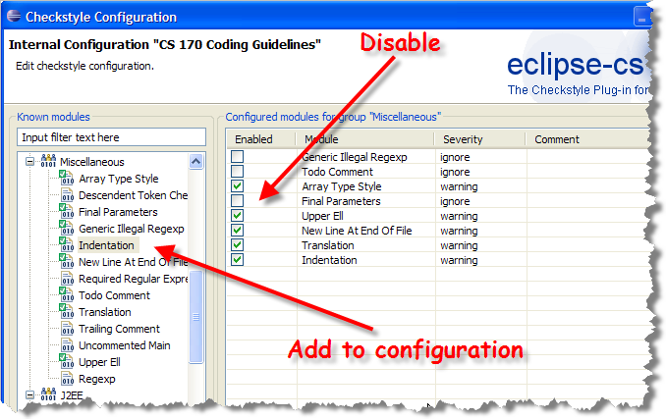
Class Design and Others

Slide 27
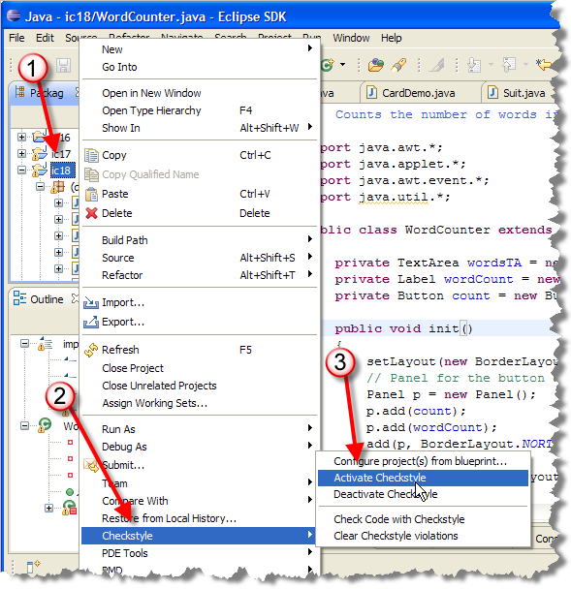
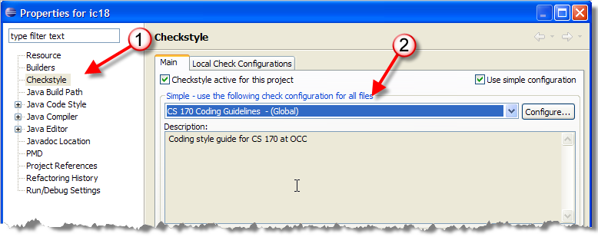
Activating Checkstyle
Right-click project,
choose CheckStyle,
Activate Checkstyle
Choose properties,
configure like this:

Slide 28
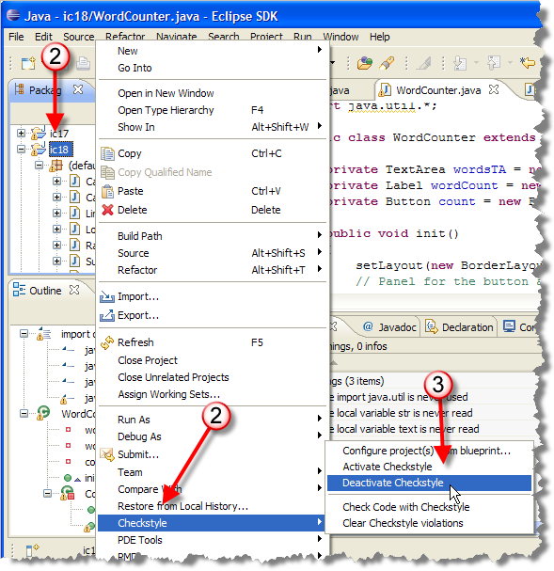
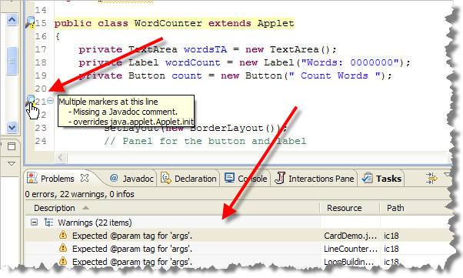
Warnings and Disabling
Exercise 9
Activate Checkstyle
Show me a
screenshot
Warnings appear as a magnifying glass and in problems pane like this

Slide 29
Finish Up
In-class exercise: submit before you leave today!
  Drop into Q:\faculty5\sgilbert\cs170\submissions
Midterm Exam #2 (Chapters 5 and 6) tomorrow
Reading Chapter 8 (not Chapter 7) for Thursday
  Lightly skim 8.1, 8.2, 8.3, 8.4. 8.5, Skip 8.9
  Study 8.6, 8.7, 8.8, 8.10

