Slide 1

Java Programming 1
Lecture 17
Looping, Jumping and Debugging
Java's Jump statements
Eclipse and the Debugger

Slide 2

Express Yourself
Open Microsoft Word and create a new document
Save the file as LastFirst_ic17.doc
  Replace LastFirst with your actual name
Put your name and today's date at the top of the sheet
Title it "CS 170 In-class Exercise 16"
Exercise 1: Open Eclipse and close all open projects
  Create a new ic17 project
  Import ContinueFor.java and BreakFor.java from the
  Q: drive using Import from File System
  Snap a picture and paste it into your document

Slide 3

Jump Statements
Jumps are "low-level" flow of control statements
  In contrast to "high-level" statements like if and loops
A jump statement is sometimes called a goto
  Although goto is a reserved word in Java, its not used
Java does have two "controlled" jump statements
  break : used to exit a switch or a loop (but not an if)
  continue : used to prematurely "restart" a loop
Java also has "labeled" versions of each of these
  Used to exit or restart a particular nested loop

Slide 4
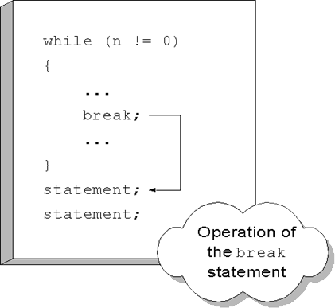
The break Statement
break jumps out of a switch or loop (but not an if)
In a loop, break jumps
to the first statement
following the loop body
as shown here.
Can make your code
clearer when used
to construct a
loop-and-a-half

Slide 5
A "Loop-and-a-half"
A loop-and-a-half is available in languages like Ada
  In Java, use if with break to do the same thing
  Put the necessary bounds in your loop condition
  Put the intentional bounds in the if statement
Exercise 2: Open BreakFor.java, locate comments
  Write a loop that visits every character in the String
  Extract the current character
  If the current character is a period, then break
  Otherwise, append it to the answer
Very useful for "primed" loops with complex setup

Slide 6
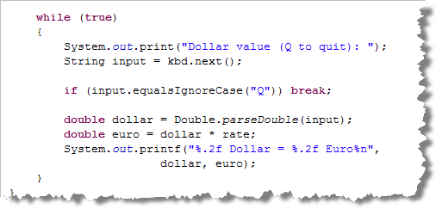
Another Loop-and-a-Half
Here's a sentinel loop replaced by loop-and-a-half

Slide 7
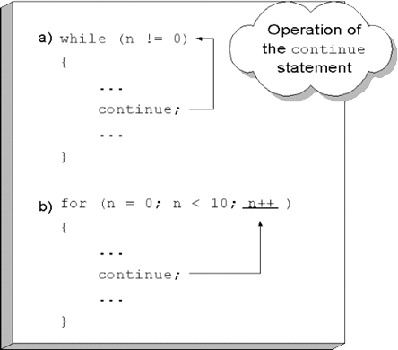
The continue Statement
The continue statement only works inside loops
Instead of leaving the
loop, it starts the next
iteration
In while and do-while
continue jumps to the
loop test expression
In for, it jumps to the
update expression

Slide 8
Completing ContinueFor
Suppose you want to convert 1,234,456 to an int
  Can't use Integer.parseInt() because of commas
You can write a loop to convert the number manually
  Use the String's length as the loop bounds
  Extract each character from the String
  Use Character.isDigit() to see if it is a number
  If not, then restart the loop using continue
  If it is, then convert the digit into a binary number
  Add it to the running total
Exercise 3: Complete and snap 2 pics (running/code)

Slide 9
Nested Loops
Loops can be nested, just like if statements
  We call the nested loop the inner loop
  We call the enclosing loop the outer loop
  for (int outer = 1; outer <= 10; outer++) {
  for (int inner = 1; inner <= 10; inner++)
  System.out.printf("%4d", outer * inner);
  System.out.println();
  }
Exercise 4: Open Dr. Java interaction pane. Type code above. Snap a screenshot.

Slide 10
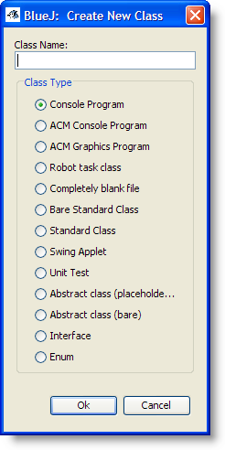
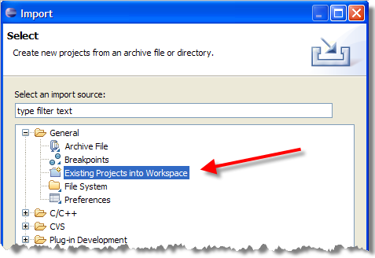
Importing Projects
Eclipse doesn't have individual code templates for different kinds of programs like BlueJ does.
Let's see how we can use the Eclipse Import Project
function to create a
library of templates.
Choose File->Import
then Existing Projects
into Workspace

Slide 11
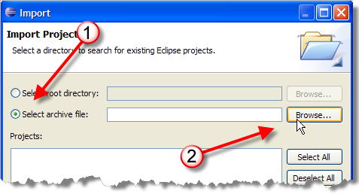
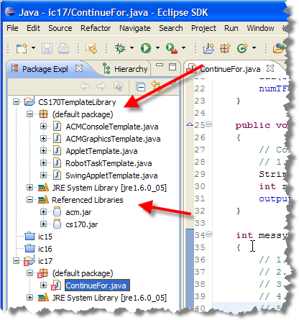
Projects from Archives
Click Select Archive file, then Browse button
Locate and select the file:
CS170TemplateLibrary.zip on the Q: drive then click
the Finish button
Exercise 5: Expand
default package and
Referenced Libraries like
this and snap a screen-shot.

Slide 12
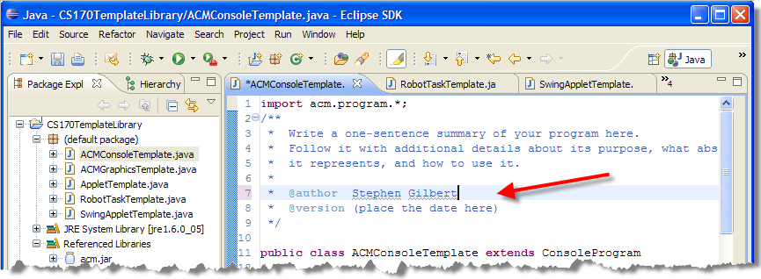
Adding Comments
When you use a template file, Eclipse won't be able to add the custom comments that you set up
  No problem, you can just add them to the templates
Exercise 6: Open each template file, add your name

Slide 13
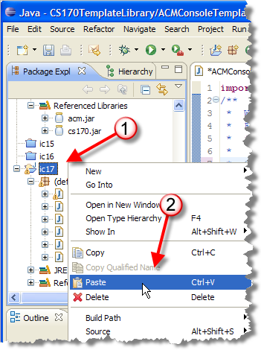
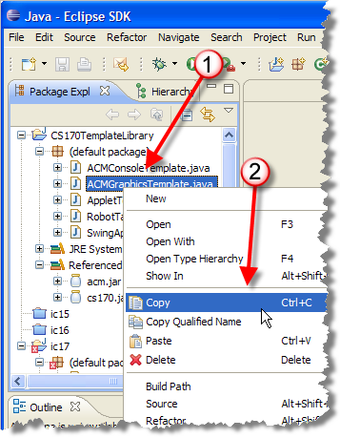
Projects from Templates
Let's create an ACM Graphics
program with nested loops.
  Select and then right-click
  ACMGraphicsTemplate,
  choose Copy from the menu.
  Then, select the ic17
  project and choose
  Paste

Slide 14
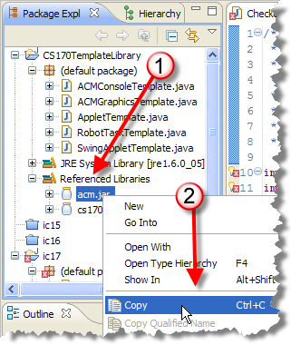
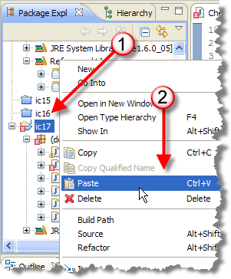
Adding a Library File
Code doesn't compile; there are two problems
  Need the library file, acm.jar in the project
  Need the class name to match the file name
Right-click acm.jar
in the Referenced
libraries section of
the template project
and choose Copy
Right-click ic17 and
click Paste

Slide 15
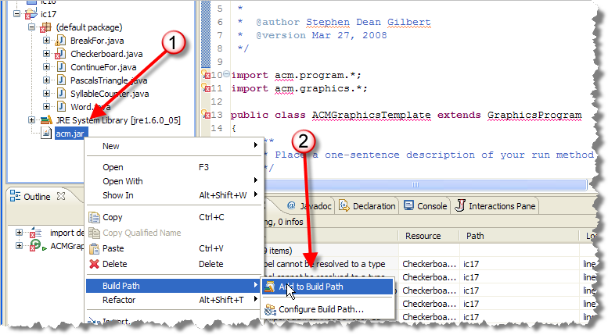
Adjusting the Build Path
Locate acm.jar in ic17, and right-click the file
  Select Build Path->Add to Build Path and save

Slide 16
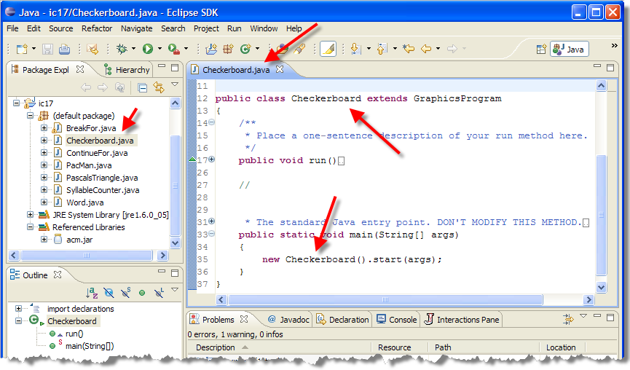
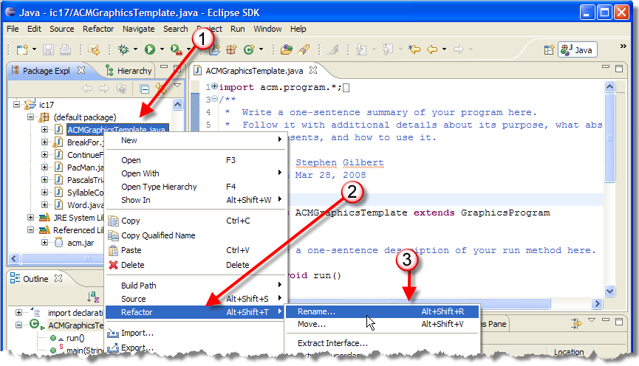
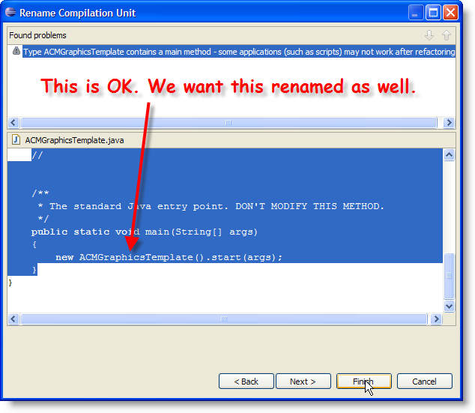
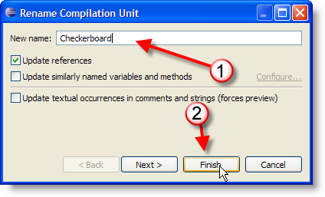
Refactoring
Use Refactoring to change class name

Slide 17
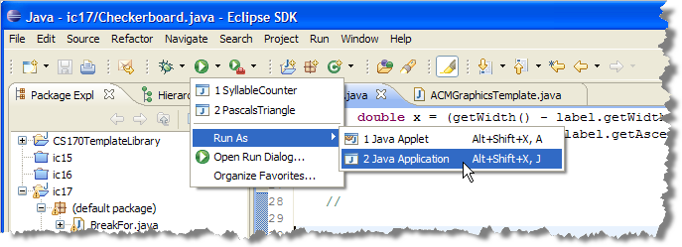
Running the Program
Now you can run by using the Run As dialog
Exercise 7: run Checkerboard and snap a picture

Slide 18
Template Program Checklist
To create an ACM console or graphics program
  Copy the template file from the library to your project
  Add acm.jar to the project and adjust the build path
  Use refactoring to change the class and file name
To create a Karel program
  Follow the same steps, but add cs170.jar instead
Can skip using the templates and just write the code from scratch, but you always need to add the jars

Slide 19
Finishing Checkerboard
Exercise 8: Run and snap a picture.
Let's use nested loops to draw the checkerboard
  Erase the code inside the run() method and then
  Add a constant ROWS set to 8
  Add a double variable for the size of each square
    Initialize by using getHeight() and dividing by ROWS
  Write a nested for loop:
    Outer loop from 0 < ROWS, inner from 0 < ROWS
    Calculate x (inner * square size) and y (outer * square size)
    Create a new GRect using x, y and the square size
    If outer + inner are odd, then setFilled(true)
    Add the GRect to the program surface

Slide 20
Using a Debugger
Modern IDEs (like Eclipse) contain programs called debuggers, that help you locate bugs by letting you interactively follow the execution of your programs
  You can stop and restart your program and see the contents of variables when your program is temporarily stopped
  Using a debugger is not cost free—it takes time to set up and carry out an effective debugging session

Slide 21
Three Useful Commands
Larger programs are harder to debug without using a debugger, so learn how to use one is time well spent.
Three important commands:
  Run to a particular location (called a breakpoint)
  Step to next line (step into, over)
  Inspect the contents of a variable
Exact names vary from debugger to debugger, but all support them

Slide 22
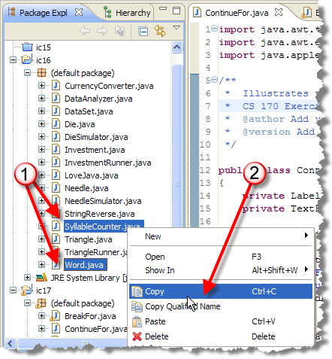
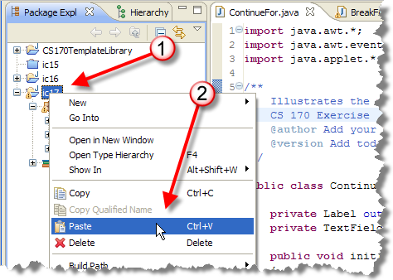
Eclipse Debugging Example
Sample debugging session on page 267
  Copy the files
  Word.java and
  SyllableCounter.java
  from ic16 project

Slide 23
Run To a Particular Line
Programs is supposed to print syllables in word
Exercise 9: Run SyllabusCounter and enter "hello yellow peach" as the input. Shoot a screen-shot.
Let's run the program line by line
  To do this, we need to set a breakpoint in the code
  When the program encounters this line it will go into suspended animation, and we can examine it
Exercise 10: Go to line 40, (header of countSyllables), and right-click to the left of the line number. Choose Toggle Breakpoint from menu. Snap a screen-shot.

Slide 24
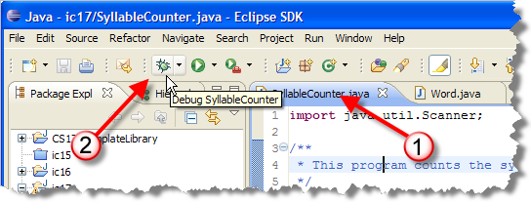
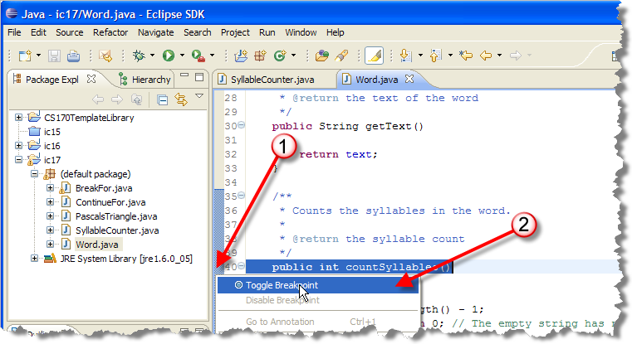
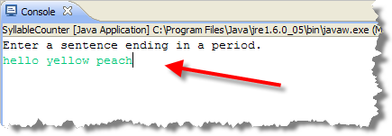
Starting the Debugger

Slide 25
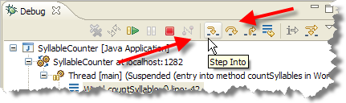
Step Over and Into
Exercise 11: Shoot a screen-shot of debug display
"Step over" and "Step into" commands advance
  The "step over" skips over function calls
  "Step into" advances into function calls
  Run to line advances to cursor position

Slide 26
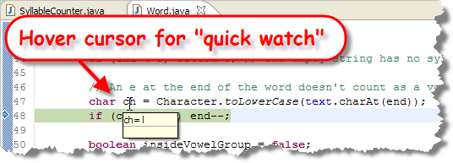
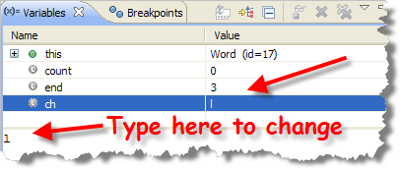
Inspecting Variables
Exercise 12: put cursor on line 48, run to line. Snap.
With program stopped, you can values of variables.
  Eclipse shows the values of all variables and allows you to change them as well.

Slide 27
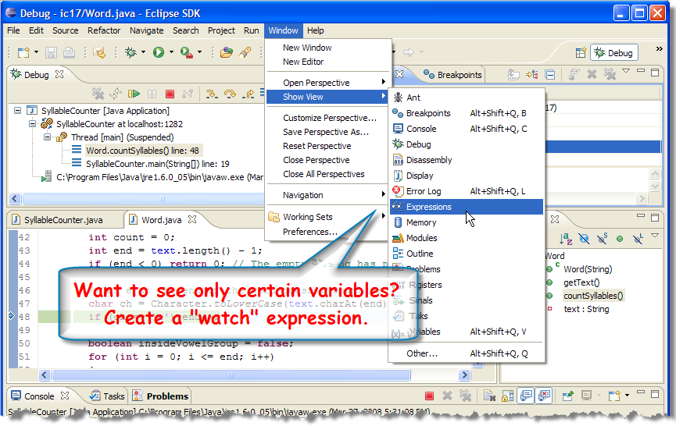
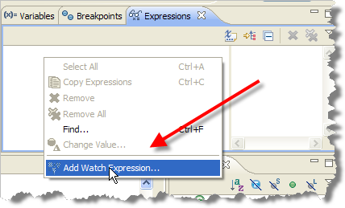
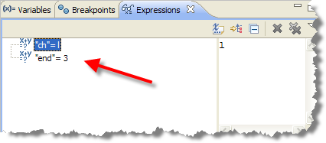
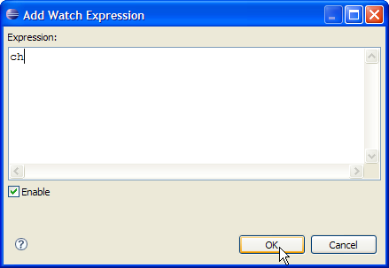
Watching Variables

Slide 28
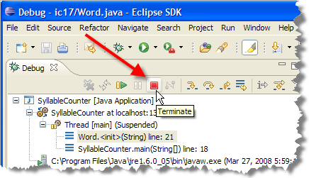
Restarting
Note that end is 3, so
we get "hell", not "hello".
Can't go back in time,
so Terminate session
like this:
Exercise 13: Put break-point on the Word constructor that creates the word passed to countSyllables
  Add watches for variables i and j
  Run to line 21, where text is set
  Single-step and shoot a screenshot of variables

Slide 29
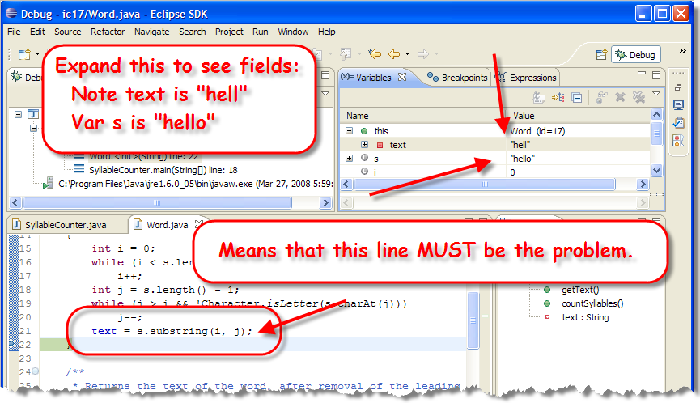
Tracking Down the Problem

Slide 30
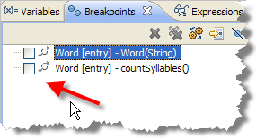
Try Again
Exercise 14: Fix the substring, turn
off the breakpoints and run the
program again. Snap a pic.
Still a problem. Let's look closer.
  Re-enable the breakpoint for countSyllables
  This time, just enter "hello"
  Single-step through countSyllables

Slide 31
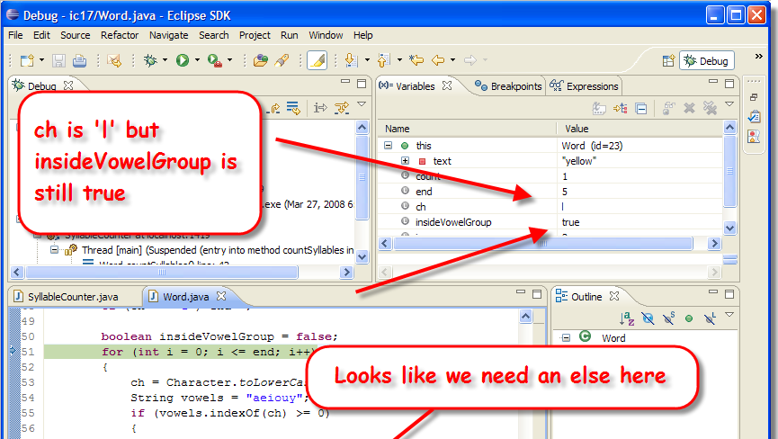
Checking Vowels
Exercise 15: Fix, run and snap a picture.

Slide 32
First, You Break It
Before you can debug your program, you must be able to reliably reproduce the error
  What numbers did you enter?
  Where did you click the mouse?
  Run the same program again
  Type in exactly the same input.
Don't try to fix it until you can break it at will

Slide 33
Next, Isolate and Understand
Use Divide and Conquer to locate and isolate
  Step over functions, don't step into them
  Locate the last procedure before failure
  Step into that procedure, and repeat
To understand the bug, you have to know what your program should do
  Before inspection, know expected values
  If value is correct, look elsewhere
  Double-check computations

Slide 34
Debugging Tips
Look for off by one errors.
Look for computation errors
  Is the formula typed in correctly?
Look at "big picture" when numbers large or complex
Avoid quick fixes - they tend to create problems elsewhere. Possibly the program logic is incorrect and the program needs to be redesigned.

Slide 35
Finish Up
In-class exercise: submit before you leave today!
  Drop into Q:\faculty5\sgilbert\cs170\submissions
We'll finish Chapter 6 on Thursday
  Start reading Chapter 8 (not Chapter 7)
    Lightly skim 8.1, 8.2, 8.3, 8.4. 8.5, Skip 8.9
    Study 8.6, 8.7, 8.8, 8.10
  Chapter 6 Quiz a week from Thursday
  No class on next Tuesday
  Midterm exam 2 (Chapters 5 and 6) on Tues. 4/22

