Slide 1

Java Programming 1
Lecture 16
Class Design and Unit Testing
Static fields and methods,
Scope, Unit Testing and JUnit

Slide 2

Express Yourself
Use OpenOffice Writer to create a new document
Save the file as LastFirst_ic16
  Replace LastFirst with your actual name
Put your name and today's date at the top of the sheet
Title it "CS 170 In-class Exercise 16"
Exercise 1: Open Eclipse
  Create a new project named ic16
  Create a class called AClass in your ic16 project
  Type along as I create examples
  Snap a picture and paste it into your document

Slide 3

Introducing Scope
Scope is the visibility of variables and methods
The first kind of scope is local scope or block scope
  Variables created in a method and formal arguments
  Variable visible from declaration to end of block
  public void aMethod()
  {
  // x is not visible here
  int x = 5;
  // x is visible here
  }
  // x is not visible here
Notes:
Scope and Identifiers
Most of us are pretty attuned to the sound of our names. If you are at a party, and you hear someone call out "Sam!", you'll probably look around and see if someone is trying to get your attention. (Assuming your name is Sam, of course.)
On the other hand, if you hear the name "Sam" in a movie, or on TV, you're unlikely to do the same thing, because the context makes it clear that you're not the Sam under discussion.
Variable names work in a similar way; the same name can mean different things, depending upon the context. As I'm sure you remember, a variable is simply a named memory location that stores a value. You'll also remember that instance variables are different than local variables. One of the things differentiating instance variables and local variables is the scope of variable names.
Scope is word that simply means "visibility", or ...
...where is the name of a variable visible?
In this section, we'll look at two kinds of scope: local scope and class scope.
Local Scope
Variables created inside a method, or inside a method "block" have local scope. (A method block is the part of a method enclosed in braces; normally a method block is the body of a loop or of a selection statement.) Formal arguments to a method also have local scope.
Here are several examples that illustrate the rules Java uses for local scope.

Slide 4
Local Scope
Exercise 2
Show me
the error
Identifier names must be unique in a single scope
  public void aMethod()
  {
  int x = 3; // OK, only x in scope
  double x = 2.5; // ERROR, x already used
  }
Can use same variable name in different scopes
  public void aMethod() { int x = 3; // OK }
  public void bMethod() { double x = 2.5; // OK }
Notes:
Same Scope
Two variables in the same scope may not have the same name:
public void methodOne()
{
int x = 3;
double x = 5; , x already in this scope
}
In Java, you cannot "hide" one local variable by creating a new local variable inside a nested block. (This is different than C/C++, which does allow this.) Here's an example, using the body of an if statement to create a local nested block. (You'll meet the if statement in the next unit.)
public void methodOne()
{
int x = 3;
if ( . . . )
{
int x = 5; , cannot nest local scopes in Java
}
}
Different Scope
Variables in different local scopes may have the same name. Here's an example that is OK:
public class A
{
public void methodOne() { int x = 3; }
public void methodTwo() { int x = 5; }
}
The variable x defined inside methodOne() is different than the variable x defined inside methodTwo(). The body of methodOne() is a different local scope than the body of methodTwo().
Variables in different local scopes are invisible to each other, and may not be accessed from another local scope. Here's an example that illustrates this:
public class A
{
public void methodOne() { int x = 3; }
public void methodTwo() { x = 5; }
, x from methodOne() is invisible in methodTwo()
}
Formal Arguments
Formal arguments to a method have local scope for the entire method. That is, you cannot have a local variable that has the same name as one of the method's formal arguments.
In the example shown here, methodOne() is illegal because the formal argument x, and the local variable x have the same name.
public class A
{
public void methodOne(int x) { int x = 3; }
public void methodTwo(int y) { int x = 5; }
}

Slide 5
Class Scope
Exercise 3
Initialize x
using PUBLIC_FIELD
Show me the error
The second type of scope is class scope
  Fields (instance vars) & methods have class scope
  Visible inside any method (even before declaration)
  Not visible to fields defined previous to declaration
  public class AClass
  {
  public void aMethod() { x = 5; // OK }
  public void bMethod() { x = 7; // OK }
  private int x = 3; // can't use PUBLIC_FIELD public int PUBLIC_FIELD = 5;
  }
Notes:
Class Scope
Class scope refers to the scope rules that apply to instance variables (fields). The scope of an instance variable is the class it is defined in. This means you cannot have two instance variables with the same name, in the same class, just like you cannot have two local variables with the same name in the same method.
Scope is also affected by the access modifiers public, private, and protected. We'll ignore that complication for right now and just look at basic visibility.

Slide 6
Unique Class-scope Names
Each field in same class must have a unique name
  public class AClass
  {
  int x;
  double x; // illegal
  }
Fields in different classes may have the same name
  public class AClass { int x; // OK }
  public class BClass { double x; // OK }
Exercise 4
Show the error
Notes:
Different Classes
What happens when two instance variables, in two different classes, have the same name, like this?
public class A { int x = 3; }
public class B { double x = 3.3; }
This is fine. Both class A, and class B are different class scopes, so the names don't clash with each other at all. That means, just like with local variables, methods in class A cannot access the instance variable x in class B, and vice-versa.
Inherited Classes
What happens if we change the picture slightly, and make class B a subclass of class A? Then we end up with this piece of code:
public class A { int x = 3; }
public class B extends A { double x = 3.3; }
Surprisingly, this also is fine; however in this case the instance variable x, defined in class B, "shadows" or "hides" the variable x declared in class A.
When a superclass instance variable is shadowed by a subclass instance variable, the more local variable takes precedence. In this case, if a method in class B wished to make changes to the instance variable x declared in class A, it would have to use the super keyword like this:
public class B extends A
{
double x = 3.3;
public void methodOne()
{
x = 5.2;
super.x = 7;
}
}

Slide 7
Shadowing or Hiding
A local variable may have the same name as a field
  The local variable hides the field inside the local scope
  You can access the field by using the keyword this
  public class AClass
  {
  double x = 2.2;
  public void aMethod() {
  int x;
  x = 7; // local variable x
  this.x = 5.5; // field x
  }
  }
Exercise 5
Add a main()
Call aMethod()
View in Debugger
Notes:
Instance and Local Variables
Instance variables and local variables exist in different scopes, so a local variable may have the same name as an instance varible. When that happens, the most local variable name takes precedence.
Here's an example:
public class A
{
double x = 2.2;
public void methodOne()
{
int x;
x = 7;
this.x = 5.5;
}
}
Just like with inherited instance variables, the most local identifier takes precedence. That means that the local variable x "wins out" over the field x. If the method needs to access the field x, it can do so by prefixing the word this as in the last line of methodOne().
Remember, if an inherited field is hidden, you use the keyword super to access the hidden inherited field If a field is hidden by a local variable, you use the keyword this to access the field. Hiding a field with a local variable is a common source of errors, so that's one of the things we had Eclipse warn us about when we configured its compiler.

Slide 8
What Are "statics"
Static fields:
  are shared among all objects in a class
  act like “class wide” global variables
  called "class variables" instead of "instance variables"
Static methods:
  do not require an object to access them
  are used by sending the message to the class
  the Math class is composed of static methods
"Effector" and "calculator methods are often static
Notes:
Static Members
A static object is one that persists as long as your program is running. In Java, we have both static fields and static methods.
Let's start by looking at static fields.
Static Fields
Static fields are shared fields. You can think of them as semi-global variables; they're not accessible everywhere in your program, but they are shared among all the objects in a class.
A static is often called a class variable, as opposed to an instance variable. You can think of it as belonging to the class as a whole, rather than to any individual object.
When you create an object from a class, that object gets a copy of each of the instance variables defined by the class. The same object, however, does not get a copy of the class variables; there is only one copy of each class variable, "living" inside the class.
A Useful Analogy
Here's an analogy that I read in a discussion group, and that I thought was very useful. Suppose that you're building a piece of software that simulates an iPod factory. Each iPod would have certain data associated with it, and one of those pieces of data would be the individual iPod serial number. In your program, serialNumber would be an instance variable because each iPod would have a unique value and that value should be attached to the individual iPod object.
In the iPod constructor, you'd want to initialize the serial number field, but you'd also have to make sure that no two iPods had the same serial number. How would you do that?
The easiest way is for the iPod class itself to keep a "master serial number" that individual iPod objects can access, and that gets updated to "the next number" whenever the current one is used by an iPod object.
If you think of a class as a "factory" for producing objects, then the serialNumber belongs to the individual iPod, while the masterSerialNumber data belongs to the iPodFactory.

Slide 9
Defining a Class Variable
Only difference syntactically is the modifier static
  Doesn't matter which modifier comes first
  public class XFighter extends SpaceCraft
  {
  private int serialNo; // instance variable
  private static int numShips; // class variable
  public XFighter(int id) {
  serialNo = id;
  numShips++;
  }
  public void dieDieDIE() { numShips--; }
  }
Notes:
Defining Class Variables
To define a class variable, you just add the keyword static as one of the modifiers appearing before the variable type. There are no rules about the order of modifiers, as long as it comes before the type.
Here's an example that illustrates shows both a class variable and an instance variable. (This is from a "SpaceWars" type game.)
public class XFighter extends Fighter
{
private int serialNo;
private int numShips = 0;
}
The class variable numShips is an example of a population counter. In the "SpaceWars" game, each XFighter object would get its own serialNo value, but all of the XFighters would share the single copy of numShips.
The constructor would be responsible for giving each ship a serial number, and incrementing the total number of ships:
public XFighter(int serialNo)
{
this.serialNo = serialNo;
numShips = numShips + 1;
}
When the ship was destroyed, a method could decrease the total number of XFighter objects in existence, like this:
public void dieDieDIE()
{
numShips = numShips - 1;
}

Slide 10
Defining static Methods
To define a static method, use the static modifier
  Only access static fields or other static methods
  You cannot access any instance variables
  public static int getNumShips()
  {
  // cannot call any instance methods in class
  // may call other static methods
  // may access static fields like numShips
  // cannot access serialNo from this method
  return numShips;
  }
Notes:
Static Methods
While the counter numShips works fine for keeping track of the number of XFighter objects, it has one nagging problem: only XFighter objects can find out how many XFighter exist! How does the UniversalOverlord object find out if he (or she!) needs to create more XFighters?
A regular method won't work in this case. Assume that you had a method named getNumShips(), defined like this:
public int getNumShips() { return numShips; }
How does the UniversalOverlord use the class? Like this?
XFighter temp = new XFighter(0);
int numXFighters = temp.getNumShips() - 1;
temp.dieDieDIE();
Well, that's We had to create, and destory, a dummy XFighter, just to find out how many fighters exist. Then we had to subtract one from the result just to eliminate the dummy variable we created. (Not to mention putting up with the pyrotechnics generated by dieDieDIE(). This is where we need the static method.
Defining and Using a Static Method
To define a static method, just add the word static as one of the modifiers; it must go before the return type, but does not have to go before the access specifier (public or private).
public int getNumShips() { return numShips; }
Inside the body of the static method, you cannot refer to any instance variables. You may create local variables, and you can refer to static fields, but not instance variables. Since the getNumShips() method only refers to the static variable numShips, the code it contains is fine.
To use a static method, you use the name of the class, instead of the name of an object, when calling the method. Here's the code that UniversalOverlord would use to call the method:
int numXFighters = .getNumShips();
Note that we need neither create, nor destroy, an XFighter object, to find out how many exist.
More Static Methods
The Math class, which consists of methods that perform arithmetic, (as you'd expect), consists entirely of static methods. Write static methods whenever you need a method that will work without first creating an object.

Slide 11
Calling static Methods
Users call a static method by using the class name:
  int ships = XFighter.getNumShips();
  No need to create an XFighter object first.
  In Java, users may call a static method using an instance of the class though
  XFighter xf = new SFighter(52);
  int ships = xf.getNumShips(); // very uncommon

Slide 12
Express Yourself
Exercise 6: Using static variables and static methods
  Import Account.java and AccountTest.java
  Try to run AccountTest. Does it run? Why not?
  Modify Account so that it works correctly
  Compile, run and snap a picture with 5 accounts
Exercise 7: Add a close() method to Account
  Set the balance to 0, append CLOSED to the account
  Make sure you decrement the number of accounts
  If an account number is odd, close it and print the number of accounts again at the end of the loop
  Compile, run, and snap a picture with 5 accounts

Slide 13

Method Signatures
Two methods in the same class can have the
same name, if:
  The number of arguments they require differs
  The type or order of their arguments differ
The combination of method name,
parameter type, number and order
is called the method signature
  It acts like "DNA" or fingerprint to uniquely
  identify a particular method
Notes:
You might be surprised to find out that the same class can have two methods that have the same name. In fact, you can have several methods, in the same class, all sharing the same name; it's quite common. Such methods are called overloaded methods.
Here is the basic rule that determines how such methods can be created and which particular version of a method will be called. Methods in the same class may have the same name, if:
The number of their formal parameters differ
The type or order of their parameter types differ
This combination of method name, formal parameter type, number, and order, is called the method's signature, and it acts like "DNA" to uniquely identify a particular method.

Slide 14
Express Yourself
Exercise 8: Which are illegal overloads and why?
public class TestIt
{
public void aMethod() { }
public void aMethod(int a) { }
public void aMethod(int a, int b) { }
public void aMethod(int c, int d) { }
public void aMethod(int a, byte b) { }
}
Return type is not considered part of the signature
Notes:
Here is a class with several methods, all having the same name. Take a look at the different method signatures, and, using the rules you've just learned, decide which methods are legal, and which methods are illegal (assuming that all of them appeared in the same class, just as shown here).
public class TestIt
{
public void aMethod() { }
public void aMethod(int a) { }
public void aMethod(int a, int b) { }
public void aMethod(int c, int d) { }
public void aMethod(int a, byte b) { }
}
Of the five methods here, numbers 1, 2, and 5 are legal, while number 3 and 4 are not, because they have the same number and type of parameters.

Slide 15
Calling Overloaded Methods
Actual parameters determine which method is called
Rule 1: Number of arguments must match
  obj.aMethod(10, 20, 30); // always fails
Rule 2: Exact matches are preferred
  obj.aMethod(10, 20, 30); // exactly matches
Rule 3: Acceptable (widening) conversions
  obj.aMethod(10, 1.5); // always fails, can't convert
Notes:
When calling a method, Java looks at the actual arguments to decide which of several overloaded methods to call. The rules for matching actual argument with the formal parameters can become quite baroque, but here's the simple version.
For this example, we'll use a version of the TestIt class, with the third method removed. Let's assume as well, that you have created a TestIt object like this:
TestIt obj = new TestIt();
Here are the rules that will apply when you try to call any of the methods in the TestIt class using your object obj.
Rule 1 : Number of arguments
Java first tries to match the number of actual arguments with a method that has the same number of formal parameters. If it cannot find a match, then it gives up as an error. Thus the method call:
obj.aMethod(10, 20, 30);
immediately fails, because there are no methods that take three arguments.
Rule 2 : Exact type matches
Once Java has located a candiate method, (or methods), having the correct number of formal parameters, it compares the type of each actual argument to the corresponding formal parameter. If an exact match can be found, then Java calls the method. Thus the method call:
obj.aMethod(10, 20);
exactly matches the third method, because both arguments are of type int.
Rule 3 : Acceptable conversions
If Java cannot match the exact types of arguments, it looks for acceptable conversions, preferring the conversions that are closest to the actual argument type. Java will not, however, make conversions where data will be lost. Thus the call:
obj.aMethod(10, 1.5);
will always fail because 1.5 cannot be converted to either an int or a byte, the only two options for the second argument, given the available methods.

Slide 16
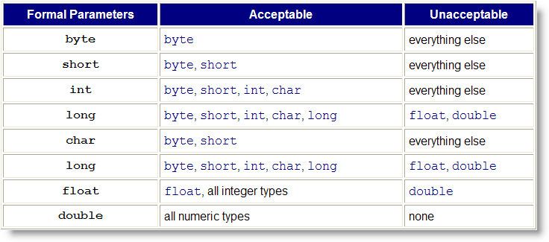
Good Arguments
Here are a list of acceptable (widening) conversions
Notes:
Good Arguments
When you call a method, the actual arguments you pass must be compatible with the formal parameters. Java will attempt to ensure this using a process called type-checking.
Generally what this means is that if assignment would succeed then the method call will also succeed. Remember, you can normally assign a smaller or less precise value to a more precise variable.
Here are some examples of acceptable primitive arguments that may help you:

Slide 17
Overloaded Methods
Why bother? More convenient coding
  Imagine writing System.out.printString(), etc.
Exercise 9: Overload Account ctors and methods:
  Account (double initBal, String owner) – initialize balance and owner; randomly generate account no.
  Account (String owner) – initialize owner; set initial balance to 0, randomly generate the account number.
  Overload the withdraw() method with one that also takes a fee and deducts that fee from the account.
Run TestAccount2.java to test your modified Account class. Snap a picture and paste it into ic19.doc
Notes:
Overloading II : Why Bother?
Why bother with method overloading? Doesn't it seem like having multiple methods, all with the same name, would be confusing? How are you supposed to remember which method is being called?
All of these are valid arguments against using overloaded methods. Simply giving all of your methods the same name without ample planning and forethought really will make your programs harder to understand and maintain.
Making Easy-to-use Methods
Properly used, however, method overloading allows you to write methods that are much easier to use than those that don't employ overloading. Here's an example.
Suppose that 90% of the buttons in your current project always use a blue, 24 point font, but that 5% require a 30 point blue font and the remaining buttons require fonts in varying sizes and colors.
The Generic Solution
To meet these requirements you could use the generic getButton() method which you wrote in the last section. If you do so, it means that for all of your buttons you'll have to write this:
Button b = getButton("String", 24, Color.blue);
even though you know that 90% of the time you will always be using 24 and Color.blue as the last two arguments.
Uniquely-named Methods
Another option would be to write multiple, uniquely-named methods, like get24ptBlueButton() and get30ptBlueButton(), and have each of these methods call getButton() passing the correct arguments.
Overloaded Methods
Finally, a third option would be to write three different methods, but to name all three methods getButton(). For the vast majority of your buttons—those blue, 24 point ones—you could call the method defined like this:
Button getButton(String text) { }
For those times when you need a blue button, but in a different size, you can call the method defined like this:
Button getButton(String text, int fontSize) { }
Finally, for the time when you really need 10 point yellow buttons, you can use the "full-featured" version of getButton() which is defined like this:
Button getButton(String text, int fontSize, Color bColor) { }

Slide 18
A Little More Eclipse
Introducing JUnit4 for writing unit tests
  Using Eclipse to generate JUnit test cases
  Using JUnit annotations to create test methods
  Using static imports to import Assert class methods
  Using different JUnit assertions
  Writing a test fixture using the setup() method

Slide 19

Testing: the Big Ideas
Testing and debugging are two sides of the same coin: ensuring correctness
  Testing is designed to expose errors
  Debugging is locating and fixing errors
Two ideas from Dijkstra
  Testing can only show the presence of bugs, never their absence
  Exhaustive testing is impossible: time to test all input combinations 2 32-bit ints?
    585,000 years at a million tests per sec.

Slide 20
Questions About Testing
To meaningfully test your program you have to ask three questions:
  1. What kind of tests are needed?
  2. How do I get my test data?
  3. How do I tell if my program works?
Three techniques to correct defects:
  1. Assertions—questioning assumptions
  2. Tracing or Logging—persistent examination
  3. Debugging—interactive examination

Slide 21
Unit Tests
Most important, basic testing tool
  Entire category of software designed to support this
  We're going to use the JUnit 4 program
Test a single method or a single class
You write a test harness
  A test harness is designed to feed arguments to your function, and to evaluate correctness of the results
  Up 'til now we've used "hand-rolled" tests
  Print expected and actual values
  Time consuming to evaluate

Slide 22
The Calculator Program
Exercise 10:We're going to start by adding some tests to a program called Calculator.java
  Import into your project from Q: drive
  Open in editor and inspect
  Active Checkstyle, set to CS 170 configuration
  Fix all errors and shoot a screen-shot
Calculator.java
  A simple calculator with an accumulator
  Methods to get/set/clear accumulator's value
  Methods to add, subtract, multiply and divide

Slide 23
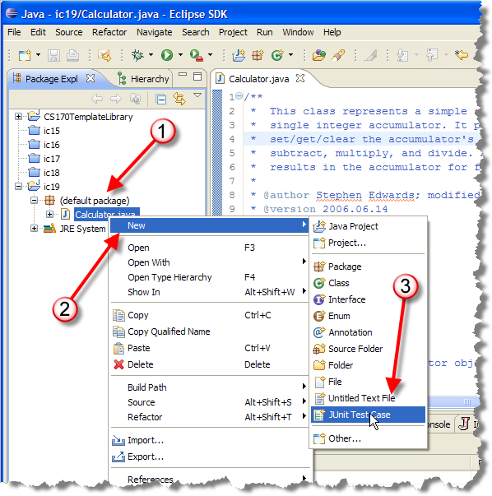
The Unit Test
A Test Case class
will include a
number of tests
  Right-click
  Calculator.java
  Choose
  New->JUnit
  Test Case
Notes:
Right-click on the Calculator.java file in the Package Explorer (on the left) and select New->JUnit Test Case. This will activate a wizard in Eclipse to help you create your test case class for the Calculator class.

Slide 24
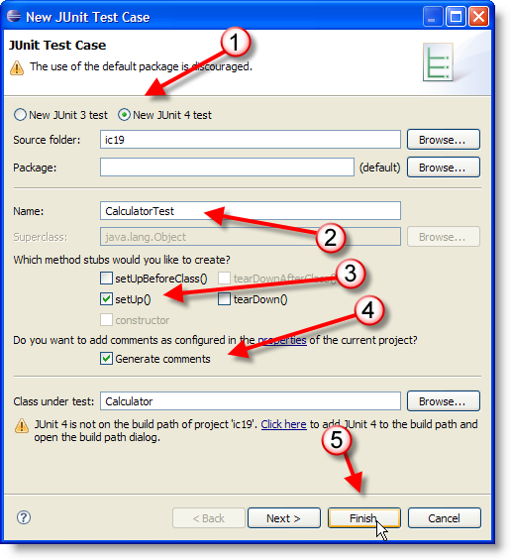
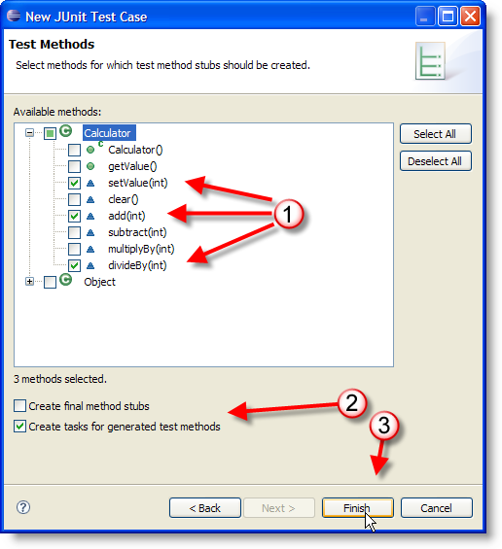
Test Class Wizard
Notes:
Use the default values for all fields (e.g. Source folder: Calculator, Name: CalculatorTest, Superclass: junit.framework.TestCase). Also, check the box next to setUp() to generate a stub for that method. Then click Next >.
Note: if you already have some experience with JUnit but have not started using JUnit 4 yet, you may wish to check the radio button to create a JUnit 4 test case at the top of the dialog.
Add some test cases
In the next step of the wizard, you will see a tree view showing the methods provided by the Calculator class. For each method you check in this view, the wizard will create a test case stub. For this example, turn on setValue, add, and divideBy. This will generate empty test cases for these methods.
Click Finish. This will generate a new CalculatorTest.java file in your project. It will also open this new file in the editor.

Slide 25
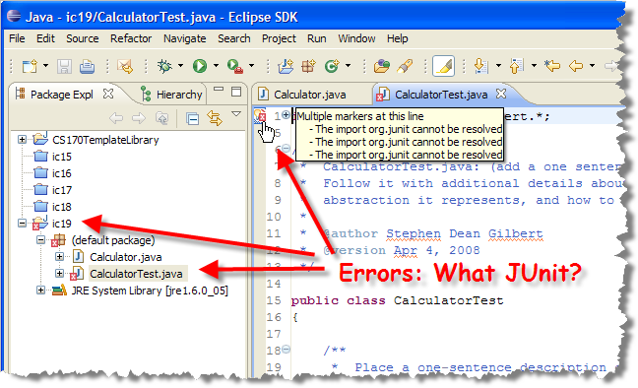
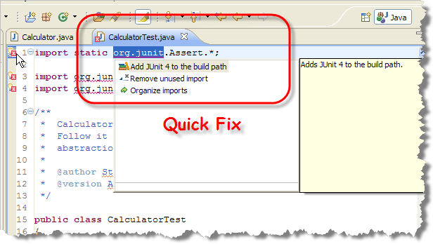
The Build Path
Errors? You have to add JUnit to the build path
  Exercise 11: Use Quick Fix to do this. Snap a pic.
Notes:
Add JUnit to your project's build path Your test cases will have a number of errors, all of them caused by the fact that the JUnit library is not in the build path for your project yet.
Look at the CalculatorTest.java file in the editor. Click on the lightbulb icon next to the import statement at the top of the file. Eclipse will pop up a window with several potential ways to fix this problem. Select the choice to "Add JUnit 3.8.1 to the build path":

Slide 26
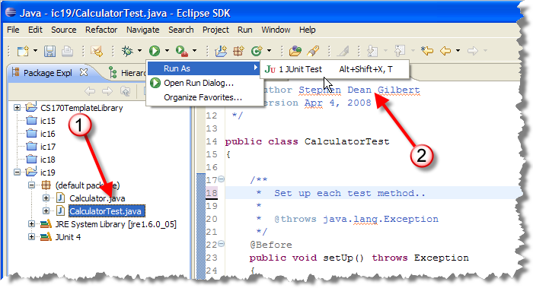
Run the Tests
Exercise 12: Run all of the tests, snap a pic
  Click CalculatorTest, Run As->JUnit Test
Notes:
Run your tests
Now select the CalculatorTest.java file in the Package Explorer view (the left pane). From the Run menu, select Run As->JUnit Test. This will run all of the test cases in your new test class (remember, the tests are just stubs at this point!). You can see the results in the JUnit tab to the right of to the Package Explorer tab. The test case stubs that were generated by the wizard have all failed.
Return to your CalculatorTest.java file in the editor and look at the code. You will see that each test case is a public void method taking no arguments, with a name that begins with the prefix "test". Each generated test case stub contains just a single line in its body:
Toggle line numbers 1 fail( "Not yet implemented." );
Now, you need to write the bodies for these test case methods.

Slide 27
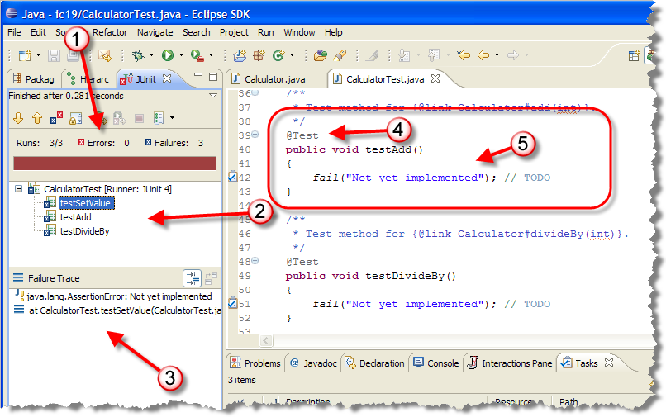
The JUnit Windows

Slide 28
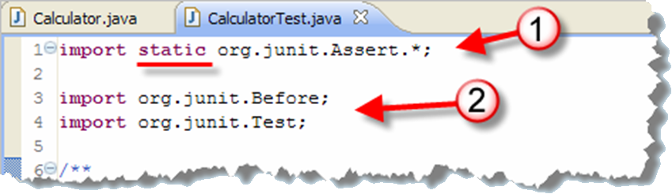
The JUnit4 Code
Static imports: use static methods w/o class name
Also uses regular imports for each annotation
  Annotations: special marker to identify code features
  JUnit uses @Test, @Before and @After

Slide 29
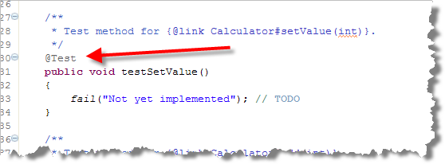
Test Methods
Any public void method taking no parameters
  Must be preceded by @Test annotation
  JUnit 3 required name to start with word test
  Not required in JUnit 4, but common convention

Slide 30
Writing Test Methods
Write a separate test method for each operation
  Create an object in a known state
  Call the method you are testing
  Compare the expected state with the actual state
Exercise 13: Add this code to the testSetValue() method, run your tests and shoot a screen-shot.
Calculator calc = new Calculator();
calc.setValue(5);
assertEquals(5, calc.getValue());

Slide 31
JUnit Assertions
Use assertions to compare expected versus actual
  Most common is assertEquals(expect, actual)
Here are some other useful assertions
  // For double or floating-point comparisons
  assertEquals(expect, actual, tolerance)
  // A simple boolean expression (true or false)
  assertTrue(condition) or assertFalse(condition)
  // Testing for null or not null
  assertNull(object) or assertNotNull(object)
Also versions that takes a string message parameter
http://junit.sourceforge.net/javadoc_40/

Slide 32
Writing a Test Fixture
Test cases often require you to repeat the same code
Test cases should be independent, so:
  you can't assume that one test will run before another
  instance and static variables are not reinitialized
Solution: create a test fixture to do the setup
  Instance variable: private Calculator calc;
  Inside setUp(): calc = new Calculator();
The setUp() method is run before each test
Exercise 14: create a test fixture and re-run your tests

Slide 33
Selecting Test Cases
Positive tests: legitimate input you expect the program handles correctly
  All values >= 0 in a square-root program
Boundary cases: also legitimate input to be handled in a trivial way
  0 or the empty string may be handled as a special case
Negative cases: input that you expect to fail
  Negative numbers, string input?

Slide 34
Regression Testing
Whenever you fix a bug, you need to make sure it doesn't reappear later
  Fixing a bug, only to have it reappear after further program modifications is called cycling
Every time you fix a bug, you should add a test for it
  Keep all tests; re-run every time you change program
Testing your code against tests from past bugs is called regression testing
  Another reason to keep your test data

Slide 35
Black-box and White-box
Testing function without regard for internal structure
  Known as black-box testing
  Testing against the problem specification
Doesn't insure all parts are tested
  Possible that our inputs don't exercise some particular branch in the code
  Looking "inside" is white-box or clear-box testing
Most common: coverage testing
  Uses specialized tools, like Clover (with Web-Cat)

Slide 36
Finish Up
Exercise 15: Complete remaining tests, shoot a screen-shot of JUnit running green.
In-class exercise: submit before you leave today!
  Drop into Q:\faculty5\sgilbert\cs170\submissions

