Slide 1
Data Mining the US DOT Statistics on Aviation
Cloud Computing Capstone
Stephen Dimig
January 2016
Task 1

Slide 2
Purpose
The goal of this paper is to analyze the transportation dataset from the US Bureau of Transportation Statistics (BTS) that is hosted as an Amazon EBS volume snapshot and answer a set of interesting questions about it. The dataset contains data and statistics from the US Department of Transportation on Aviation in CSV format. The dataset we are using does not extend beyond 2008, it contains flight data such as departure and arrival delays, flight times, etc. The set of questions that will be answered fall into three groups as outlined below. All code and results for this project can be viewed at:
https://github.com/stephendimig/cc-capstone

Slide 3
System Setup and Installation
Summary
Attribute | Value
Instance Type | C3.xlarge
AMI ID | ami-36d95d5e | hortonworks 2.1 - sandbox
vCPUs | 4
Memory | 7.5 GB
Instance Storage | 128 GB | Increased the storage size
EBS Vol. ID | snap-23a9cf5e | BTS transportation data
R | 3.2 | R programming language
Cassandra | 2-1.2.10-1 | NoSQL Database

Slide 4
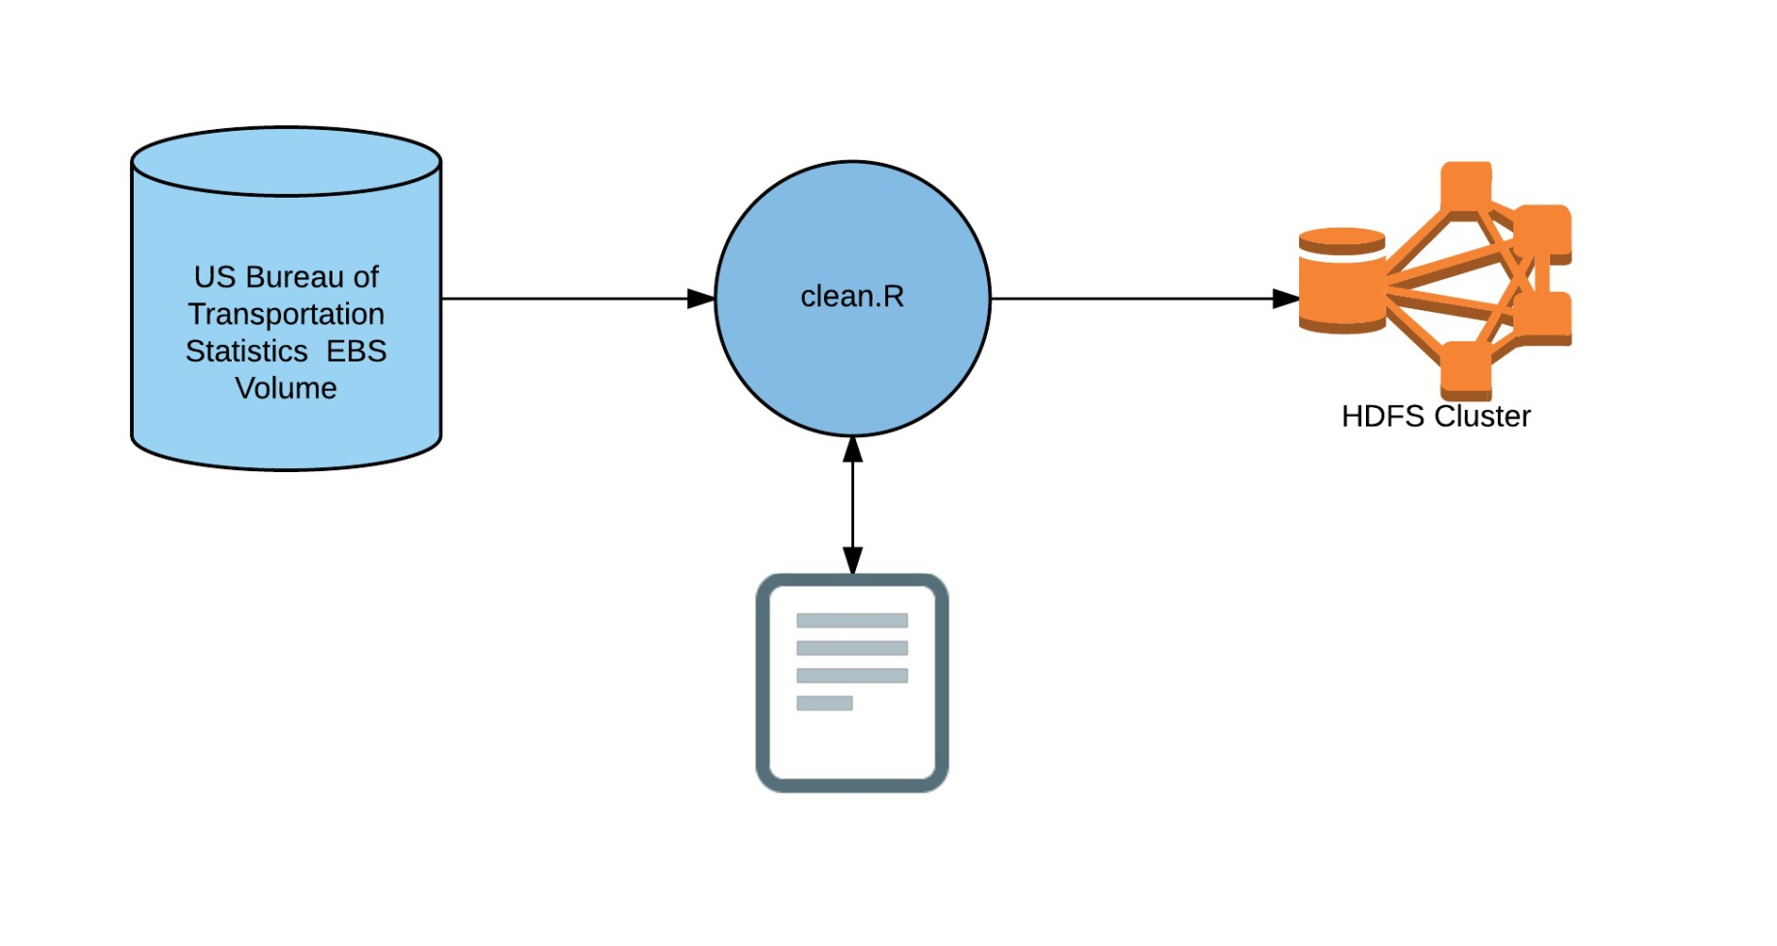
Cleaning the Data
Data is read from EBS volume, filtered through R, and stored in HDFS

Slide 5
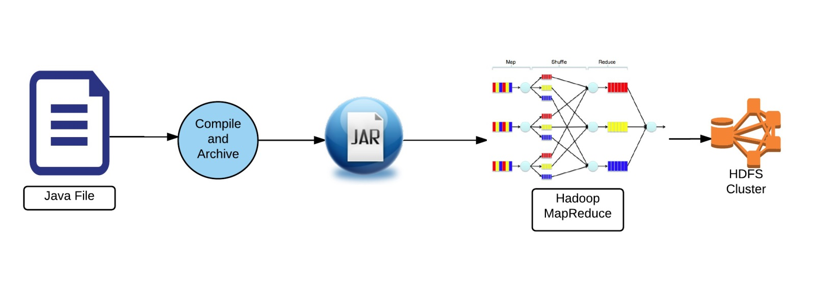
Group 1 Problems
These problems were solved with straight MapReduce using Java

Slide 6
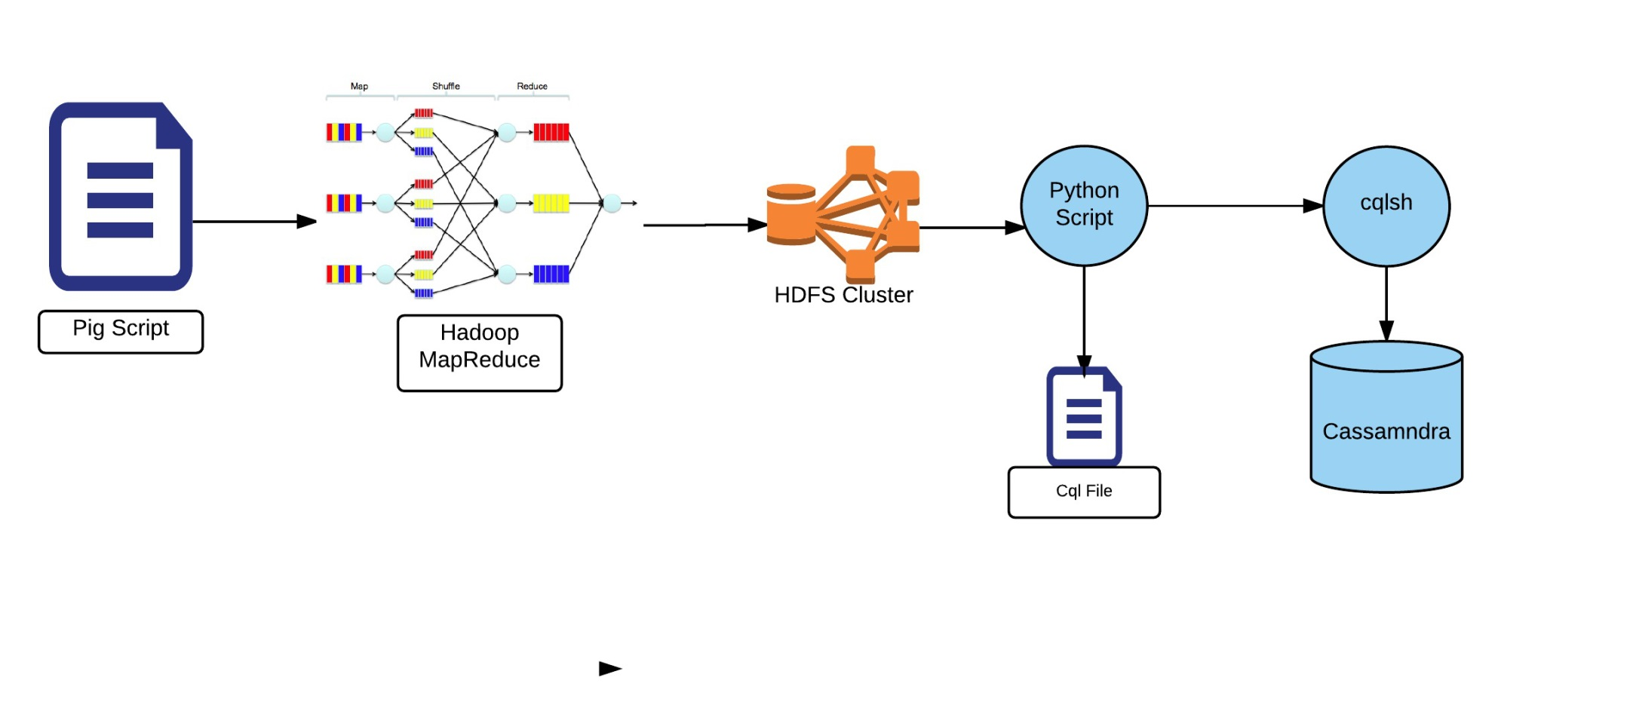
Group 2 Problems
Main processing by Pig, output is filtered through python, stored in Cassandra

Slide 7
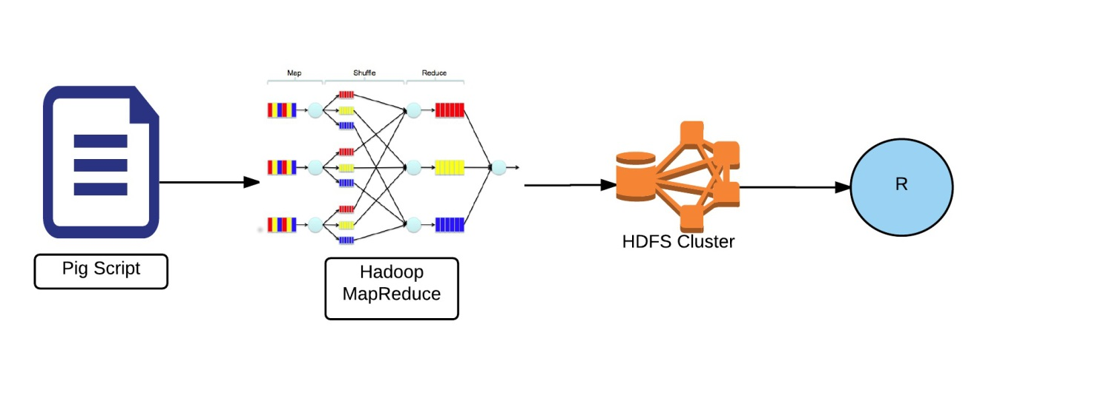
Group 3 Problems
Main processing by Pig, output is filtered through R

Slide 8
Conclusions
I like the results in the data but I think I might have not cleaned it properly. For example, I believe that flight cancellations should be removed rater than replacing the delay values with zeroes which skews the data for carriers with a smaller number of flights. I struggled at the beginning of this project due to some technical difficulties with the ami image I was using. I figured that out though and had a lot of fun. I was wanting to do something similar to this in the Data Science specialization from Johns Hopkins since R is so slow with large data sets. This proves to me you can extract the majority of the data using Hadoop and do the final analysis in R in a powerful way.

