Slide 1
EER Model –
Chapter 4.1-4.3

Slide 2
Why EER? -- Enhanced Entity Relationship
There are limitations to the ER model
ER model enhanced (EER) to include:
  superclass/subclass relationships
  type inheritance
  specialization and generalization
  constraints

Slide 3
Subclasses
Subclass of an entity type
  relationship – is-a
  derive subclass from superclass
  manager “is a(n)” employee
    subset symbol in connecting line
  member of a subclass must also be a member of some superclass

Slide 4
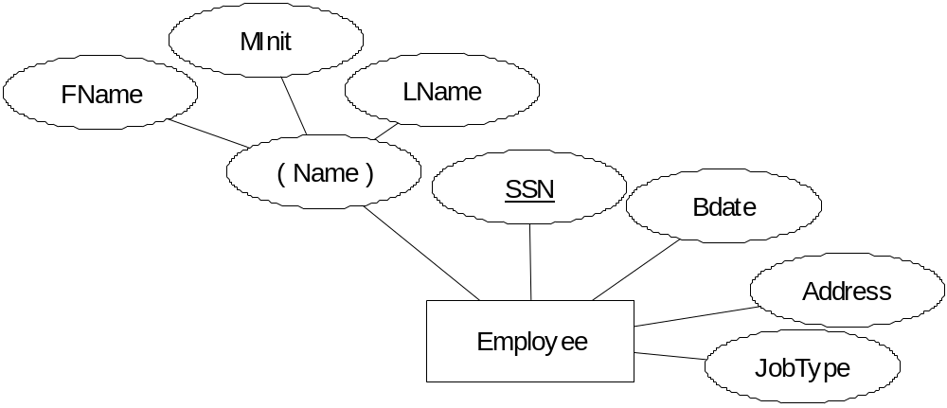

Ù

Slide 5
Type inheritance
inherit all attributes of superclass
useful for modeling, convenience

Slide 6
Specialization
Specialization
e.g. salaried and hourly – specialization of employee
  circle connecting all specialized subclasses
  still use subset symbol to connect subclass to circle
  specific attributes attached to subclass
  subclasses can also participate in specific relationship types

Slide 7
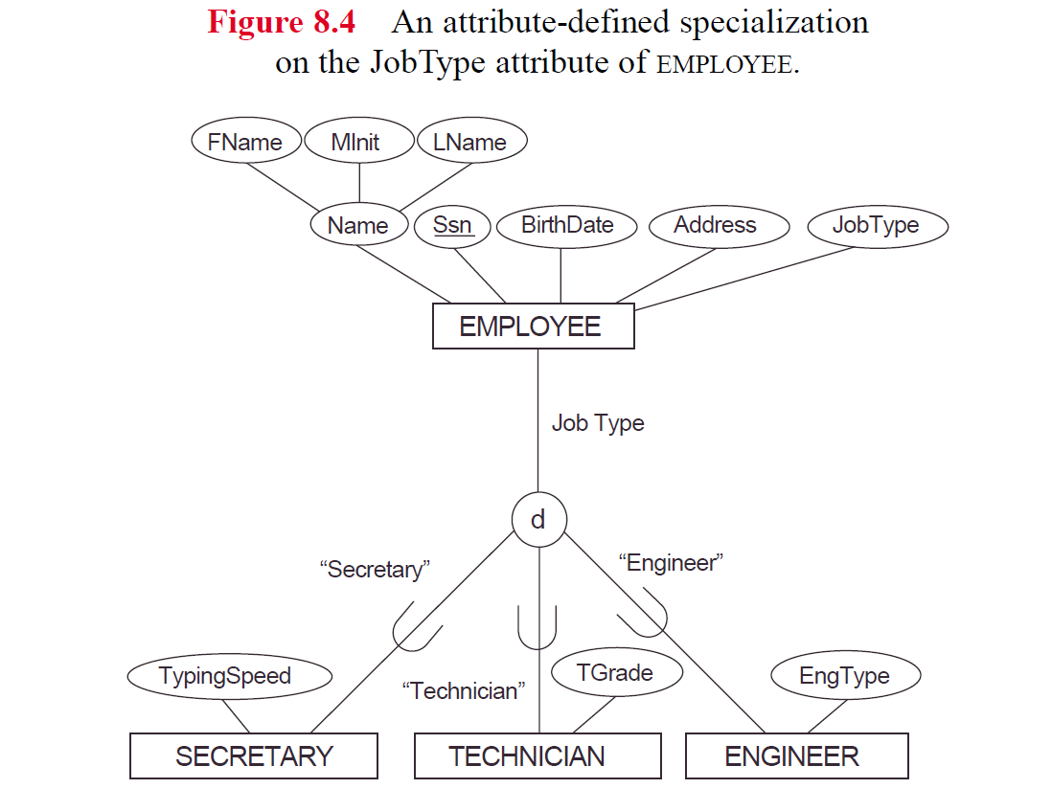

Slide 8
Specialization Constraints
Predicate defined (condition-defined) subclasses
manager = True
  has a defining predicate for the subclass
Attribute defined
  if all subclasses have membership based on same attribute
User defined - if no condition

Slide 9
Constraints cont’d
Disjointedness constraint
  subclasses disjoint
  member of at most 1 subclass
  use ‘d’ in circle to indicate
Otherwise,
Overlapping constraint
  sets of entities may overlap
  member of more than 1 subclass
  use ‘o’ in circle to indicate

Slide 10
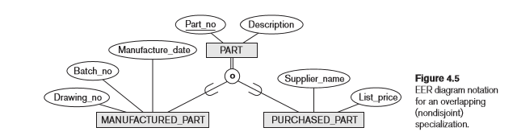

Slide 11
Constraints cont’d
Completeness constraint
  total specialization
    every entity in superclass must be member of some subclass of specialization
    indicate with double line from superclass to circle
  partial specialization
    entity does not have to belong to any subclass
    indicate with single line
    Can have disjoint total, disjoint partial, overlapping total, overlapping partial

Slide 12
Generalization
Generalization of entity types into a single superclass
vehicle is generalization of car, truck

Slide 13
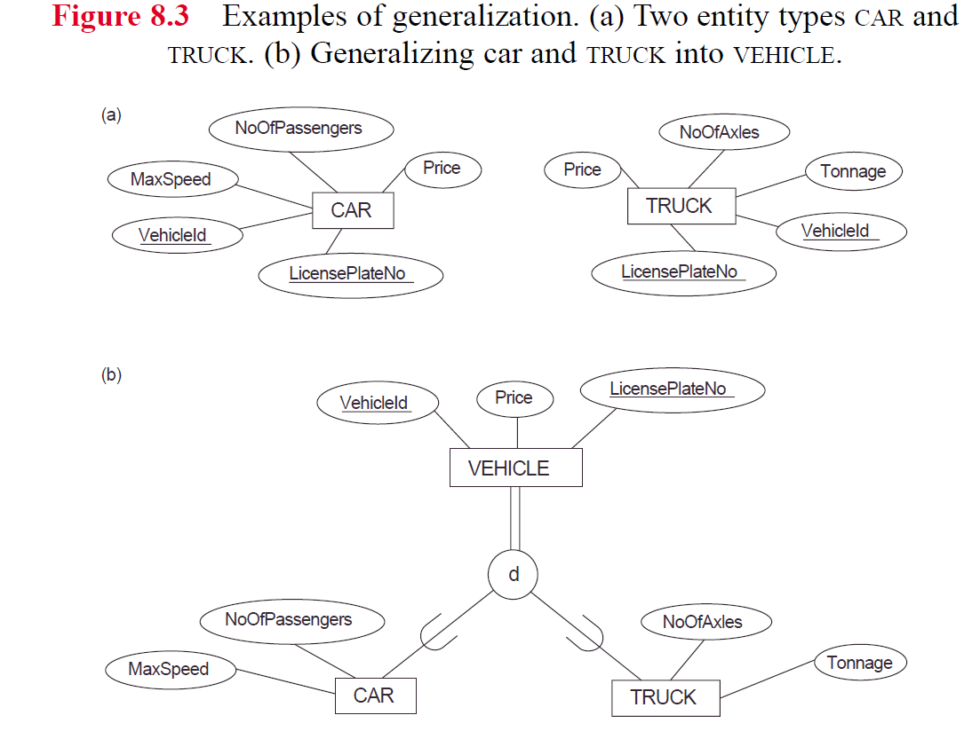

Slide 14
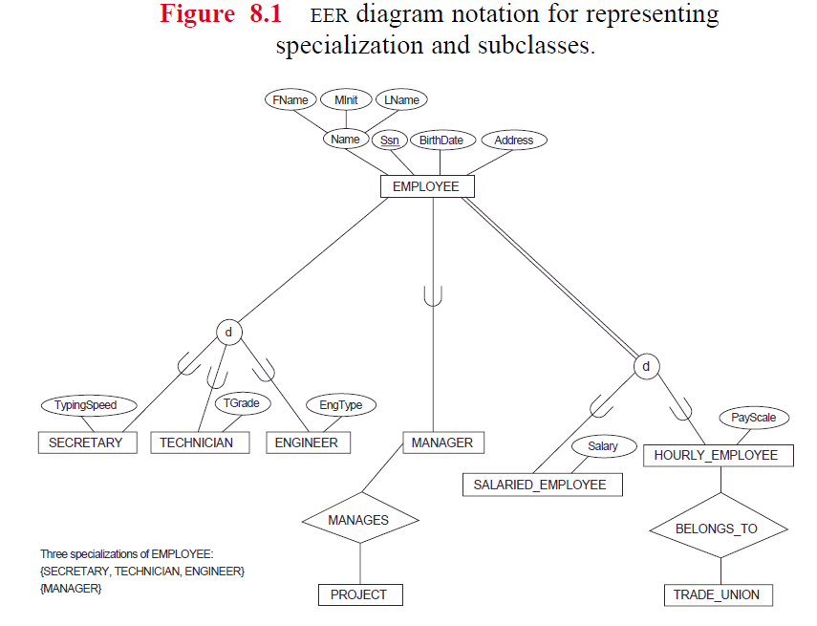

Slide 15
Specialization/Generalization Lattice
a class can be a subclass in more then one class/subclass relationship
an entity may exist in several leaf nodes
multiple inheritance

Slide 16
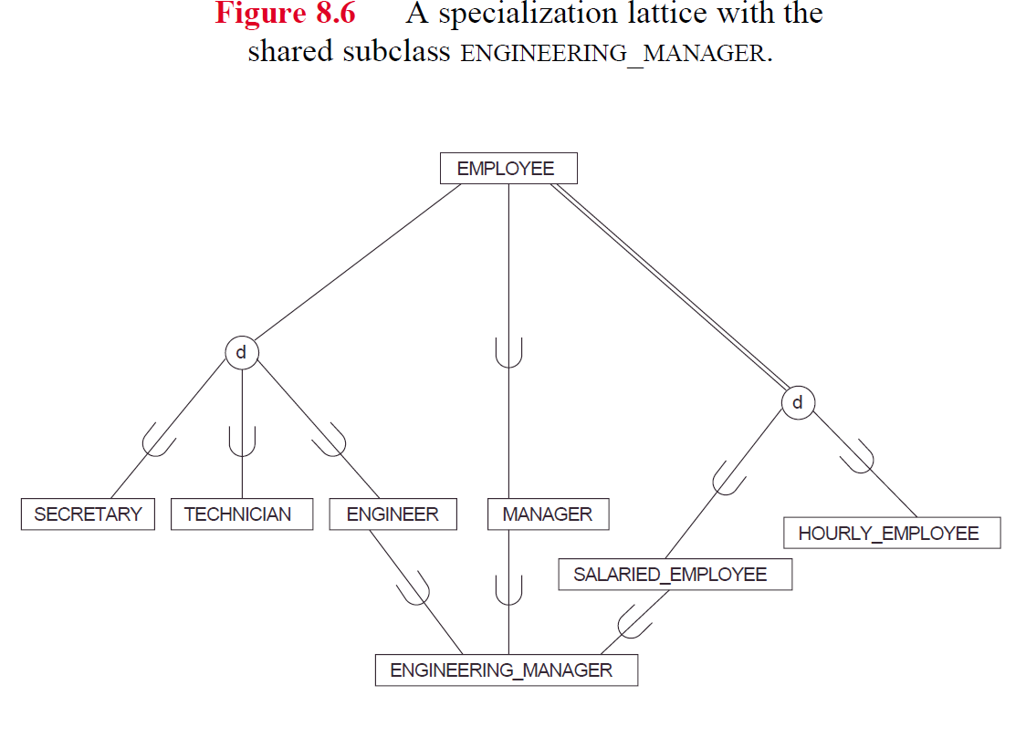

Slide 17
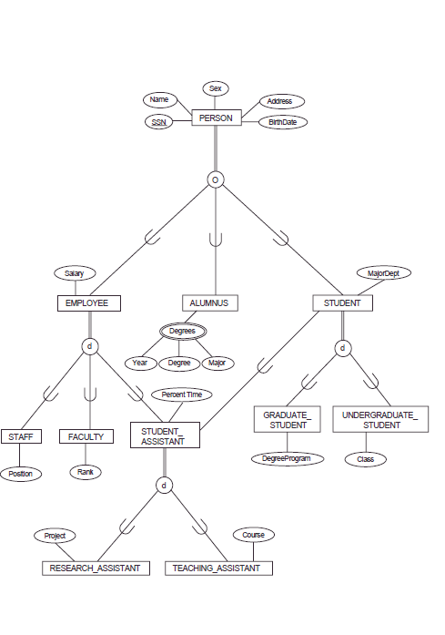

Slide 18
Union Types
Union of objects of different entity types (superclasses)
Union type is a subclass of a collection of objects that is a subset of the union of its superclasses
  Union means can only be a member of one of the superclasses
    Different from multiple inheritance, which was subset of intersection of superclasses, e.g. was an engineer and a manager and a salaried employee
  Can only inherit attributes from one superclass, not all
  Can even have different key attributes, depending on which inherit from

Slide 19
Union Types
Subclass of the union of 2 or more subclasses
  create a new table
  PK is a surrogate key, since it can have different types of PKs
  Include surrogate key as foreign key in all tables corresponding to the superclasses
  If entity is not a member of subclass, foreign key is null
  Can add a type attribute to indicate to which superclass entity is a member

Slide 20
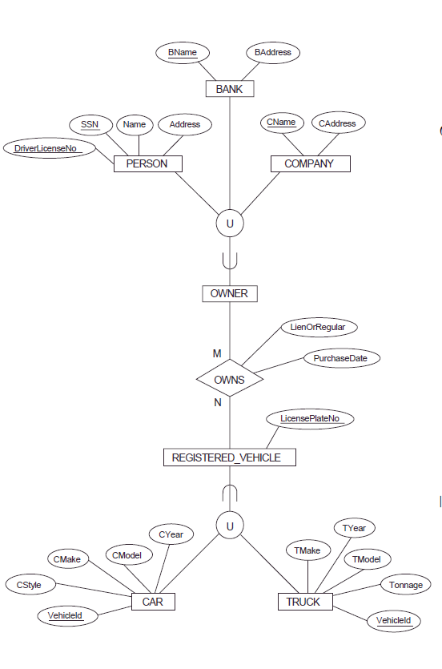

Slide 21
UML notation – Chap. 4.6
Subclasses - specialization/generalization (is-a)
  Triangle to indicate
    blank triangle is disjoint
    filled triangle is overlapping
Aggregation – relationship between object and component parts (has-a relationship)
  Diamond indicates whole vs. part

Slide 22
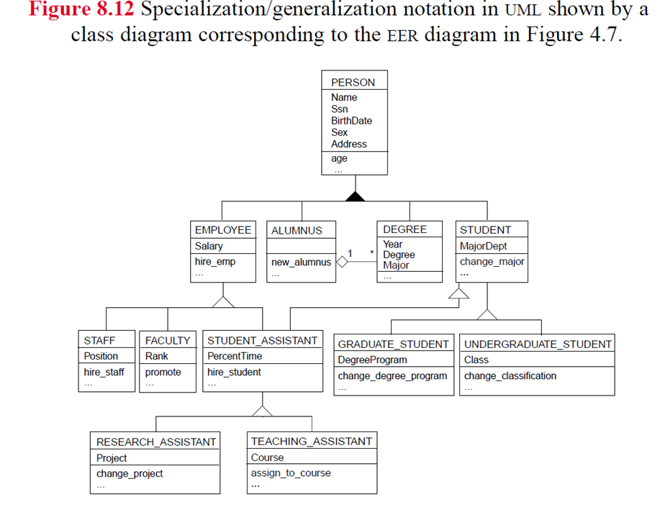

Slide 23
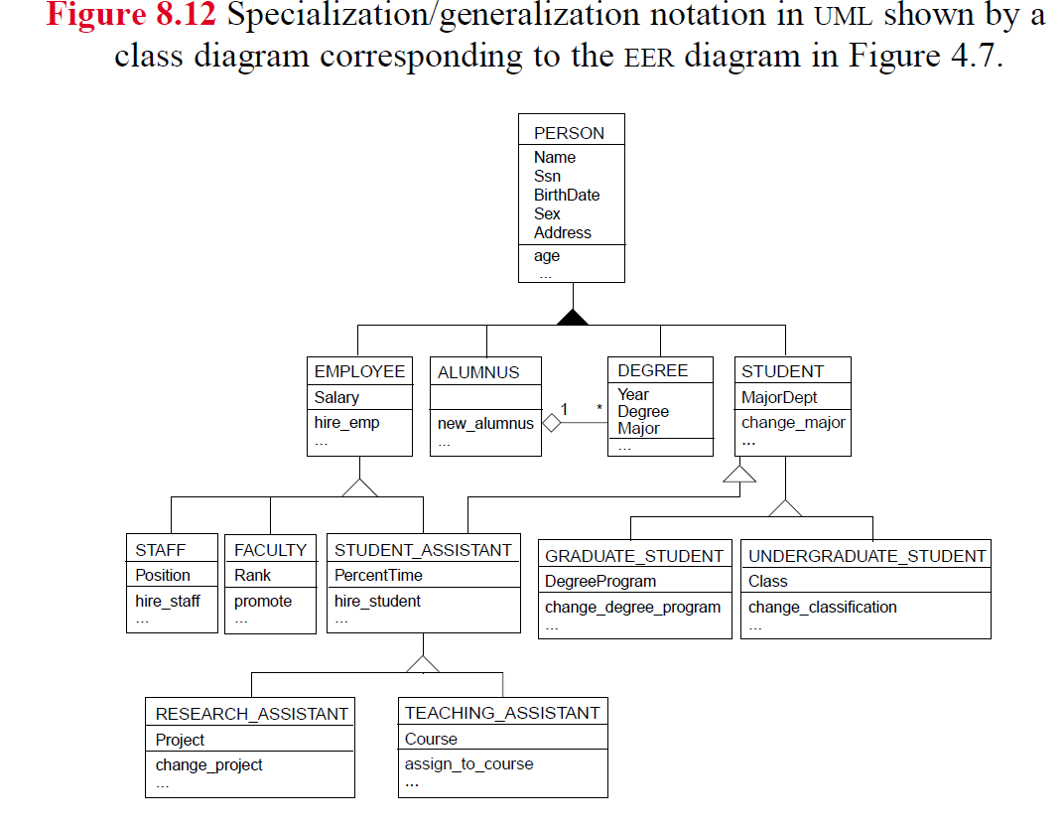
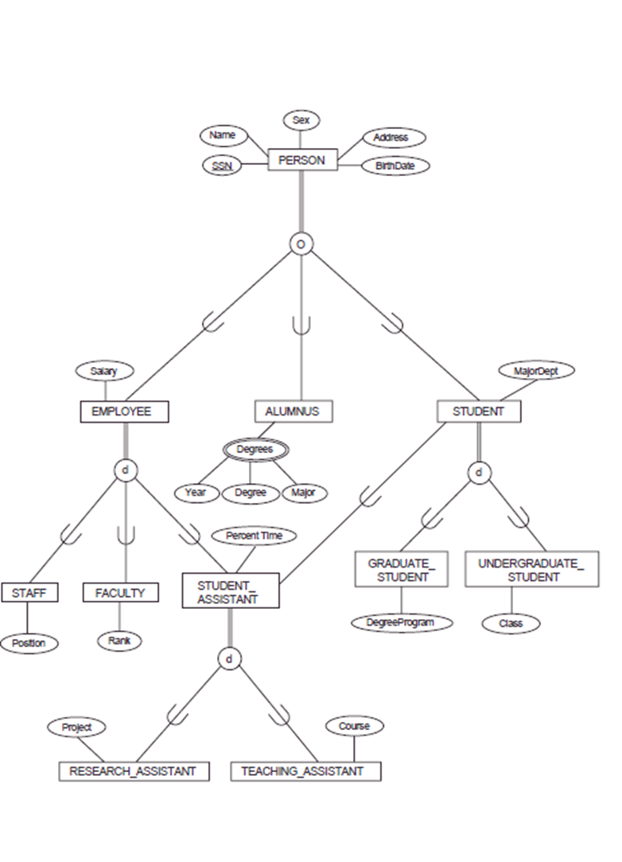

Slide 24
The remaining slides will be discussed later

Slide 25
Step 8 - Mapping EER model concepts to Relations
Superclass/Subclass and Specialization/Generalization
  Convert each specialization with m subclasses
    {S1, S2, ..Sm}
  and superclass C where attributes of C are:
    {PK, A1, ...An}
  Using 1 of the following options:

Slide 26
Option 1 (Option A in book)
Create a new relation L with attributes of C
Create new relations Li for each subclass Si with attributes
{PK} U {attr. of Si}

Slide 27
Option 2 (Option B in book)
Create new relations Li for each subclass Si with attributes
(attr. of Si} U {PK, Ai, ..An}

Slide 28
Option 3 (Options C and D in book)
Create one new relation L with attributes
{PK, Ai, ..An} U (attr. of S1} U{attr. of S2} ... U {attr. of Sm} U {t1, ... tm}
  each ti is a Boolean indicating whether tuple belongs to Si
  Have one type field t, instead of m type fields if disjoint

Slide 29
Summary of Options
Option 1
  Create one table for superclass, and one table for each subclass
    Include PK of superclass in subclass tables
Option 2
  Create one table for each subclass
    include superclass attributes in each subclass table
Option 3
  Create one table with attributes from superclass and all subclasses
    If overlapping, include m columns, one for each subclass to indicate membership in that subclass
    If disjoint, include 1 column to indicate which subclass a member of

Slide 30
Which option is better/worse under which circumstances?

