Slide 1
DB storage
A page can contain one or more objects (row order)
Many databases are still stored on hard drive disks
Pages from a table can be stored anywhere on a disk, e.g. scattered around the disk or hopefully, next to each other
Must perform disk access to get to data

Slide 2
DB Storage Hierarchy
Pages stored on disk and/or memory
HDD – Hard disk drives: disks with tracks, cylinders, heads, sectors
SSDs: array of semiconductor memory – read a specific flash SSD location, organized as blocks
Flash memory – SSD that stores persistent data in flash memory but limited size
Cache DB in memory

Slide 3
Indexes - Chapter 17.3-17.5

Slide 4
Why use an index
For example:
If always want to retrieve student records based on CWID
If I always want to retrieve a record where key = some value
If I retrieve documents that contain the word “Stormy”
Instead of reading the entire file until value is found, it would be nice if we had a pointer to that employee, record, document
Also useful in relational model for joins
Want a way to improve performance
Want to minimize the amount of data read and the number of disk accesses

Slide 5
Alternatives?
Why not just use a binary search ?
Data file must be sorted - insertions and deletions can be a problem
Binary search requires searching the data file
Disk access?
Instead use an index so just search the index

Slide 6
What is an index?
An index is itself an ordered file
The index file is physically ordered on disk by the key field
The index file has records of fixed length, containing:
key field, pointer to data
< ki pi >
If key field is not a PK
< ki pi, pj, pm,…pn >

Slide 7
Single level index file
Index can be a single level file listing each value in data file and pointers to data
key field, pointer to data
< ki pi >
Textbook calls this a primary index

Slide 8
PK | Ptr
1
5
34
66
75
PK | Name | Gen | Univ | Major
66 | Bob | M | UA | CS
75 | Carol | F | UAB | EE
1 | Ahmed | M | UA | CS
34 | Nico | M | UAH | EE
5 | Jamal | M | UA | EE

Slide 9
Limitations
How to search index file?
Binary search – same issues, sorted, etc.
What happens as the index itself grows?
Increase levels? (next slide)
How can we improve upon this?
Tree structured index (B+tree)
Hash Index

Slide 10
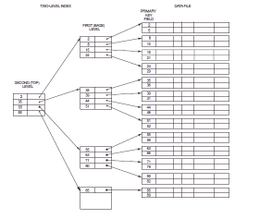
Multi-level index
Possible problems?
Balanced?

Slide 11
Current Implementation of indexes
To implement an index use B+ tree
B+ tree is based on a B-tree
B-tree
balanced tree
insert, delete is efficient
nodes are kept half full, a node is split when it is full
nodes are combined when less than half full

Slide 12
B-tree
Each B-tree has an order p (fan out) which is the maximum number of child nodes for each node
The value of the search field appears once along with a data pointer

Slide 13
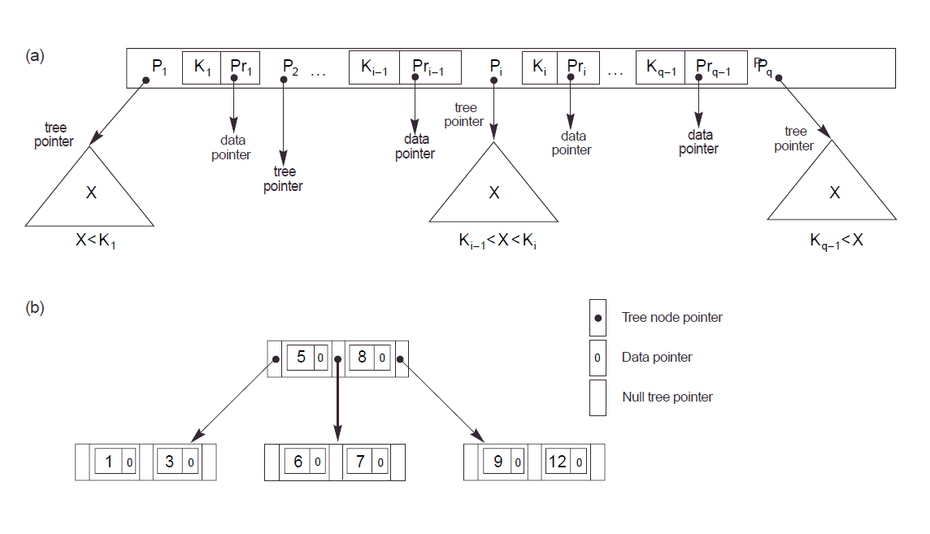

Slide 14
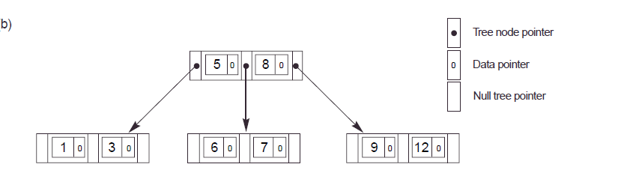
B-tree
Each node contains the following information:
<P1, <K1, Pr1>, P2, <K2, Pr2>, … < > Pq>
where Pi is a pointer to another node in the tree
K_{i} is a key field
Pr_{i} is a data pointer - a pointer to a record (page) whose key field value is equal to K_{i}

Slide 15
B-tree
Within each node K1 < K2 < .. Kq-1
Each node has at most p tree pointers
A node with q tree pointers, q <= p, has q-1 field values and q-1 data pointers
Each node except the root and leaf nodes has at least ceiling(p/2) tree pointers
Leaf nodes have the same structure as internal nodes except that all of the their tree pointers are null
Balanced tree – meaning all leaf nodes at same level
Problems?

Slide 16
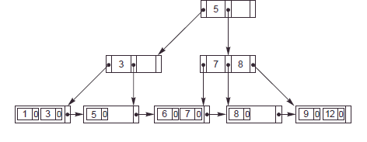
B+ tree
A variation of the B-tree
Data pointers are stored only at the leaf nodes of the tree
A data value can appear in both the upper level and in a leaf level
Leaf nodes different from internal nodes
Leaf nodes have an entry for every value of the search field along with a data pointer
Leaf nodes are linked together to provide ordered access
When using a DB, if say B-tree, usually mean B+-tree

Slide 17
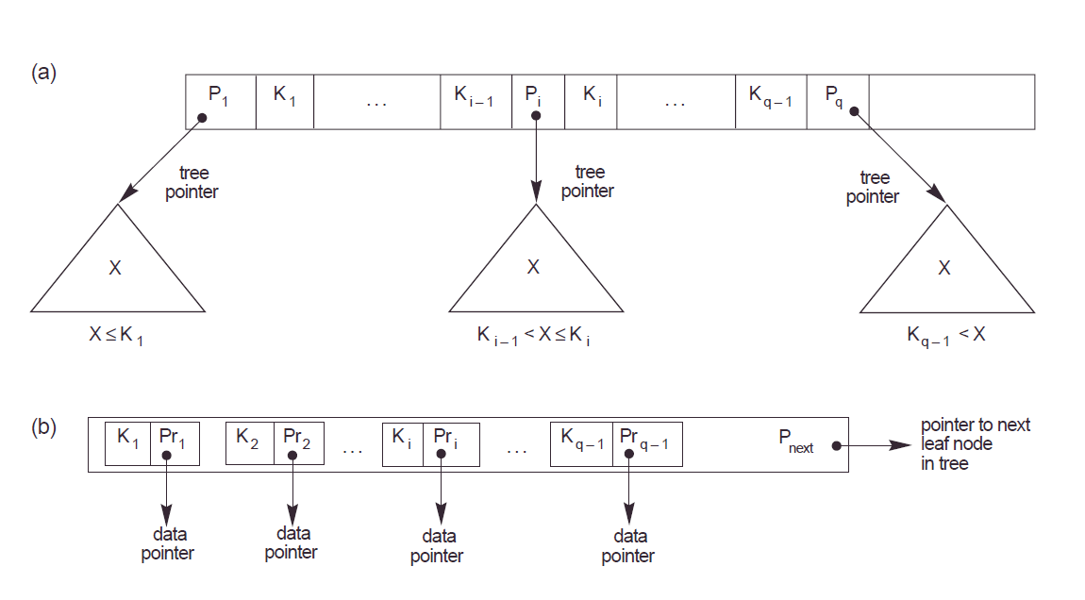

Slide 18
B+ tree
Internal nodes of a B+ tree
<P1, K1, P2, K2, … Pq-1, Kq-1, Pq>
where each P_{i} is a tree pointer
Each internal node has at most p tree pointers
p is called the fanout
Each internal node (except the root) has at least ceiling(p/2) tree pointers
An internal node with q pointers has q-1 key field values

Slide 19
B+ tree
The structure of the leaf nodes of a B+ tree:
<<K1, Pr1>, <K2, Pr2>, … <Kq-1, Prq-1>, P_{next}>
where Pr_{i} is a data pointer and P_{next} points to the next leaf node of the tree
Each leaf node has a least floor((p-1)/2) or ceiling(p/2)-1 values
All leaf nodes are at the same level

Slide 20
B+tree info
Each internal node has:
at most p tree pointers
at least ceiling(p/2) tree pointers
If q pointers has q-1 key field values
Each leaf node has:
a least floor(p/2) values
All leaf nodes are at the same level

Slide 22
B+ Trees in Practice
Typical order: between 100-200 children
Typical fill-factor: 2/3 full (66.6%)
Average fanout = 133
Typical capacities:
Height 4: 133⁴ = 312,900,700 records
Height 3: 133³ = 2,352,637 records
Can often hold top levels in buffer pool:
Level 1 = 1 page = 8 Kbytes
Level 2 = 133 pages = 1 Mbyte
Level 3 = 17,689 pages = 133 MBytes

Slide 23
Types of B+ indexes
Non-clustered index (secondary index in textbook)
key field is a non ordering field
not used to physically order the data file
the index itself is still ordered
How many non-clustered indexes can a table have?

Slide 24
Types of B+ indexes
Clustered/clustering Index
Key field is an ordering field
Same values for the key on the same pages (clustering index in textbook)
If a candidate key, data sorted by key field (primary index in textbook)
Usually assume disk pages themselves also clustered on the disk
How many clustered indexes can a table have?

Slide 25
Performance – clustered vs. non-clustered
http://www.dba-oracle.com/oracle_tip_hash_index_cluster_table.htm

Slide 26
Why use B+ tree instead of B-tree?
The leaf nodes are linked together to provide ordered access on the key field to records – range queries
Can access all of the data by one pass through the upper levels of the tree
Other reasons?
Is it always faster to search a B+-tree than a B-tree?
Will revisit this later

Slide 27
SQL Create Index
Create index index_name
on table_name (col_list) [options];

Slide 28
Definitions
Can have multiple indexes - more than 1 index on table
How to create?
Create index Idx1 on Table (c1);
Create index Idx2 on Table (c2);
Can have composite indexes - more than 1 key field, 1 index
Create index I1 on Table (c1, c2);
What does it look like if B+-tree?

Slide 29
Clustering Index Info
Can only cluster table by 1 clustering index at a time
In DB2 –
Use cluster clause in create index statement
if the table is empty, rows sorted as placed on disk
subsequent insertions not clustered, must use REORG
In SQL server
creates clustered index on PK automatically if no other clustered index on table and PK nonclustered index not specified
In Oracle-
No clustered index – instead Index-organized table (as opposed to unordered collection)
Stores entire table in B+ tree
Instead of storing just key, store all columns from table
index is the table
Claims more efficient than regular clustered index

Slide 30
B+-tree vs. B-tree
Select A1, A2, … An
From R
Where A1 <= val1 and A1 >= val2
Assume an index on A1
Which is better?
B+-tree
Why?
A range query so can traverse the leaf nodes to find the data

Slide 31
B+-tree vs. B-tree
Select A1, A2, … An
From R
Where A1 = val
Assume an index on A1
Which is better?
Maybe B-tree
Why?
Because the val for A1 may be in the root node of the B-tree and you are then done searching the rest of the B-tree

Slide 32
B+ Tree Similar to Multi-Way Search Tree
A B+tree is an ordered tree such that
Each internal node (except root) has at least ceiling(p/2) children and stores a maximum of p −1 key-element items (k_{i}, ptr_{i}) where p is the number of children
For a node with children v₁ v₂ … v_{d} storing keys k₁ k₂ … k_{p−1}
keys in the subtree of v₁ are less than or equal to k₁
keys in the subtree of v_{i} are between (k_{i−1} and k_{i}] (i = 2, …, p − 1)
keys in the subtree of v_{p} are greater than k_{p−1}
The leaves point to the data containing the key value k_{i}
8 15
2o 6o 8o
11o 15o
24o 32o
Input: 11 24 32 15 8 6 2 and p=4 and o is a pointer to the data

Slide 33
Inserting into B+ Tree
Find correct leaf L.
Insert data into L.
If L has enough space, done!
Else, must split L (into L and a new node L’)
Copy up middle key to non-leaf node
If 2 middle values, choose smallest
Redistribute entries evenly into 2 nodes
If odd number of entries, left-most sibling gets the extra
Insert entry pointing to L’ in parent of L
Split can happen recursively
To split non-leaf node, redistribute entries evenly into 2 nodes, but push up middle key to parent node. NO need to copy, just push.
Splits “grow” tree; root split increases height.
Tree growth: gets wider or one level taller at top.

Slide 34
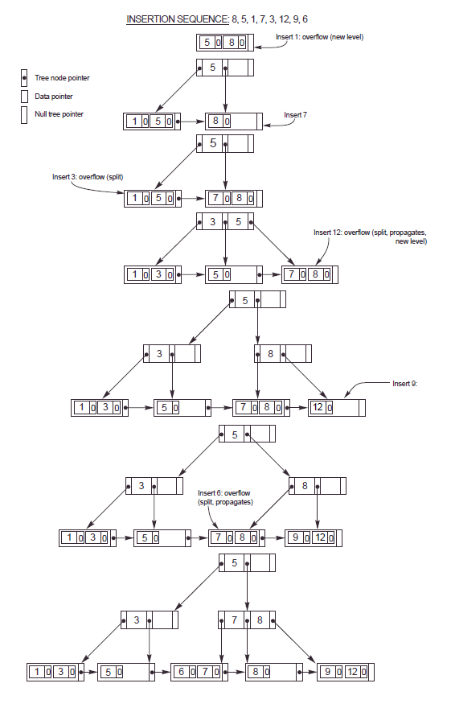

Slide 35
Inserting into B+ Tree
Find correct leaf L.
Insert data into L.
If L has enough space, done!
Else, must split L (into L and a new node L’)
Copy up middle key to non-leaf node
If 2 middle values, choose smallest
Redistribute entries evenly into 2 nodes
If odd number of entries, left-most sibling gets the extra
Insert entry pointing to L’ in parent of L
Split can happen recursively
To split non-leaf node, redistribute entries evenly into 2 nodes, but push up middle key to parent node. NO need to copy, just push.
Splits “grow” tree; root split increases height.
Tree growth: gets wider or one level taller at top.

Slide 37
Important points
If you must split a LEAF node, COPY the appropriate value to a parent
If you must split a NON-LEAF node, you move a value up, DO NOT COPY IT
Specific to this class: (for exams and homework)
If 2 middle values, pick the smallest middle value to copy or move up
If odd number of values, when split node, leftmost sibling gets the extra value
Assume the value of a child node is <= value of the parent

Slide 38
Deleting from Tree
If node is less than half full can:
Borrow from sibling
If can’t may have to merge with sibling
Affect parent, merge with cousin
May propagate up …

Slide 39

Other types of indexes
Can also have hash indexes based on hashing - hash search algorithm based on K
<K, P>
apply hash function to K to get to correct entry in index, index gives pointer to actual tuple(s)

Slide 40
Hash Indexes
Hash terminology
Bucket – unit of storage for one or more tuples, typically a disk block
K – set of all search-key values
B- set of all bucket addresses
h - hash function from K to B
Bi = h(Ki)
Hash function returns bucket number to use

Slide 41
Hash index challenges
Skew
Multiple records same search key
Hash function may result in nonuniform distribution of search keys
Insufficient buckets
Overflow buckets, overflow chaining

Slide 42
PK | Name | Dept. | Loc
666 | Jones | CS | UA
66662 | Lee | ECE | UAH
6661 | Liu | CS | AU
36365 | Ahmed | CS | UAB
24245 | Dolf | CS | AU
12125 | Sky | EE | UAB
12121 | Jukic | MIS | UA
Use mod 6 for hash function
Assume 2 values per bucket

Slide 43
Bucket 0
Mod 6 hash function, Bucket holds 2, assume chaining if overflow
666
PK | Name | Dept. | Loc
666 | Jones | CS | UA
66662 | Lee | ECE | UAH
6661 | Liu | CS | AU
36365 | Ahmed | CS | UAB
24245 | Dolf | CS | AU
12125 | Sky | EE | UAB
12121 | Jukic | MIS | UA
Bucket 1
6661
12121
Bucket 2
66662
…
Bucket 5
36365
24245
12125
Overflow Bucket

Slide 44
Static and Dynamic Hashing
Static hashing – DBs grow large over time
Choose hash function based on anticipated size
Buckets created for each value
Reorganize hash structure as file grows
New function, recompute function, new buckets
Dynamic hashing – extendable
Hash function generates value over large range
Do not create bucket for each value
Create buckets on demand
Add additional table – bucket address table

Slide 45
B+-tree vs. Hashing – pros/cons
B+-tree must access index to locate data
Hashing requires potential cost of reorganization
Which is better depends on types of queries

Slide 46
B+-tree vs. Hashing
Select A1, A2, … An
From R
Where A1 = val
Index created in A1
In hash, average lookup time is
constant, independent of size of DB
However, in worst case, hashing
proportional to number of values in R for Ai
B+-tree Requires time
proportional to the
log base fanout of the number of values in A1

Slide 47
B+-tree vs. Hashing
Select A1, A2, … An
From R
Where A1 <= val1 and A1 >= val2
B+-tree is best
Why?
hash function
If good function, buckets assigned values randomly
is this good for range queries?

Slide 48
Bitmap indexes
Bitmap index
Create 1 index for each value in domain of attribute
Bitmap=1 for value, 0 for others
E.g. (N, S, E, W requires 4 indexes)
When would this be useful?
Name | Sex
Bob | 1
Sue | 0
Lee | 1
JT | 0
Name | Sex
Bob | 0
Sue | 1
Lee | 0
JT | 0
Name | Other
Bob | 0
Sue | 0
Lee | 0
JT | 1

Slide 49
Index Usage
May not always use index
Query optimizer decides when to use index
Doesn’t use index if would access a large percentage of rows in the table

Slide 50
Oracle
Can create:
Normal index – B+-tree
Cluster index
Must create a cluster first (one or more table)
Stores together all rows from the tables that share the same cluster key
Index-organized table
Sounds like a Primary index
Data sorted by PK, table does not have a stable physical location
Leaves of B+-tree have PK and actual row data
Bitmap
Function-based
Hash – must create a hash cluster
Application domain

Slide 51
Oracle guidelines
Oracle automatically creates indexes, or uses existing indexes, for attributes defined with unique and primary keys.

Slide 52
Oracle guidelines
When to create an index?
Index keys with high selectivity – this means selects small number
use ANALYZE to obtain selectivity
If low selectivity helpful if the data distribution skewed
Several values occur more frequently
Keys that are frequently used in WHERE clauses.
Keys that are frequently used to join tables in SQL statements.
Do not index columns that are frequently modified

Slide 53
Oracle guidelines
When choosing to index a key
performance gain for queries
performance loss for INSERTs, UPDATEs, and DELETEs
space required to store the index
Use SQL trace facility to measure

Slide 54
Create Indexes for RDMS
Details for Oracle
MySQL
CREATE [UNIQUE|FULLTEXT|SPATIAL] INDEX index_name [index_type] ON tbl_name (index_col_name,...)
[index_type]index_col_name: col_name [(length)] [ASC | DESC]index_type: USING {BTREE | HASH}

Slide 55
MySQL
Hash Indexes
Used for equality comparisons, not for range of values
Cannot use to speed up order by

Slide 56
MongoDB Indexes
Uses a B+tree structure
Unique index created on _id during creation of collection
Can create an index on one field in ascending or descending order
Multikey index for arrays
Text indexes
Hashed indexes
Geospatial index

