Slide 1
Conceptual Data Models
Chapter 3

Slide 2
Conceptual Data Model
Requirement collection/analysis results in well-formed requirements
Can be used to create conceptual data model diagram
Useful in understanding DB
Used to map to DB model of DBMS
Examples are:
ER/EER model
UML

Slide 3
Conceptual Mapping
Conceptual model can then be mapped to:
Relational
NoSQL – key value, graphical
Data warehouses

Slide 4
What are the basic aspects of a DB?
Must identify objects in DB, characteristics of the objects and the relationships among them

Slide 5
ER model – Entity-Relationship
ER model – Chen
High-level conceptual model
Concepts
Entity – basic object from real-world
Entity type – defines collection/set of entities with same attributes
box in diagram
Entity set – collection of entities of entity type (instances)

Slide 6
Attributes
Describes property of entity set
Oval in ER diagram
Atomic vs. composite (levels of ovals)
Single-valued vs. multivalued (double oval)
Stored vs. derived (dashed-line oval)
Key attribute (name underlined)
Example of multivalued composite

Slide 7
Attributes cont’d
Every entity has a value for each attribute
Null valued
Not applicable
Missing
Not known/not applicable or missing
Attribute associated with domain of values

Slide 8
Relationship
Relationship – one entity type refers to another entity type
Relationship type – set of associations between entities
Relationship set – collection of all relationships of relationship type
Diamond in ER diagram

Slide 9
Relationship cont’d
Relationship types of different degrees:
Binary (typical) – two entity types participate
Ternary – three entity types participate
Higher degrees (rare)
Relationship instance – associates an entity from each set that participates
Can participate in > 1 relationship
Recursive relationship – same entity participates in relationship
Role names (on lines)

Slide 10
Relationships cont’d
Structural constraints on relationship types
Cardinality ratio - # of instances
1:1 relationship
1:N relationship
M:N relationship
Participation constraint
Total participation
Partial participation
Relationship attributes

Slide 11
Structural Constraints
2 options:
1. Separate notation
One for cardinality ratio
One for participation constraints
2. Combine notation – ERD Tool
Also notation from textbook
Min, Max

Slide 12
ERD Tool Notation
Notation– structural constraints
One: | Many (N) : > (outer notation)
Mandatory: | Optional: 0 (inner notation)
NOTE: N is on same side as previous model but participation is on the opposite side
Employee must work for one and only one department
Department has one to many employees working for it
Employee works for one or no department

Slide 13
Separate notation
Cardinality ratio( # on line)
Participation constraint (double line for total)
e.g. If N employees work for 1 department, put N on line from employee to works_for and 1 on line from department to works_for
If must work for a department, double line, else single line

Slide 14
N
1

Slide 15
Min,Max
(min, max) where each entity participates in at least min and at most max relationships
captures both cardinality ratio and participation constraints
If min = 0, means partial, if min >= 1, total participation
e.g. (1, 1) Employee works for 1 and only 1 department
(1, N) Departments have working for it at least 1 and at most N employees
On which side to put min,max? Text book uses opposite side of ERD tool. We will be consistent with ERD tool.

Slide 16
(0,1)
(1,N)

Slide 17
Different ways to represent structural constraints
Textbook Notations
N
1
(0,1)
(1,N)
ERD Tool

Slide 20
Weak entity sets
Weak entity sets have no key attributes of their own (double box)
Always related to identifying owner via identifying relationship (double diamond)
Total participation (double line)
Partial key (dashed underline)

Slide 21
ER diagram
Fig. 7.7 shows all ER components

Slide 22
Mini-world is company DB (textbook)
The database will keep track of employees and departments.
For each employee we will keep track of their name and their unique employee ID.
For each department we will keep track of the unique department ID and location.
Each employee reports to exactly one department. A department may have many employees reporting to it.

Slide 23
Mini-world is company DB (textbook) – initial requirements
Company has departments and department managers
Employees in company work for a department and work on project
Projects are associated with a department
Employee has name, SSN, address, salary, sex, birth date
For each project keep track of number of hours worked on project
Maintain information about dependents for insurance

Slide 24
Company DB requirements - refined
http://cs457.cs.ua.edu/Company DB Requirements.pdf
Company is organized into departments
Each department has a unique name, unique number and an employee who manages the department
Keep track of the start date when employee began managing department
Department has several locations
Department controls a number of projects
Each project has a unique name, unique number and a single location

Slide 25
Company DB requirements Cont’d
Each employee has a name, SSN, address, salary, sex, and birth date
Employee is assigned to one department but works on several projects which are not necessarily controlled by the same department
Keep track of the number of hours per week an employee works on each project
Keep track of supervisor of each employee
Want to keep track of the dependents of each employee for insurance
Keep each dependent’s first name, sex, birth date, relationship to employee

Slide 26
Company DB
What were the 1:1 relationships?
What were the 1:N relationships?
What were the N:M relationships?
Clarification to requirements – assumptions?

Slide 27
Missing information in requirements
Planned use? User groups?
Typical operations?

Slide 28
Conceptual DB design
Approaches to Conceptual Schema Design
Top down, Bottom up, mixed
One shot
All requirements merged before design
Reconcile differences
View integrated
Every user group define own schema
Merged to provide global conceptual schema
Requires data integration
Identify and resolve:
name – synonym (2 different words same thing), homonym (2 words sound same different thing)
Type/domain – set vs. attributes, char vs. int
Constraints – key
Merge views
Remove redundancies

Slide 29
ER diagram
ER diagram (ERD) for the company database in the 2 different styles follows

Slide 30
Company DB using ERD Tool
Company

Slide 31
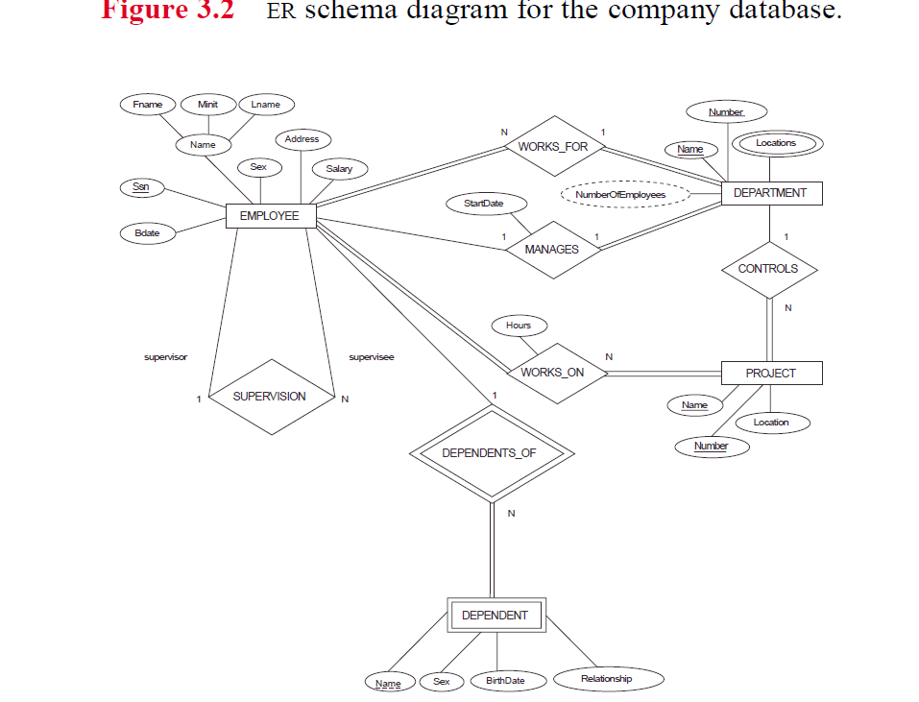
7.2

Slide 32
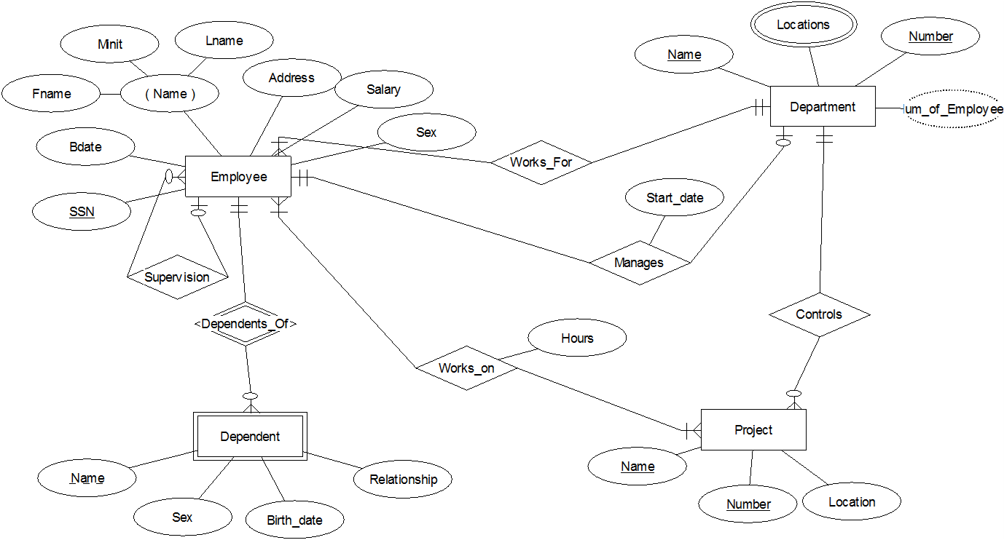
How would the diagram be different if location were a separate entity?

Slide 33
Ternary
Useful for many-to-many-to-many relationships
When should one use a ternary?

Slide 34
Example of Ternary
Relationship: a lecturer recommends a certain text for a certain course.
Objects – lecturer, text, course
Could try to capture this ternary relationship with binary relationships
Lecturer teaches one or more courses
Text used in course
Lecturer recommends a text

Slide 35
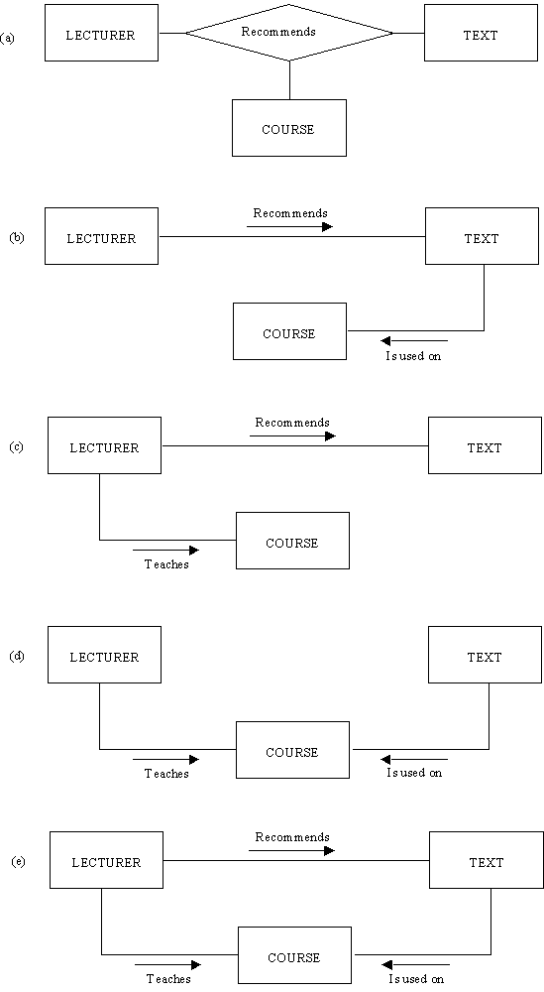

Slide 37
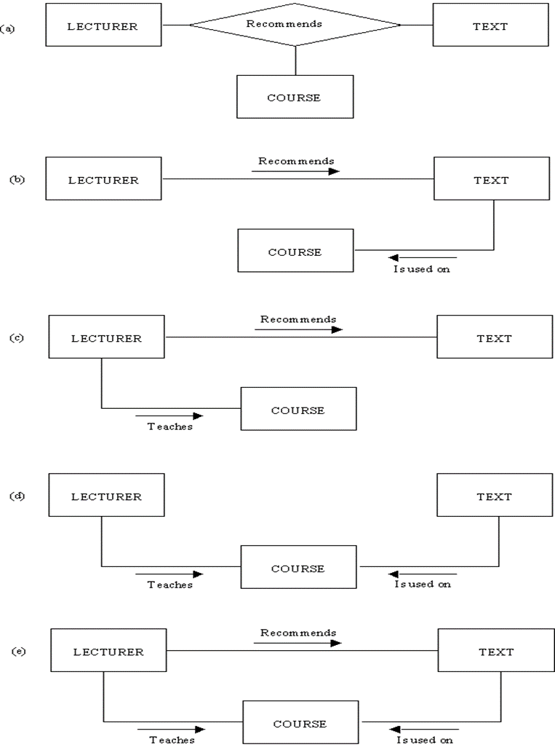
In Fig. 3.8(b) an attempt has been made to replace the ternary relationship type with two binary relationship types. LECTURERs 'recommend' TEXTs and TEXTs 'are_used_on' COURSEs. The fact that a lecturer recommends a text and that text is used on a course does not necessarily mean that that lecturer recommended that text for that course. The text might be used on the course and recommended by someone else, whereas our lecturer does recommend that text but for a different course.
In Fig. 3.8(c) it is possible to tell which texts a lecturer recommends and which courses he or she teaches on, but not which texts are used on a course or which courses use a given text. The fact that a lecturer recommends a text and teaches a course does not imply that he or she recommends that text for that course.

Slide 38
In Fig. 3.8(d) it is possible to tell which courses a lecturer teaches and which texts a course uses but not which texts a teacher recommends. Only if every course had only one lecturer would (d) be satisfactory because then the fact that a course used a text implies who recommended it. Otherwise (d) is unsatisfactory.
If many-to-many-to-one, can just use binary relationships (depending on requirements)
Not true of many-to-many-to-many

Slide 39
In Fig. 3.8(e) it is possible to tell who recommends which texts, who teaches which courses, and which texts are used on which courses. However it is still not possible to ascertain, in general, the answers to questions like:
'Which text does Mr Smith recommend for the 4th year Database course?'
The reason is that even though Mr Smith may recommend text1 and Mr Smith teaches on 4th year Database, it is not known whether it was Mr Smith who recommended the text for the course, because he may have recommended the text for another course, and another lecturer on the 4th year Database course may have recommended text1. The only satisfactory relationship type is that shown in Fig. 3.8(a).

Slide 40
UML

Slide 41
UML Notation – Universal Modeling Language
Objects (entities) are classes (box)
box contains the following separated by lines:
Object name
Attributes
method names

Slide 42
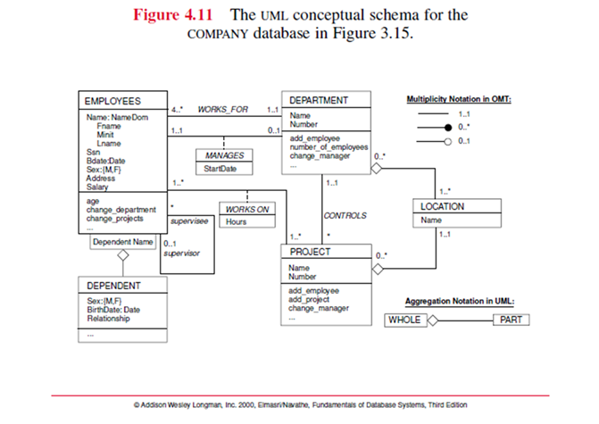
Attributes in UML
Composite attribute modeled as structured domain
e.g. Name: NameDom
Fname
Minit
Lname
Can specify domain of attribute by using :
e.g. Sex: {M, F}
Multivalued attribute modeled as a separate class
e.g. separate box, with aggregation notation using a diamond

Slide 43

Relationships - associations
Relationship types are associations (lines)
Can be named (name on line)
Relationship instances are called links
(min, max) notation used - same as ERD tool
* indicates no limit
Relationship (link) attributes
Dashed line to box
Box with association name and attribute

Slide 44
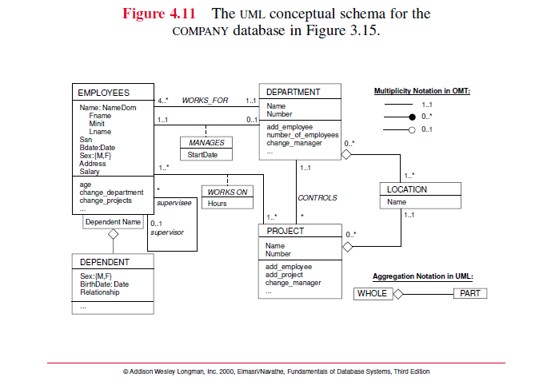

Slide 45
Weak entities
Weak entity – qualified association
placed in box directly attached to owner class
Partial key in box
Remaining attributes considered an aggregation (has a)
Multi-valued attributes represented by aggregation notation

Slide 46


Slide 47
Issues
Primary keys
Typically added as a tag next to attribute name

