Slide 1
CS301 Introduction –
  Chapters 1-2

Slide 2
CS301
For students who first took CS100 before Fall 2018
  You can take 300, 301, 495, 4xx in ANY ORDER
  We cannot enforce the new prerequisites
  Since CS301 would not be a prerequisite for these students, a D- is a passing grade
For students who first took CS100 in Fall 2018 or later
  You must take CS300 and 301 before any 4xx courses
  C- is a passing grade

Slide 3
Relevance of Databases
DBs are a part of most decisions in an enterprise
  Traditional DBs – Operational
  Data Warehouses – Decision Support
  NoSQL DBs – Information, Big data

Slide 4
Databases
Databases play a critical role in?
  Business, medicine, industry, etc.,
  everything?
Databases can be?
  Relational, XML, Object-relational, multimedia, Web, VERY large, NoSQL

Slide 5

What databases have you used today?

Slide 6
Data vs. Databases
Data
  Recorded known facts, implicit meaning
Database (DB)
  Logically coherent collection of related data
  Represents some aspect of the real-world known as a mini-world or universe of discourse
  Designed, built for specific purpose, specific purpose and group of users

Slide 7
Database Management System
Database Management System (DBMS)
  Software program to
    Create and maintain a DB
    Define types of data
    Manipulate data
    Store on disk controlled by DBMS

Slide 8
Data vs DB vs DBMS vs DBS
Data
  Recorded known facts
Database
  Collection of data
Database Management System
  Computer program for managing databases
Database System
  Data + DBMS

Slide 9
Data and Metadata
Data
  Has Records and Data elements
Metadata – “data about data”
  Types of data elements
  Structure of Records
  Constraints

Slide 10
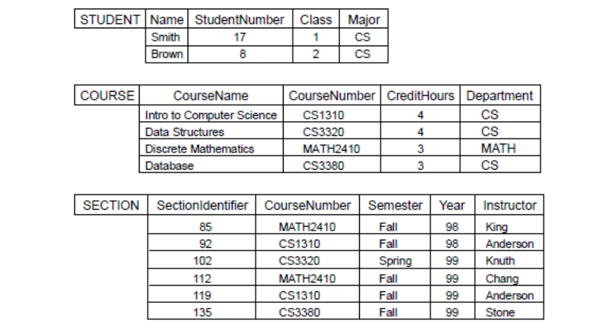
Data

Slide 11
Data
{
"_id" : ObjectId("5be9d3809645938881769ba8"),
"RequestID" : 2,
"StartDate" : "10/10/2014",
"EndDate" : "10/10/2014",
"AgencyName" : "HRA/DEPT OF SOCIAL SERVICES",
"SectionName" : "Changes in Personnel",
"AdditionalDescription1" : "Effective Date: 01/05/2014; Provisional Status: Yes; Title Code: 10104;
Reason For Change: RESIGNED; Salary: 32467.00; Employee Name: HOSSAIN,MD H."
}
{
"_id" : ObjectId("5be9d3859645938881785689"),
"RequestID" : 3,
"StartDate" : "10/10/2014",
"EndDate" : "10/10/2014",
"AgencyName" : "POLICE DEPARTMENT",
"SectionName" : "Changes in Personnel",
"AdditionalDescription1" : "Effective Date: 10/22/2013; Provisional Status: Yes; Title Code: 10144;
Reason For Change: DECREASE; Salary: 37755.00; Employee Name: LEE,JOSEPHIN S."
}

Slide 12
Metadata - Database Catalog
Object_name | No_of_columns
Student | 4
Course | 4
Section | 5
Grade_Report | 3
Prerequisite | 2
Column_name | Data_type | Belongs_to
Name | Char(30) | Student
Student_number | Char(4) | Student
…
Course_name | Char(10) | Course
…

Slide 13
Metadata - Schema
Student (Name, Student_number, Class, Major, SSN)
Name | Student_number | Class | Major | SSN

Slide 14
Metadata and Data
{
"_id" : ObjectId("5be9d3809645938881769ba8"),
"RequestID" : 2,
"StartDate" : "10/10/2014",
"EndDate" : "10/10/2014",
"AgencyName" : "HRA/DEPT OF SOCIAL SERVICES",
"SectionName" : "Changes in Personnel",
"AdditionalDescription1" : "Effective Date: 01/05/2014; Provisional Status: Yes; Title Code: 10104;
Reason For Change: RESIGNED; Salary: 32467.00; Employee Name: HOSSAIN,MD H."
}
{
"_id" : ObjectId("5be9d3859645938881785689"),
"RequestID" : 3,
"StartDate" : "10/10/2014",
"EndDate" : "10/10/2014",
"AgencyName" : "POLICE DEPARTMENT",
"SectionName" : "Changes in Personnel",
"AdditionalDescription1" : "Effective Date: 10/22/2013; Provisional Status: Yes; Title Code: 10144;
Reason For Change: DECREASE; Salary: 37755.00; Employee Name: LEE,JOSEPHIN S."
}

Slide 15
Meta Data for a DB
It is more than this
  Data object name, its characteristics, data types
  Account#, when created, modified

Slide 16
Meta Data
Three categories of meta data (books as example):
  Structural metadata: A way to define how objects are put together
    how pages are ordered to form chapters.
  Administrative metadata: Information to help manage a resource
    when and how it was created, types, and who has access
  Descriptive metadata: A resource for discovery and identification
    including elements such as title, abstract, author, and keywords.

Slide 17
Meta Data – Complete Definition
Structural
  Student (Name, CWID, address, GPA, major)
Administrative
  Owner of data
    Account#, when created, modified, who can access
Descriptive:
  Everything but the content – constraints, max/min values

Slide 18
Meta Data - Examples
Metadata associated with emails:
  Sender's name, email, and IP address
  Recipient's name and email address
  Date, time, and time zone
  Mail client header formats
  Unique identifier of email and related emails
  Mail client login records with IP address
  Subject of email

Slide 19
Meta Data - Examples
Metadata associated with texting:
  Phone number of participants
  Time of text
  Length of text
  Serial numbers of phones involved
  Location of each participant

Slide 20
Meta Data - Examples
Metadata associated with Facebook:
  Username and unique identifier
  User subscriptions
  User device
  Activity date, time, and time zone
  User location
  Username and profile bio information including:
    Birthday
    Hometown
    work history
    interests

Slide 21
Characteristics of Database Approach
Why a DBMS?
  Self-describing nature of a DB system
  Program-data independence
  Multiple views – share data
  Sharing of data and multiuser transaction processing

Slide 22
Self-Describing Nature
Object_name | No_of_columns
Student | 4
Course | 4
Section | 5
Grade_Report | 3
Prerequisite | 2
Column_name | Data_type | Belongs_to
Name | Char(30) | Student
Student_number | Char(4) | Student
…
Course_name | Char(10) | Course
…

Slide 23
Program data-independence
Internal storage format for a file access program:
Data Item Name | Starting Position in Storage | Length in Characters /bytes
Name | 1 | 30
Student_number | 31 | 4
Class | 35 | 1
Major | 36 | 4
SSN | 40 | 4
Data abstraction: characteristic that allows program-data independence

Slide 24
Program data-independence
With program data-independence all the user needs to know is the schema
  Students (Name, Student_number, Class, Major, SSN)
If want to add bdate?
Students (Name, Student_number, Class, Major, SSN, bdate)

Slide 25
Multiple Views
  Students (Name, Student_number, Class, Major, SSN, bdate)
  Not everyone should be able to see SSN or bdate
  A possible View:
  Students (Name, Student_number, Class, Major)

Slide 26
Sharing of data and multiuser transaction processing
DBMS must support concurrency control
  Example application: flight reservation system
  OLTP: online transaction processing system
Transaction
  An executing program or process that includes one or more database accesses, such as reading or updating of database records

Slide 27
Database Concepts
Data models, schemas, instance
Three-schema architecture for data independence
Database language
Users

Slide 28
Data Model
Abstraction: suppression of details
  Essential attributes of an entity for a particular application
Data model: collection of concepts describing a database
  Describes the structure: entities or objects, attributes or fields, data types, relationships, constraints
  basic operations: updates and retrievals
DBMS based on data model

Slide 29
Data Models
Types:
  High-level (conceptual) - ER, UML, OO
    The end users' conception of their data, understood by end users and database developers
    A tool for understanding user data in enough detail to derive an implementation model from it
  Low level (physical) – XML
    How data are stored on disk (the code inside a DBMS)
  Implementation (representational) combines conceptual and physical – Relational
    Understood by database developers
  NoSQL data models – Column, key-value, document stores

Slide 30
Conceptual Data Model: Entity-Relationship
Entity: a real world object or concept that will be modeled in the database
Attribute: a property of interest of some entity
Relationship: an association between two or more entities

Slide 31
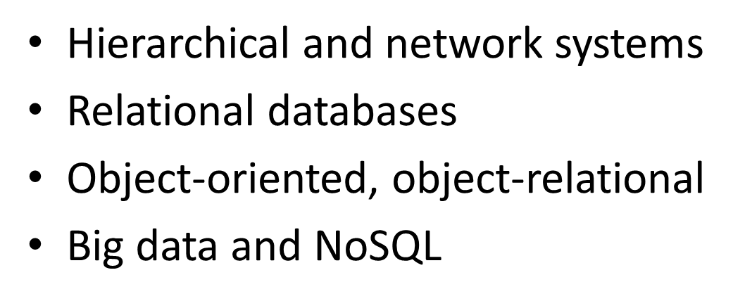
Representational (Implementation) Models
Most common: relational data model (focus of this class)
Others
  Legacy: network, hierarchical
  Object data models: never gained widespread adoption
History of DBs

Slide 32
Additional Data Models
Low-level
  XML, understand how data is stored based on path specified to access data
NoSQL
  Key-value stores: Redis, Google BigTable, Amazon Dynamo
  Document-based stores: CouchDB, MongoDB
  Column-based stores: Hbase, Cassandra
  Graph-based: Neo4J

Slide 33
Schema Diagram
Student
Name | Student_number | Class | Major | SSN
Course
Course_name | Course_number | Credit_hours | Department
Section
Section_ID | Course_number | Semester | Year | Instructor

Slide 34
Schemas and Databases
A schema is a description of the data in a database (metadata), typically depicted in a schema diagram
  Structures, e.g., STUDENT, COURSE, that specify elements of the data model
  Constraints, e.g., STUDENT.CWID must be unique
  Database state is set of instances of entities specified in the schema
  As data is loaded into database, DBMS ensures valid states by ensuring data instances conform to schema and meet constraint
  Sometimes schema is called intension, state is called extension

Slide 35
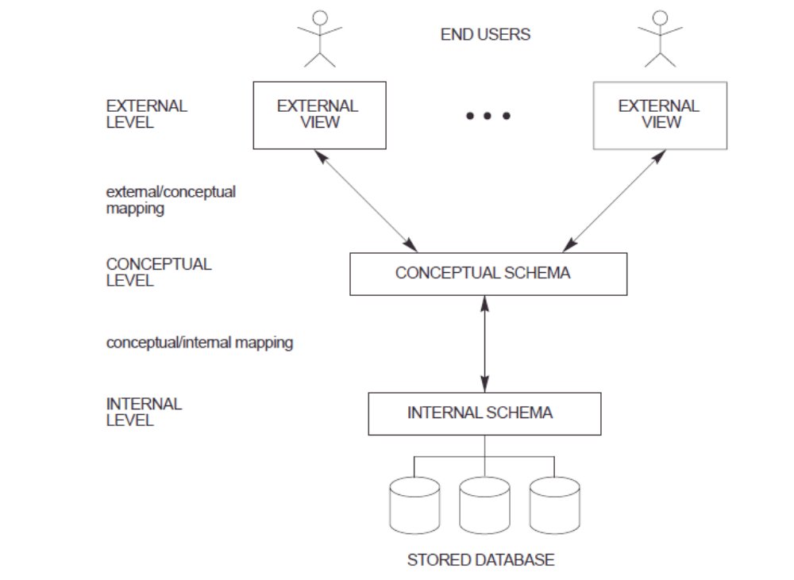

Slide 36
3-schema architecture
3 levels of abstraction
  External level: external schemas, aka views
    Also representational, but tailored to particular (group of) user(s)
  Conceptual level: conceptual schema
    Corresponds to representational (implementation) data model, not conceptual data model
    structure of DB, hides physical
  Internal level: internal schema
    physical storage structures
Transformations between levels: mapping
  3-schema architecture Fig 2.2

Slide 37
Data Independence
Goal of 3-schema architecture to
Separate user applications from physical database, so data independence:
  Logical data independence: changes to the conceptual schema don’t require changes to external schemas
  Physical data independence: changes to internal schema don’t require changes to conceptual schema

Slide 38
DBMS Languages
DBMS provides a language to define, manipulate data
  DDL - data definition language
    specifies conceptual and internal schemas
  VDL – view definition language
    Specifies user views (external schema)
  DML - data manipulations language to insert, update, delete data
    High-level, nonprocedural
    Set at a time
  Modern DB system languages combine DDL, VDL and DML

Slide 39
Users
Users: Actors on the Scene
  DBA – oversee and manage resources
  DB Designers – create DB
  Casual End Users – different info each time/GUI to specify requests
  naïve or parametric users – canned transactions (mobile apps)
  Systems Analysts and Application programmers
Users: Workers behind the scene
  DBMS system designers and implementers
  Tool developers
  Operators and maintenance personnel

Slide 40
DBS Utilities
Loading – into DB, conversion tools
Backup – copy on durable mass storage
DB storage reorganization – of files to better performance
Performance Monitoring – to reorganize, etc.

Slide 41
Advantages of DBMS approach
But higher overhead and increased complexity
So why use a DBMS?
Optimization!
  Storage structures and search techniques for efficient query processing
Controlling redundancy
  Data normalization, Denormalization
Restricting unauthorized access
Backup and recovery
Enforcing integrity constraints

