Slide 1

OpenHouse Insurance Machine Learning
Yongyang Huo

Slide 2

Goal
Data Description
Data Preprocessing
Prediction Models
Result Summary

Slide 3
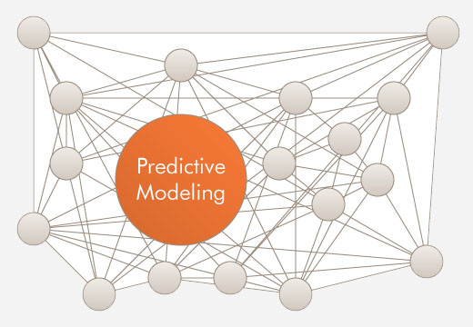
Project Goal
5 Digit Zip Code
creditLevel
insuranceTier
financeTier
decile
DOB
Age Range
Est. Household Income
Length of Residence
Home Purchase Date
Number of credit lines
Auto year
Auto make
Est. Home Value
Est. Net Worth
Upscale card holder
Wealth Score
Auto Buyer Lead Score
New Tech Adopter Score
Prediction Model
Predict InsuranceScore based on the sample data

Slide 4
Data Description
Main Information from the Sample Data
  Small size dataset
    Total Records: 893
    Total Attributes: 19
  Certain fields contain high number of missing data

Slide 5

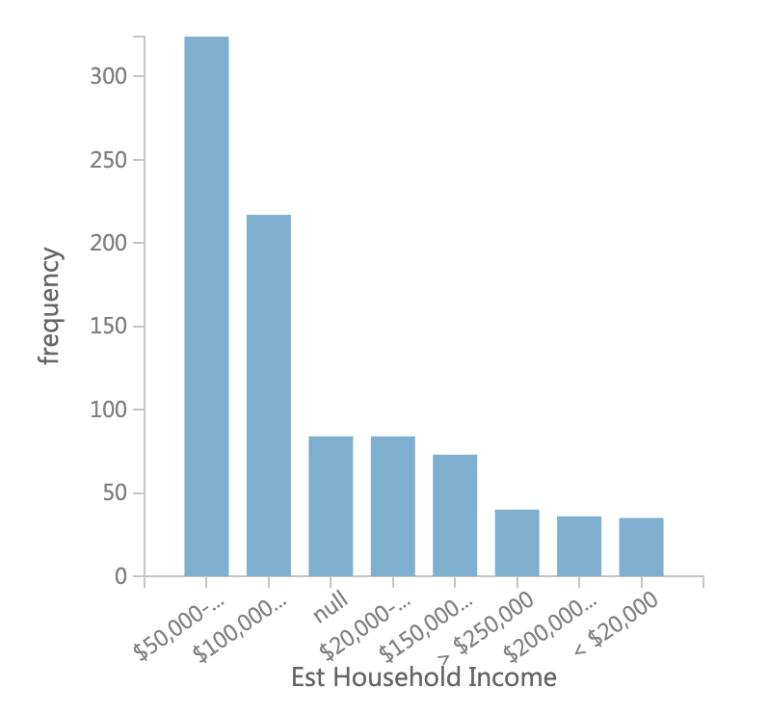
Data Description
  This sample data is more leaning to middle/middle-upper class customer
    33% of the customer are upsale card holder
    Credit Level : 48% Very Good , 36% Good
    56% of the customer with Financial Tie is Super Prime
    Majority of the customer got the household income between 50k – 150k (60%)

Slide 6
Data Preprocessing
  Derived Column
    Age :Derive from DOB and Age Group
    HomePurchasedYear: Derived from HomePurchaseDate
    HouseholdIncomeGroup: Derived from HouseholdIncome
    HomeValueGroup: Derived from HomeValue

Slide 7
Missing Value Estimation
    Age
    HouseholdIncomeGroup
    HomePurchaseYear
    HomeValueGroup
    Wealth Score
    Auto Buyer Lead Score
    New Tech Adopter Score
    NetWorthGroup
    Number of credit lines
PCA
Mean
Median
EM
MICE

Slide 8
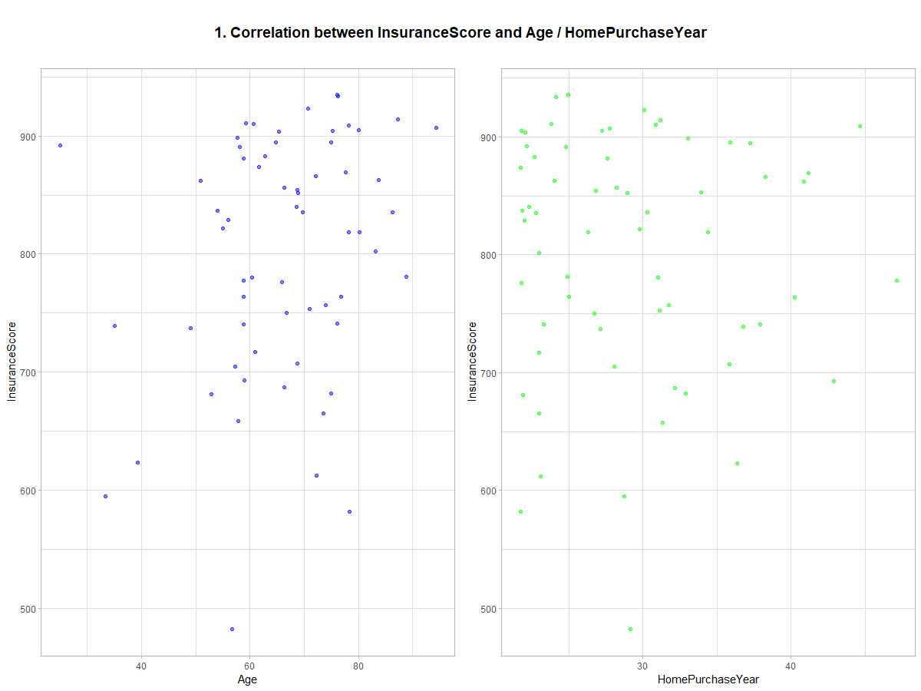

Slide 9
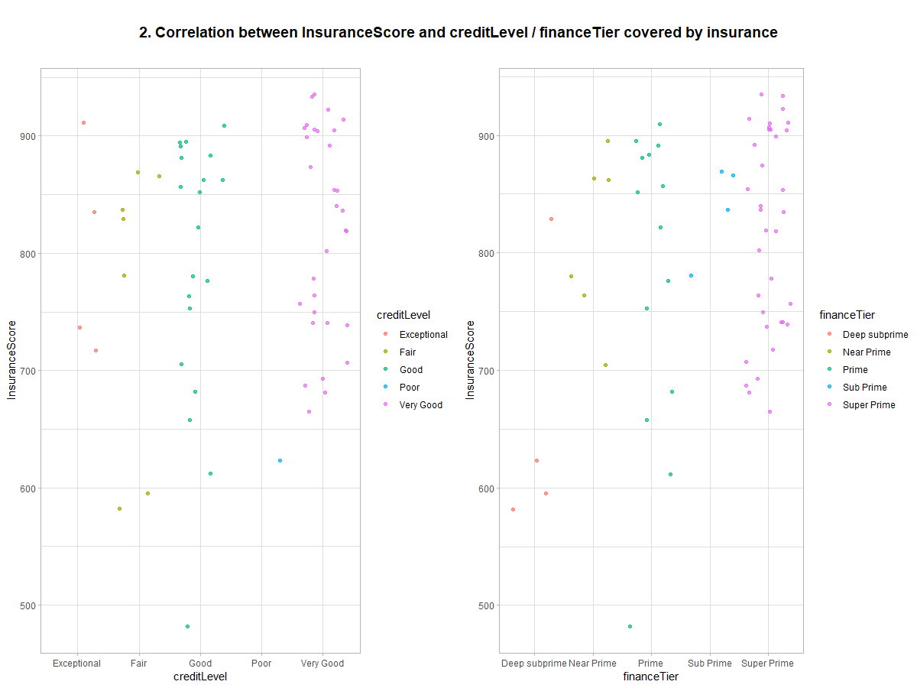

Slide 10
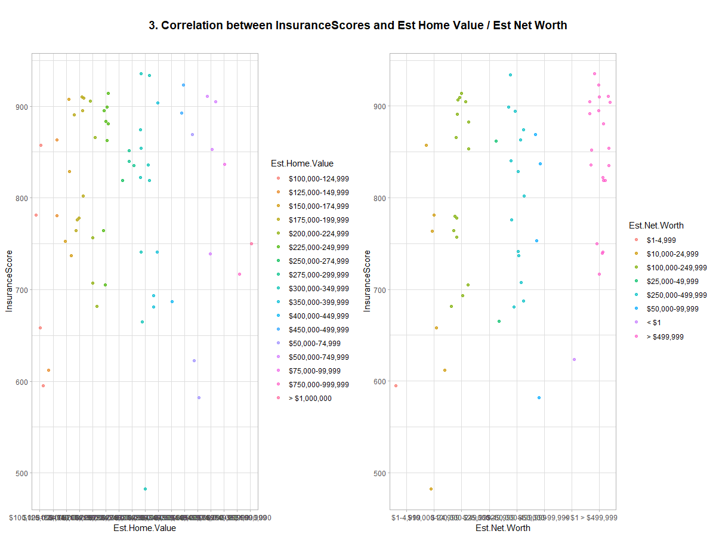

Slide 11
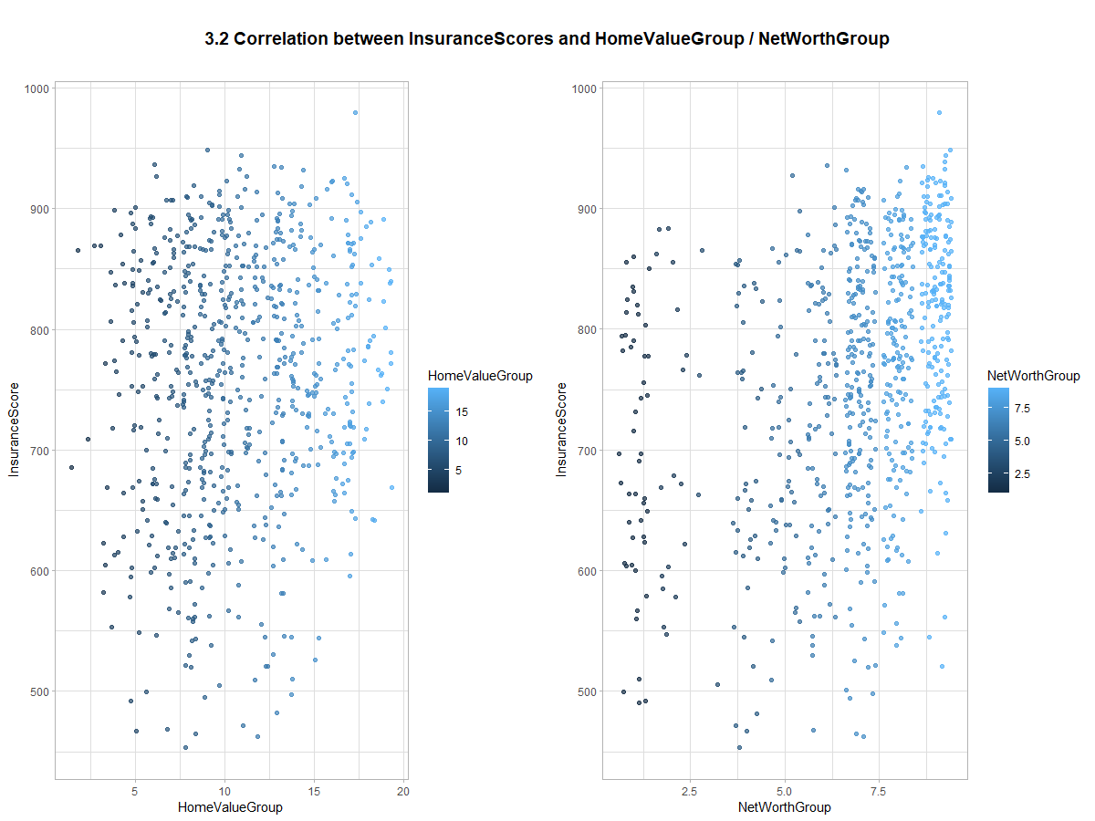

Slide 12
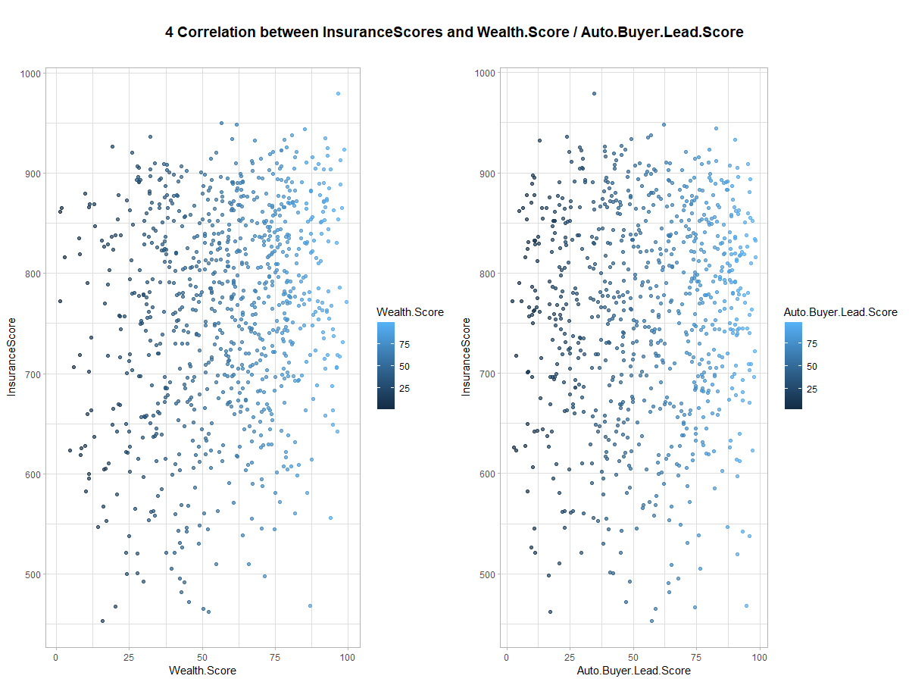

Slide 13
Feature Selection
1.Start with All Features N
2. Repeat the Modeling with N-1 Most Correlated Features
3. Evaluate the Model
4. Go back to Step 1
15 Attributes are selected for Optimize Result
Notes:
1. Use Machine Learning as a Service
Microsoft Azure offers Azure Machine Learning as a pay-as-you-go service. Using Azure ML, the businesses do not require setting up complex or purchasing any big hardware or software. They just need to purchase the services and can start developing their Machine Learning applications immediately.
2. Easy & Flexible building interface
Business can execute their Machine Learning development through the Microsoft Azure Machine Learning Studio. It offers drag and drop components that minimize the code development and straightforward configuration of properties. Moreover, it helps businesses to build, test and generate advanced analytics based on the data.
3. Wide range of supported algorithms
Azure ML offers readily available well-known algorithms that can be configured simply by drag and drop. It does not require the knowledge of data science or expertise in algorithms; you just need to know when to use them. Specific algorithms like logistic regression and decision tree can also help in devising real-time predictions or forecasts. Moreover, there is no limit in importing training data and you can fine-tune your data easily. This feature of Azure ML significantly saves the cost and help to generate revenue.
4. Easy implementation of web services
All you need is to drag and drop your data sets, algorithms, and link them together to implement web services needed for ML development. Once you have practiced with the environment, you just need to test, which would be ready for the further use, then you need to click one button to create and publish the web service. Now, you can use the web service from any device by passing valid credentials.

Slide 14
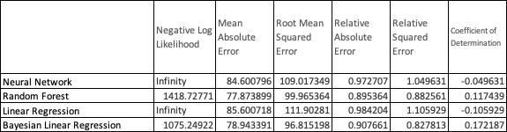
Prediction Model
The following algorithms are chosen to build the prediction model
  LR, BLR, NN, RF
  *Skip the Normalization step for invariant Regression Model

Slide 15
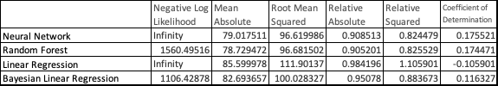
Prediction Model
Reduce to only including 10 attributes

Slide 16

Large Picture Slide
Summary

Slide 17

Summary
Random Forest outperform compare to other regression model
Missing value estimation is the key during Data Preprocess
The optimise number of features is 15
A quick Home Quote Engine can be provided with only 10 attributes but comes similar accuracy

Slide 18

Q&A
Yongyang Huo

