Slide 1


Insight Machine Learning

Slide 2
ML Workflow
Time Series Forecast
Demo
AGENDA

Slide 3
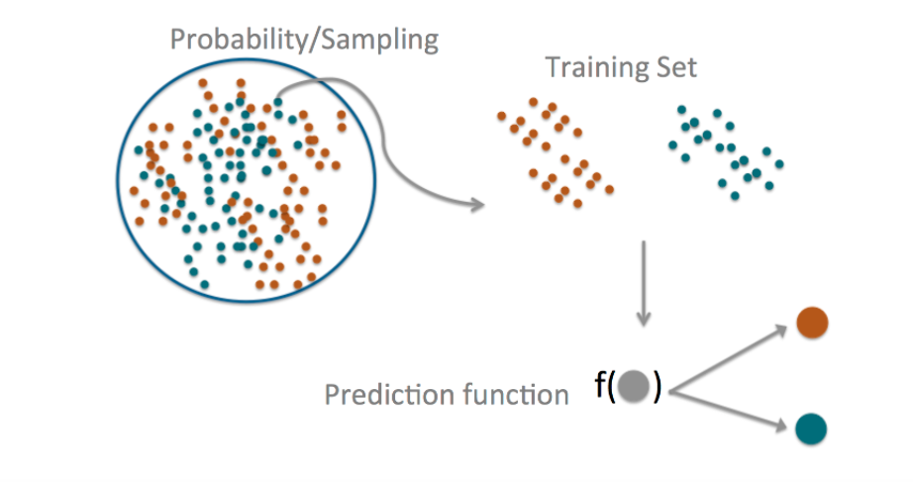
Machine Learning Algorithm

Slide 4
Types of Learning
Supervised learning
Training data includes desired outputs
Unsupervised learning
Training data does not include desired outputs
Semi-supervised learning
Training data includes a few desired outputs
Reinforcement learning
Rewards from sequence of actions

Slide 5
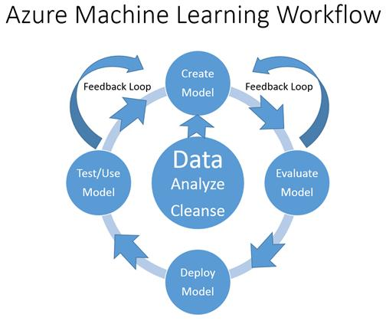

Slide 6
AML
Fully
managed
Intuitive
Best in Class Algorithms + R + Python
Deploy in minutes
No software to install, no hardware to manage, and one portal to view and update
Simple drag, drop and connect interface for both data acquisition and modeling
Access to sample experiments, tested algorithms, support for your custom R, and over 350 R packages
Tooled for quick deployment, hand-off and updates – click “Publish Web Service”

Slide 7

Time Series Forecast
AML

Slide 8
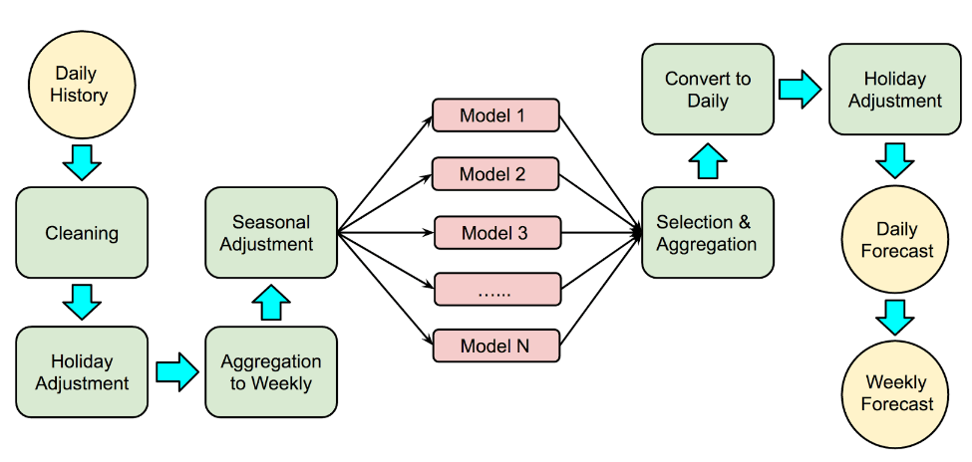
Forecast Model

Slide 9
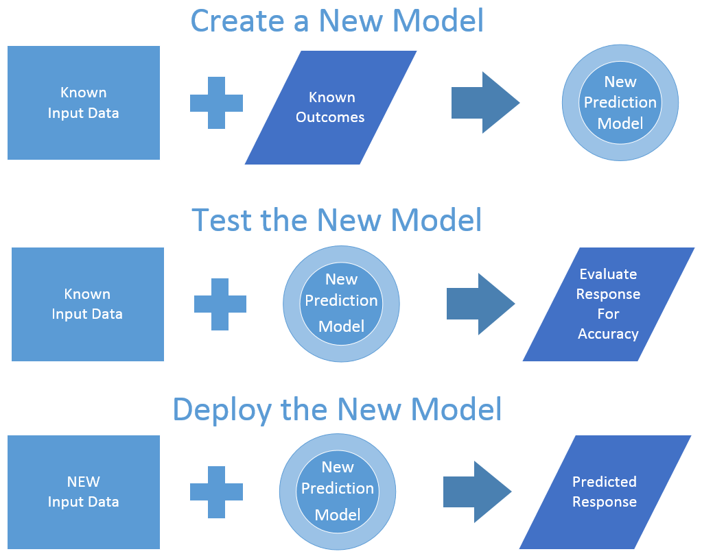
Testing the new prediction model

Slide 10
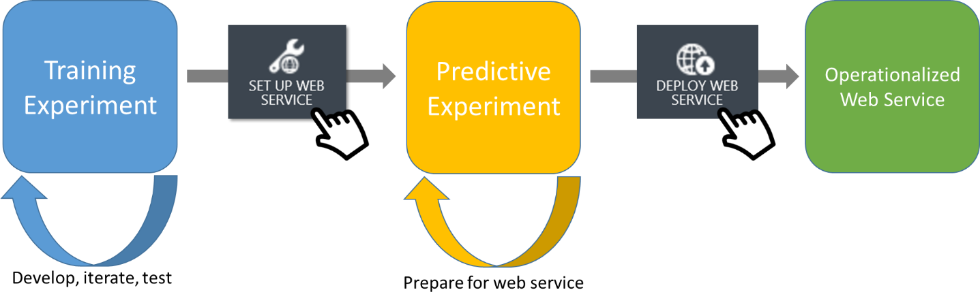
Deploy predictive Web service

Slide 11
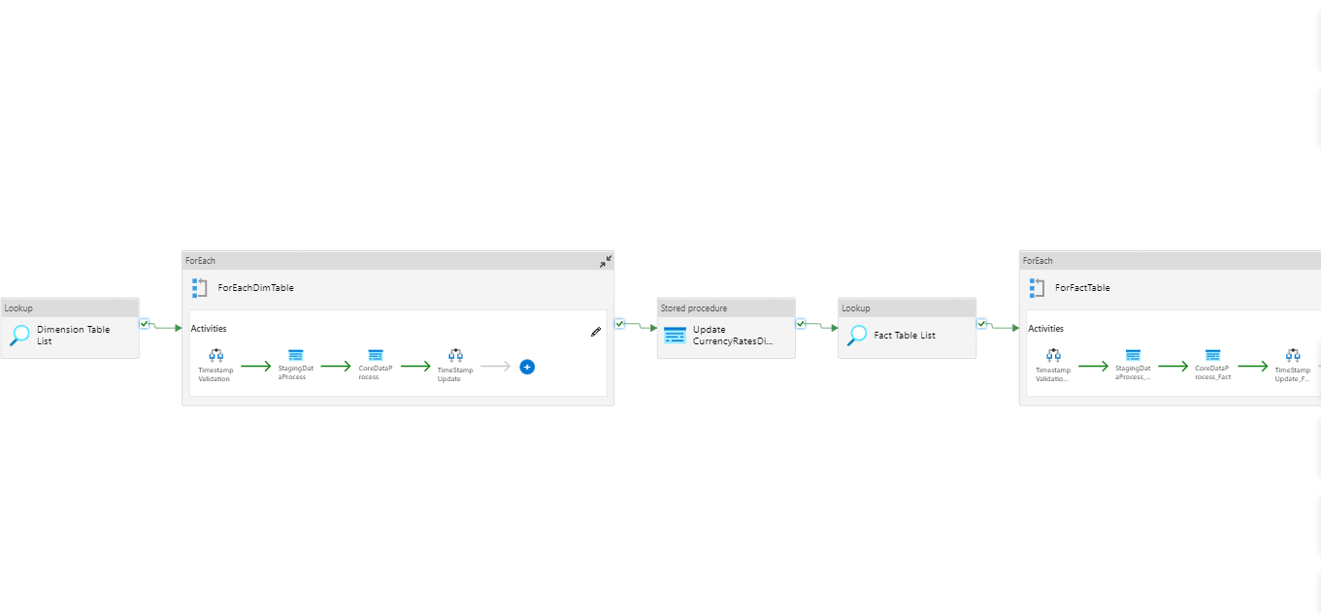
{
"type" : "linkedServices",
"name": "AzureMLLinkedService",
"apiVersion" : "2022-09-01-preview",
"properties": {
"type": "AzureML",
"typeProperties": {
"mlEndpoint": "URL to Azure ML Predictive Web Service",
"apiKey": {
"type": "SecureString",
"value": "api key"
}
}
"connectVia": {
"referenceName": "<name of Integration Runtime>",
"type": "IntegrationRuntimeReference"
}
}
}
Calling From Pipeline

Slide 12
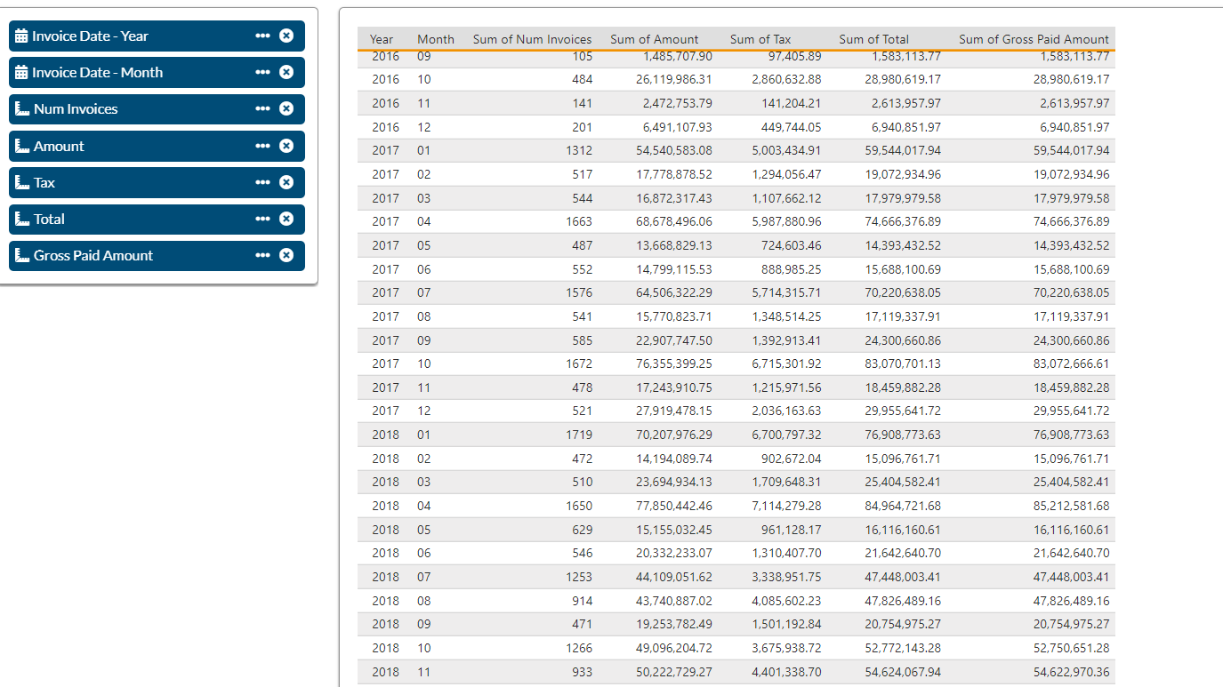
Dataset

Slide 13
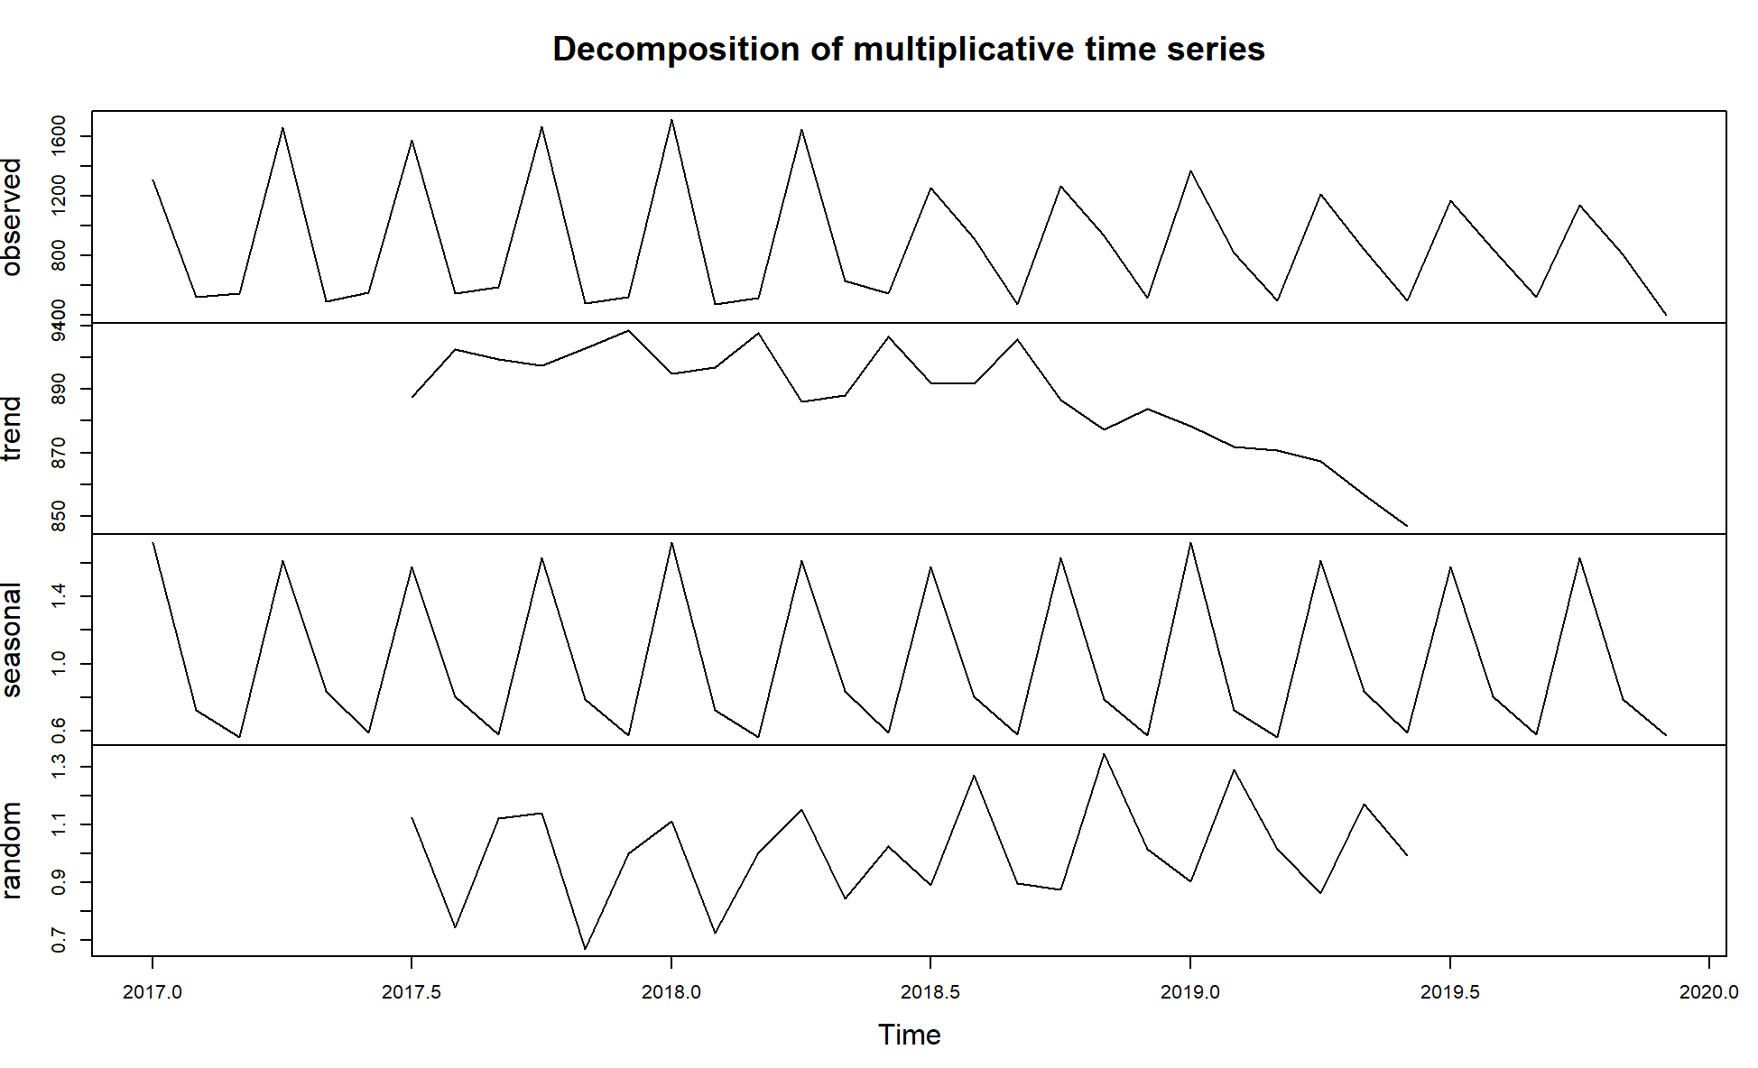
Number of Invoices Data Trend
Trend: 12-months moving average
Seasonality: average values for a month after removal of trend
Remainder: the residual left in the series after removal of trend and seasonal components

Slide 14
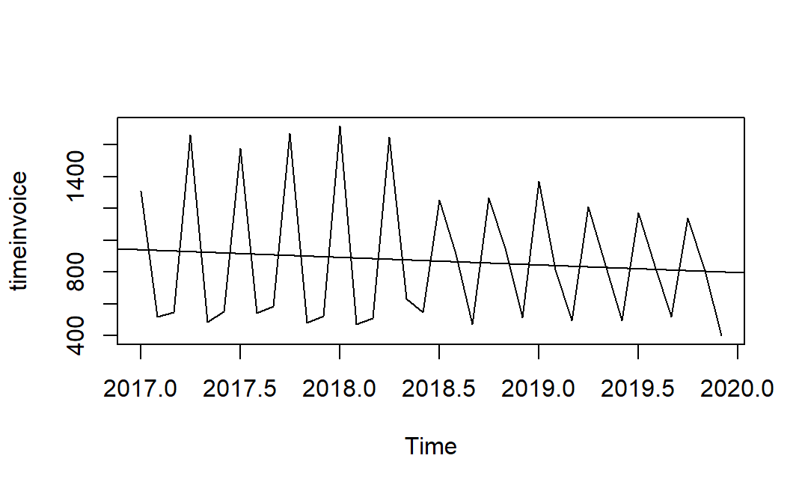
Number of Invoices Data Trend

Slide 15
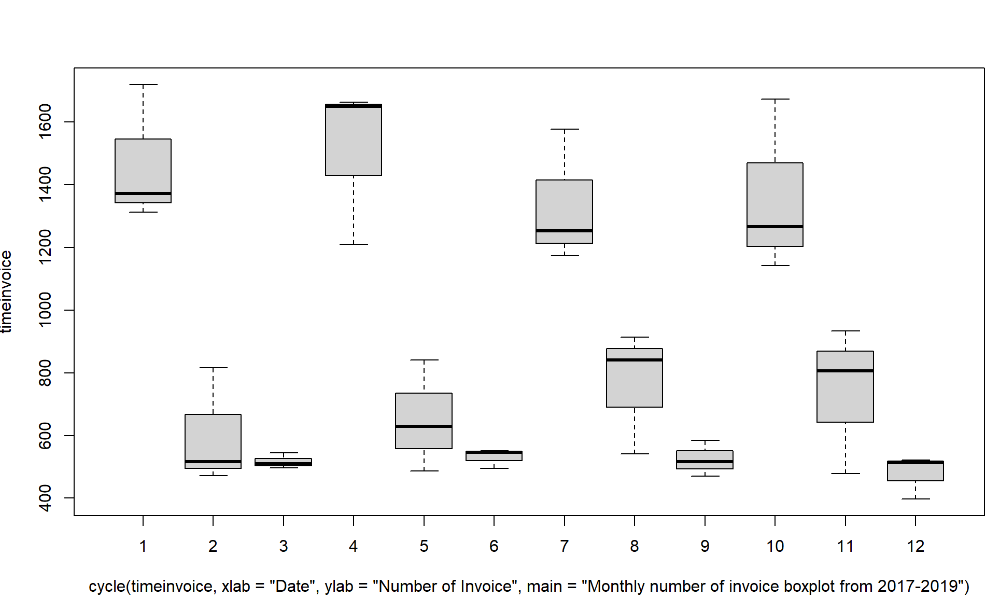

Slide 16
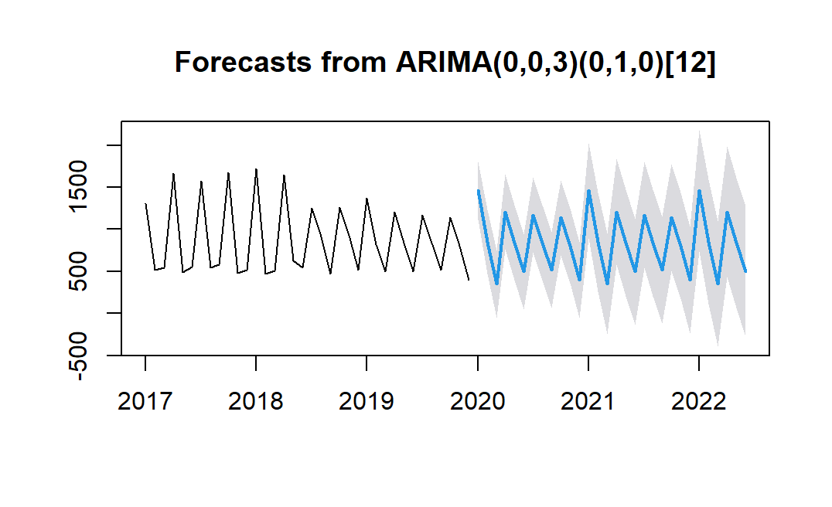
Model Performance Measure
Box-Ljung Test
X-squared = 6.635, df = 5, p-value = 0.2492
the p value is low -> model is relatively accurate

Slide 17
Free Text Question
Power BI

Slide 18
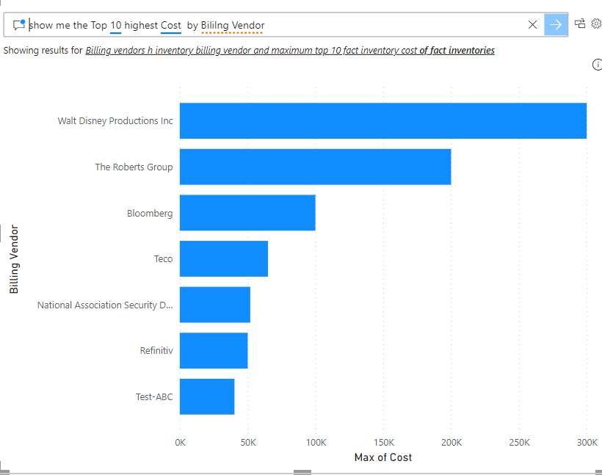

Slide 19

ML Models

Slide 20
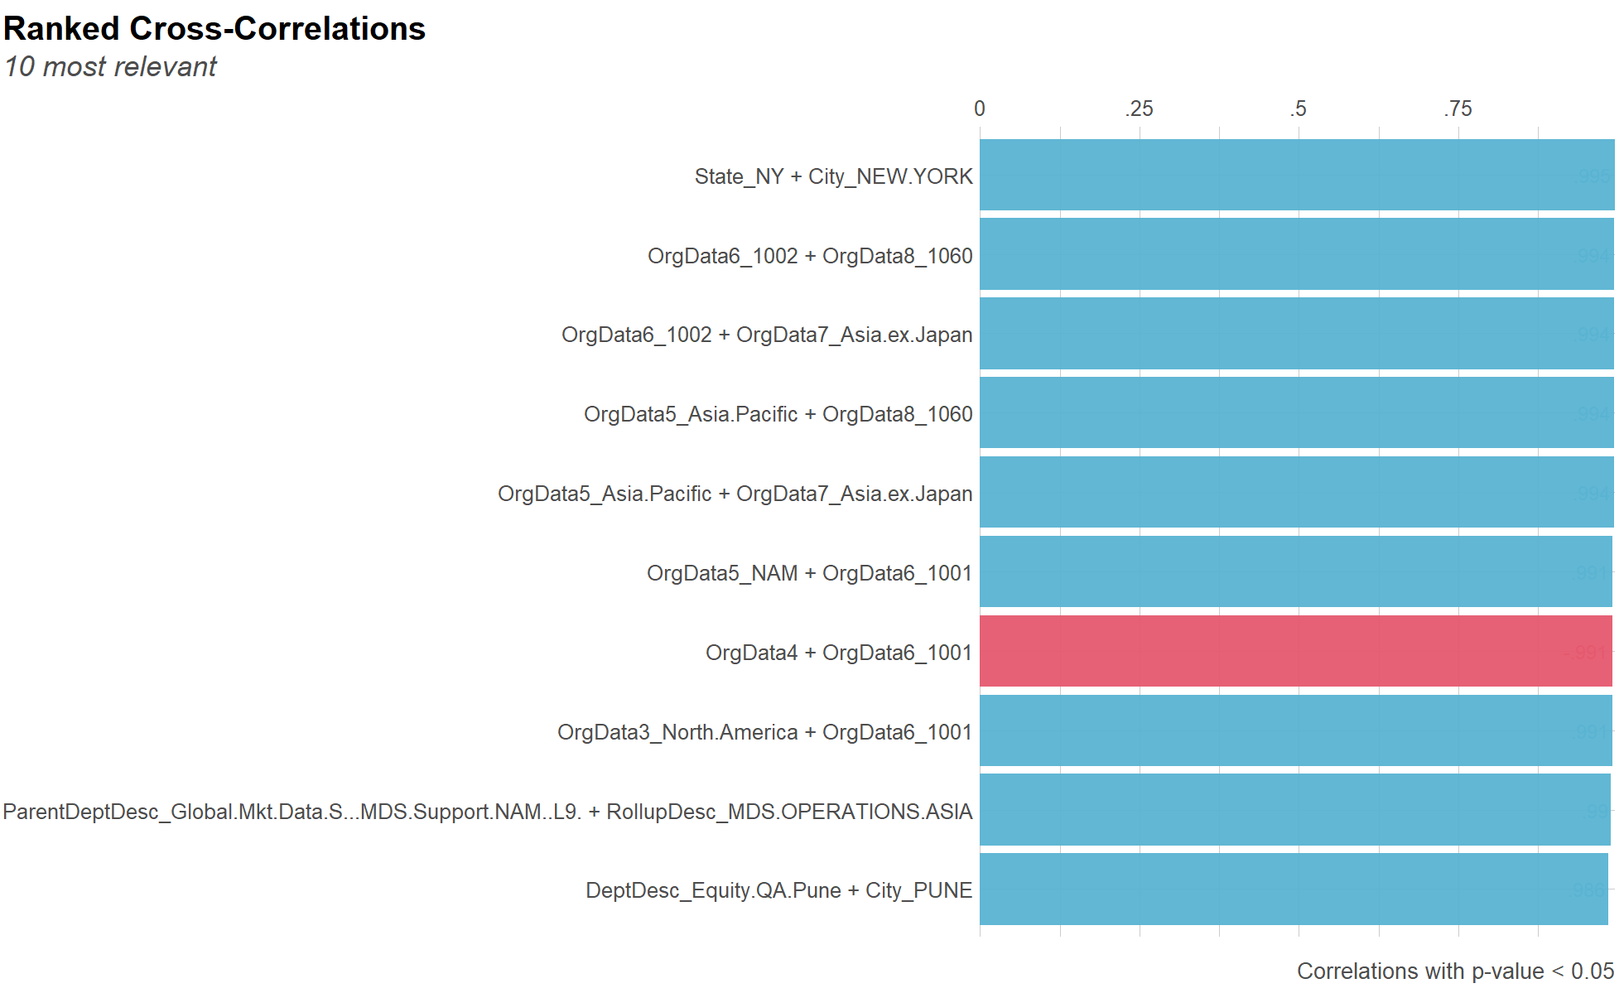

Slide 21
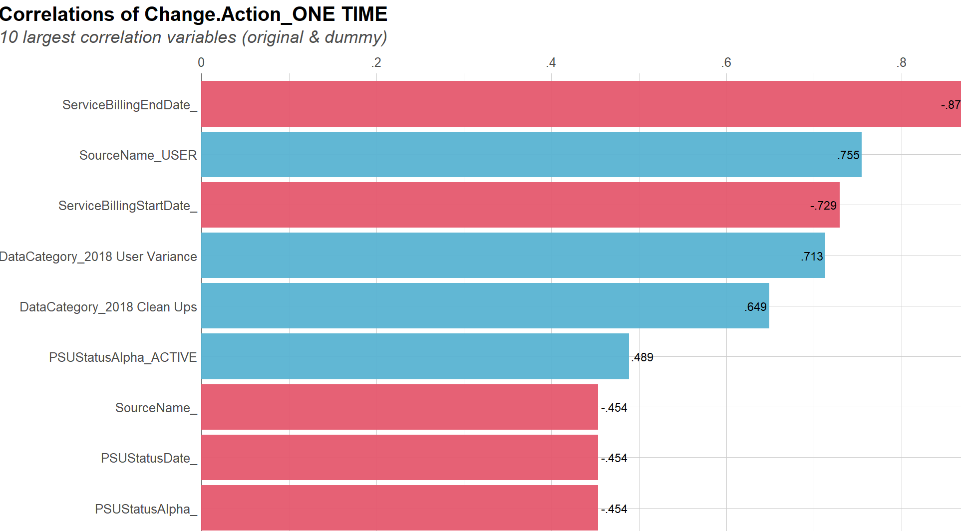

Slide 22

Large Picture Slide
Demo

Slide 24


THANK YOU
Yongyang Huo
Yongyang.huo@trgscreen.com

