Slide 1
UNIVERSITY MASTERCLASS | MBA • MSc MARKETING • MSc DIGITAL MARKETING
AI in Practice:
Driving Business and
Marketing Value
From prediction and optimisation to customer strategy, commercial decisions and measurable impact
Practical case studies • Model thinking • Strategic application
01

Slide 2
WELCOME
What you should be able to do by the end
Frame the decision
Interrogate the model
Translate a business problem into a clear prediction, classification or optimisation task.
Understand data, features, evaluation metrics and limitations without needing to code.
Choose the action
Prove the value
Connect model output to a customer, operational or commercial decision.
Define a credible test and measure incremental business impact.
AI IN PRACTICE • MASTERCLASS
02

Slide 3
WELCOME
The journey: from model to market value
01
Business value lens
Start with decisions and economics
02
AI essentials
Learning types, workflow and evaluation
03
In practice
Scheduling, invoices, sensors, insurance and gamebot
04
Marketing applications
Renewal, segmentation and whisky maturation
05
Execution
Experimentation, governance and value realisation
AI IN PRACTICE • MASTERCLASS
03

Slide 4
WELCOME
Opening question: what is the business actually buying?
Not an algorithm. A better decision.
Prediction
Decision
Value
Which customer may not renew?
Who should receive which intervention?
Did retention and profit improve?
Discuss: what could go wrong if we optimise model accuracy but ignore the business decision?
04

Slide 5
FOUNDATION
The AI value chain: prediction is only one link
BUSINESS NEED
DATA
MODEL
ACTION
OUTCOME
A decision worth improving
Signals about customers, products or operations
Prediction, classification or optimisation
A change in offer, plan or resource allocation
Incremental value, measured against a baseline
Value can be lost at every hand-off: poor data, a misframed target, a model nobody uses, or an intervention that does not change behaviour.
AI IN PRACTICE • MASTERCLASS
05

Slide 6
FOUNDATION
A practical map of AI and machine learning
Predict
Discover
Optimise / learn
Estimate an unknown or future outcome.
Examples: invoice volumes, renewal probability, maturation loss.
Find structure in data without a labelled answer.
Example: customer segmentation from behaviour and value signals.
Choose actions under constraints or learn through feedback.
Examples: dynamic scheduling and reinforcement learning.
Generative AI adds a further capability: creating or transforming content, summaries, code and conversational experiences.
AI IN PRACTICE • MASTERCLASS
06

Slide 7
FOUNDATION
Four learning approaches — and the business question each answers
Supervised learning
Learn from examples with known outcomes
Will this customer renew? What will invoice volume be?
Unsupervised learning
Find patterns without a target label
Which customers behave in similar ways?
Semi-supervised learning
Use a small labelled set with a larger unlabelled set
Can limited human labels support broader classification?
Reinforcement learning
Learn actions through rewards over time
Which sequence of actions improves the objective?
AI IN PRACTICE • MASTERCLASS
07

Slide 8
FOUNDATION
A repeatable machine-learning workflow
1
2
3
4
5
6
7
Frame
Understand
Prepare
Train
Evaluate
Deploy
Monitor
Decision + target
Data quality + context
Clean, derive, encode
Compare candidates
Holdout + relevant metric
Embed in workflow
Drift + value
The workflow is iterative: results may send the team back to the target definition, feature design or data collection.
AI IN PRACTICE • MASTERCLASS
08

Slide 9
FOUNDATION
Choose evaluation metrics that match the decision
Classification
Regression / forecasting
Optimisation
Precision / recall
ROC-AUC or PR-AUC
Calibration
Useful for renewal, risk flags and response prediction.
MAE / RMSE
MAPE (with care near zero)
Bias and forecast intervals
Useful for invoice volumes and maturation loss.
Cost / service level
Constraint violations
Decision quality
Useful for schedules, routing and resource allocation.
A metric describes model behaviour; a business KPI describes the outcome the organisation cares about.
AI IN PRACTICE • MASTERCLASS
09

Slide 10
IN PRACTICE
The project portfolio: different models, one value question
Dynamic scheduling
Optimisation
Service efficiency, capacity, customer experience
Invoice prediction
Time-series forecasting
Planning, workload, finance operations
Sensor analytics
Detection + forecasting
Proactive service, reliability, resource use
Insurance score
Supervised prediction
Quote journeys, targeting, underwriting support
Gamebot
Reinforcement learning
Sequential decisions, simulation, adaptive agents
AI IN PRACTICE • MASTERCLASS
10

Slide 11
IN PRACTICE
Case 1 | Dynamic scheduling: optimisation in the real world
The challenge
The decision logic
• Assign jobs to field staff as conditions change.
• Balance location, travel time, availability and skill.
• Respect priority rules and customer commitments.
• Use penalties to represent the cost of undesirable assignments.
Inputs
Jobs • skills • locations
Objective
Minimise travel + penalties
Schedule
Feasible assignments
Feedback
Compare plan and outcomes
Marketing link: more reliable service can support customer satisfaction, retention and a stronger service promise — if the operation delivers.
AI IN PRACTICE • MASTERCLASS
11

Slide 12
IN PRACTICE
Dynamic scheduling builds on a classic optimisation problem
Travelling Salesman Problem
Real-world scheduling
Managerial lesson
Find a low-cost route that visits each location and returns to the start.
A useful teaching example for combinatorial optimisation.
More than distance: staff skills, time windows, job duration, priorities and changing demand.
The objective includes trade-offs.
The 'best' schedule depends on the objective function and constraints chosen.
What gets measured and penalised shapes the solution.
Class prompt: if premium customers receive priority, how should the system balance fairness, cost and service levels?
AI IN PRACTICE • MASTERCLASS
12

Slide 13
IN PRACTICE
Case 2 | Invoice forecasting: turning history into a plan
From historical series to forecast
Trend
Longer-term direction in invoice volume.
Seasonality
Recurring monthly patterns after trend is considered.
Residual
Illustrative monthly volume pattern
Variation the trend and seasonal components do not explain.
Business value: plan capacity, processing workload and operational readiness. Forecast quality should be evaluated on unseen periods.
AI IN PRACTICE • MASTERCLASS
13

Slide 14
IN PRACTICE
Forecast validation: accuracy is not the same as usefulness
Baseline first
Test honestly
Measure impact
Compare against a simple benchmark such as last period or seasonal naïve forecast.
Use time-ordered validation; do not leak future information into training.
Would the forecast have changed staffing, cost, service or cash-flow decisions?
Teaching note: statistical diagnostics are not a substitute for out-of-sample forecast errors and a decision-focused evaluation.
AI IN PRACTICE • MASTERCLASS
14

Slide 15
IN PRACTICE
Case 3 | Sensor machine learning: from monitoring to intervention
INGEST
MONITOR
PREDICT
RESOLVE
Collect sensor readings
Spot state changes
Forecast or detect anomalies
Trigger a human or automated action
Example signals in the original project included motion, temperature, humidity, power, battery and open/close states.
Marketing / customer link: reliability and proactive resolution can improve the experience — but only if alerts are accurate and acted on.
AI IN PRACTICE • MASTERCLASS
15

Slide 16
IN PRACTICE
Case 4 | Insurance prediction: what the original project taught
SOURCE PROJECT
What the source deck reported
Project objective
• 893 records and 19 attributes.
• Substantial missingness in several fields.
• Random Forest outperformed the other tested regression models.
• 15 attributes were selected for the reported optimised result.
• A 10-attribute quote engine was described as having similar accuracy.
Predict an InsuranceScore from a sample dataset to support a faster, data-informed quote process.
Strategic implication: a shorter quote journey may reduce friction. Validate fairness, suitability and business outcomes before using scores in live decisions.
AI IN PRACTICE • MASTERCLASS
16

Slide 17
MARKETING CASE STUDIES
New application | Insurance renewal propensity
Predict the risk — then choose the intervention
1. Predict
2. Prioritise
3. Act + learn
Estimate each policyholder's renewal probability before the renewal date.
Combine renewal risk with customer value, expected margin and contactability.
Test service outreach, reminders or tailored offers; measure incremental effect.
Avoid the discount trap
A high-risk customer is not automatically worth a discount. Estimate whether the intervention changes the outcome and whether the retained policy remains profitable.
AI IN PRACTICE • MASTERCLASS
17

Slide 18
MARKETING CASE STUDIES
Renewal strategy: risk × value × treatment effectiveness
CUSTOMER VALUE
The extra question
HIGH
Protect margin
Retention focus
Good service; avoid unnecessary discount.
Test targeted intervention; protect profitable value.
Will this treatment change renewal behaviour?
Use a controlled experiment to estimate incremental retention and contribution margin, not just the model's propensity score.
Low-cost journey
Selective action
LOW
Automate reminders; keep contact economical.
Use low-cost service fixes; discount only if incremental.
LOW RENEWAL RISK
HIGH RENEWAL RISK
AI IN PRACTICE • MASTERCLASS
18

Slide 19
MARKETING CASE STUDIES
New application | Customer segmentation for marketing action
From data patterns to usable segments
• Build features from behaviour, needs, lifecycle, value and engagement.
• Use clustering or a business-led segmentation framework.
• Profile segments and give them meaningful, testable names.
• Choose different propositions, channels and service levels.
LOYAL VALUE
GROWTH POTENTIAL
Retain & reward
Cross-sell / educate
PRICE SENSITIVE
AT-RISK / DISENGAGED
Value message
Re-engage selectively
Illustrative segment labels — validate with actual data and customer research.
AI IN PRACTICE • MASTERCLASS
19

Slide 20
MARKETING CASE STUDIES
A segment only matters if it changes the marketing mix
WHO?
WHY?
WHAT?
WHERE?
PROVE?
Segment definition
Observable, stable, reachable
Customer need
Research + behavioural evidence
Value proposition
Relevant benefit, not just a label
Channel & timing
Cost-effective contact strategy
Experiment
Incremental conversion / margin
Do not confuse clusters with strategy: a segment must be actionable, economically meaningful and responsibly usable.
AI IN PRACTICE • MASTERCLASS
20

Slide 21
MARKETING CASE STUDIES
New application | Whisky maturation loss prediction
An operational model with portfolio implications
PRODUCT
• Predict volume loss during maturation from relevant historical cask and warehouse data.
• Forecast future saleable inventory by product, age and release window.
• Support production planning and scenario analysis.
• Use uncertainty ranges rather than treating each prediction as certain.
Which expressions and age statements can be supported by future stock?
PRICE
What are the cost, scarcity and margin implications?
PLACE / PROMOTION
How should release timing and brand storytelling align with availability?
Marketing connection: better inventory visibility can inform product, price and launch decisions; it does not replace consumer demand insight.
AI IN PRACTICE • MASTERCLASS
21

Slide 22
MARKETING CASE STUDIES
Whisky case | Translate forecast into a commercial decision
Forecasted available volume → portfolio scenarios → release and pricing choices
Scenario A | Lower loss
Scenario B | Expected loss
Scenario C | Higher loss
More saleable stock than expected.
Review release phasing and channel allocation.
Plan against the central forecast.
Align marketing demand and production.
Potential scarcity or margin pressure.
Review commitments and protect brand trust.
Class prompt: if a premium release is scarce, is a price increase always the best response? Consider brand equity, customer lifetime value, channel relationships and future supply.
AI IN PRACTICE • MASTERCLASS
22

Slide 23
IN PRACTICE
Case 5 | AI gamebot: learning through feedback
Reinforcement learning loop
Agent
Environment
Reward
Policy update
Chooses an action
Returns a new state
Scores the outcome
Improves future choices
The original project used a fighting game environment, with rewards reflecting outcomes such as winning, losing and changes in health.
Transferable idea
Define the reward carefully: what the system learns to optimise may differ from what the organisation truly values.
AI IN PRACTICE • MASTERCLASS
23

Slide 24
IN PRACTICE
What can business learn from the gamebot?
Sequential decisions
Reward design
Simulation first
Some actions have delayed consequences; the best immediate move may not be best overall.
A narrow reward can create unwanted behaviour. Include constraints and business guardrails.
Test safely in a controlled environment before acting on customers, staff or physical systems.
Potential applications include simulation, routing, dynamic pricing experiments and resource allocation — each needs domain-specific safeguards.
AI IN PRACTICE • MASTERCLASS
24

Slide 25
SYNTHESIS
Across the portfolio: match the model to the decision
Forecast
Invoice volume / maturation loss
Plan capacity, stock and releases
Predict / score
Insurance score / renewal
Prioritise journeys and interventions
Cluster
Customer groups
Adapt proposition and channel
Optimise
Dynamic scheduling
Allocate scarce resources
Learn by reward
Gamebot
Improve sequential choices
Detect
Sensor anomalies
Resolve issues proactively
AI IN PRACTICE • MASTERCLASS
25

Slide 26
VALUE REALISATION
Business case: calculate value before scaling
Incremental value = outcome with AI-enabled action − outcome under a credible baseline
Benefits
Costs
Evidence
Revenue / retention uplift
Lower waste or service cost
Better capacity utilisation
Data and integration
Model build and monitoring
Operational change + incentives
Holdout / A-B test
Incremental margin
Payback and downside risk
Avoid attributing every improvement to AI: seasonality, pricing changes, selection effects and concurrent campaigns can distort results.
AI IN PRACTICE • MASTERCLASS
26

Slide 27
VALUE REALISATION
From model score to causal evidence: run an experiment
01
02
03
04
Define
Randomise
Compare
Decide
Primary KPI + guardrails
Eligible customers / units
Treatment vs control
Incremental value + uncertainty
Examples of primary KPIs: incremental renewal margin, conversion, customer retention, cost per resolved issue or forecast-driven cost avoided.
AI IN PRACTICE • MASTERCLASS
27

Slide 28
VALUE REALISATION
Responsible AI: commercial performance includes trust
Data quality
Missingness, stale data, leakage, unrepresentative samples
Fairness
Proxy variables, disparate impact, inappropriate targeting
Transparency
Can staff explain the recommendation and challenge it?
Privacy & security
Purpose limitation, access controls, retention
Human oversight
Escalation, accountability, safe fallback
In insurance and customer marketing, involve legal, compliance, data protection and relevant domain owners before deployment.
AI IN PRACTICE • MASTERCLASS
28

Slide 29
DISCUSSION
Class exercise | You have one week and a limited budget
Choose one use case. Decide what you would build, what you would do with the output, and how you would prove value.
Insurance
Customer segments
Whisky portfolio
Renewal risk is rising, but blanket discounts erode margin.
Campaign performance is flat and customers receive generic messages.
Future inventory is uncertain; marketing wants to commit to a launch.
Prepare a 60-second recommendation: target outcome • minimum viable data • model approach • action • KPI • key risk.
AI IN PRACTICE • MASTERCLASS
29

Slide 30
DISCUSSION
A one-minute AI business case canvas
Decision
What decision will change?
Prediction / insight
What must the model estimate or discover?
Intervention
What will someone do differently?
Success metric
Which KPI moves, versus what baseline?
Risk / safeguard
What could go wrong and how will you detect it?
AI IN PRACTICE • MASTERCLASS
30

Slide 31
CLOSE
Five takeaways to take back to the business
01
Start with a decision and a business outcome, not with an algorithm.
02
Data understanding and target definition are often as important as model choice.
03
Different problems need different approaches: forecast, score, segment, optimise or learn.
04
A prediction creates value only when it changes an action and the action works.
05
Measure incremental outcomes, monitor risks and keep humans accountable.
AI IN PRACTICE • MASTERCLASS
31

Slide 32
AI IN PRACTICE | MASTERCLASS
Questions & discussion
Where could a better prediction or decision create the most value in your organisation?
Thank you
32

Slide 33
APPENDIX • SELECTED ORIGINAL SLIDES
Original project material
The main lecture tells a connected business-and-marketing story. This appendix preserves selected original slides from your project decks, retaining their original diagrams, charts, terminology and project-specific detail.
Use these source slides as deeper technical examples or optional discussion material.

Slide 34
APPENDIX • SELECTED ORIGINAL SLIDES
Original material | Invoice forecasting & ML workflow
Source deck: TRG_Presentation_ML.pptx. The following are selected original slides, inserted as full-slide images to preserve their original layout and visual content.
Use these source slides as deeper technical examples or optional discussion material.

Slide 35
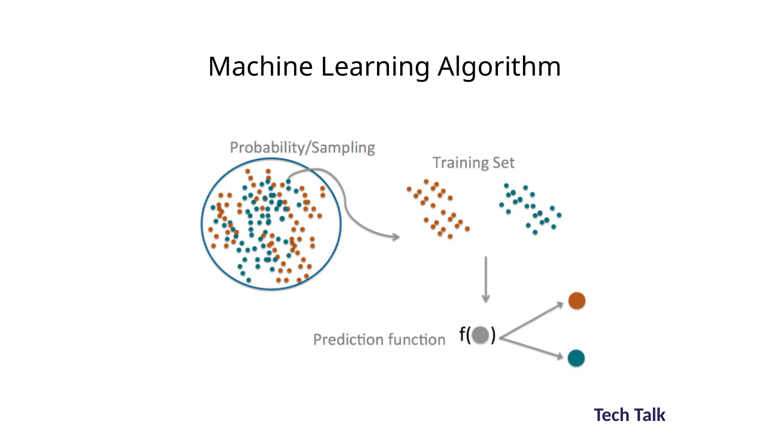
ORIGINAL • 03

Slide 36
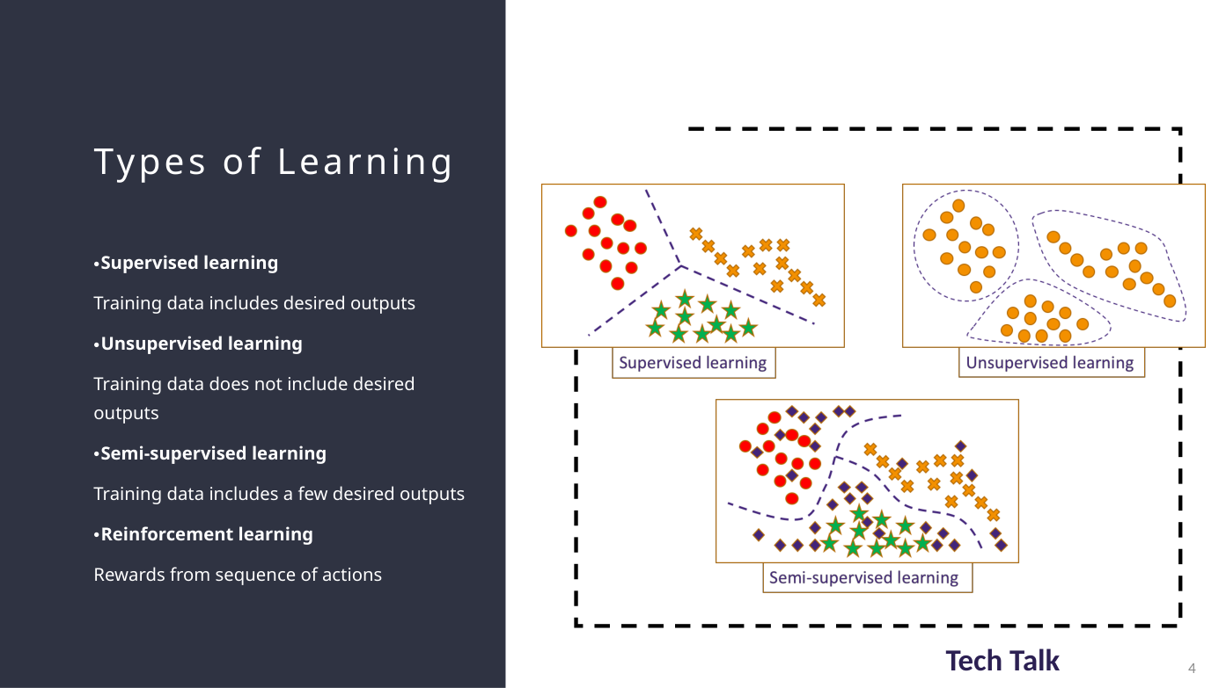
ORIGINAL • 04

Slide 37
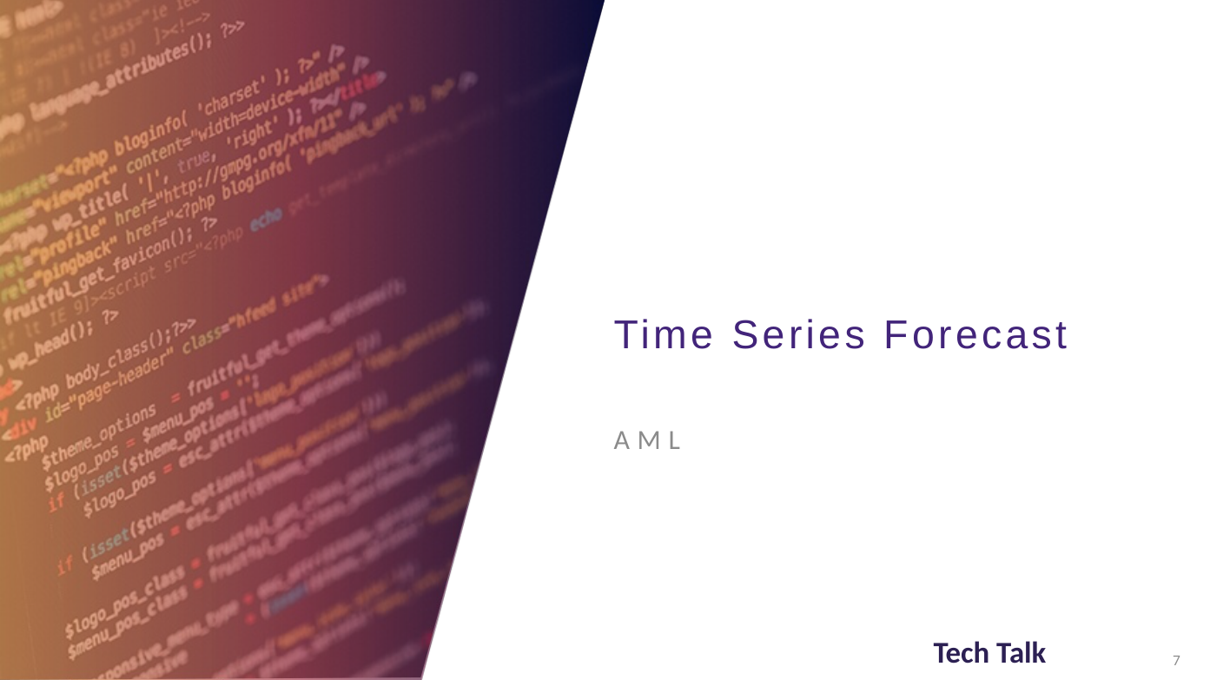
ORIGINAL • 07

Slide 38
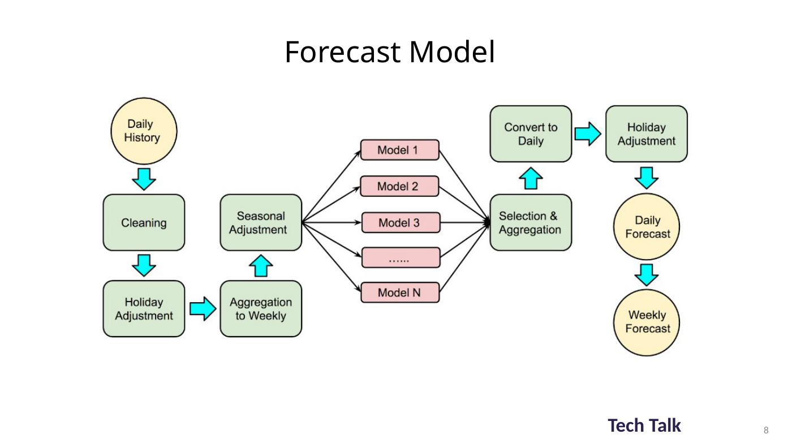
ORIGINAL • 08

Slide 39
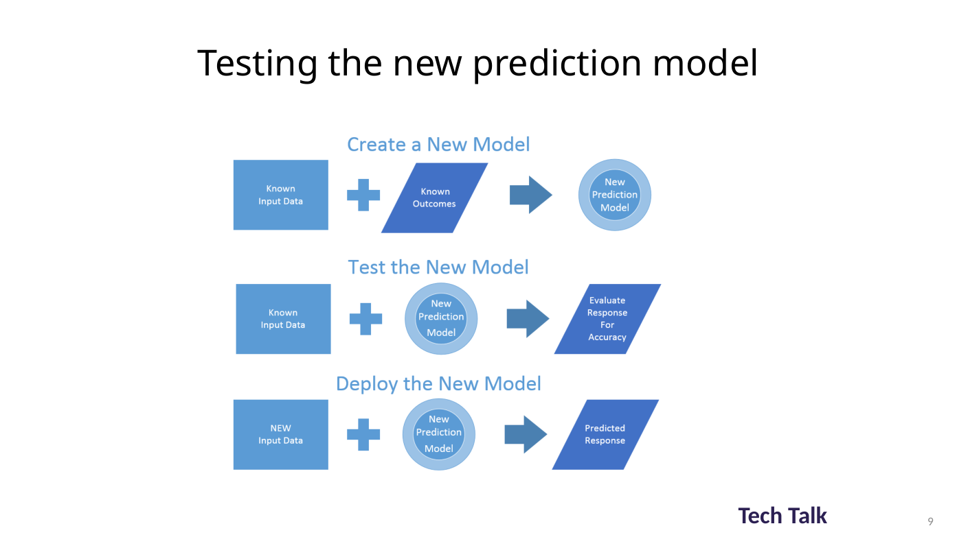
ORIGINAL • 09

Slide 40
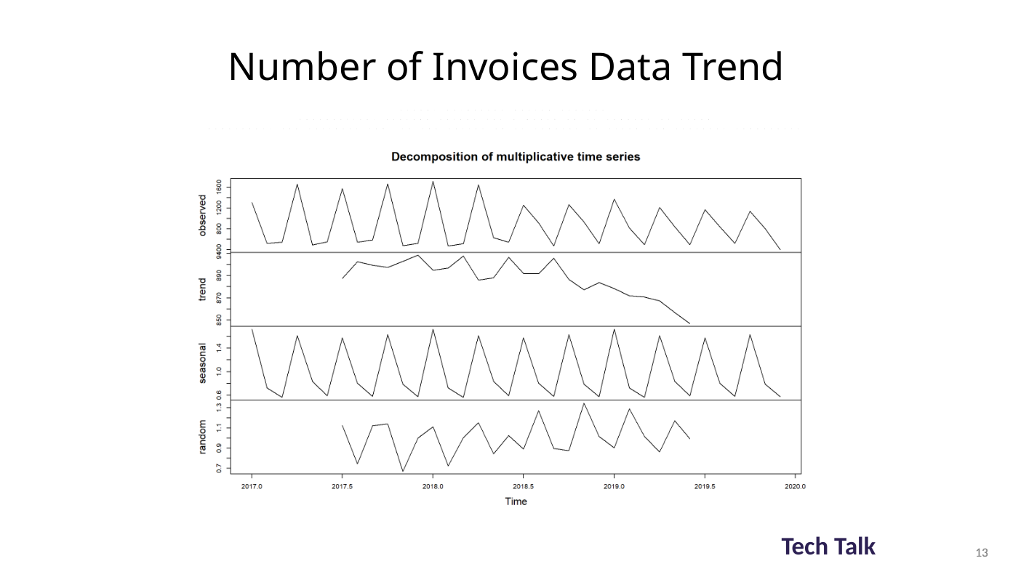
ORIGINAL • 13

Slide 41
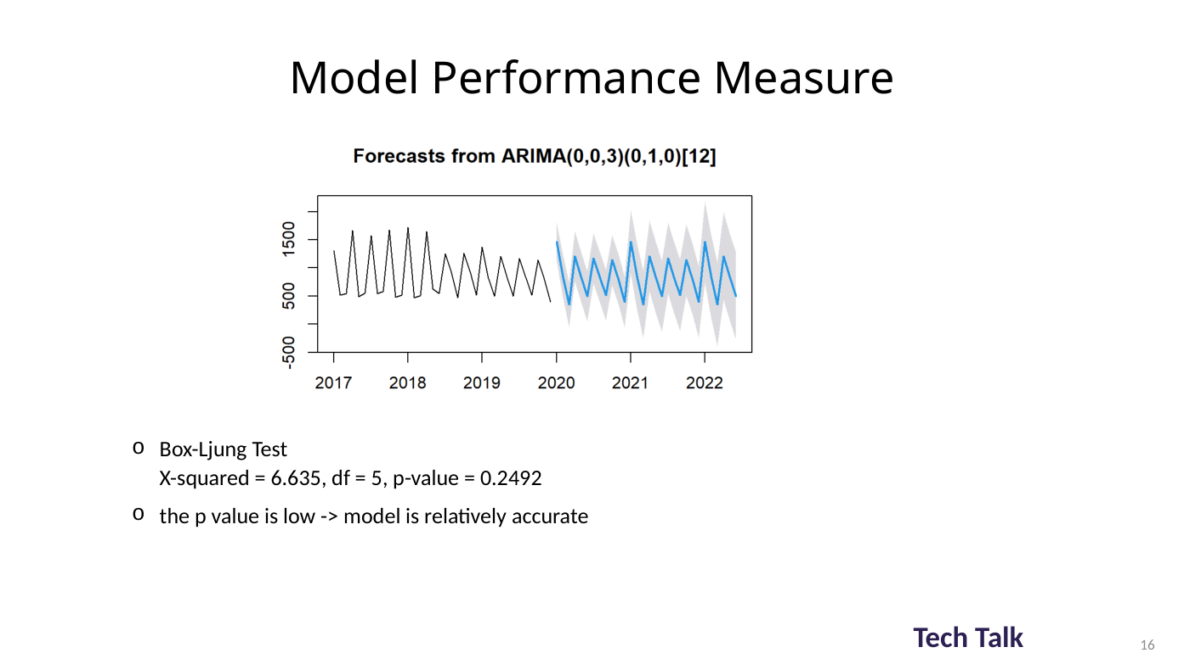
ORIGINAL • 16

Slide 42
APPENDIX • SELECTED ORIGINAL SLIDES
Original material | Insurance prediction
Source deck: OpenHouse_Insurance_Prediction_Presentation.pptx. The following are selected original slides, inserted as full-slide images to preserve their original layout and visual content.
Use these source slides as deeper technical examples or optional discussion material.

Slide 43
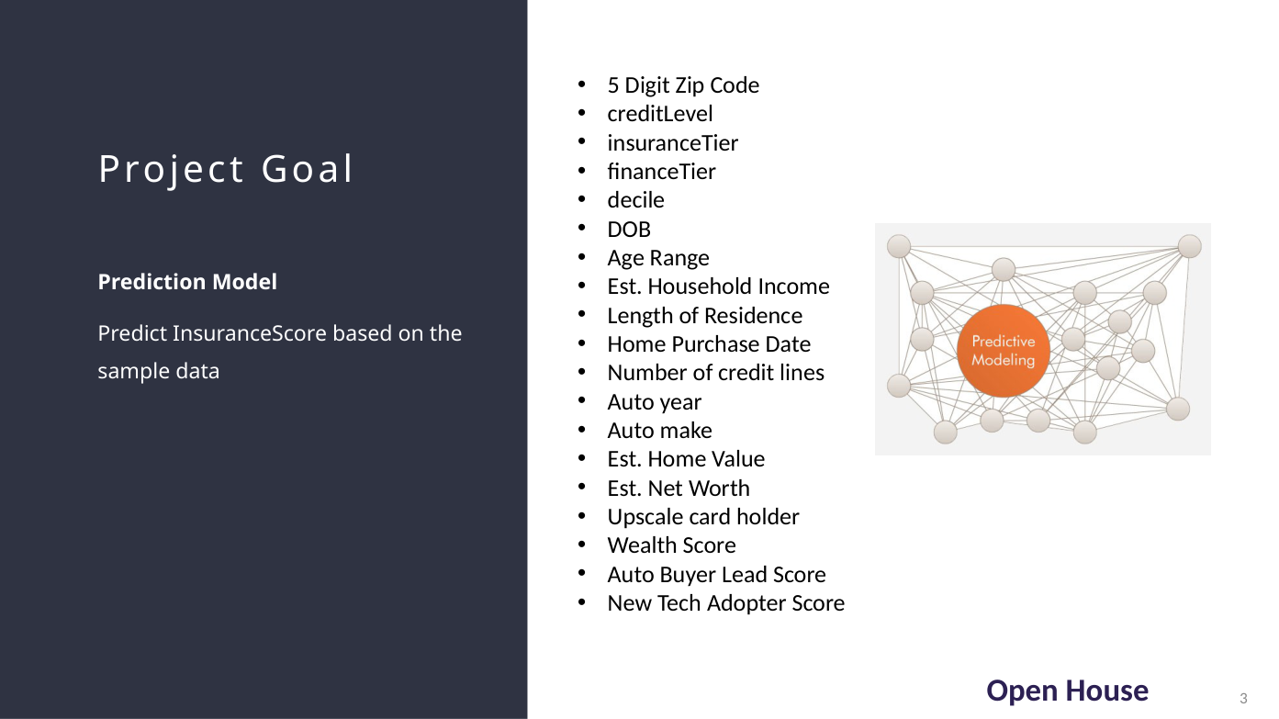
ORIGINAL • 03

Slide 44
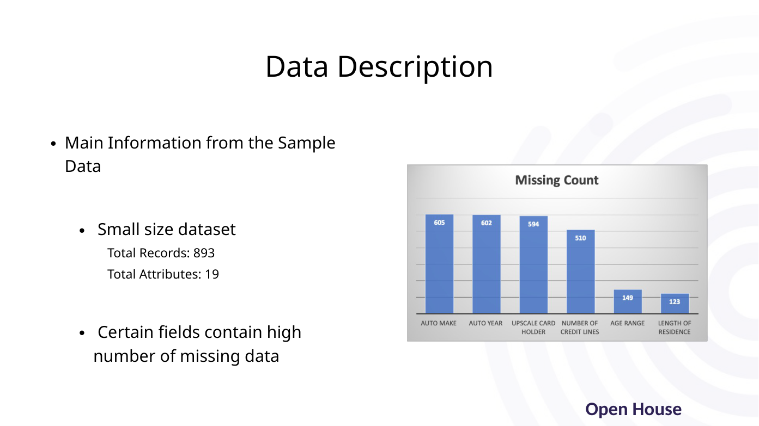
ORIGINAL • 04

Slide 45
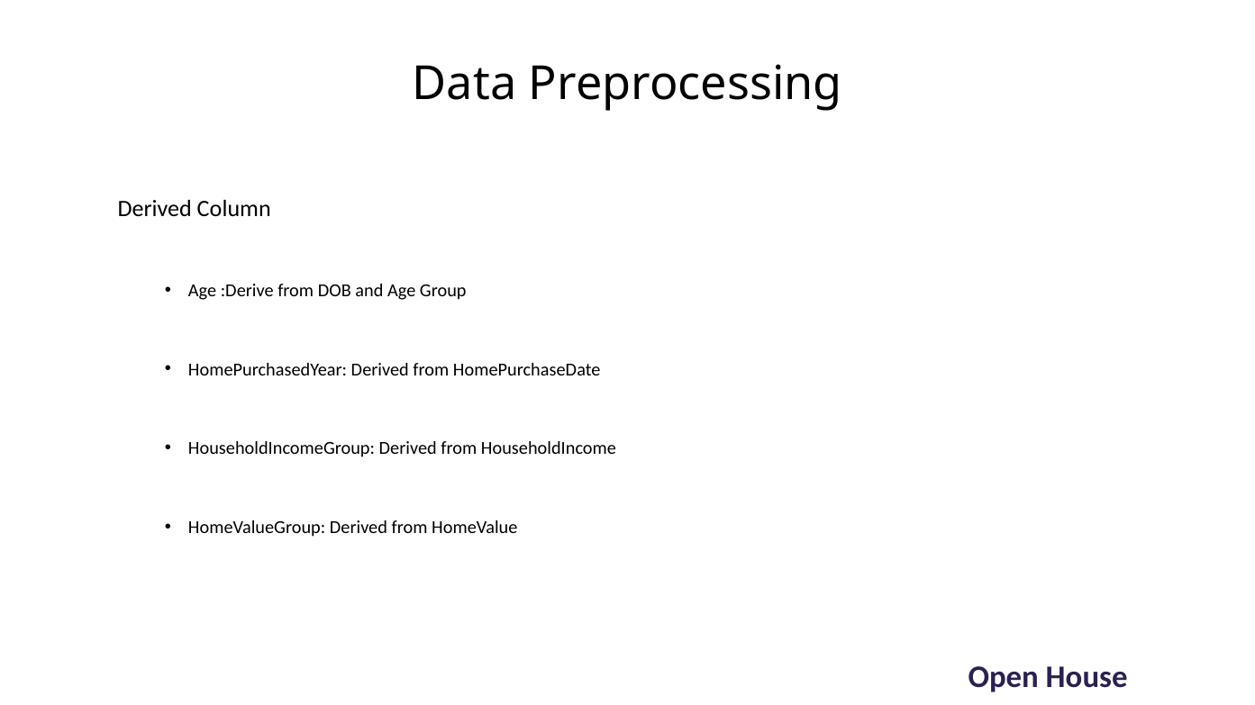
ORIGINAL • 06

Slide 46
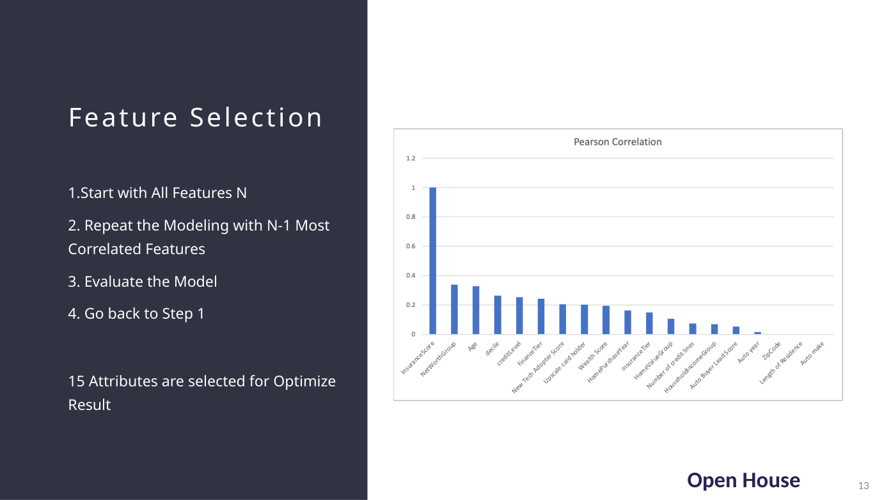
ORIGINAL • 13

Slide 47
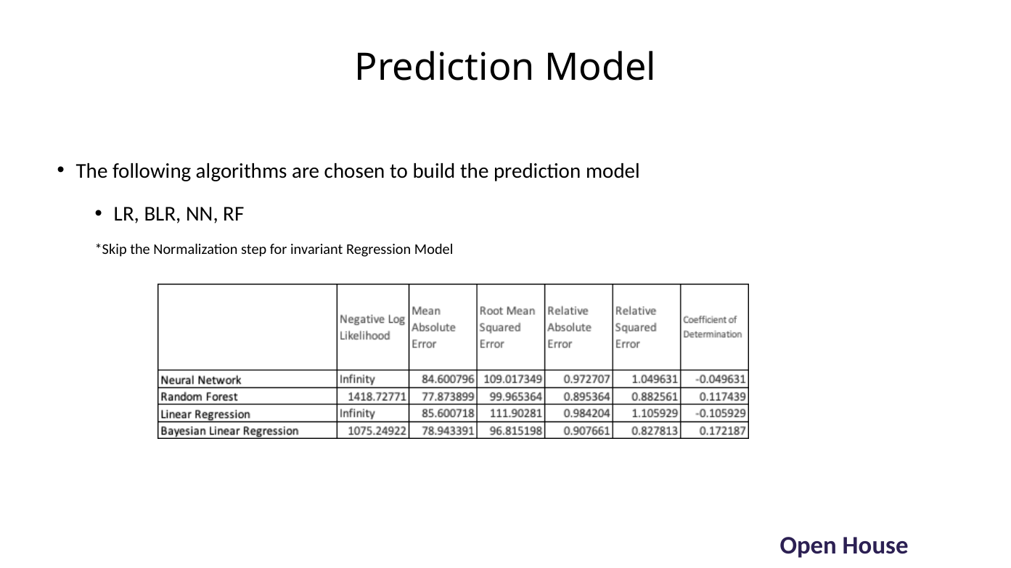
ORIGINAL • 14

Slide 48
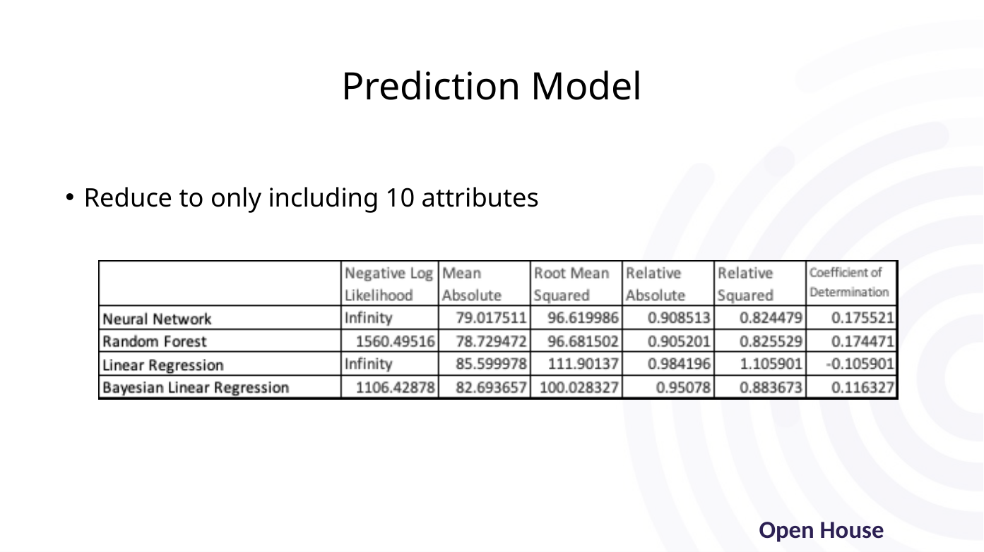
ORIGINAL • 15

Slide 49
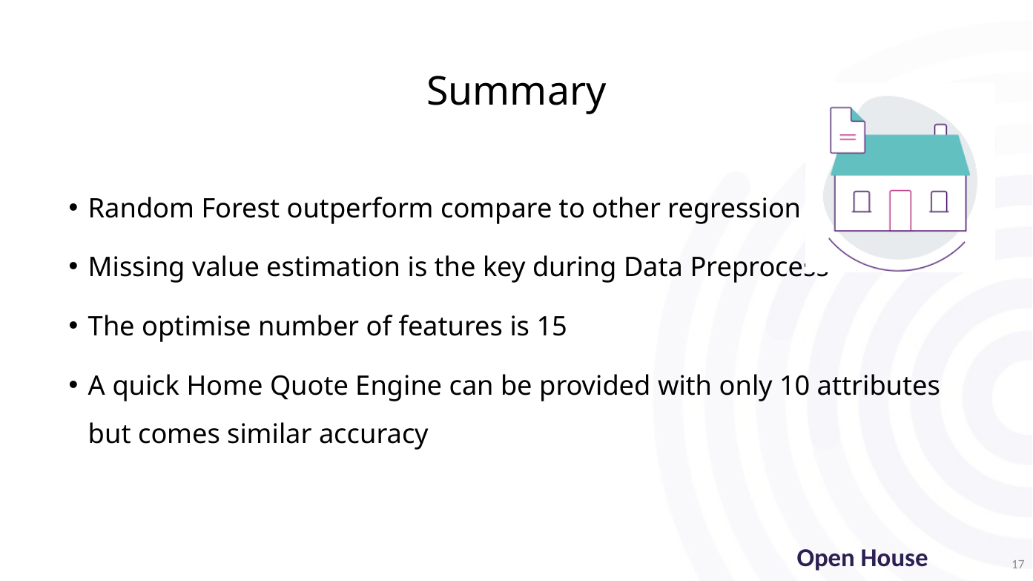
ORIGINAL • 17

Slide 50
APPENDIX • SELECTED ORIGINAL SLIDES
Original material | Dynamic scheduling
Source deck: Enhance Modelling For Dynamic Scheduling.pptx. The following are selected original slides, inserted as full-slide images to preserve their original layout and visual content.
Use these source slides as deeper technical examples or optional discussion material.

Slide 51
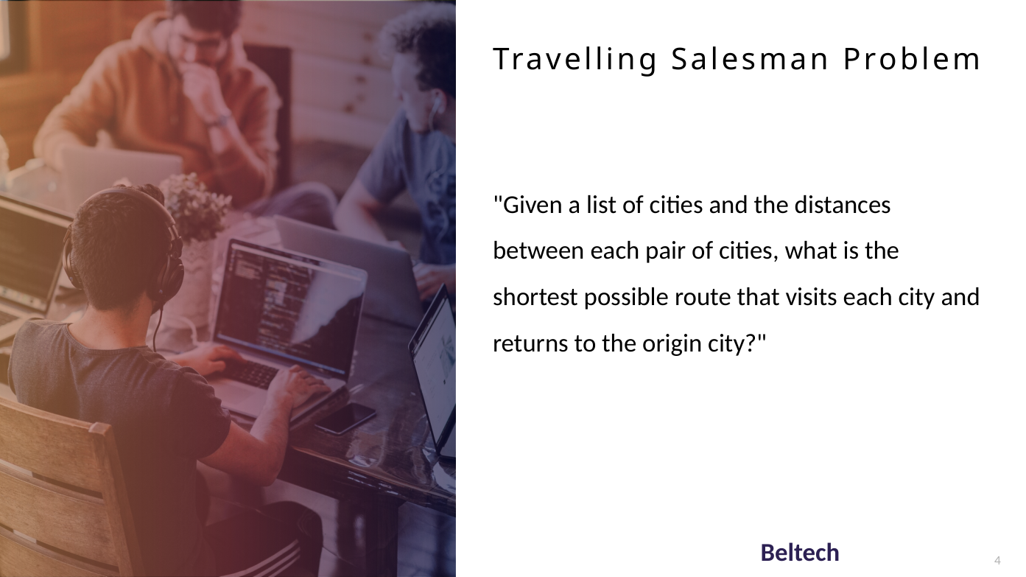
ORIGINAL • 04

Slide 52
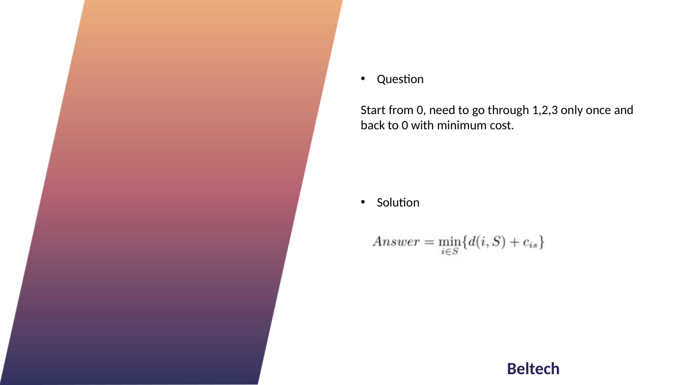
ORIGINAL • 07

Slide 53
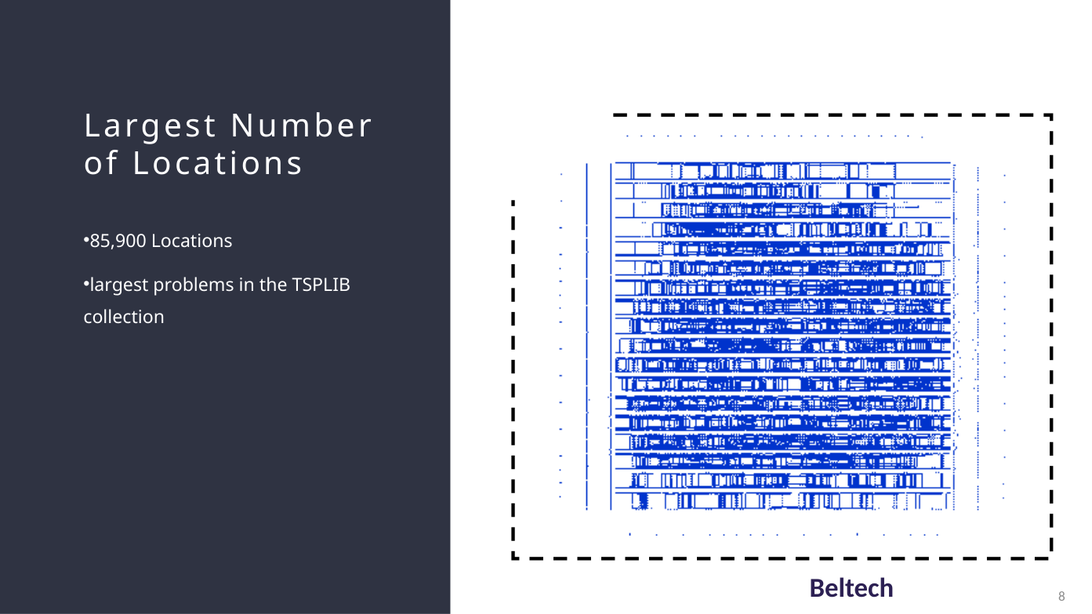
ORIGINAL • 08

Slide 54
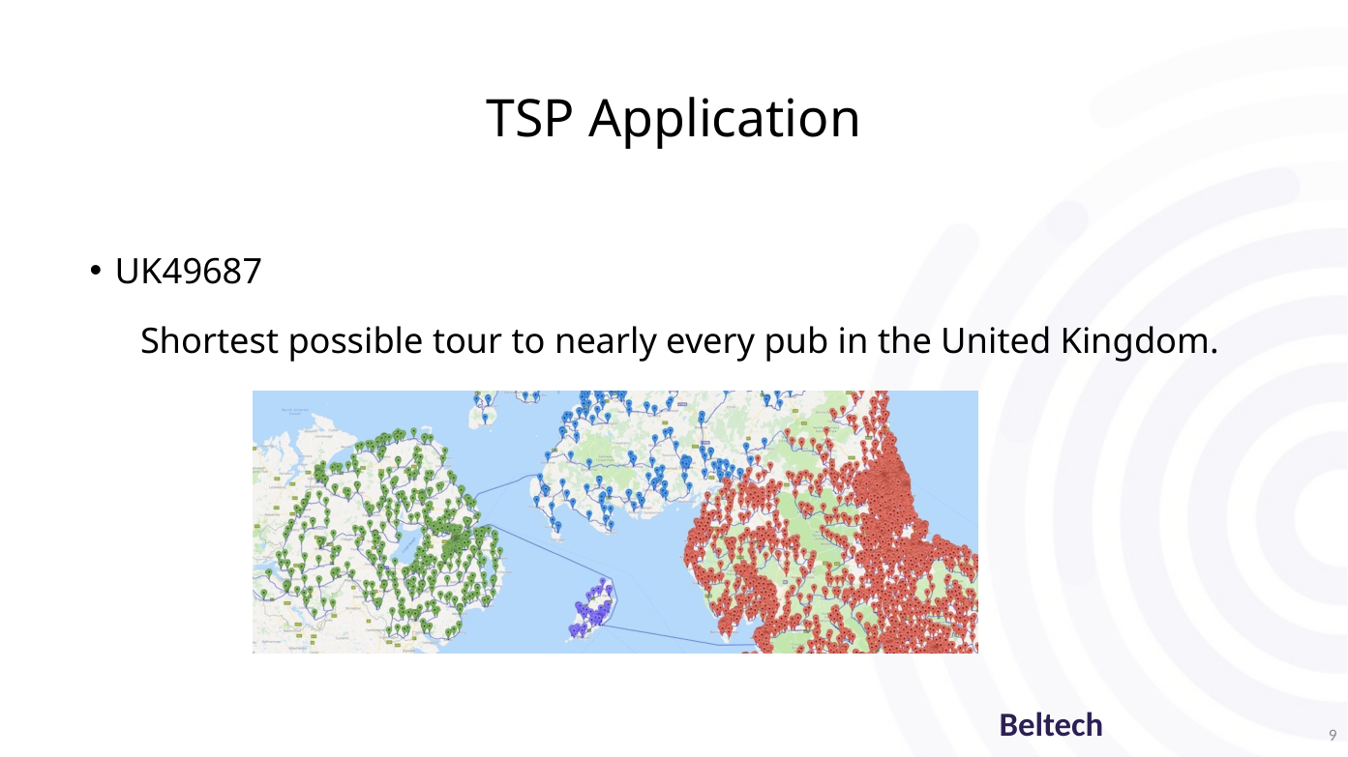
ORIGINAL • 09

Slide 55
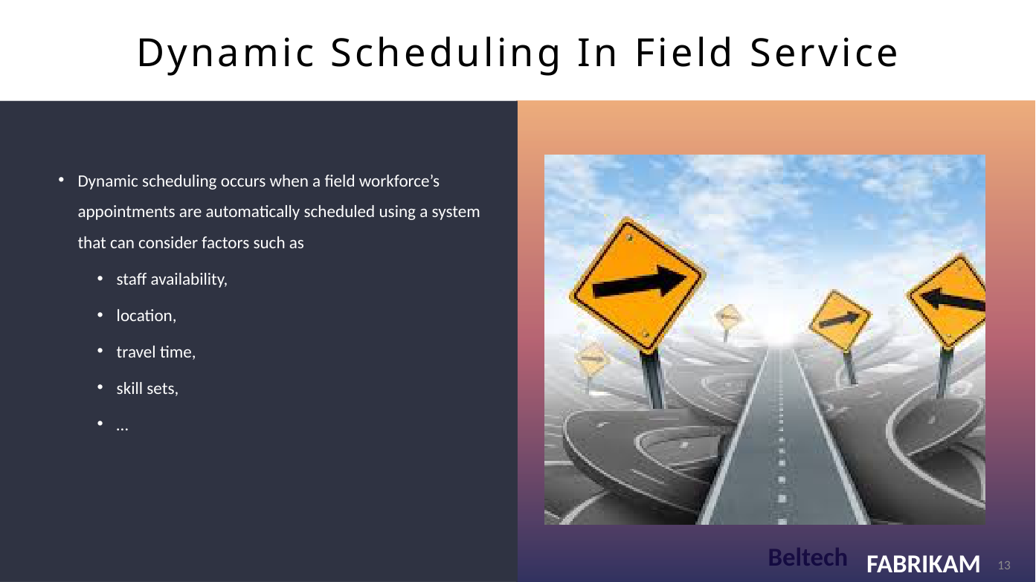
ORIGINAL • 13

Slide 56
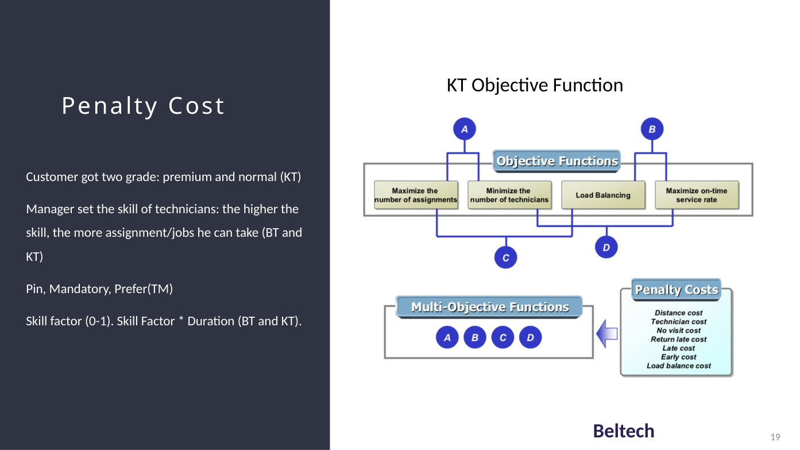
ORIGINAL • 19

Slide 57
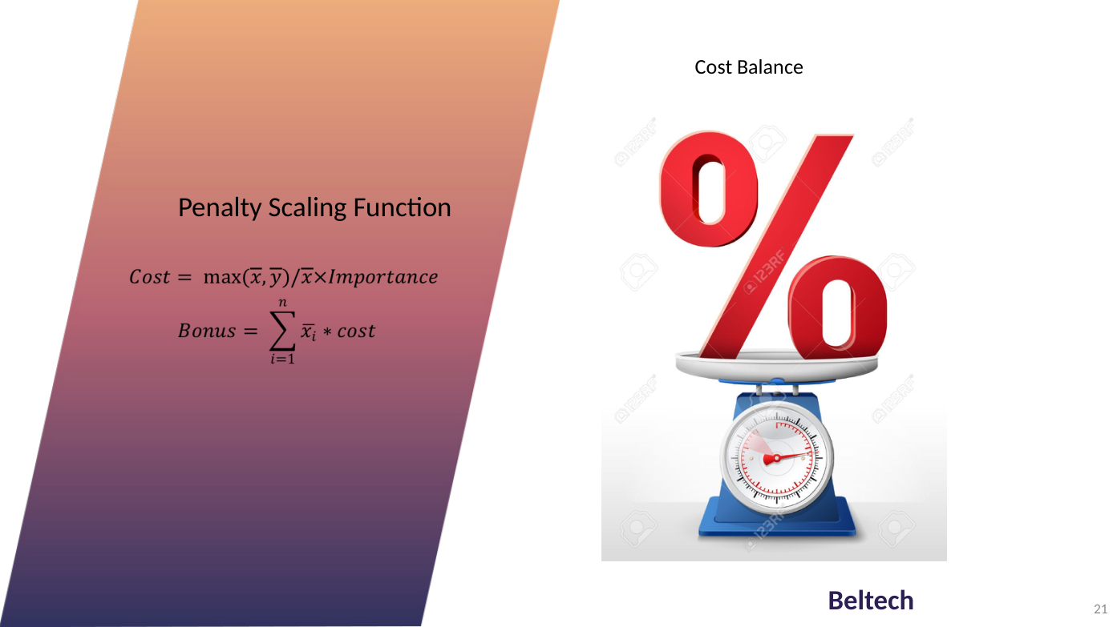
ORIGINAL • 21

Slide 58
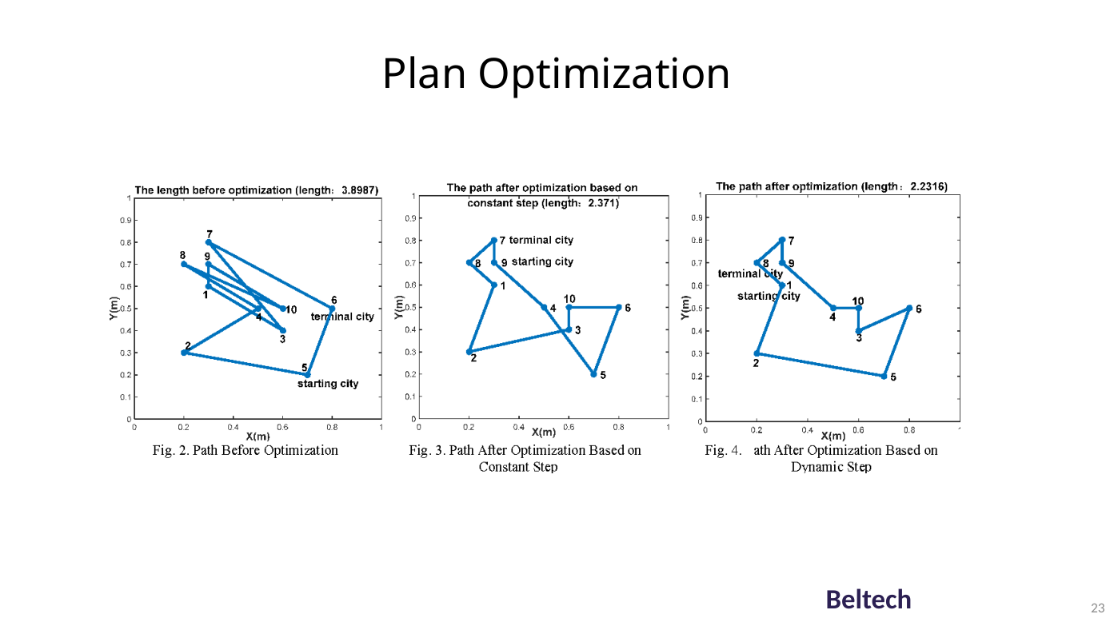
ORIGINAL • 23

Slide 59
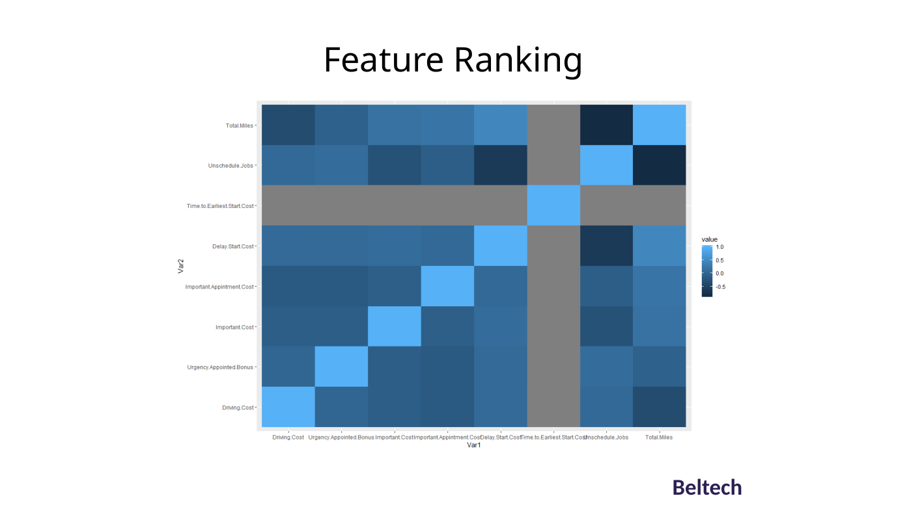
ORIGINAL • 24

Slide 60
APPENDIX • SELECTED ORIGINAL SLIDES
Original material | Sensor machine learning
Source deck: Sensor Machine Learning Project Q1.pptx. The following are selected original slides, inserted as full-slide images to preserve their original layout and visual content.
Use these source slides as deeper technical examples or optional discussion material.

Slide 61
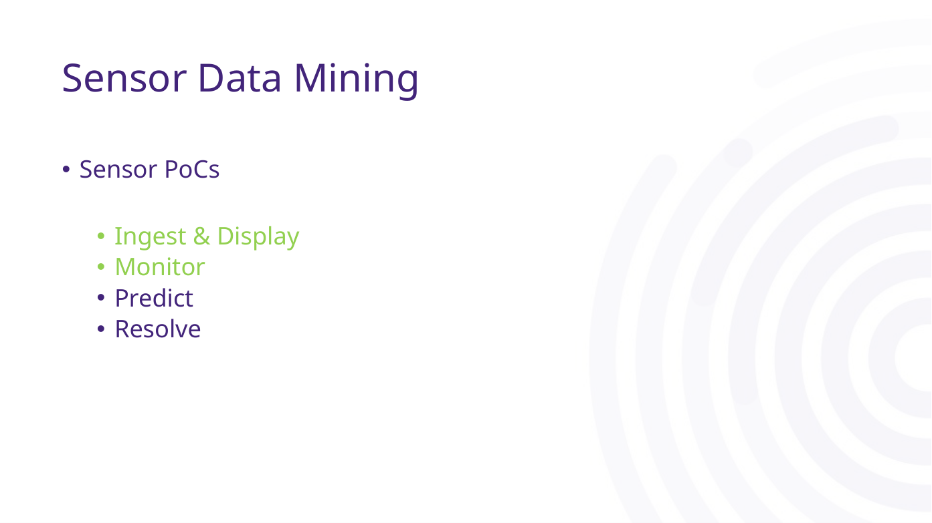
ORIGINAL • 08

Slide 62
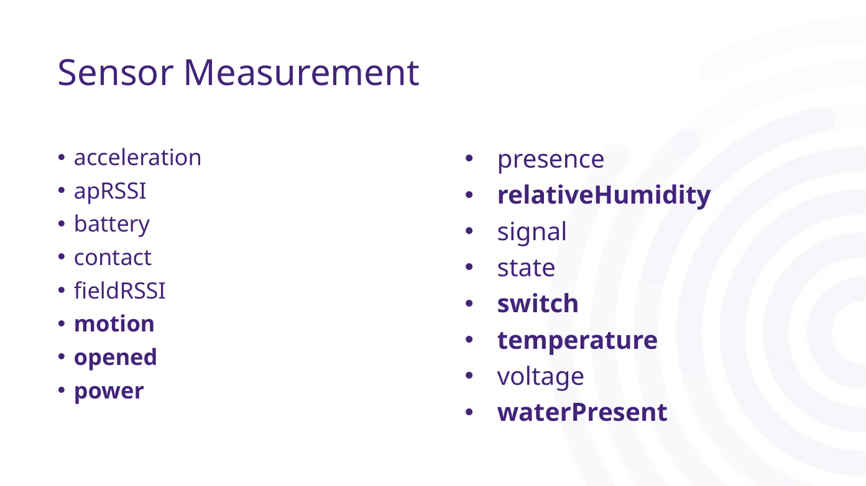
ORIGINAL • 11

Slide 63
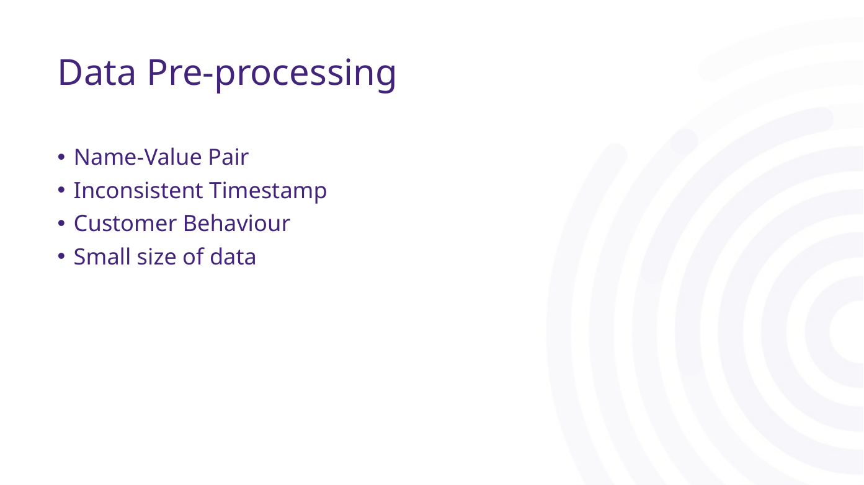
ORIGINAL • 13

Slide 64
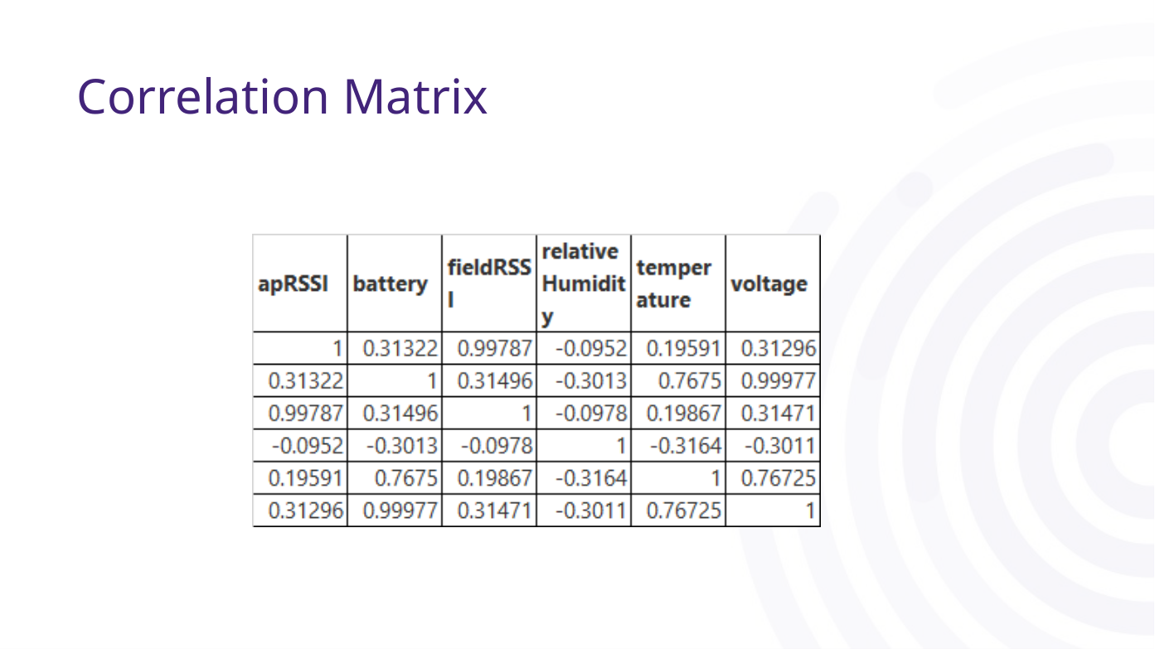
ORIGINAL • 15

Slide 65
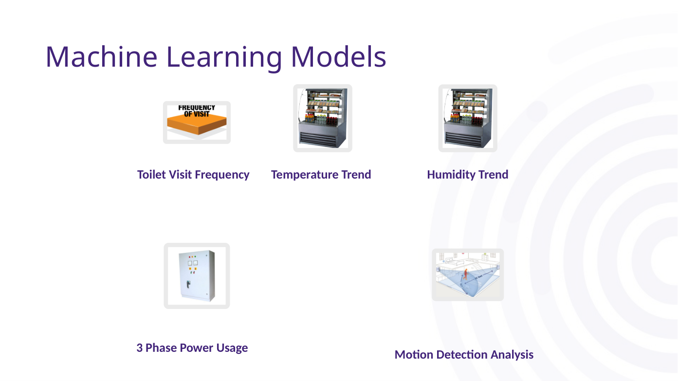
ORIGINAL • 17

Slide 66
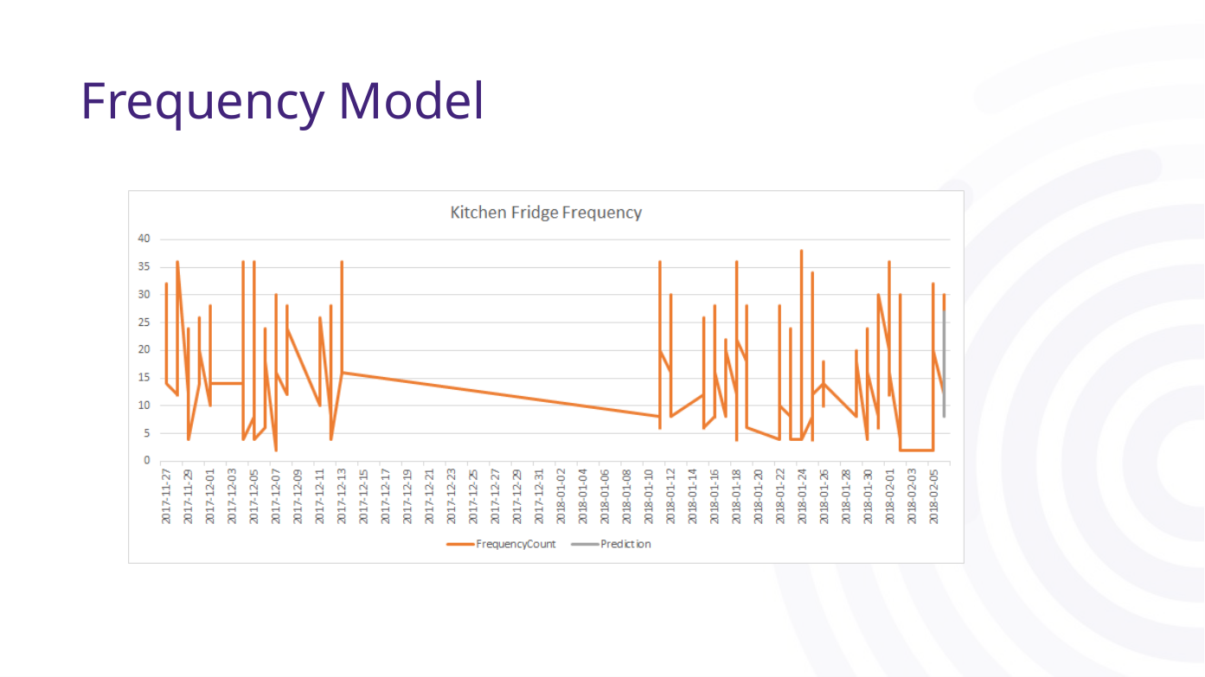
ORIGINAL • 18

Slide 67
APPENDIX • SELECTED ORIGINAL SLIDES
Original material | Reinforcement learning gamebot
Source deck: AI Gamebot Reinforcement Learning.pptx. The following are selected original slides, inserted as full-slide images to preserve their original layout and visual content.
Use these source slides as deeper technical examples or optional discussion material.

Slide 68
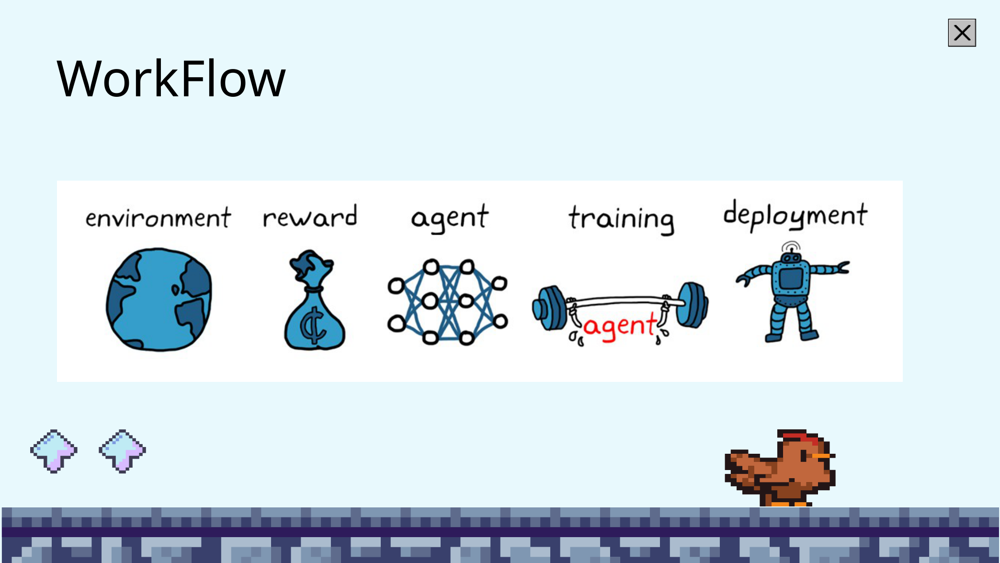
ORIGINAL • 05

Slide 69
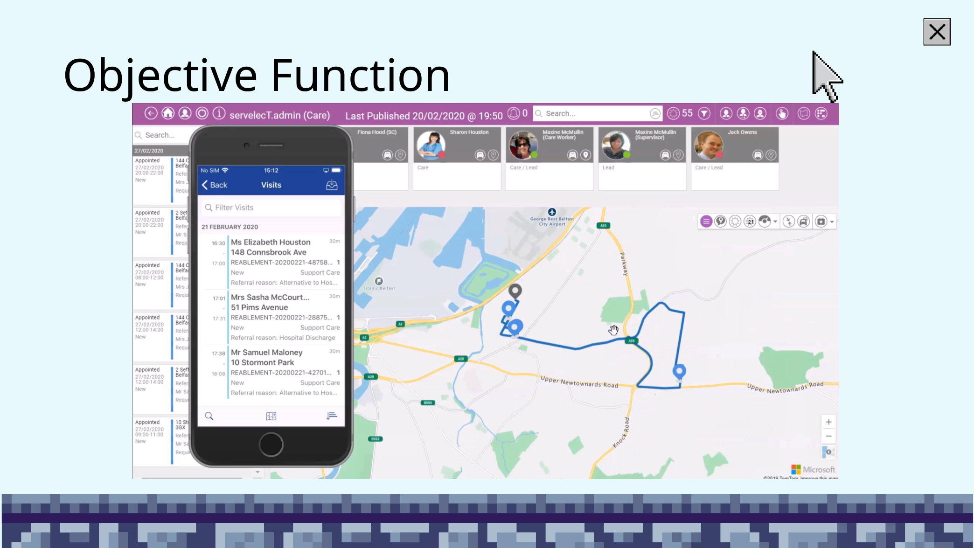
ORIGINAL • 07

Slide 70
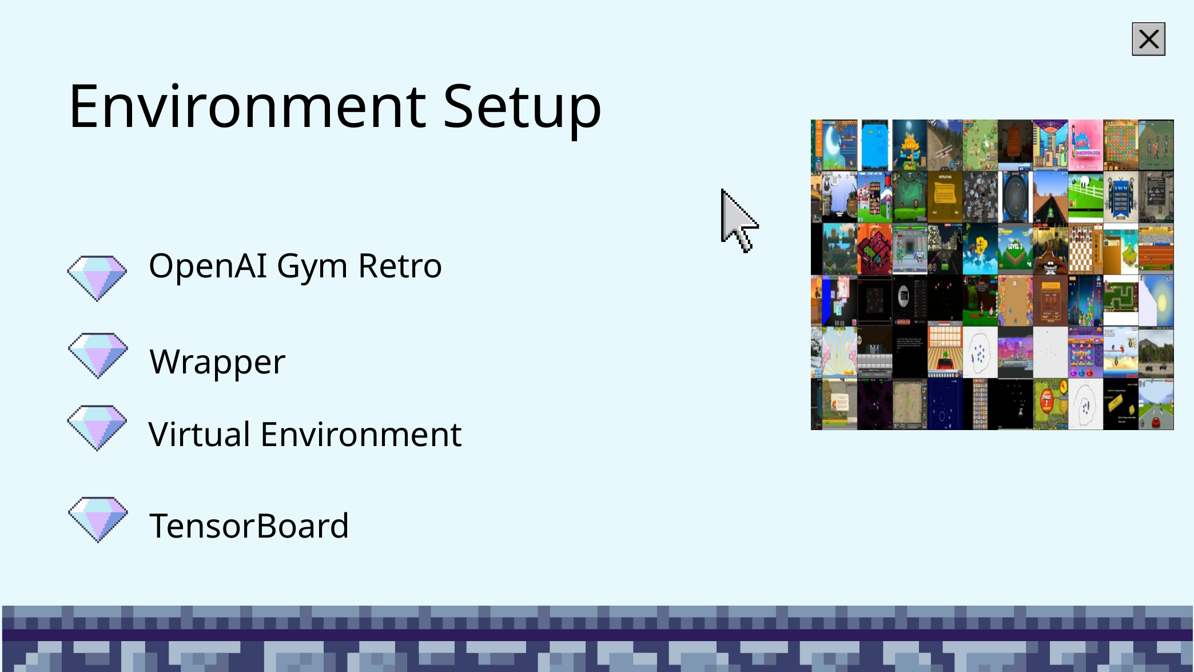
ORIGINAL • 08

Slide 71
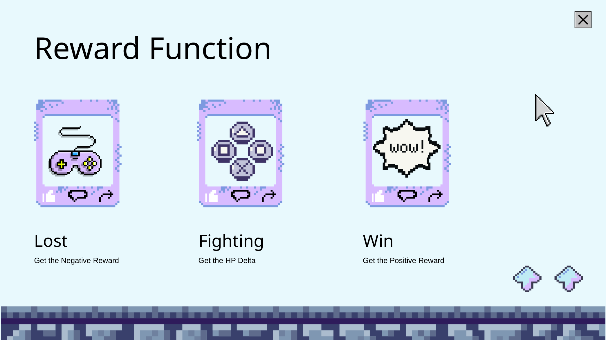
ORIGINAL • 10

Slide 72
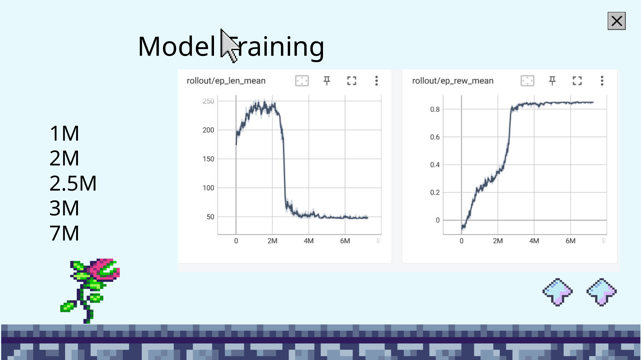
ORIGINAL • 12

Slide 73
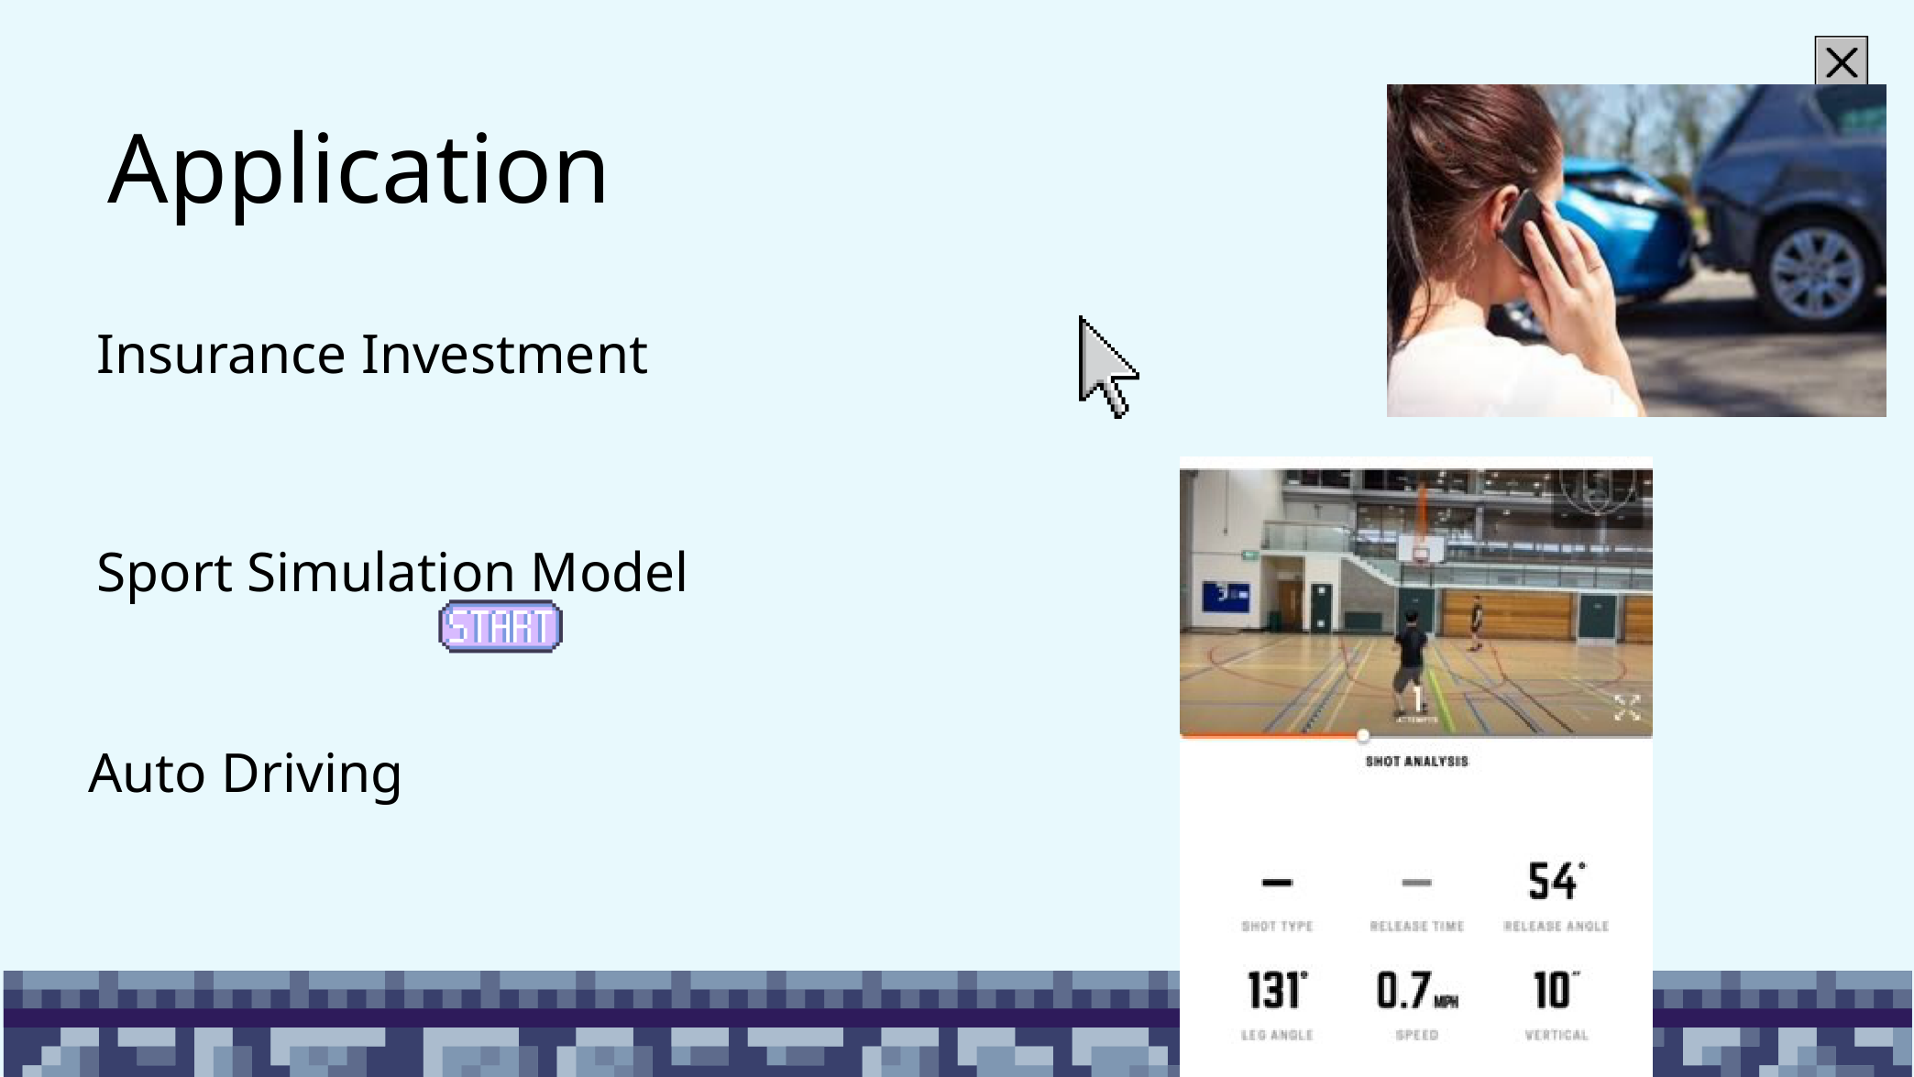
ORIGINAL • 14

