Slide 1
MathBoy3000
Stephen Iskander and Nicholas Esposito

Slide 2
The Team
Nicholas Esposito
Sophomore
Software Engineering Major
Stephen Iskander
Junior
Computer Science Major

Slide 3
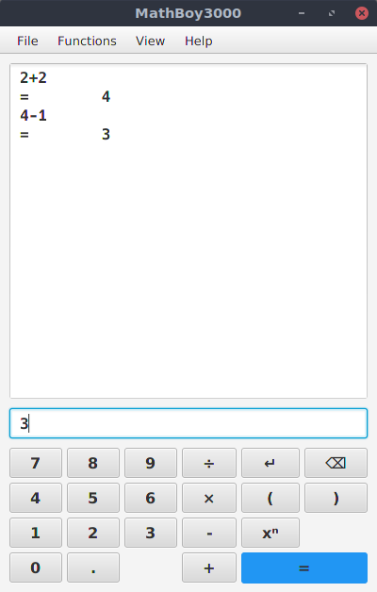
The Project
The MathBoy3000 is a calculator with various mathematical applications
Simple Expressions
Matrix Multiplication
Definite Integrals and Derivatives

Slide 4
The code
JavaFX GUI
  Written in Java without FXML
Parsing
  Uses regex to parse commands, matrices, and polynomials
  Shunting yard algorithm to generate reverse Polish notation from infix notation
    (modified to better support negative numbers)
Exact numerical representation
  Rational numbers are represented by a class containing a pair of BigInteger objects
  Integrals and derivatives are calculated by symbolic manipulation of polynomials

Slide 5
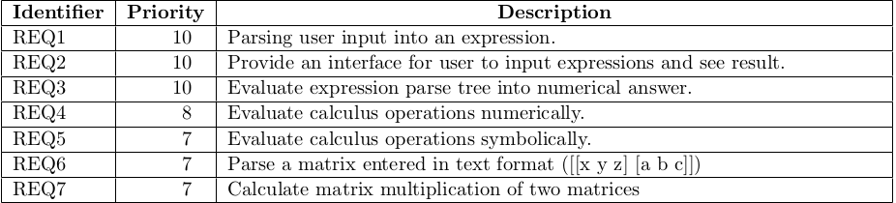
Requirements

Slide 6
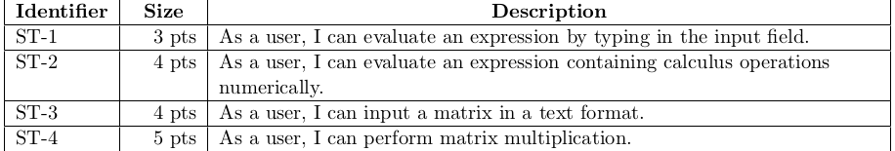
User Stories

Slide 7
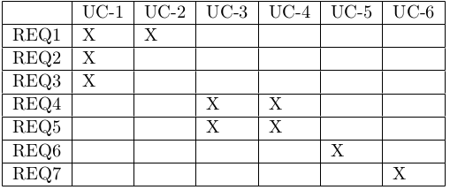
Traceability Matrix

Slide 8
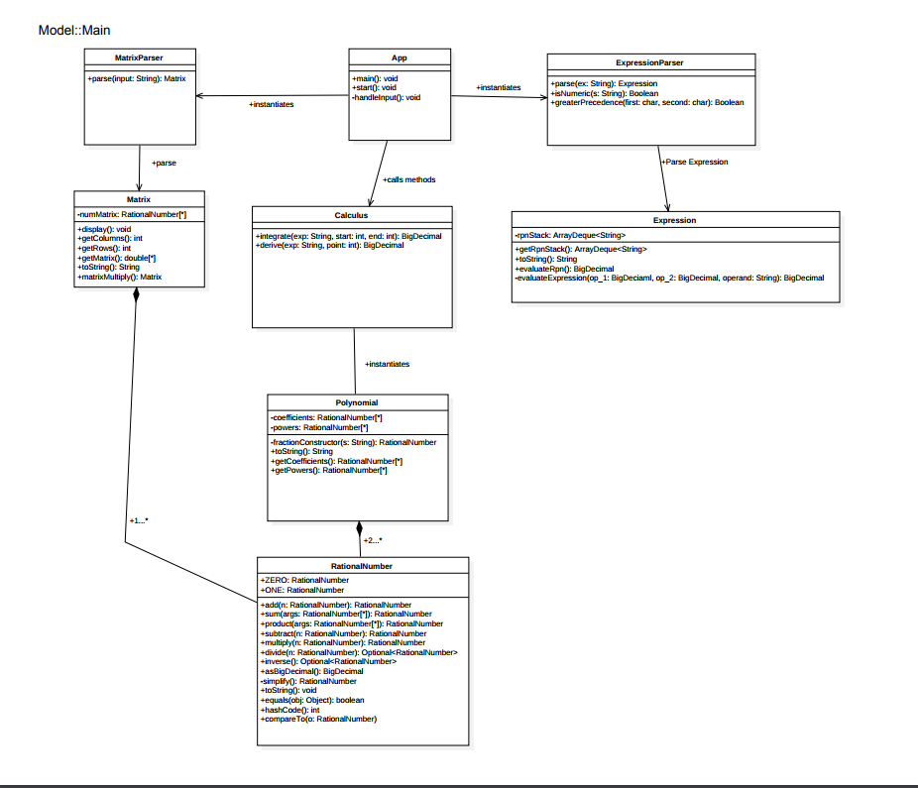
Class Diagram

Slide 9
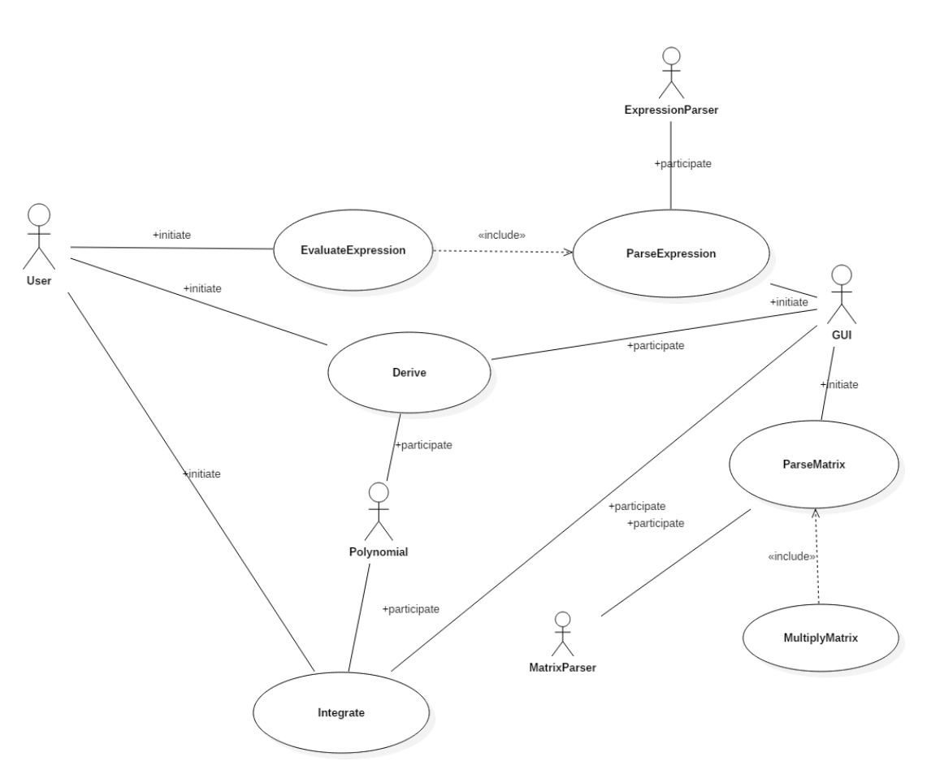
Use Case Diagram

