Slide 1
Cisco IOS Automation and IPSec VPN Planning
Part 1: Flask + GNS3 switch automation
Part 2: FortiGate-to-Palo Alto IPSec VPN automation plan
Project Review Deck

Slide 2
Review Agenda
2/18
1. Project objective and repository structure
2. Part 1 architecture, topology, workflow, validation, and tests
3. Part 2 VPN topology, parameters, APIs, automation flow, and alerts
4. Evidence and final review summary
Repository: /Users/thunder/Documents/Meli
Evidence: README, setup guide, test plan, VPN plan, screenshots, CLI examples
Current verification: 26 automated tests passing

Slide 3
Part 1
Cisco IOS switch automation with Flask, GNS3, Netmiko, backup, and compliance validation
3/18

Slide 4
Part 1 GNS3 Topology
5/18
IOSvL2 Switch
SVI 192.168.31.50/24
GW 192.168.31.1
SSH TCP/22
Mac
Flask App
http://127.0.0.1:5000 local IP:192.168.31.75
GNS3
Cloud / NAT
Management Path bridge:192.168.31.251
Netmiko Brief Introduction
Takeaway: Netmiko mode depends on IP reachability and SSH availability before automation starts.

Slide 5
Part 1 Automation Flow
6/18
1
Submit Flask form
2
Create driver
3
Push hostname + VLANs
4
write memory
5
Backup + validate
Takeaway: The same workflow runs against the mock driver or a real GNS3 IOSvL2 SSH target.

Slide 6
Part 1 Configuration and Compliance
7/18
Configuration Inputs
Compliance Checks
Hostname defaults to AUTOMAT and can be submitted from the frontend.
Required VLANs: 10 VLAN_DATA, 20 VLAN_VOICE, 50 VLAN_SECURITY.
One optional additional VLAN can be pushed if it does not duplicate another VLAN ID.
Hostname is compared against the submitted frontend hostname.
VLAN 10/20/50 names are validated from show vlan brief output.
Optional additional VLAN is configured but not included in compliance scoring.
Takeaway: Compliance is based on observed switch output, not only successful command submission.
Takeaway: Compliance is based on observed switch output, not only successful command submission.

Slide 7
Part 1 Architecture
4/18
Runtime Components
Control Outputs
main.py handles Flask routes, form parsing, and workflow orchestration.
templates/index.html provides the browser UI.
driver.py exposes MockSwitchDriver and NetmikoSwitchDriver.
validator.py compares observed switch output with intended state.
backups/ stores timestamped running-config files.
demoresult/ stores Part 1 screenshot evidence.
Takeaway: The UI, device driver, validation, and backup responsibilities are separated cleanly.
Takeaway: The UI, device driver, validation, and backup responsibilities are separated cleanly.

Slide 8
Part 1 Netmiko and Reliability Controls
8/18
Connection Behavior
Prompt Handling
Device type is cisco_ios.
conn_timeout, auth_timeout, and banner_timeout are 15 seconds.
read_timeout is 60 seconds for config and show commands.
Generic IOS prompt pattern [>#] avoids hostname-specific prompt failures.
Hostname changes disable command verification.
Base prompt is refreshed after hostname changes.
Takeaway: These controls address common IOSvL2 SSH delays and prompt changes in GNS3.
Takeaway: These controls address common IOSvL2 SSH delays and prompt changes in GNS3.

Slide 9
Part 1 Testing and Evidence
9/18
Automated Testing
Demo Evidence
pytest -q currently returns 26 passed.
Tests cover Flask UI flow, mock driver, validator behavior, Netmiko timeouts, and prompt handling.
Reachability helper tests verify ping and TCP checks.
demoresult/part1screenshot.md indexes screenshots.
Screenshots cover frontend, switch CLI, validation alerts, compliance, and backup evidence.
PART1_FLASK_GNS3_SETUP.md documents the GNS3 setup path.

Slide 10
Part 2
FortiGate-to-Palo Alto IPSec VPN automation planning with parameters, APIs, validation, and alerts
10/18

Slide 11
Part 2 VPN Topology
11/18
FortiGate
FGT-BRANCH
WAN 198.51.100.10
LAN 10.10.10.0/24
IPSec Tunnel
169.255.1.0/30
FGT 169.255.1.1
PA 169.255.1.2
Palo Alto
PA-DC
WAN 203.0.113.20
LAN 10.20.20.0/24
Takeaway: The tunnel uses mirrored selectors: FortiGate local 10.10.10.0/24 to Palo Alto local 10.20.20.0/24.

Slide 12
Part 2 Required Parameters
12/18
Network Parameters
Tunnel and Crypto
FortiGate WAN IP: 198.51.100.10.
Palo Alto WAN IP: 203.0.113.20.
FortiGate protected subnet: 10.10.10.0/24.
Palo Alto protected subnet: 10.20.20.0/24.
Tunnel network: 169.255.1.0/30.
FortiGate tunnel IP: 169.255.1.1/30.
Palo Alto tunnel IP: 169.255.1.2/30.
IKE version: IKEv2
Authentication: Pre-shared key, or certificates if available
Phase 1 encryption: AES-256-GCM preferred
PRF: SHA-256 or SHA-384
DH group: Group 20, ECP384 preferred
Lifetime: 8 hours / 28,800 seconds
Phase 2 protocol: ESP
Phase 2 encryption: AES-256-GCM preferred
PFS: enabled
PFS group: Group 20
Lifetime: 1 hour / 3,600 seconds
If AES-GCM compatibility is a problem, use this fallback:
IKE version: IKEv2
Phase 1 encryption: AES-256-CBC
Phase 1 integrity: SHA-256
DH group: Group 14 minimum, Group 20 preferred
Lifetime: 28,800 seconds
Phase 2 protocol: ESP
Phase 2 encryption: AES-256-CBC
Phase 2 integrity: SHA-256
PFS: enabled
PFS group: Group 14 minimum, Group 20 preferred
Lifetime: 3,600 seconds

Slide 13
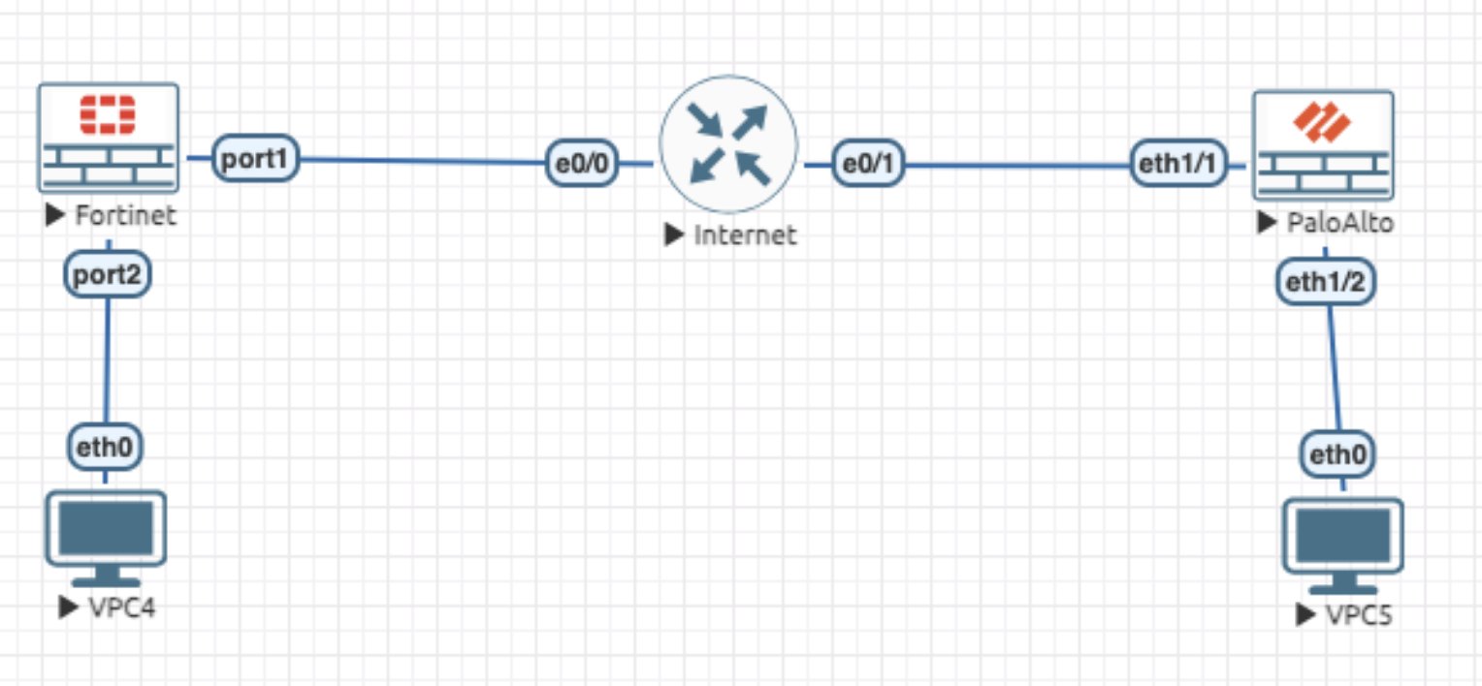
Part 2 Tools and API Strategy
13/18
FortiGate
Palo Alto
FortiOS REST CMDB endpoints for VPN Phase 1 and Phase 2.
REST endpoints for interfaces, address objects, policies, and routes.
Monitor API or SSH commands for tunnel state and route checks.
API token docs: docs.fortinet.com/.../administration-guide/940602/using-apis
REST API admin docs: docs.fortinet.com/.../administration-guide/399023/rest-api-administrator
PAN-OS REST API for objects, tunnel interfaces, gateways, tunnels, routes, and policy.
XML API or Panorama for operational commands and commit workflows.
SSH remains a fallback for show/test commands.
REST API key docs: https://docs.paloaltonetworks.com/pan-os/11-1/pan-os-panorama-api/get-started-with-the-pan-os-rest-api
XML API key docs: docs.paloaltonetworks.com/.../get-your-api-key
EVE-NG would be simulator to test

Slide 14
Part 2 Automation Flow
14/18
1
Validate inputs
2
Create objects
3
Build tunnels
4
Routes + policy
5
Commit/apply
6
Validate + alert
Define what is the platform - Paloalto or Fortinet
Takeaway: The plan is repeatable: validate, configure both vendors, commit/apply, then verify operational state.

Slide 15
Part 2 Multi-Vendor Considerations
15/18
Common Failure Points
Operational Considerations
Proxy-ID and traffic selector mismatch.
Phase 1 / Phase 2 proposal mismatch.
PFS or lifetime mismatch.
Missing static routes or asymmetric routing.
PAN-OS candidate configuration must be committed.
FortiGate and Palo Alto use different zone and policy models.
NAT-T and logging behavior should be aligned with the design.
Pre-shared keys must come from a secret manager.

Slide 16
Part 2 Validation and Alerts
16/18
Validation Methods
Alert Conditions
FortiGate: get vpn ipsec tunnel summary.
FortiGate: diagnose vpn tunnel list and route lookup.
Palo Alto: show vpn ike-sa and show vpn ipsec-sa.
End-to-end ICMP or application traffic test.
VPN_DOWN.
PROXY_ID_MISMATCH.
PROPOSAL_MISMATCH.
ROUTE_MISSING.
POLICY_MISSING or COMMIT_PENDING.

Slide 17
Part 2 Repository Artifacts
17/18
Planning Artifacts
Execution Examples
VPN_PLAN.md provides the written automation plan.
PART2_VPN_DELIVERABLES.md maps requirements to artifacts.
vpn_planner.py builds structured plan data.
scripts/generate_vpn_plan.py prints the plan as JSON.
vpncliexamples/ stores FortiGate and Palo Alto conceptual CLI examples.
scripts/vpn_connectivity_check.py provides optional ICMP validation.

Slide 18
Final Review Summary
18/18
Part 1 demonstrates working Cisco switch automation with Flask, GNS3 readiness, backup, and compliance validation.
Part 2 provides a complete FortiGate-to-Palo Alto IPSec VPN automation plan with structured code and example artifacts.
The repository includes setup documentation, test plan, requirement mapping, screenshot evidence, and CLI examples.

