Slide 1
Lightweight MDA

Slide 2
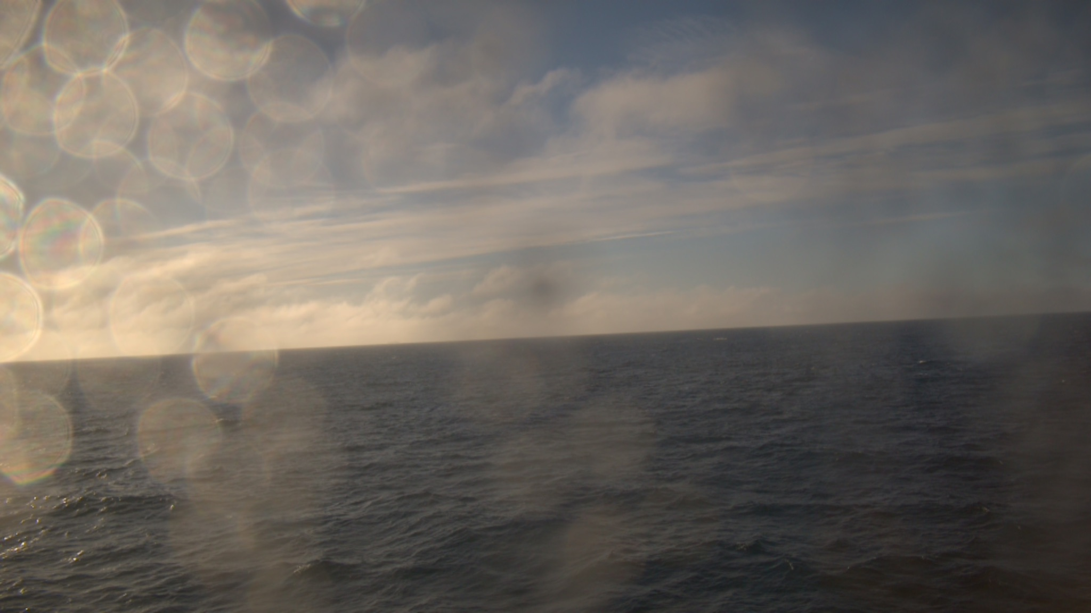

Slide 3
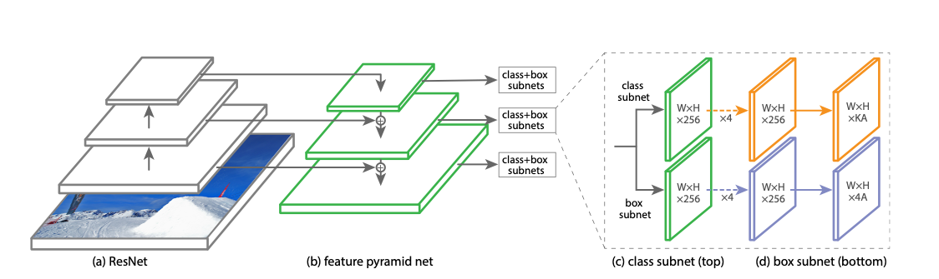
Previous MDA ML Strategy: Prescreening
The Meta-Architecture of our previous MDA approach
Classifier and Detection Model
Classifier identifies good candidates for object detection
Reduces computational expense by running detection inference only when a vessel is found
Birds
Vessels
Saildrones
Inference Time Per Image
Power Mode | RetinaNet v11
Nano | 3751 ms
AGX in Explorer Mode | 695 ms
AGX in 30W_2Core Mode | 234 ms

Slide 4
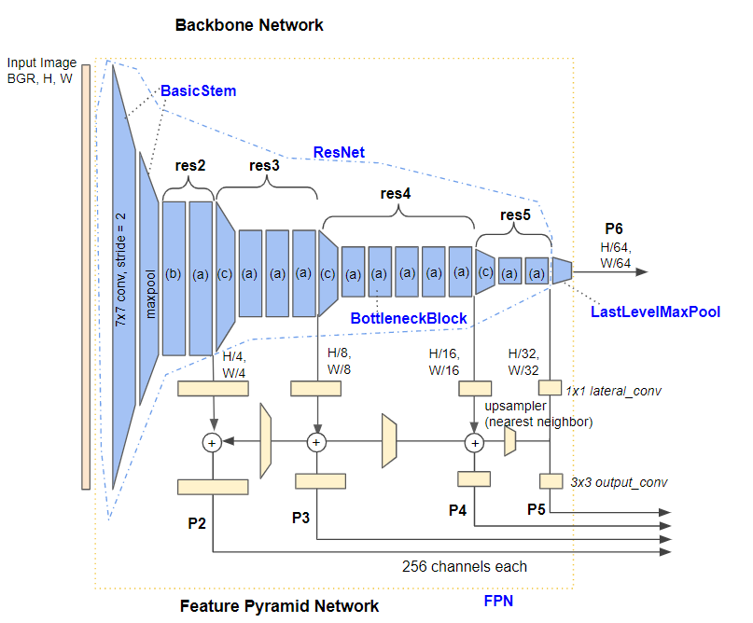
Prescreen Classifier
Classifier identifies if there is an object of interest somewhere in the image
Image Captured by the Argus
Bird
Vessel
Saildrone
Bird
Simplified:
Vessel
Saildrone

Slide 5
Detection RetinaNet
Generates a bounding box localization and classification
Simplified:
Notes:
This generalization shows that a lot of extra work needs to be able to generate a bounding box that localizes a vessel, as well as the classification that identifies it as a vessel.

Slide 6
Previous MDA ML Strategy: Areas for Improvement
Redundancy in deploying two similar ML models
Redundant feature extraction
Detector Backbone holds 89.6% of Gflops
Difficult to maintain
Concern with False Negatives
Slow Detection Inference
Birds
Vessels
Saildrones
Notes:
If Object Detection can be improved, the Classifier is Redundant

Slide 7
Backbone Replacement: FLOPs
351 billion less floating point operations!
 | ResNet-50 | ResNet-18
Backbone | 720.4 Gflops | 302.8 Gflops
Feature Pyramid Net | 16.2 Gflops | 8.8 Gflops
Class+Box Subnets | 58.5 Gflops | 57.6 Gflop
Total Model Inference | 720.4 Gflops | 369.3 Gflops
Notes:
\

Slide 8
Backbone Replacement: Inference Time Per Image
Performance benefit of reducing the backbone network complexity
Power Mode | ResNet-50 | ResNet-18
Nano | 3751 ms | 1818 ms
AGX in Explorer Mode | 695 ms | 359 ms
AGX in 30W_2Core Mode | 234 ms | 135 ms

Slide 9
Backbone Replacement: ResNet-18
Swapping a ResNet-50 Backbone with ResNet-18
Blocks Per Stage
Stage | ResNet-18 | ResNet-34 | ResNet-50
res2 | 2 | 3 | 3
res3 | 2 | 4 | 4
res4 | 2 | 6 | 6
res5 | 2 | 3 | 3
ResNet-18 | ResNet-34 | ResNet-50
Features Output
Stage | ResNet-18 | ResNet-34 | ResNet-50
res2 | 64 | 64 | 256
res3 | 128 | 128 | 512
res4 | 256 | 256 | 1024
res5 | 512 | 512 | 2048

Slide 10
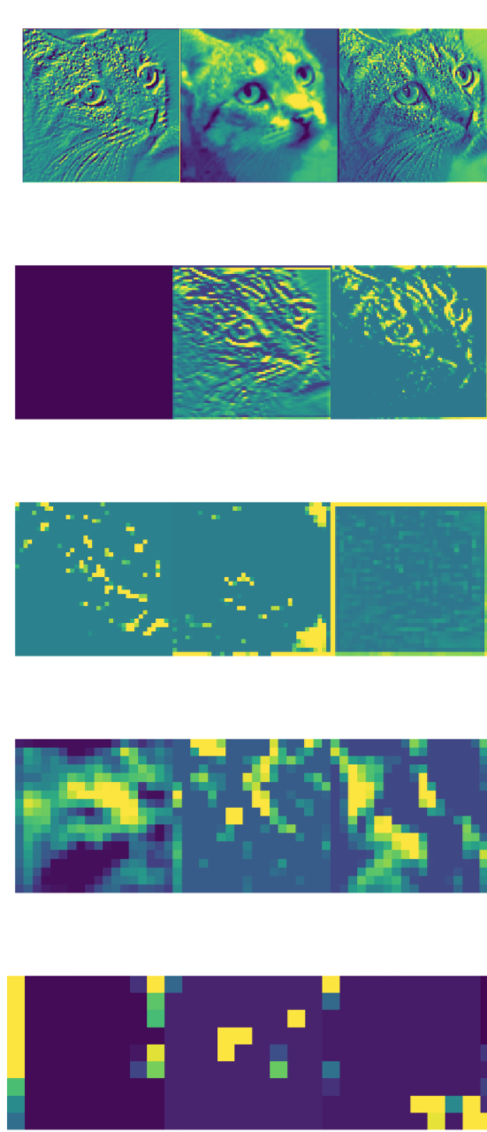
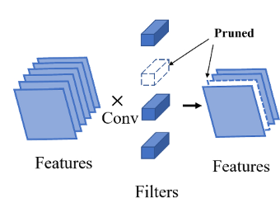
Structured Pruning
Reducing model complexity further by pruning excess channels
Pruning pipeline
Identify weights with smallest l2-norms
Reparametrize the layers with binary mask buffers, adding multiplications by 0 and 1
Retrain the model
Permanently apply masks

Slide 11
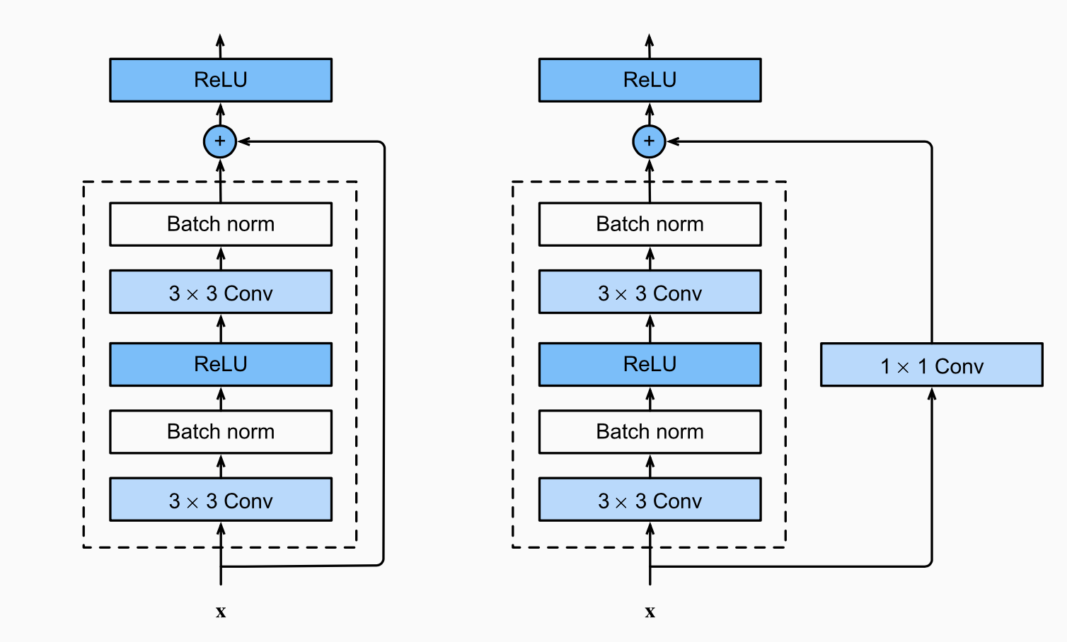
Structured Pruning
Reducing model complexity further by pruning excess channels
[1, 64, 500, 900]
[1, 32, 500, 900]
[1, 64, 500, 900]
[1, 64, 500, 900]

Slide 12
Resource Efficiency
The single model strategy saves energy and memory
Model takes ~500MB instead of ~1GB of memory
2W of power saved during inference
Birds
Vessels
Saildrones

Slide 13
Average Inference Time Per Image
The Performance Advantage of Backbone Replacement and Pruning
Power Mode | RetinaNet v11 | Pre-pruned v12 | Final v12 | Speed
Nano | 3751 ms | 1818 ms | 1053 ms | 3.56x
AGX in Explorer Mode | 695 ms | 359 ms | 276 ms | 1.94x
AGX in 30W_2Core Mode | 234 ms | 135 ms | 105 ms | 2.23x

Slide 14
Inference on the Argus 1 and 2
Average Inference time on a batch of images on Argus 1 and 2, with 4 and 6 cameras respectively
Argus 1
Power Mode | V11 Inference | V12 Inference
Nano | 15.00 sec | 4.21 sec
Inference Accuracy
Metric | V11 | V12
Recall@ Precision=80 | 92.66 | 91.84
Argus 2
Power Mode | V11 Inference | V12 Inference
AGX in Explorer Mode | 4.17 sec | 1.66 sec
AGX in 30W_2Core Mode | 1.404 sec | 0.63 sec

