Slide 1
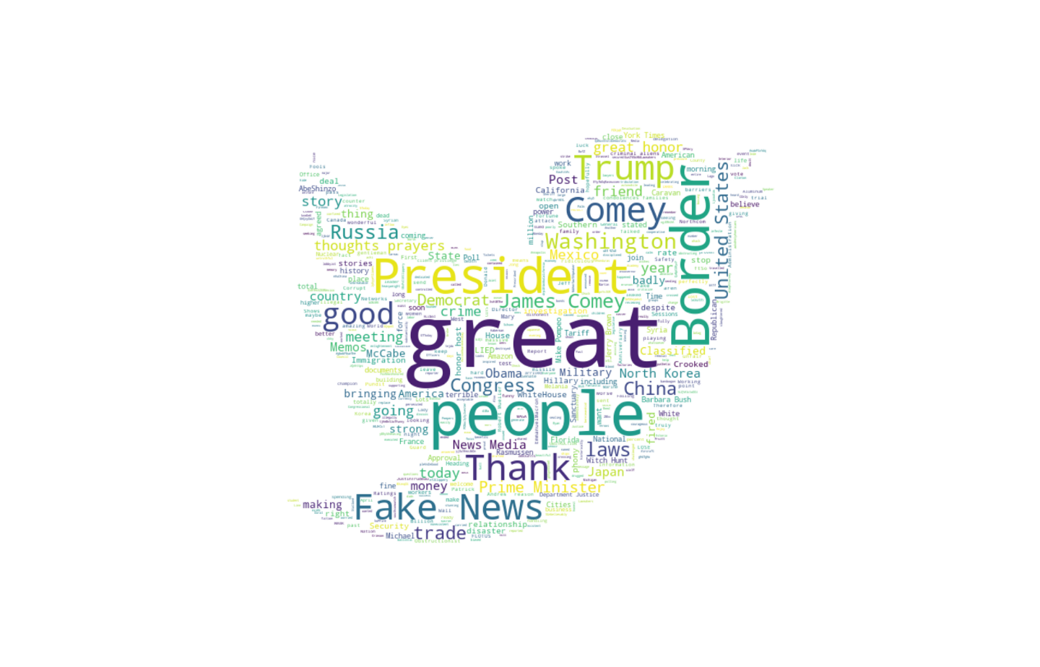
Visualizing Russian Fake Tweets
David Kes
Stephen Hsu

Slide 2
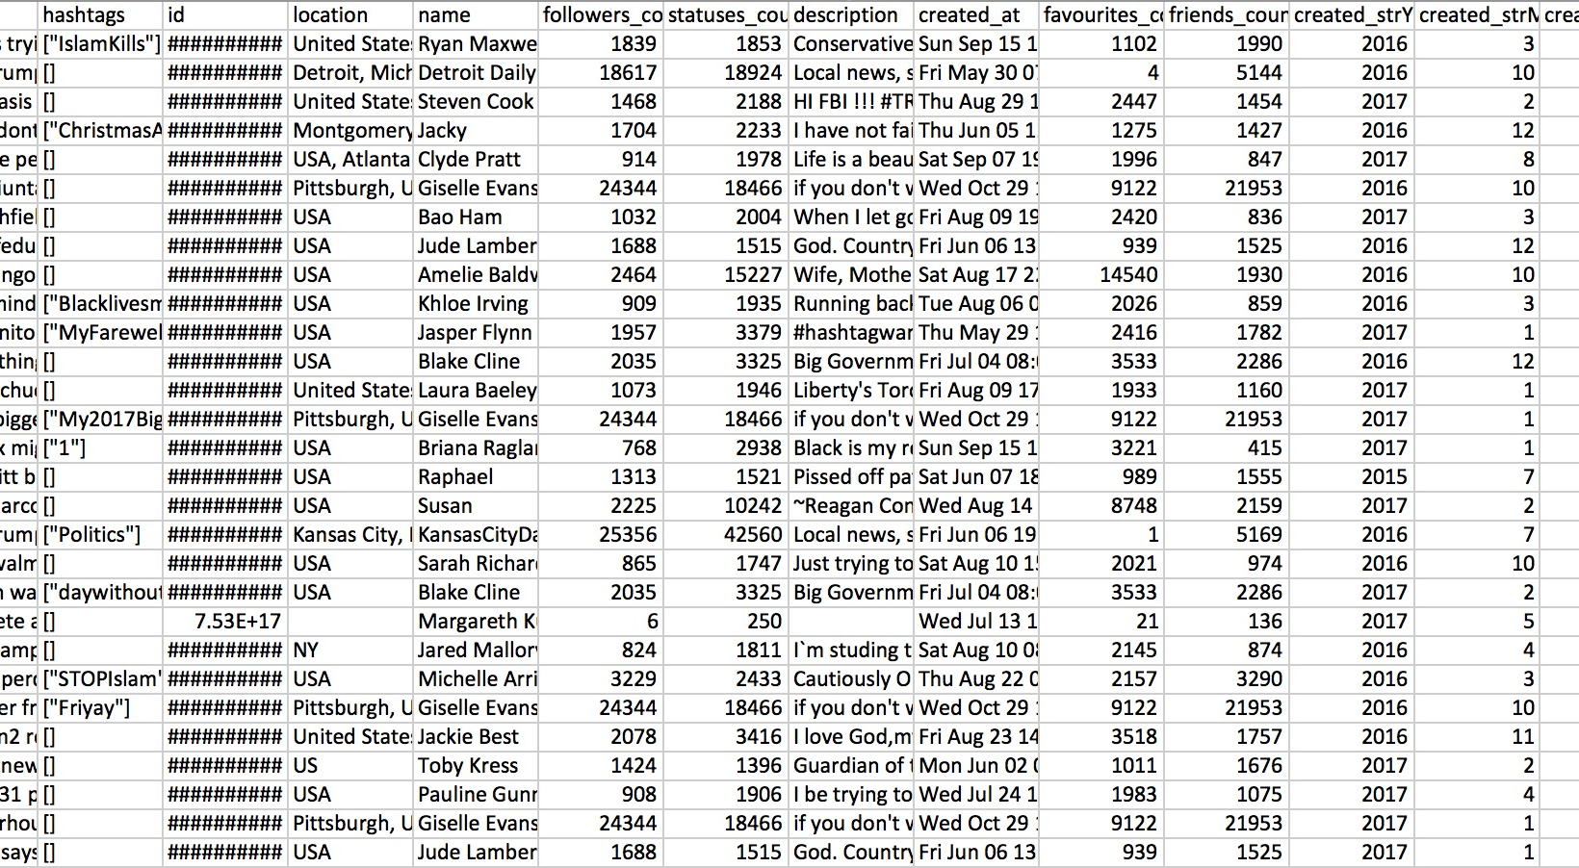
Data

Slide 3
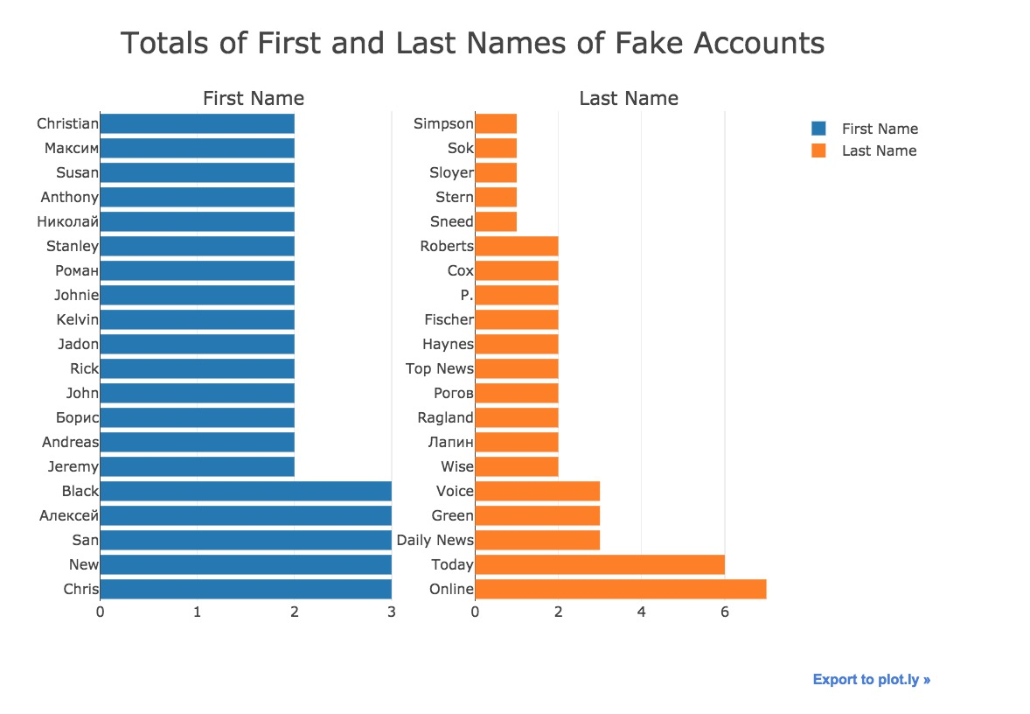
Who are they?
First and last names
3 Categories
American sounding names
Official News Sounding
Foreign names

Slide 4
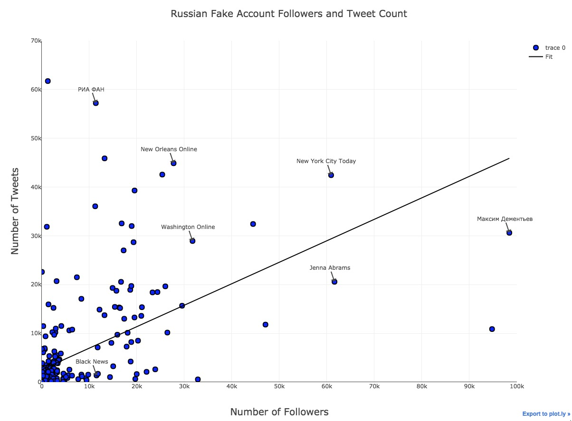
How Influential are they?

Slide 5
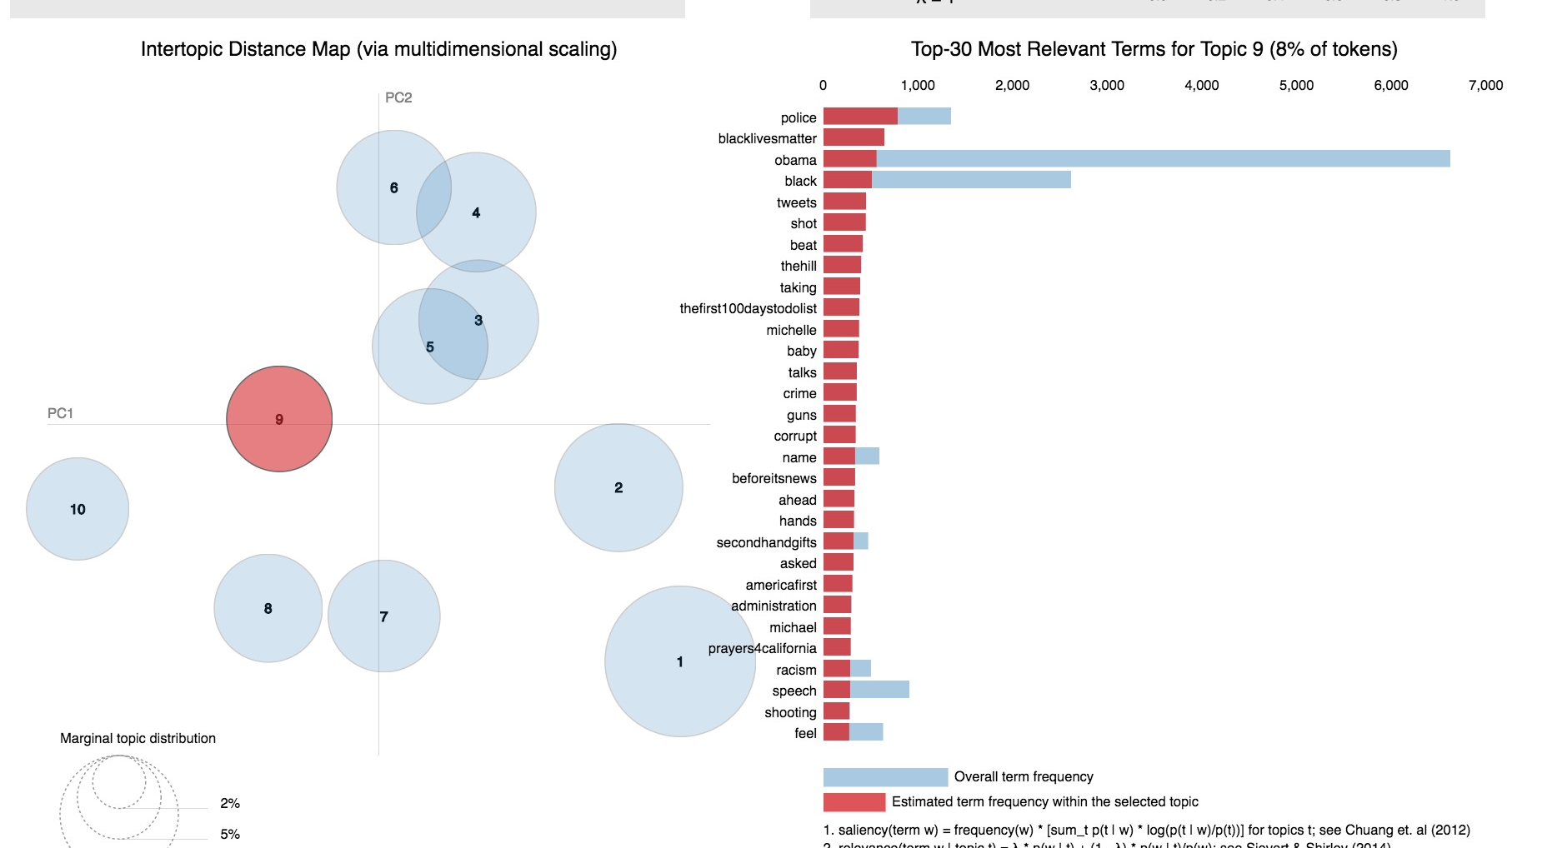
What do they say?

Slide 6
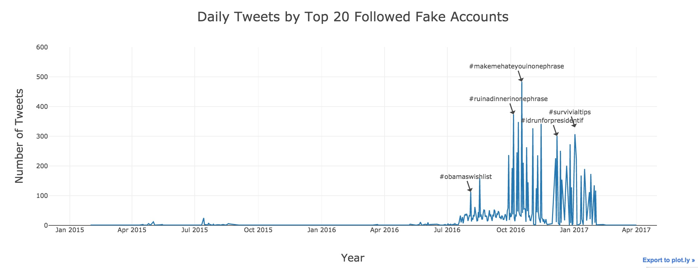
When do they strike?

