Slide 1
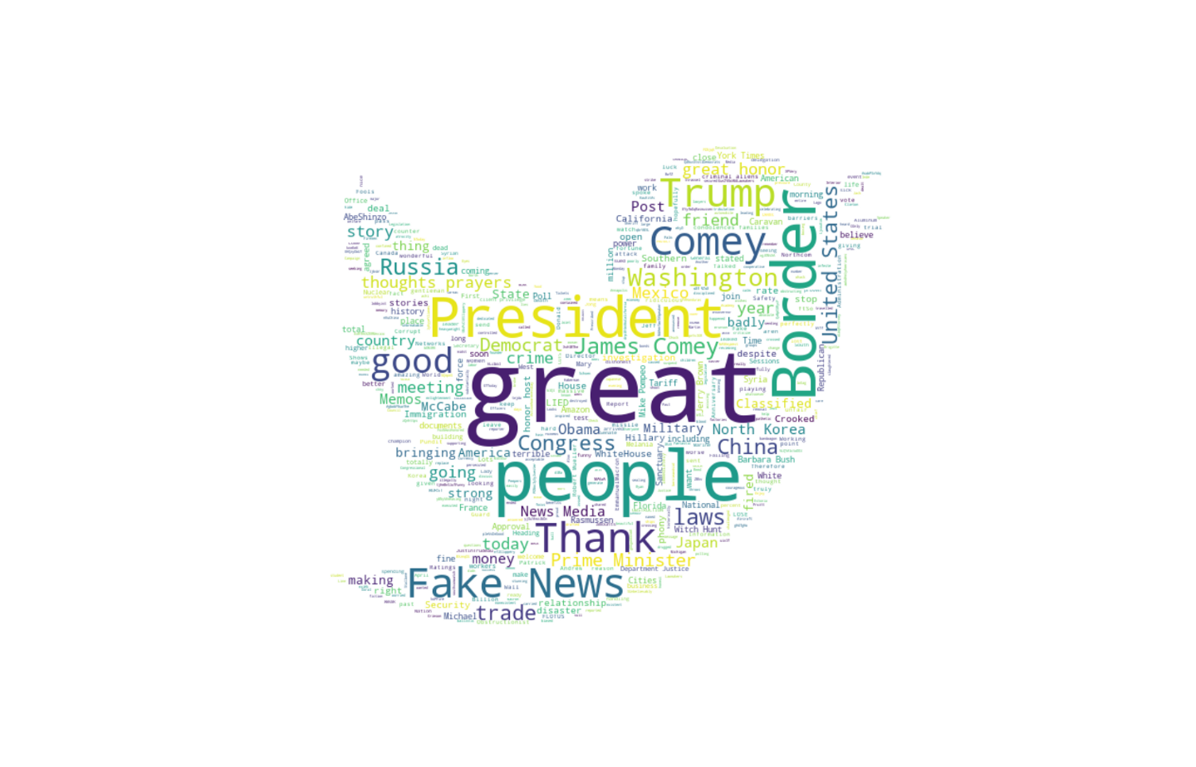
Visualizing Russian Fake Tweets
David Kes
Stephen Hsu
https://medium.com/@shsu14/russian-fake-tweets-visualized-6f73f767695

Slide 2
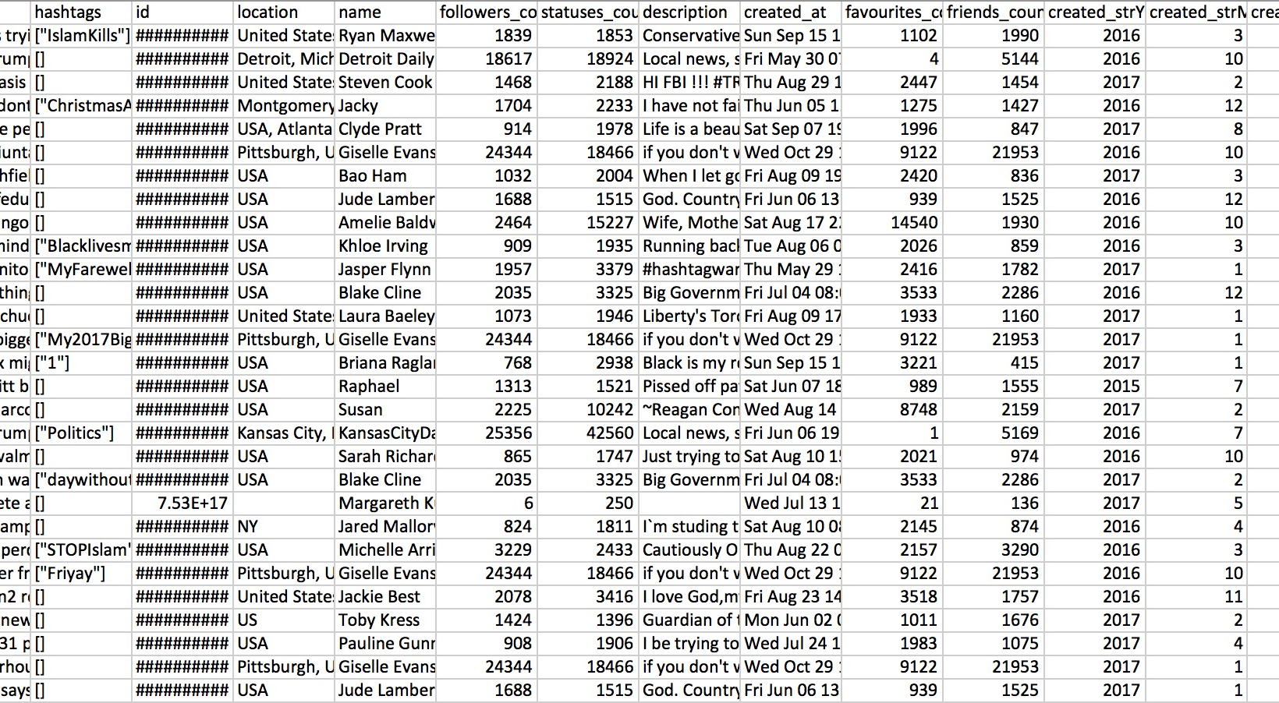
Data

Slide 3
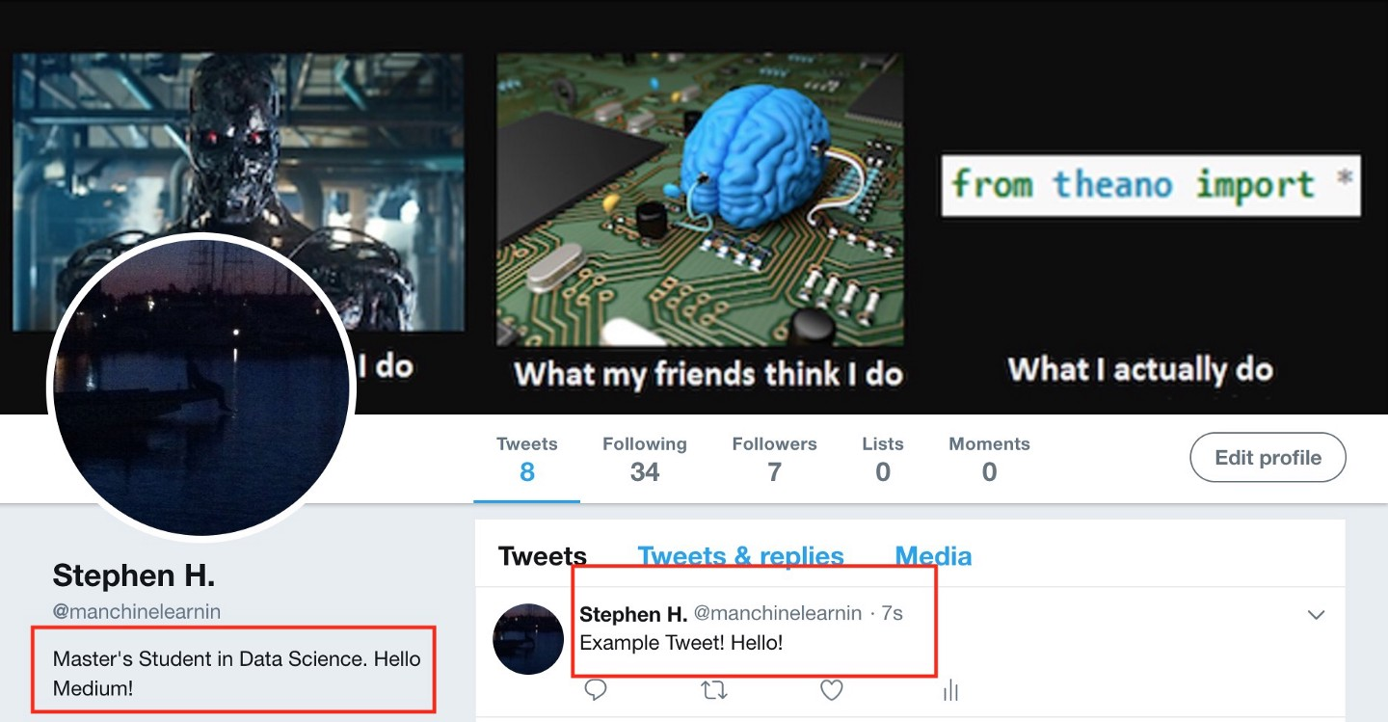
Example Bio

Slide 4
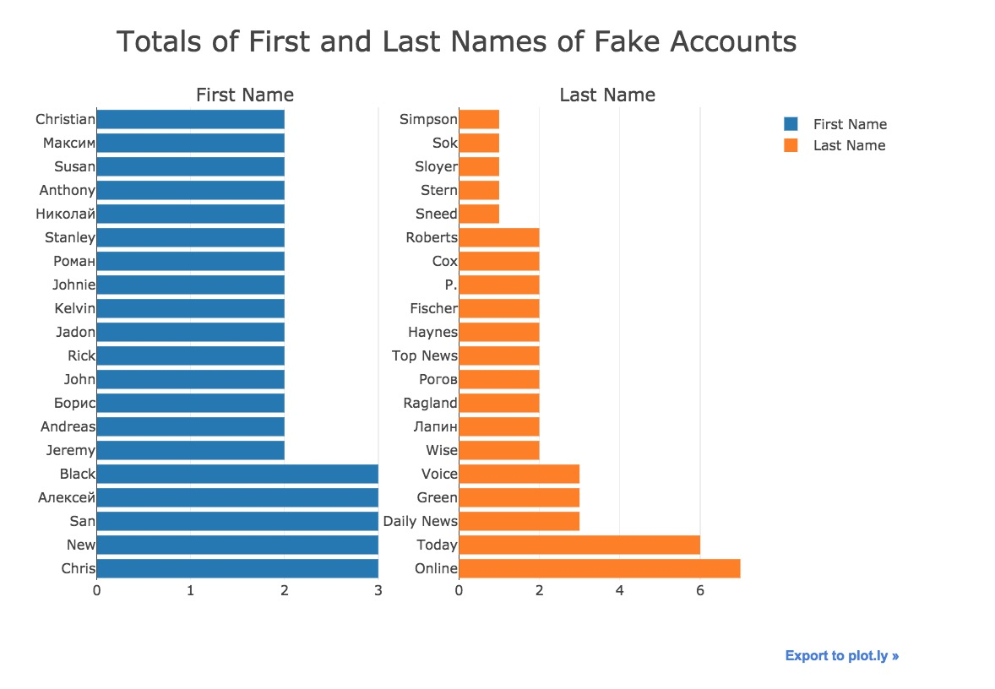
Who are they?
First and last names
3 Categories
American sounding names
Official News Sounding
Foreign names

Slide 5
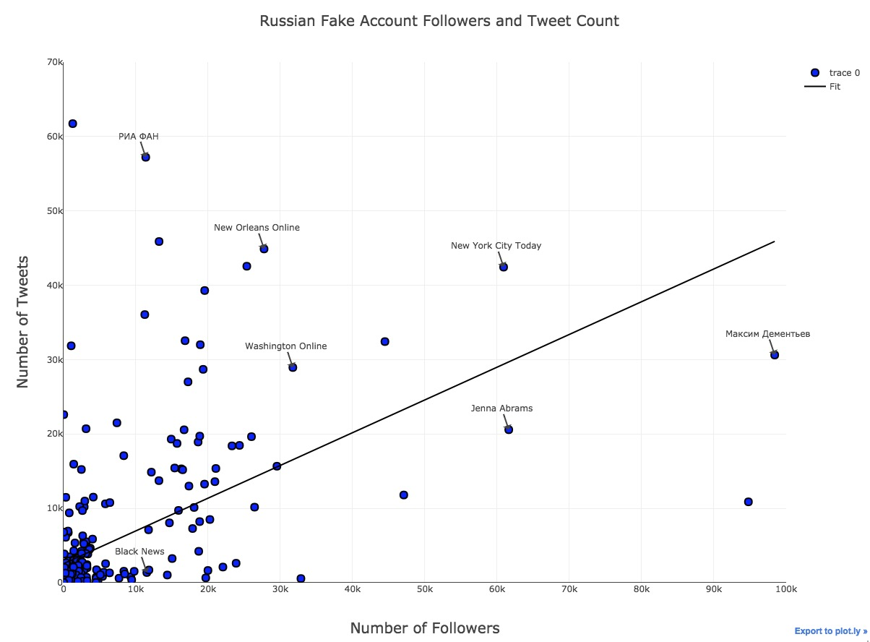
How Influential are they?

Slide 6
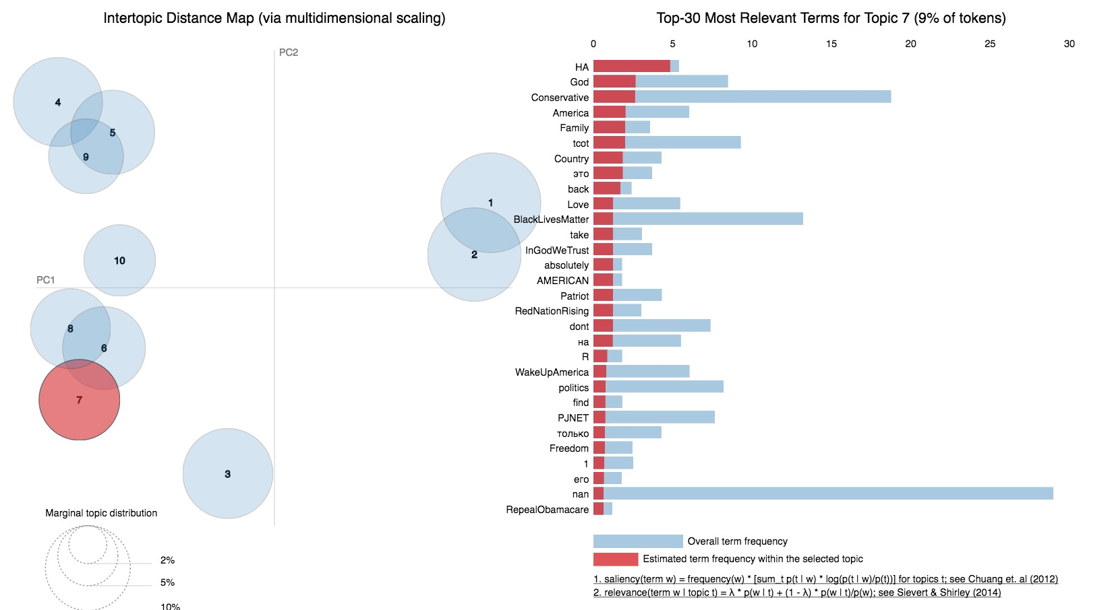
What do they say - bio?

Slide 7
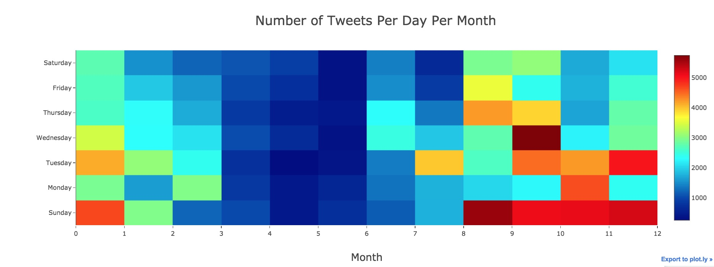
When do they Tweet?

Slide 8
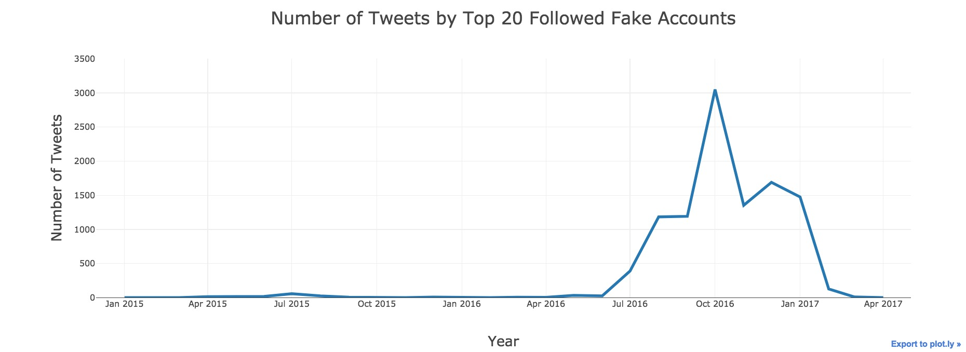
Top 20 Followed Users Analysis

Slide 9
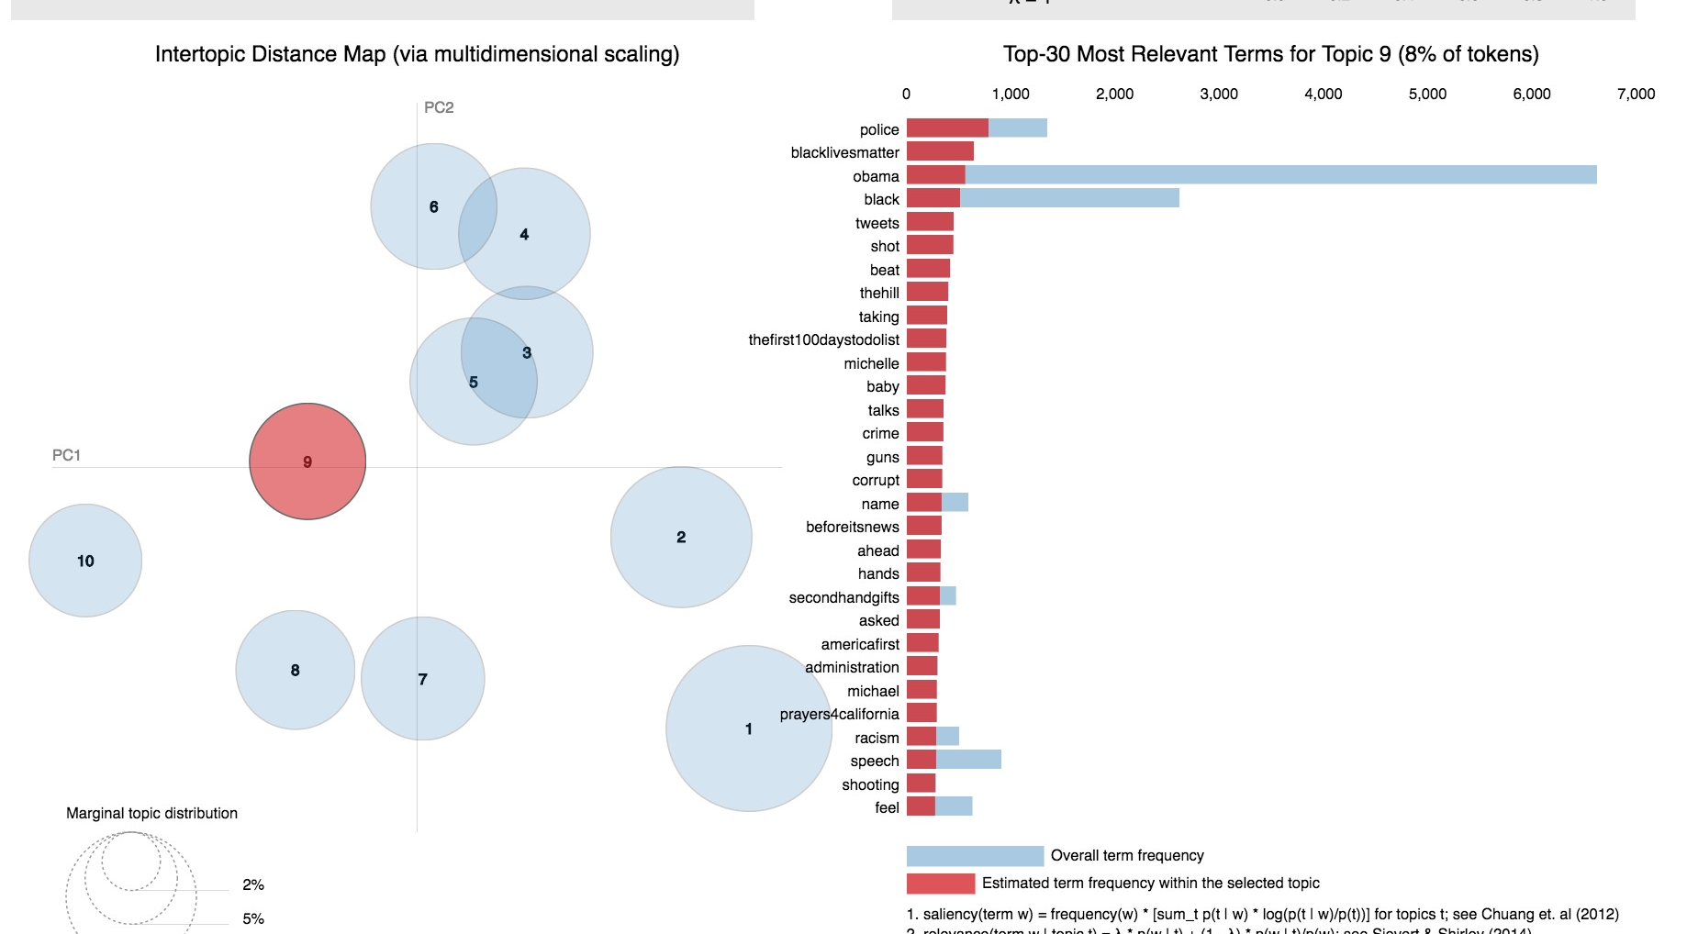
Top 20 – What does the fake account say?

Slide 10
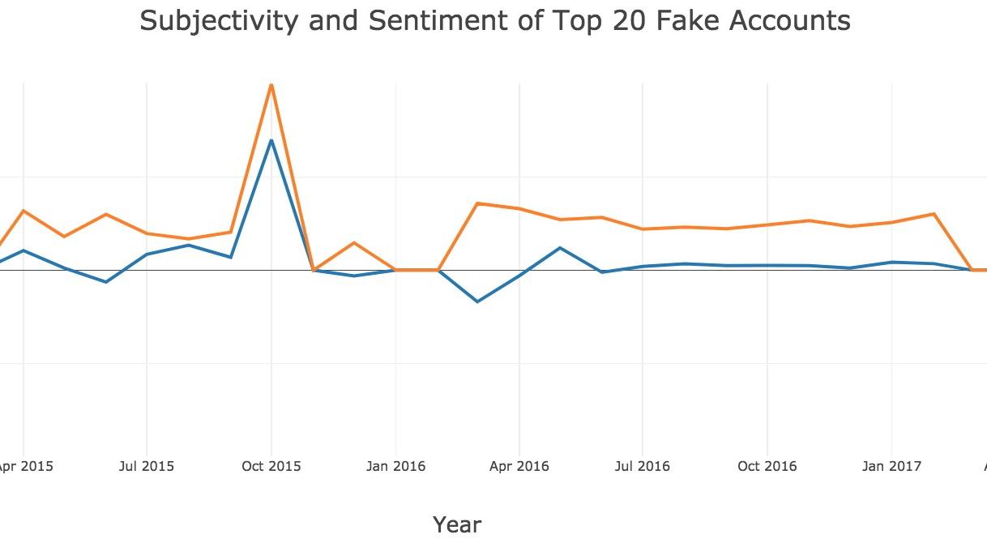
Top 20 – Sentiment and Subjectivity

Slide 11
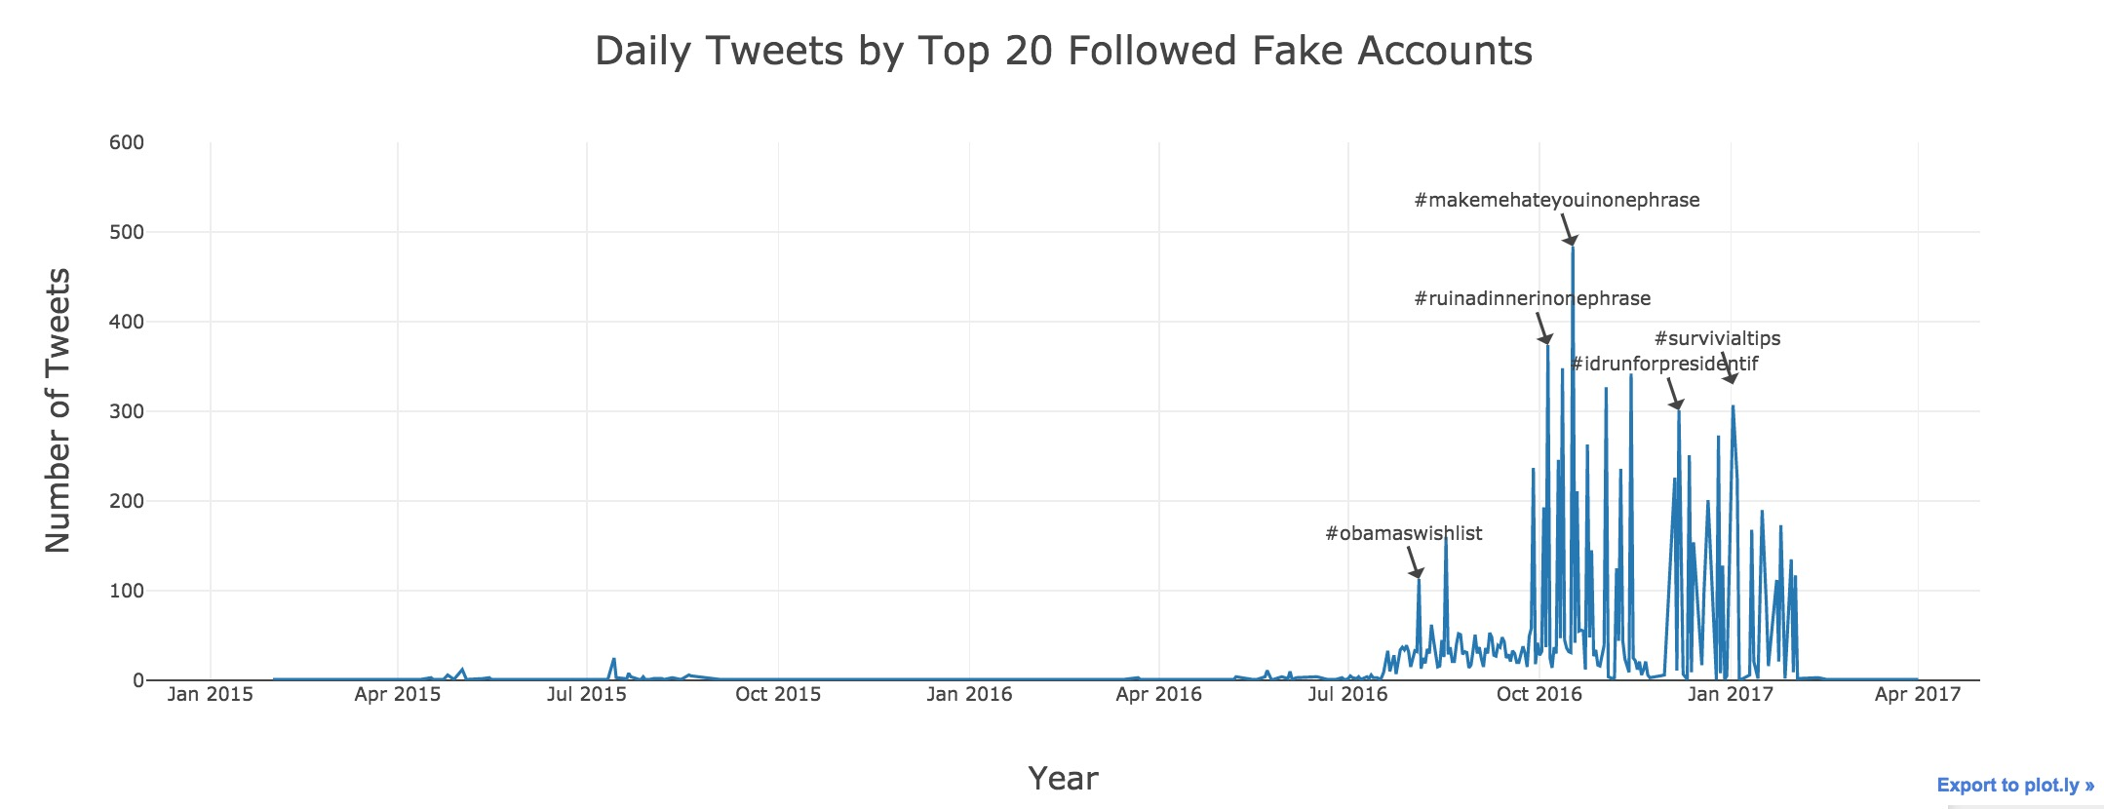
Top 20 – Tweet Timeline

