Slide 1
TWITTER SENTIMENTS ON GOOGLE AND APPLE PRODUCTS
BY: STEPHEN JILANI

Slide 2
BUSINESS OVERVIEW
A Kenyan company is in the predicament of classifying twitter reviews on Google and Apple products and would like to build a model that can assist in sentiment classification.

Slide 3
BUSINESS OBJECTIVES
Build a classification model that helps in the classification of twitter reviews.
Compare multiple model performance based on F1 score, precision and recall.
To provide insights on customer sentiment distribution.

Slide 4
DATA UNDERSTANDING
The data was obtained from CrowdFlower via dataworld and is composed of sentiments in over 9,000 tweets in relation to Apple and Google products.
The data contains 3 columns i.e tweet text, Brand and Sentiment classification

Slide 5
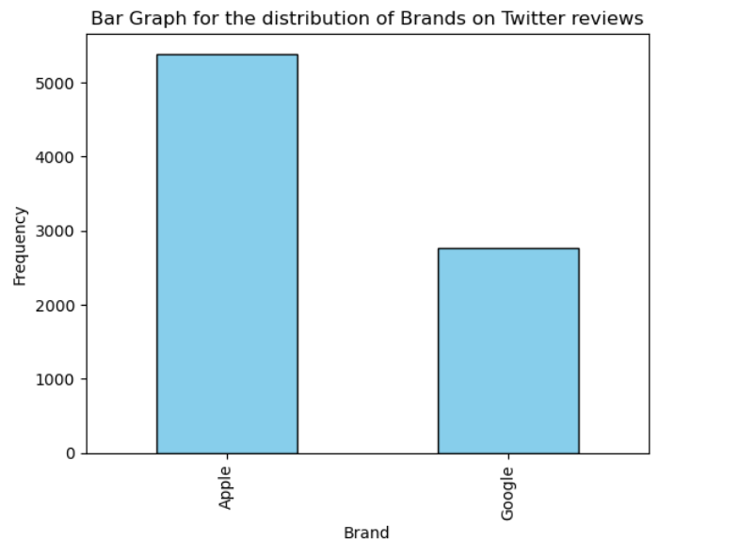
EXPLORATORY DATA ANALYSIS
The graph shows that most of the reviews are directed toward Apple compared to Google

Slide 6
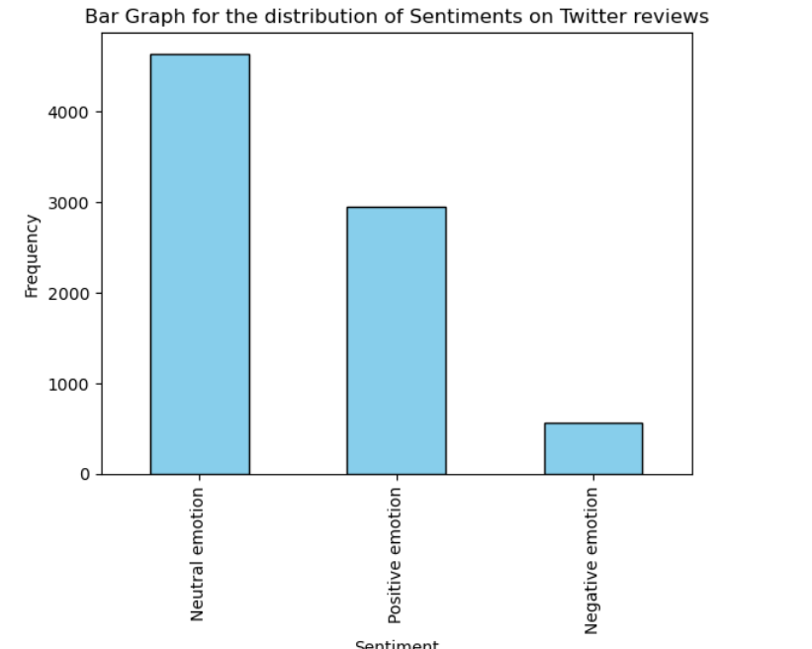
EXPLORATORY DATA ANALYSIS….contd
The graph shows that most of the reviews have been classified as neutral indicating indifference in the products.

Slide 7
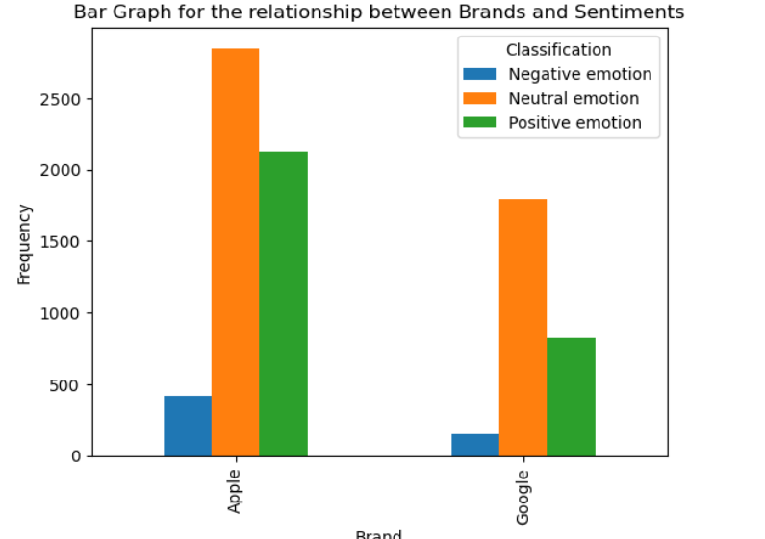
EXPLORATORY DATA ANALYSIS….contd
The graph shows the distribution of reviews between Apple and Google together with their respective sentiments.

Slide 8
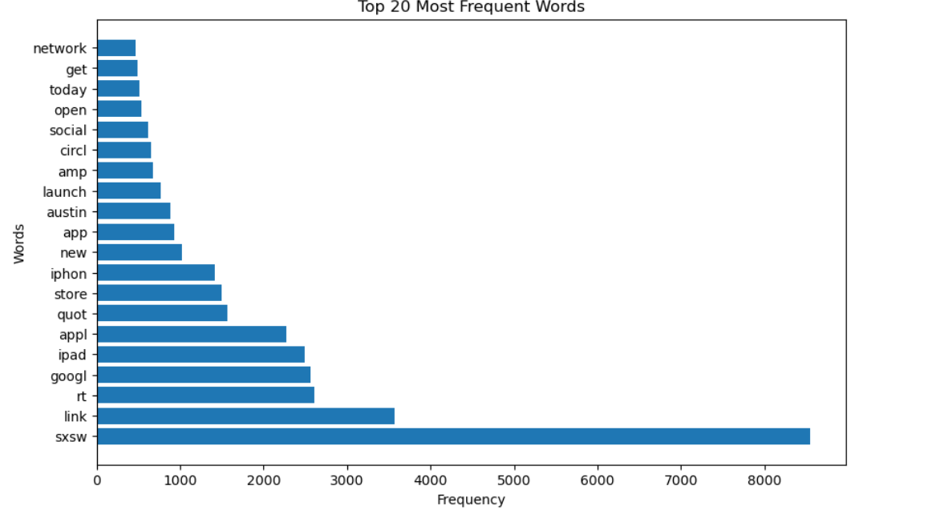
EXPLORATORY DATA ANALYSIS….contd
The graph shows the the most frequent words in the dataset which may be the biggest drivers of sentiment classification.

Slide 9
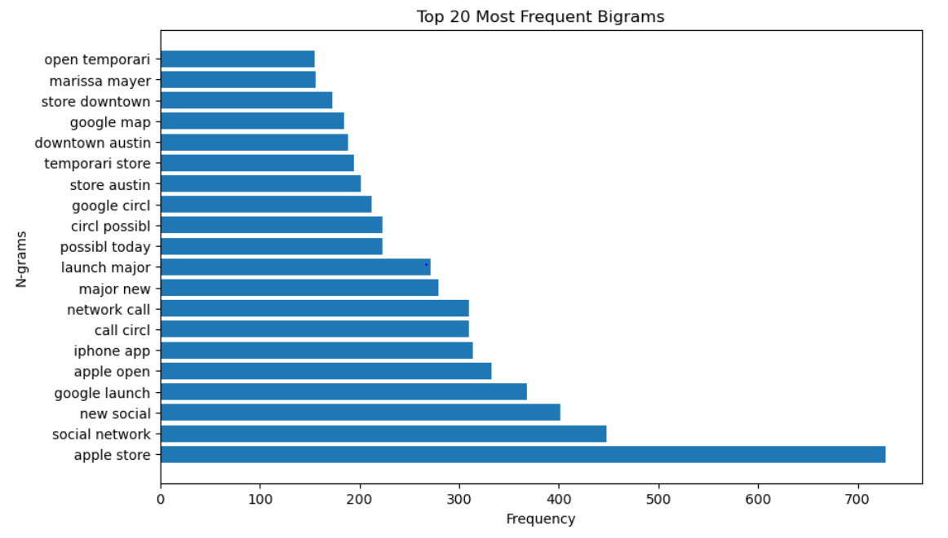
EXPLORATORY DATA ANALYSIS….contd
This is a visualization of the most frequent phrases in the dataset.

Slide 10
DATA MODELLING AND EVALUATION
3 binary classification models were explored i.e Logistic Regression, RandomForest and XGBoost. Both RandomForest and XG Boost were fine tuned.
1 multiclass classification model was explored i.e XGBoost and it was fine tuned.
The best models have been discussed below

Slide 11
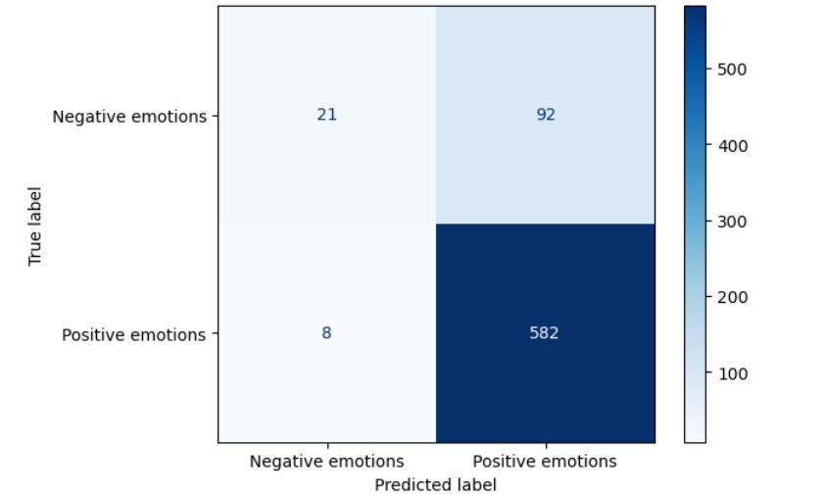
DATA MODELLING AND EVALUATION….contd
The confusion matrix is for the best binary(tuned XG Boost) classification model.

Slide 12
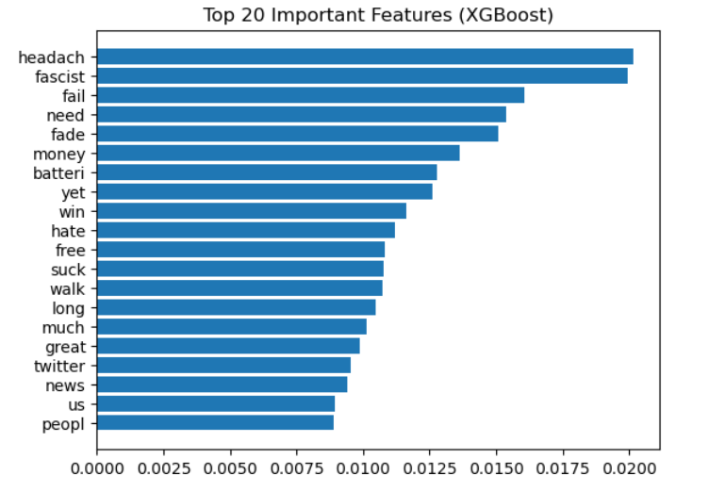
DATA MODELLING AND EVALUATION….contd
The graph is for the 20 most important features in the binary classification problem.

Slide 13
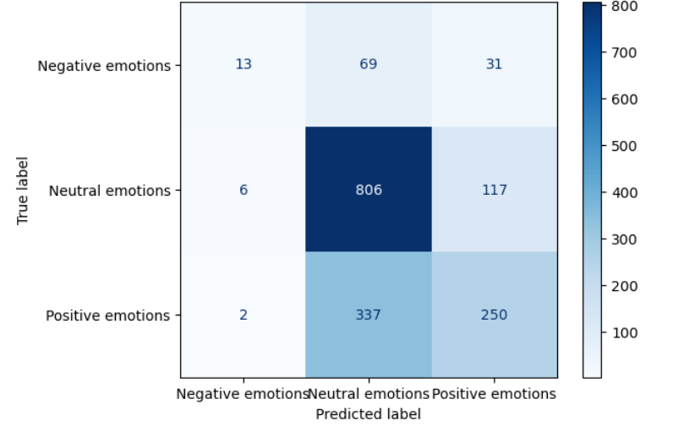
DATA MODELLING AND EVALUATION….contd
The confusion matrix is for the best multiclass model (tuned XGBoost) classification model.

Slide 14
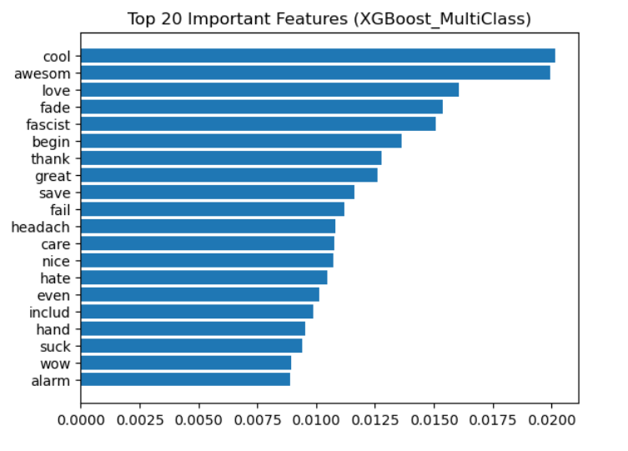
DATA MODELLING AND EVALUATION….contd
The graph shows the most important features in the multiclass classification model.

Slide 15
BUSINESS RECOMMENDATIONS
1. The stakeholders should implement the best models in the classification of review sentiments.
2. The stakeholders need to analyse top features that drive negative emotions and identify what exactly lead to such sentiments.
3. The stakeholders should focus more on negative sentiments and route them to customer support and product teams.

Slide 16
LIMITATIONS
- Class imbalance may affact the performance of the model
- The data was social media noisy and that may affect the performance of the model
The data may be from a specific region in the world and may not be fit for the stakeholder’s region.

Slide 17
THANK YOU

Slide 18
QUESTIONS

