Slide 1
Full stack coding task
Stephen jm
27 August 2019

Slide 2
The Problem
Develop a solution to retrieve, extract and store data from a file into a database.
Develop a client & server solution to CRUD data in database

Slide 3
Background Information
Setting up and managing a Java application server (Tomcat preferred)
Client-side development (HTML, JavaScript, AJAX, CSS)
Server-side development (Java, servlet, data access)
Setting up and managing a database and configuring a data-source for the app server

Slide 4
Workable Solution
At extreme minimum, the application should consist of:
One HTML page with some dynamic elements and a ‘submit element’
One AJAX call to submit data from client-side to server-side
One servlet to handle the request and return JSON response
Saving and retrieving data to/from database

Slide 5


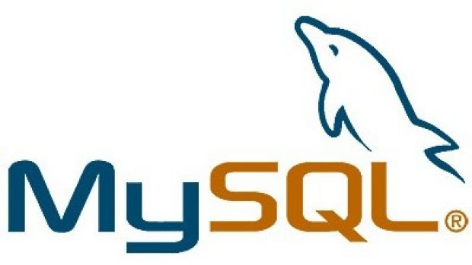
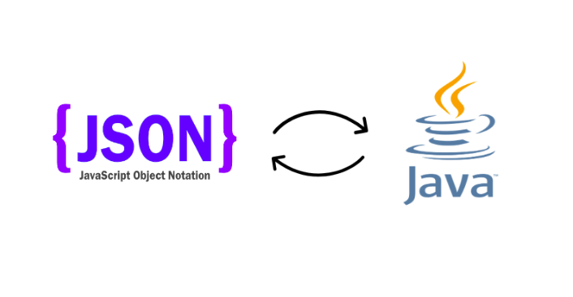
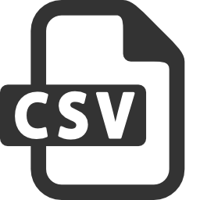
The Prototype

Slide 6
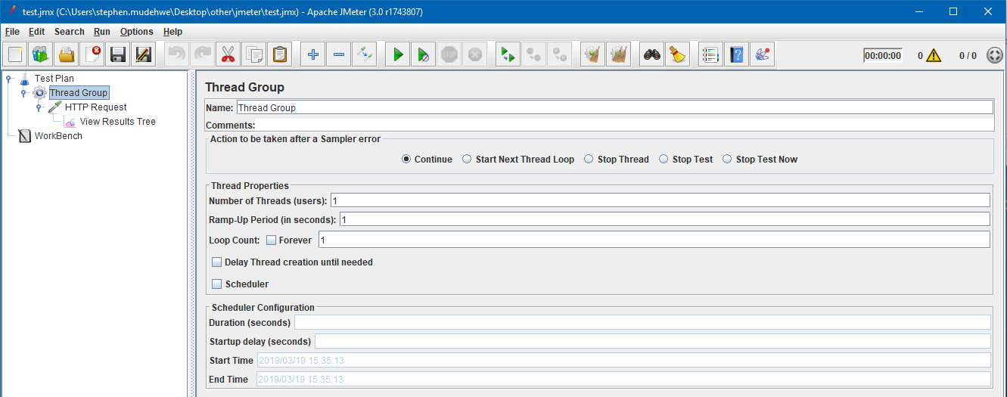
Testing The Prototype

Slide 7
Redesigning The Prototype
Once the API calls for GET, PUT, POST and DELETE were tested the next step was to work on the GUI
A simple single HTML 4.0 page was created
Added form with options to Create, Read, Update and Delete
Added enhancement to display geolocation data in map

Slide 8
Final Result
A tomcat run webapp that extracts data from a remote CSV file, stores data into MySQL database and exposes a REST API to manipulate stored data.

Slide 9
Limitations
Handling invalid requests
Lack of security of webapp
Hard-coded message responses
Filter client data with HTML 5 would have allowed for input field types like “number” to ensure only integers are submitted

