Slide 1
Scrum master
GitLab
Kafka
OAuth2

Slide 2
Scrum master
PC/C/T Request -> PO(product owner产品经理) -> SA(架构师) -> PM(项目经理) -> SM(scrum master)/Team
1. Planning Game (SA introduce and team members estimate task, on the 1st or 2nd day or the sprint)
2. Stand up daily (team members get task for coding)
3. Code review (SA involve, every week)
4. DoD (Definition of Done, PO involve, every sprint)
5. Retrospective (SM/team every sprint)
6. team sharing & team development
Other: Team vision

Slide 3
GitLab CI
Docker install
K8s install
Gitlab install
Gitlab runner
Gitlab CI Flow

Slide 4
Docker install
yum install docker-engine
service docker start
docker run hello-world
Note: need to resolve great wall, use mirror or proxy.
Notes:
镜像和Proxy选其一
CentOS Docker Proxy
#mkdir /etc/systemd/system/docker.service.d
#vi /etc/systemd/system/docker.service.d/http-proxy.conf
[Service]
Environment="HTTP_PROXY=http://proxy.example.com:80/" "NO_PROXY=localhost,127.0.0.1,docker-registry.somecorporation.com"
#systemctl daemon-reload
# systemctl show --property=Environment docker
# systemctl restart docker
使用国内163 mirror
vi /etc/docker/daemon.json
{
"registry-mirrors": ["http://hub-mirror.c.163.com"]
}
systemctl restart docker
使用 ustc 镜像
https://docker.mirrors.ustc.edu.cn

Slide 5
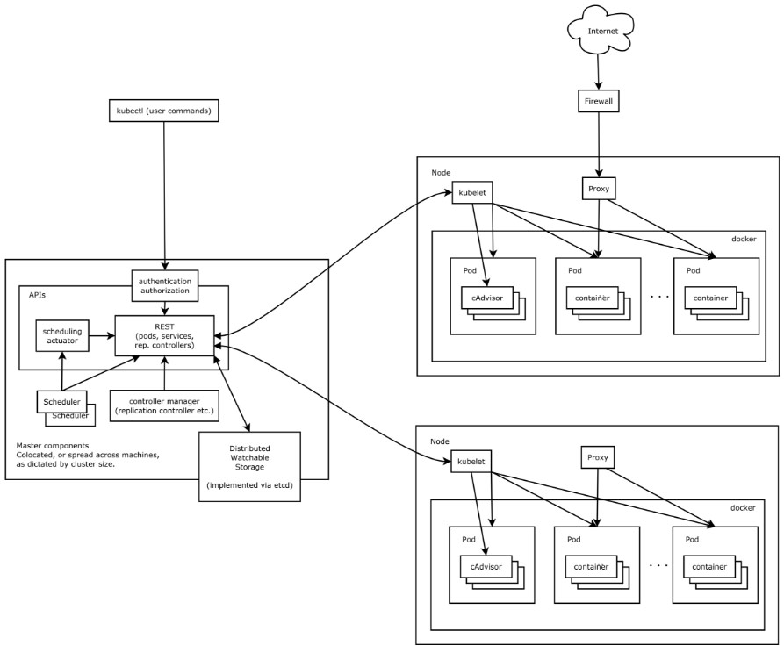
K8s install
Notes:
1. Add yum repo
[kubernetes]
name=Kubernetes
baseurl=http://mirrors.aliyun.com/kubernetes/yum/repos/kubernetes-el7-x86_64
enabled=1
gpgcheck=0
repo_gpgcheck=0
gpgkey=http://mirrors.aliyun.com/kubernetes/yum/doc/yum-key.gpg
http://mirrors.aliyun.com/kubernetes/yum/doc/rpm-package-key.gpg
2. install
yum install kubeadm
3. (master) kubeadm init
4. (node) kubeadm join
5. Ref
https://blog.qikqiak.com/post/use-kubeadm-install-kubernetes-1.10/
[使用kubeadm搭建kubernetes1.10集群]
https://kubernetes.io/docs/setup/independent/create-cluster-kubeadm/
https://www.linuxtechi.com/install-kubernetes-1-7-centos7-rhel7/
[How to Install Kubernetes (k8s) 1.7 on CentOS 7 / RHEL 7]
https://www.kubernetes.org.cn/doc-16
https://www.kubernetes.org.cn/kubernetes%E8%AE%BE%E8%AE%A1%E6%9E%B6%E6%9E%84

Slide 6
GitLab install
Add gitlab-ce repo
[gitlab-ce] name=Gitlab CE Repository baseurl=https://mirrors.tuna.tsinghua.edu.cn/gitlab-ce/yum/el$releasever/ gpgcheck=0 enabled=1
Install
yum install gitlab-ce
Notes:
GitLab常用命令
sudo gitlab-ctl start # 启动所有 gitlab 组件； sudo gitlab-ctl stop # 停止所有 gitlab 组件； sudo gitlab-ctl restart # 重启所有 gitlab 组件； sudo gitlab-ctl status # 查看服务状态； sudo gitlab-ctl reconfigure # 启动服务； sudo vim /etc/gitlab/gitlab.rb # 修改默认的配置文件； gitlab-rake gitlab:check SANITIZE=true --trace # 检查gitlab； sudo gitlab-ctl tail # 查看日志；

Slide 7
Gitlab runner
OS version
gitlab-runner install
https://mirrors.tuna.tsinghua.edu.cn/help/gitlab-runner/
gitlab-runner regitser
https://docs.gitlab.com/runner/register/
gitlab-runner register
Docker version
gitlab-runner install
docker run -d --name gitlab-runner -v /var/run/docker.sock:/var/run/docker.sock -v /srv/gitlab-runner/config:/etc/gitlab-runner gitlab/gitlab-runner
gitlab-runner regitser
docker exec -it gitlab-runner gitlab-runner register

Slide 8


GitLab CI flow
New Branch/Repo
coding
test(CT, CT)
merge request
merge review
package
test(FT)
New Task
Task finish

Slide 9
Kafka knowledge
Kafka producer
Kafka consumer
Kafka server
Kfaka Replica
Kafka tools
kafkaOffsetMonitor
kafdrop
Blog
http://www.jasongj.com/2015/01/02/Kafka%E6%B7%B1%E5%BA%A6%E8%A7%A3%E6%9E%90/

Slide 10
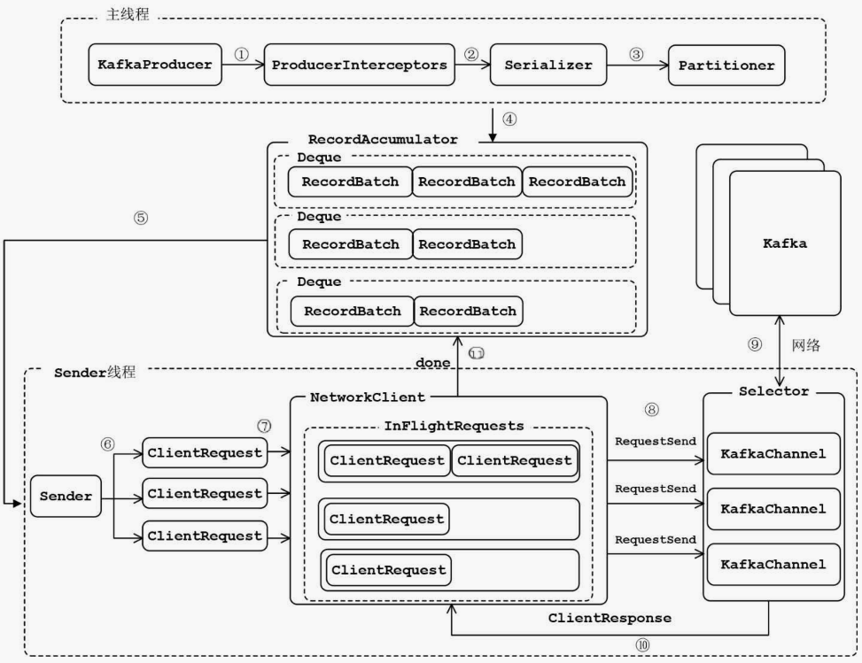
Kafka producer

Slide 11
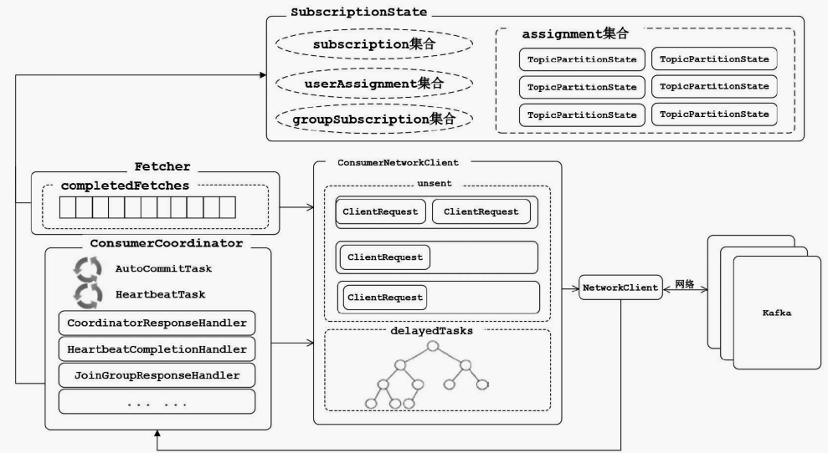
Kafka consumer

Slide 12
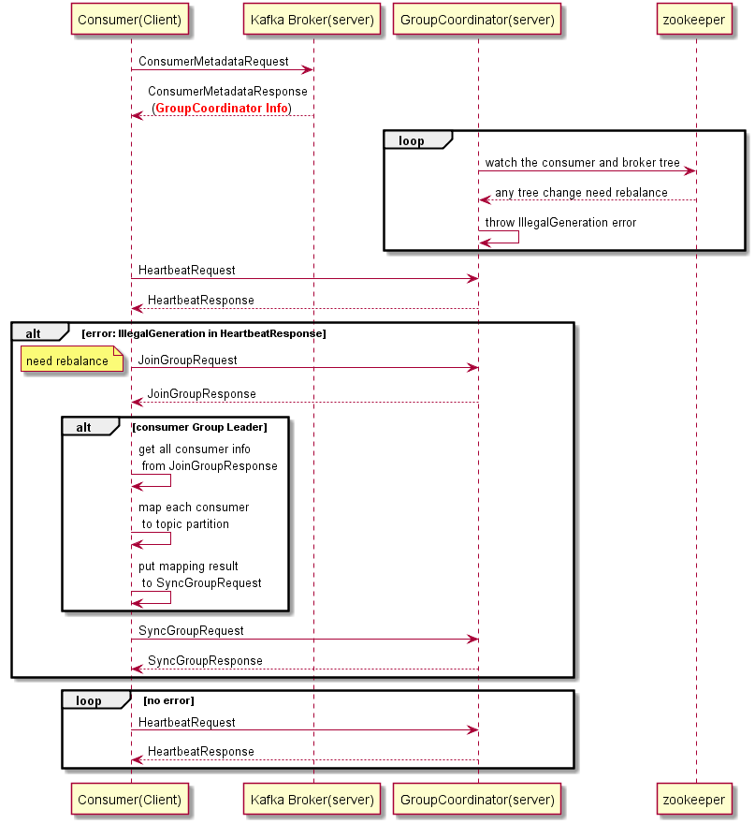
Kafka consumer rebalance
Notes:
@startuml participant "Consumer(Client)" as c participant "Kafka Broker(server)" as kb participant "GroupCoordinator(server)" as gc participant zookeeper as z c -> kb: ConsumerMetadataRequest kb --> c: ConsumerMetadataResponse\n (<font color=red><b>GroupCoordinator Info</b></font>) loop gc -> z: watch the consumer and broker tree z --> gc: any tree change need rebalance gc -> gc: throw IllegalGeneration error end c -> gc: HeartbeatRequest gc --> c: HeartbeatResponse alt error: IllegalGeneration in HeartbeatResponse c -> gc: JoinGroupRequest note left: need rebalance gc --> c: JoinGroupResponse alt consumer Group Leader c -> c: get all consumer info\n from JoinGroupResponse c -> c: map each consumer\n to topic partition c -> c: put mapping result\n to SyncGroupRequest end c -> gc: SyncGroupRequest gc --> c: SyncGroupResponse end loop no error c -> gc: HeartbeatRequest gc --> c: HeartbeatResponse end @enduml

Slide 13
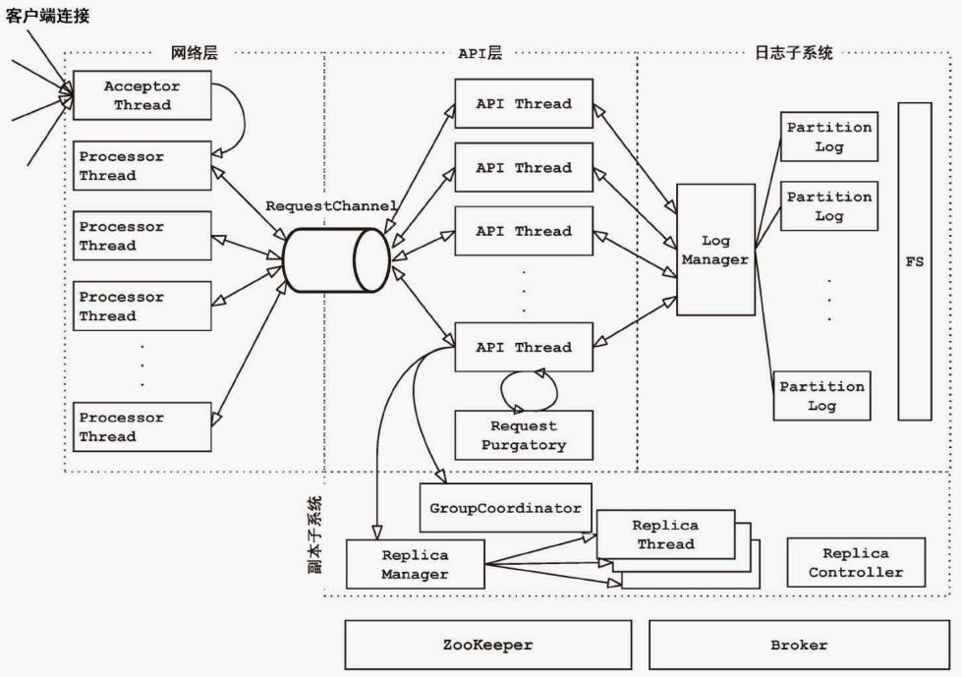
Kafka server

Slide 14
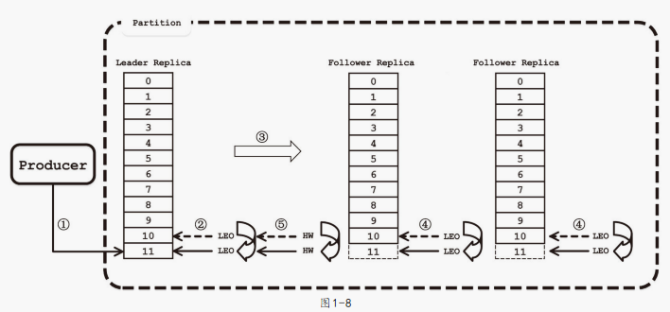
Kafka Replica
Notes:
ISR 集合 (2)
HW > 11
11<
(HighWatermark)
LEO (LogEndOffset)

Slide 15
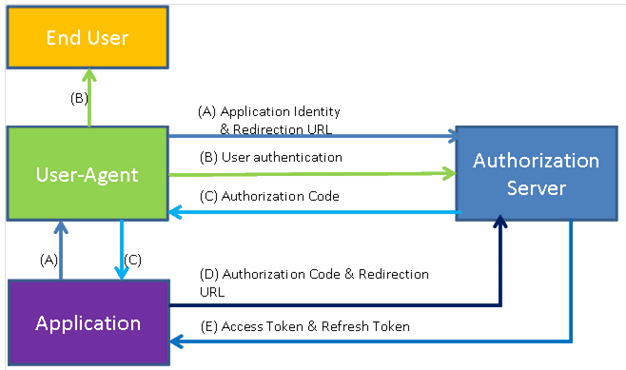
OAuth2
Notes:
http://calstore.internal.ericsson.com/alexserv?AC=LINKEXT&ID=23565&DB=218805-jhgjgh.alx&FN=7_22103-FGB101641_170Uen.C.html
http://calstore.internal.ericsson.com/alexserv?AC=LINKEXT&ID=23565&DB=218805-jhgjgh.alx&FN=3_1553-CXP9040266_170Uen.B.html

