Slide 1
INTRODUCTION
Does weather have an impact on gas prices across the United States.

Slide 2
Questions
What month was the hottest?
What month had the highest gas prices?3
What city is the hottest (yearly and monthly)? 4.
What city has the highest gas prices (yearly and monthly)?
5. How does each city compare to US average (weather and gas)?
6. Does the weather affect gas prices?

Slide 3
Data Sources
Gasoline Prices
Weather Data
U.S. Enegry Information Administration
https://www.eia.gov/dnav/pet/pet_pri_gnd_a_epmr_pte_dpgal_w.htm
World Weather Online
https://www.worldweatheronline.com/developer/

Slide 4
Process
Step 1
Step 3
Step 2
Step 4
Step 5
Find working data, team pivoted on the question and data sets multiple times
Create calculations
Clean data in jupyter notebook so that two data sets could be compared
Create graphs and conduct analysis
Create presentation

Slide 5
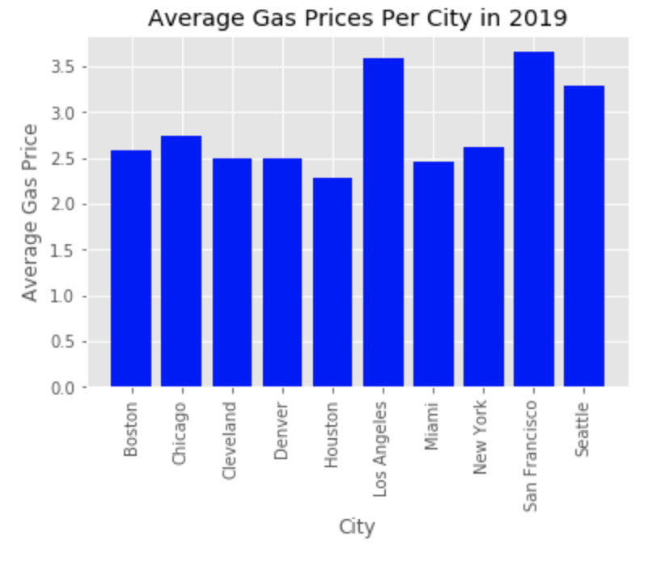
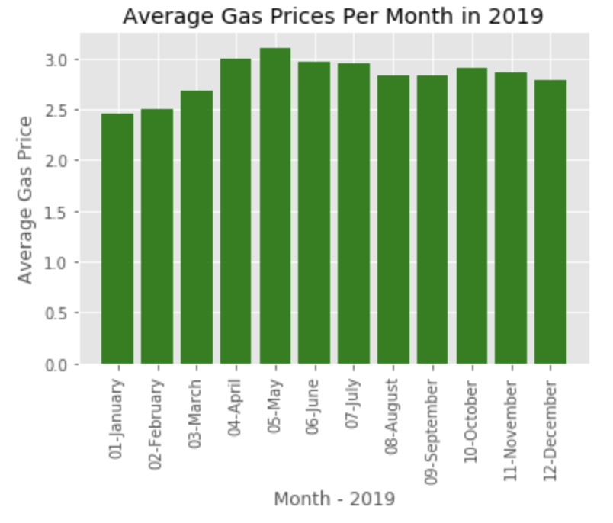
Gas Data
$3.11 - May
$3.65 – San Francisco

Slide 6
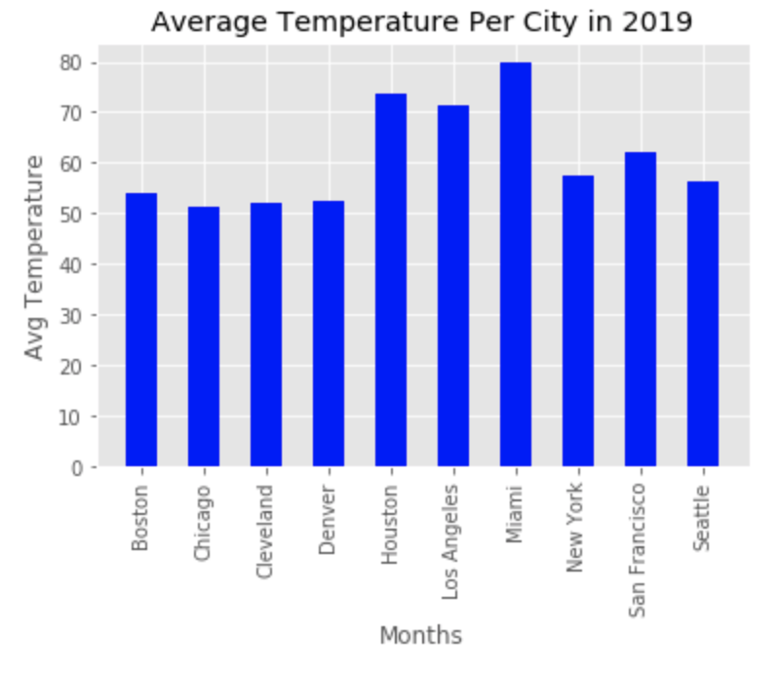
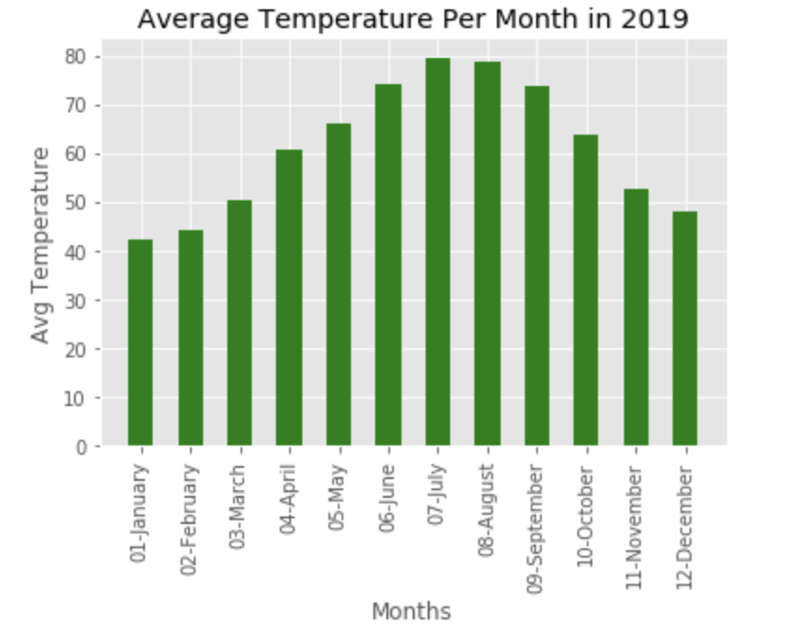
Weather Data
79.54 - May
79.68 – Miami

Slide 7
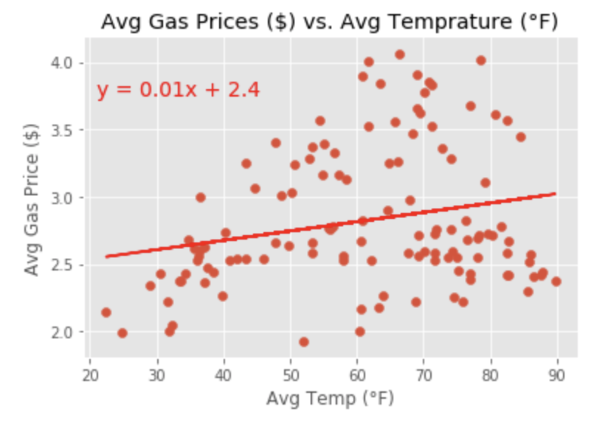
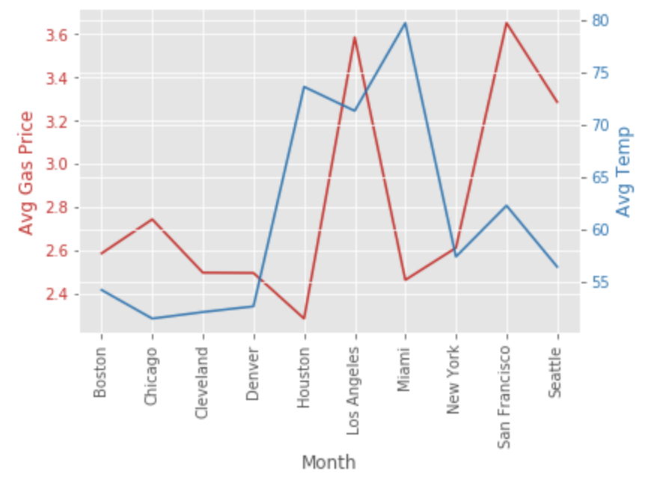
Gas/Weather Data
The correlation coefficient between temperature and gas prices is 0.23 and shows that there is a weak correlation

Slide 8
Summary
There is no correlation between temperature and gas price.

