Slide 1
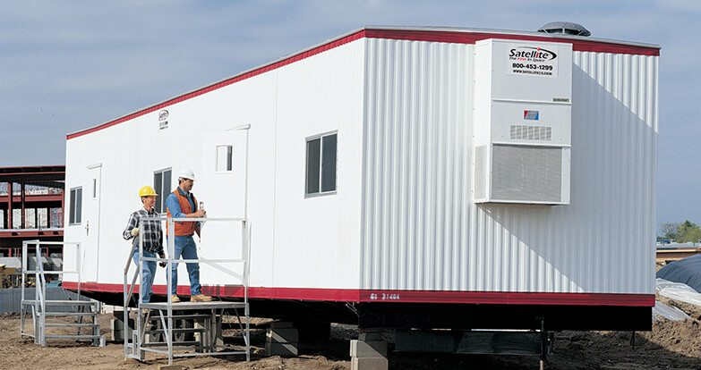
N/A
First floor, outside building
1
1
Player starts outside in third-person viewpoint near the worksite’s temporary office structure. The player appears in front of the supervisor NPC.
The supervisor NPC introduces the game, its subject matter, and how Level 1 will proceed. There is audio for the supervisor’s speech as well as captions at the bottom of the screen.
Supervisor NPC: Welcome to your worksite safety training. I’m Cruz, and I’ll be your site supervisor. This is Level 1, where I’ll teach you five worksite safety protocols one at a time. After each lecture, I’ll show you an example of a potential hazard and how to respond to it. Then you’ll practice identifying and responding to that type of hazard. Let’s begin.

Slide 2

1) Comply with personal protective equipment (PPE) standards.
First floor, outside building
2
1
Supervisor NPC guides player into office structure. Inside, there are four open boxes: hardhat, earmuffs, gloves, and safety boots. Supervisor explains the rules and procedures for wearing personal protective equipment (PPE) on a worksite and tells player how to put on PPEs and then waits for the player to do so. After the player selects all the appropriate PPEs, the player exits the office, where the supervisor is waiting.
Supervisor NPC (Cruz): At the starting point of each environment on the worksite, you’ll find containers for the required personal protective equipment, known as PPEs. For the first floor of this site, we’ll need to wear a hardhat, earmuffs, gloves, and safety boots. Stand in front of each box and click the action button to don on the PPE. You’ll receive a confirmation when you’ve selected all the appropriate PPE for the environment. Go ahead and do that now, and I’ll wait for you outside.

Slide 3
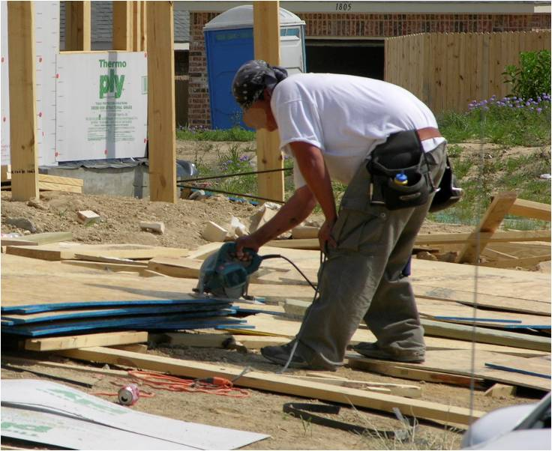
1) Comply with personal protective equipment (PPE) standards.
First floor, outside building
3
1
How would you like to respond to the hazard?”
No response required.
Put up signs.
Put up barriers.
Instruct worker to put on the proper PPE.
Supervisor guides the player to an example problem—a construction worker NPC in violation of PPE standards. The construction worker NPC is sawing wood without a hardhat and safety boots. The supervisor instructs the player to approach the construction worker and respond to the hazard. When the player hits the action button while in front of the construction worker, an alert box pops up asking “Is this a hazard?” The player must select yes or no. After selecting yes, a menu pops up with the question, “How would you like to respond to the hazard?”, and offers a selection of responses. After selecting the correct response, supervisor congratulates player.
Supervisor (Cruz): Now I want to show you how to respond to hazards on the worksite. This construction worker is not wearing the proper PPEs. Walk up to him, click the action button, confirm whether or not this is a hazard, and then select the response.

Slide 4
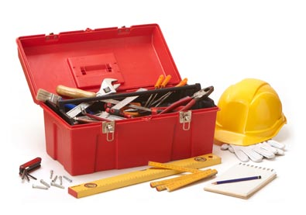
2) Maintain a clear work area during construction to prevent trips, slips, and falls.
First floor, outside building
4
1
How would you like to respond to the hazard?”
No response required.
Put tools away.
Put up signs.
Put up barriers.
Supervisor guides player to a work area with an open toolbox and scattered tools. Supervisor explains rules and procedures for preventing trips, slips, and falls by removing or cleaning up obstructions and otherwise maintaining a clear work area. Supervisor instructs player to clear a work area. When the player hits the action button while in front of the hazard, an alert box pops up asking “Is this a hazard?” The player must select yes or no. After selecting yes, a menu pops up with the question, “How would you like to respond to the hazard?”, and offers a selection of responses. After selecting the correct response, supervisor congratulates player.

Slide 5
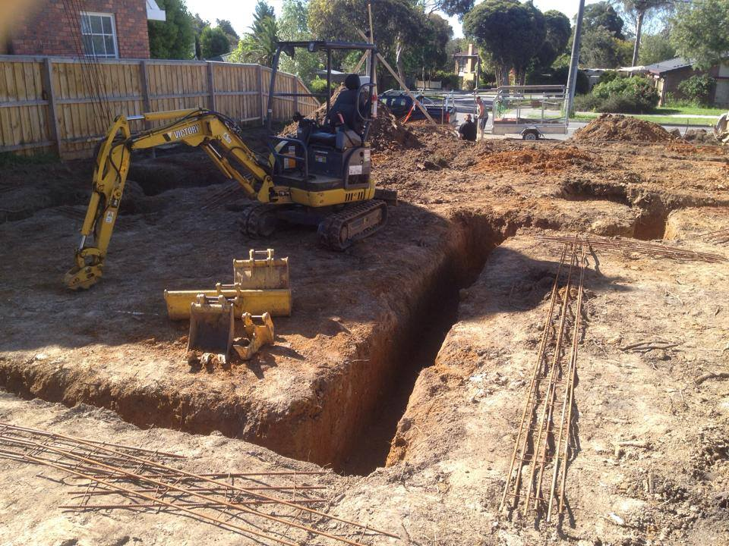
3) Identify all environmental hazards and place a warning sign or barriers in front of them.
First floor, outside building
5
1
How would you like to respond to the hazard?”
No response required.
Tell a co-worker to fix it.
Put up barriers.
Walk into dirt trench.
Supervisor guides player to a dirt trench and explains that they must place either a warning sign or safety barriers in front of environmental hazards that can’t be easily cleaned up. When the player hits the action button while in front of the hazard, an alert box pops up asking “Is this a hazard?” The player must select yes or no. After selecting yes, a menu pops up with the question, “How would you like to respond to the hazard?”, and offers a selection of responses. After selecting the correct response, supervisor congratulates player.

Slide 6
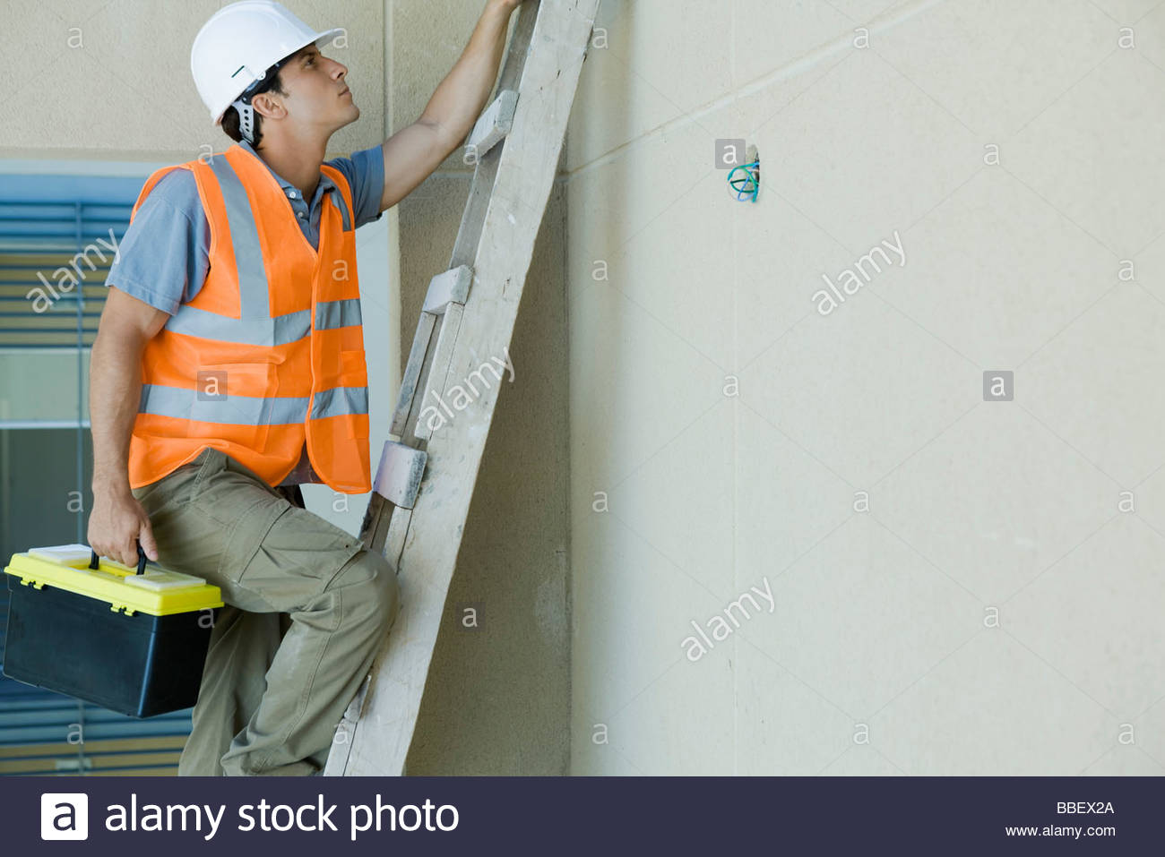
4) Identify and correct all ladder safety hazards
First floor, outside building
6
1
How would you like to respond to the hazard?”
No response required.
Put up barriers.
Put up signs.
Instruct worker to carry tools in toolbelt and climb ladder with both hands.
Supervisor guides player to where a construction worker NPC begins climbing a high ladder while holding a toolbox. Supervisor explains rules and procedures for ladder safety (using both hands). Supervisor instructs player to address this hazard before the construction worker gets hurt. Player has ten seconds to respond or the worker falls and gets injured. When the player hits the action button while in front of the hazard, an alert box pops up asking “Is this a hazard?” The player must select yes or no. After selecting yes, a menu pops up with the question, “How would you like to respond to the hazard?”, and offers a selection of responses. After selecting the correct response, supervisor congratulates player.

Slide 7
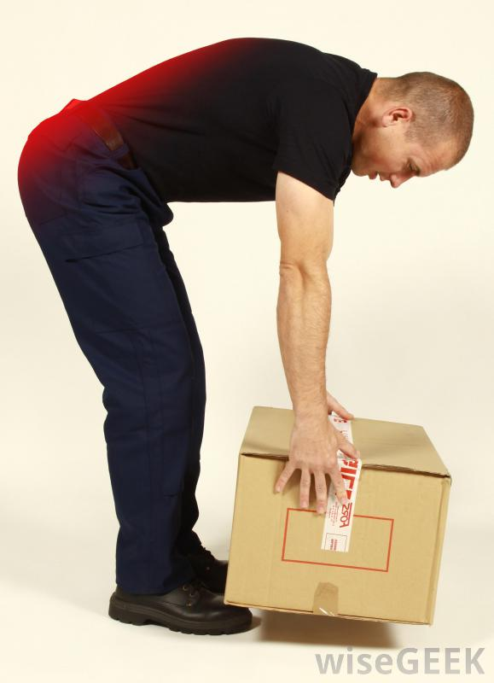
5) Identify and correct all unsafe handling of heavy or large objects.
First floor, outside building
7
1
How would you like to respond to the hazard?”
No response required.
Instruct co-worker to follow safe lifting practices.
Put up barriers.
Put up warning signs.
Supervisor guides player to a construction worker NPC about to lift a heavy beam incorrectly. Supervisor explains rules and procedures for lifting and carrying large or heavy objects (i.e. list with legs or ask for help lifting and carrying the object). Supervisor instructs player to address the hazard before worker injures himself. Player has five seconds to respond. When the player hits the action button while in front of the hazard, an alert box pops up asking “Is this a hazard?” The player must select yes or no. After selecting yes, a menu pops up with the question, “How would you like to respond to the hazard?”, and offers a selection of responses. After selecting the correct response, supervisor congratulates player.

Slide 8
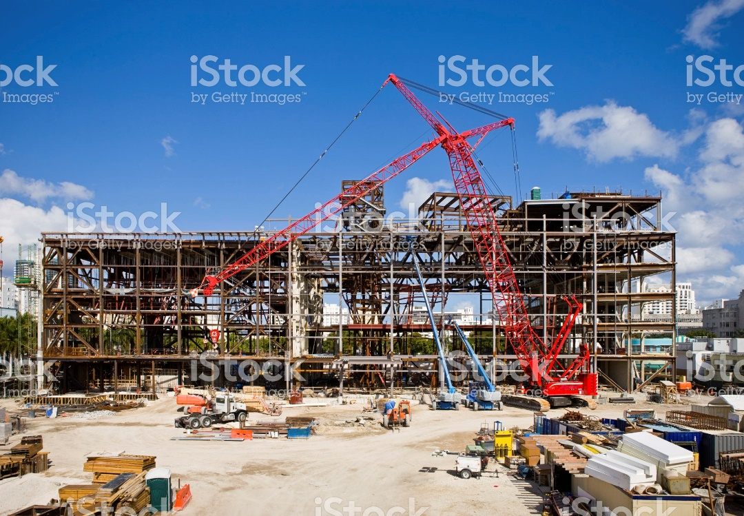
All.
First floor, outside building
8
1
Player is set free to explore Level 1 to identify and respond to hazards learned from supervisor. Supervisor provides corrective and explanatory feedback when player makes errors. Mistakes and successes on this level will not be scored. Some hazards pose eminent threats to co-worker NPCs and must be caught before NPC gets hurt.

