Slide 1
Prescriptive Analytics For Response variation reduction
stephen.leo87@gmail.com

Slide 2
Project analysis slide 2
Problem Statement
Customer Specs for ‘response’
Upper Control Limit = 24
Lower Control Limit = 21
Current Performance
~10% of ‘response’ falls outside the control limits and cannot be sold to the customer
Questions to Answer with data:
Which features have the most impact on response’s variation?
How much should the variation in these features be tightened to ensure response variation meets customer specs?
Approach:
1st question to be answered with a linear model for interpretability
2nd question to be answered with Monte-Carlo simulation
Challenge:
Features are sampled measurements to control cost and hence have ~80% missing data

Slide 3
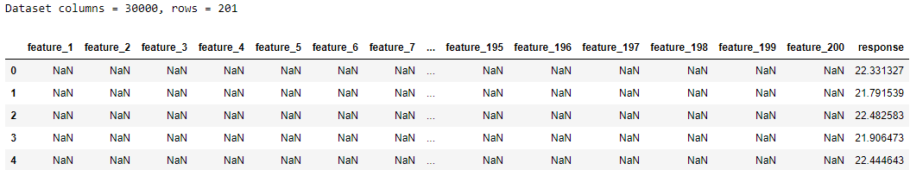
Project analysis slide 2
Dataset Analysis
201 columns
1 Response column
200 Feature columns
30K rows
80:20 split between Train and Test
First 24K rows used to Train model
Last 6K rows used to Test model
Simulate Training model on historical data and predicting on future data
Many missing values observed

Slide 4
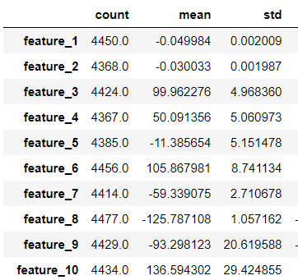
Project analysis slide 2
Features Analysis
200 features available.
Approximately 80% of values missing for each feature.
Probably due to sampling of measurements.
Different features have different magnitude of measurement.
Mean missing = 81.39%
Min missing = 65.23%
Max missing = 81.98%
Notes:
Mean missing = 81.39%; Min missing = 65.23% ; Max missing = 81.98%

Slide 5
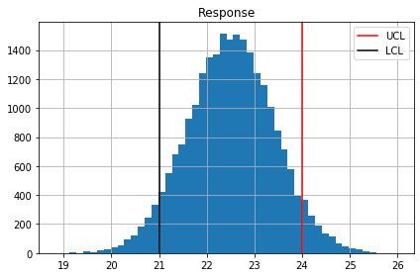
Project analysis slide 2
Response Analysis
Response Mean: 22.51, StdDev: 0.91
Below LCL(21): 4.92%, Above UCL(24): 5.01%
Response has normal distribution.
Approximately 10% of Response falls outside customer specs
Customer Specs:
LCL = 21
UCL = 24
Hence,
Desired response stddev = (UCL-LCL)/6 = 0.5

Slide 6
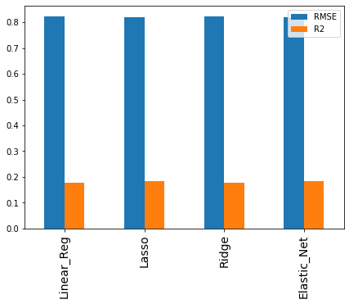
Project analysis slide 2
Initial Model
Missing data filled with column mean.
Choose Linear Models to have interpretable results
All Models have high error (high RMSE)
All Models have low correlation between model’s predicted value and actual value (low R2)

Slide 7
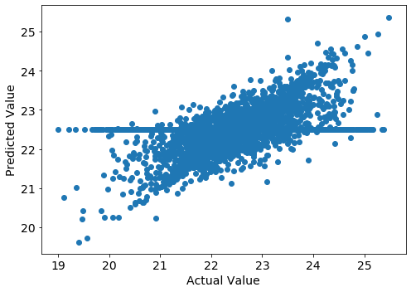
Project analysis slide 2
Model Investigation
Investigate further into 1 model to find reason for high error and low correlation
Plot the actual correlation between model’s predicted value vs actual value
Correlation looks significant for many points
However, there is a second distribution that has weak correlation
This is an artifact of filling missing data with the column mean.
Let’s change the prediction to only predict the response when the row has values for all the columns used by the model.
Weak Correlation
Significant Correlation

Slide 8
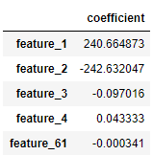
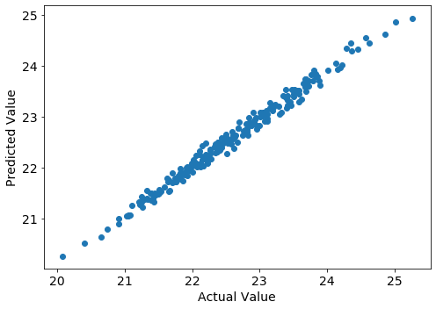
Project analysis slide 2
Lasso Model
Important Features
Lasso model has automatic feature selection and only uses features that are important for prediction.
The model picks up 5 features as important. Coefficients are the Model’s estimate of rate of change of response per unit change in feature.
For these 5 features, drop the rows that have missing values and plot predicted vs actual again
Very high correlation and low error observed
Hence the model is very good at predicting those rows that have measurements for all 5 important features
Recommendation: Ensure measurement sampling can measure all 5 features as much as possible
RMSE: 0.1098
R2: 0.9861
Very Significant Correlation

Slide 9
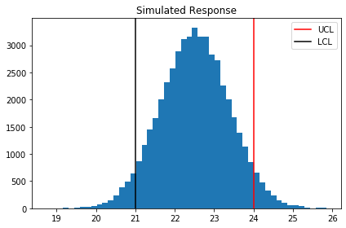
Project analysis slide 2
Monte-Carlo Simulation
Response Mean: 22.51, StdDev: 0.91
Below LCL(21): 4.92%, Above UCL(24): 5.01%
Run simulation 50K times
Each time, randomly choose a value from each of the 5 important features and calculate simulated response using the model parameters.
Compare final simulated response to actual response and see that they are quite similar which indicates simulation is successful.
Simulated Response Mean: 22.51, StdDev: 0.87
Below LCL(21): 4.19%, Above UCL(24): 4.29%

Slide 10
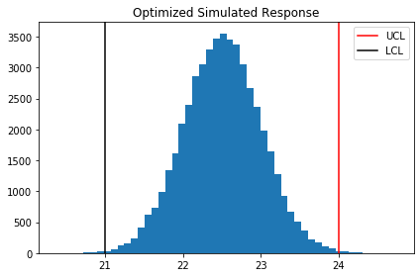
Project analysis slide 2
Optimization
Optimized Simulated Response Mean: 22.51, StdDev: 0.49
Below LCL(21): 0.11%, Above UCL(24): 0.12%
Run optimization by reducing the stddev of each of the 5 important features and calculate stddev of simulated response.
Stop when the stddev of simulated response is lower than the customer specs (0.5)
StdDev of each feature needs to divide by: 1.80 to get Final Simulated Response StdDev: 0.49.
The desired std dev for each of the important features are shown in the table. If these conditions are met, only 0.2% of response will fall outside customer specs.
 | Current StdDev | Desired StdDev
feature_1 | 0.002009 | 0.001116
feature_2 | 0.001987 | 0.001104
feature_3 | 4.96836 | 2.7602
feature_4 | 5.060973 | 2.811652
feature_61 | 4.053497 | 2.251943

Slide 11
Project analysis slide 2
Conclusion & Recommendations
Conclusions:
Response can be predicted with low error stddev of 0.1 using 5 features: feature_1,2,3,4,61.
Desired stddev of important features are shown in the table. Each stddev needs to divide by 1.8 of current value.
Response not meeting customer specs can be drastically reduced from ~10% to 0.2% if all features meet the desired stddev values.
Recommendations:
Ensure measurement can measure all 5 important features as much as possible
Control 5 important features within desired stddev values
Optimized Simulated Response:
Below LCL(21): 0.11%, Above UCL(24): 0.12%
 | Current StdDev | Desired StdDev
feature_1 | 0.002009 | 0.001116
feature_2 | 0.001987 | 0.001104
feature_3 | 4.96836 | 2.7602
feature_4 | 5.060973 | 2.811652
feature_61 | 4.053497 | 2.251943

Slide 12
Thank You

