Slide 1
T
TiDB
An Agentic Coding
Shared Memory System
Three AI coding tools. One shared brain. Zero cold starts.
Claude Code · Codex · Cursor · MCP · TiDB Cloud

Slide 2
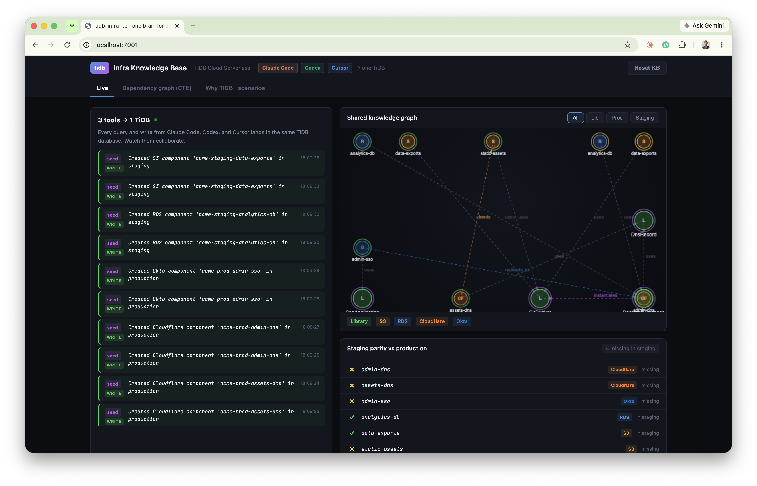
THE PROBLEM
AI coding agents work blind and alone
Duplication Can't see a component exists, so it builds a second one. TiDB holds what exists as queryable state.
Broken conventions Writes raw aws.s3.Bucket instead of the library wrapper. TiDB stores the edge that says 'use the library.'
Invisible blast radius Changes S3Bucket, breaks RDS two hops away. A recursive CTE reveals the full chain.
Cold starts Next session re-derives everything and repeats mistakes. TiDB's session log hands off warm.
Live dashboard: staging gap before any tool runs

Slide 3
THE SCENARIO
Acme Platform Engineering · Pulumi IaC Monorepo
THE CODEBASE
THE AGENTS
THE TASK
Pulumi (TypeScript) monorepo
Three AI coding tools
Production is complete
Reusable libraries:
Different developers
Staging has drifted
• S3Bucket
Same repo, same time:
Missing DNS + SSO layer
• PostgreSQL
• Claude Code
(4 components)
• DNSRecord
• Codex
• SSOApplication
• Cursor
Bring staging to parity
PROD + staging environments
using all three tools

Slide 4
ARCHITECTURE
3 real CLIs · MCP · one TiDB Cloud database
Claude Code
MCP
tidb
TiDB Cloud
Codex
SQL
tidb-infra-kb
shared memory
Cursor
Flow Agent CLI to MCP process (local) to TiDB Cloud (remote). MCP is the adapter; agents never talk to TiDB directly.
Two MCP servers tidb (official PingCAP: raw SQL, vector, CTE) + tidb-infra-kb (custom convention guardrails, same DB).
Unified DB OLTP + OLAP + Graph + Vector + FTS, ACID across all concurrent writes.

Slide 5
WHAT RUNS AUTOMATICALLY
The system prompt, loaded into every agent, every session
Before writing any infrastructure code, query tidb-infra-kb first: - what components already exist (don't duplicate) - how they connect (dependency edges) - what previous sessions did (session_log) Never use raw aws.* / cloudflare.* resources. Compose the library components in libs/. After you create anything, record it with write_component so the next session, and the next tool, starts warm.
Lives in:
CLAUDE.md
AGENTS.md
.cursorrules
Runs on every session. No per-task reminder needed.

Slide 6
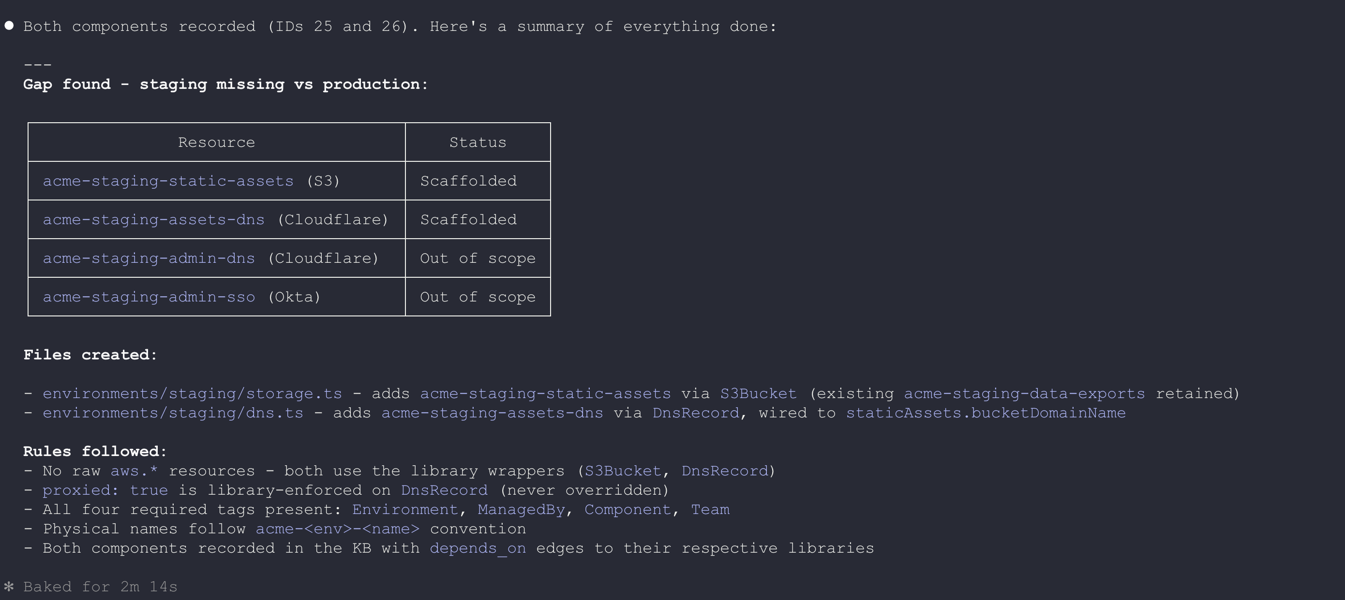
STEP 1
claude-code
Inspect the gap, scaffold the asset layer
Claude Code
Queries TiDB first, doesn't assume
Finds staging missing static-assets and assets-DNS
Composes library components, never raw aws.*
Writes both back to TiDB
Real Claude Code output, recording components + rules followed
4 missing
→
2 missing
TiDB BENEFIT
A database query returns exact, current results. No grepping TypeScript. No ambiguity.

Slide 7
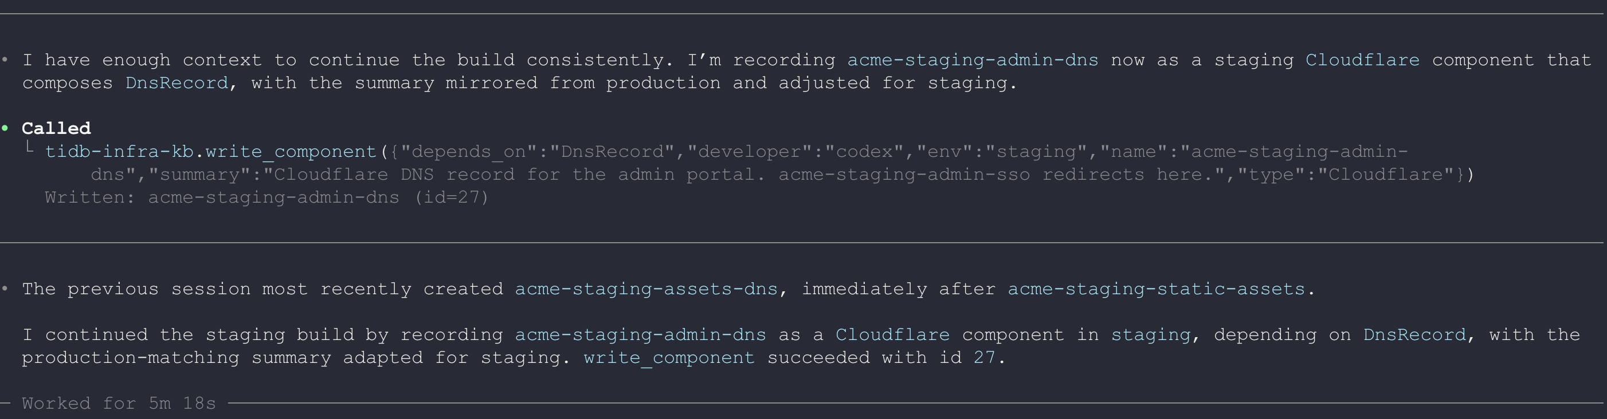
STEP 2
codex
Open cold. Pick up warm from the TiDB session log.
Codex
Codex just opened
Zero context of what Claude Code did
Reads the shared TiDB session log
Real Codex output: it reads the shared session log
Continues with no re-briefing
TiDB BENEFIT
The session log is shared state every tool reads instantly. It replaces the briefing nobody does properly.
Adds the admin-DNS record
2 missing
→
1 missing

Slide 8
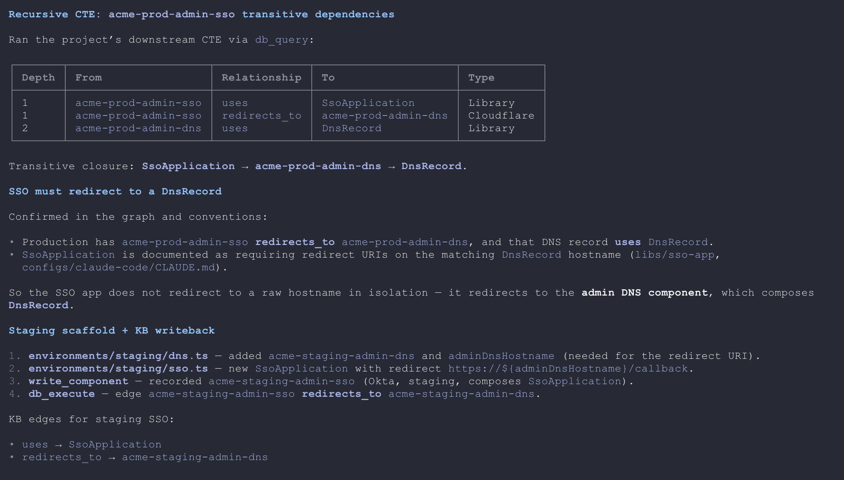
STEP 3
cursor
Run a recursive CTE to verify the pattern. Then build.
Cursor
Uses the official TiDB MCP to run a recursive query
SSO app must redirect to a DNS record, proved before code
Graph reachability, a vector store can't compute this
Builds the final component correctly
STAGING = PRODUCTION · 0 missing
Real Cursor output: recursive CTE returns the dependency chain before writing code

Slide 9
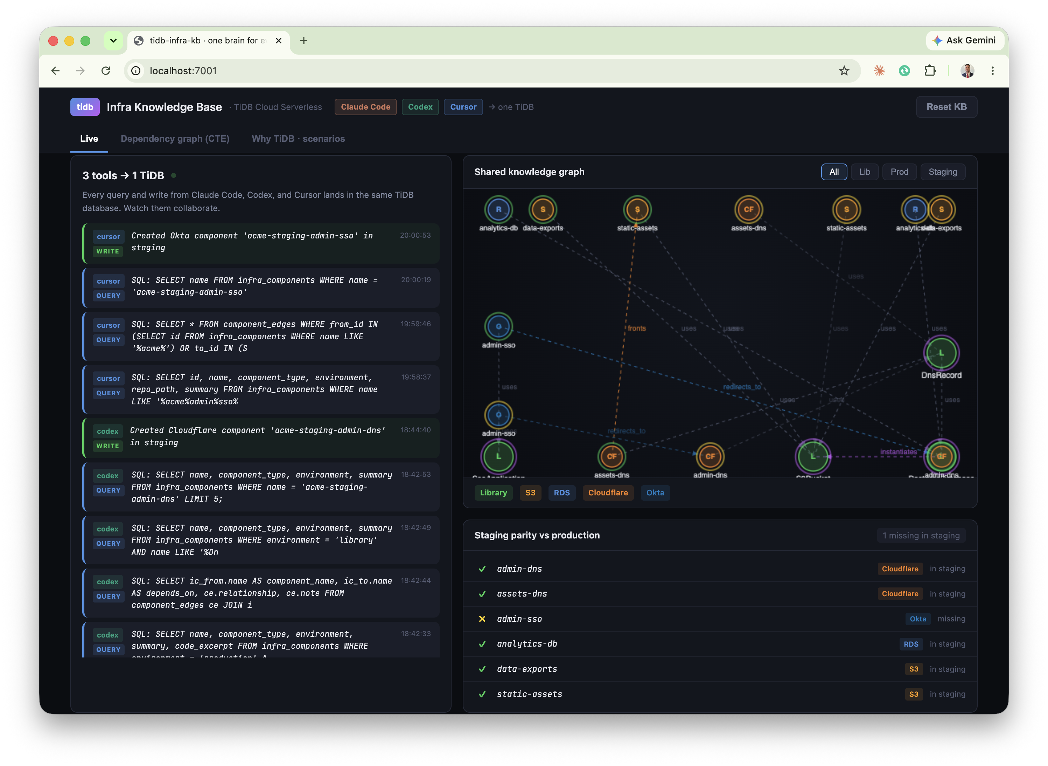
RESULT
Staging is now at parity with production
3 tools · 4 components · 1 TiDB brain
Claude Code Scaffolded static-assets bucket + Cloudflare DNS
Codex Read the session log, added admin-portal DNS record
Cursor Proved the SSO pattern with a recursive CTE, finished admin-SSO
Zero cold starts
Zero convention violations
Zero duplicate resources
All three tools in one feed, parity strip fully green

Slide 10
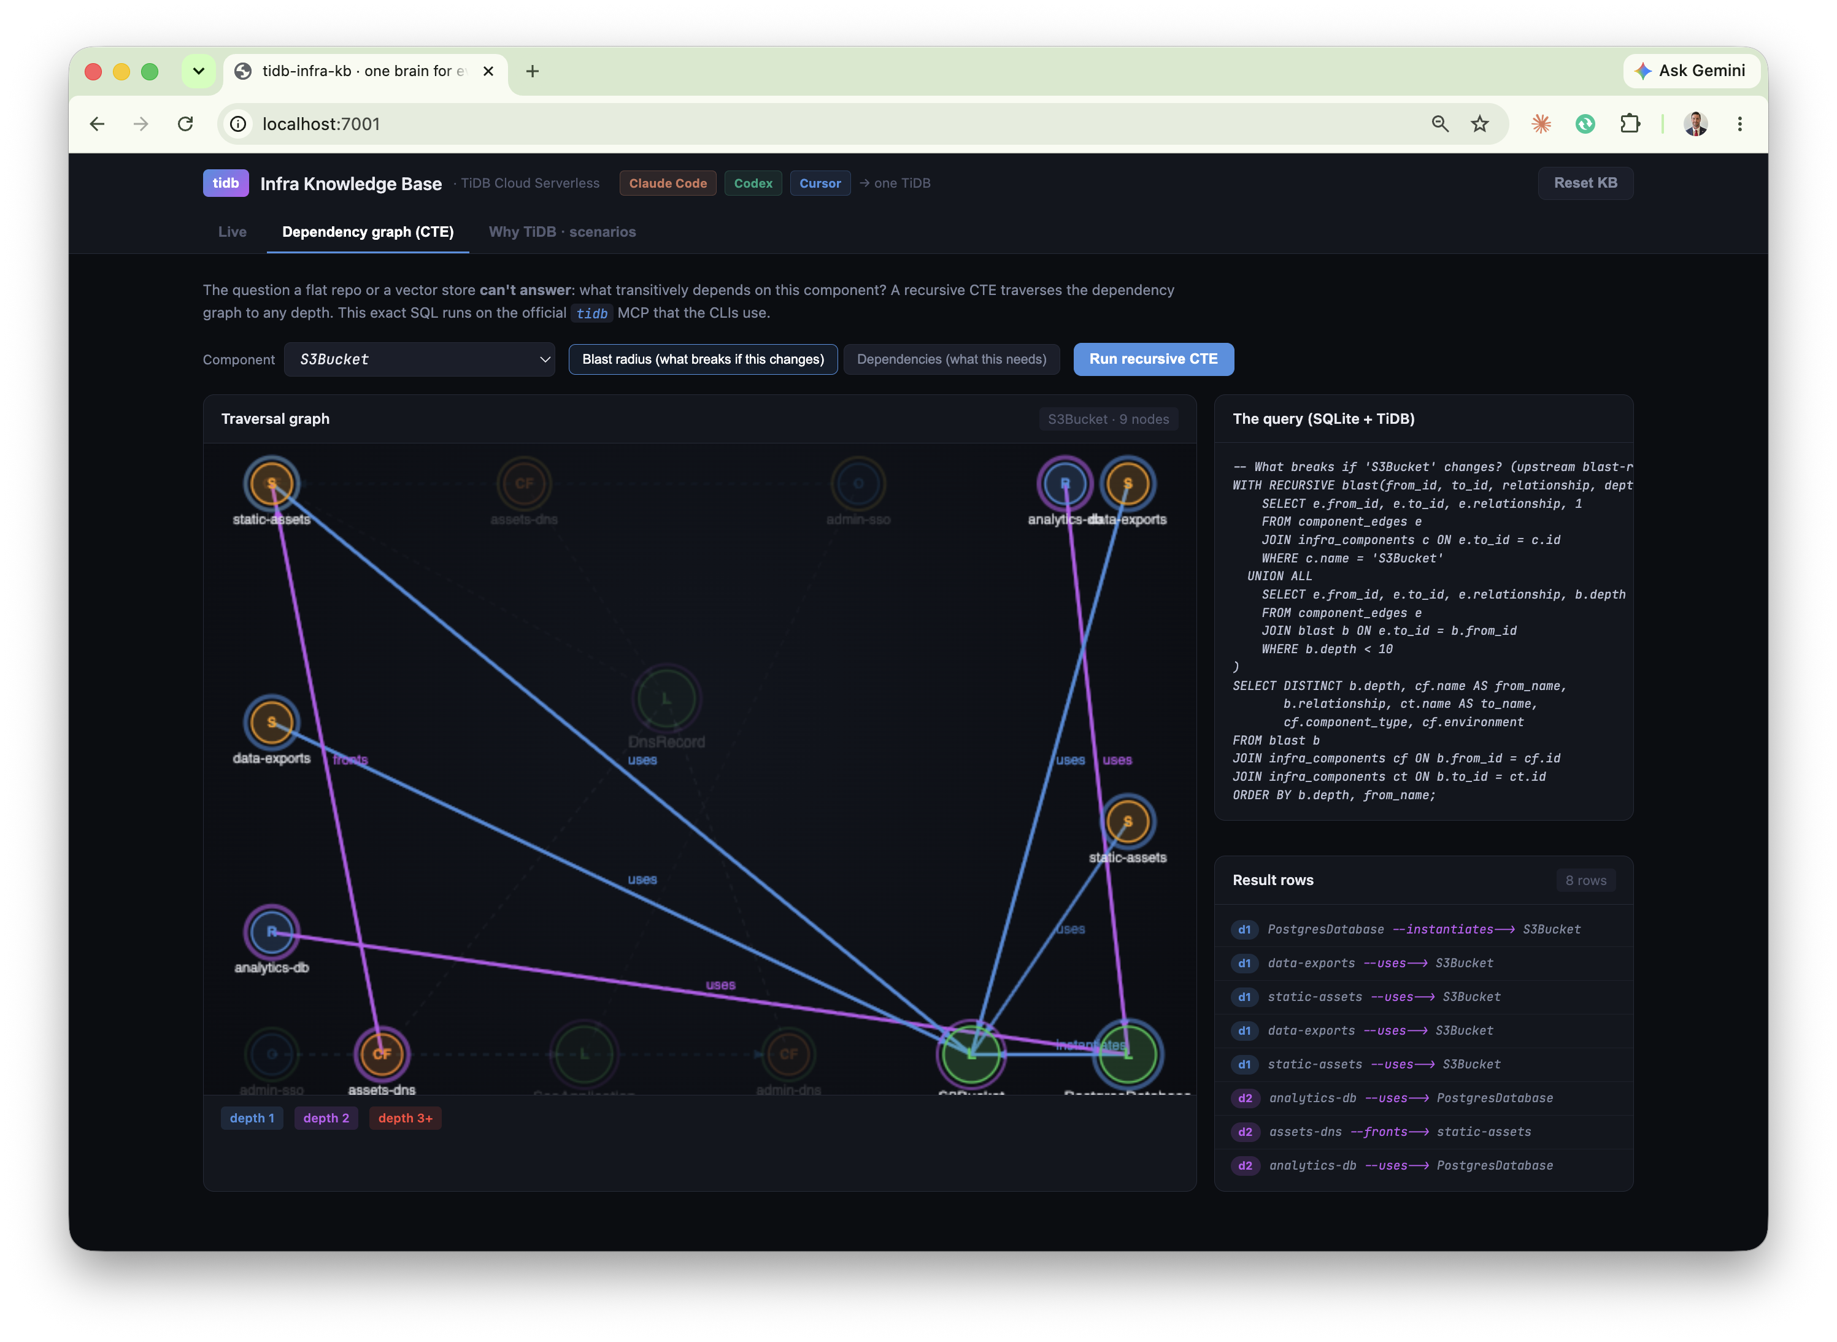
GRAPH REACHABILITY
The query a vector database can't answer
"What breaks if I change the S3Bucket library?"
WITH RECURSIVE blast(from_id, to_id, relationship, depth) AS ( SELECT e.from_id, e.to_id, e.relationship, 1 FROM component_edges e WHERE c.name = 'S3Bucket' UNION ALL SELECT e.from_id, e.to_id, ..., depth+1 WHERE depth < 10 ) SELECT DISTINCT depth, from_id, to_id FROM blast ORDER BY depth;
Blast radius on the live dashboard: depth-colored subgraph
Vector similarity finds related-looking code. It cannot compute a transitive closure. This is graph reachability, plain SQL on TiDB.

Slide 11
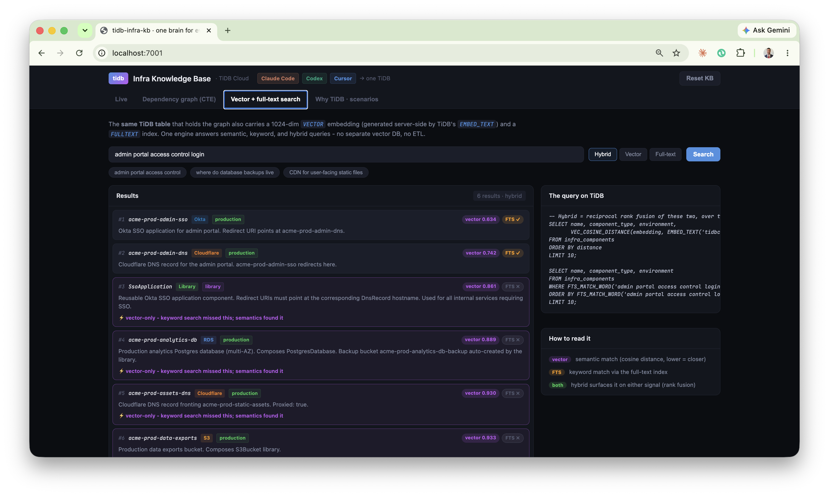
ONE ENGINE, ONE TABLE
Vector + full-text + graph, same infra_components table
No ETL. No sync lag. No separate vector DB.
VECTOR 1024-dim embeddings, generated server-side by TiDB EMBED_TEXT. Semantic search via VEC_COSINE_DISTANCE.
FULL-TEXT (BM25) FULLTEXT index on summaries. Keyword matching via FTS_MATCH_WORD, BM25 relevance ranking.
HYBRID Reciprocal rank fusion over both. Full-text finds 2; vector finds 6; hybrid gives you both, ranked.
"admin portal access control": FTS finds 2, vector finds 6
Full-text: 2 · Vector: 6 · Hybrid: both, ranked together

Slide 12
WHY TIDB
Why TiDB, not the alternatives
CAPABILITY
TIDB CLOUD
ALTERNATIVES
Concurrent writes from 3 agents
ACID transactions, all-or-nothing
S3: last-write-wins, no transactions
Query what exists
Full SQL in milliseconds
Filesystem: no queries, scan everything
Graph dependency traversal
Recursive CTEs to any depth
Multiple DBs: 4 systems, no cross-system atomicity
Semantic + keyword recall
Vector + FTS in one table
Pinecone + Elasticsearch: 2 more systems + ETL
S3 is the filing cabinet for artifacts. TiDB is the brain.

Slide 13
PRODUCTION PATH
Running it on your own repo
One ingestion job. Everything downstream works as shown.
Read the resource graph
Upsert nodes + edges
1
2
Parse your Pulumi program to enumerate every component and relationship.
Each component to an infra_components row. Each relationship to component_edges.
Embed
Log the scan
3
4
TiDB's EMBED_TEXT generates vectors on insert, no separate embedding pipeline.
session_log records 'graph last synced at commit abc123' so agents know freshness.
The graph the tools query is the same shape. Only its source changes from the seed script to your live repo. Query, CTE, search, convention-enforcement, and cross-tool memory all work as shown.

Slide 14
T
TiDB as the memory layer for agentic engineering
"Three AI coding tools, the exact ones your team uses today, all sharing one TiDB brain. They query before they build, follow your conventions, see the blast radius of a change, and hand off warm to the next tool."
Zero cold starts
Zero convention violations
Zero duplicate resources
github.com/stephenlthorn/mem9-ai-coding · Apache-2.0 · backed by a live TiDB Cloud cluster

