Slide 1
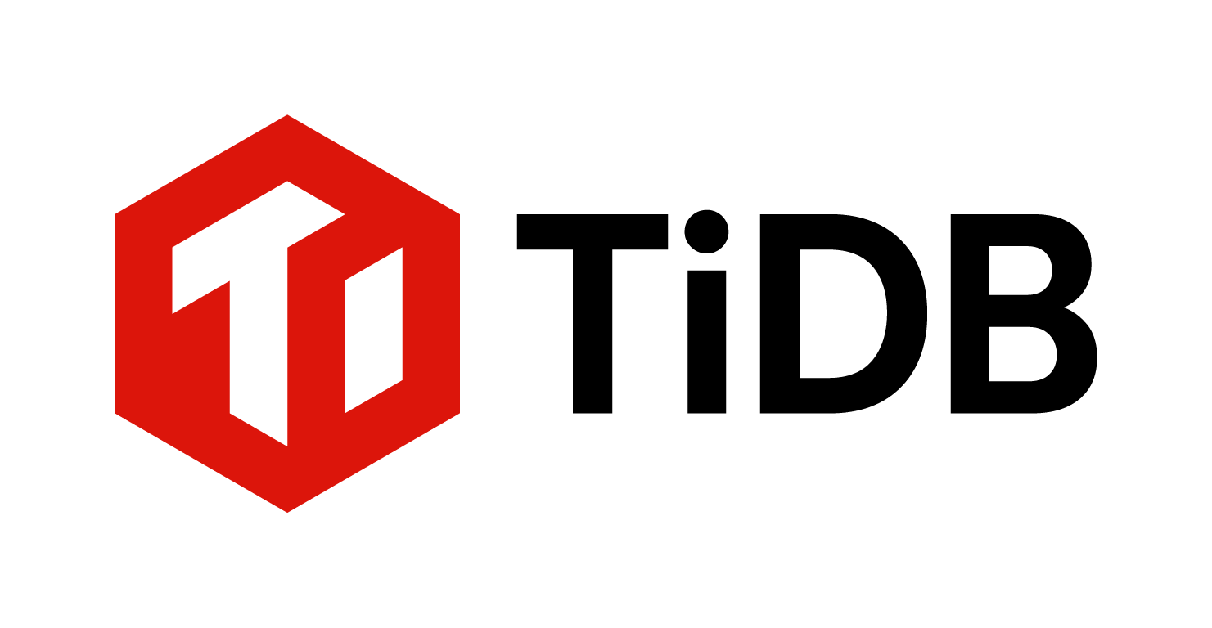
TiDB Oracle
Internal GTM copilot for answers, recommendations, and asset generation
What it is and why it matters
One internal workspace that turns docs + call transcripts into grounded answers and next-step actions.
Outputs include follow-up emails, discovery questions, technical collateral, and account briefs.
Value to GTM: faster deal cycles, consistent technical messaging, and less manual prep per opportunity.
Every answer is evidence-backed with citations and full audit logs.

Slide 2
Simple Architecture: One Enterprise LLM + MCP
Single-model path with internal TiDB knowledge grounding
Single LLM path
MCP internal knowledge layer
Use one enterprise-grade OpenAI model endpoint for all generation.
Business/API data is not used for model training by default.
Apply retention and storage controls from enterprise/API policy.
No consumer ChatGPT plan is used for this workload.
MCP server fronts the internal TiDB knowledge DB (docs + approved call transcripts).
Retriever sends only relevant chunks and metadata to the model.
Responses require citations back to internal chunk/document IDs.
Policy filters and redaction run before external API calls.
Flow: user query -> policy checks -> MCP retrieval -> enterprise LLM -> cited output.

Slide 3
Guardrails for Prospect Calls
How we protect sensitive prospect data with one LLM
Only prospect calls with valid recording consent are eligible for ingestion and analysis.
All-party consent states (for example CA and WA) must be handled with stricter notice controls.
No existing customer private data is included unless it is already public marketing content.
Internal-only access via OAuth/SSO; outbound messages restricted to @pingcap.com.
Every generated asset includes retrieval citations and audit logs for traceability.

Slide 4
Cost Model (AWS VM + One Enterprise LLM)
Simpler operating model with one model path
Line Item | Monthly (USD) | Annual (USD)
App/API/UI VM (t3.xlarge) | $121.91 | $1,462.92
Storage + networking + monitoring | $79.72 | $956.64
ChatGPT Business seats (20 users @ $25) | $500.00 | $6,000.00
Enterprise LLM API usage budget | $250.00 | $3,000.00
Backups + operating reserve | $19.00 | $228.00
Total operating cost | $970.63 | $11,647.56
With 20% contingency | $1,164.76 | $13,977.07
Typical single GTM technical hire | - | $200,000+
Seat baseline uses published ChatGPT Business pricing; swap this row with enterprise contract pricing when finalized.

Slide 5
Rollout + Exit Plan + Sources
Start fast, measure value, and stop anytime if it is not working
90-day rollout
Cancel anytime + key sources
Days 0-30: secure MVP, ingest core docs/transcripts, enable pilot reps and SEs.
Days 31-60: launch coaching + asset workflows and tune retrieval quality.
Days 61-90: scale to broader GTM teams with KPI reporting.
No long-term lock-in required for this architecture.
If value is weak, we can stop quickly and retain internal artifacts/logs.
OpenAI Enterprise Privacy (Jan 8, 2026): openai.com/enterprise-privacy
OpenAI API data controls: platform.openai.com/docs/guides/your-data
OpenAI Services Agreement (Jan 1, 2026): openai.com/policies/services-agreement
MCP spec: modelcontextprotocol.io/introduction
Consent laws: 18 U.S.C. 2511, CA Penal Code 632, WA RCW 9.73.030
Decision framing: high upside, low operating cost, and reversible at any point.

