Slide 1
Slide Title
main_wrapper()
start timer
main()
get_api_responses()
read_excel_to_sqlite()
build_three_week_range()
df_to_sqlite()
WEEK_LIST loop
sqlite_to_df()
write to execution log
stop timer
commit_to_xdo()

Slide 2
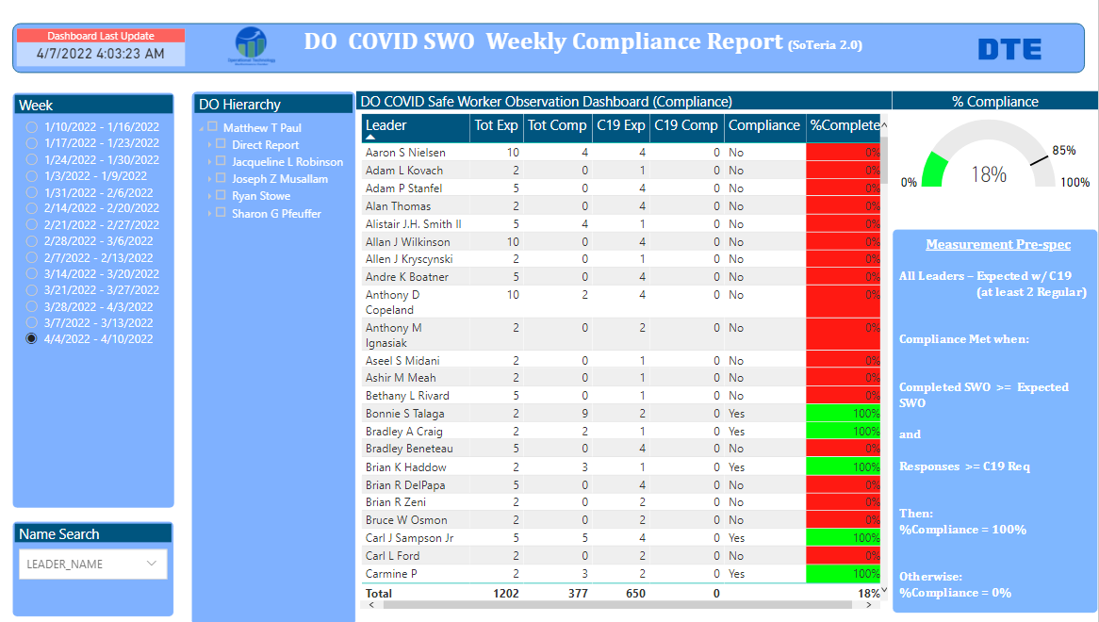

Flowchart for Safe Worker Observation process

