Slide 1
NEXYGEN
Net-Zero Emissions Forecasting Platform
Scope 1 & 2 forecasting • automated model selection • net-zero target-gap tracking
Prepared for Nexygen Energy Ltd.

Slide 2
Executive Summary
A working forecasting platform, and one finding leadership should act on.
Behind target
every year
Prophet beats
SARIMA
5 REST
endpoints
27 automated
tests
since 2020, gap has widened from 1.1 to 2.6 points
on both Scope 1 and Scope 2 — selected automatically by R²
forecast, scenario, historical, target-gap, model-info
+ CI that builds and boots the real Docker images
NEXYGEN Net-Zero Emissions Forecasting Platform
2

Slide 3
Business Context
Nexygen Energy Ltd.
A UK electricity & gas provider, founded 2009, serving 1.5M+ customers across England, Scotland, and Wales.
Publicly committed to net-zero operational emissions by 2040.
As its renewable portfolio and regulator/investor scrutiny grew, historical emissions tracking was no longer enough — it needed forward-looking forecasts of Scope 1 (direct: fuel, vehicles) and Scope 2 (indirect: purchased electricity) emissions.
Founded
2009
1.5M+
Customers
3
UK regions served
2040
Net-zero target year
NEXYGEN Net-Zero Emissions Forecasting Platform
3

Slide 4
The Core Finding: Behind the Net-Zero Path
Actual vs. published % reduction from the 2020 baseline, by year
2.64 pts
behind target in 2025 — up from 1.1 points in 2021
Every current reduction initiative
is insufficient to hit the published path on current trend — not a data artifact: gap widens monotonically, year over year.
NEXYGEN Net-Zero Emissions Forecasting Platform
4

Slide 5
Data Overview
ESG_Data.csv — daily granularity, validated by data_prep_pipeline.py
236,736
2020–2025
18
rows
date range
assets tracked
5
3
3
asset types
UK regions
energy types
NEXYGEN Net-Zero Emissions Forecasting Platform
5

Slide 6
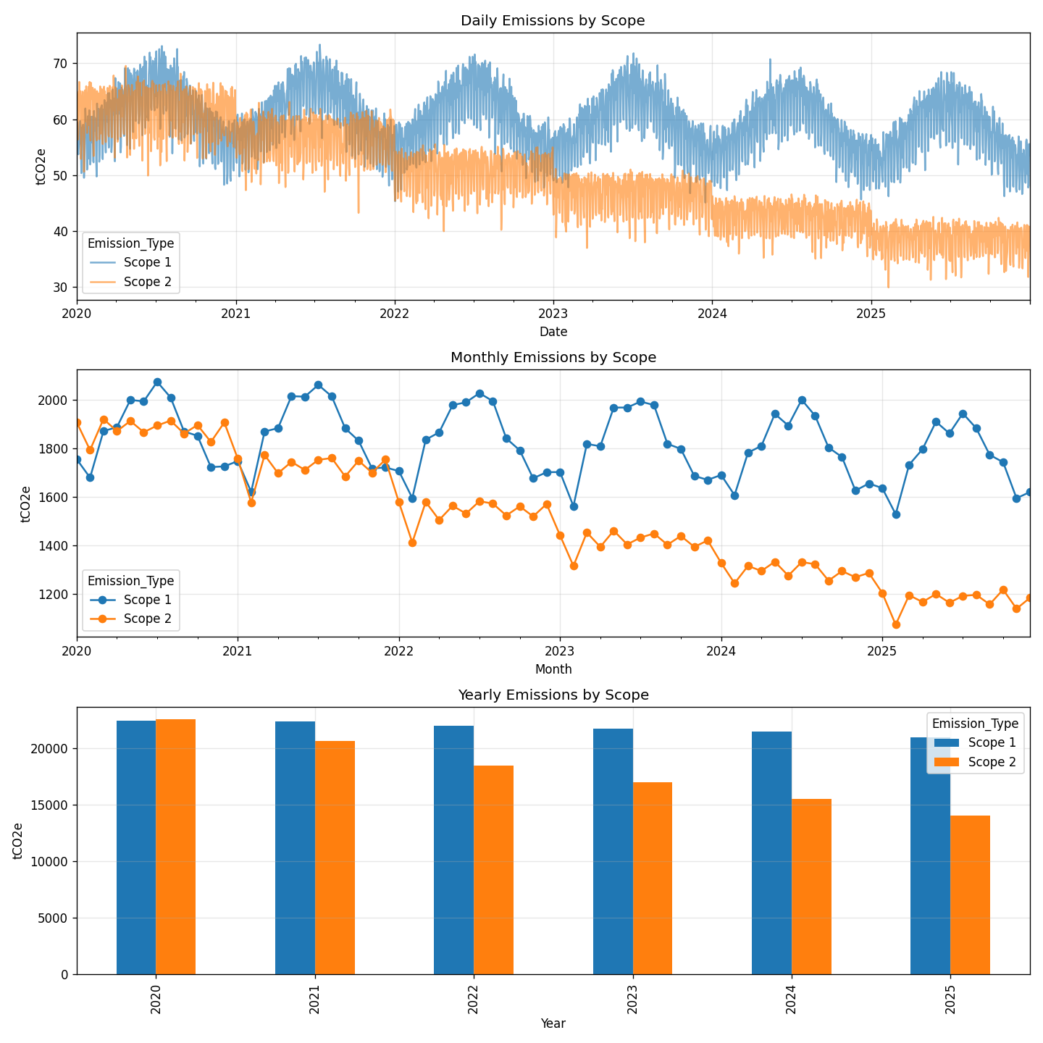
EDA: Emissions Trend
Six-year trend, both scopes declining — unevenly
Scope 1
−6.3%
2020 → 2025
Scope 2
−37.6%
2020 → 2025
Scope 2's steeper decline is the headline — but it's still not steep enough to hit target (see previous slide).
NEXYGEN Net-Zero Emissions Forecasting Platform
6

Slide 7
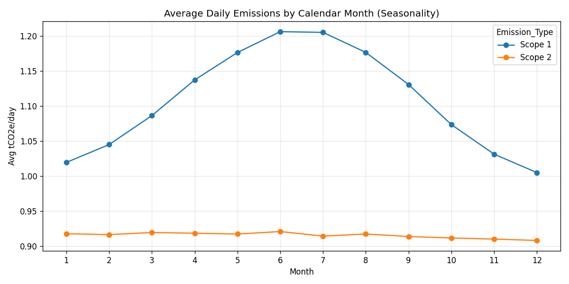
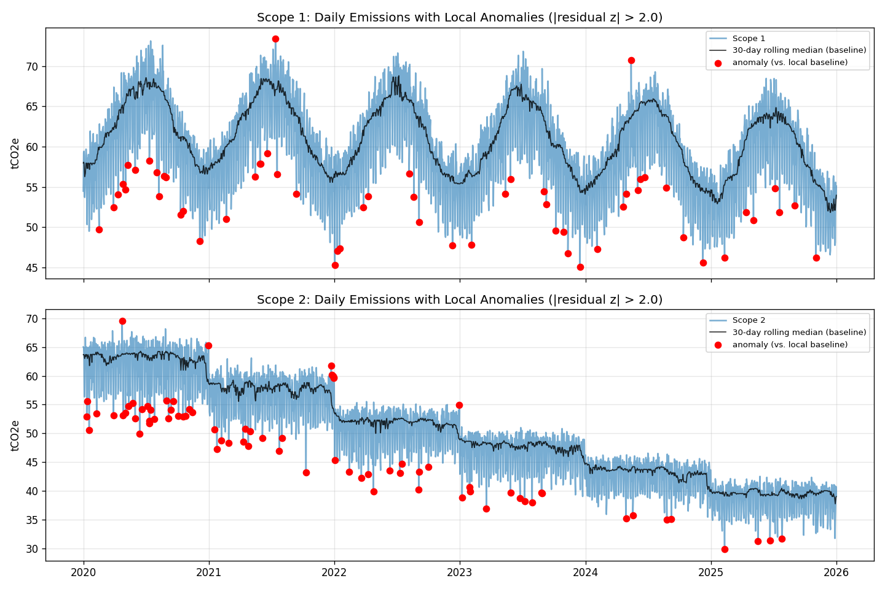
EDA: Seasonality & Anomalies
Scope 1: strong seasonality (18.1% peak-to-trough swing, June peak). Scope 2: negligible (1.4%) — not meaningfully seasonal.
133 anomalous days flagged, using a 30-day rolling-median local baseline — not raw z-score, which would mistake trend drift for anomalies.
NEXYGEN Net-Zero Emissions Forecasting Platform
7

Slide 8
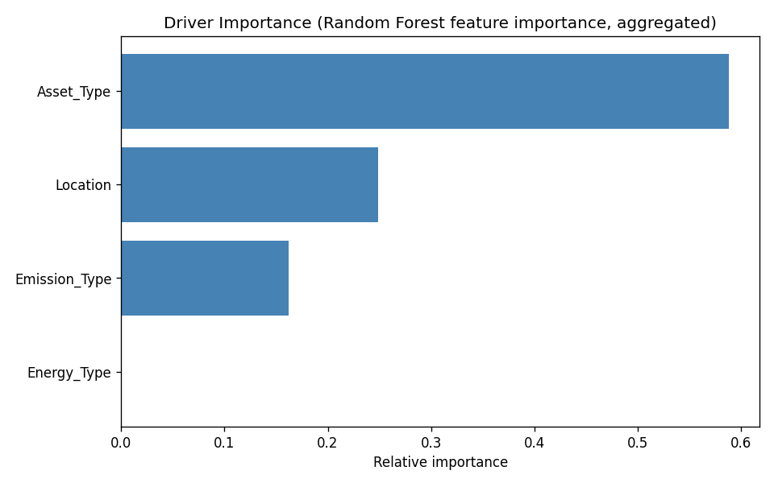
EDA: What Drives Emissions?
Random Forest feature importance across Asset Type, Location, Emission Type, Energy Type
59%
of driver importance is Asset Type alone — which asset, not which region or energy source, matters most
Highest-emitting asset type: ControlRoom
Operational_Status excluded — zero variance in this dataset (always “Active”), so it can't explain anything.
NEXYGEN Net-Zero Emissions Forecasting Platform
8

Slide 9
Modeling Approach
Two candidates, one apples-to-apples bake-off, per scope
1
2
3
4
Same split
Two candidates
Same test set
Winner ships
58 months train / 14 months test, identical for both candidates and both scopes
SARIMA/SARIMAX (auto_arima order search) vs. Prophet (grid search over changepoint scale + seasonality mode)
Both scored by R² / MSE / MAE on the same held-out 14 months — no peeking
Higher-R² candidate is refit and shipped; both scores kept in model_manifest.json for audit
Selection is genuinely data-driven, not hardcoded to prefer either model — a future retrain on new data could flip the winner, and the API would serve it automatically.
NEXYGEN Net-Zero Emissions Forecasting Platform
9

Slide 10
Model Results: Prophet Wins Both Scopes
R² on the held-out 14-month test set
Scope 2 jump
0.792 → 0.908
MAE nearly halves: 16.5 → 9.2 tCO2e
Why Scope 2 improved so much:
the SARIMA order originally shipped for Scope 2 was mistakenly tuned on daily data, then applied to monthly — severely overparameterized and never converged (R² = −1.96 before that fix). Even after fixing the SARIMA order, Prophet's seasonal decomposition still fits this series better.
NEXYGEN Net-Zero Emissions Forecasting Platform
10

Slide 11
Architecture
Data → pipelines → model registry → API → dashboard
data/ESG_Data.csv
236,736 rows, 2020–2025
pipeline/
data_prep → eda_report → train (SARIMA vs Prophet)
models/model_manifest.json
winner + both candidates' metrics, per scope
Streamlit UI (:8501)
FastAPI backend (:8000)
Forecast · Scenario · Historical · Target-Gap tabs
/forecast /scenario /historical /target-gap /model-info /health
run.py — single entry point: --env {local, docker} × --app {fastapi, streamlit, both}
NEXYGEN Net-Zero Emissions Forecasting Platform
11

Slide 12
API Reference
Technical Appendix — auto-generated Swagger docs at /docs
GET
/health
Readiness: model/data load status, active model + R² per scope, auth state
POST
/forecast
Forecast a scope N months ahead using whichever model won
🔒
POST
/scenario
Forecast with an adjustable annual reduction-rate assumption
🔒
GET
/historical
Historical emissions, filterable by scope/granularity/date/asset/location
🔒
GET
/target-gap
Actual vs. target % reduction vs. baseline, per year, with on-track verdict
🔒
GET
/model-info
Full training manifest: winning model + both candidates' metrics
🔒
🔒 = requires X-API-Key header when API_KEY is configured (opt-in auth; unset = open for local dev/CI)
NEXYGEN Net-Zero Emissions Forecasting Platform
12

Slide 13
Deployment & CI
Containerized, env-configured, tested on every push
Docker + Compose
CI — 3 jobs on every push/PR
Separate backend/frontend images; health-gated startup (frontend waits for backend's /health)
backend-tests — 27 pytest cases
.env-driven config
pipeline-smoke-test — re-runs data prep, EDA, and training end to end
Ports, model dir, log level, API_KEY — no hardcoded values; .env.example documents every setting
docker-build — builds both images, boots the backend, polls /health until green
Health checks
Docker HEALTHCHECK + Compose depends_on: service_healthy, not just a bare liveness ping
The docker-build job would have caught a real bug shipped earlier in this project: a docker-compose.yml dockerfile: Dockerfile vs. actual lowercase dockerfile filename mismatch that silently broke docker compose up --build.
NEXYGEN Net-Zero Emissions Forecasting Platform
13

Slide 14
Roadmap & Known Limitations
Shipped honestly documented, not hidden
No database
Single shared API key
ESG_Data.csv read directly at startup — fine at this volume; revisit if write-access or larger data is needed
No per-user roles; adequate for a small internal deployment, not multi-tenant
No auto-deploy
SHAP not implemented
CI validates but doesn't deploy; cloud deployment (AWS/Azure/GCP) is a natural next step
Doesn't natively apply to SARIMA or Prophet — would need a feature-based model to add meaningfully
Grid search, not AutoML
Driver analysis is descriptive
Adequate for two ~72-month series; would need rethinking for a much larger model set
Random Forest importances rank drivers; not a causal claim about why they matter
NEXYGEN Net-Zero Emissions Forecasting Platform
14

Slide 15
Questions
NEXYGEN Net-Zero Emissions Forecasting Platform
github.com/stephenogodo/Nexygen-Net-Zero-Project

