Slide 1
Pathogen Genomics: Introduction to genome sequencing and analysis
Adam Reid & Steve Doyle
Wellcome Sanger Institute/LSHTM
LSHTM Pathogen Genomics

Slide 2
Summary
What is the point of a genome sequence?
Genome sequencing technologies
Sequence data files
Viewing genomes
Computer practical 1: Viewing genome sequences
Computer practical 2: Analysis of sequence variants

Slide 3
Why do genome sequencing?
Reference for molecular biology
Tropheryma whipplei causes the potentially fatal Whipple’s disease. Could not easily be grown. Genome revealed it had lost genes involved in producing amino acids.
Identify all the genes that determine the function of the organism
Neisseria meningitidis, a major cause of meningitis. The first vaccine for a particular form of meningitis for identified by looking for candidates in its genome.
Rickettsia prowazekii is the cause of epidemic typhus, which killed millions in the early 20th century. It cannot reproduce outside of these cells. It was found to have just over 800 genes.
Examine evolution by comparative genomics
Track spread of pathogens
Identify antimicrobial/drug resistance genes and drug targets
Mtb researchers made bacteria resistant to a new drug. Genome sequencing identified the gene involved in resistance.
Basis for other omics technologies – RNA-seq, ChIP-seq, Methylome etc.

Slide 4
Why do genome sequencing? - Video of Wellcome Sanger Institute researchers

Slide 5
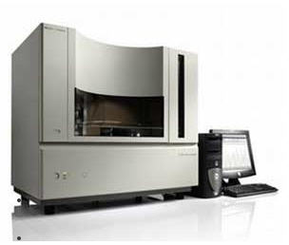
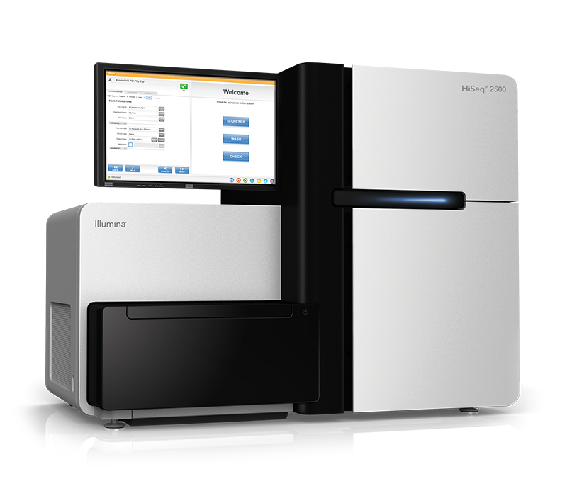
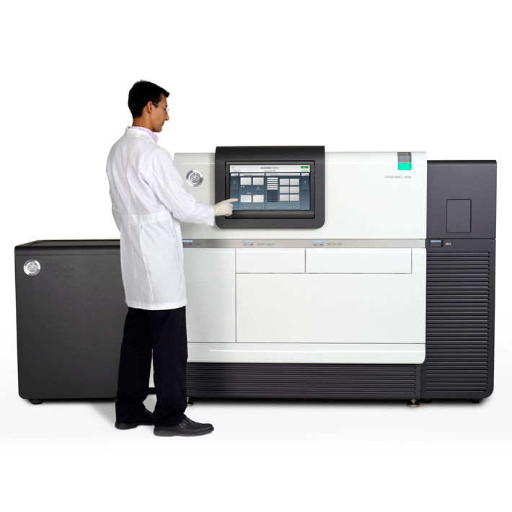
Technology overview
Sanger sequencing produces ~500bp reads
Pros: Highly accurate
Cons: Expensive, laborious
Uses: High quality reference genomes
Illumina’s sequencing-by-synthesis 75-250bp
Pros: cheap, lots of reads (e.g. 500 million per run)
Cons: short reads
Uses: Resequencing, draft genomes, RNA-seq
Pacific Biosciences Single-Molecule Real Time (SMRT) reads of 5000bp-40000bp
Pros: long reads
Cons: Fewer reads than Illumina - ~1 million, low accuracy
Uses: Reference genomes

Slide 6
Genome sequencing technologies – Interview with Mike Quail

Slide 7
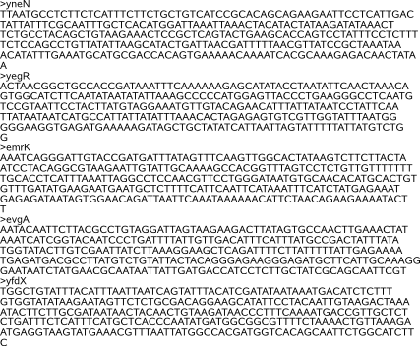
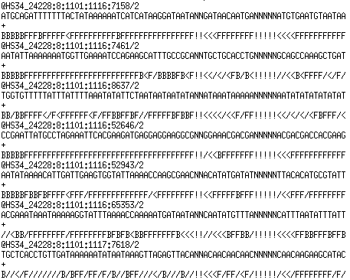
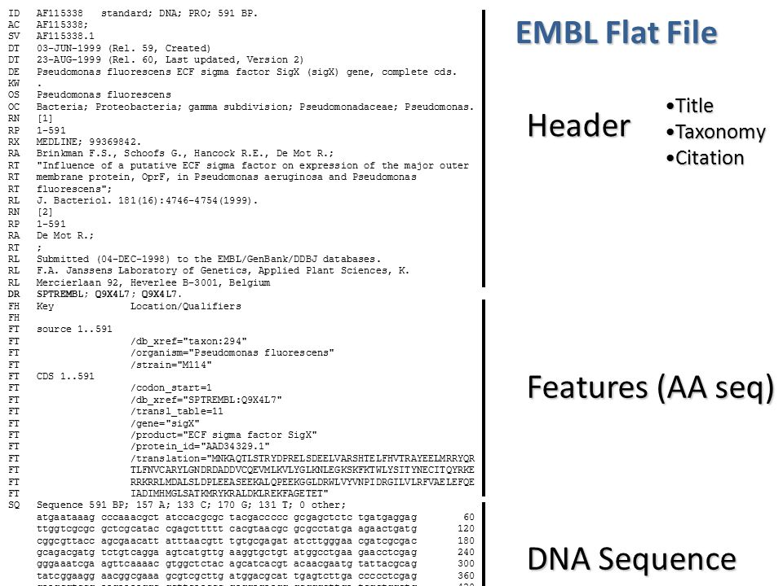
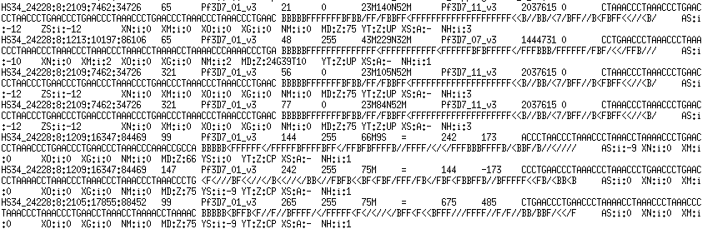
Sequence data
Fasta
Fastq
EMBL
SAM/BAM

Slide 8
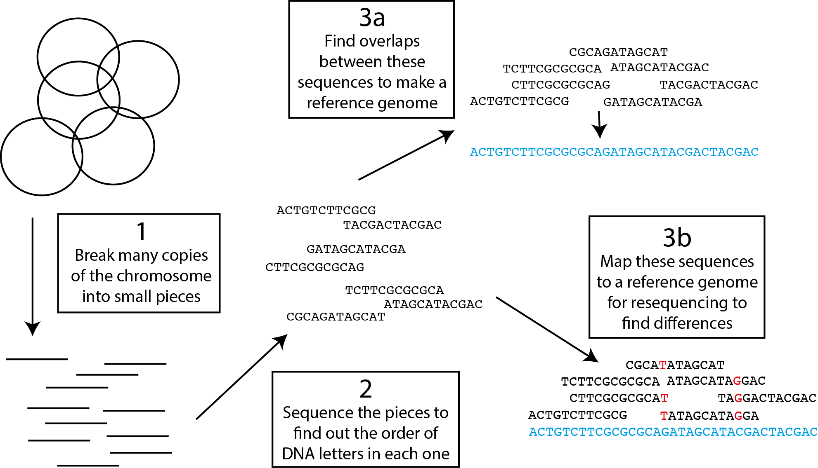
What do we do with these data?
Annotation (find the genes)
Look for interesting differences
Build a tree

Slide 9
How are we going to do our bioinformatics?
Virtual machine with Linux
Artemis for viewing genomes
Various command line tools for mapping, assembling etc.
Web-based applications

Slide 10
What will we do in the practicals?
Get familiar with the Virtual Machine
Computer practical 1: Use Artemis to get familiar with looking at genomes (morning)
Computer practical 2: Map short-read genome sequencing data to identify differences between closely related bacteria (afternoon)

Slide 11

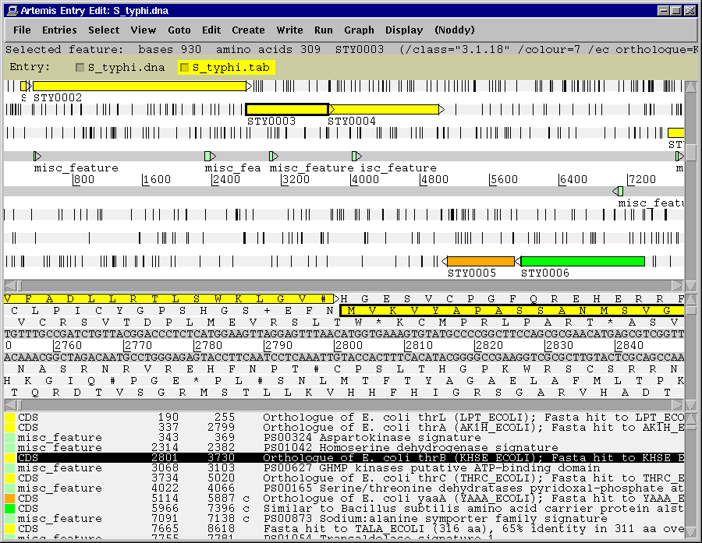
Genome browser and annotation tool
visualization of sequence
DNA
six frame translation
Panoramic and sequence view
Annotation
Features
Mapped and listed
Editable
In layers (entry)
perform and view analysis
basic analysis
Basic stats & index can be plotted
import and view the results of other searches/analysis
Different lines of evidence can be seen together

Slide 12

Artemis
Drop Down Menus
Drop Down Menus
Entry Button Line
Entry Button Line
Main Sequence View Panel
Main Sequence View Panel
Sliders
Magnified Sequence View Panel
Magnified Sequence View Panel
Sliders
Feature Menu
Feature Menu

Slide 13
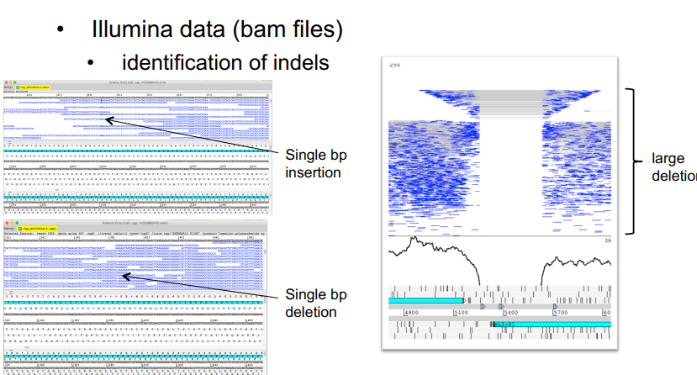
Viewing mapped reads in Artemis
we will see it on Module 4

Slide 14
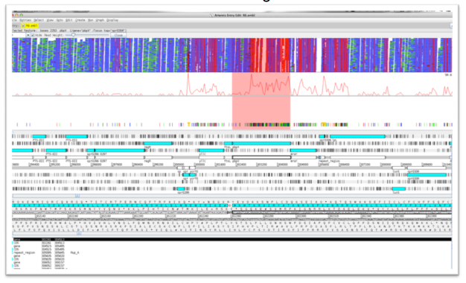
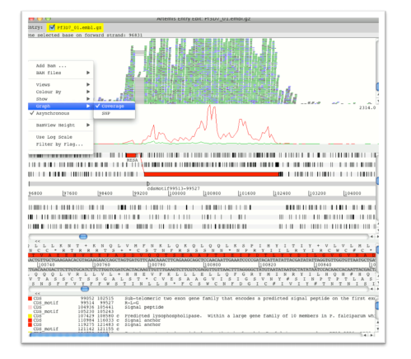
Viewing mapped reads in Artemis
Single nucleotide variants (SNVs)
RNAseq data
Illumina data (bam files)

Slide 15
Resequencing and mapping
Aims to capture information on:
Single Nucleotide Variants (SNVs/SNPs),
insertions and deletions (indels)
Copy Number Variants (CNVs) between individuals of a species.
As sequences diverge from the reference, mapping becomes progressively less effective

Slide 16
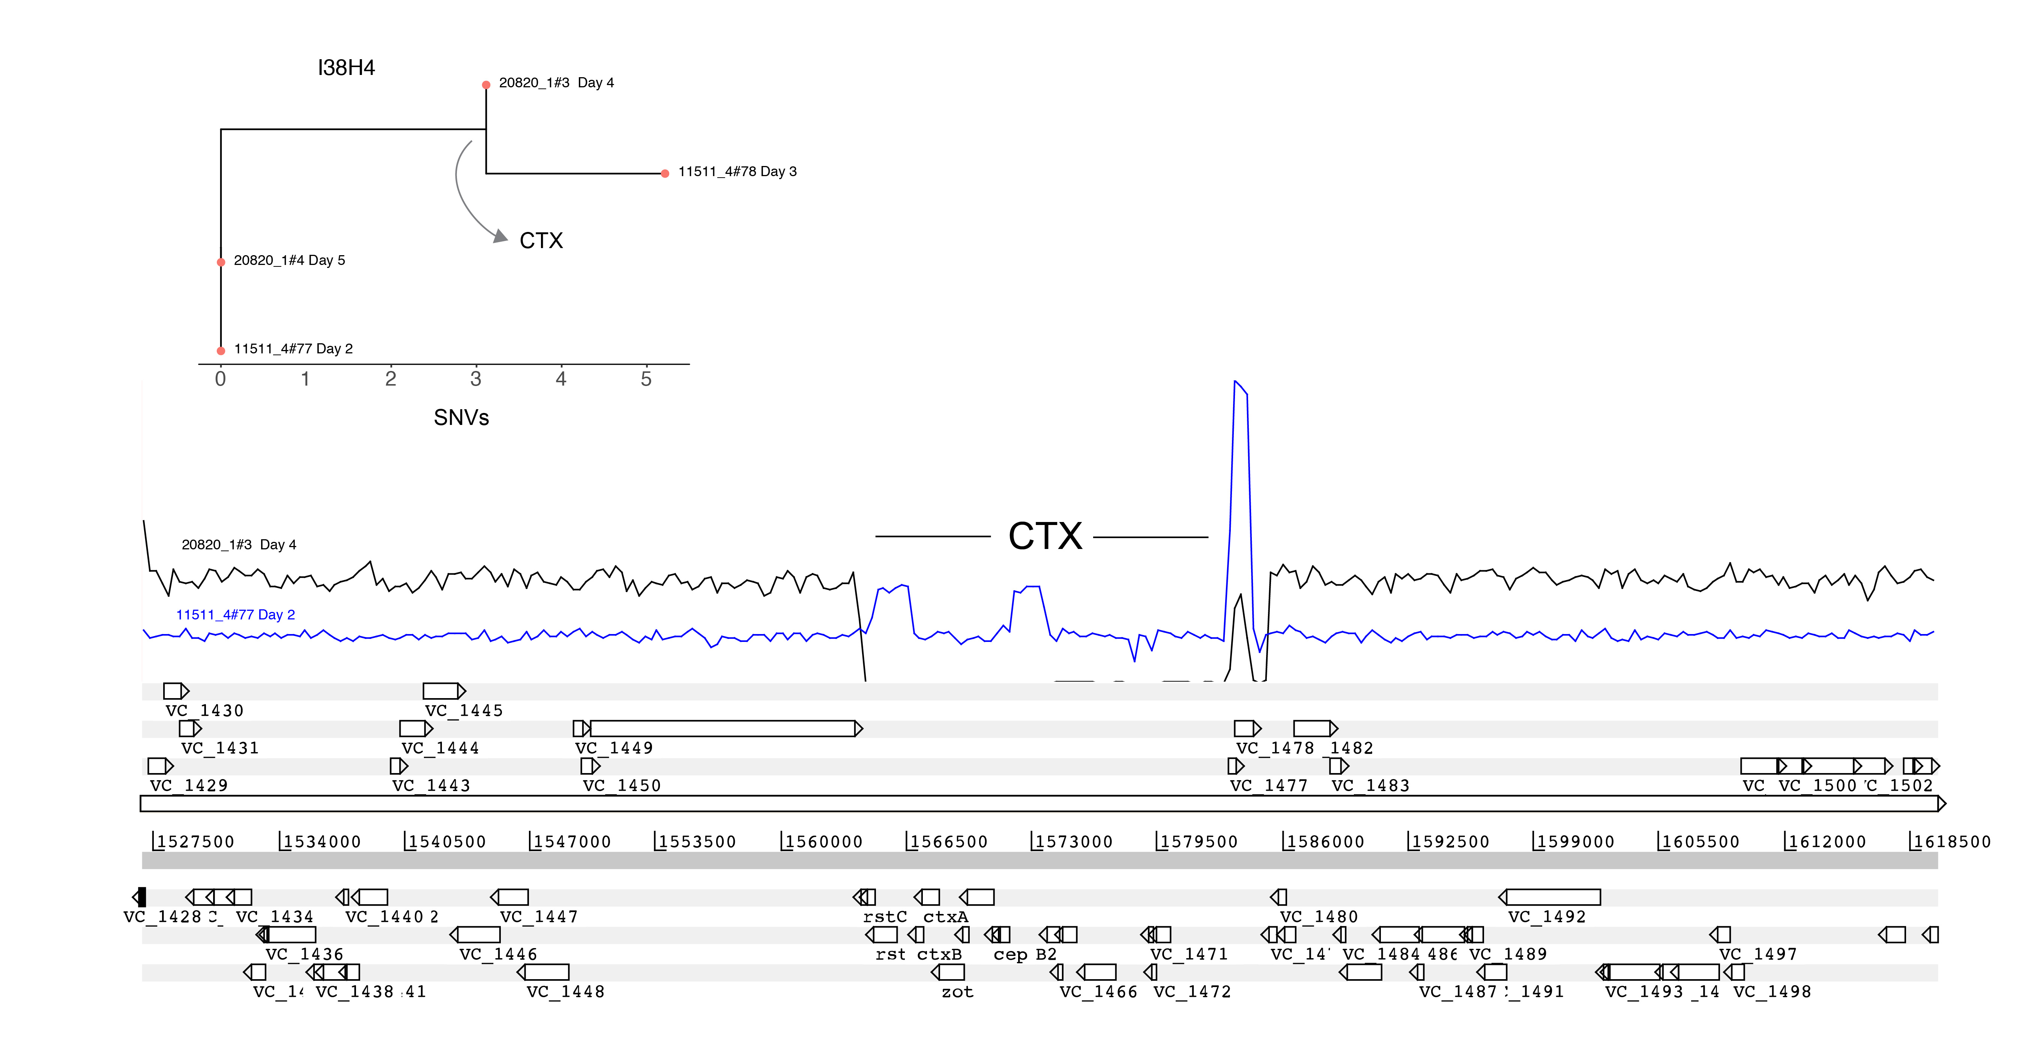
Gene presence / absence

Slide 17
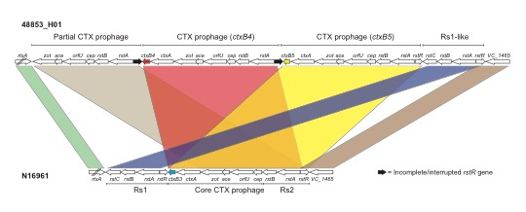
Copy number variation

Slide 19
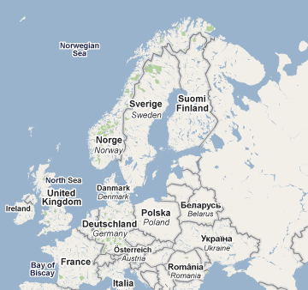
The Swedish Story
Prior to 2006, C. trachomatis in Sweden was following the same pattern as in the UK
In 2006, across Sweden there was a reported drop in cases
Notes:
* Editorial
A new genetic variant of Chlamydia trachomatis
1. Björn Herrmann
1. Correspondence to: Björn Herrmann Department of Clinical Microbiology, Uppsala University Hospital, S-751 85 Uppsala, Sweden; bjorn.herrmann@medsci.uu.se
* Chlamydia trachomatis
* Sweden
A thrilling story in Sweden, with global impact
A new variant of Chlamydia trachomatis was discovered in Sweden in 2006. This variant contains a mutant sequence that cannot be detected with either the Abbott m2000 (Abbott Diagnostics, Chicago, IL, USA) or Cobas Amplicor/TaqMan48 (Roche Diagnostics, Basel, Switzerland) systems. 1 The first description reported that the new variant constituted 13% of all detected chlamydia infections (from mid-September to October 2006) in the county of Halland (south west of Sweden). It soon became apparent that the proportion was higher and that the new variant had spread widely in Sweden. We now know that in the counties that have used the Abbott or Roche test systems during the past year or so the new variant accounts for 20% to 65% of all detected chlamydia cases. In local areas, as many as 78% of all cases have been found to have the mutation (Britta Loré, personal communication).

Slide 20
The Swedish story
It was noticed that counties using the NAATs (Abbott / Roche) diagnostic system showed a drop in C. trachomatis cases in 2006
Counties using other diagnostic methods (BecktonDickinson) still showed an increase in cases, in line with that of previous years
The obvious conclusion was that the NAATs was missing a subset of infections
Why?
Let’s find out using the awesome power of genomic sequencing!!!!

Slide 21
Summary
Computer practical 1
Use Artemis to view genomes
Understand genome data files
Understand relationship between the sequence and annotation
Understand what bacterial genomes look like and how they are arranged
Computer practical 2
Practice short read alignment
View mapped reads in Artemis
Call and view SNPs
Uncover why the PCR test failed for new variant Chlamydia

