Slide 1
Parasite Genomics: Day 2
Steve Doyle & Adam Reid
Wellcome Sanger Institute / LSHTM
LSHTM Pathogen Genomics

Slide 2
Program
Manual, individual presentations
https://stephenrdoyle.github.io/LSHTM_ParasiteGenomics/
Day 1
Module 1: Artemis
Module 2: Short read mapping
Day 2
Module 3: Comparative genomics
Module 4: Transcriptome analysis - RNAseq

Slide 3
Module 3:
Comparative Genomics

Slide 4
Comparative Genomics
Previously worked on individual genomes from a species - can teach us a lot about species biology
We can learn more by analysing complete (or large parts of) genomes from within and/or between species
Identification of similarities and differences between organisms can tell us about:
Core functions
Evolutionary history
Adaptation (for ex. Infectivity and virulence, alternative metabolic pathways, etc. )
Particularly useful with increasing size of genomic datasets

Slide 5
Comparative Genomics
Whole genomes
Useful over a wide variety of scales:
Chromosomal structure & rearrangements
Gene gain & loss
Gene order & rearrangements
Pseudogenes
Coding and non-coding variation
Single nucleotides

Slide 6
Resources and tools
Many resources exist for undertaking comparative genomic analyses
Databases: Genbank, Ensemble, MBGD…
Datasets: Metagenomic data, curated data, refseq...
Dataset formats: fasta, GFF, VCF…
DNA similarity: BLAST, Mummer…
DNA composition: GC%, codon usage, kmer…

Slide 7
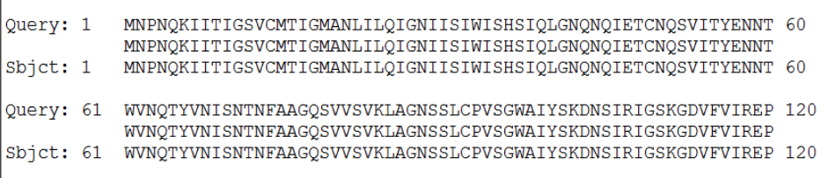
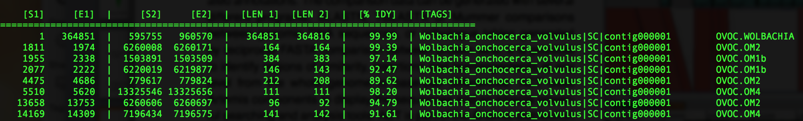
Challenge: single gene to whole genome
The output of these resources & tools is not easy to visualise / conceptualise, esp for large datasets / whole genomes
BLAST
nucmer

Slide 8
Artemis Comparison Tool (ACT)
Interactive tools to visualise and compare two or more sequences and their annotations
Useful for whole genomes down to single genes
Based on, and builds upon, Artemis
Many of the functions learnt in Artemis are the same

Slide 9
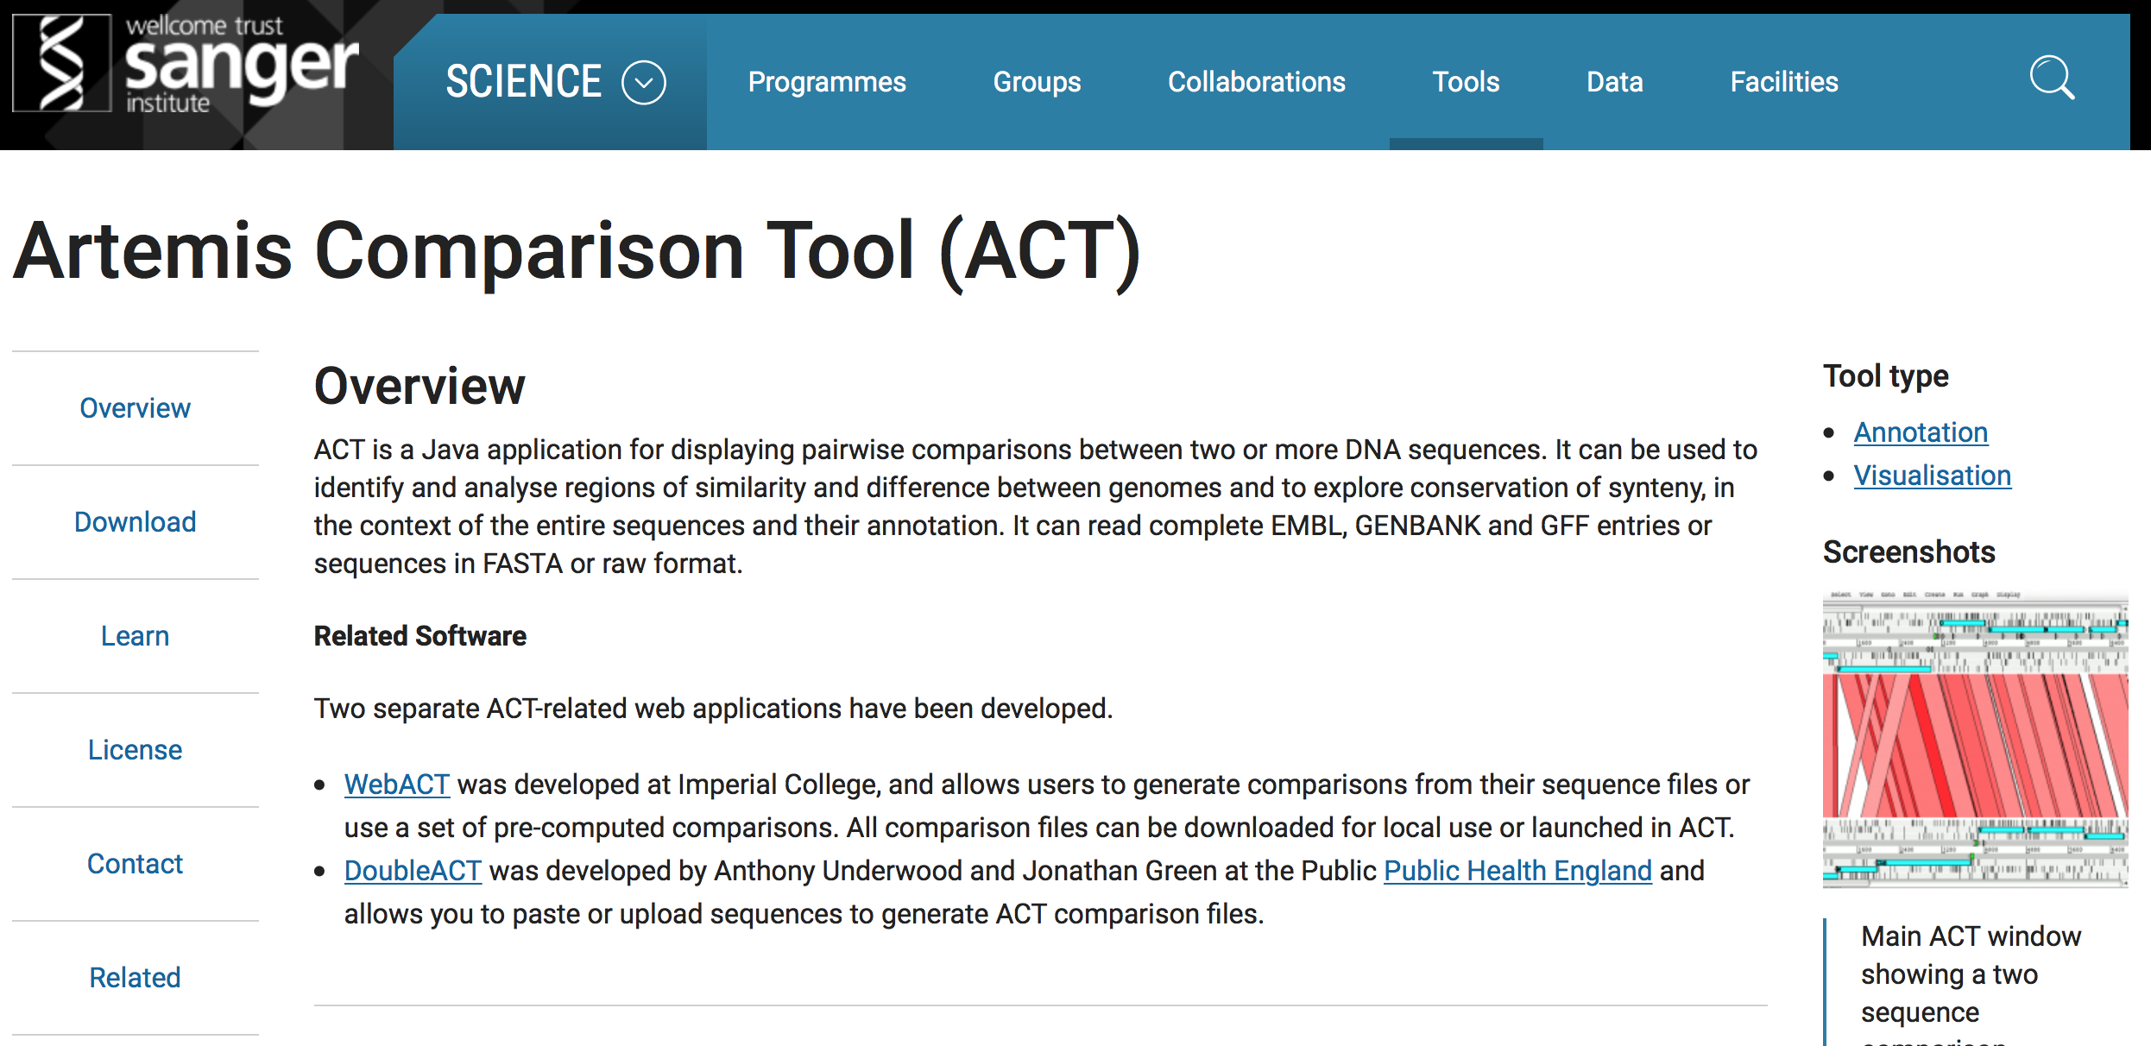
Where to find ACT?
Freely available (unix, mac, win)
- WEB: http://www.sanger.ac.uk/science/tools/artemis-comparison-tool-act
MANUAL: ftp://ftp.sanger.ac.uk/pub/resources/software/act/act.pdf
PAPER: Carver et al. (2005) Bioinformatics. 21;16;3422-3

Slide 10
What do you need to run ACT?
The program
Local install (currently on your VM desktop) or on the web (as described in your manual)
Two or more files containing sequence information
Format: Fasta, EMBL, Genbank
Output from a comparative analysis of those sequence files
Format: BLAST, mummer, VCF
Optional: Additional metadata
Format: GFF, EMBL

Slide 11
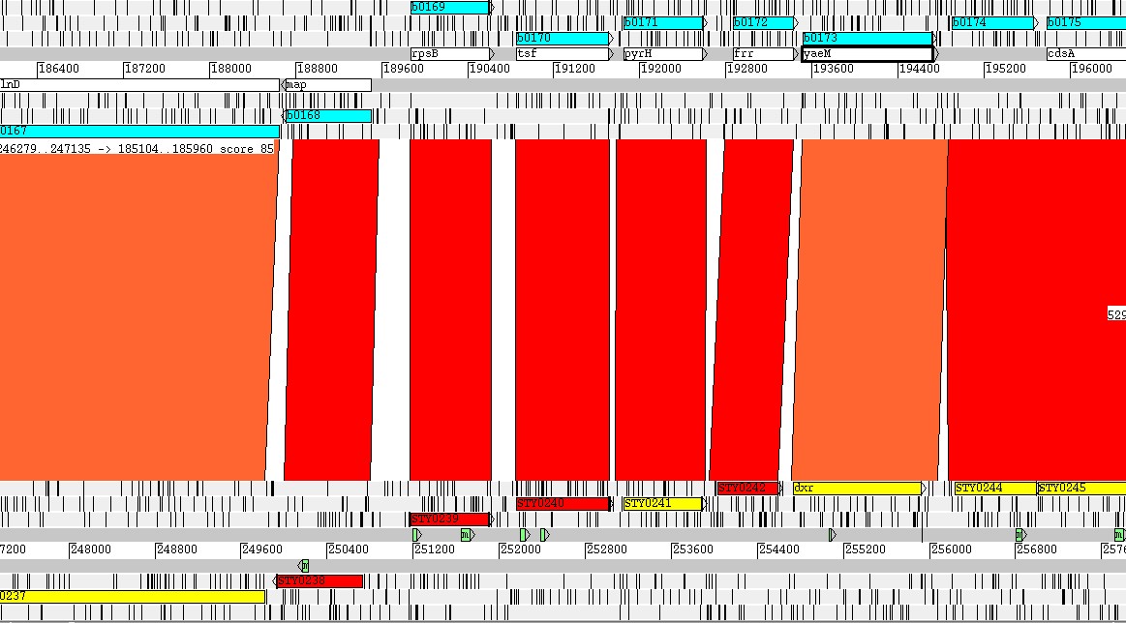
Basic setup of an ACT session
Stop codons
Sequence 1
bp
Sequence 2
6 Reading Frames
Coding sequences
Regions of homology

Slide 12
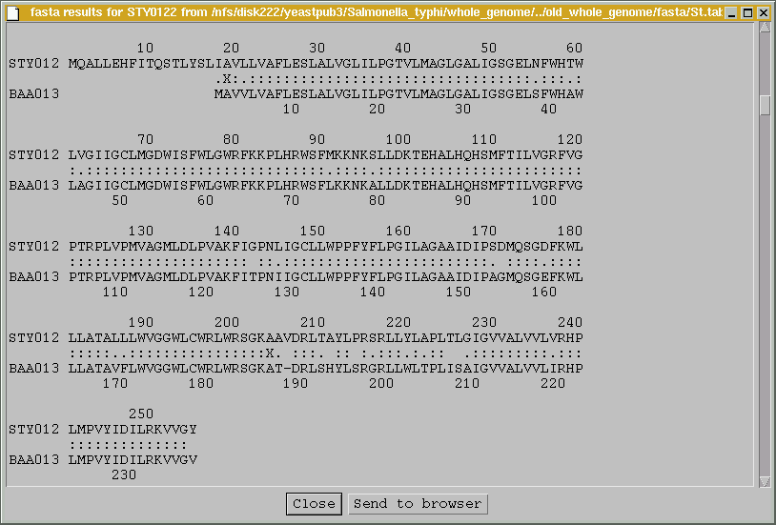
Visualising sequence similarity
MQALL…
…RHP
Region sharing similarity
(BLASTP)
MAVV…
…RHP

Slide 13
Visualising genome rearrangements
Genome 1
Blast output
Region of homology in:
Same orientation
Reverse orientation
Genome 2
Same genes present in the same orientation

Slide 14
Visualising genome rearrangements
Genome 1
Blast output
Region of homology in:
Same orientation
Reverse orientation
Genome 2
The same genes are present but the blue genes have undergone a rearrangement

Slide 15
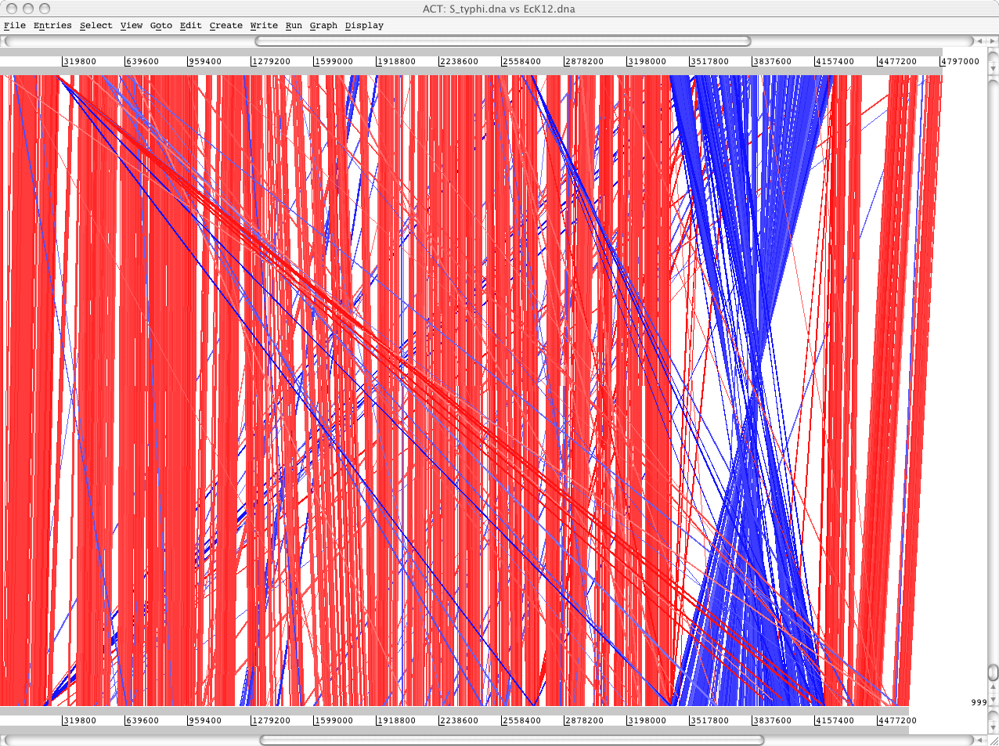
Visualising genome rearrangements
S. typhi
BLASTN
DNA-DNA
matches
E. coli

Slide 16
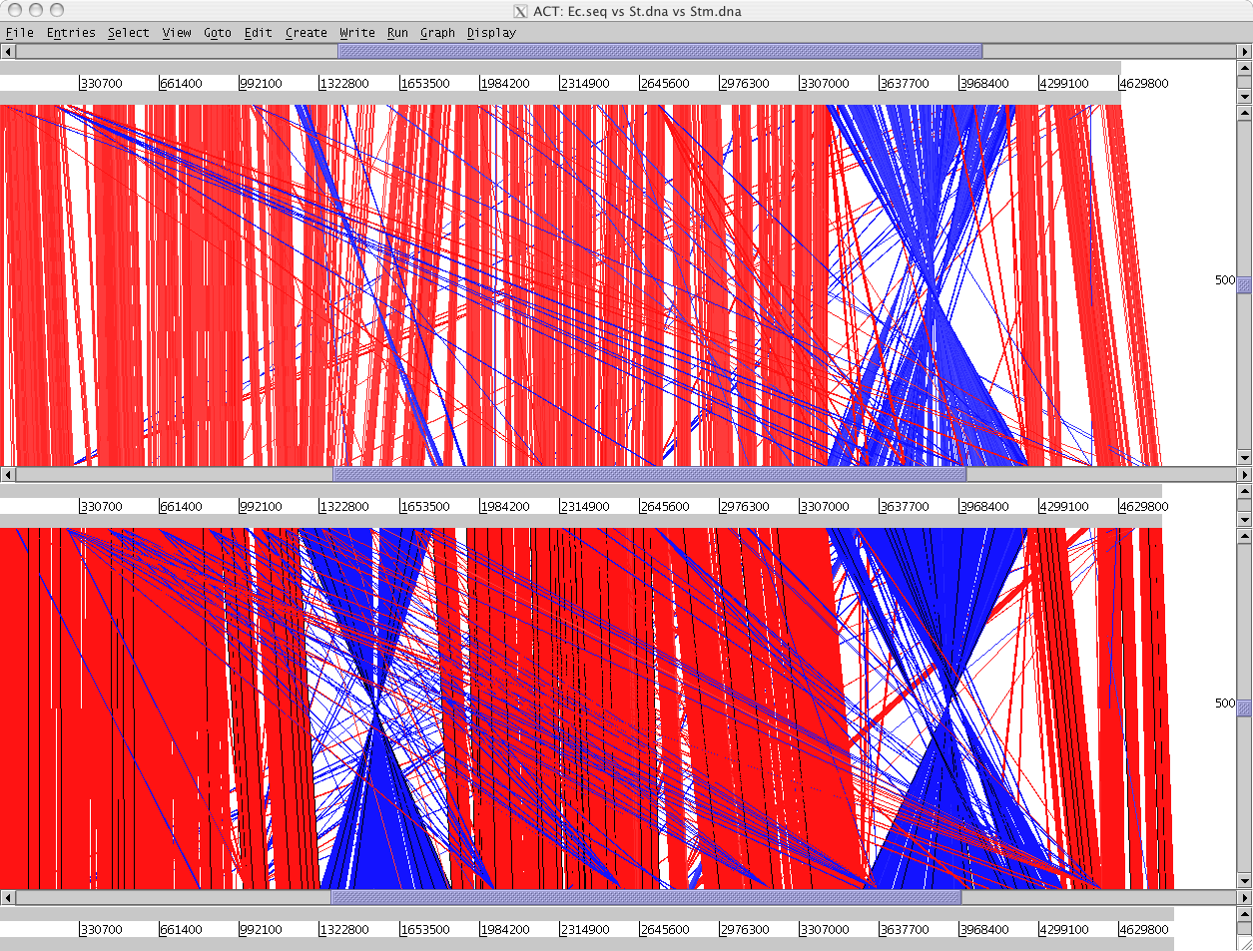
Visualising genome rearrangements
E. coli
S. typhi
S. typhimurium

Slide 17
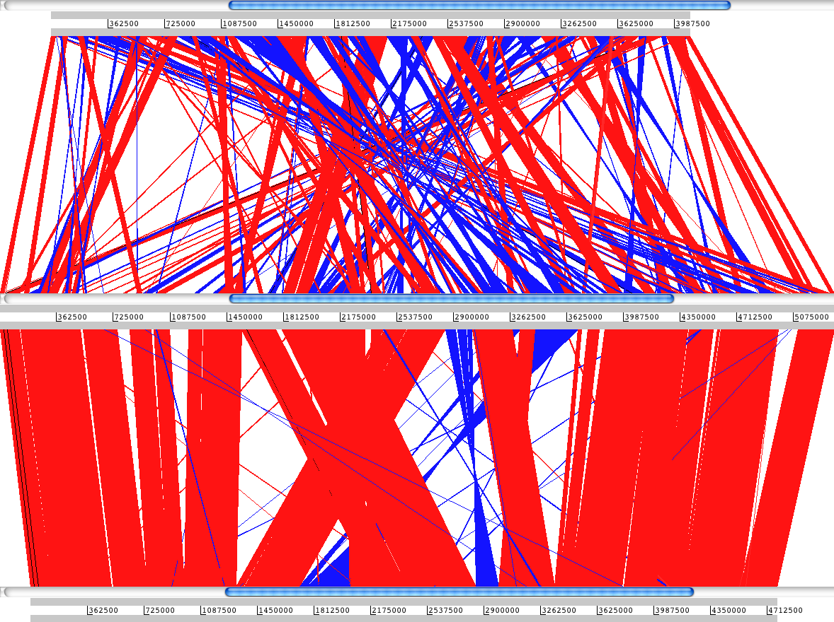
Visualising genome rearrangements: Bordetella spp.
Bordetella pertussis
B. bronchiseptica
B. parapertussis

Slide 18
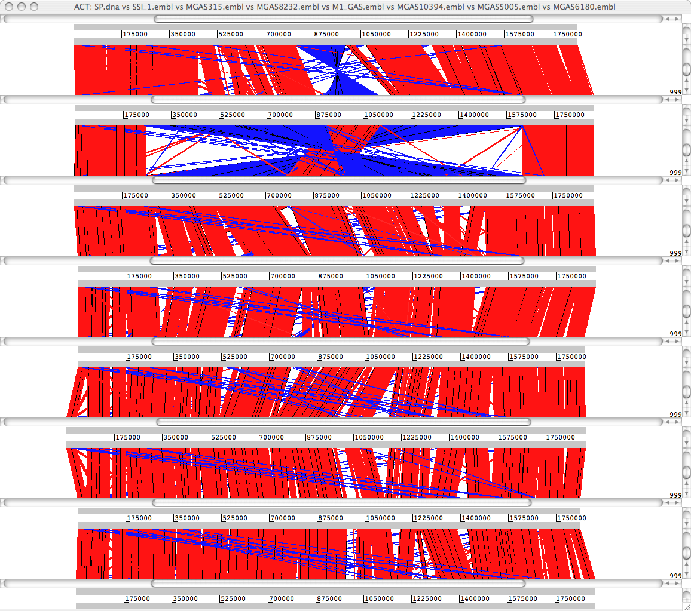
Comparison of strain diversity: Streptococcus pyogenes
Manfredo
SS_1
MGAS315
MGAS8232
M_1
MGAS10394
MGAS5005
MGAS6180

Slide 19
Comparison of genic diversity
Gene gain and/or loss
Duplication, horizontal gene transfer, indels
Gene function modification
Loss of function (pseudogenes, gene fission)
Gain of function (gene fusion)
Mutation accumulation (SNPs)

Slide 20
Visualising gene gain or loss
Genome 1
Genome 2
Example of an insertion or deletion

Slide 21
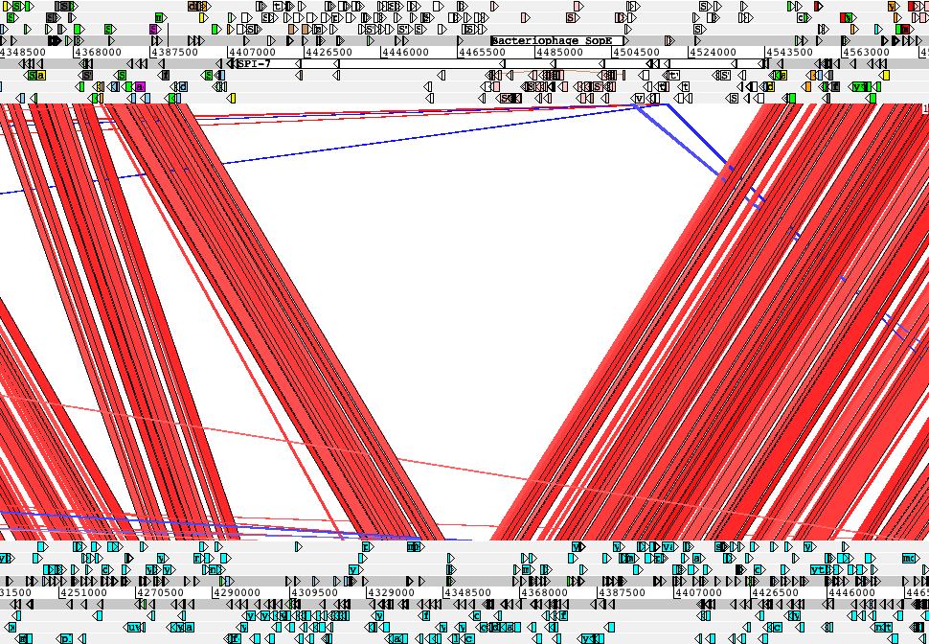
Visualising gene gain or loss
tRNA-Phe
type IV pilus
sopE
Vi antigen
S. typhi
E. coli

Slide 22
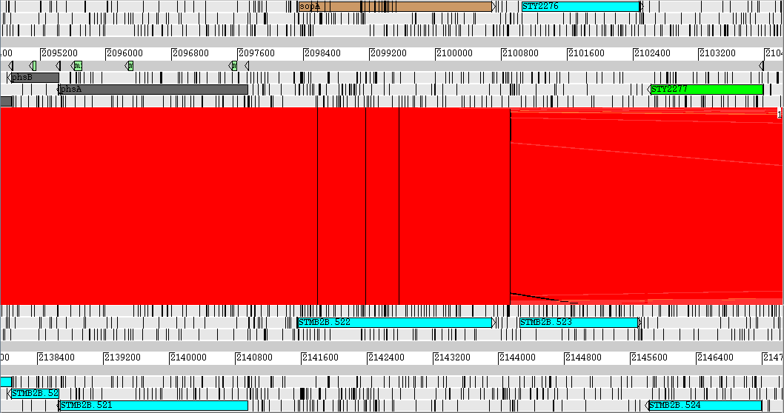
Loss of function: pseudogenes
secreted effector protein (type-III)

Slide 23
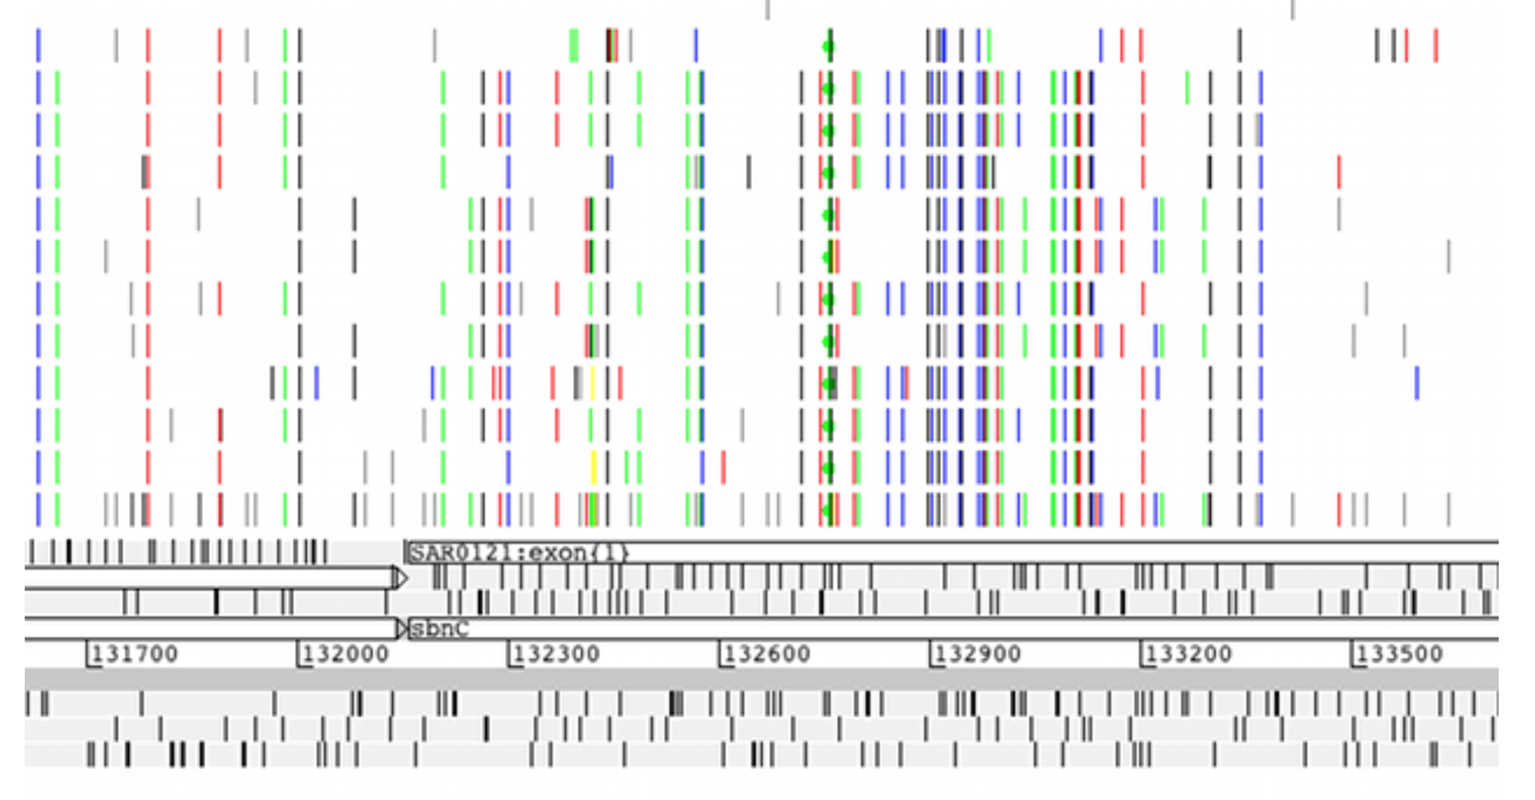
Genetic variation among populations
VCF input: row represents an individual, line represents a SNP

Slide 24
Aims of this module
Demonstrate some of the the basic functions of ACT
Enable you to perform basic comparative analyses

