Slide 1
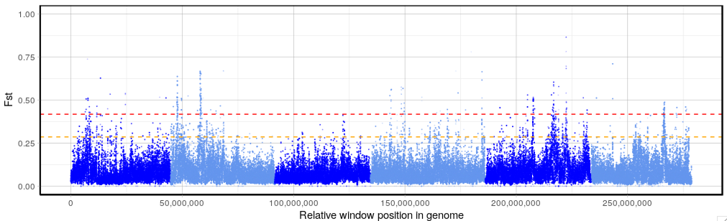
XQTL_Figure 1
- UGA vs ISE parents

Slide 2
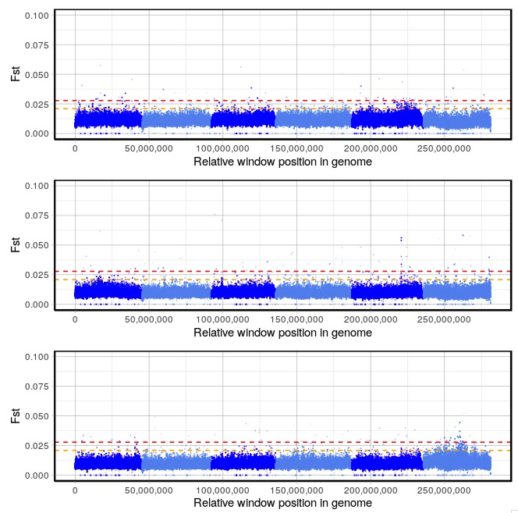
XQTL_control

Slide 3
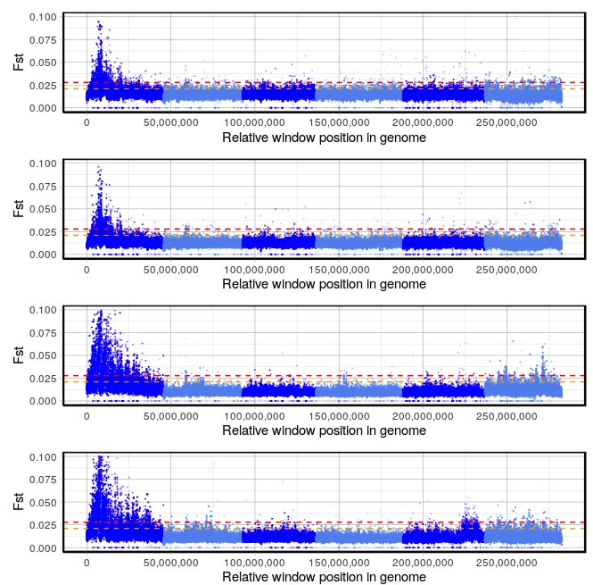
XQTL_BZ

Slide 4
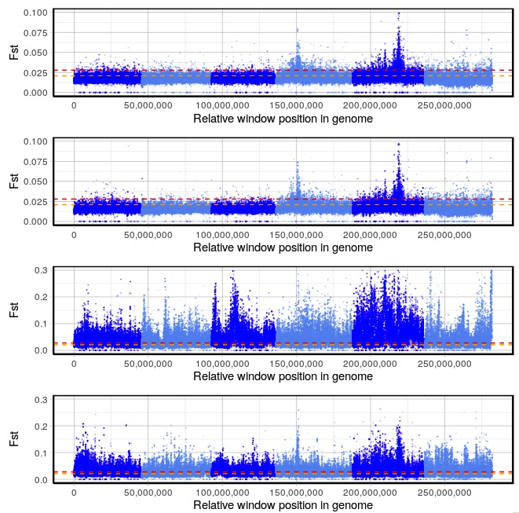
XQTL_LEV

Slide 5
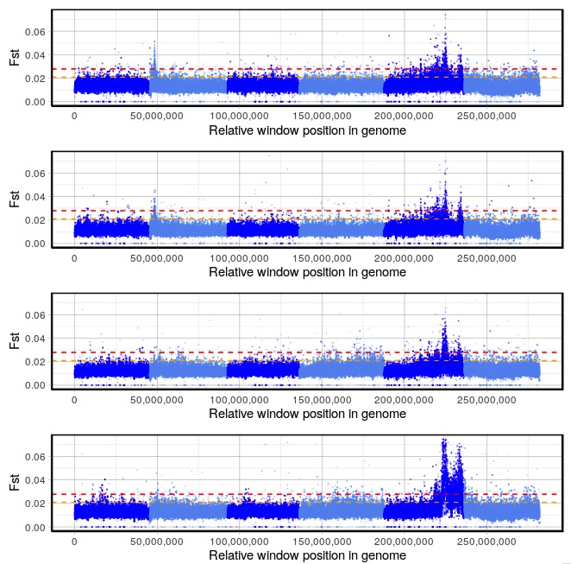
XQTL_IVM

Slide 6
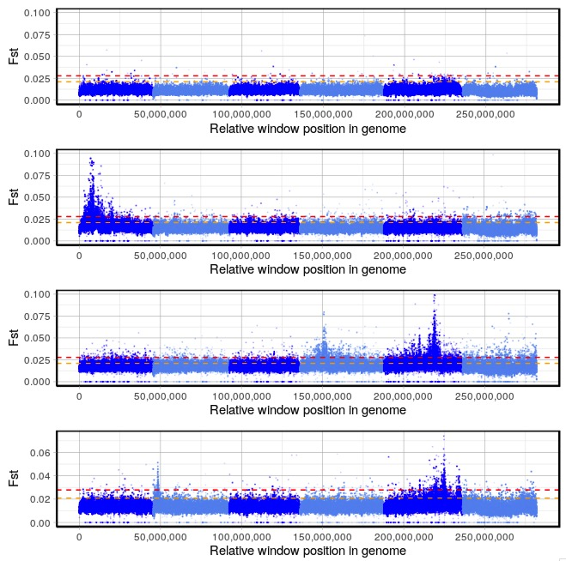
XQTL_Figure 2

