Slide 1
UNIVERSITY OF RHODE ISLAND · SODHI LAB × JEONG LAB
Programmable Characterisation of
3D-Printed Wind Turbine Blades
Automated load sweeps in the Aerolab wind tunnel
Stephen Acuello
seacuello@uri.edu · 26 August 2026
Notes:
Setup pair = slides 2-3. Results pair = slides 4-5. Slides 6-7 are optional; 6 is the ask.

Slide 2
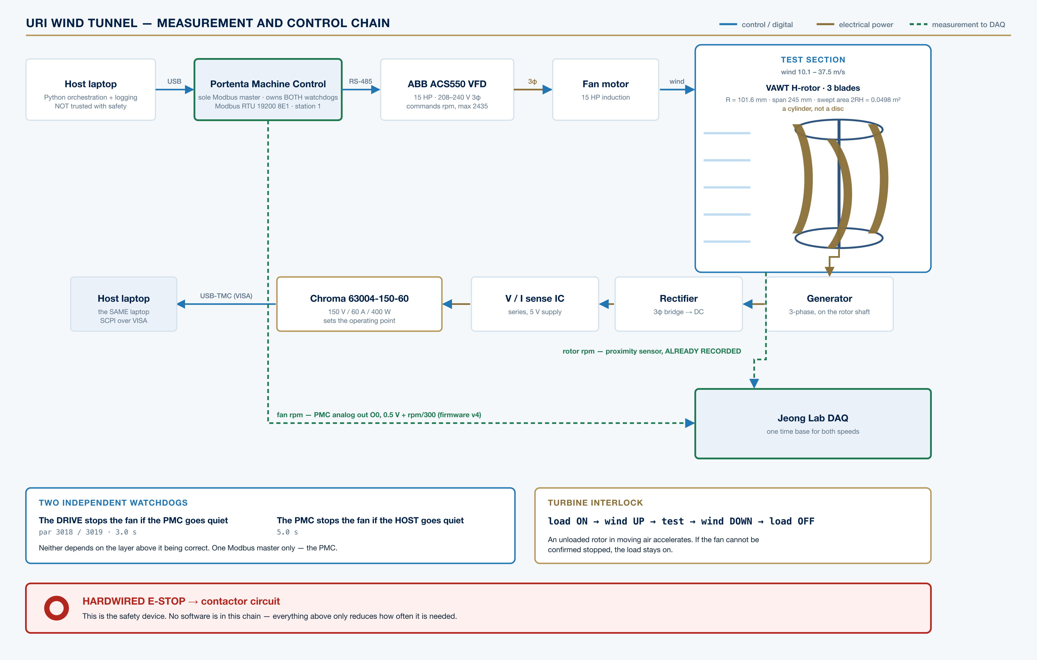
SLIDE 1 OF 2 · EXPERIMENTAL SETUP
The Rig
CONTROL CHAIN
Drive — ABB ACS550-U1-046A-2, 15 HP, 208–240 V 3φ. Commands speed in rpm; full scale 2435
Path — Python → USB → Portenta Machine Control → RS-485 Modbus → drive
Load — Chroma 63004-150-60 — sets the rotor's operating point and measures it
Wind — 500–1800 rpm fan = 10.1–37.5 m/s, v = 0.02132·rpm − 0.424 (R² = 0.9996)
Bandwidth — τ = 0.63 ± 0.12 s, from five 1-cosine gusts
ROTOR UNDER TEST
Vertical-axis H-rotor, 3 blades, R = 101.6 mm, span 245 mm. Swept area 2RH = 0.0498 m² — a cylinder, not a disc.
Blade: thin cambered plate — 1.79 mm wall, t/c 4%, 42% camber, 183° turning. Not an airfoil.
Full measurement and control chain
Notes:
Swept area is 2RH because it is a VAWT. Using pi*R^2 overstates Cp by 1.54x. The blade is a cambered plate, NOT an airfoil - it matters for any polar or XFOIL cross-check.

Slide 3
SLIDE 2 OF 2 · EXPERIMENTAL SETUP
Safety Architecture
The hardwired E-stop is the safety device.
No software is in that chain. Everything below reduces how often it is needed — none of it replaces it.
TWO INDEPENDENT WATCHDOGS
• The drive stops the fan if the PMC goes quiet — par 3018/3019, 3.0 s
• The PMC stops the fan if the host goes quiet — 5.0 s
• Neither depends on the layer above it being correct
ONE MODBUS MASTER ONLY
• The PMC is the master. Modbus RTU permits exactly one
• A direct host-to-drive cable must never be landed as well
• Two devices commanding a 15 HP fan, neither aware of the other, is the failure this prevents
TURBINE INTERLOCK
load ON → wind UP → test → wind DOWN → load OFF
• An unloaded rotor in moving air accelerates until something mechanical stops it
• Enforced on every path that can move the fan
• If the fan cannot be confirmed stopped, the load stays on
Each layer is watched by the layer below it — so a host that is wrong, hung or unplugged cannot run the fan away.
Notes:
The two watchdogs are the slide's point: each layer is watched by the layer BELOW it, so the host being wrong cannot run the fan away.

Slide 4
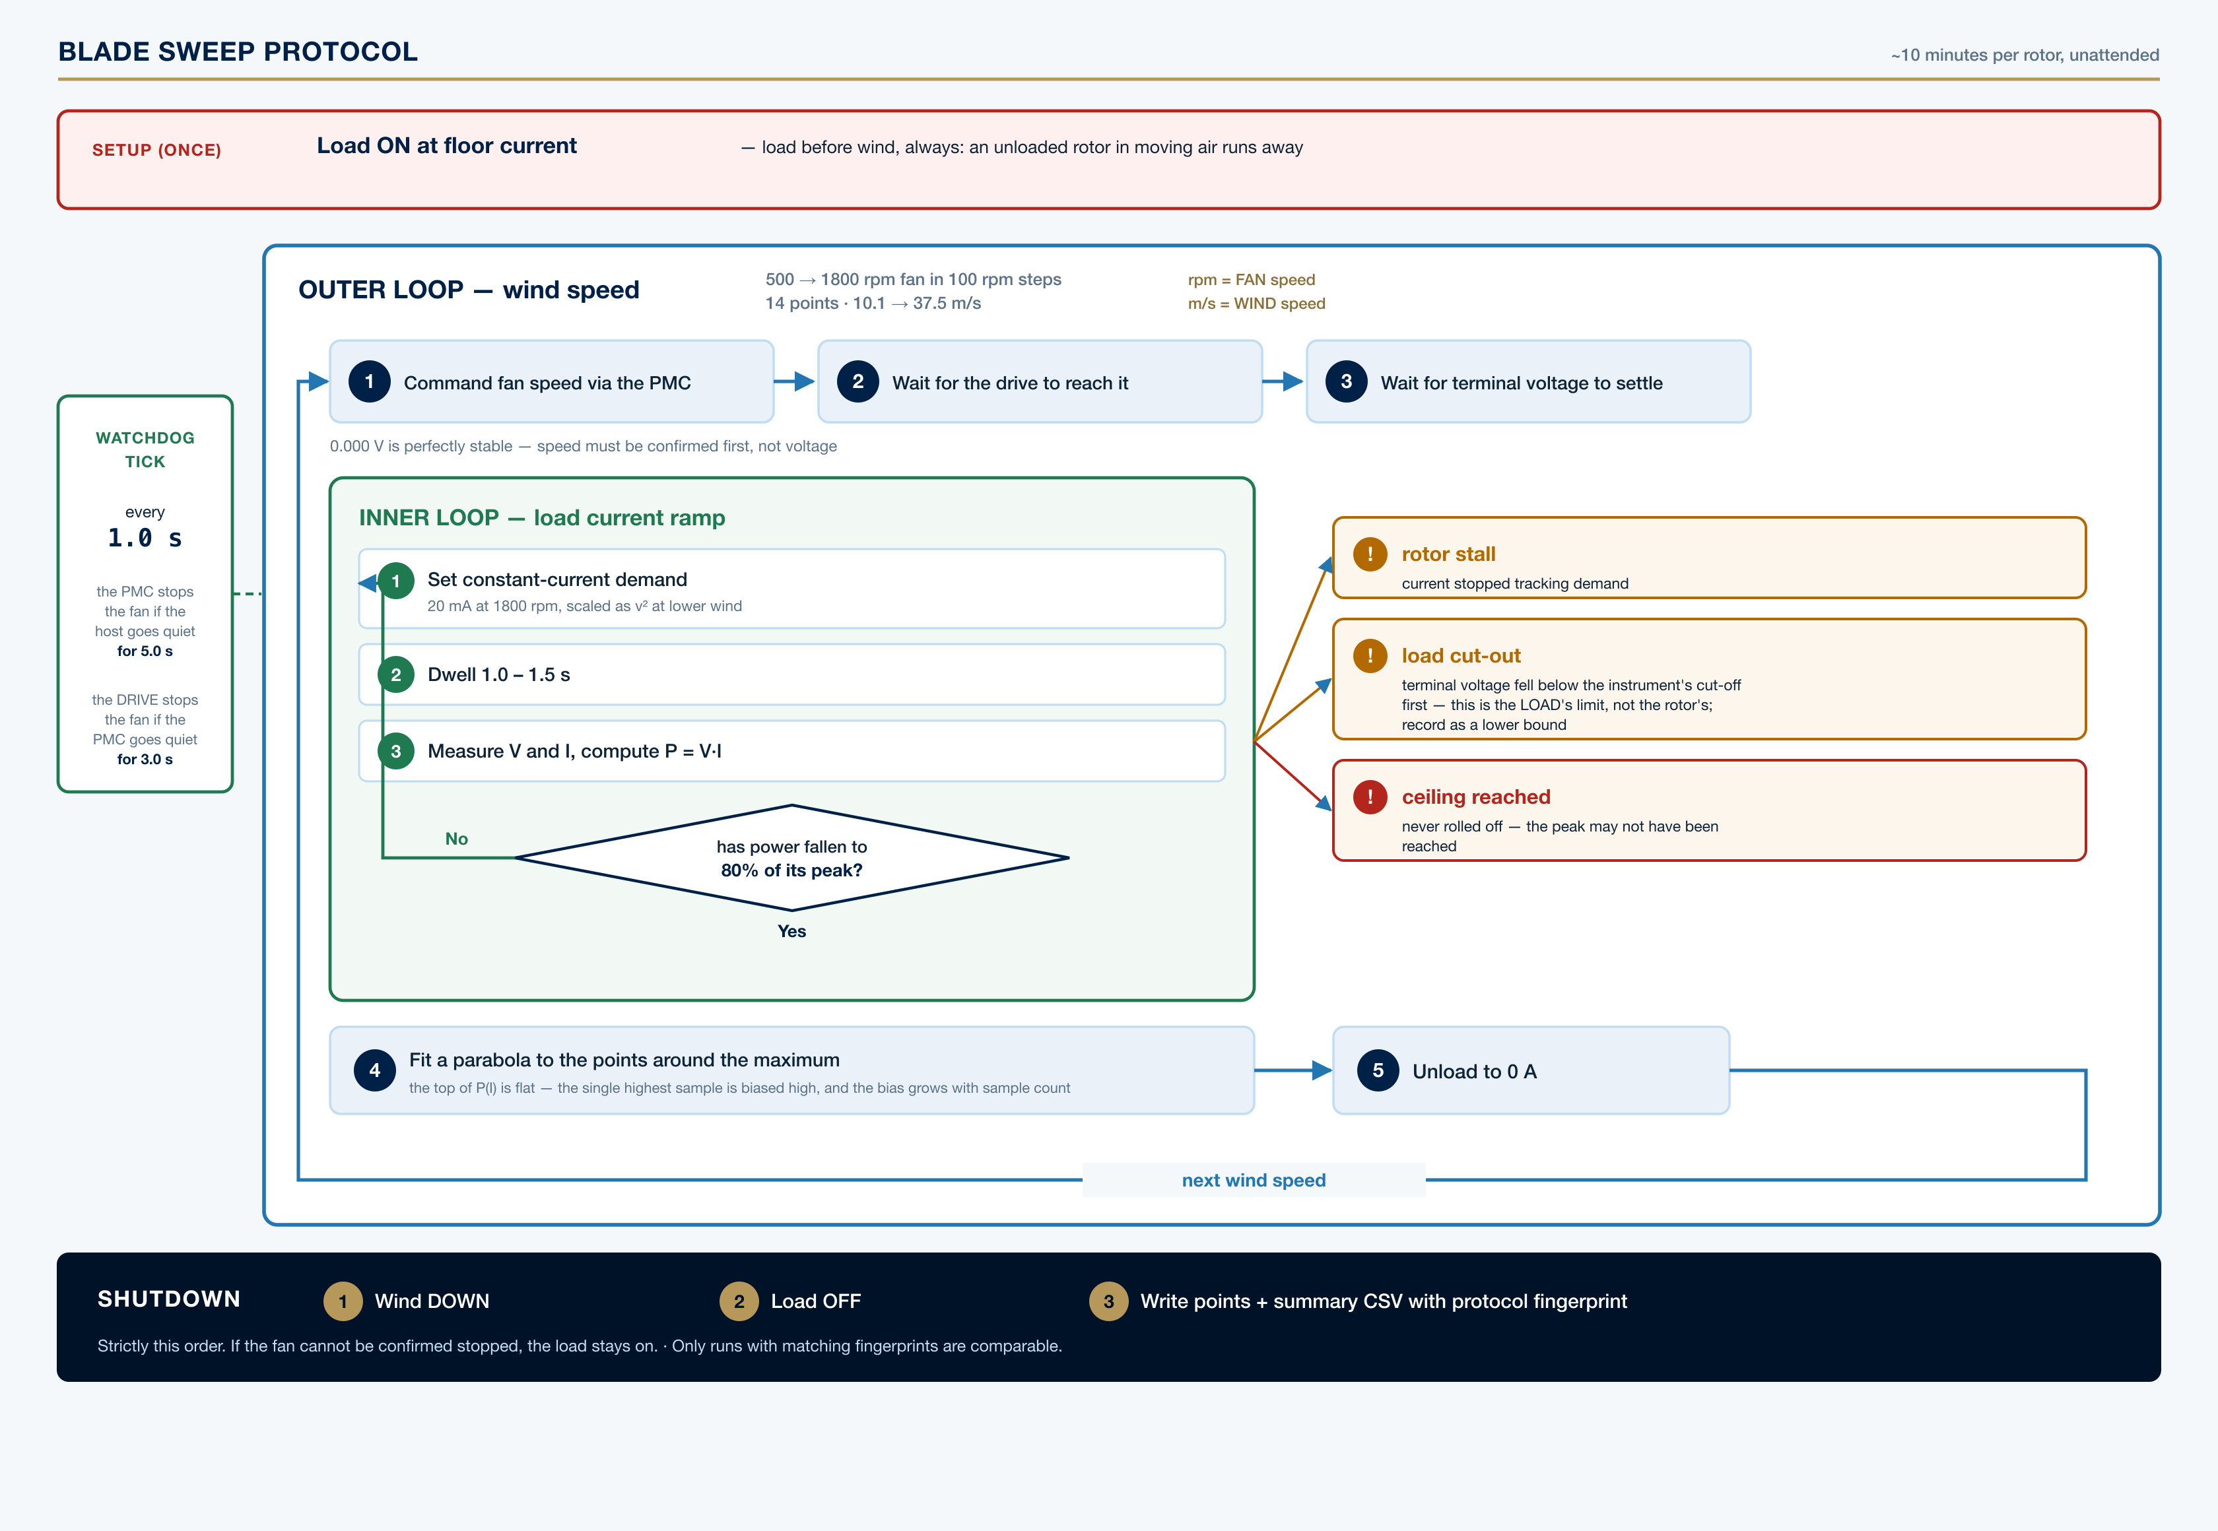
SLIDE 1 OF 2 · RESULTS
Method
Automated blade characterisation — ~10 minutes per rotor, unattended, 14 wind speeds
AT EACH WIND SPEED
• Ramp the electronic load in constant-current steps
• Stop once electrical power falls to 80% of its peak — the rotor is never driven to stall
• Record V and I at every step, unload, advance the wind
WHY A PARABOLIC FIT
The top of P(I) is flat. The largest single sample is biased high, and the bias grows with sample count — so blades with different point counts would be compared unfairly.
PROTOCOL FINGERPRINT
Every run carries one. Runs measured under different settings are not comparable — the fingerprint makes that visible instead of silent.
Outer loop = wind speed; inner loop = load current
Notes:
The fingerprint is the campaign's integrity mechanism. Across a dozen rotors it is very easy to change a setting by accident and impossible to spot afterwards - the numbers stay plausible.

Slide 5
SLIDE 2 OF 2 · RESULTS
Blade v1, Ra 20 µm
fan rpm cmd | measured | m/s | P_max | at
500 | 496 | 10.1 | 0.030 W | 0.018 A
900 | 894 | 18.6 | 0.273 W | 0.068 A
1400 | 1384 | 29.1 | 1.665 W | 0.240 A
1800 | 1779 | 37.5 | 3.793 W | 0.320 A
WHAT IT DOES NOT YET SHOW
This is electrical power at the terminals — not Cp.
That exponent describes the GENERATOR, not the blade:
V_oc ∝ v^1.50 R_int ∝ v^-0.79
R_int falls 88 → 36 Ω across the range
peaks at the Thévenin match, P = V_oc²/4R_int
n = 2a − b = 3.79 vs 3.77 measured
→ Almost nothing is left for the blade to move. Without rotor speed, comparing blades partly means comparing the generator.
Efficiency is Cp = 0.10–0.24%, about 100× below a working turbine — the rotor spins far too fast for its own good, held there by the generator.
Wind speed is derived from MEASURED fan rpm, not commanded — the drive settles 4–13 rpm below setpoint.
WHAT IS SOLID
• 14 / 14 points clean, single continuous run
• P ∝ v^3.77, R² = 0.998 across 10.1–37.5 m/s
• Independent repeats at 1200 and 1800 rpm match to 0.3% / 0.2%
The measurement is sound. Its interpretation needs rotor speed — which is the next slide.
Notes:
Do NOT present v^3.77 as 'Cp still climbing with Reynolds'. A 9-agent audit on 25 Aug showed the exponent is a generator characteristic. Fitted from the CSV by src/generator_model.py: V_oc ~ v^1.50, R_int ~ v^-0.79, n = 2a-b = 3.79 vs 3.77 measured. The honest version is stronger and it is the argument for slide 6.

Slide 6
OPTIONAL · THE NEXT MEASUREMENT
One Channel Unlocks Cp(λ)
The rotor-speed measurement already exists in the Jeong lab DAQ.
A proximity sensor on the rig already records it. What is needed is its channel number and pulses-per-revolution — not new hardware.
WHY IT MATTERS MORE THAN ANY BLADE RUN
• Without rotor speed there is no λ and no Cp — the rig cannot tell blade aerodynamics from generator matching.
• A better blade can measure as LESS power. A blade that grabs more energy spins slower, and slower means less voltage, so the meter reads lower.
• Two rotors five times apart in efficiency would rank purely by how freely they spin.
THE PAYOFF IS RETROACTIVE
Every sweep_*_points.csv already holds a full load ramp at all 14 wind speeds. Adding one rotor-speed channel converts the entire existing archive into a Cq(λ) traverse — without another minute of tunnel time.
ALSO USEFUL, AND ALREADY BUILT
Fan rpm now leaves the PMC as a 0–10 V analog signal for the DAQ (0.5 V + rpm/300), so fan speed and rotor speed share one time base. 0.000 V is a live zero meaning INVALID, not zero rpm.
The ask is two numbers: which DAQ channel, and how many pulses per revolution.
Notes:
This is the ask, aimed at the person who owns the DAQ. Keep it concrete: channel number and pulses-per-rev, that is all.

Slide 7
OPTIONAL · STATED PLAINLY
Known Limitations
Every one of these was found by adversarial review of our own results, and each is recorded in the repository.
Not Cp
Electrical power only. Cp(λ) needs the rotor-speed channel; every blade tested before that lands must be re-run to obtain λ.
The blade is not an airfoil
1.79 mm wall, t/c 4%, 42% camber, square-cut edges. Separation is pinned by geometry, so XFOIL and polar cross-checks answer a different question.
Reynolds range
Re_chord = 32,376 → 119,735. Below Reynolds-independence for a cross-flow turbine (~2×10⁵), so absolute performance is not transferable to full scale.
Source impedance not separated
R_int is fitted at r² ≥ 0.986, but it is the WHOLE source — winding, rectifier, wiring and sense IC together. Ohm the winding phase-to-phase to separate them.
Wind speed disagreement
Summary and points files differ by 1.1–1.2% at the same fan set point. At v^3.77 that is 4.5% in power. Unresolved — flagged, not averaged away.
Single-mount data
Every result so far comes from one mounting of one rotor. There is no mount-to-mount error bar yet; the ABBA protocol for the next session produces the first one.
Notes:
Optional slide. For an academic audience this is the most credible thing in the deck - it shows the limits are known and quantified rather than unexamined.

