Slide 1


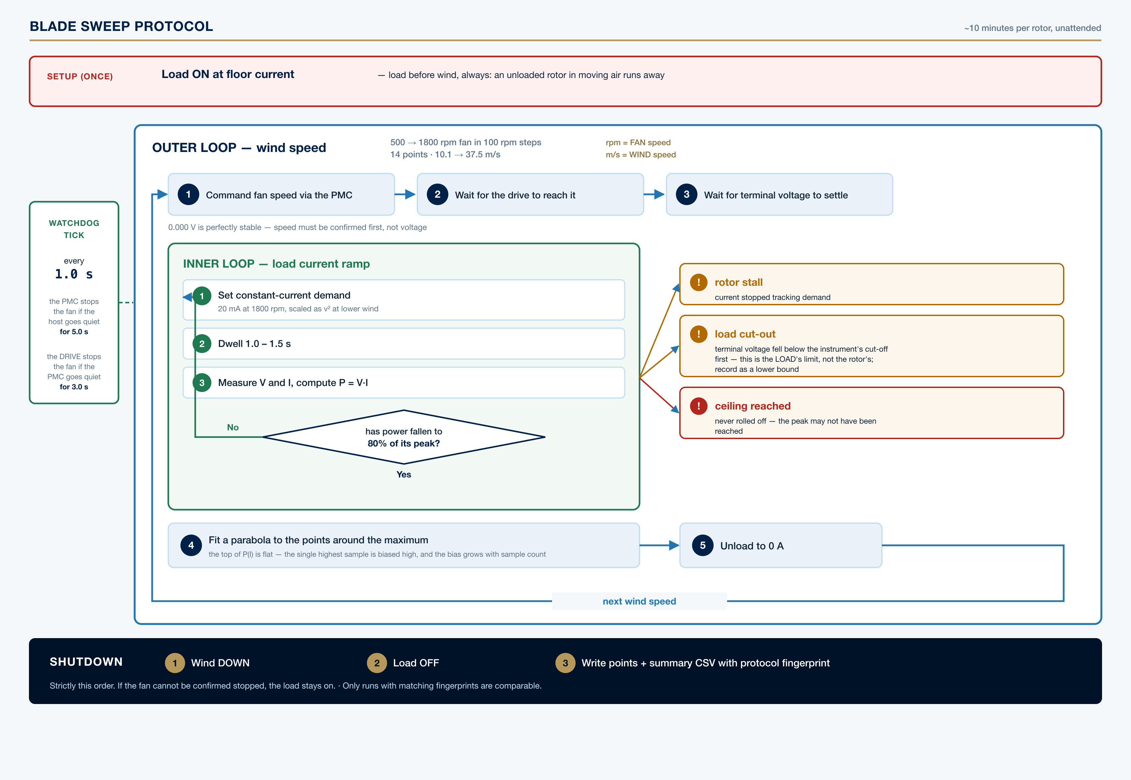
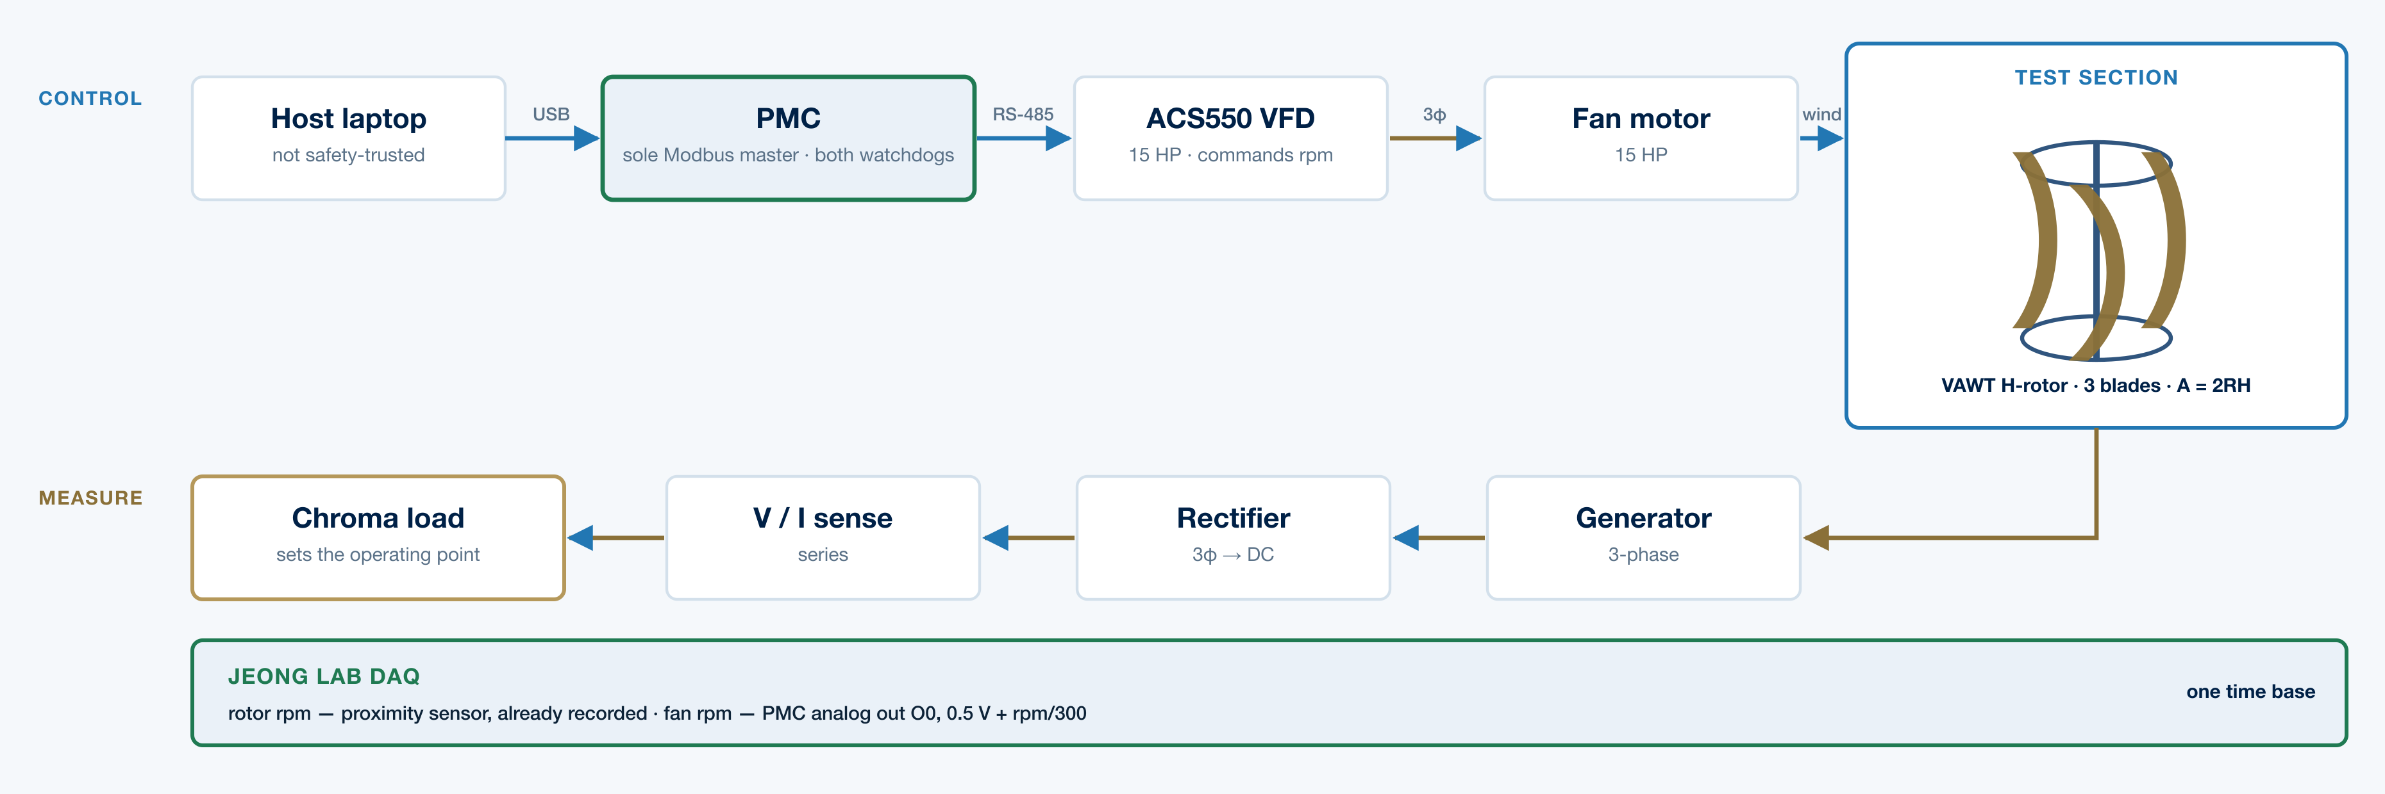

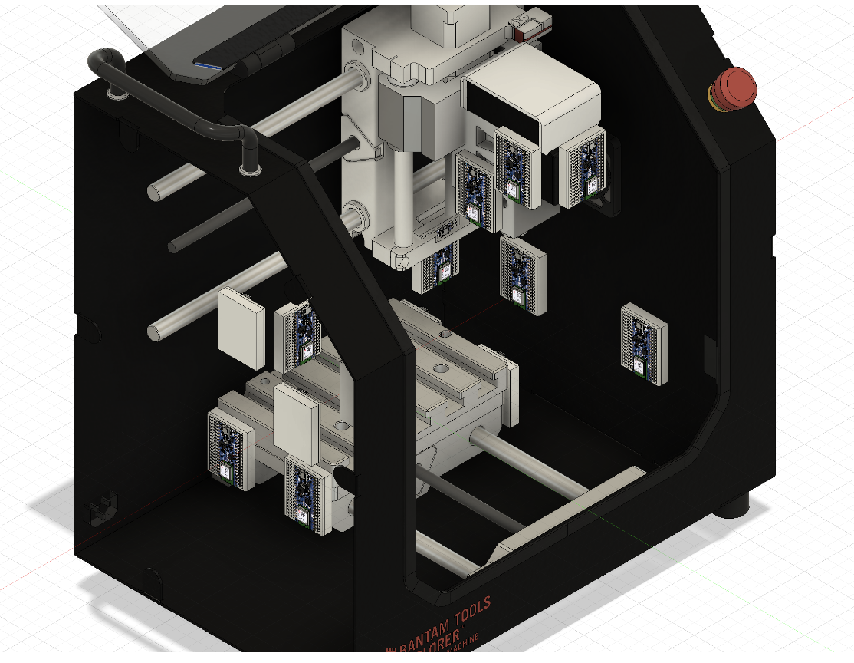
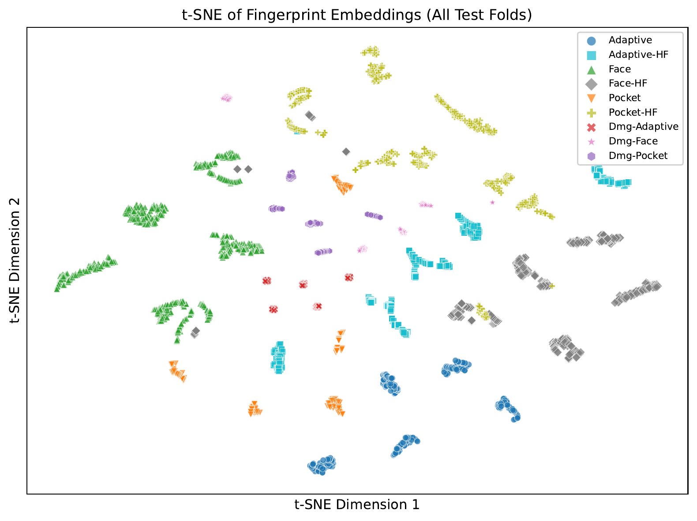
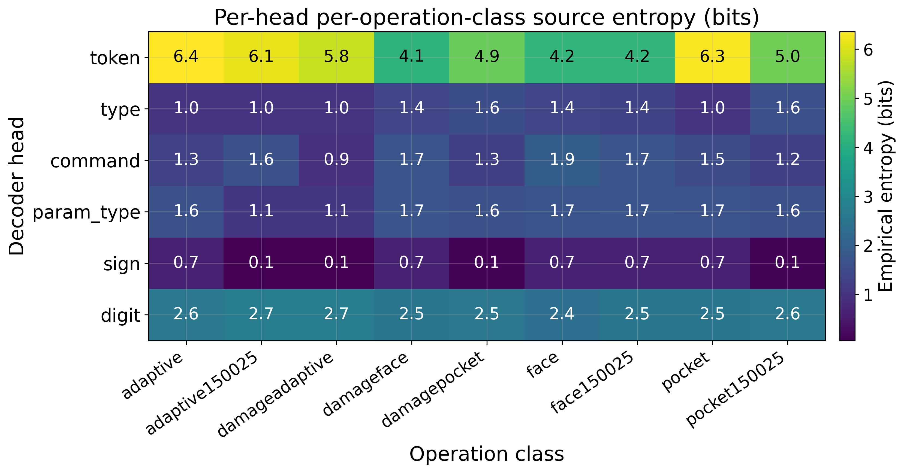
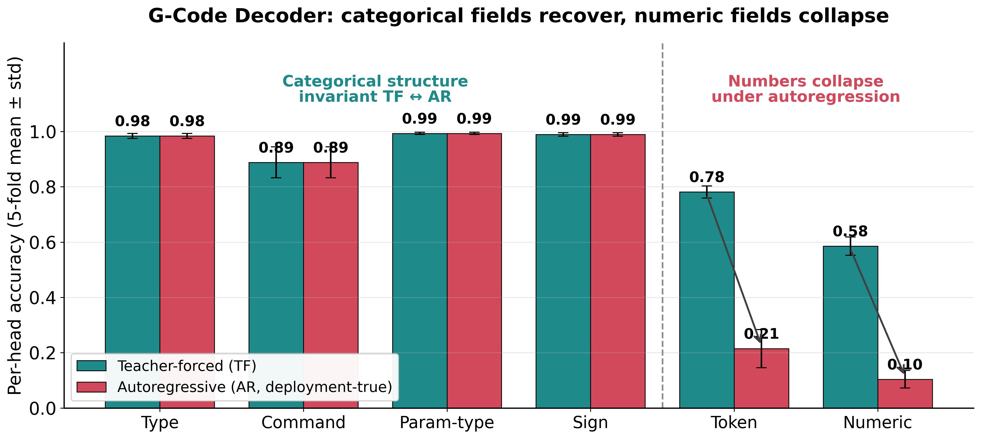
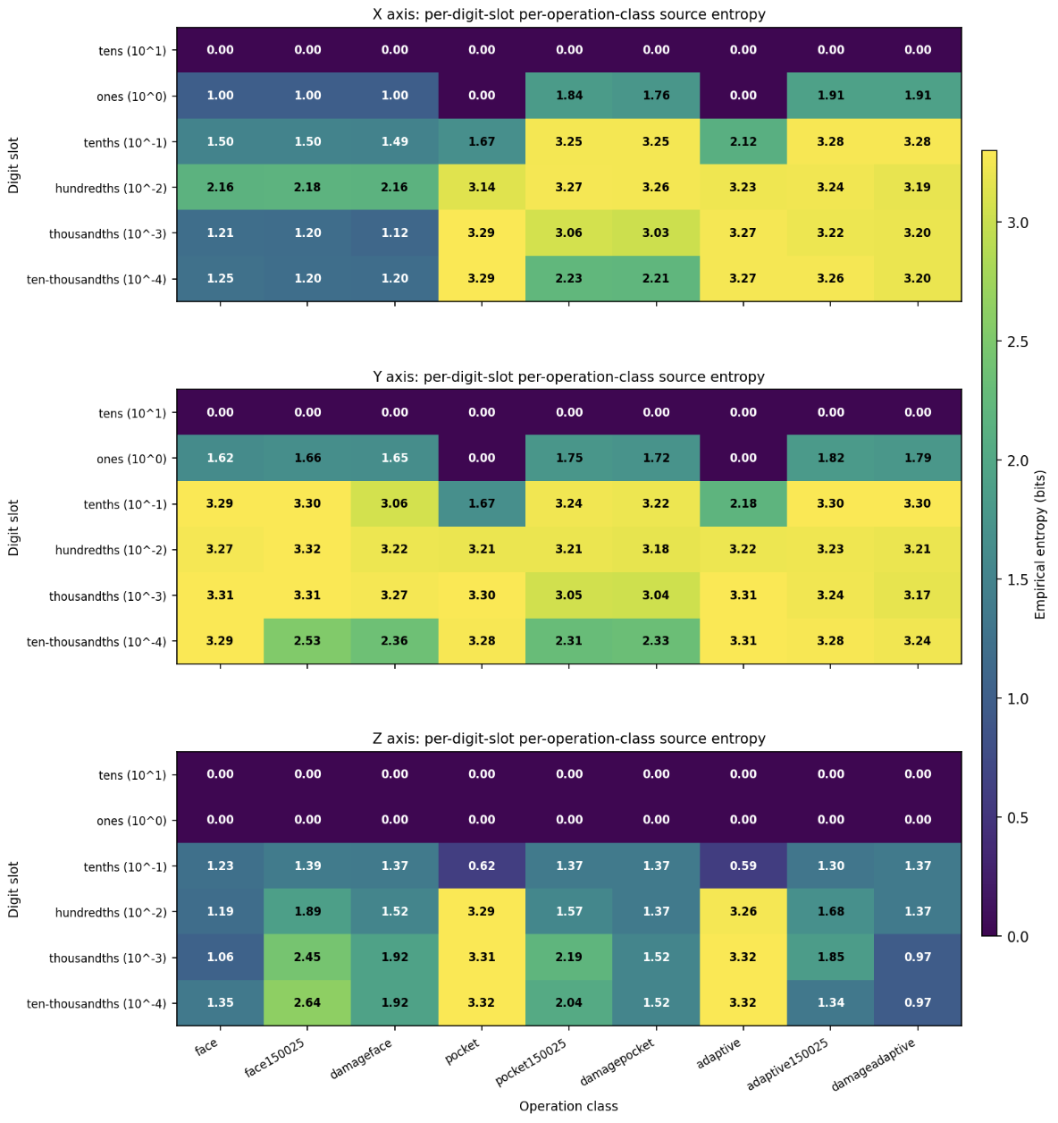
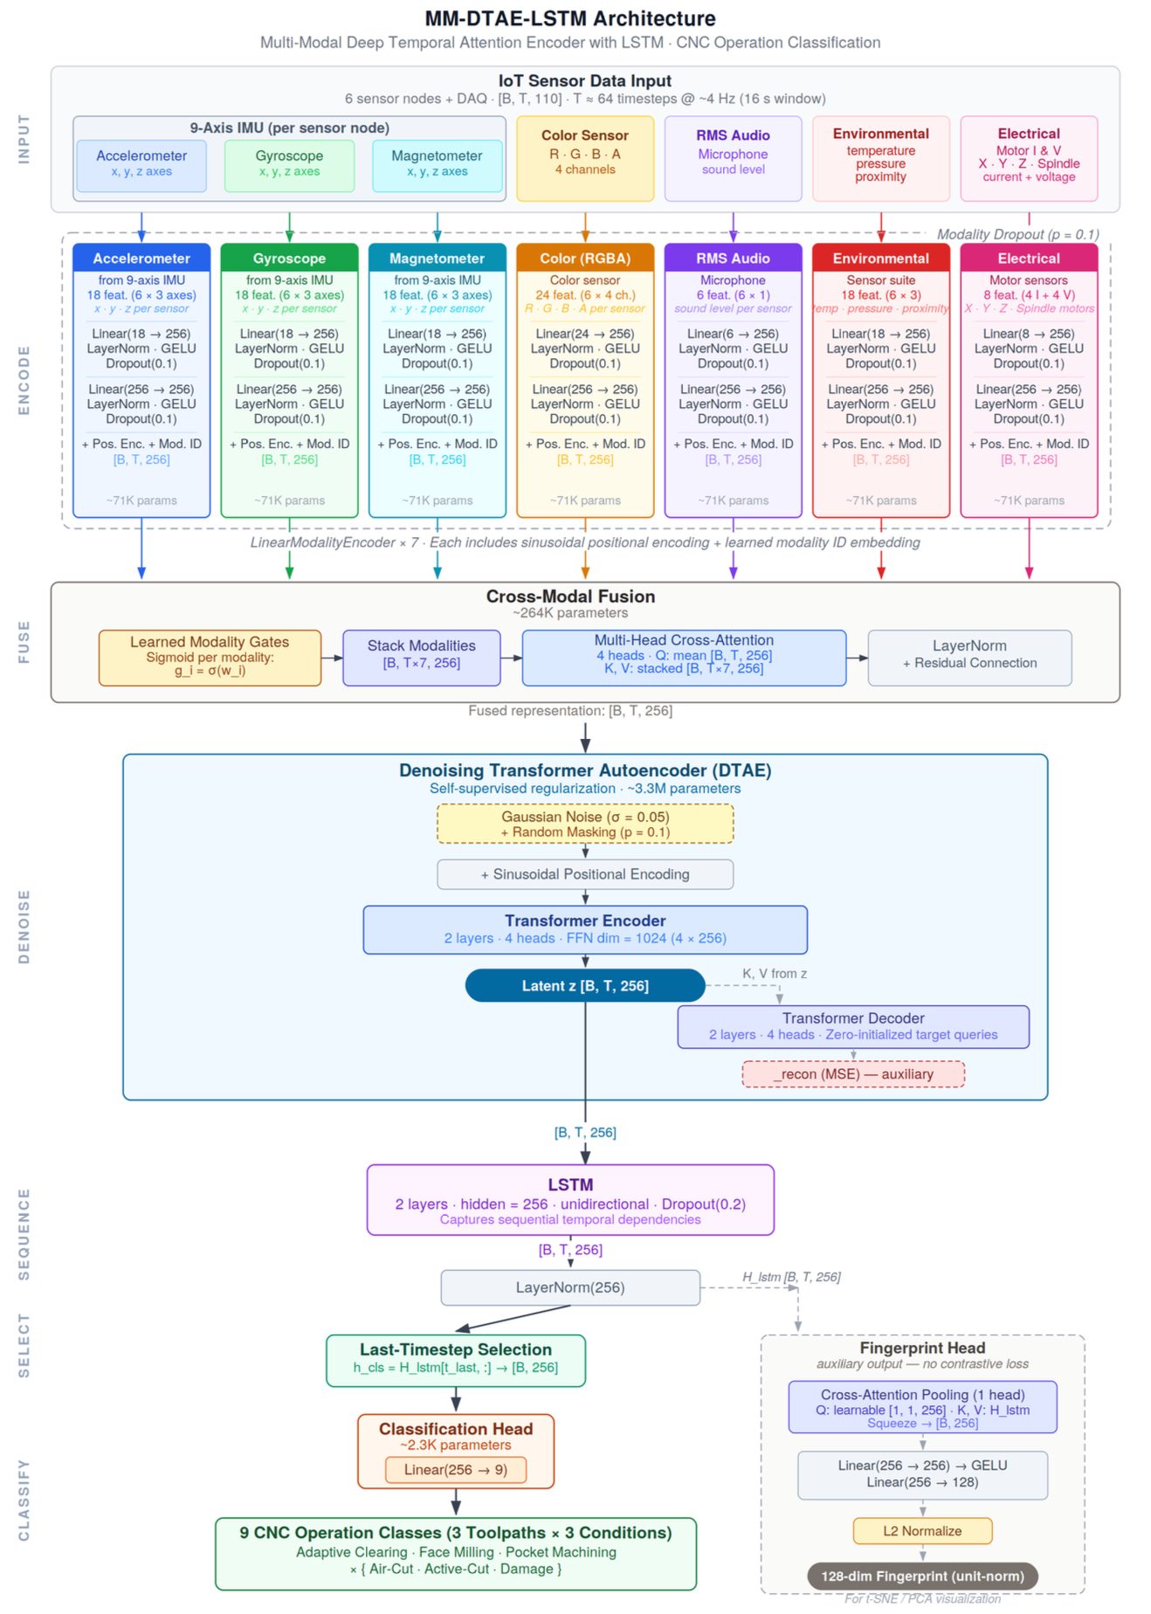
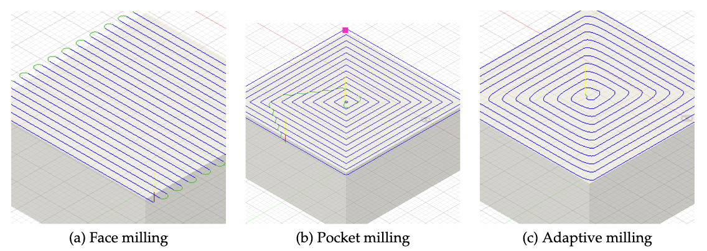
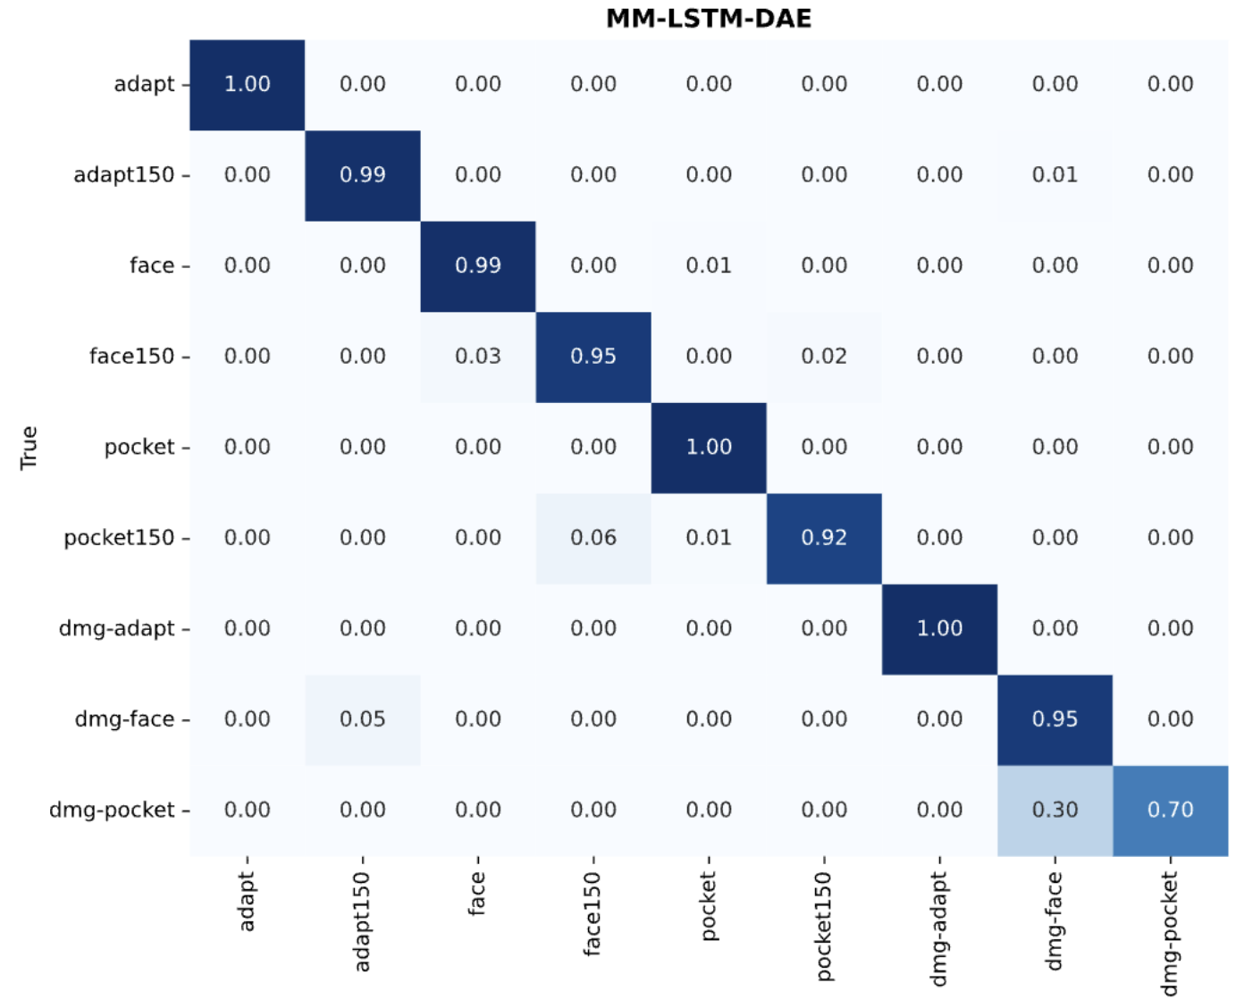
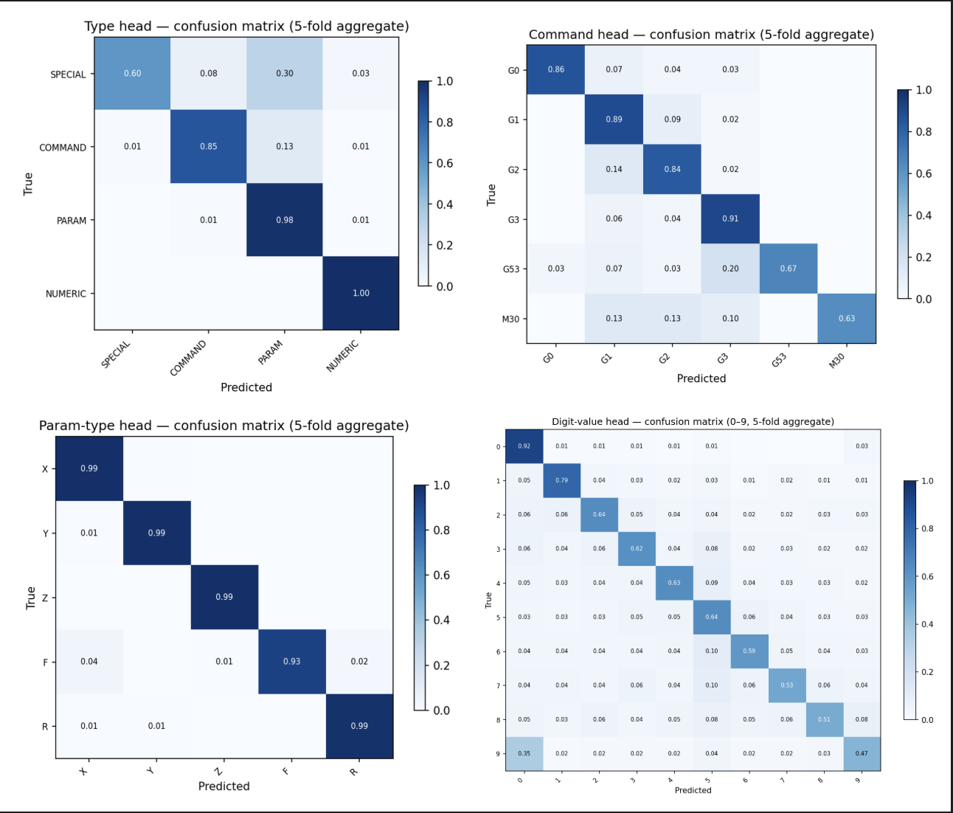

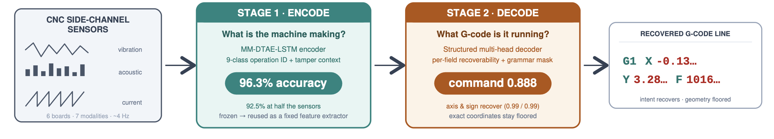
Programmable Characterisation of
3D-Printed Wind Turbine Blades
Stephen S. Eacuello, ISE Ph.D. Candidate
Department of Mechanical, Industrial and Systems Engineering
Introduction
Project Details
Results
3D printing makes new blade shapes cheap.
Measuring whether a shape is actually better does not.
Compare a dozen blades over a few weeks and the method drifts. You end up comparing settings, not blades.
So we automated it: one rotor, 10 minutes, unattended — and a record of exactly how it was measured.
▪ Automated 14-point load sweep, drive and load on one clock
▪ Two-layer watchdog safety, hardware E-stop untouched
▪ Protocol fingerprinting so runs are provably comparable
▪ Live dashboard, digital twin, and a full parameter archive
At each of 14 wind speeds (500 → 1800 rpm fan, 100 rpm steps):
• Ramp the electronic load in constant-current steps
• Stop once electrical power falls to 80% of its peak — the rotor is never driven to stall
• Record V and I at every step, unload, advance the wind
Fit a parabola; don't take the highest reading. The top of the power curve is flat, so the highest single reading always sits above the true peak — and the more points you take, the higher it sits.
Fingerprint every run. Each sweep records a hash of its settings. Different hash = not comparable. The alternative is finding out much later, from numbers that looked fine.
Rotor vertical-axis H-rotor, 3 blades, R = 101.6 mm, span 245 mm. Swept area 2RH = 0.0498 m² — a cylinder, not a disc.
Blade PETG thin cambered plate: 1.79 mm wall, t/c 4%, 42% camber, 183° turning, square edges — not an airfoil.
14 / 14 points clean, single continuous run
P ∝ v^3.77 R² = 0.998
peak 3.793 W at 37.5 m/s
Independent repeats at 1200 and 1800 rpm match the sweep to 0.3% and 0.2%.
But that exponent describes the GENERATOR,
not the blade.
V_oc ∝ v^1.50 and R_int ∝ v^-0.79 (88 → 36 Ω)
every peak sits at the Thévenin match, P = V_oc² / 4R_int
n = 2a − b = 3.79, against 3.77 measured
Efficiency is Cp = 0.10 – 0.24%, about 100× below a working turbine — the rotor is spinning far too fast for its own good, held there by the generator.
fan rpm | m/s | P_max | at
496 | 10.1 | 0.030 W | 0.018 A
894 | 18.6 | 0.273 W | 0.068 A
1384 | 29.1 | 1.665 W | 0.240 A
1779 | 37.5 | 3.793 W | 0.320 A
System Architecture
Drive ABB ACS550-U1-046A-2, 15 HP, 208–240 V 3φ. Commands speed in rpm, full scale 2435
Controller Portenta Machine Control — sole Modbus RTU master, owns both watchdogs
Load Chroma 63004-150-60 DC electronic load, SCPI over USB-TMC
Wind 10.1 – 37.5 m/s; v = 0.02132·rpm − 0.424, R² = 0.9996
The hardwired E-stop is the safety device. No software is in that chain.
• Two independent watchdogs — the drive stops the fan if the PMC goes quiet (3.0 s); the PMC stops the fan if the host goes quiet (5.0 s). Neither depends on the layer above it.
• One Modbus master only. Two devices commanding a 15 HP fan, neither aware of the other, is the failure this design prevents.
• Interlock: load ON → wind UP → test → wind DOWN → load OFF. An unloaded rotor in moving air accelerates.
Wind speed from MEASURED fan rpm — the drive settles 4–13 rpm below setpoint.
Conclusion
A better blade can measure as less power. A blade that grabs more energy spins slower — and slower means less voltage, so the meter reads lower. Watts alone cannot rank blades.
The fix is one more channel: rotor speed. Every sweep already records a full load ramp at all 14 wind speeds, and a sensor on the rig already feeds the DAQ. Adding that one channel turns the whole archive into Cp(λ) — no new hardware, no new tunnel time.
Limits: electrical power only, not Cp · Re_chord 32,376–119,735, below Reynolds-independence (~2×10⁵) · R_int fitted but never separated from wiring · single-mount data, no error bar yet.
Measurement and control chain
Outer loop = wind speed; inner loop = load current
The University of Rhode Island CYPHER Research Center IPT Meeting for Power Systems and Manufacturing
Sodhi Lab × Jeong Lab · Department of Mechanical, Industrial and Systems Engineering

