Slide 1


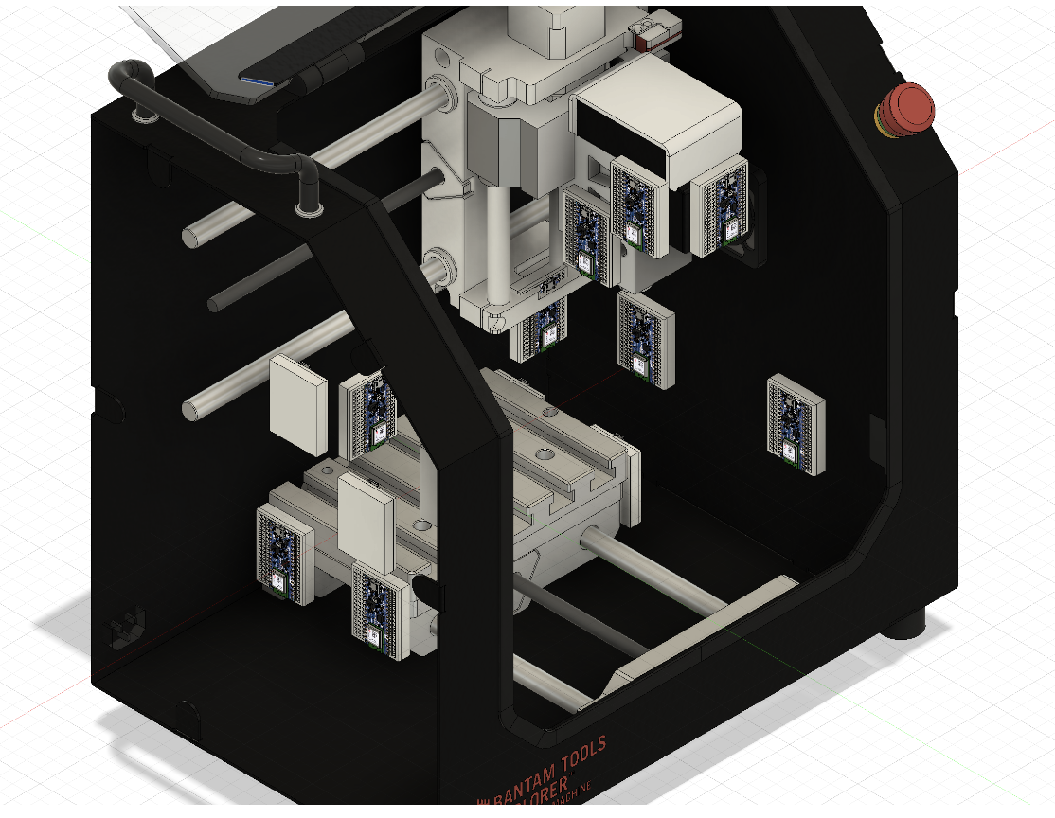
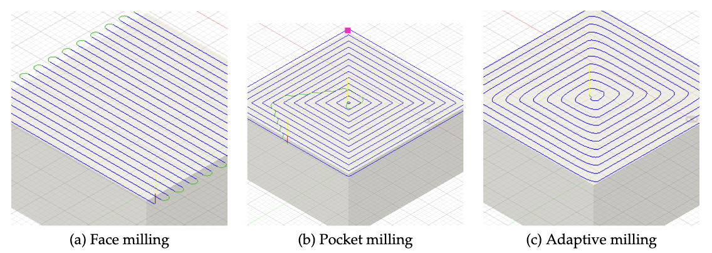
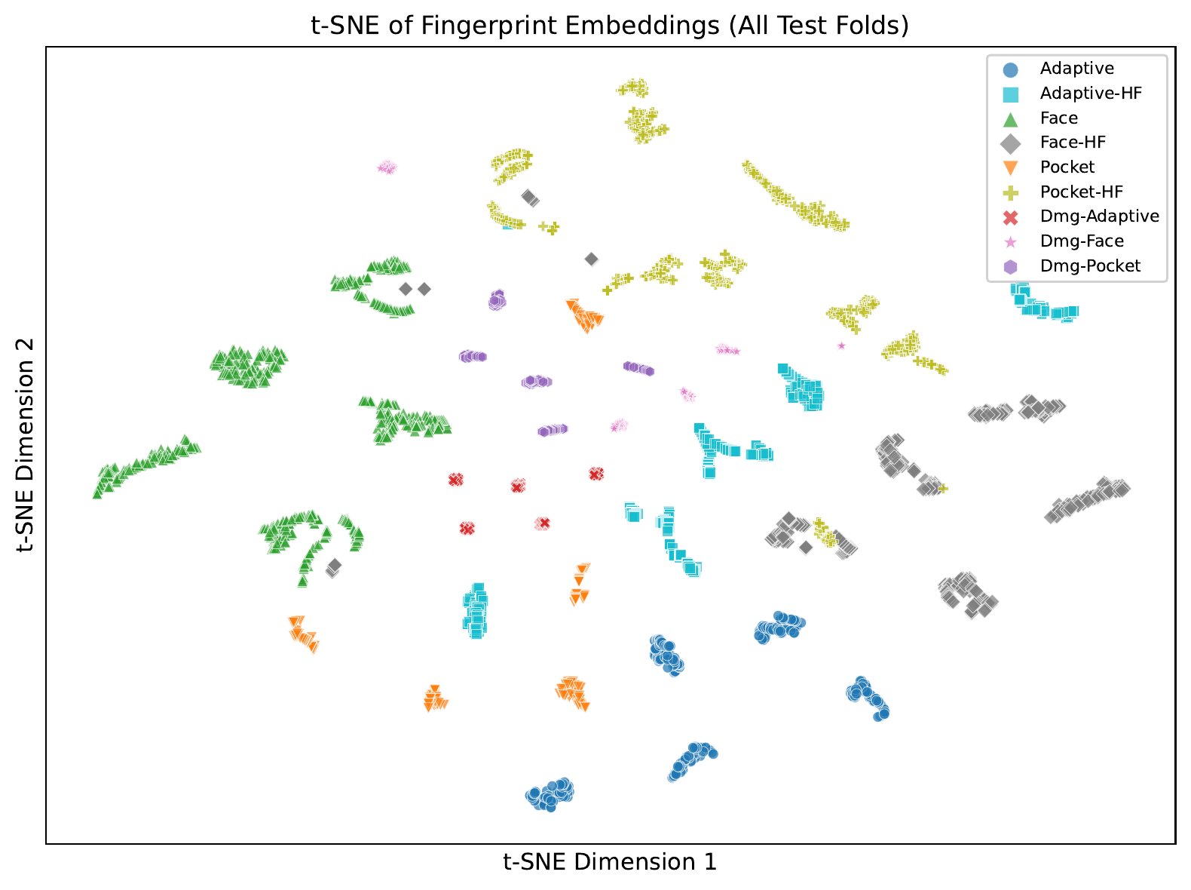
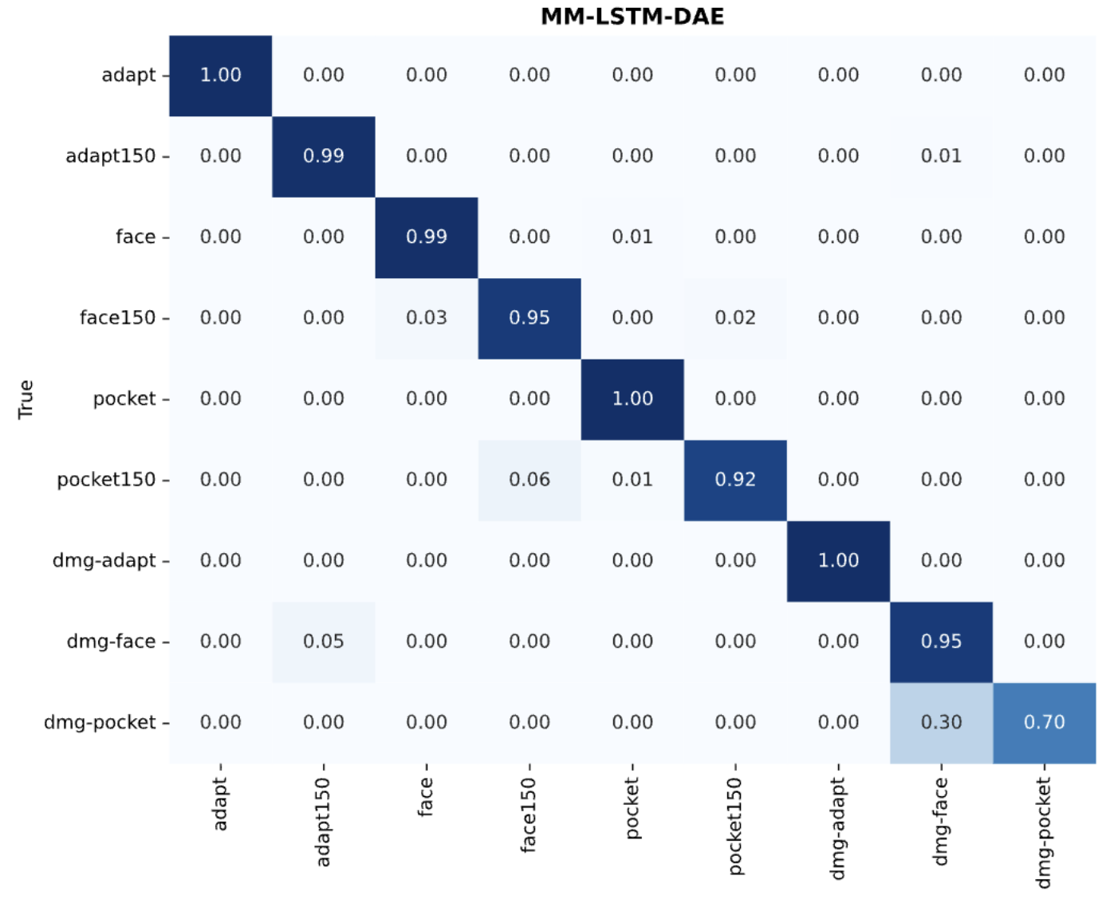
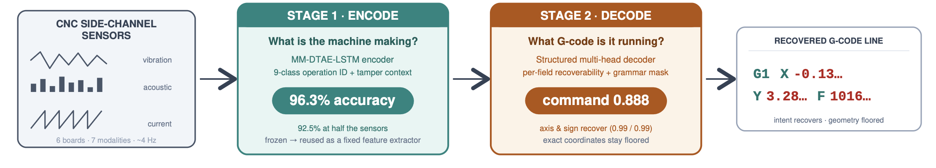
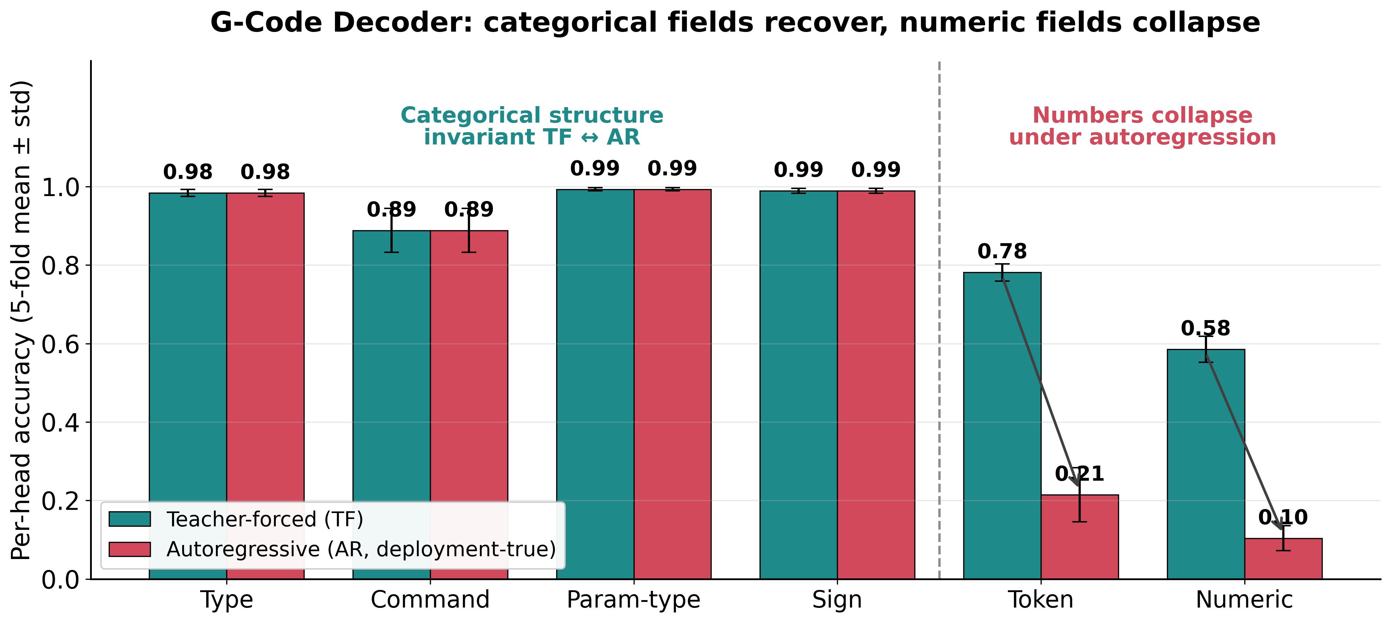
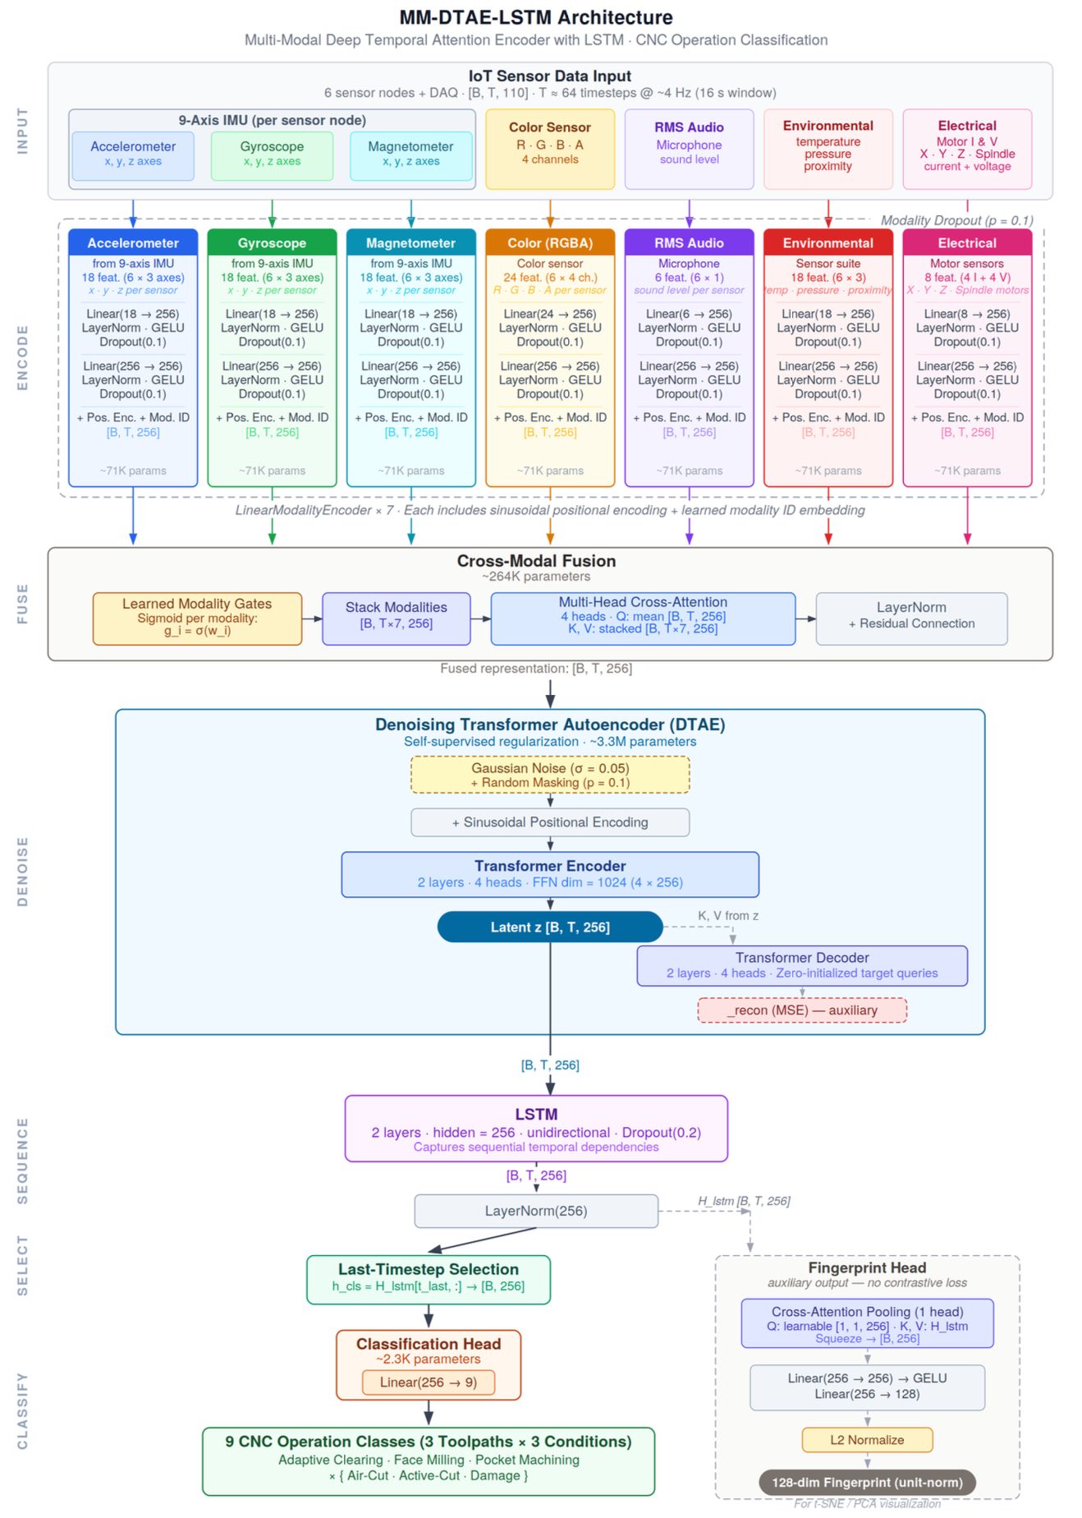
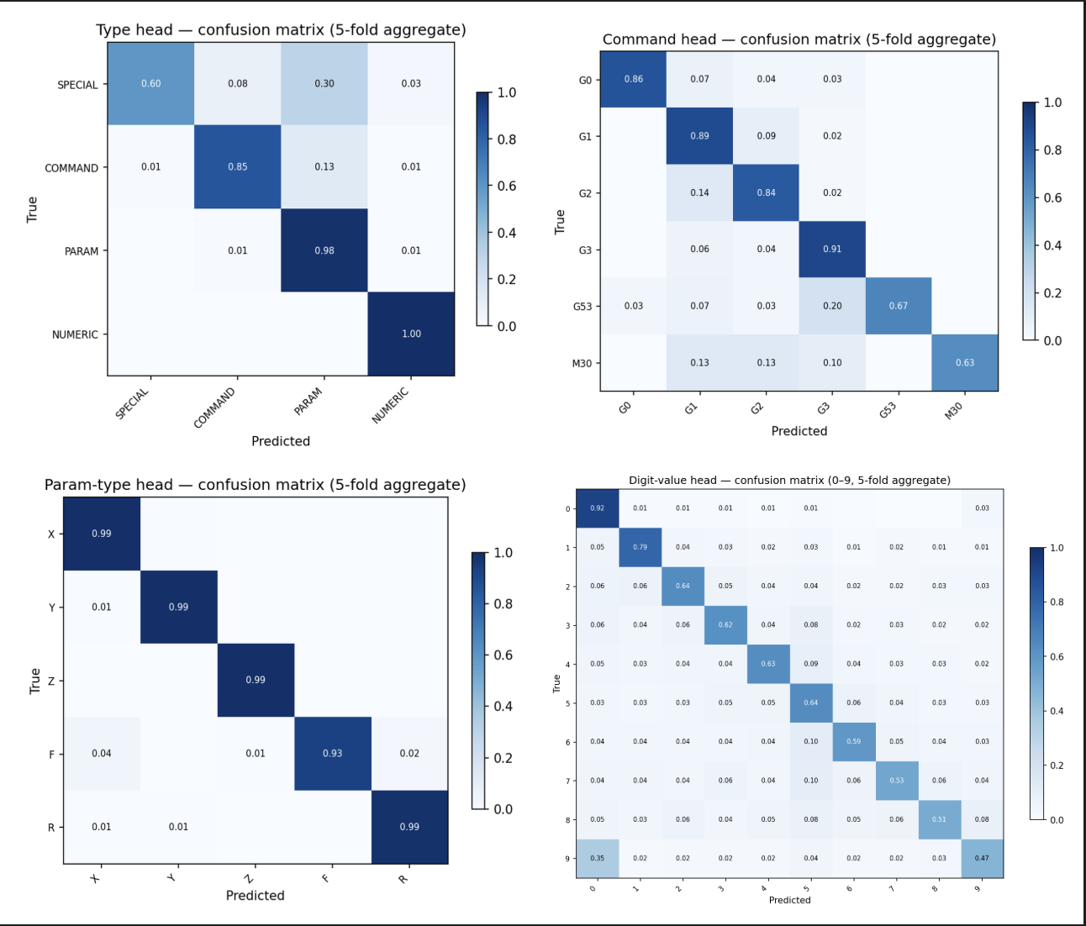
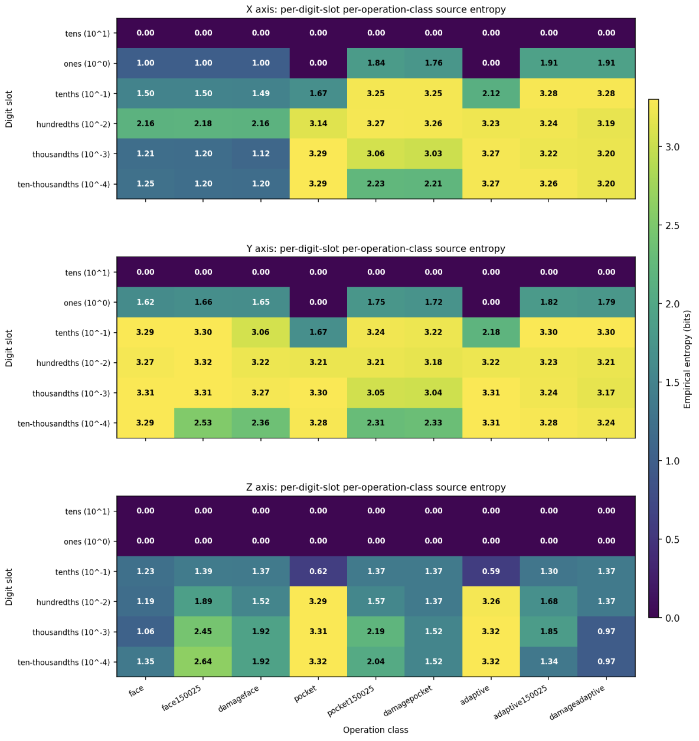
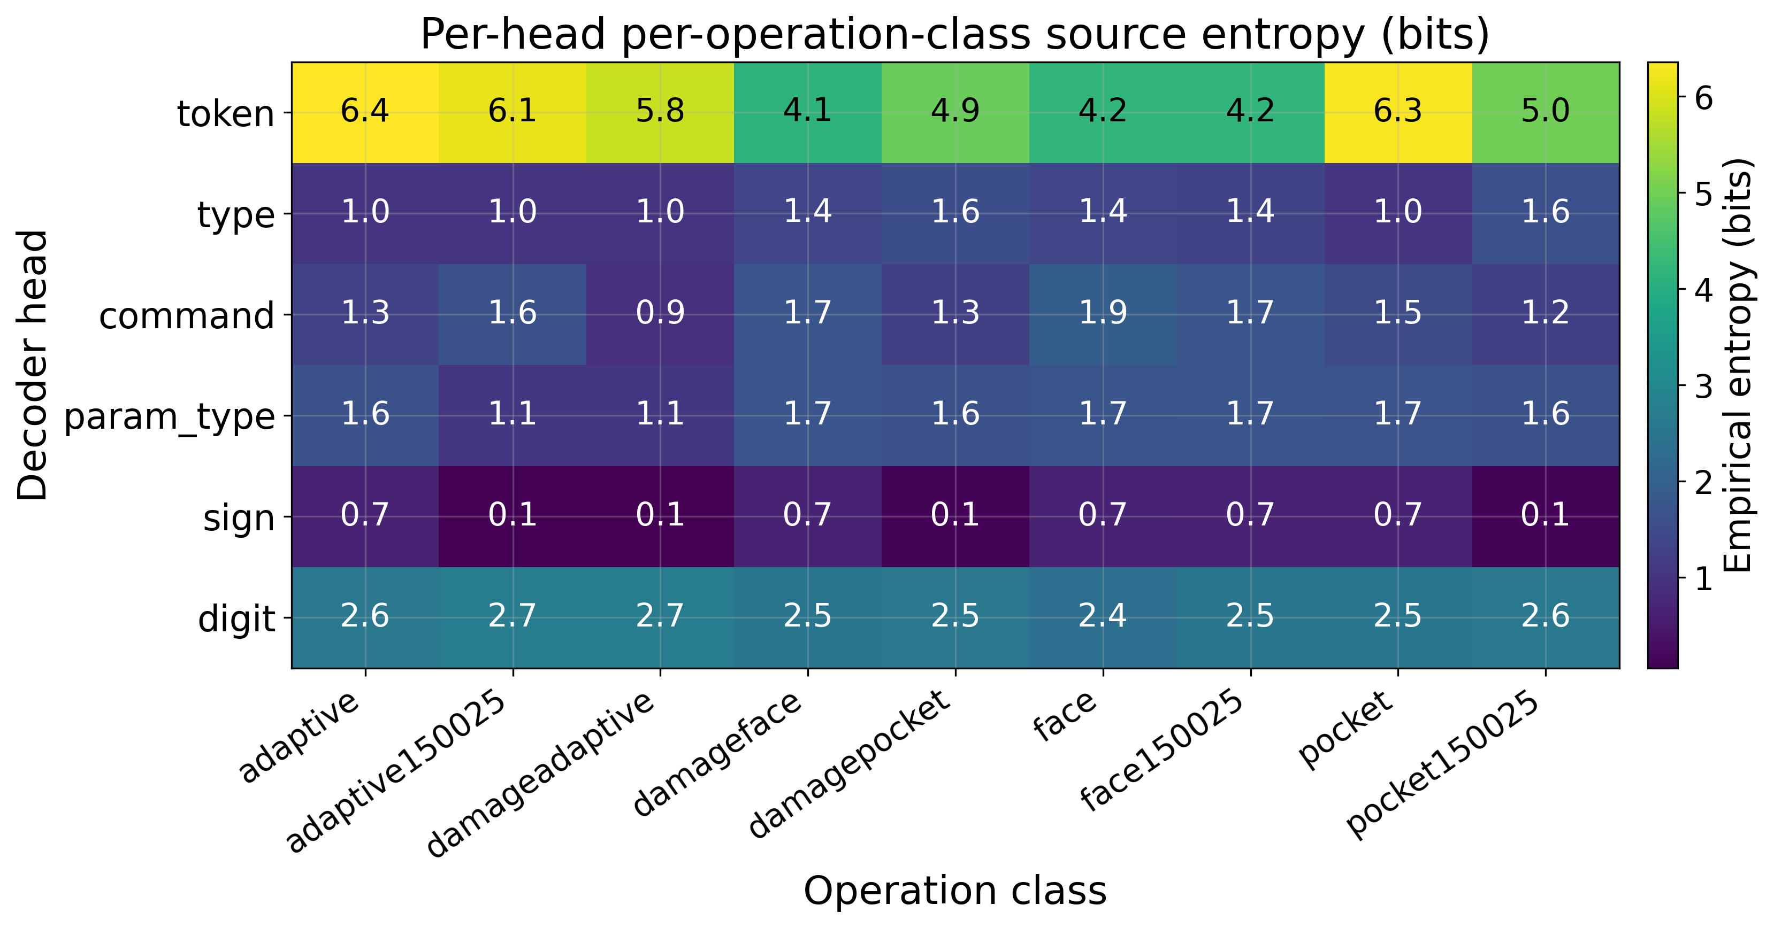


G-Code Fingerprinting: Multimodal Sensor-Fusion Deep-Learning for
CNC Toolpath Encoder & Machine Instructions Decoder
Stephen S. Eacuello, ISE Ph.D. Candidate
Department of Mechanical, Industrial and Systems Engineering
CYPHER Center | seacuello@uri.edu
System Model
System Model
Introduction
Project Details
Results
CNC machines emit side channels — vibration, acoustic emission, motor current — correlated with the proprietary part program data.
Exposure — These emissions can be observed passively using external sensors, without controller or network connectivity.
Open Question — How much of the executing program — the machining toolpath, operating condition, and the underlying G-code instructions — is recoverable from the emissions alone?
Offensive Risk — unmonitored side channels may expose toolpaths, process parameters, and mfg. IP to nearby observers.
Defensive Opportunity — The same signals enable a post-hoc integrity audit of executed instructions that file-hash signing cannot provide.
Significance — Categorical program structure is recoverable, exact coordinate recovery remains limited by source entropy.
Encoder identifies which of nine states are running using sensors alone, and holds as sensors are removed:
Accuracy — 96.3% across 9 operation classes (file-level 5-fold CV).
Resilient Degradation — 92.5% with the sensor set halved, where simple baselines drop up to 10%.
Errors — confined to physically similar classes; the damaged-tool variants drive most of the confusion (see matrix).
Decoder reconstructs G-code structure almost perfectly yet cannot fix its coordinates — each field is recovered up to its source entropy.
Categorical fields recoverable — Token Type 98.4%, Command 88.8%, Axis 99.3%, & Motion Sign 98.9%.
Numeric fields do not — Token 78% → 21% and Numeric Digits 59% → 10% under autoregressive decoding.
Bantam CNC instrumented with Arduino,
Nine classes (3 toolpaths × 3 conditions) with class t-SNE & Confusion Matrix.
System Model
A Bantam Tools desktop mill was externally instrumented with six Arduino Nano 33 BLE Sense and motor current monitoring; the controller was untouched.
Sensors — 9-axis IMU, acoustic RMS, temperature, pressure, and RGBA color across the frame, spindle, and bed. Current measured for each motor.
Task — 3 toolpaths — face, pocket, adaptive — across 3 conditions: air-cut, active-cut, and damaged. Each toolpath contains 100’s of G-code instructions.
Evaluation — 120 program files with per-line labels, leakage-resistant file-level CV, and deployment-true autoregressive decoding compared to teacher forcing.
System Architecture
Conclusion
External sensors recover the shape of execution, but low-frequency emissions lose the numeric precision needed for exact coordinates, feed rates and full toolpath reconstruction.
Deployment Posture — Post-hoc forensic audit, not real-time IDS: numeric/feed-rate substitutions undetectable; per-line false alarms exceed analyst triage capacity.
Defense— Sensor-side audit is informative where operations are low-entropy; cryptographic file-hash signing covers the high-entropy regime where sensor audit is blind.
Scope & Next Steps — Single-platform results; high-frequency production-machine replication remains future work.
One frozen encoder, six structured decoder heads — grammar constraints preclude malformed G-code.
Two-stage pipeline: frozen encoder builds the machine-state representation; structured decoder recovers G-code.
Stage 1 — Encoder: Fuses modality-specific sensor features using learned gating, denoising, and temporal modeling. First trained for nine-class operation classification, then frozen and reused as a fixed feature extractor.
Stage 2 — Decoder: A transformer cross-attends to frozen encoder features and predicts structured G-code using six heads. Grammar constraints block invalid tokens during decoding, eliminating malformed G-code without loss of accuracy.
Errors confined to physically similar classes; source entropy bounds per-field recovery.
Eacuello, et al. "Multimodal Sensor Fusion and Temporal Deep Learning for Computer Numerical Control Toolpath and Condition Classification: A Cross-Validated Ablation Study." Sensors, vol. 26, no. 8, 2026,
Scan for the paper
The University of Rhode Island CYPHER Research Center IPT Meeting for Power Systems and Manufacturing
This research was supported by the Office of Naval Research under Grant No. N00014-24-1-2129.
The views and conclusions contained in this poster are those of the authors and should not be interpreted as representing the official policies, either expressed or implied, of the Office of Naval Research or the U.S. Government
Special Thanks to:
Dr. Manbir Sodhi
Dr. Romesh Prasad
Andrew Oxley

